Slide 1
Exam 2 Review Topics
Chapter 5
  Saturation vs. not saturated, phase changes, moisture variables
  Maximum amount of water vapor vs. actual amount of water vapor
  Measuring humidity
  Condensation in the atmosphere
  Lapse rates (dry adiabatic, moist adiabatic, environmental)

Slide 2
Exam 2 Review Topics
Chapter 6
  Lifting mechanisms
  Stability criteria (and what is stability?)
  Inversions
  Cloud types and classifications
  Observing clouds

Slide 3
Exam 2 Review Topics
Chapter 7
  Growth of cloud droplets into precipitation (warm and cold/cool clouds)
  Types of precipitation (e.g. snow, rain, sleet, etc.)

Slide 4
Exam 2 Review Topics
Exam will be a combination of multiple choice and short answer questions

Slide 5
Exam 2 Review Topics
Exam will be a combination of multiple choice and short answer questions
Example Short Answer Question:
Describe the difference between freezing rain and sleet and the environmental conditions that cause both

Slide 6
Exam 2 Review Topics
Freezing rain is supercooled liquid rain that freezes on contact with the ground, while sleet is liquid rain that freezes in the air before it hits the ground.
Freezing rain occurs when rain falls through a very shallow cold layer and does not have time to freeze, while sleet falls through a thicker cold layer and does freeze (hitting the ground as ice pellets) because it has longer in the sub-freezing air.

Slide 7
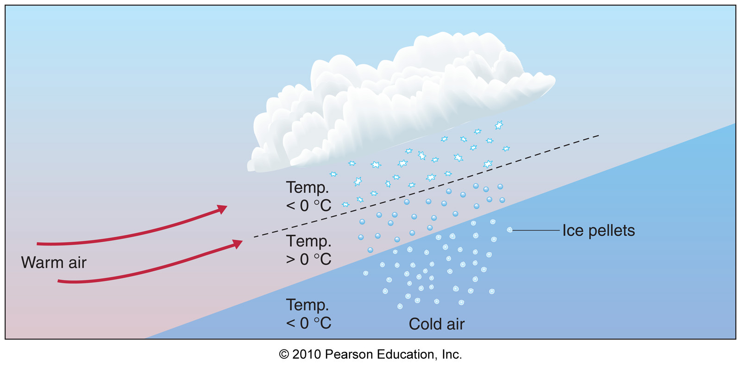
Exam 2 Review Topics

