Slide 1
Exam 1 Review Topics
Chapter 1
Atmospheric structure in the vertical (pressure, density, temperature, height)
Weather vs. climate (examples)
Composition of the atmosphere, details of permanent and variable gases

Slide 2
Exam 1 Review Topics
Chapter 2
Energy transfer in the atmosphere
The spectrum of radiation (UV, visible, IR, etc.)
Characteristics of emitted radiation (what does it look like in a plot?)
Why are there seasons, what does Earth’s orbit look like

Slide 3
Exam 1 Review Topics
Chapter 3
Details on input energy (including orbital variations), output energy, energy moving around within system
What happens to radiation
Greenhouse effect
Radiative equilibrium and climate change

Slide 4
Exam 1 Review Topics
Chapter 4
The nature of pressure (vertical and horizontal) and the pressure gradient force
Highs, lows, troughs, ridges
The nature of atmospheric thickness, how it causes wind
Other forces - Coriolis force, friction
Hydrostatic, geostrophic, cyclostrophic, gradient wind balance
Upper-air and surface winds and the forces involved
Measuring wind, station plots on weather maps

Slide 5
Exam 1 Review Topics
Exam will be a combination of multiple choice and short answer questions

Slide 6
Exam 1 Review Topics
Exam will be a combination of multiple choice and short answer questions
Example Short Answer Question:
Describe how the concentration of carbon dioxide (CO₂) has changed over the last 50 years and why.

Slide 7
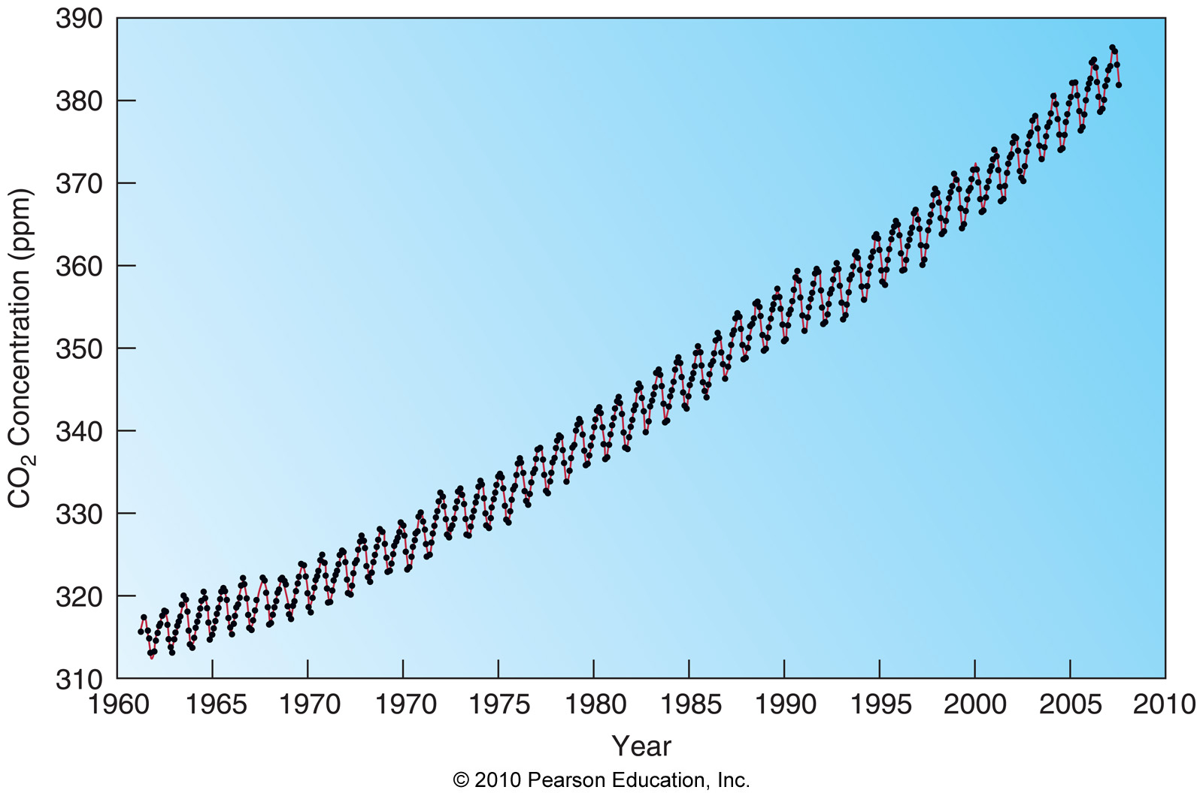
Exam 1 Review Topics
CO2 has been steadily increasing over that time period very likely due to human activities like fossil fuel burning. CO2 has also varied on an annual time period due to the natural growth and decay of Earth’s plant life.

