Slide 1
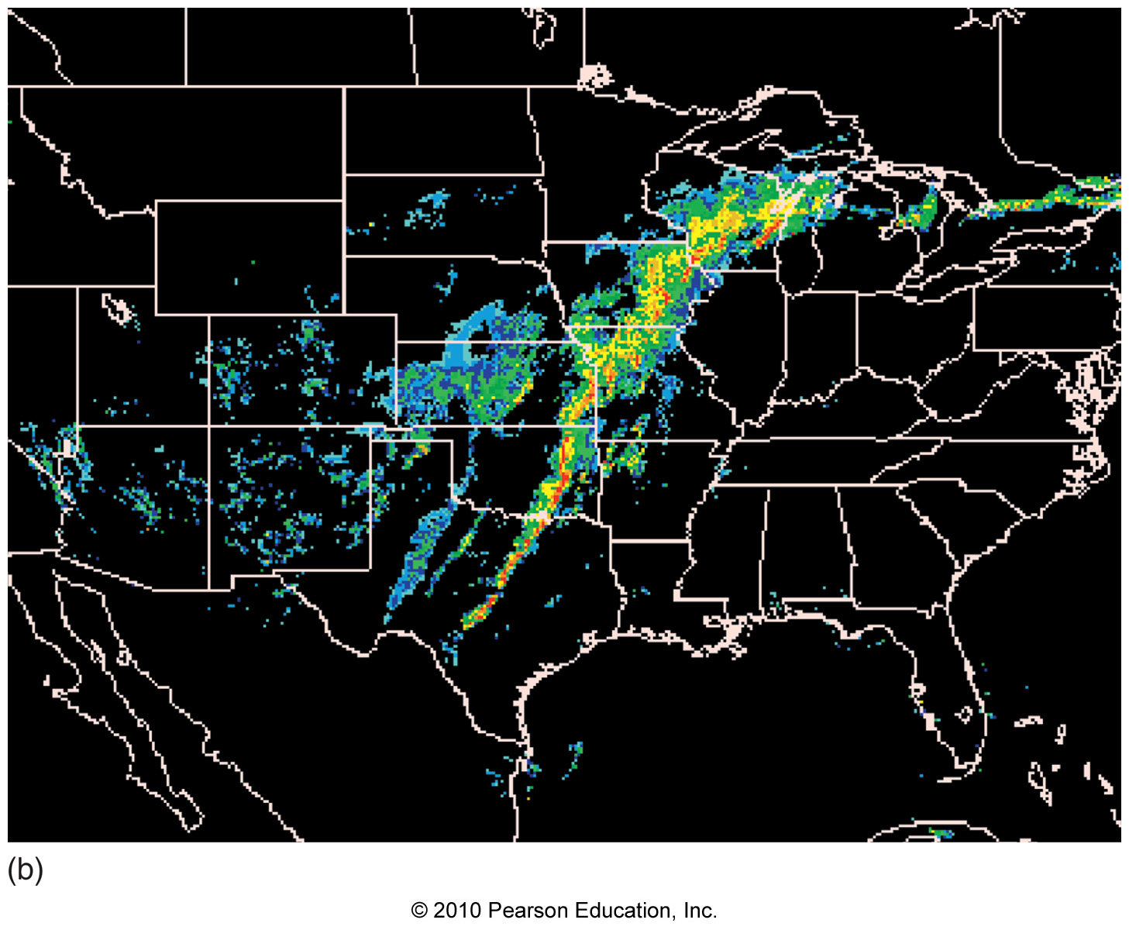
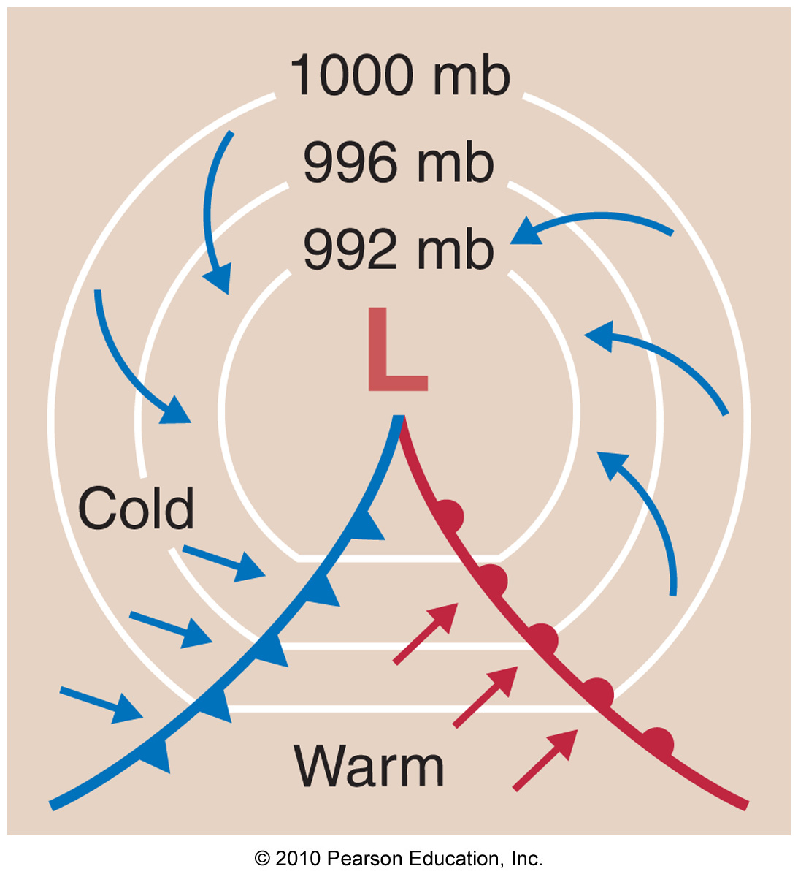
Chapter 9 – Air Masses and Fronts

Slide 2
Theme of Chapter 9: Air Masses are Important!
Air mass – a large region of air (thousands of square miles) having similar temperature, pressure, and moisture characteristics

Slide 3
Theme of Chapter 9: Air Masses are Important!
Air mass – a large region of air (thousands of square miles) having similar temperature, pressure, and moisture characteristics
Air masses move and strongly influence the changing of the weather, making them very important to understand

Slide 4
Theme of Chapter 9: Air Masses are Important!
Air mass – a large region of air (thousands of square miles) having similar temperature, pressure, and moisture characteristics
Air masses move and strongly influence the changing of the weather, making them very important to understand
Fronts – boundaries between air masses

Slide 5
Formation of Air Masses
Air masses attain their characteristics from the part of earth’s surface over which they exist

Slide 6
Formation of Air Masses
Air masses attain their characteristics from the part of earth’s surface over which they exist
Simple Examples
- air sitting over tropical ocean becomes
warm and moist
- air sitting over a desert will be warm
and dry

Slide 7
Formation of Air Masses
Source region – an area of earth where air masses form

Slide 8
Formation of Air Masses
Source region – an area of earth where air masses form
- Source regions are very large

Slide 9
Formation of Air Masses
Source region – an area of earth where air masses form
- Source regions are very large
- Source regions occur at high and low
latitudes (mid-latitudes are too variable)

Slide 10
Air Masses
Air masses are classified according to their temperature and moisture characteristics:
1) Based on moisture – continental (dry)
or maritime (moist)

Slide 11
Air Masses
Air masses are classified according to their temperature and moisture characteristics:
1) Based on moisture – continental (dry)
or maritime (moist)
2) Based on temperature – tropical (warm),
polar (cold), or arctic (very cold)

Slide 12
Air Masses
There are 5 different types of air mass:
1) Continental arctic
2) Continental polar
3) Continental tropical
4) Maritime polar
5) Maritime tropical

Slide 13
Continental Polar Air Mass
Continental polar air masses are dry and cold

Slide 14
Continental Polar Air Mass
Continental polar air masses are dry and cold
Form over high-latitude land surfaces (including ice)

Slide 15
Continental Polar Air Mass
Continental polar air masses are dry and cold
Form over high-latitude land surfaces (including ice)
In winter, very little solar radiation causes net cooling of air mass

Slide 16
Continental Polar Air Mass
Continental polar air masses are dry and cold
Form over high-latitude land surfaces (including ice)
In winter, very little solar radiation causes net cooling of air mass
Extremely dry since cold air cannot contain much water vapor

Slide 17
Water Vapor in Cold Air

Slide 18
Continental Polar Air Mass
Continental polar air masses are dry and cold
Form over high-latitude land surfaces (including ice)
In winter, very little solar radiation causes net cooling of air mass
Extremely dry since cold air cannot contain much water vapor
Typically clear and cloudless

Slide 19
Continental Polar Air Mass
Continental polar air masses are dry and cold
Form over high-latitude land surfaces (including ice)
In winter, very little solar radiation causes net cooling of air mass
Extremely dry since cold air cannot contain much water vapor
Typically clear and cloudless
Very stable (resists vertical motion)

Slide 20
Continental Arctic Air Masses
Continental arctic air masses are extremely dry, extremely cold versions of continental polar air masses

Slide 21
Continental Arctic Air Masses
Continental arctic air masses are extremely dry, extremely cold versions of continental polar air masses
The only difference: Continental arctic air masses are shallower than continental polar air masses

Slide 22
Maritime Polar Air Masses
Maritime polar air masses are moist and cool

Slide 23
Maritime Polar Air Masses
Maritime polar air masses are moist and cool
Form over oceans (not ice) at high latitudes

Slide 24
Maritime Polar Air Masses
Maritime polar air masses are moist and cool
Form over oceans (not ice) at high latitudes
Cool and moist due to contact with cold ocean water

Slide 25
Maritime Polar Air Masses
Maritime polar air masses are moist and cool
Form over oceans (not ice) at high latitudes
Cool and moist due to contact with cold ocean water
Generally cloudy

Slide 26
Continental Tropical Air Masses
Continental tropical air masses are dry and warm

Slide 27
Continental Tropical Air Masses
Continental tropical air masses are dry and warm
Form over low-latitude land surfaces

Slide 28
Continental Tropical Air Masses
Continental tropical air masses are dry and warm
Form over low-latitude land surfaces
Hot and dry due to contact with hot land surfaces with little moisture

Slide 29
Continental Tropical Air Masses
Continental tropical air masses are dry and warm
Form over low-latitude land surfaces
Hot and dry due to contact with hot land surfaces with little moisture
Generally cloud-free

Slide 30
Continental Tropical Air Masses
Continental tropical air masses are dry and warm
Form over low-latitude land surfaces
Hot and dry due to contact with hot land surfaces with little moisture
Generally cloud-free
Fairly unstable due to heating from below (but dryness inhibits cloud formation)

Slide 31
Maritime Tropical Air Masses
Maritime tropical air masses are

Slide 32
Maritime Tropical Air Masses
Maritime tropical air masses are moist and

Slide 33
Maritime Tropical Air Masses
Maritime tropical air masses are moist and warm

Slide 34
Maritime Tropical Air Masses
Maritime tropical air masses are moist and warm
Form over warm ocean (tropical) waters

Slide 35
Maritime Tropical Air Masses
Maritime tropical air masses are moist and warm
Form over warm ocean (tropical) waters
Unstable conditions (moist warm air at surface)

Slide 36
Maritime Tropical Air Masses
Maritime tropical air masses are moist and warm
Form over warm ocean (tropical) waters
Unstable conditions (moist warm air at surface)
Generally cloudy and partly cloudy

Slide 37
Maritime Tropical Air Masses
Maritime tropical air masses are moist and warm
Form over warm ocean (tropical) waters
Unstable conditions (moist warm air at surface)
Generally cloudy and partly cloudy
Responsible for daily showers/thunderstorms in the southeast U.S.

Slide 38
The Importance of Different Air Masses: The Pineapple Express
The Pineapple express – a weather phenomena that impacts the NW U.S.

Slide 39
The Importance of Different Air Masses: The Pineapple Express
The Pineapple express – a weather phenomena that impacts the NW U.S.
Constant flow of maritime tropical air into the NW U.S.

Slide 40
The Importance of Different Air Masses: The Pineapple Express
The Pineapple express – a weather phenomena that impacts the NW U.S.
Constant flow of maritime tropical air into the NW U.S.
Significant orographic (mountain-induced) rainfall

Slide 41
The Importance of Different Air Masses: The Pineapple Express
The Pineapple express – a weather phenomena that impacts the NW U.S.
Constant flow of maritime tropical air into the NW U.S.
Significant orographic (mountain-induced) rainfall
High freezing (and snow) levels

Slide 42
The Importance of Different Air Masses: The Pineapple Express
The Pineapple express – a weather phenomena that impacts the NW U.S.
Constant flow of maritime tropical air into the NW U.S.
Significant orographic (mountain-induced) rainfall
High freezing (and snow) levels
Causes destructive flooding

Slide 43
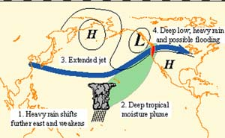
The Importance of Different Air Masses: The Pineapple Express

Slide 44
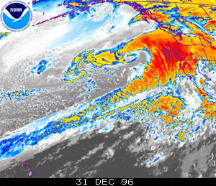
The Importance of Different Air Masses: The Pineapple Express

Slide 45
Summary of Air Masses

Slide 46
Fronts
Fronts – boundaries between different air masses

Slide 47
Fronts
Fronts – boundaries between different air masses
Cause significant changes in the weather (wind shift, temperature, moisture)

Slide 48
Fronts
Fronts – boundaries between different air masses
Cause significant changes in the weather (wind shift, temperature, moisture)
Usually associated with clouds, precipitation, and sometimes severe weather

Slide 49
Fronts
There are 4 different kinds of fronts:
1) Cold front – cold air advancing
toward warm air

Slide 50
Fronts
There are 4 different kinds of fronts:
1) Cold front – cold air advancing
toward warm air
2) Warm front – warm air advancing
toward cold air

Slide 51
Fronts
There are 4 different kinds of fronts:
1) Cold front – cold air advancing
toward warm air
2) Warm front – warm air advancing
toward cold air
3) Stationary front – air mass boundary
that isn’t moving

Slide 52
Fronts
There are 4 different kinds of fronts:
1) Cold front – cold air advancing
toward warm air
2) Warm front – warm air advancing
toward cold air
3) Stationary front – air mass boundary
that isn’t moving
4) Occluded front – cold air advancing
toward cool air

Slide 53
Cold Fronts
Cold fronts are at the leading edge of advancing cold air

Slide 54
Cold Fronts
Cold fronts are at the leading edge of advancing cold air
Cold air
Cold air
Warm air
Warm air

Slide 55
Cold Fronts
Cold fronts are at the leading edge of advancing cold air
A rapid decrease in temperature occurs behind the front
Cold air
Cold air
Warm air
Warm air

Slide 56
Cold Fronts
Vital Stats
Move 0-30 mph

Slide 57
Cold Fronts
Vital Stats
Move 0-30 mph
Lift the warm air into which its advancing

Slide 58
Cold Fronts
Vital Stats
Move 0-30 mph
Lift the warm air into which its advancing
Often produce brief, intense showers and thunderstorms

Slide 59
Cold Fronts
Vital Stats
Move 0-30 mph
Lift the warm air into which its advancing
Often produce brief, intense showers and thunderstorms
Often located in a pressure trough

Slide 60
Cold Fronts
Vital Stats
Move 0-30 mph
Lift the warm air into which its advancing
Often produce brief, intense showers and thunderstorms
Often located in a pressure trough
Usually are associated with a strong decrease in moisture as well as temperature

Slide 61
Cold Fronts
Vital Stats
Move 0-30 mph
Lift the warm air into which its advancing
Often produce brief, intense showers and thunderstorms
Often located in a pressure trough
Usually are associated with a strong decrease in moisture as well as temperature
1:100 vertical slope

Slide 62
Cold Fronts
Vital Stats
Move 0-30 mph
Lift the warm air into which its advancing
Often produce brief, intense showers and thunderstorms
Often located in a pressure trough
Usually are associated with a strong decrease in moisture as well as temperature
1:100 vertical slope
Wind shift is typically southerly to westerly

Slide 63
Cold Fronts

Slide 64
Cold Fronts

Slide 65
Cold Fronts

Slide 66
Warm Fronts
Warm fronts are at the leading edge of advancing warm air

Slide 67
Warm Fronts
Warm fronts are at the leading edge of advancing warm air
Cold air
Cold air
Warm air
Warm air

Slide 68
Warm Fronts
Warm fronts are at the leading edge of advancing warm air
A decrease in temperature occurs ahead of the front (less pronounced temperature gradient than with a cold front)
Cold air
Cold air
Warm air
Warm air

Slide 69
Warm Fronts
Vital Stats
Move 0-12 mph

Slide 70
Warm Fronts
Vital Stats
Move 0-12 mph
Warm air overruns cold air

Slide 71
Warm Fronts
Vital Stats
Move 0-12 mph
Warm air overruns cold air
Often produce long-lasting, steady, stratiform precipitation

Slide 72
Warm Fronts
Vital Stats
Move 0-12 mph
Warm air overruns cold air
Often produce long-lasting, steady, stratiform precipitation
Often located in a pressure trough

Slide 73
Warm Fronts
Vital Stats
Move 0-12 mph
Warm air overruns cold air
Often produce long-lasting, steady, stratiform precipitation
Often located in a pressure trough
Usually are associated with an increase in moisture as well as temperature

Slide 74
Warm Fronts
Vital Stats
Move 0-12 mph
Warm air overruns cold air
Often produce long-lasting, steady, stratiform precipitation
Often located in a pressure trough
Usually are associated with an increase in moisture as well as temperature
1:200 vertical slope

Slide 75
Warm Fronts
Vital Stats
Move 0-12 mph
Warm air overruns cold air
Often produce long-lasting, steady, stratiform precipitation
Often located in a pressure trough
Usually are associated with an increase in moisture as well as temperature
1:200 vertical slope
Wind shift is typically easterly to southerly

Slide 76
Warm Fronts

Slide 77
Warm Fronts

Slide 78
Stationary Fronts
Stationary fronts are located at a boundary between air masses that isn’t moving
Cold air
Cold air
Warm air
Warm air

Slide 79
Occluded Fronts
Occluded fronts form when a cold front catches up with a warm front (traditional explanation)
Cool air
Cool air
Cold air
Cold air

Slide 80
Occluded Fronts: The Traditional Explanation

Slide 81
Occluded Fronts: The Traditional Explanation

Slide 82
Occluded Fronts: The Traditional Explanation

Slide 83
Drylines
Drylines exist at a boundary between a dry and moist air mass (without a temperature gradient)

Slide 84
Drylines
Drylines exist at a boundary between a dry and moist air mass (without a temperature gradient)
Advancing drylines act like cold fronts since dry air is more dense than moist air

Slide 85
Drylines
Drylines exist at a boundary between a dry and moist air mass (without a temperature gradient)
Advancing drylines act like cold fronts since dry air is more dense than moist air
Drylines are very common in the South Plains (due to local geography)

Slide 86
Drylines
Drylines exist at a boundary between a dry and moist air mass (without a temperature gradient)
Advancing drylines act like cold fronts since dry air is more dense than moist air
Drylines are very common in the South Plains (due to local geography)
Severe weather is common along drylines

Slide 87
Drylines
Drylines exist at a boundary between a dry and moist air mass (without a temperature gradient)
Advancing drylines act like cold fronts since dry air is more dense than moist air
Drylines are very common in the South Plains (due to local geography)
Severe weather is common along drylines
Drylines can both retreat and advance

Slide 88
Drylines

Slide 89
Drylines

Slide 90
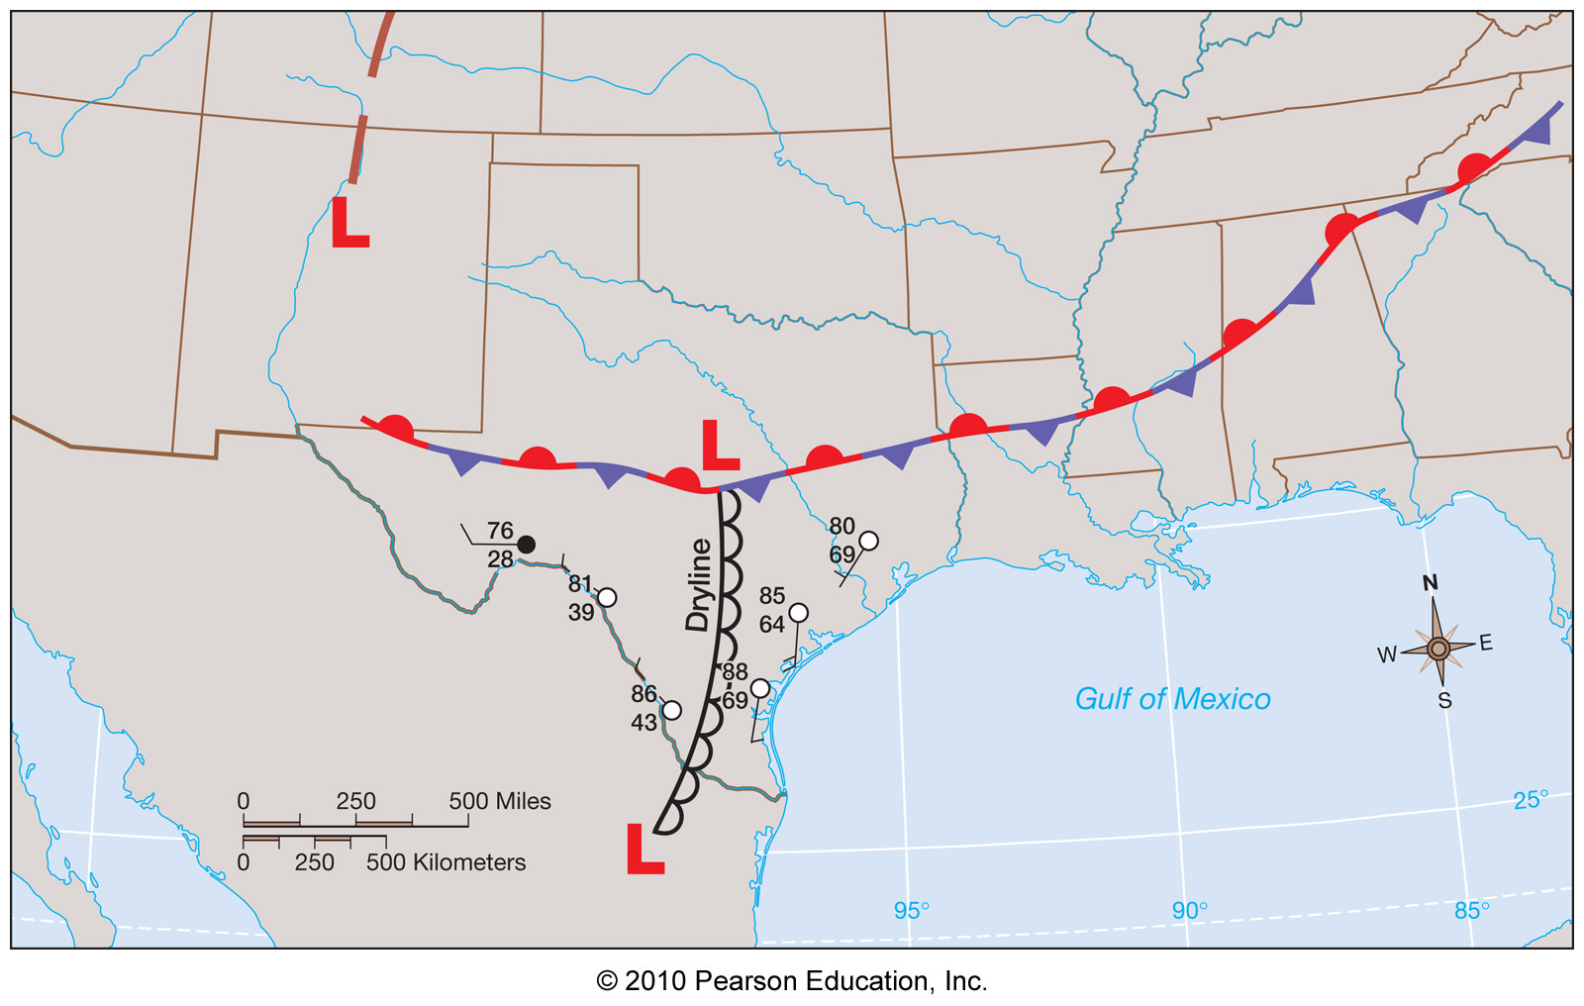
Cold Front or Dryline?
Cold fronts and drylines are sometimes difficult to discern due to dirurnal effects like daytime heating/nighttime cooling
Clear
Cloudy

