Slide 1
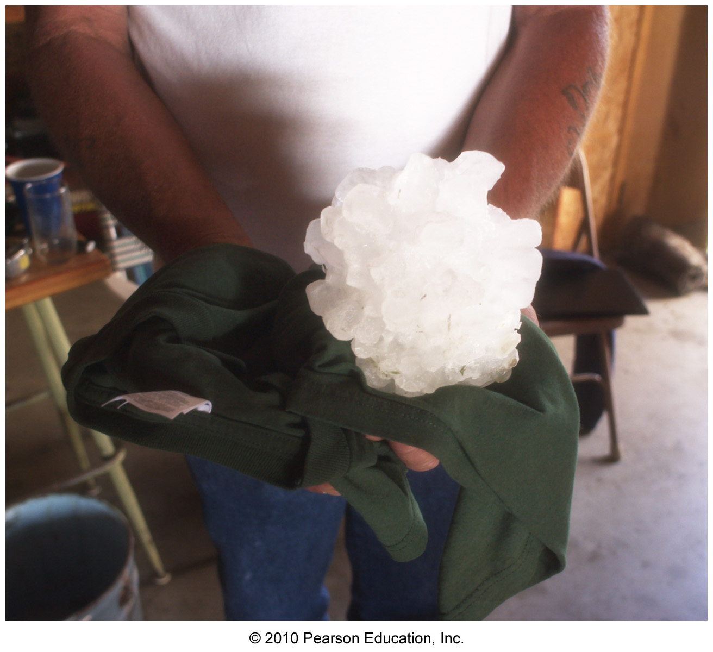
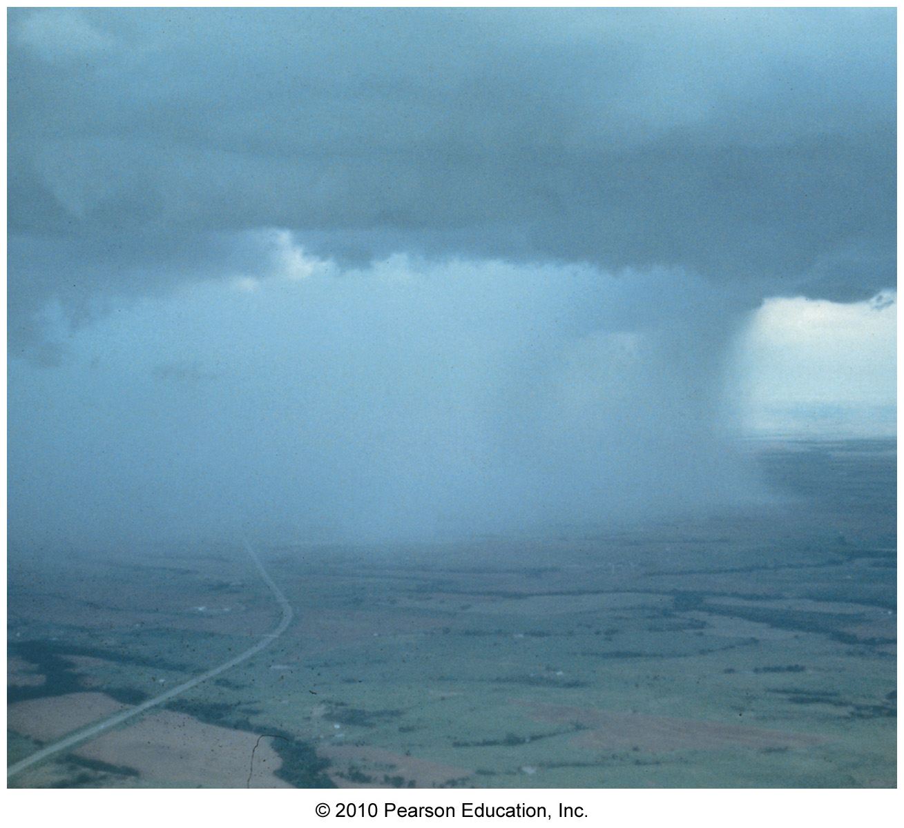
Chapter 7 – Precipitation Processes

Slide 2
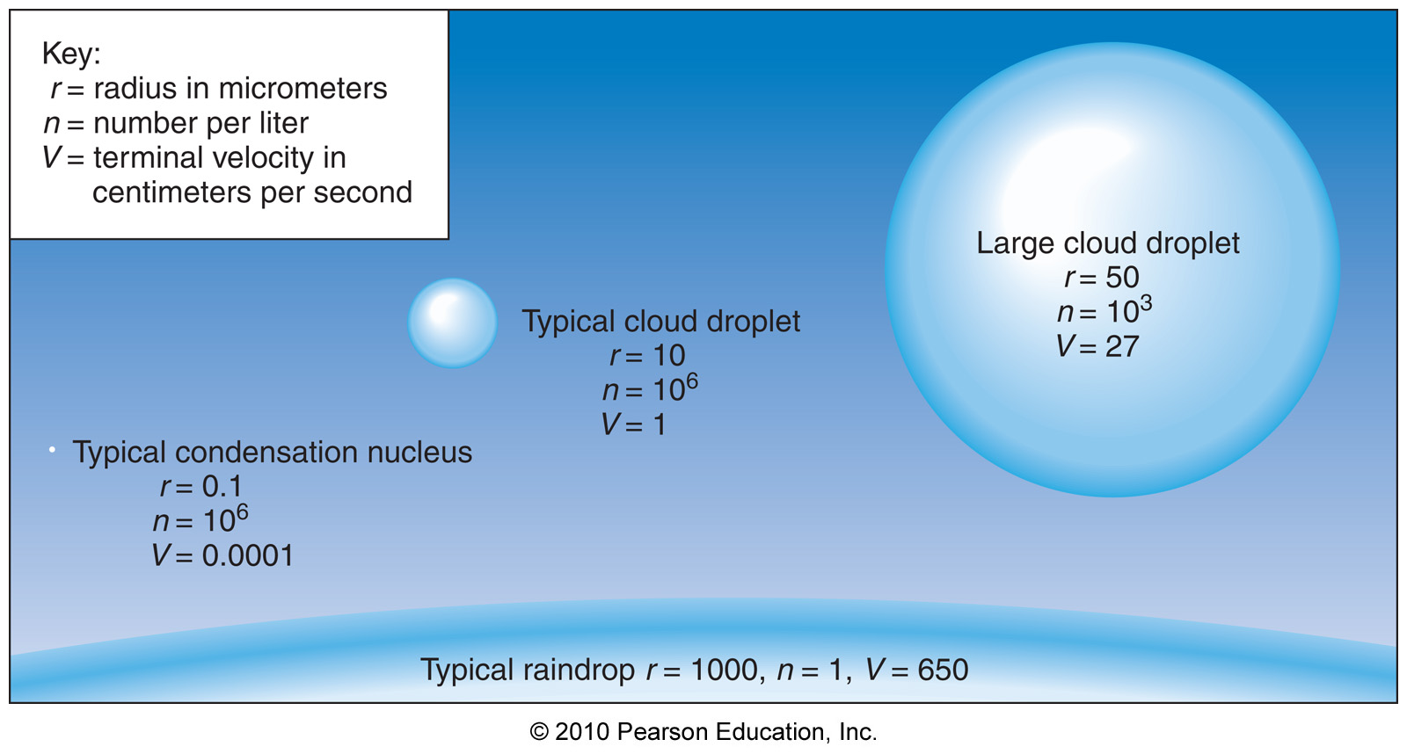
It all begins with clouds…
Clouds are composed of tiny water droplets from condensation onto CCN

Slide 3
Clouds -> Precipitation
Cloud droplet fall speeds are way too low to become precipitation

Slide 4
Clouds -> Precipitation
Cloud droplet fall speeds are way too low to become precipitation
For clouds to produce precipitation, cloud droplets must get bigger!

Slide 5
Growth of Cloud Droplets
Condensation is only effective from nucleation up to around radii of 0.02 mm

Slide 6
Growth of Cloud Droplets
Condensation is only effective from nucleation up to around radii of 0.02 mm
There’s just too many drops, too little
moisture

Slide 7
Growth of Cloud Droplets
Condensation is only effective from nucleation up to around radii of 0.02 mm
There’s just too many drops, too little
moisture
So, for precipitation, we need another mechanism!

Slide 8
Growth of Cloud Droplets
Condensation is only effective from nucleation up to around radii of 0.02 mm
There’s just too many drops, too little
moisture
So, for precipitation, we need another mechanism!
This other mechanism depends on the type of cloud:

Slide 9
Growth of Cloud Droplets
Condensation is only effective from nucleation up to around radii of 0.02 mm
There’s just too many drops, too little
moisture
So, for precipitation, we need another mechanism!
This other mechanism depends on the type of cloud:
1) Warm clouds (totally > 0ºC)

Slide 10
Growth of Cloud Droplets
Condensation is only effective from nucleation up to around radii of 0.02 mm
There’s just too many drops, too little
moisture
So, for precipitation, we need another mechanism!
This other mechanism depends on the type of cloud:
1) Warm clouds (totally > 0ºC)
2) Cool and cold clouds (at least partially below 0ºC)

Slide 11
Precipitation in Warm Clouds
Warm clouds – clouds with only liquid water above 0ºC

Slide 12
Precipitation in Warm Clouds
Warm clouds – clouds with only liquid water above 0ºC
2 processes produce warm cloud precipitation:
1) Collision

Slide 13
Precipitation in Warm Clouds
Warm clouds – clouds with only liquid water above 0ºC
2 processes produce warm cloud precipitation:
1) Collision
2) Coalescence

Slide 14
Collision in Warm Clouds
Collision – when cloud droplets collide with each other

Slide 15
Collision in Warm Clouds
Collision – when cloud droplets collide with each other
Collision efficiency depends on relative size of a collector drop and droplets below
- Low efficiency for very small drops

Slide 16
Collision in Warm Clouds
Collision – when cloud droplets collide with each other
Collision efficiency depends on relative size of a collector drop and droplets below
- Low efficiency for very small drops
- Low efficiency for same-size drops

Slide 17
Collision in Warm Clouds
Collision – when cloud droplets collide with each other
Collision efficiency depends on relative size of a collector drop and droplets below
- Low efficiency for very small drops
- Low efficiency for same-size drops
- High efficiency for drops in between
these sizes

Slide 18
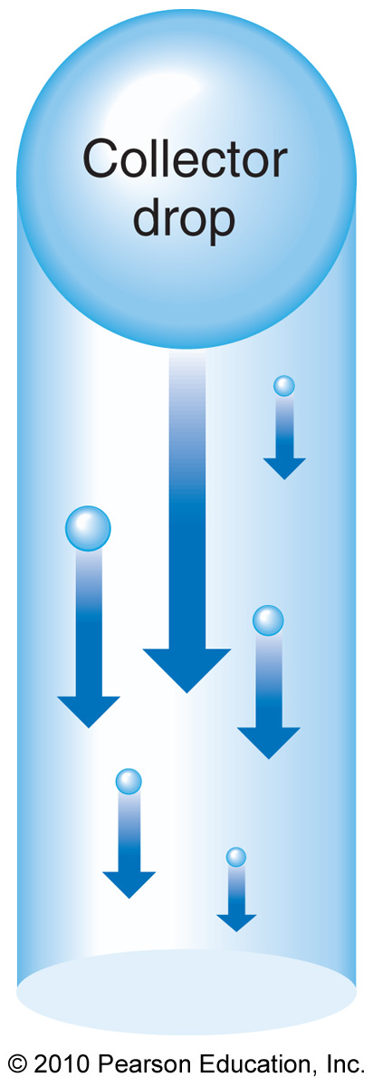
Collision in Warm Clouds

Slide 19
Collision in Warm Clouds

Slide 20
Coalescence in Warm Clouds
Coalescence – when colliding cloud droplets stick together

Slide 21
Coalescence in Warm Clouds
Coalescence – when colliding cloud droplets stick together
Coalescence efficiency is assumed to be near 100% (all drops stick together if they collide)

Slide 22
Precipitation in Cool and Cold Clouds
Cold cloud – a cloud entirely below 0ºC that may contain supercooled water, ice, or both

Slide 23
Precipitation in Cool and Cold Clouds
Cold cloud – a cloud entirely below 0ºC that may contain supercooled water, ice, or both
Cool cloud – a cloud with regions both above and below 0ºC

Slide 24
Precipitation in Cool and Cold Clouds
Precipitation in cool and cold clouds relies on a mixture of supercooled water and ice

Slide 25
Precipitation in Cool and Cold Clouds
Precipitation in cool and cold clouds relies on a mixture of supercooled water and ice
Key Concept
Saturation vapor pressure_{ice} is less than Saturation vapor pressure_{water}

Slide 26
Precipitation in Cool and Cold Clouds
Precipitation in cool and cold clouds relies on a mixture of supercooled water and ice
Key Concept
Saturation vapor pressure_{ice} is less than Saturation vapor pressure_{water}
The Bergeron Process

Slide 27
The Bergeron Process

Slide 28
The Bergeron Process
For air with both supercooled water and ice:
1) Amount of water vapor is in equilibrium
with water (saturated)

Slide 29
The Bergeron Process
For air with both supercooled water and ice:
1) Amount of water vapor is in equilibrium
with water (saturated)
2) Amount of water vapor is not in equilibrium
with ice (supersaturated)

Slide 30
The Bergeron Process
For air with both supercooled water and ice:
1) Amount of water vapor is in equilibrium
with water (saturated)
2) Amount of water vapor is not in equilibrium
with ice (supersaturated)
3) Water vapor deposits onto ice, lowering the
amount of water vapor, causing evaporation
of water

Slide 31
The Bergeron Process
For air with both supercooled water and ice:
1) Amount of water vapor is in equilibrium
with water (saturated)
2) Amount of water vapor is not in equilibrium
with ice (supersaturated)
3) Water vapor deposits onto ice, lowering the
amount of water vapor, causing evaporation
of water
4) The cycle continues – ice grows and water
vanishes

Slide 32
Precipitation in Cool and Cold Clouds
Once the Bergeron Process takes place, ice becomes big enough to fall, and 2 additional processes occur:
1) Riming – ice collides with
supercooled water which freezes on
contact

Slide 33
Precipitation in Cool and Cold Clouds
Once the Bergeron Process takes place, ice becomes big enough to fall, and 2 additional processes occur:
1) Riming – ice collides with
supercooled water which freezes on
contact
2) Aggregation – ice crystals collide
and stick together

Slide 34
Precipitation Distribution
38.8 in/year annual average precipitation

Slide 35
Precipitation Distribution
38.8 in/year annual average precipitation
Each year (for the last ~100 years) has been within 2 in of this average

Slide 36
Global Precipitation Distribution

Slide 37
U.S. Precipitation Distribution

Slide 38
Types of Precipitation
Several types of precipitation exist and depend on the atmospheric temperature profile:
1) Snow
2) Rain
3) Graupel and hail
4) Sleet
5) Freezing rain

Slide 39
Snow
Snow occurs from the Bergeron process, riming, and aggregation
The nature of snowflakes depends on temperature and moisture content

Slide 40
The Nature of Snowflakes
Dendrites
Plates
Columns

Slide 41
U.S. Annual Snowfall

Slide 42
U.S. Annual Snowfall
The 2 primary causes of local maxima in annual average snowfall are:
1) Mountains (orographic snow)

Slide 43
U.S. Annual Snowfall
The 2 primary causes of local maxima in annual average snowfall are:
1) Mountains (orographic snow)
2) The Great Lakes (lake effect snow)

Slide 44
Lake Effect Snow

Slide 45
Lake Effect Snow

Slide 46
Lake Effect Snow

Slide 47
Rain
The nature of rain formation typically depends on location:
1) Tropics – warms clouds - rain
forms by condensation, collision,
and coalescence

Slide 48
Rain
The nature of rain formation typically depends on location:
1) Tropics – warms clouds - rain
forms by condensation, collision,
and coalescence
2) Mid-latitudes – cool clouds – rain
forms as snow then melts

Slide 49
Rain
Rain is also classified in terms of how it lasts in time
1) Steady (stratiform) rain – rain that
lasts for long periods of time (hours)

Slide 50
Rain
Rain is also classified in terms of how it lasts in time
1) Steady (stratiform) rain – rain that
lasts for long periods of time (hours)
2) Showers (cumuliform) rain – rain that
is short-lasting (minutes)

Slide 51
Another Myth Dismissed…
Myth: raindrops are shaped like teardrops

Slide 52
Raindrop Shape

Slide 53
Raindrop Shape

Slide 54
Raindrop Shape

Slide 55
Raindrop Shape

Slide 56
Graupel and Hail
Graupel – ice crystals that undergo riming upon collisions with supercooled water
Hail – Severely rimed ice crystals resulting from repeated upward and downward motions in a thunderstorm

Slide 57
Hail

Slide 58
Hail
Biggest hailstone ever recorded=17cm - Yikes!!!

Slide 59
Hail

Slide 60
Hail

Slide 61
Freezing Rain and Sleet
Freezing rain – supercooled rain that freezes on contact or shortly after contact with surface

Slide 62
Freezing Rain and Sleet
Freezing rain – supercooled rain that freezes on contact or shortly after contact with surface
Sleet – raindrops that have frozen while falling, reaching the surface as ice pellets

Slide 63
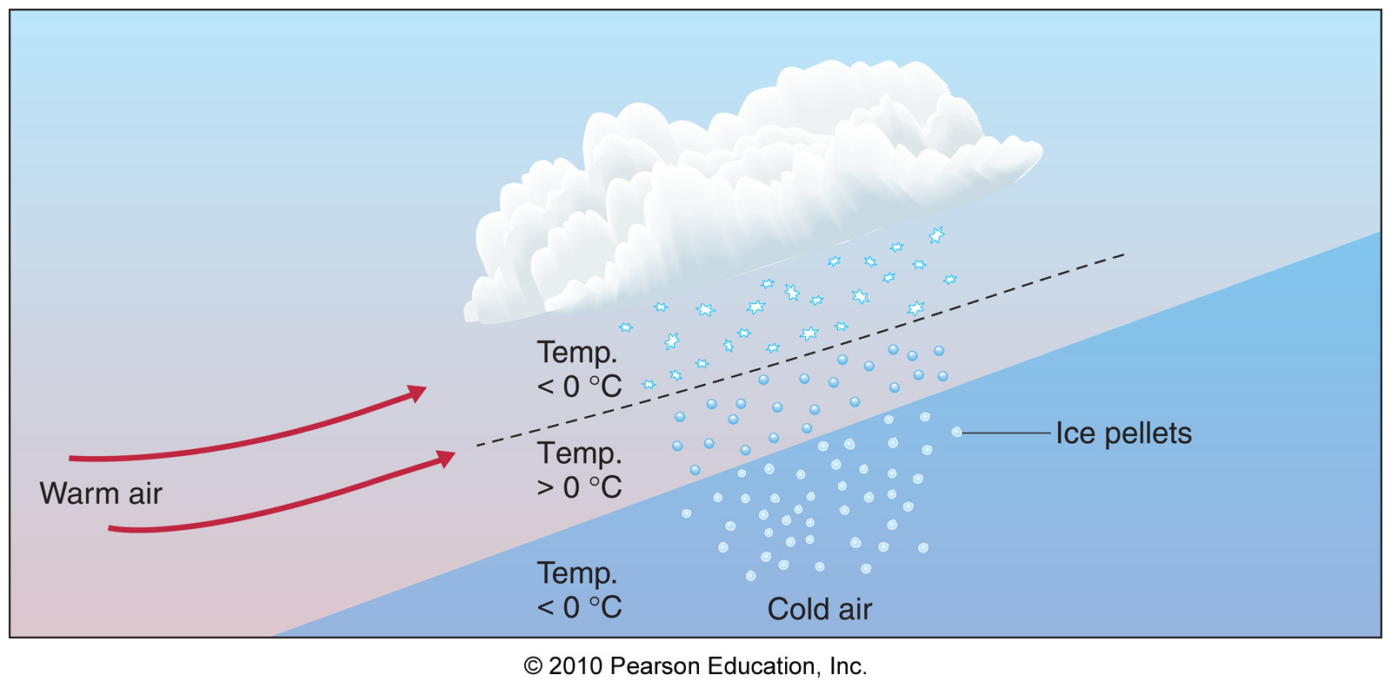
Freezing Rain and Sleet

Slide 64
Freezing Rain

Slide 65
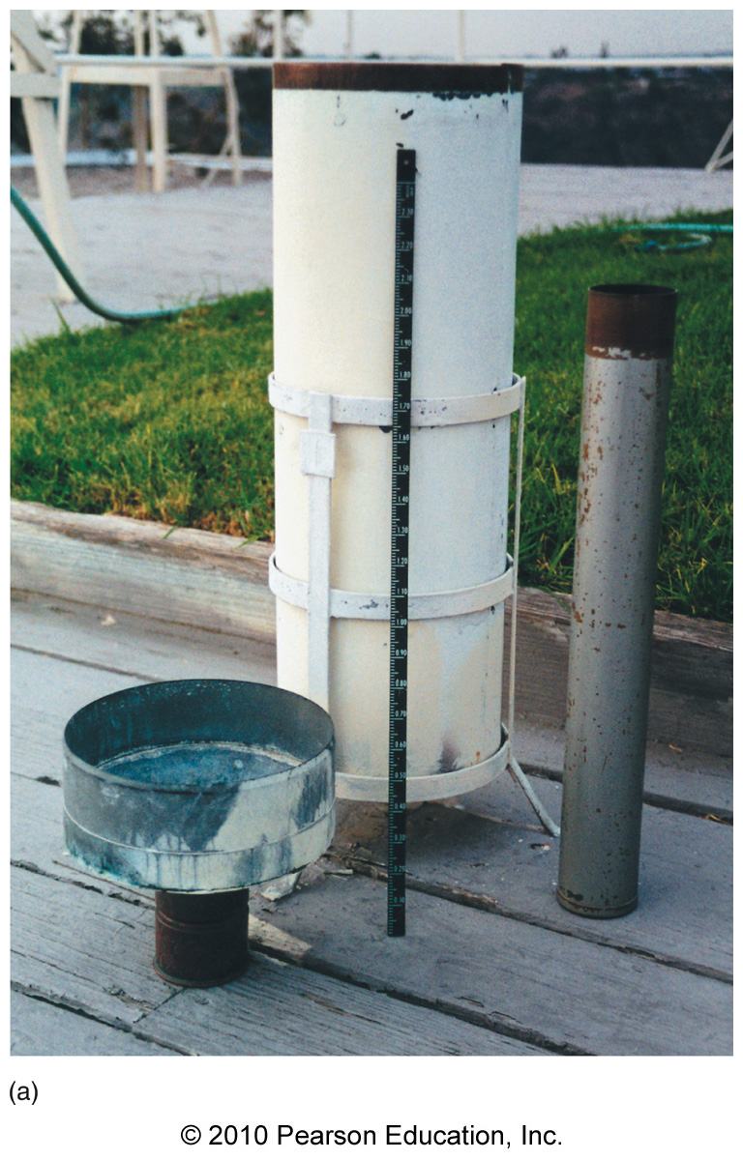
Measuring Precipitation
Raingage – A cylindrical container that collects rainfall and measures its depth

Slide 66
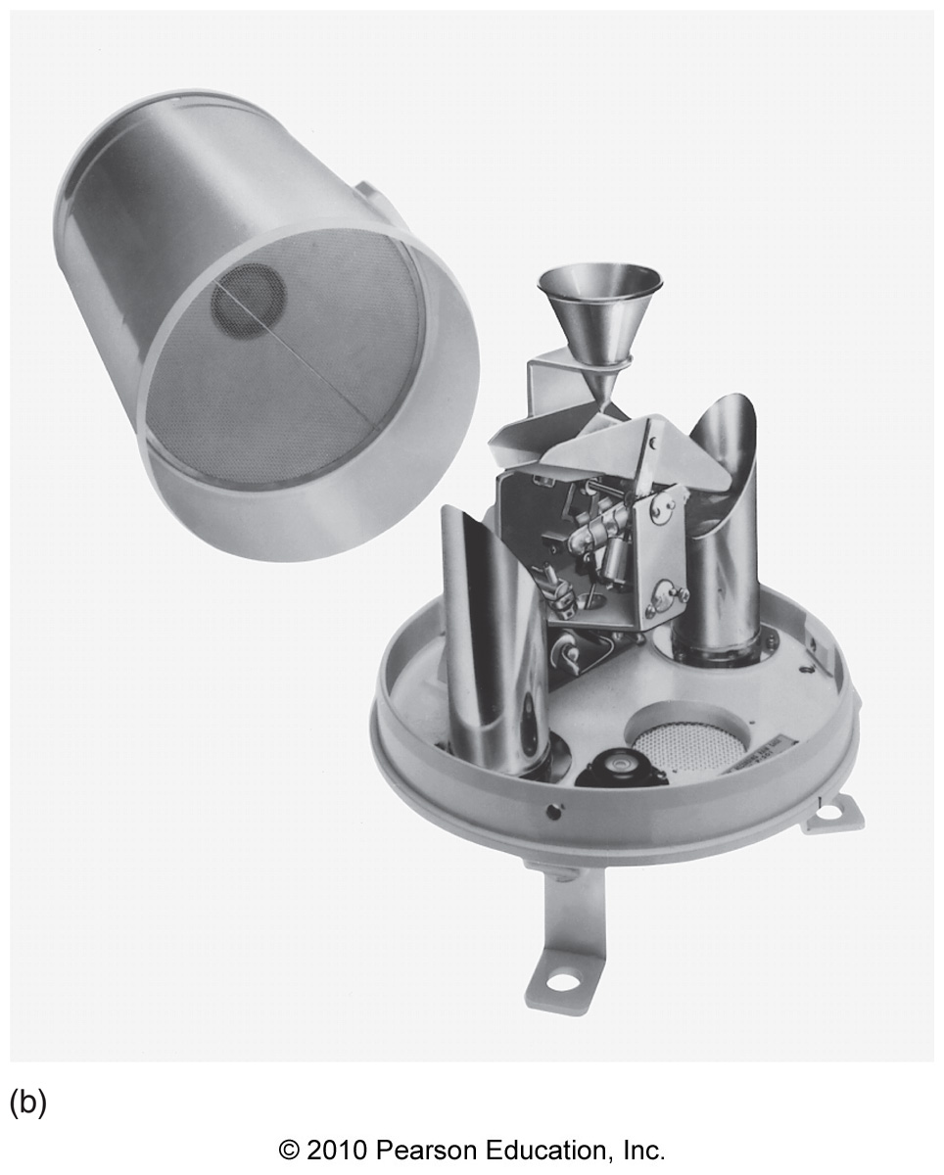
Measuring Precipitation
Tipping-bucket gage – a raingage that also measures timing and intensity

Slide 67
Precipitation Measurement by Radar

Slide 68
Cloud Seeding
Cloud seeding – injecting foreign materials into clouds to initiate precipitation by the Bergeron process

Slide 69
Cloud Seeding
Cloud seeding – injecting foreign materials into clouds to initiate precipitation by the Bergeron process
1) Dry ice is used to cool clouds to very
cold temperatures, causing ice crystals
to form

Slide 70
Cloud Seeding
Cloud seeding – injecting foreign materials into clouds to initiate precipitation by the Bergeron process
1) Dry ice is used to cool clouds to very
cold temperatures, causing ice crystals
to form
2) Silver iodide (similar structure to ice) is
used as ice nucleii

