Slide 1
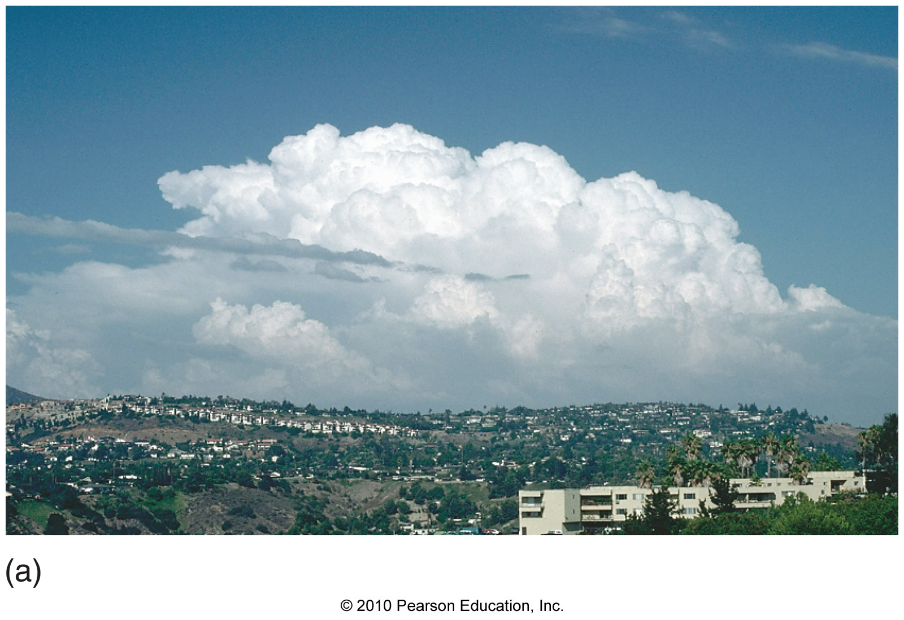
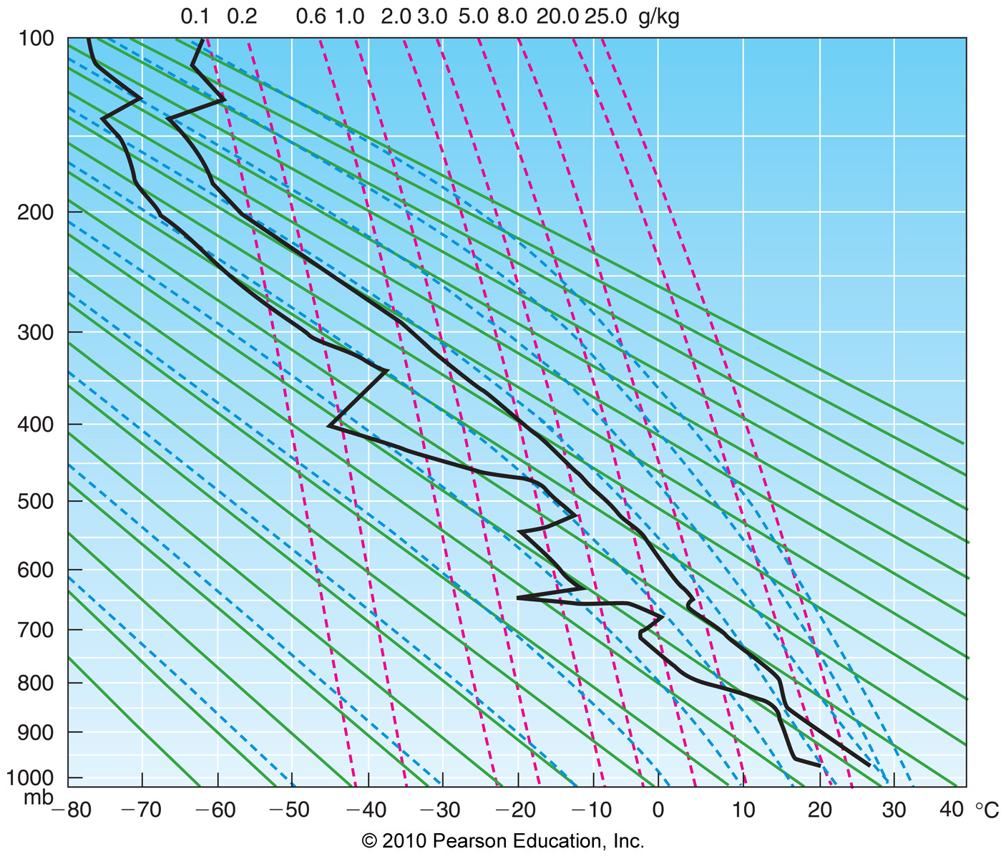
Chapter 6 – Cloud Development and Forms

Slide 2
Cloud Formation
Condensation (i.e. clouds,fog) results from:

Slide 3
Cloud Formation
Condensation (i.e. clouds,fog) results from:
Diabatic cooling (important for fog)

Slide 4
Cloud Formation
Condensation (i.e. clouds,fog) results from:
Diabatic cooling (important for fog)
Adiabatic cooling (important for clouds)

Slide 5
Cloud Formation
Condensation (i.e. clouds,fog) results from:
Diabatic cooling (important for fog)
Adiabatic cooling (important for clouds)
Clouds form due to adiabatic cooling in rising air
Γ_{d} = 9.8ºC/km (unsaturated lapse rate)
Γ_{m} ~ 5ºC/km (saturated lapse rate)

Slide 6
How Does Air Rise?
4 mechanisms cause air to rise:
1) Orographic lift – air that rises
because it is going over a mountain

Slide 7
How Does Air Rise?
4 mechanisms cause air to rise:
1) Orographic lift – air that rises
because it is going over a mountain
2) Frontal lift – air that rises at a front

Slide 8
How Does Air Rise?
4 mechanisms cause air to rise:
1) Orographic lift – air that rises
because it is going over a mountain
2) Frontal lift – air that rises at a front
3) Horizontal convergence – air that
is forced to rise because it is
converging

Slide 9
How Does Air Rise?
4 mechanisms cause air to rise:
1) Orographic lift – air that rises
because it is going over a mountain
2) Frontal lift – air that rises at a front
3) Horizontal convergence – air that
is forced to rise because it is
converging
4) Convection – air that rises because
it is less dense that its surroundings

Slide 10
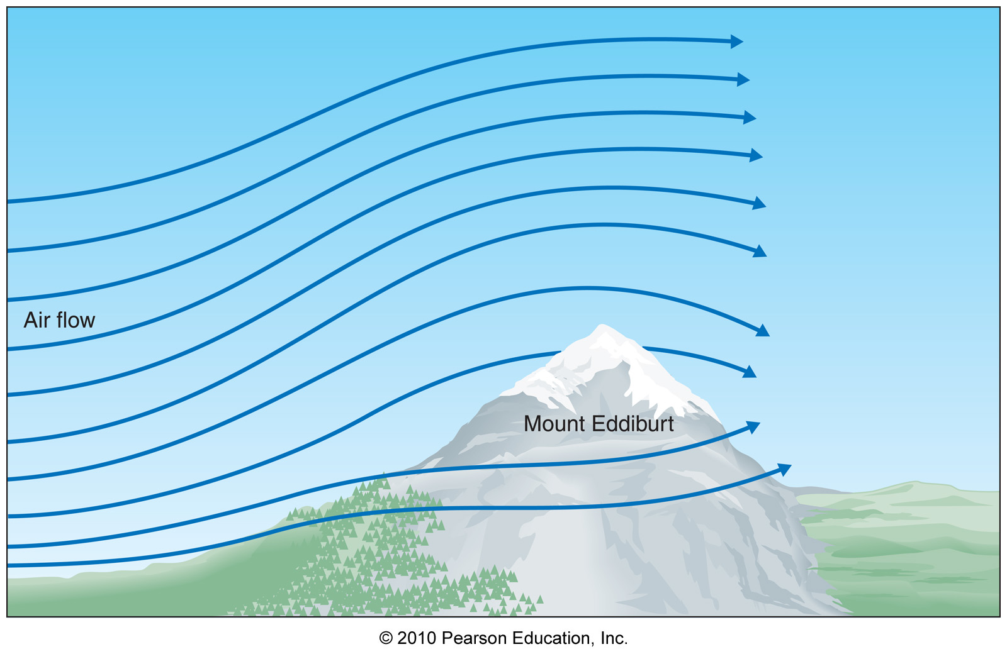
Orographic Lift
Air rises as it approaches a mountain peak

Slide 11
Orographic Lift
Air rises as it approaches a mountain peak

Slide 12
Orographic Lift
Air descends after it goes over a mountain peak
Clear air

Slide 13
Rain Shadow
A rain shadow is an area of less precipitation and clouds on the downwind side of a mountain (the anti-cloud!)

Slide 14
Rain Shadow
A rain shadow is an area of less precipitation and clouds on the downwind side of a mountain (the anti-cloud!)
Air descends downwind of a mountain peak

Slide 15
Rain Shadow
A rain shadow is an area of less precipitation and clouds on the downwind side of a mountain (the anti-cloud!)
Air descends downwind of a mountain peak
Air warms adiabatically due to compression

Slide 16
Rain Shadow
A rain shadow is an area of less precipitation and clouds on the downwind side of a mountain (the anti-cloud!)
Air descends downwind of a mountain peak
Air warms adiabatically due to compression
Precipitation and clouds evaporate to form rain shadow

Slide 17
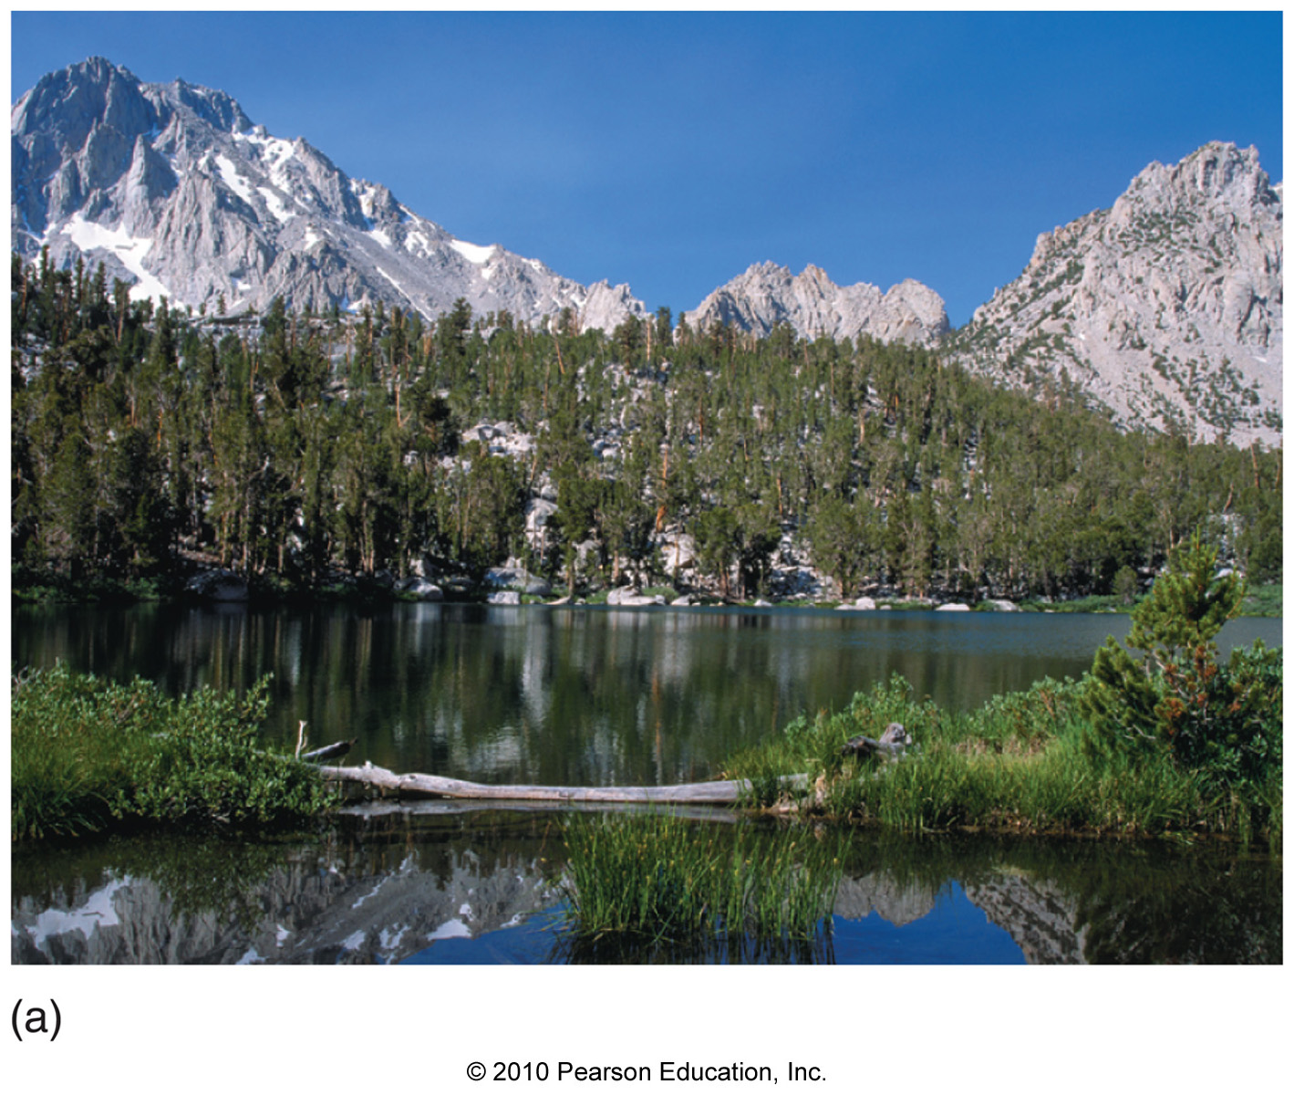
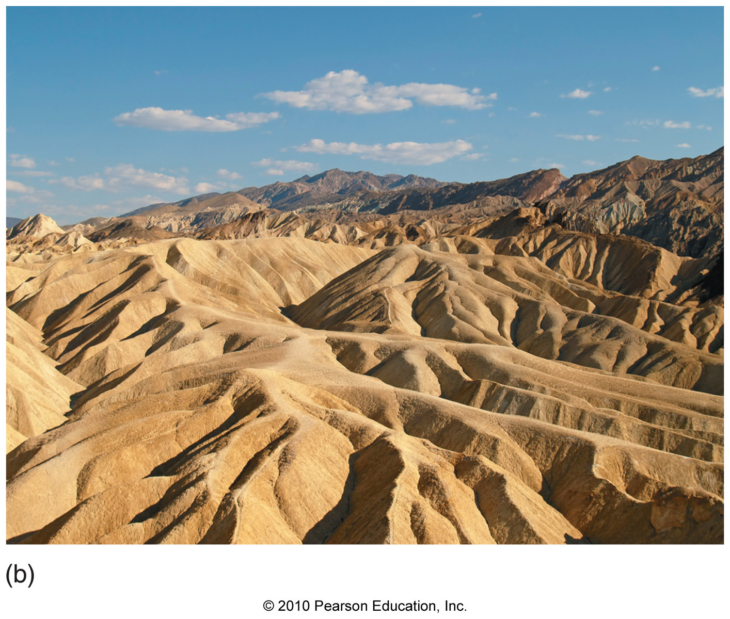
Rain Shadow

Slide 18
Frontal Lifting
Front – a zone of rapidly changing temperature (strong temperature gradient)

Slide 19
Frontal Lifting
Front – a zone of rapidly changing temperature (strong temperature gradient)
Types of Fronts
1) Cold Front – cold air is advancing

Slide 20
Frontal Lifting
Front – a zone of rapidly changing temperature (strong temperature gradient)
Types of Fronts
1) Cold Front – cold air is advancing
Warm Front – warm air is advancing

Slide 21
Frontal Lifting
Front – a zone of rapidly changing temperature (strong temperature gradient)
Types of Fronts
1) Cold Front – cold air is advancing
Warm Front – warm air is advancing
3) Stationary Front – front isn’t moving

Slide 22
Frontal Lifting
Front – a zone of rapidly changing temperature (strong temperature gradient)
Types of Fronts
1) Cold Front – cold air is advancing
Warm Front – warm air is advancing
3) Stationary Front – front isn’t moving
4) Occluded Front – you’ll find out later

Slide 23
Frontal Lifting
Example of a cold front

Slide 24
Frontal Lifting
Cold Front
(cold air pushes warm air up)
Warm Front
(Warm air overruns cold air)

Slide 25
Convergence
Air must rise when it converges

Slide 26
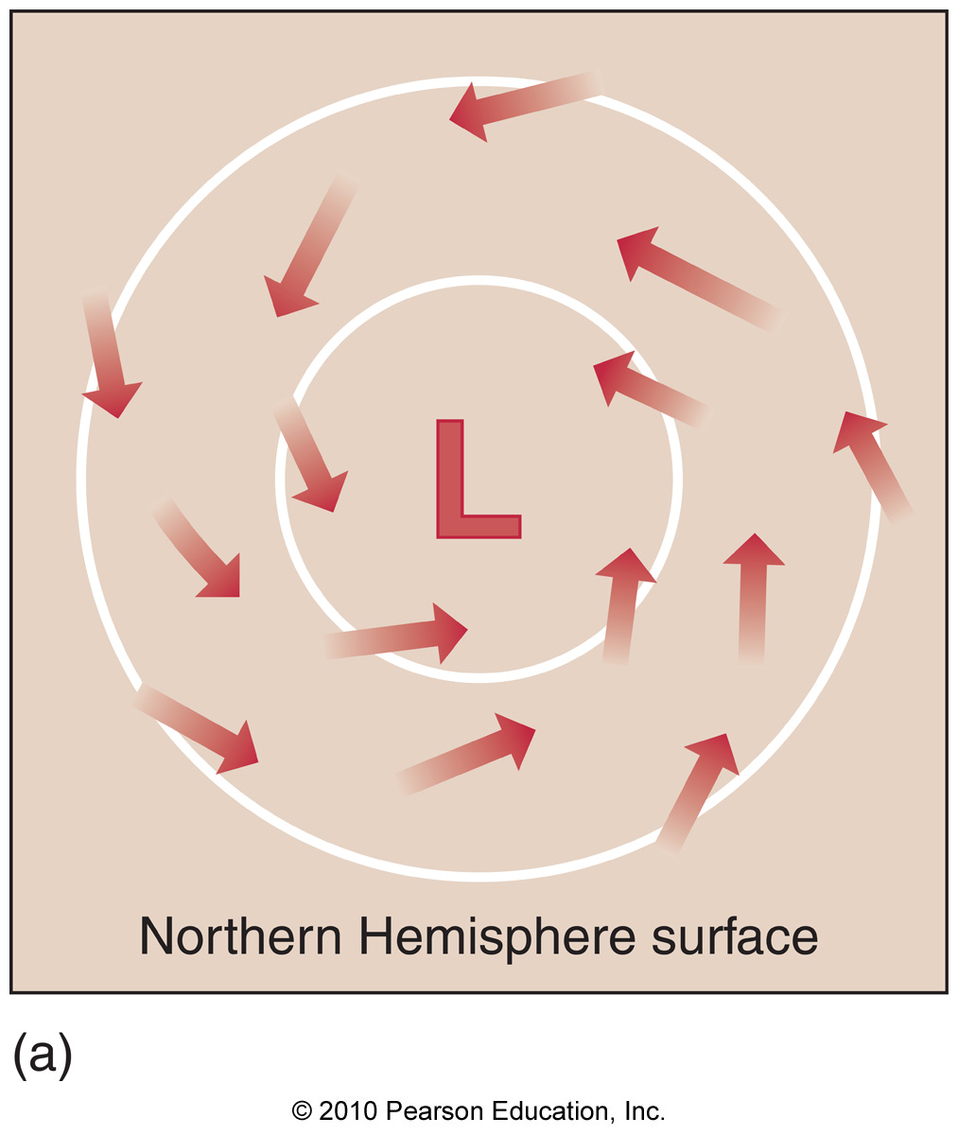
Convergence
Air must rise when it converges

Slide 27
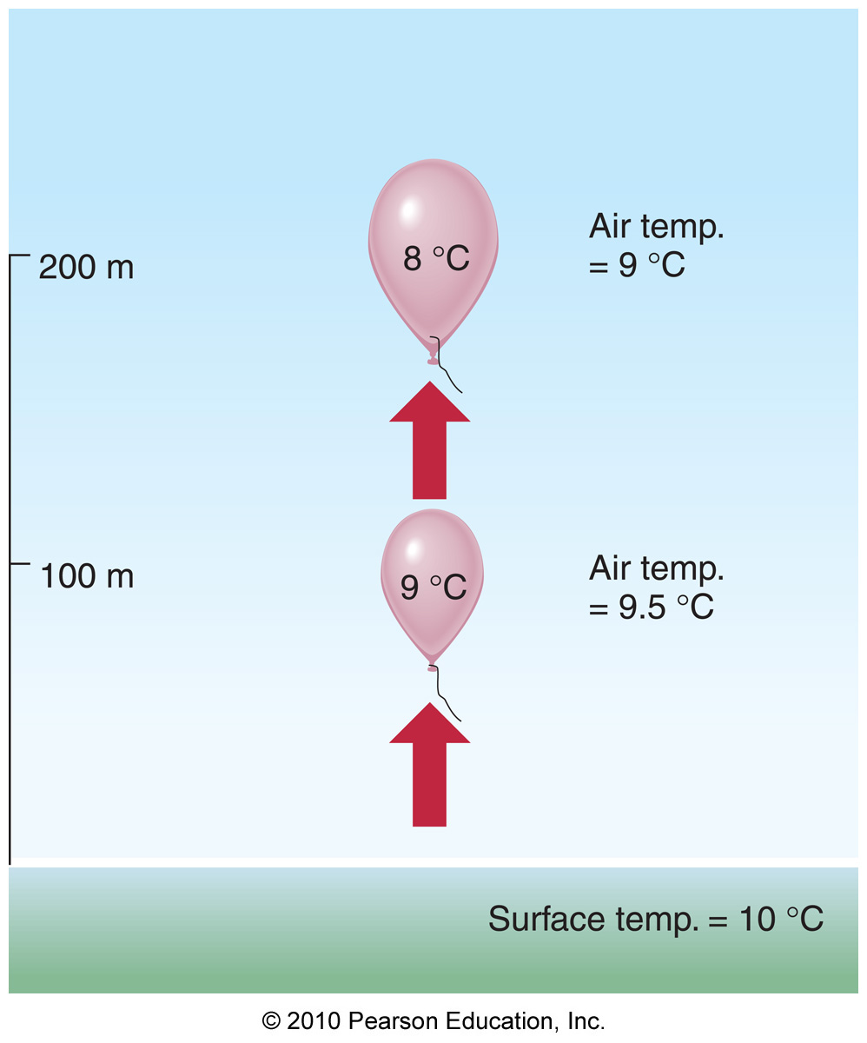
Convection
Air “bubbles” or “parcels” rise when they are warmed and become less dense than their surroundings (exactly the same way a helium balloon does)
2km
T = -8.6ºC
1km
T = 1.2ºC
T = 11ºC

Slide 28
Convection
Air “bubbles” or “parcels” rise when they are warmed and become less dense than their surroundings (exactly the same way a helium balloon does)
This is how
thunderstorms form!
2km
T = -8.6ºC
1km
T = 1.2ºC
T = 11ºC

Slide 29
Atmospheric Stability
Atmospheric stability – a measure of the atmosphere’s susceptibility to vertical motion

Slide 30
Atmospheric Stability
Atmospheric stability – a measure of the atmosphere’s susceptibility to vertical motion
Atmospheric stability depends on the environmental lapse rate (Γ_{e})

Slide 31
Atmospheric Stability
Atmospheric stability – a measure of the atmosphere’s susceptibility to vertical motion
Atmospheric stability depends on the environmental lapse rate (Γ_{e})
Atmospheric stability comes in 3 flavors:
1) Absolutely stable

Slide 32
Atmospheric Stability
Atmospheric stability – a measure of the atmosphere’s susceptibility to vertical motion
Atmospheric stability depends on the environmental lapse rate (Γ_{e})
Atmospheric stability comes in 3 flavors:
1) Absolutely stable
2) Absolutely unstable

Slide 33
Atmospheric Stability
Atmospheric stability – a measure of the atmosphere’s susceptibility to vertical motion
Atmospheric stability depends on the environmental lapse rate (Γ_{e})
Atmospheric stability comes in 3 flavors:
1) Absolutely stable
2) Absolutely unstable
3) Conditionally unstable

Slide 34
Absolutely Unstable Air
The slightest nudge sends the ball accelerating away…

Slide 35
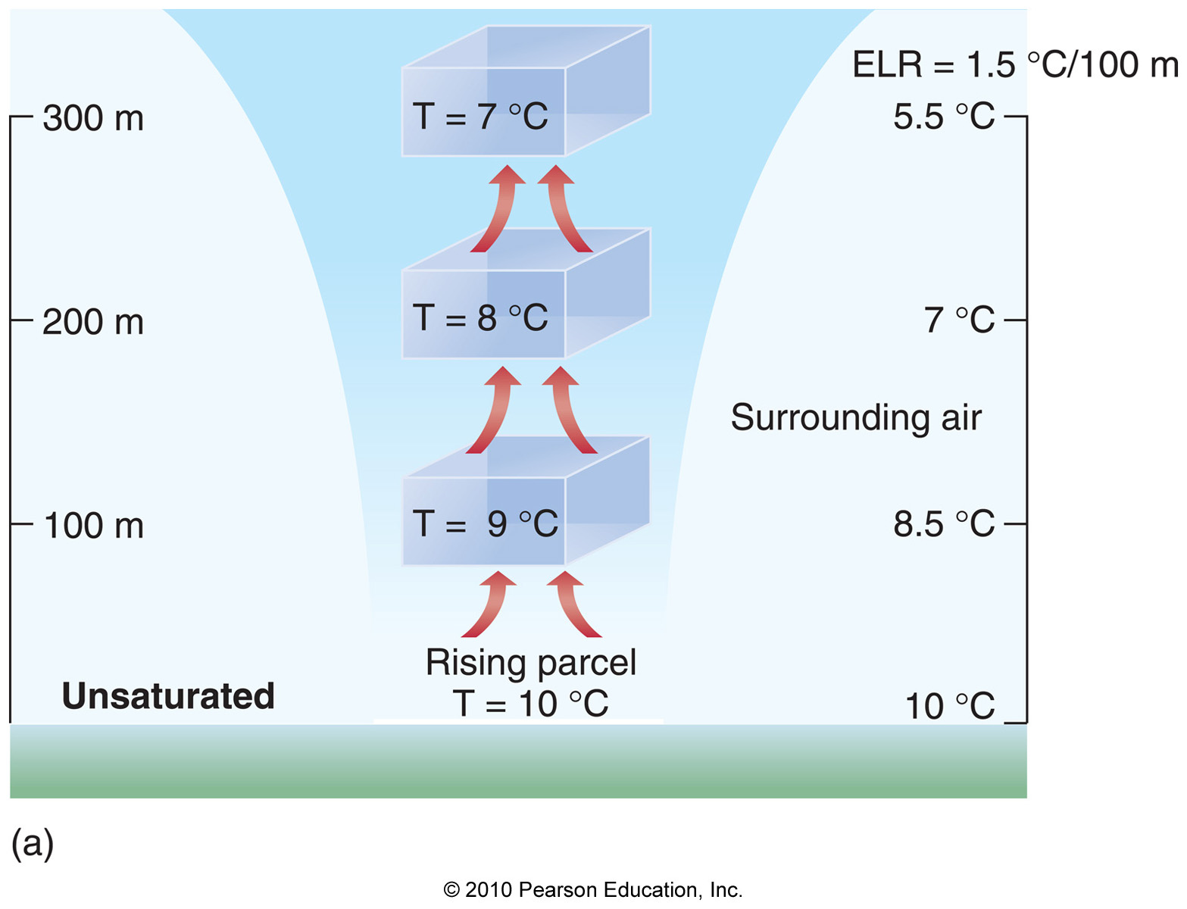
Absolutely Unstable Air
Absolutely unstable: Γ_{e} > Γ_{d} (unsaturated air)
Γ_{e} = 1.5ºC/100m
Γ_{d} = 1.0ºC/100m

Slide 36
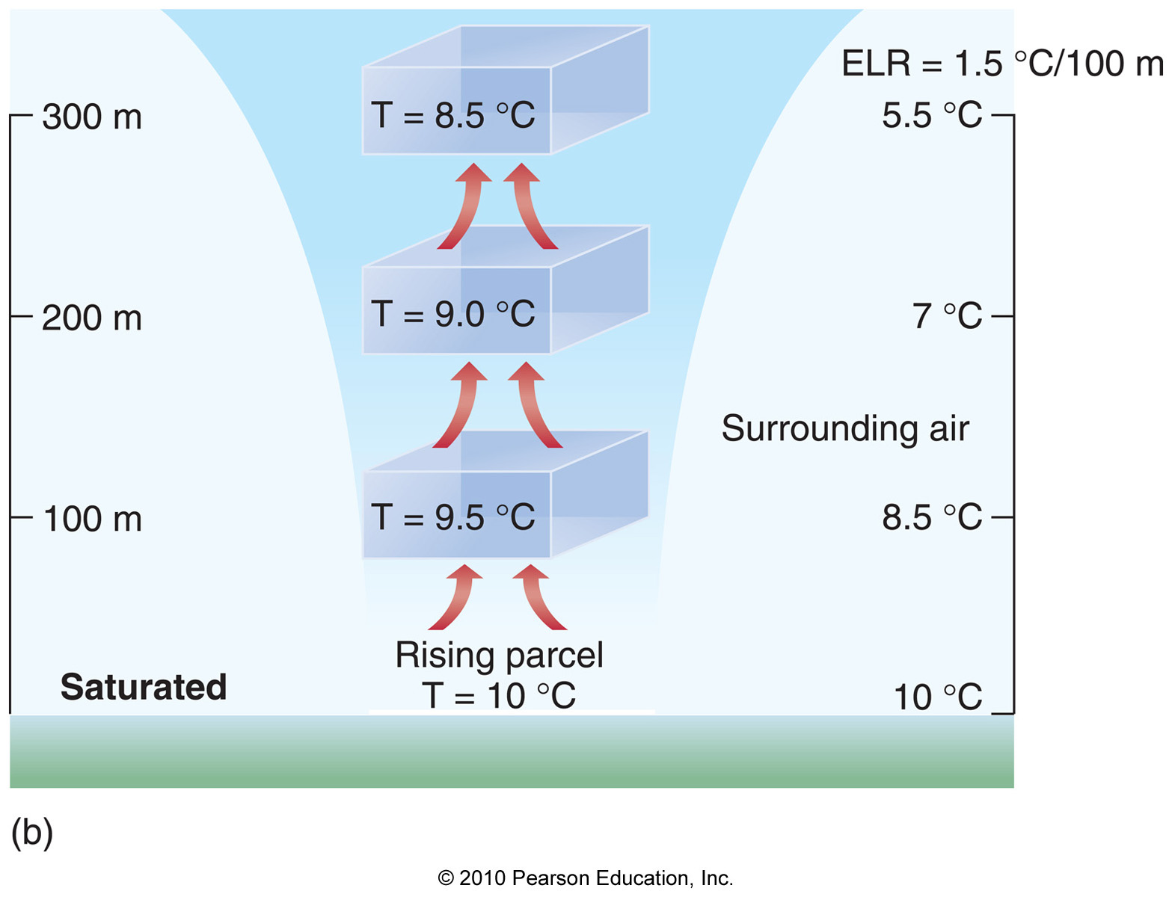
Absolutely Unstable Air
Absolutely unstable: Γ_{e} > Γ_{m} (saturated air)
Γ_{e} = 1.5ºC/100m
Γ_{m} = 0.5ºC/100m

Slide 37
Absolutely Stable Air
Any push and the ball will go back to the valley and come to rest again…

Slide 38
Absolutely Stable Air
Γ_{d} = 1.0ºC/100m
Γ_{m} = 0.5ºC/100m
Γ_{e} = 0.2ºC/100m
Γ_{e} = 0.2ºC/100m
Unsaturated
Saturated

Slide 39
Conditionally Unstable Air
If the ball is pushed high enough, it will go over the hump and accelerate away… (otherwise it comes back to rest)

Slide 40
Conditionally Unstable Air
Γ_{d} = 1.0ºC/100m
Γ_{m} = 0.5ºC/100m
Γ_{e} = 0.7ºC/100m
Γ_{e} = 0.7ºC/100m
Always unsaturated
Becomes saturated when rising

Slide 41
Stability Summary
Absolutely unstable:
Γ_{e} > both Γ_{d} and Γ_{m}

Slide 42
Stability Summary
Absolutely unstable:
Γ_{e} > both Γ_{d} and Γ_{m}
Absoutely stable:
Γ_{e} < both Γ_{d} and Γ_{m}

Slide 43
Stability Summary
Absolutely unstable:
Γ_{e} > both Γ_{d} and Γ_{m}
Absoutely stable:
Γ_{e} < both Γ_{d} and Γ_{m}
Conditionally unstable
Γ_{d} > Γ_{e} > Γ_{m}

Slide 44
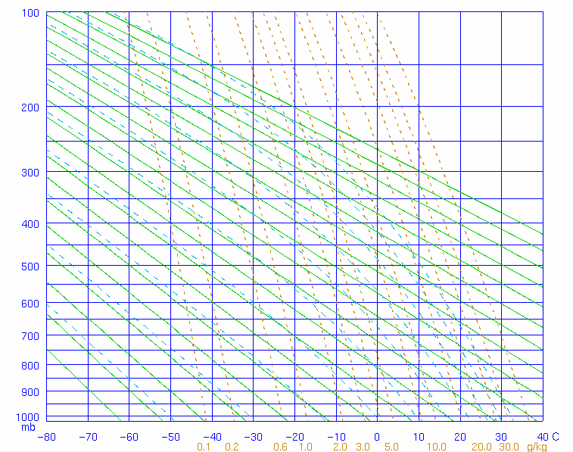
Absolutely Unstable
Γ_{d} – green solid line
Γ_{m} – blue dashed line
Γ_{e} – black solid line

Slide 45
Absolutely Stable
Γ_{d} – green solid line
Γ_{m} – blue dashed line
Γ_{e} – black solid line

Slide 46
Conditionally Unstable
Γ_{d} – green solid line
Γ_{m} – blue dashed line
Γ_{e} – black solid line

Slide 47
What Makes the Environmental Lapse Rate (Γ_{e})?
Γ_{e} is extremely variable in space and time
Γ_{e} is influenced by 2 primary factors:
1) Near surface heating/cooling
2) Differential temperature advection

Slide 48
Limitations on Convection
What stops vertical motion?
- The only “stopper” is if air becomes more
dense (colder) than its surroundings!!

Slide 49
Limitations on Convection
What stops vertical motion?
- The only “stopper” is if air becomes more
dense (colder) than its surroundings!!
This happens in 2 ways:
1) Stable air aloft

Slide 50
Limitations on Convection
What stops vertical motion?
- The only “stopper” is if air becomes more
dense (colder) than its surroundings!!
This happens in 2 ways:
1) Stable air aloft
2) Entrainment – intake of drier air
from surroundings

Slide 51
Convection
Lifting condensation level (LCL) – The level at which a cloud forms (altitude of cloud base)
Level of Free Convection (LFC) – the level at which air becomes less dense (warmer) than its surroundings

Slide 52
Stable Air Aloft (Dry Example)
Γ_{d} – green solid line
Air stops accelerating
Air is accelerating up
Γ_{e} – black solid line

Slide 53
Inversions – Extremely Stable Air
Inversion – when temperature increases with height

Slide 54
Inversions
Γ_{d} – green solid line
Γ_{m} – blue dashed line
Γ_{e} – black solid line

Slide 55
Types of Inversions
1) Radiation inversion – caused by
nighttime cooling of surface air

Slide 56
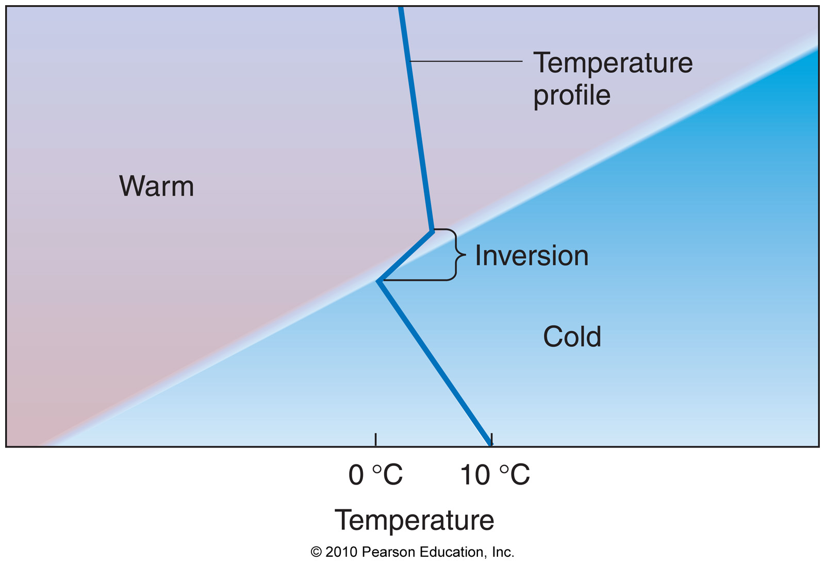
Types of Inversions
2) Frontal inversion – occurs at fronts

Slide 57
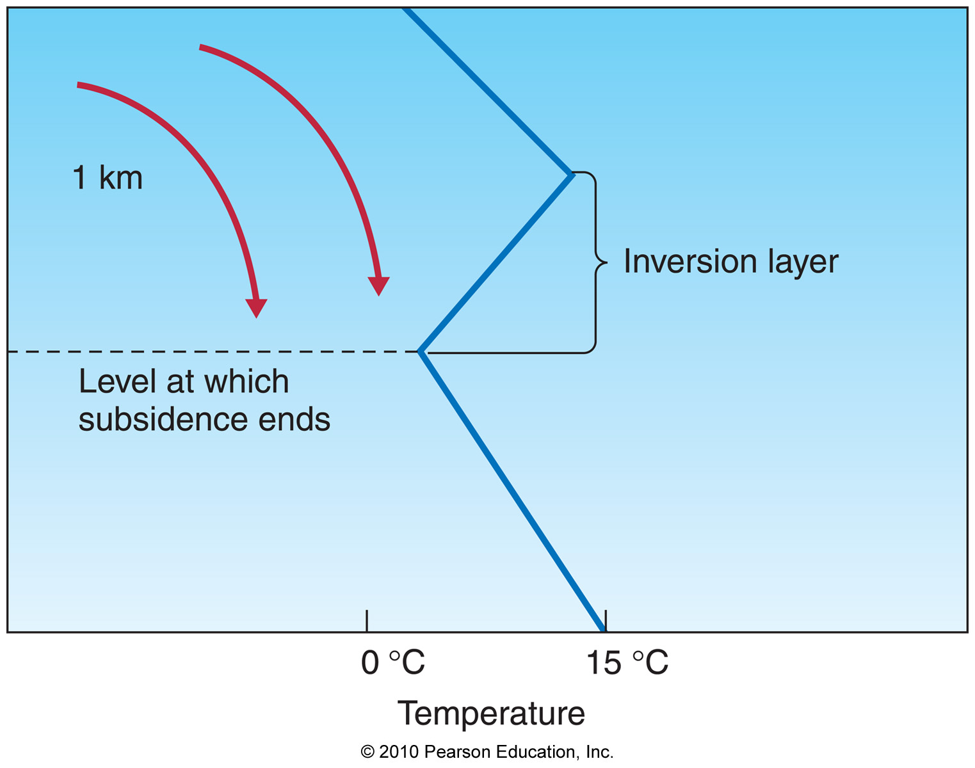
Types of Inversions
3) Subsidence inversion – caused by
sinking air above a static layer

Slide 58
Inversions and Agriculture

Slide 59
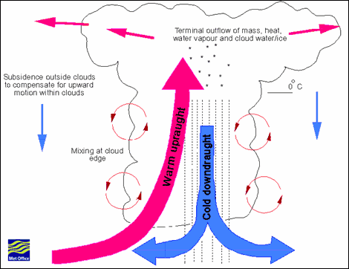
Entrainment
Mixing with surrounding drier, cooler air cools rising parcels through:
1) Mixing
2) Evaporation

Slide 60
Cloud Types
Old classification of clouds
Cirrus (high, thin, wispy)

Slide 61
Cloud Types
Old classification of clouds
Cirrus (high, thin, wispy)
Stratus (layered)

Slide 62
Cloud Types
Old classification of clouds
Cirrus (high, thin, wispy)
Stratus (layered)
Cumulus (puffy, vertically-developed)

Slide 63
Cloud Types
Old classification of clouds
Cirrus (high, thin, wispy)
Stratus (layered)
Cumulus (puffy, vertically-developed)
Nimbus (rain-producing)

Slide 64
Cloud Types
New classification of clouds
High clouds (higher than 19,000 ft.)
Middle clouds (b/w 6,000 and 19,000 ft.)
Low clouds (below 6,000 ft.)
Clouds with vertical development

Slide 65
Cloud Types

Slide 66
High Clouds (> 19,000 ft.)
Composed of ice crystals

Slide 67
High Clouds (> 19,000 ft.)
Composed of ice crystals
Principal types:
1) Cirrus

Slide 68
High Clouds (> 19,000 ft.)
Composed of ice crystals
Principal types:
1) Cirrus
2) Cirrostratus

Slide 69
High Clouds (> 19,000 ft.)
Composed of ice crystals
Principal types:
1) Cirrus
2) Cirrostratus
3) Cirrocumulus

Slide 70
Cirrus

Slide 71
Cirrostratus

Slide 72
Cirrocumulus

Slide 73
Other High Clouds - Contrails

Slide 74
Middle Clouds (between 6,000 and 19,000 ft.)
Composed mostly of supercooled water

Slide 75
Middle Clouds (between 6,000 and 19,000 ft.)
Composed mostly of supercooled water
Principal types:
1) Altostratus

Slide 76
Middle Clouds (between 6,000 and 19,000 ft.)
Composed mostly of supercooled water
Principal types:
1) Altostratus
2) Altocumulus

Slide 77
Altostratus

Slide 78
Altocumulus

Slide 79
Low Clouds (< 6,000 ft.)
Composed of liquid water

Slide 80
Low Clouds (< 6,000 ft.)
Composed of liquid water
Principal types:
1) Stratus

Slide 81
Low Clouds (< 6,000 ft.)
Composed of liquid water
Principal types:
1) Stratus
2) Nimbostratus

Slide 82
Low Clouds (< 6,000 ft.)
Composed of liquid water
Principal types:
1) Stratus
2) Nimbostratus
3) Stratocumulus

Slide 83
Stratus

Slide 84
Nimbostratus

Slide 85
Stratocumulus

Slide 86
Cumulus Clouds
Cumulus clouds can extend the entire depth of the atmosphere
Principal types:
1) Cumulus
- cumulus humilis (fair-weather cumulus)
- cumulus congestus (fortress-like)
2) Cumulonimbus

Slide 87
Cumulus Humilis

Slide 88
Cumulus Congestus

Slide 89
Cumulonimbus

Slide 90
Other Types of Clouds
Lenticular clouds – clouds that form in wavy airstreams after air goes over a moutain

Slide 91
Other Types of Clouds
Banner clouds – clouds located at mountain peaks as they ascend a mountain

Slide 92
Other Types of Clouds
Banner clouds – clouds located at mountain peaks as they ascend a mountain
Mammatus clouds – balloon-like clouds hanging down from cumulonimbus clouds

Slide 93
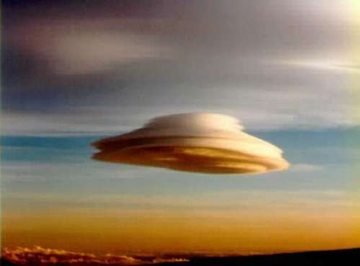
Lenticular clouds

Slide 94
Mammatus Clouds

Slide 95
Banner Clouds

Slide 96
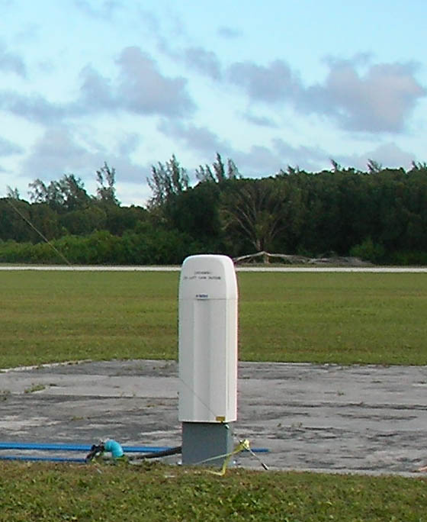
Observing Clouds
Ceilometers – automated instrument that measures the height of the cloud base, or ceiling, as well as coverage

Slide 97
Cloud Coverage

Slide 98
Observing Clouds
Both cloud ceilings and coverage is reported in the standard ASOS hourly observation

Slide 99
Observing Clouds
Satellite imagery is also a primary tool for observing clouds and cloud motions
Visible satellite imagery
Infrared satellite imagery

Slide 100
Visible Satellite Imagery

Slide 101
Infrared Satellite Imagery

