Slide 1
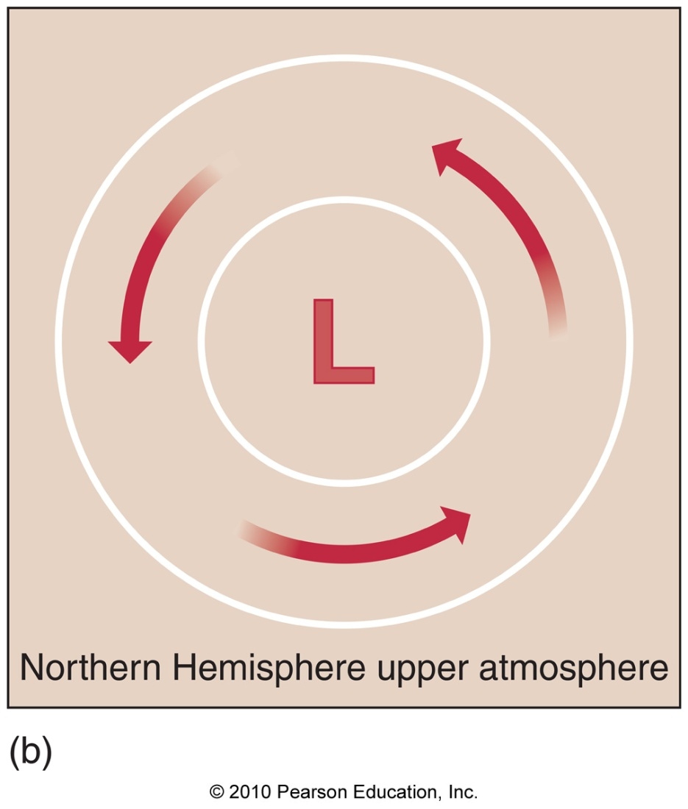
Chapter 4 – Atmospheric Pressure and wind

Slide 2
Recall: Pressure
General Characteristics
Pressure is defined as force per unit area

Slide 3
Recall: Pressure
General Characteristics
Pressure is defined as force per unit area
Pressure comes in different units:
- Pascals(Pa), milibars(mb), inches of mercury (in Hg),
pounds per square inch (psi)

Slide 4
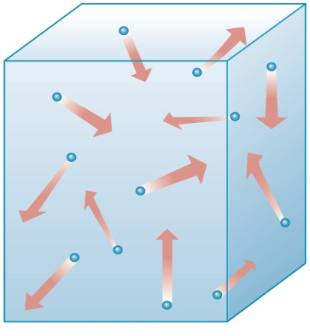
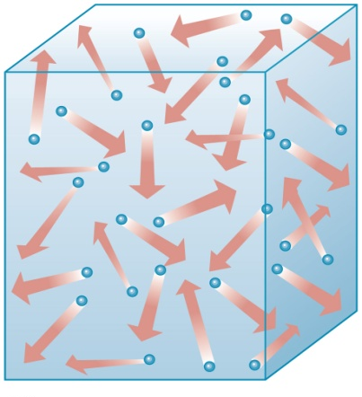
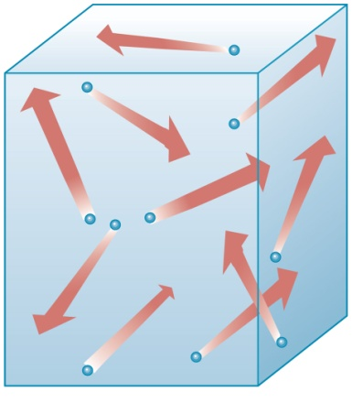
Recall: Pressure
General Characteristics
Pressure is defined as force per unit area
Pressure comes in different units:
- Pascals(Pa), milibars(mb), inches of mercury (in Hg),
pounds per square inch (psi)
Pressure exists due to molecular collisions
Pressure increases with:
Higher density
Higher temperature
(1)
(2)

Slide 5
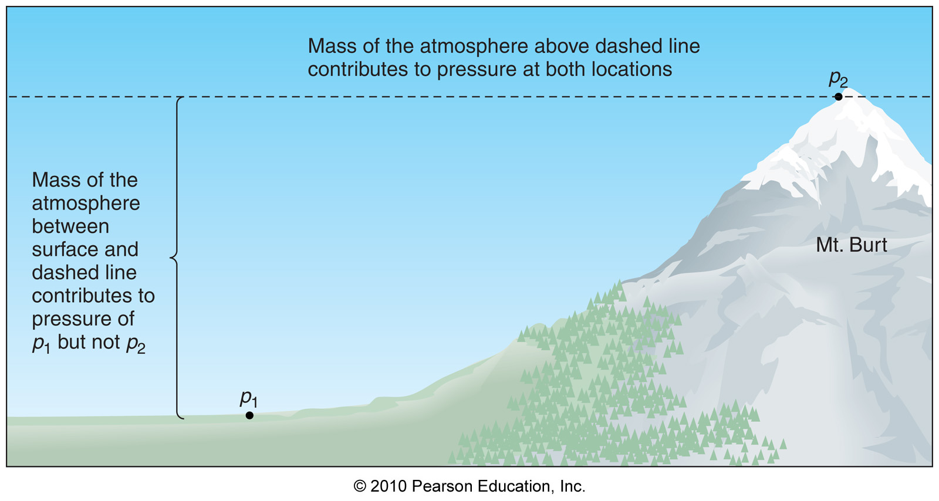
Atmospheric Pressure
Pressure anywhere in the atmosphere is due to the weight of air above

Slide 6
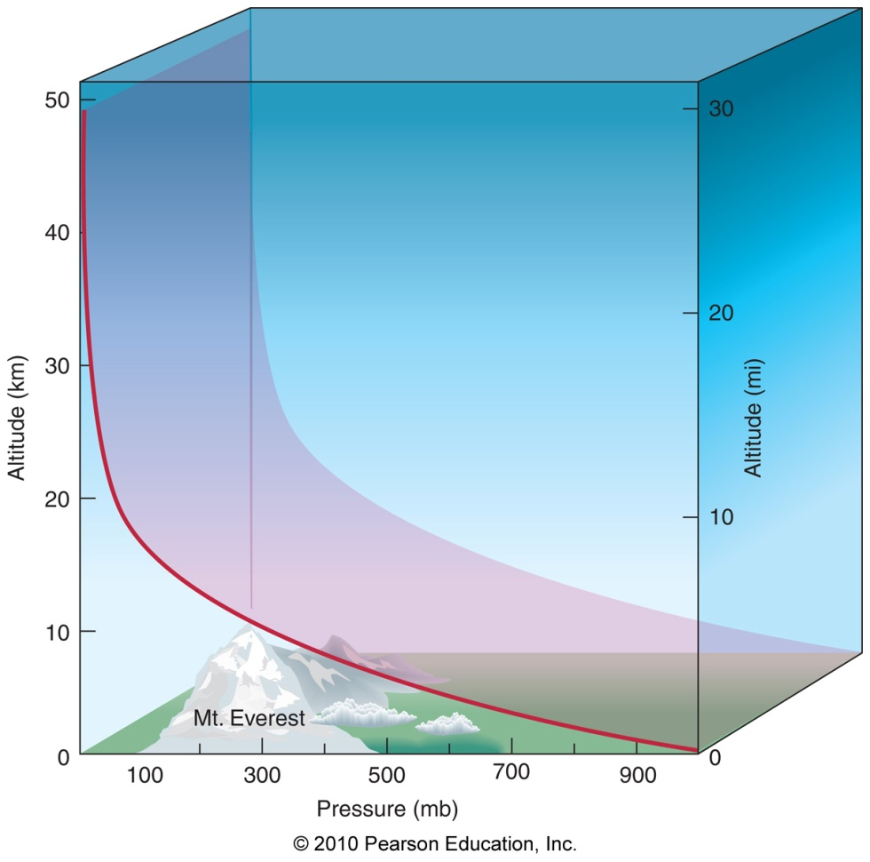
Atmospheric Pressure
Pressure decreases faster near the surface, less so aloft (due to higher density near surface)

Slide 7
Atmospheric Pressure
Pressure decreases faster near the surface, less so aloft (due to higher density near surface)
Ultimately due to
compressibility

Slide 8
Atmospheric Pressure
The nature of atmospheric pressure explains much, including:
1) My exploding bag of chips

Slide 9
Atmospheric Pressure
The nature of atmospheric pressure explains much, including:
1) My exploding bag of chips
2) The gravity-defying upside-down cup of
water (and the straw trick)

Slide 10
Atmospheric Pressure
The nature of atmospheric pressure explains much, including:
1) My exploding bag of chips
2) The gravity-defying upside-down cup of
water (and the straw trick)
3) Why flight attendants aren’t worried about
airplane doors being opened at cruising
altitude

Slide 11
Force on an Airplane Door
Cabin pressurized @ 850 mb
Pressure at cruising altitude – 300 mb
Inside plane
outside plane
850 mb
300 mb

Slide 12
Force on an Airplane Door
Cabin pressurized @ 850 mb
Pressure at cruising altitude – 300 mb
Inside plane
outside plane
850 mb
300 mb
Pressure difference on door = 550 mb

Slide 13
Force on an Airplane Door
Cabin pressurized @ 850 mb
Pressure at cruising altitude – 300 mb
Inside plane
outside plane
850 mb
300 mb
Pressure difference on door = 550 mb
Area of door = 6’ X 3’ = 18 ft² = 2592 in²

Slide 14
Force on an Airplane Door
550 mb pushing on 2592 in²

Slide 15
Force on an Airplane Door
550 mb pushing on 2592 in²
1 mb = 0.0145 psi (unit conversion)

Slide 16
Force on an Airplane Door
550 mb pushing on 2592 in²
1 mb = 0.0145 psi (unit conversion)
550 mb = 8 psi

Slide 17
Force on an Airplane Door
550 mb pushing on 2592 in²
1 mb = 0.0145 psi (unit conversion)
550 mb = 8 psi
Pressure = Force/Area

Slide 18
Force on an Airplane Door
550 mb pushing on 2592 in²
1 mb = 0.0145 psi (unit conversion)
550 mb = 8 psi
Pressure = Force/Area
Force = Pressure x Area

Slide 19
Force on an Airplane Door
550 mb pushing on 2592 in²
1 mb = 0.0145 psi (unit conversion)
550 mb = 8 psi
Pressure = Force/Area
Force = Pressure x Area
Force = 8 pounds/in² x 2592 in²

Slide 20
Force on an Airplane Door
550 mb pushing on 2592 in²
1 mb = 0.0145 psi (unit conversion)
550 mb = 8 psi
Pressure = Force/Area
Force = Pressure x Area
Force = 8 pounds/in² x 2592 in²
Force on door = 20,736 pounds (~10 tons)!!

Slide 21
Atmospheric Pressure
The nature of atmospheric pressure explains much, including:
1) My exploding bag of chips
2) The gravity-defying upside-down cup of
water (and the straw trick)
3) Why flight attendants aren’t worried about
airplane doors being opened at cruising
altitude
4) The incredible can crushing power of
atmospheric surface pressure

Slide 22
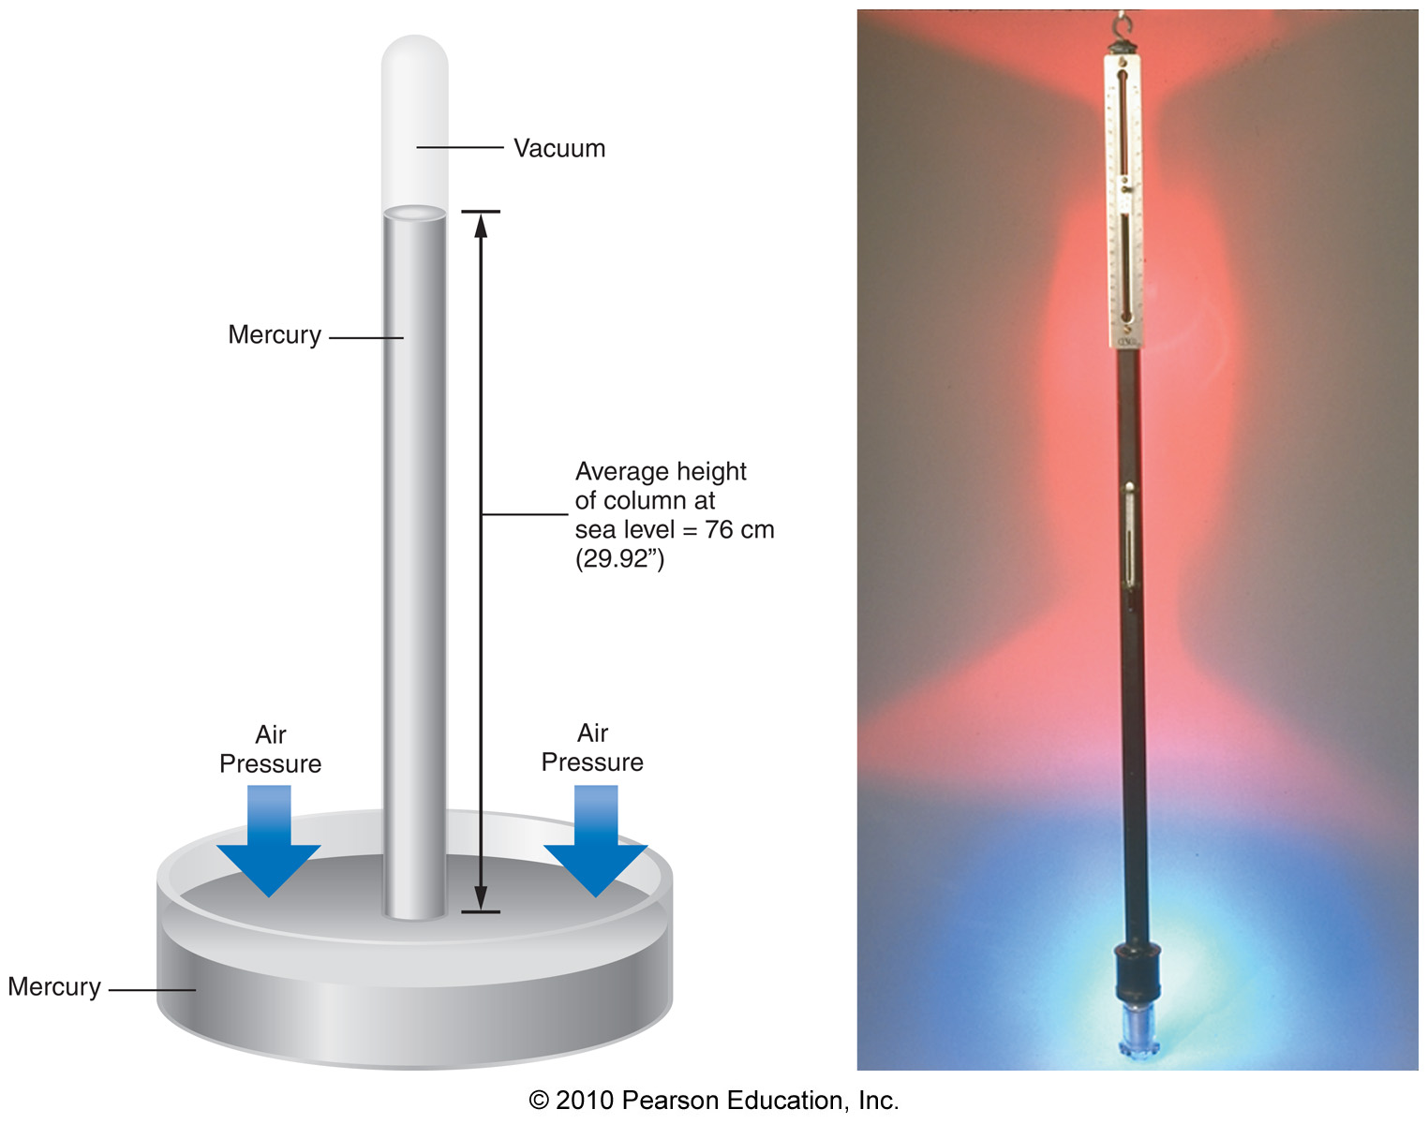
Measuring Pressure
Barometer – an instrument that measures pressure
1) Mercury barometer

Slide 23
Corrections to Mercury Barometer Readings
Correction for altitude (standardized to
sea level)

Slide 24
Corrections to Mercury Barometer Readings
Correction for altitude (standardized to
sea level)
Correction for temperature (standardized to 32ºF)

Slide 25
Corrections to Mercury Barometer Readings
Correction for altitude (standardized to
sea level)
Correction for temperature (standardized to 32ºF)
Correction for gravity difference with respect to latitude (earth’s not a sphere?) (standardized to 45ºN)

Slide 26
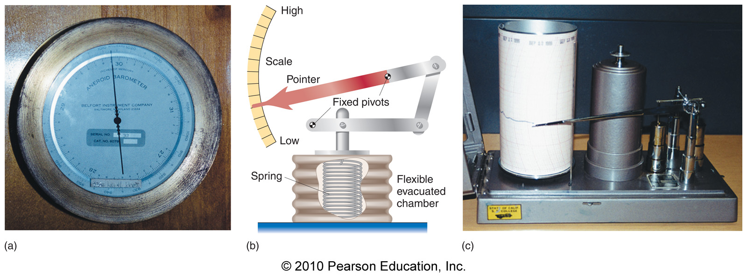
Measuring Pressure
Barometer – an instrument that measures pressure
2) Aneroid barometer

Slide 27
Horizontal Pressure Distribution
Pressure gradients (change in pressure with distance) cause air to move
Wind!!!

Slide 28
Horizontal Pressure Distribution
Pressure gradients (change in pressure with distance) cause air to move
Wind!!!
This wind is a direct application of how force equals mass times acceleration
F = M x A

Slide 29
Horizontal Pressure Distribution
Pressure gradients (change in pressure with distance) cause air to move
Wind!!!
This wind is a direct application of how force equals mass times acceleration
F = M x A
In the case of wind, the force (F) is the pressure gradient force

Slide 30
Pressure Gradient Force
The pressure gradient force always points from HIGH pressure toward LOW pressure!!!
H
L
Pressure Gradient Force

Slide 31
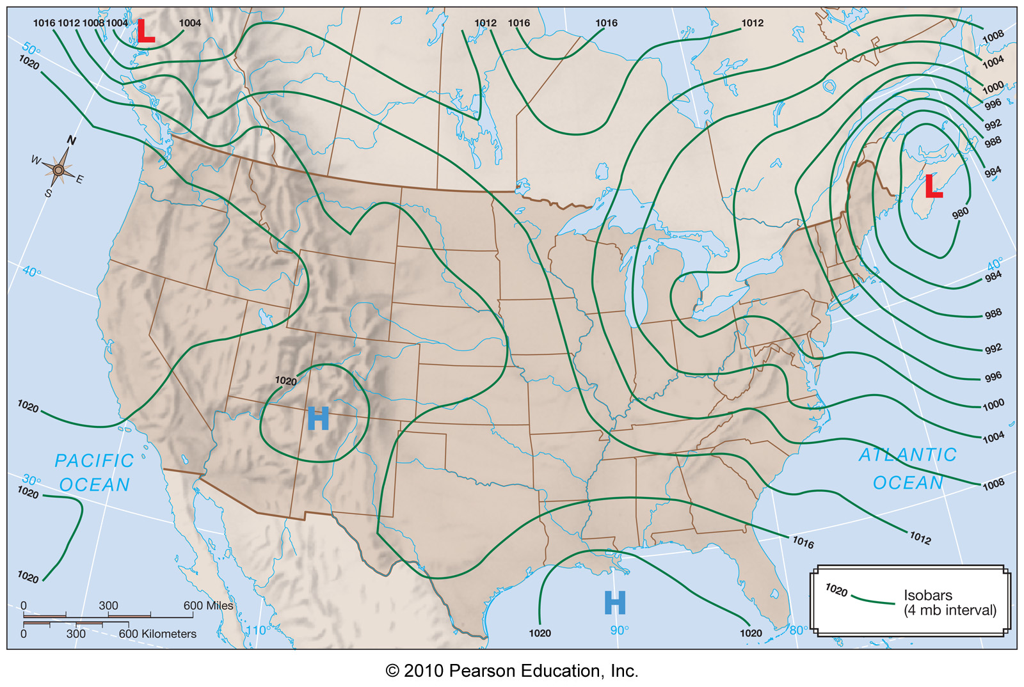
Horizontal Pressure Distribution
Pressure is viewed horizontally using isobars (lines of constant pressure)
Strong PGF
Weak PGF

Slide 32
Horizontal Pressure Distribution
Sea level pressure maps are a good weather analysis tool, but wait a second…

Slide 33
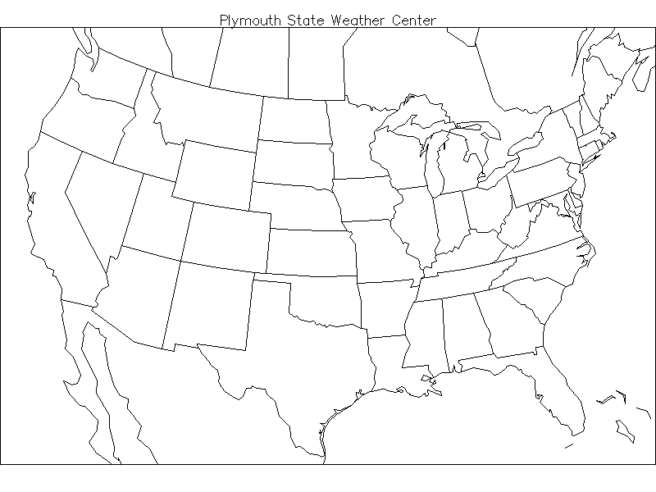
If Station Pressures Were Used
Lower pressure in mountain areas
Higher pressure in coastal areas
Not a true picture of atmospheric effects
L
L
L
H
H H
Notes:
Slide27.mp3
If station pressures at cities all over the nation were plotted on a map and analyzed, it would always show lower pressure in mountainous areas such as the Rockies and high pressure in coastal regions. This would not be a true picture of the horizontal variation in pressure. Differences in atmospheric pressure caused by changes occurring in the atmosphere would be masked by the elevation factor if station pressures were used.

Slide 34
Sea Level Pressure
Surface pressure observations are “reduced” to sea level (10 mb/100 meters is typical in lower atmosphere)

Slide 35
Sea Level Pressure
Surface pressure observations are “reduced” to sea level (10 mb/100 meters is typical in lower atmosphere)
These sea level pressure values are the numbers on sea level pressure maps

Slide 36
Sea Level Pressure
Surface pressure observations are “reduced” to sea level (10 mb/100 meters is typical in lower atmosphere)
These sea level pressure values are the numbers on sea level pressure maps
The effects of elevation are removed, revealing a more useful horizontal pressure distribution

Slide 37
Sea Level Pressure
Why do we care? SLP maps are an important weather analysis tool:
- Low pressure centers (cyclones)
- High pressure centers (anticyclones)
- Troughs
- Ridges
All of the above associated with various weather

Slide 38
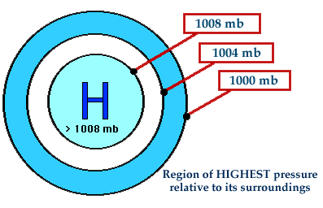
Lows and Highs
Cyclone
Anticyclone

Slide 39
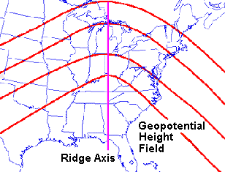
Ridges and Troughs
Ridge – a bow in isobars indicating a line of high pressure
1000 mb
1004 mb
1008 mb
1012 mb

Slide 40
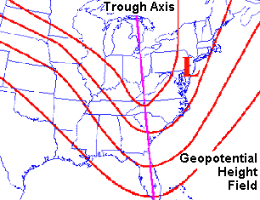
Ridges and Troughs
Trough – a bow in isobars indicating a line of low pressure
1000 mb
1004 mb
1008 mb
1012 mb

Slide 41
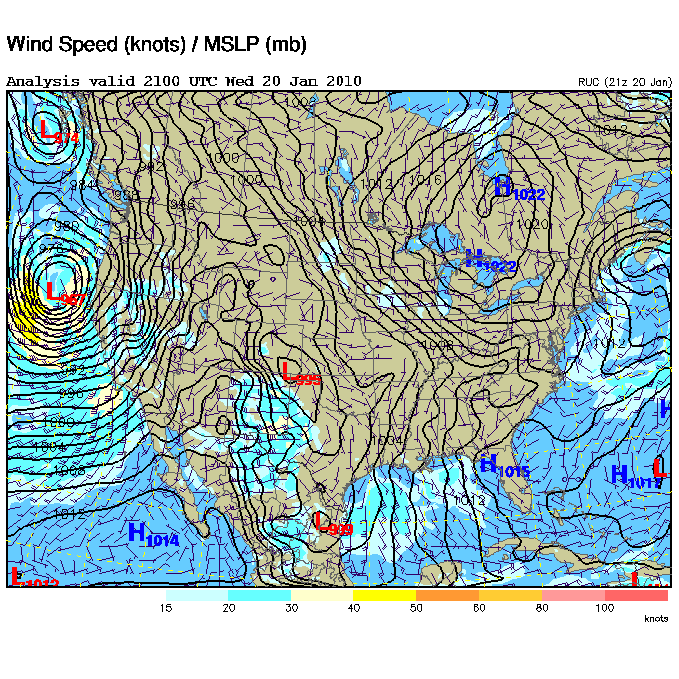
Sea Level Pressure

Slide 42
Vertical Pressure Distribution
Pressure always decreases with height

Slide 43
Vertical Pressure Distribution
Pressure always decreases with height
Fastest near the surface

Slide 44
Vertical Pressure Distribution
Pressure always decreases with height
Fastest near the surface
Vertical pressure gradients many times greater than horizontal pressure gradients

Slide 45
Vertical Pressure Distribution
Pressure always decreases with height
Fastest near the surface
Vertical pressure gradients many times greater than horizontal pressure gradients
Why doesn’t air go up?
500 mb
AIR
Up
600 mb
PGF

Slide 46
Vertical Pressure Distribution
Pressure always decreases with height
Fastest near the surface
Vertical pressure gradients many times greater than horizontal pressure gradients
Why doesn’t air go up?
500 mb
AIR
Up
600 mb
Gravity!!!!
PGF

Slide 47
Hydrostatic Balance
Hydrostatic balance (or equilibrium) is the balance between the pressure gradient and gravity forces in the vertical

Slide 48
Hydrostatic Balance
Hydrostatic balance (or equilibrium) is the balance between the pressure gradient and gravity forces in the vertical
Exists almost always in the atmosphere

Slide 49
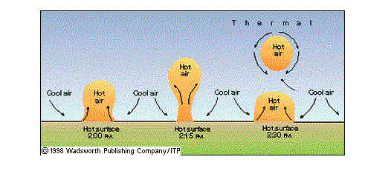
Hydrostatic Balance
Hydrostatic balance (or equilibrium) is the balance between the pressure gradient and gravity forces in the vertical
Exists almost always in the atmosphere
Exception is convection and thunderstorms

Slide 50
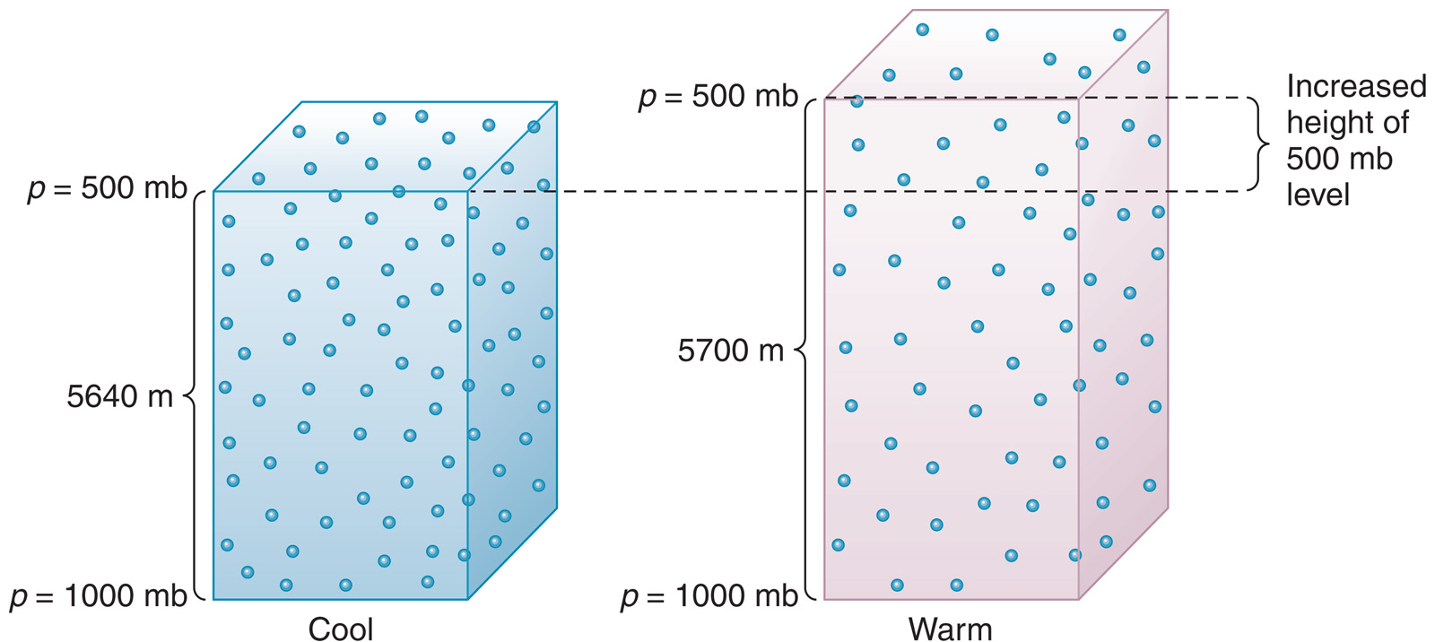
Horizontal Pressure Maps Aloft
The height of a pressure level depends on temperature

Slide 51
Horizontal Pressure Maps Aloft
PGF
P = 600 mb

Slide 52
Horizontal Pressure Maps Aloft
Stronger temperature difference = stronger pressure gradients
Higher heights means higher pressure

Slide 53
The 500 mb Map
Closer lines = larger slopes = stronger PGF
Higher heights to the south (warmer)
Ridges and troughs (Important – they make the weather!)
Lines of constant height = isohypse (isoheight)

Slide 54
Other Standard Pressure Levels
In addition to 500mb, other standard levels are:
850mb - 1500m (5000’)
700mb - 3000m (10000’)
300mb - 10000m (33000’)

Slide 55
What About Wind???
You are now experts on pressure gradient force (PGF), but where’s the wind?
- Recall: The PGF makes the wind
H
L
Wind
But there’s more…

Slide 56
Forces Affecting the Wind
Pressure gradient force (PGF, directed from high pressure to low pressure)

Slide 57
Forces Affecting the Wind
Pressure gradient force (PGF, directed from high pressure to low pressure)
The Coriolis Force
1) Due to earth’s rotation
2) Known as an apparent force
3) Conservation of angular momentum (N-S)
4) Centrifugal force (E-W)

Slide 58
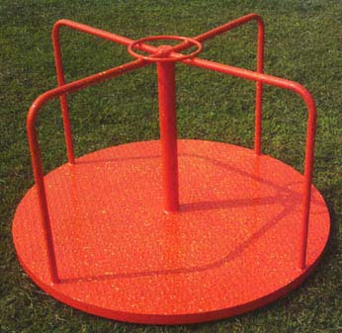
The Coriolis Force
An apparent force because of different frames of reference

Slide 59
The Coriolis Force
In the N-S direction, conservation of angular momentum produces the Coriolis Force

Slide 60
The Coriolis Force
In the N-S direction, conservation of angular momentum produces the Coriolis Force
Think figure skaters…

Slide 61
The Coriolis Force
In the N-S direction, conservation of angular momentum produces the Coriolis Force
angular momentum = R² * Ω
R = radius
Ω = rate of rotation

Slide 62
The Coriolis Force
In the N-S direction, conservation of angular momentum produces the Coriolis Force
angular momentum = R² * Ω
R = radius
Ω = rate of rotation
- deflects right as one moves equator to
North Pole (and vice-versa)

Slide 63
The Coriolis Force
In the N-S direction, conservation of angular momentum produces the Coriolis Force
angular momentum = R² * Ω
R = radius
Ω = rate of rotation
- deflects right as one moves equator to
North Pole (and vice-versa)
- deflects left as one moves equator to
South Pole (and vice-versa)

Slide 64
The Coriolis Force
In the E-W direction, changing the centrifugal force produces the Coriolis Force

Slide 65
The Coriolis Force
In the E-W direction, changing the centrifugal force produces the Coriolis Force
- Think about those spinning
chairs at the carnival…

Slide 66
The Coriolis Force
In the E-W direction, changing the centrifugal force produces the Coriolis Force
- Think about those spinning
chairs at the carnival…
- Wanna lose weight? Run really fast
around the equator (but don’t go the wrong
way…)

Slide 67
The Coriolis Force
In the E-W direction, changing the centrifugal force produces the Coriolis Force
- deflects right as one moves east
- deflects right as one moves west
- deflects left as one moves east
- deflects left as one moves west
Northern Hemisphere
Southern Hemisphere

Slide 68
The Coriolis Force
Main points to remember:
1) Coriolis Force deflects moving things
right (NH) or left (SH)

Slide 69
The Coriolis Force
Main points to remember:
1) Coriolis Force deflects moving things
right (NH) or left (SH)
2) There is no Coriolis Force at the
equator, and it is maximum at the poles

Slide 70
The Coriolis Force
Main points to remember:
1) Coriolis Force deflects moving things
right (NH) or left (SH)
2) There is no Coriolis Force at the
equator, and it is maximum at the poles
3) The Coriolis Force is proportional to
speed

Slide 71
The Coriolis Force
Main points to remember:
1) Coriolis Force deflects moving things
right (NH) or left (SH)
2) There is no Coriolis Force at the
equator, and it is maximum at the poles
3) The Coriolis Force is proportional to
speed
4) The Coriolis Forces changes only
direction, not speed

Slide 72
The Coriolis Force
Main points to remember:
5) Coriolis force is slow to act (noticeable
only after a few hours)

Slide 73
Forces Affecting the Wind
Pressure gradient force (PGF, directed from high pressure to low pressure)
The Coriolis Force
1) Due to earth’s rotation
2) Known as an apparent force
3) Conservation of angular momentum (N-S)
4) Centrifugal force (E-W)
Friction (from the ground, within the planetary boundary layer)

Slide 74
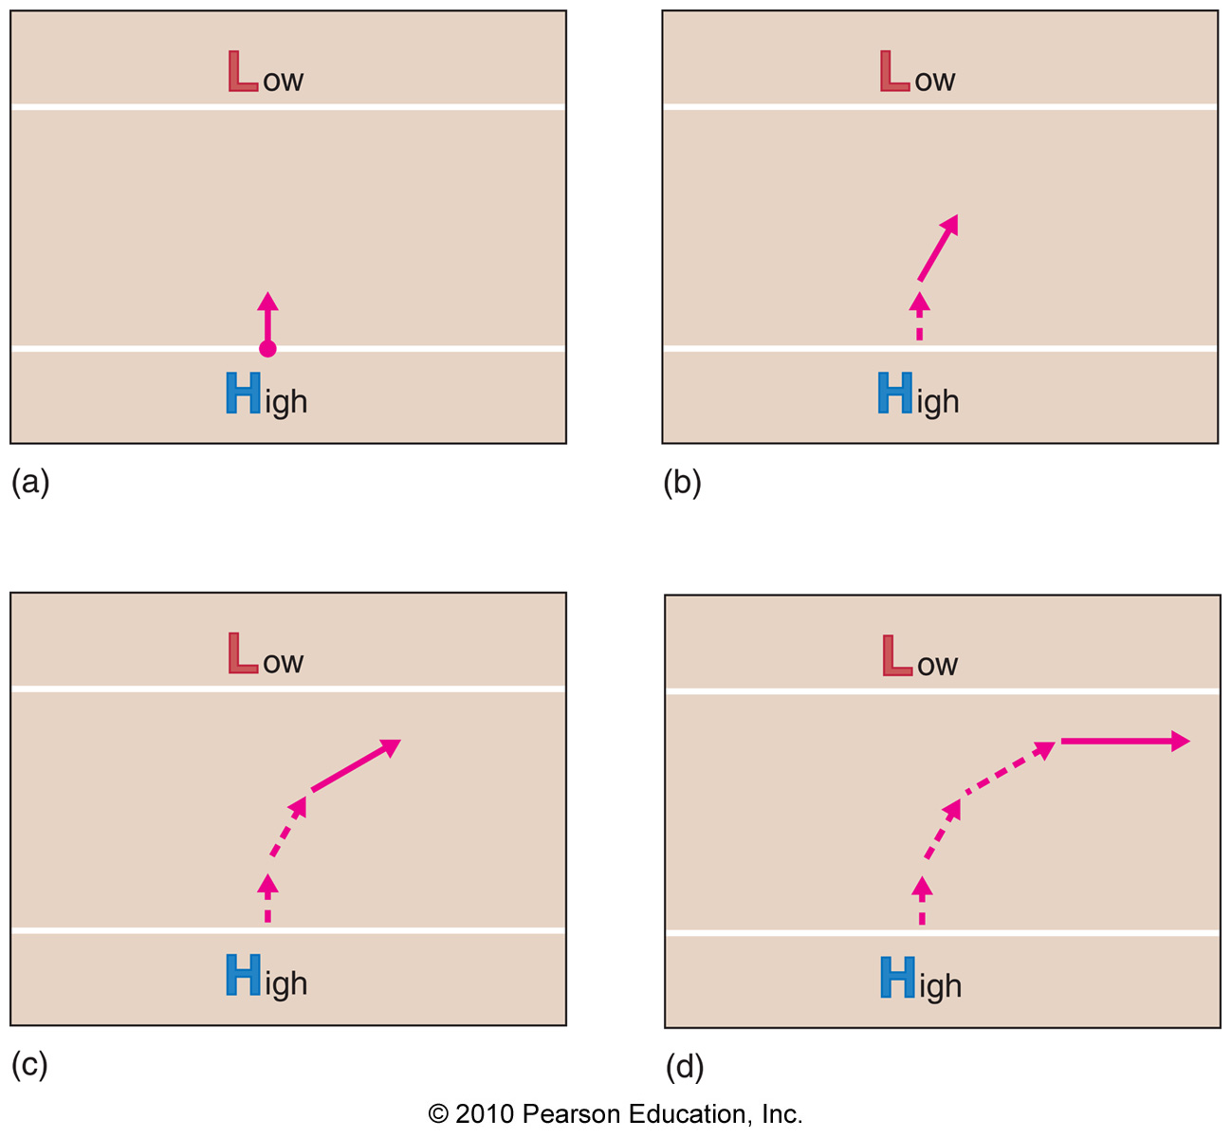
How the Wind Blows (The Upper Atmosphere Version)
Forces acting on air above the boundary layer are the PGF and the Coriolis Force
5400 m
5400 m
5460 m
5460 m
PGF
5400 m
5400 m
5460 m
5460 m
Coriolis Force

Slide 75
How the Wind Blows (The Upper Atmosphere Version)
The balance between the PGF and the Coriolis Force is called geostrophic balance (wind is geostrophic wind)
Geostrophic balance is a very good approximation of the atmosphere above the boundary layer
PGF
5400 m
5460 m
Coriolis Force

Slide 76
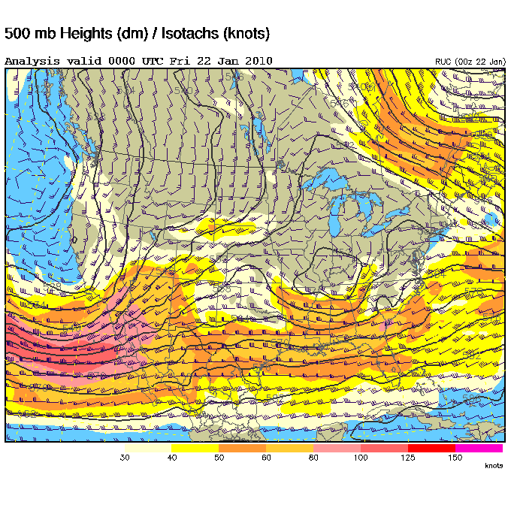
Geostrophic Balance
500 mb heights and winds

Slide 77
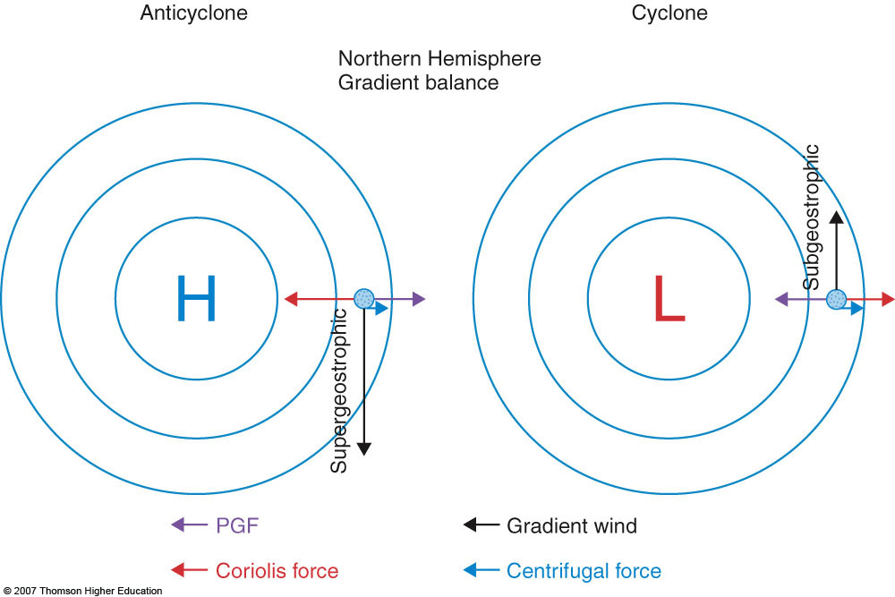
How the Wind Blows (The Upper Atmosphere Version)
In curved flow, another force comes into play – centrifugal force (results in gradient wind balance)

Slide 78
How the Wind Blows (The Upper Atmosphere Version)
Subgeostrophic flow occurs around Lows
Supergeostrophic flow occurs around Highs
key: wind speed is proportional to the Coriolis Force

Slide 79
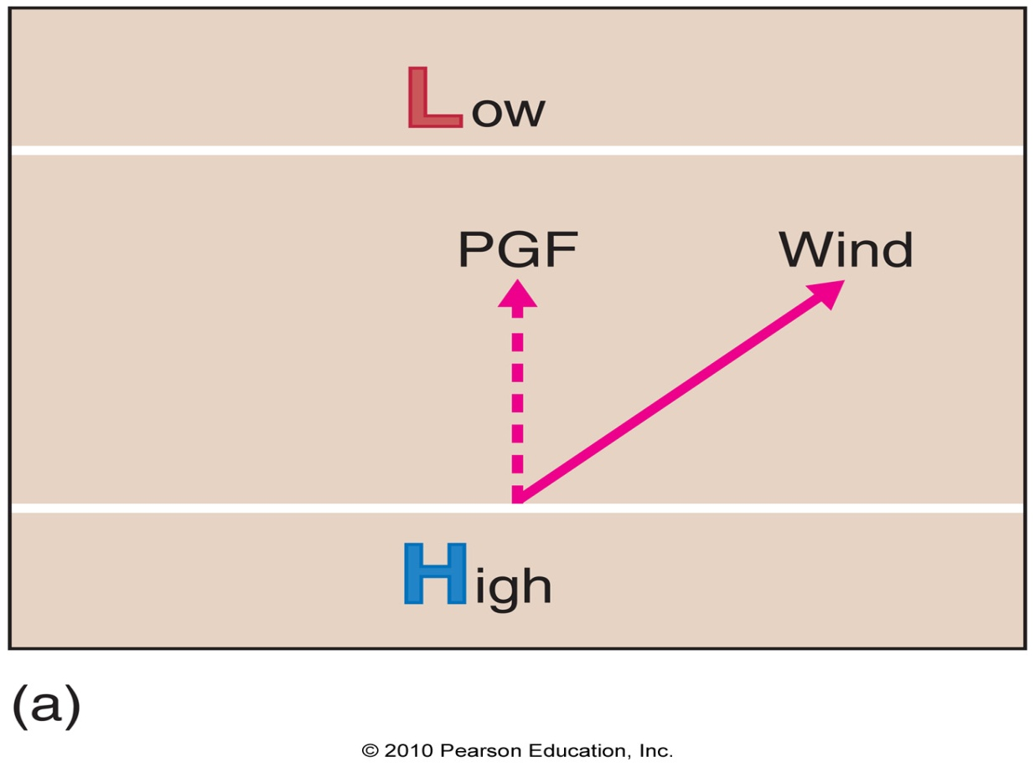
How the Wind Blows (The Lower Atmosphere Version)
Now we have PGF, the Coriolis Force, and friction:
Friction
Coriolis Force

Slide 80
How the Wind Blows (The Lower Atmosphere Version)
Now we have PGF, the Coriolis Force, and friction:
Wind blows across isobars toward lower pressure
Friction
Coriolis Force

Slide 81
How the Wind Blows (The Lower Atmosphere Version)
Surface SLP and winds

Slide 82
Upper vs. Lower Atmospheric Winds

Slide 83
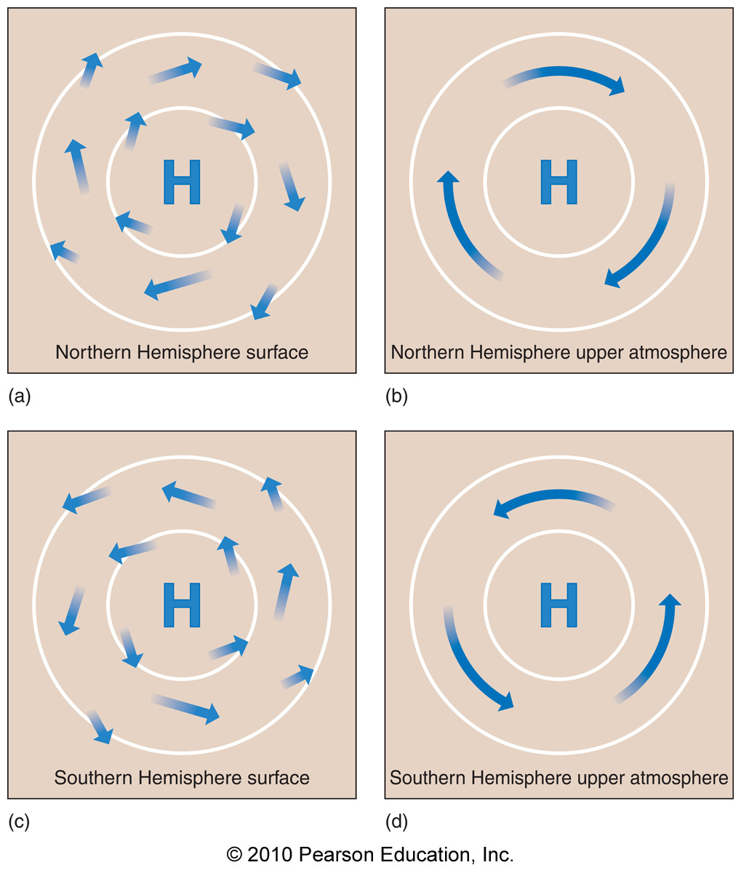
Upper vs. Lower Atmospheric Winds

Slide 84
Cyclostrophic Balance
Wind field achieves a balance between the centrifugal force and the PGF

Slide 85
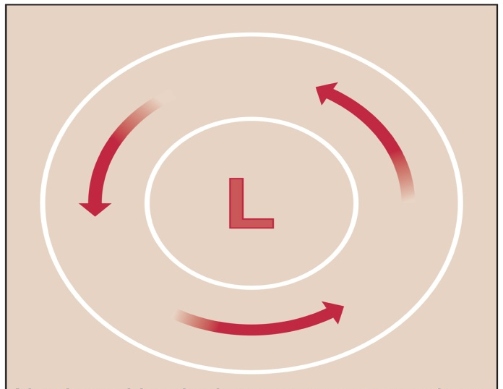
Cyclostrophic Balance
Wind field achieves a balance between the centrifugal force and the PGF
This occurs on short time scales (tornadoes) before the Coriolis Force can act (think draining bathtub drains…)
Centrifugal
force
PGF

Slide 86
Measuring Wind
Both wind speed and direction are measured

Slide 87
Measuring Wind
Both wind speed and direction are measured
direction: measured as the direction
where the wind blows from
in degrees clockwise from North

Slide 88
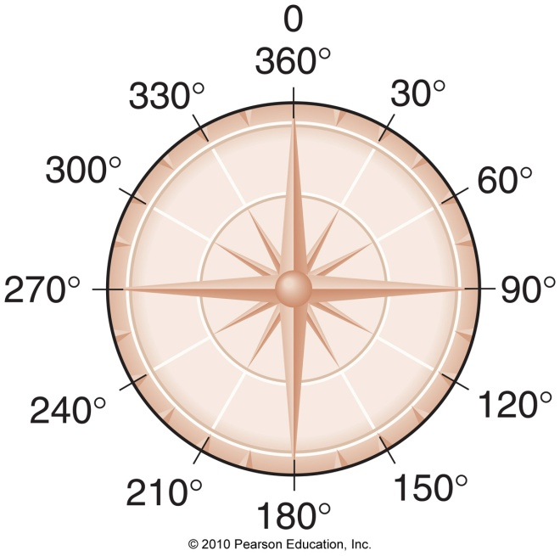
Measuring Wind
Both wind speed and direction are measured
direction: measured as the direction
where the wind blows from
in degrees clockwise from North
- wind is 30 knots at
60º
30 knots

Slide 89
Measuring Wind
Both wind speed and direction are measured
direction: measured as the direction
where the wind blows from
in degrees clockwise from North
- wind is 30 knots at
60º
mph = 1.15 * knots (30 knots = 34.5 mph)
30 knots

Slide 90
Measuring Wind
Wind vane – measures wind direction only

Slide 91
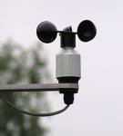
Measuring Wind
Wind vane – measures wind direction only
Anemometer – measures wind speed only

Slide 92
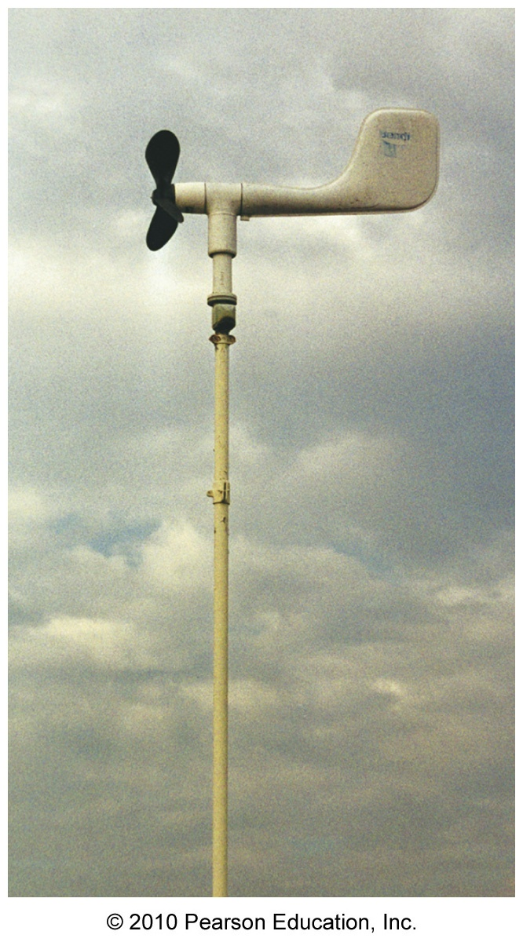
Measuring Wind
Aerovane – measures wind speed and direction

Slide 93
The Observational Network
Upper-air observations
Radiosondes – a package of instruments launched twice daily on weather balloons from stations around the globe

Slide 94
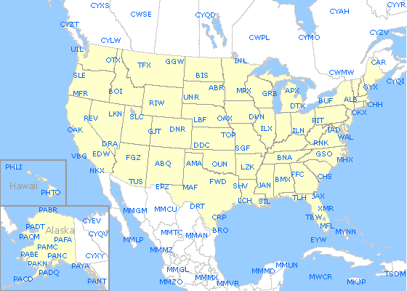
The Observational Network
Radiosonde Stations

Slide 95
Radiosondes
Launched globally at 0000 UTC and 1200 UTC
UTC – Universal Time Coordiante – same
time everywhere on earth (as
opposed to local time)
Local Lubbock time = UTC time – 6 hours (CST)
= UTC time – 5 hours (CDT)

Slide 96
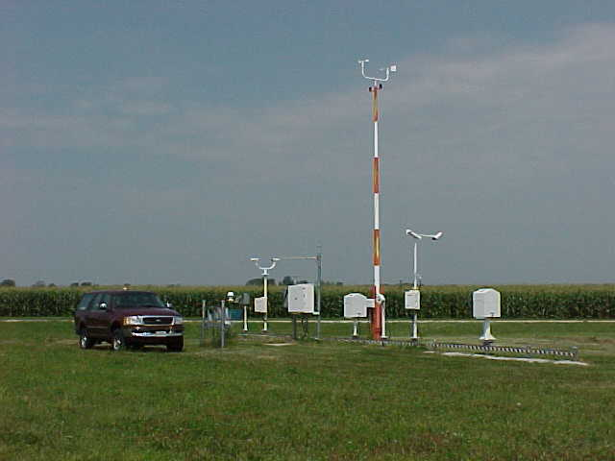
The Observational Network
Surface observations
Automated Surface Observing System (ASOS) – the primary U.S. surface observing network, observation stations located at airports

Slide 97
ASOS Observation Stations
Observations are reported hourly, except in the case of severe or unusual weather

Slide 98
ASOS Observation Stations
Observations are reported hourly, except in the case of severe or unusual weather
Observations are coded in METAR format:
METAR KTTN 051853Z 04011KT 1/2SM VCTS SN FZFG BKN003 OVC010 M02/M02 A3006 RMK AO2 TSB40 SLP176 P0002

Slide 99
The Observational Network
Surface observations
Hundreds of other surface observational networks exist that provide different amounts of observation types at various time intervals (i.e. West Texas Mesonet)

Slide 100
Observation Station Model
Observations are plotted on surface and upper-air maps in the following form:
Surface
59
989
36

Slide 101
Observation Station Model
Observations are plotted on surface and upper-air maps in the following form:
Surface
Wind speed and direction
(knots)
Temperature (ºF)
If slp>500 place “9” in front, if slp<500 place “10” in front, then divide by 10
59
989
36
Sea level pressure
(mb)
Dew point temperature (ºF)
Cloud cover (see page 22 in text)

Slide 102
Observation Station Model
Observations are plotted on surface and upper-air maps in the following form:
Upper air (500mb)
-22
540
-33

Slide 103
Observation Station Model
Observations are plotted on surface and upper-air maps in the following form:
Upper air (500mb)
Temperature (ºC)
Geopotential height (dm)
Wind speed and direction (knots)
-22
540
-33
Dew point temperature (ºC)

Slide 104
Dew Point Temperature
The temperature to which the air must be cooled to achieve saturation (also called dew point)

Slide 105
Dew Point Temperature
The temperature to which the air must be cooled to achieve saturation (also called dew point)
- The closer the dew point to the
temperature, the more humid the air

Slide 106
Dew Point Temperature
The temperature to which the air must be cooled to achieve saturation (also called dew point)
- The closer the dew point to the
temperature, the more humid the air
- This difference is called the dew point
depression

Slide 107
Dew Point: Key Idea
The dew point corresponds to the amount of water vapor in the air:
- Higher dew point: More water vapor!
- Lower dew point: Less water vapor!

Slide 108
Dew Point: Key Idea
The dew point corresponds to the amount of water vapor in the air:
- Higher dew point: More water vapor!
- Lower dew point: Less water vapor!
- 60ºF+ dew points: noticeably humid
- Less than 40ºF dew points: fairly dry

