Slide 1
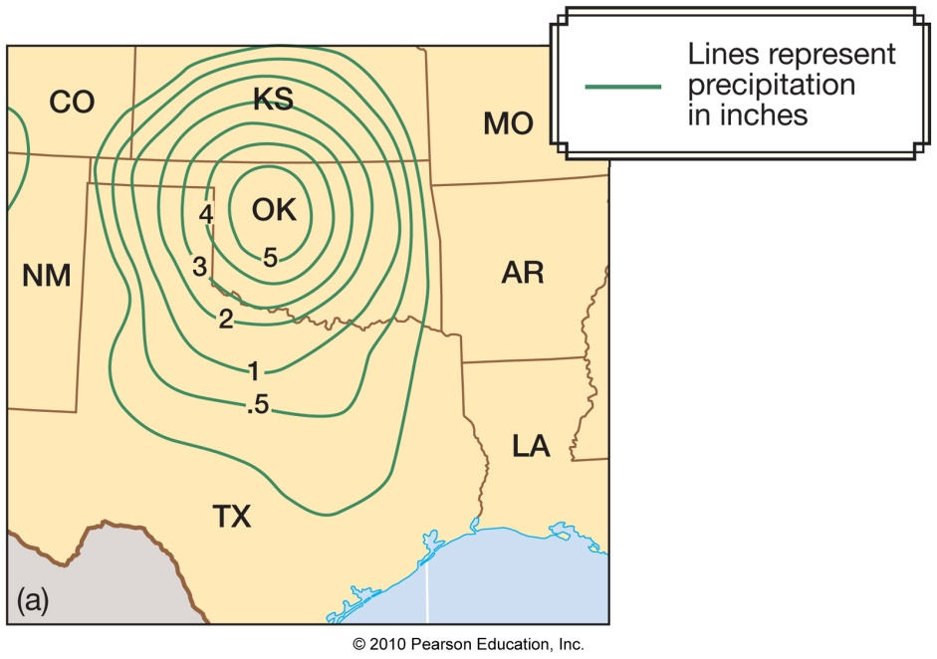
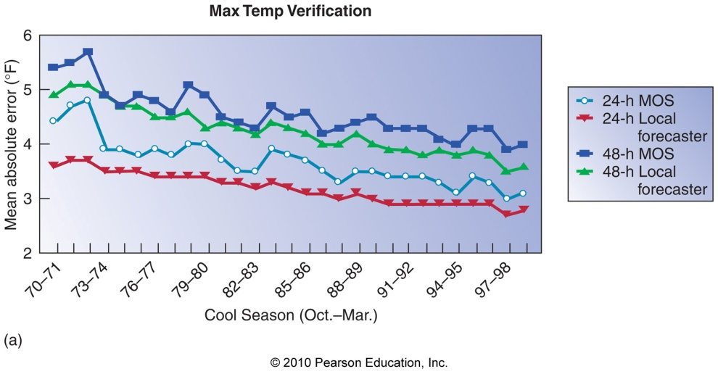
Chapter 13 – Weather Analysis and Forecasting

Slide 2
The National Weather Service
The National Weather Service (NWS) is responsible for forecasts several times daily

Slide 3
The National Weather Service
The National Weather Service (NWS) is responsible for forecasts several times daily
Different weather forecast offices (WFOs) are responsible for their specific region

Slide 4
The National Weather Service
The National Weather Service (NWS) is responsible for forecasts several times daily
Different weather forecast offices (WFOs) are responsible for their specific region
WFOs are also responsible for warnings in their specific region

Slide 5
The National Weather Service
The National Weather Service (NWS) is responsible for forecasts several times daily
Different weather forecast offices (WFOs) are responsible for their specific region
WFOs are also responsible for warnings in their specific region
NWS forecasters rely heavily on the Advanced Weather Information Processing System (AWIPS) to understand current conditions and make forecasts

Slide 6
The National Weather Service

Slide 7
The National Weather Service

Slide 8
The National Weather Service

Slide 9
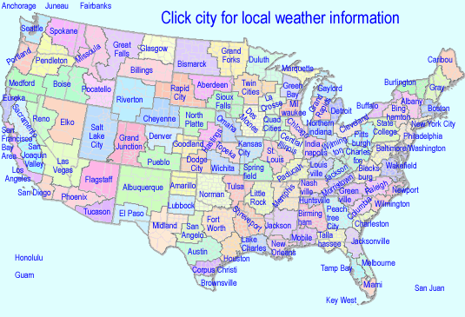
The National Weather Service WFOs

Slide 10
The National Weather Service
A variety of products are created at NWS WFOs

Slide 11
The National Weather Service
A variety of products are created at NWS WFOs
Short-term forecasts
7-day zone forecasts
Aviation forecasts
Marine forecasts
Forecast discussions

Slide 12
The Forecasting Process
Forecasts from now out to a few hours is called nowcasting

Slide 13
The Forecasting Process
Forecasts from now out to a few hours is called nowcasting
Strongly based on observations (radar, satellite images, surface observations)

Slide 14
The Forecasting Process
Forecasts from now out to a few hours is called nowcasting
Strongly based on observations (radar, satellite images, surface observations)
Forecasts beyond about 6 hours is based mostly on numerical weather prediction (NWP) models

Slide 15
Numerical Weather Prediction – The Analysis Phase
A gridded, 3-dimensional analysis is produced with
1) A previous forecast

Slide 16
Numerical Weather Prediction – The Analysis Phase
A gridded, 3-dimensional analysis is produced with
1) A previous forecast
2) Observations

Slide 17
Numerical Weather Prediction – The Analysis Phase
A gridded, 3-dimensional analysis is produced with
1) A previous forecast
2) Observations
The process by which the above are combined is called data assimilation

Slide 18
Numerical Weather Prediction – The Prediction Phase
The prediction phase of NWP involves calculating the future state of the atmosphere (starting point = the analysis) under the following governing equations:
1) Conservation of momentum

Slide 19
Numerical Weather Prediction – The Prediction Phase
The prediction phase of NWP involves calculating the future state of the atmosphere (starting point = the analysis) under the following governing equations:
1) Conservation of momentum
2) Conservation of mass

Slide 20
Numerical Weather Prediction – The Prediction Phase
The prediction phase of NWP involves calculating the future state of the atmosphere (starting point = the analysis) under the following governing equations:
1) Conservation of momentum
2) Conservation of mass
3) Conservation of energy

Slide 21
Numerical Weather Prediction – The Prediction Phase
The prediction phase of NWP involves calculating the future state of the atmosphere (starting point = the analysis) under the following governing equations:
1) Conservation of momentum
2) Conservation of mass
3) Conservation of energy
Example: F = ma = m = m
dv
V₂-V₁
dt
∆t

Slide 22
Numerical Weather Prediction – The Prediction Phase
NWP takes massive amounts of computing power!!!

Slide 23
Numerical Weather Prediction – The Prediction Phase
NWP takes massive amounts of computing power!!!
1980s: U.S. nested grid model – 80-km
resolution over continental U.S.
(48-hr forecast runtime = hours)

Slide 24
Numerical Weather Prediction – The Prediction Phase
NWP takes massive amounts of computing power!!!
1980s: U.S. nested grid model – 80-km
resolution over continental U.S.
(48-hr forecast runtime = hours)
Today: Weather Research and Forecasting
model – 12-km resolution over U.S.
(48-hr forecast runtime = 10 minutes)

Slide 25
Numerical Weather Prediction – The Prediction Phase
NWP can be classified in 2 ways:
1) Deterministic – a single forecast is
produced and relied upon

Slide 26
Numerical Weather Prediction – The Prediction Phase
NWP can be classified in 2 ways:
1) Deterministic – a single forecast is
produced and relied upon
2) Probabilistic – many forecasts are
produced and forecast probabilities can
be generated (ensemble forecasting)

Slide 27
Deterministic vs. Probabilistic Forecasting
Time = 00-hr

Slide 28
Deterministic vs. Probabilistic Forecasting
Time = 00-hr
Time = 72-hr

Slide 29
Probabilistic Forecasting
10-day forecasts

Slide 30
Probabilistic Forecasting
Main challenge = Expressing uncertainty to the public in a way it will be useful

Slide 31
Probabilistic Forecasting
Main challenge = Expressing uncertainty to the public in a way it will be useful
- Do people want to hear what the high
temperature will be, or do they want to
know the possible range of high
temperatures?

Slide 32
The Prediction Phase – How Can Forecasts Go Bad?
There are 2 main sources of error in NWP forecasts:
1) Initial condition error – errors in the
analysis of a NWP model

Slide 33
The Prediction Phase – How Can Forecasts Go Bad?
There are 2 main sources of error in NWP forecasts:
1) Initial condition error – errors in the
analysis of a NWP model
2) Physics errors – physics that are
wrong in the NWP model (mostly
associated with surface processes)

Slide 34
Initial Condition Error
Initial condition errors are always present in NWP analyses

Slide 35
Initial Condition Error
Initial condition errors are always present in NWP analyses
Because of chaos, errors in the analysis will eventually grow to be large (forget about 30-day forecasts!)

Slide 36
Physics Errors
The physics in NWP models aren’t perfect

Slide 37
Physics Errors
The physics in NWP models aren’t perfect
- Surface radiation processes

Slide 38
Physics Errors
The physics in NWP models aren’t perfect
- Surface radiation processes
- Frictional turbulence of surface winds

Slide 39
Physics Errors
The physics in NWP models aren’t perfect
- Surface radiation processes
- Frictional turbulence of surface winds
- Convection

Slide 40
Physics Errors
The physics in NWP models aren’t perfect
- Surface radiation processes
- Frictional turbulence of surface winds
- Convection
- Cloud processes

Slide 41
Physics Errors
Physics errors often lead to model biases – consistent errors in certain model variables (e.g. surface temperature)

Slide 42
Numerical Weather Prediction – The Post-processing Phase
The post-processing phase of NWP involves creating graphics of the forecast:

Slide 43
Numerical Weather Prediction – The Post-processing Phase
The post-processing phase of NWP involves creating graphics of the forecast:
1) 500-mb height
2) SLP
3) Surface wind
4) 3-hr precipitation
5) 1000-500mb thickness

Slide 44
NWP Post-processing
The final forecast product includes the human factor – judgments based on both a forecaster’s experience and NWP

Slide 45
NWP Post-processing

Slide 46
NWP Post-processing
Model Output Statistics (MOS) – a post-processing technique that correlates relationships between a model forecast and reality over many, many forecasts

Slide 47
NWP Post-processing
Model Output Statistics (MOS) – a post-processing technique that correlates relationships between a model forecast and reality over many, many forecasts
MOS produces a forecast incorporating these statistical relationships

Slide 48
Forecast Verification
Forecast verification is the process of measuring the skill of a forecast (model, human forecaster, MOS…)

Slide 49
Forecast Verification
Forecast verification is the process of measuring the skill of a forecast (model, human forecaster, MOS…)

Slide 50
Long-range Forecasts
The Climate Prediction Center (CPC) is responsible for forecasts valid more than 1 week into the future (numerical models and statistics)

Slide 51
Long-range Forecasts
The Climate Prediction Center (CPC) is responsible for forecasts valid more than 1 week into the future (numerical models and statistics)
Seasonal forecasts are also made by the CPC that indicate above or below probabilities of warm/cold or wet/dry seasons

