Slide 1
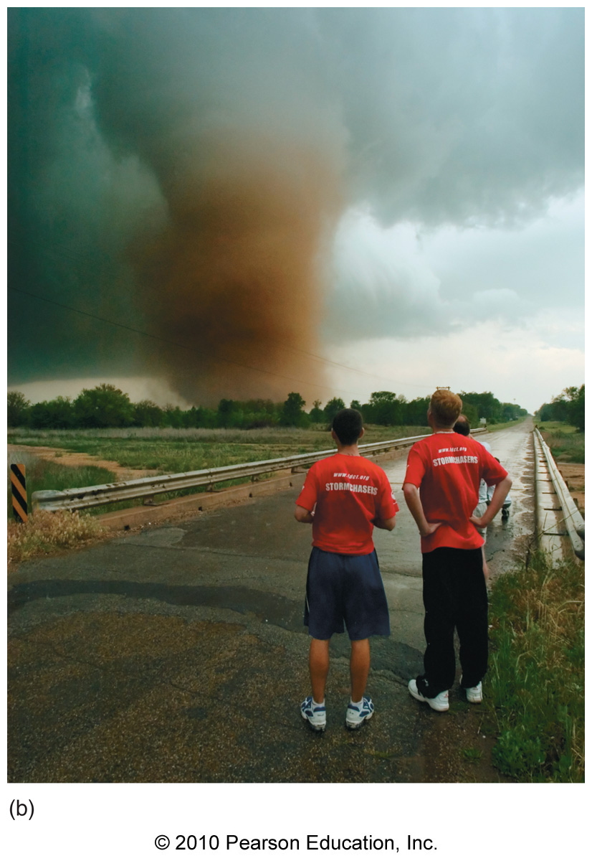
Chapter 11 - Lightning, Thunder, and Tornadoes

Slide 2
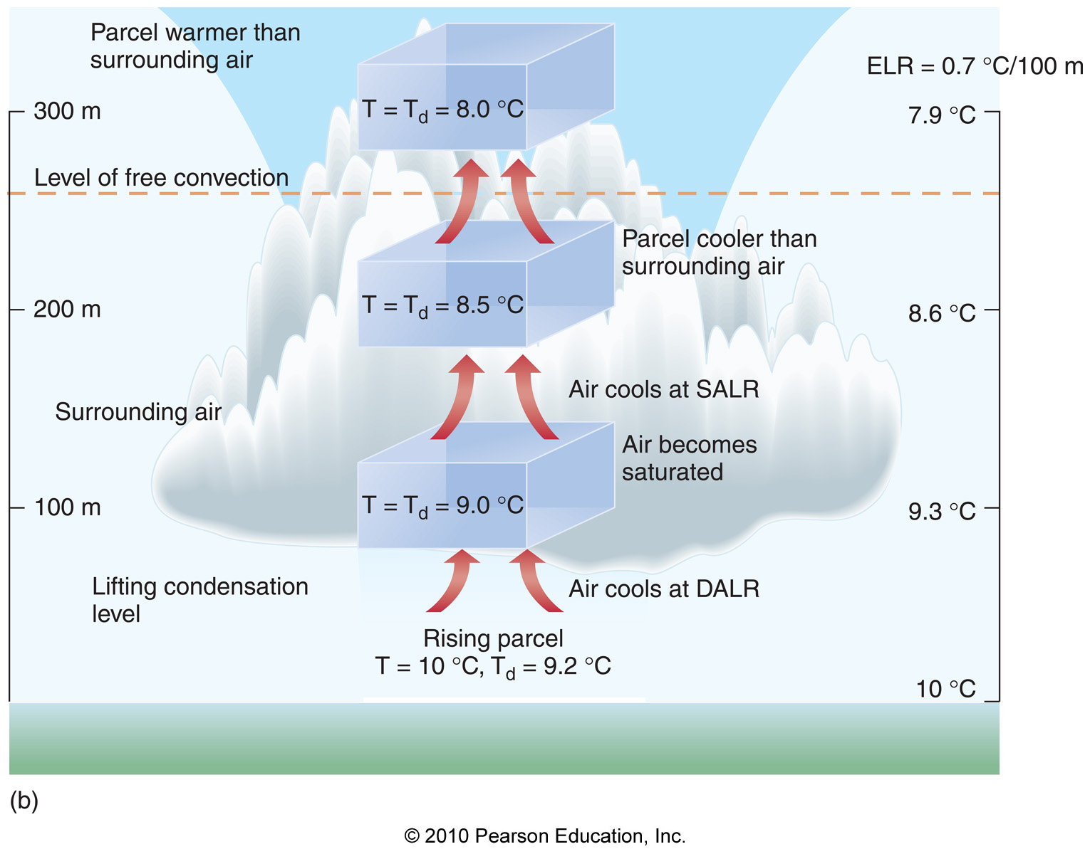
Lightning, Thunder, and Tornadoes
Lightning, thunder, and tornadoes all come from storms resulting from moist convection

Slide 3
Lightning
Lightning is the visible discharge of atmospheric electricity

Slide 4
Lightning
Lightning is the visible discharge of atmospheric electricity
Lightning is visible because the air in a lightning stroke is energized and hot (up to 54,000ºF), causing the emission of visible radiation

Slide 5
Lightning
Lightning is the visible discharge of atmospheric electricity
Lightning is visible because the air in a lightning stroke is energized and hot (up to 54,000ºF), causing the emission of visible radiation
Lightning strokes are a few inches in diameter and travel ~270,000 mph

Slide 6
Lightning
Different types of lightning:
1) Cloud-to-cloud lightning (sheet
lightning)
2) Cloud-to-ground lightning
3) Ball lightning
4) St. Elmo’s fire
5) Sprites
6) Blue jets

Slide 7
Lightning
Step 1: Charge Separation – the organization of different charges (+ and -) in different regions of a cloud

Slide 8
Lightning
Step 1: Charge Separation – the organization of different charges (+ and -) in different regions of a cloud
Occurs in precipitating clouds that extend above the freezing level

Slide 9
Lightning
Step 1: Charge Separation – the organization of different charges (+ and -) in different regions of a cloud
Occurs in precipitating clouds that extend above the freezing level
Transfer of negative charge to graupel and hail (heavy), causing bottom of cloud to become negatively charged

Slide 10
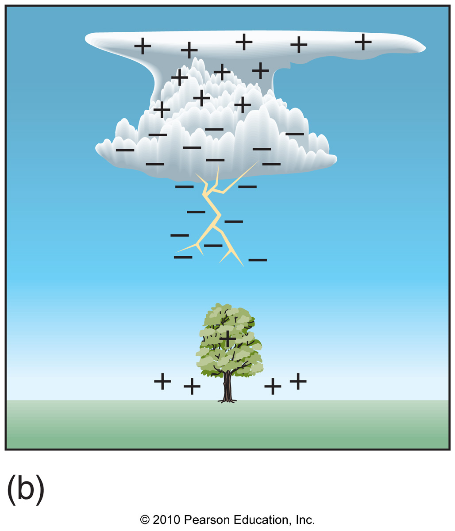
Cloud-to-ground Lightning
Step 2: Formation of a stepped leader (branched advance of negative charge from cloud base toward ground)

Slide 11
Cloud-to-ground Lightning
Step 3: Positive charge surges from ground, and electricity flows (the return stroke)

Slide 12
Cloud-to-ground Lightning
Step 3: Positive charge surges from ground, and electricity flows (the return stroke)
Step 4: A dart leader forms, and additional return strokes occur to even out the charge

Slide 13
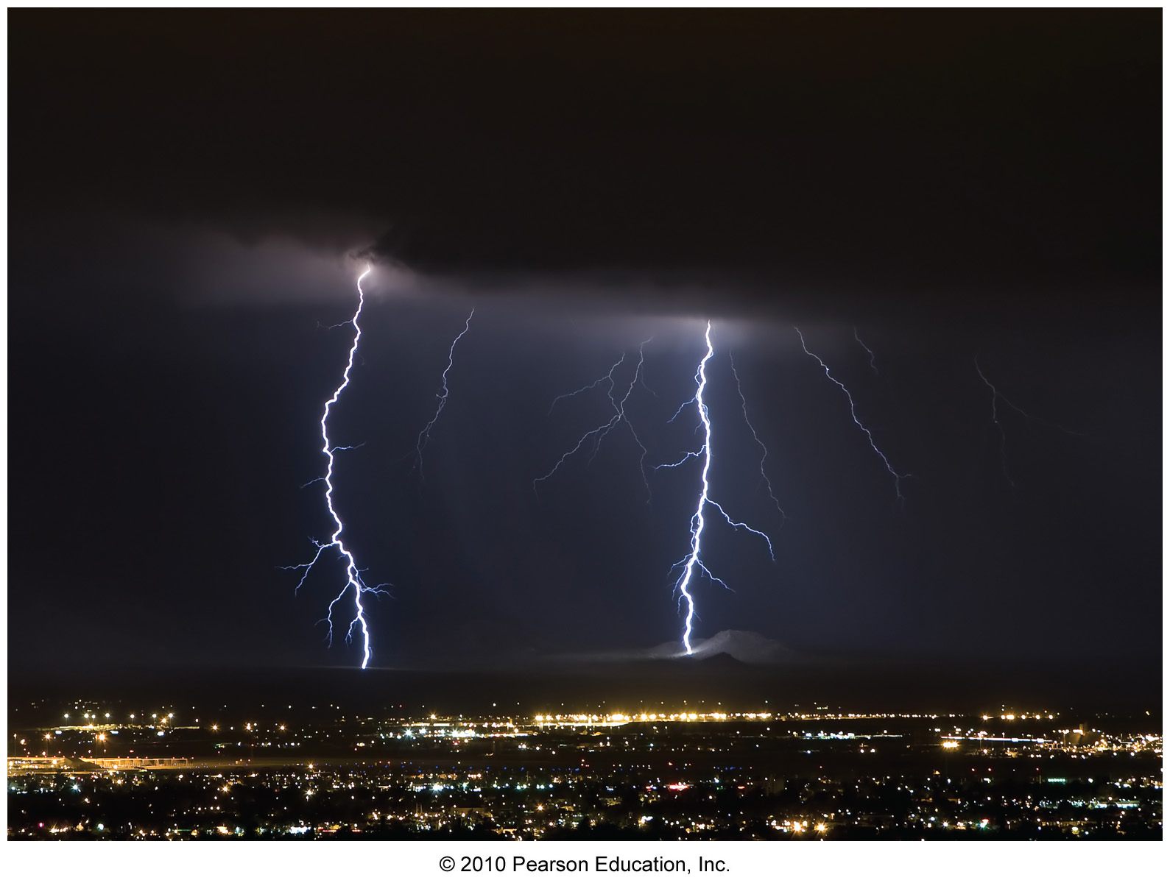
Cloud-to-ground Lightning
Combination of all strokes is called a flash

Slide 14
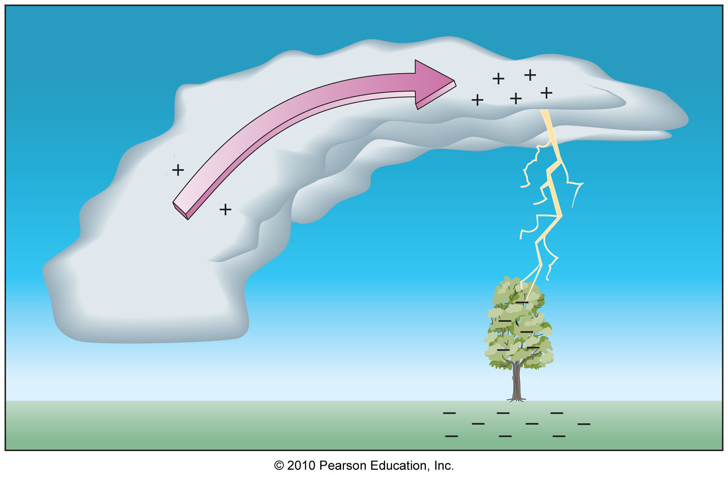
Cloud-to-ground Lightning
Cloud-top positive charge can also create cloud-to-ground lightning

Slide 15
Cloud-to-ground Lightning
Such cloud-to-ground lightning (positive charge in cloud) can be more powerful than the more typical negative strokes

Slide 16
Cloud-to-ground Lightning
Such cloud-to-ground lightning (positive charge in cloud) can be more powerful than the more typical negative strokes
Positive strokes can occur away from precipitation, making them very dangerous

Slide 17
Cloud-to-ground Lightning
Such cloud-to-ground lightning (positive charge in cloud) can be more powerful than the more typical negative strokes
Positive strokes can occur away from precipitation, making them very dangerous
Positive strokes last longer and have more fire-starting potential

Slide 18
Ball Lightning
Ball lightning – A spherical ball of light (usually the size of a basketball) observed during thunderstorms

Slide 19
Ball Lightning
Ball lightning – A spherical ball of light (usually the size of a basketball) observed during thunderstorms
Often go into windows or open doorways

Slide 20
Ball Lightning
Ball lightning – A spherical ball of light (usually the size of a basketball) observed during thunderstorms
Often go into windows or open doorways
Float through air at low speeds for ~10-30 seconds

Slide 21
Ball Lightning
Ball lightning – A spherical ball of light (usually the size of a basketball) observed during thunderstorms
Often go into windows or open doorways
Float through air at low speeds for ~10-30 seconds
Possibly explained by floating, oxidizing, unstable chemical compounds created by cloud-to-ground lightning

Slide 22
Other Types of Lightning
St. Elmo’s Fire – Glowing, hissing tall structures (such as a ship’s mast) during a thunderstorm

Slide 23
Other Types of Lightning
St. Elmo’s Fire – Glowing, hissing tall structures (such as a ship’s mast) during a thunderstorm
Sprites – Red blob-looking electrical bursts extending up to 57 miles above a cloud as lightning occurs below

Slide 24
Other Types of Lightning
St. Elmo’s Fire – Glowing, hissing tall structures (such as a ship’s mast) during a thunderstorm
Sprites – Red blob-looking electrical bursts extending up to 57 miles above a cloud as lightning occurs below
Blue jets – Blue electrical bursts extending up to 30 miles above a cloud

Slide 25
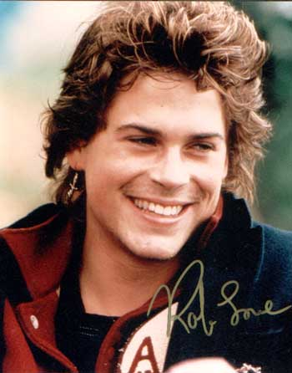
St. Elmo’s Fire

Slide 26
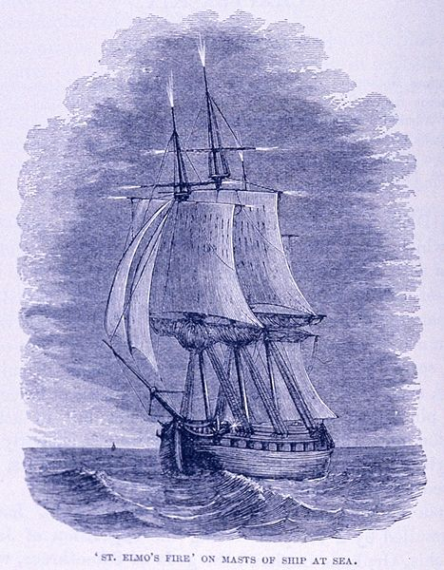
St. Elmo’s Fire

Slide 27
Sprites

Slide 28
Blue Jets

Slide 29
Lightning Safety
Lightning kills an average of 69 people each year in the U.S.

Slide 30
Lightning Safety
Lightning kills an average of 69 people each year in the U.S.
The U.S. state with the most lightning strikes is…

Slide 31
Lightning Safety
Lightning kills an average of 69 people each year in the U.S.
The U.S. state with the most lightning strikes is… Florida

Slide 32
Lightning Safety
Lightning kills an average of 69 people each year in the U.S.
The U.S. state with the most lightning strikes is… Florida
Best things to do in a thunderstorm
Get inside

Slide 33
Lightning Safety
Lightning kills an average of 69 people each year in the U.S.
The U.S. state with the most lightning strikes is… Florida
Best things to do in a thunderstorm
Get inside
Get low

Slide 34
Lightning Safety
Lightning kills an average of 69 people each year in the U.S.
The U.S. state with the most lightning strikes is… Florida
Best things to do in a thunderstorm
Get inside
Get low
Don’t stand near tall objects

Slide 35
Lightning Safety
Lightning kills an average of 69 people each year in the U.S.
The U.S. state with the most lightning strikes is… Florida
Best things to do in a thunderstorm
Get inside
Get low
Don’t stand near tall objects
Don’t stand in open, exposed areas

Slide 36
Lightning Detection
The Canadian Lightning Detection Network (CLDN) and the National Lightning Detection Network (NLDN) detect lightning flashes with ground-based radiation sensors

Slide 37
Lightning Detection
The Canadian Lightning Detection Network (CLDN) and the National Lightning Detection Network (NLDN) detect lightning flashes with ground-based radiation sensors
28 million cloud-to-ground strikes each year in Canada and the U.S.

Slide 38
Lightning Distribution

Slide 39
Lightning Distribution

Slide 40
Thunder
Thunder is the sound produced when superheated air from a lightning strike rapidly expands

Slide 41
Thunder
Thunder is the sound produced when superheated air from a lightning strike rapidly expands
Thunder reaches the ear well after we see lightning (speed of light=186,000 mi/sec, speed of sound=0.2 mi/sec)

Slide 42
Thunder
The rumbling nature of thunder is due to:
1) Hearing thunder from a part of a
lightning stroke further away
2) Echoes

Slide 43
Thunderstorms
There are 4 different types of thunderstorms:
1) Air mass thunderstorms

Slide 44
Thunderstorms
There are 4 different types of thunderstorms:
1) Air mass thunderstorms
2) Squall-line thunderstorms

Slide 45
Thunderstorms
There are 4 different types of thunderstorms:
1) Air mass thunderstorms
2) Squall-line thunderstorms
3) Mesoscale convective complexes

Slide 46
Thunderstorms
There are 4 different types of thunderstorms:
1) Air mass thunderstorms
2) Squall-line thunderstorms
3) Mesoscale convective complexes
4) Supercell thunderstorms

Slide 47
Severe Thunderstorms
Severe thunderstorms have 1 or more of the following characteristics:
1) Wind speeds more than 58 mph
2) Hail larger than 1 inch in
diameter
3) Spawns a tornado

Slide 48
Air Mass Thunderstorms
The least destructive type of thunderstorm

Slide 49
Air Mass Thunderstorms
The least destructive type of thunderstorm
Occur within a given air mass and away from frontal boundaries

Slide 50
Air Mass Thunderstorms
The least destructive type of thunderstorm
Occur within a given air mass and away from frontal boundaries
Typically last for an hour or less

Slide 51
Air Mass Thunderstorms
The least destructive type of thunderstorm
Occur within a given air mass and away from frontal boundaries
Typically last for an hour or less
Localized and vertically stacked

Slide 52
Air Mass Thunderstorms
The least destructive type of thunderstorm
Occur within a given air mass and away from frontal boundaries
Typically last for an hour or less
Localized and vertically stacked
Generally move slowly

Slide 53
The 3 Stages of Air Mass Thunderstorms

Slide 54
Air Mass Thunderstorms

Slide 55
Mesoscale Convective Complexes
Oval or circular organized systems containing several thunderstorms

Slide 56
Mesoscale Convective Complexes
Oval or circular organized systems containing several thunderstorms
Self-propagating with outflow boundaries

Slide 57
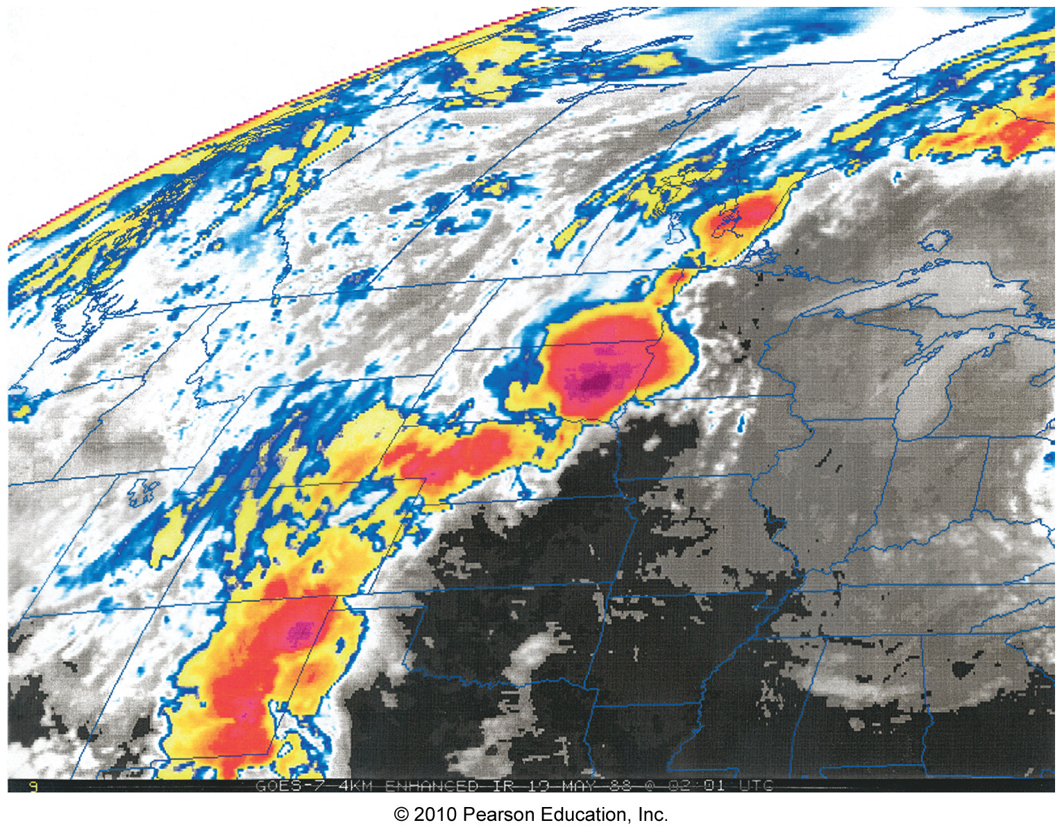
Mesoscale Convective Complexes

Slide 58
Mesoscale Convective Complexes

Slide 59
Squall Line Thunderstorms
Arranged in linear bands roughly 300 miles in length and 60 miles wide

Slide 60
Squall Line Thunderstorms
Arranged in linear bands roughly 300 miles in length and 60 miles wide
Caused by lifting at air mass boundaries (fronts and drylines)

Slide 61
Squall Line Thunderstorms
Arranged in linear bands roughly 300 miles in length and 60 miles wide
Caused by lifting at air mass boundaries (fronts and drylines)
Contain large vertical wind shear that sustains storms for hours

Slide 62
Squall Line Thunderstorms
Arranged in linear bands roughly 300 miles in length and 60 miles wide
Caused by lifting at air mass boundaries (fronts and drylines)
Contain large vertical wind shear that sustains storms for hours
Often produce gust fronts

Slide 63
Squall Line Thunderstorms

Slide 64
Squall Line Thunderstorms

Slide 65
Squall Line Thunderstorms

Slide 66
A Shelf Cloud

Slide 67
Supercell Thunderstorms
Most destructive type of thunderstorm (often spawn tornadoes, large hail, high winds)

Slide 68
Supercell Thunderstorms
Most destructive type of thunderstorm (often spawn tornadoes, large hail, high winds)
Rotating

Slide 69
Supercell Thunderstorms
Most destructive type of thunderstorm (often spawn tornadoes, large hail, high winds)
Rotating
Typically last 2-4 hours

Slide 70
Supercell Thunderstorms
Most destructive type of thunderstorm (often spawn tornadoes, large hail, high winds)
Rotating
Typically last 2-4 hours
Often produces hook-like structure at edge of storm (known as a hook echo)

Slide 71
Supercell Thunderstorms

Slide 72
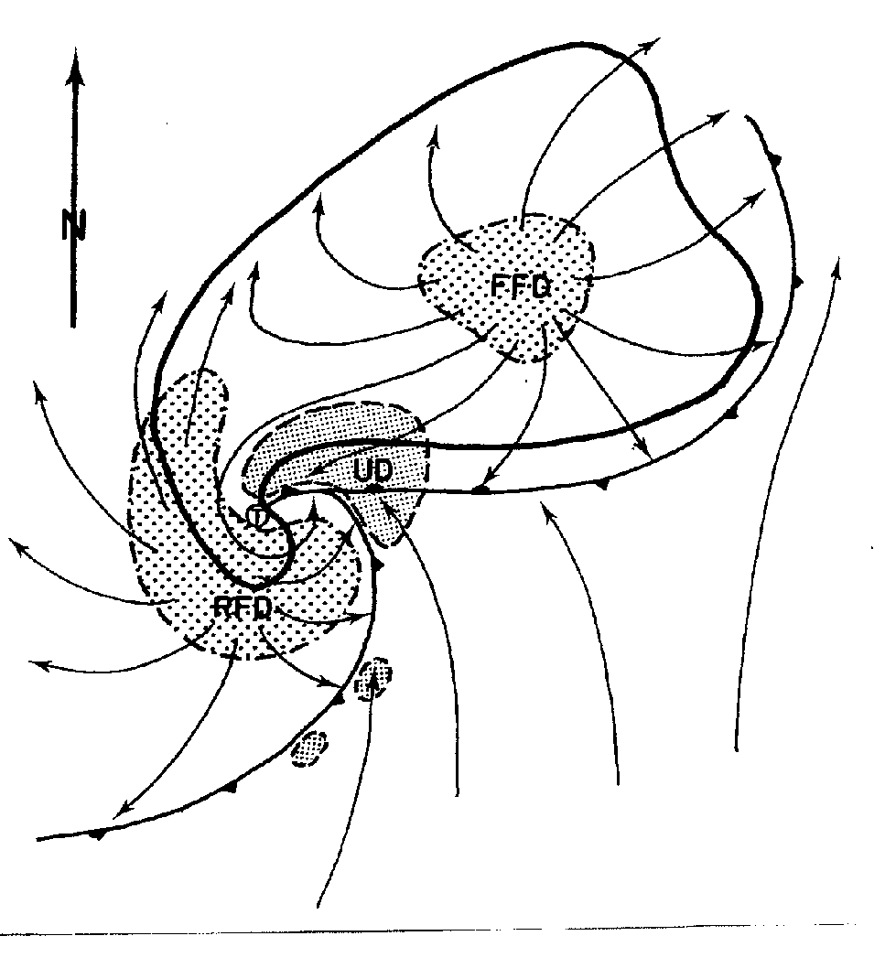
Supercell Thunderstorms

Slide 73
Supercell Thunderstorms

Slide 74
Supercell Thunderstorms and Doppler Radar

Slide 75
Supercell Thunderstorms and Doppler Radar

Slide 76
Dangers of Severe Thunderstorms: Downbursts
Downbursts – strong downdrafts that spread out in all directions from a severe thunderstorm

Slide 77
Dangers of Severe Thunderstorms: Downbursts
Downbursts – strong downdrafts that spread out in all directions from a severe thunderstorm
Can reach 165 mph

Slide 78
Dangers of Severe Thunderstorms: Downbursts
Downbursts – strong downdrafts that spread out in all directions from a severe thunderstorm
Can reach 165 mph
Exist over much larger areas than tornadoes

Slide 79
Dangers of Severe Thunderstorms: Downbursts
Downbursts – strong downdrafts that spread out in all directions from a severe thunderstorm
Can reach 165 mph
Exist over much larger areas than tornadoes
Damage sometimes blamed on tornadoes

Slide 80
Dangers of Severe Thunderstorms: Downbursts
Downbursts – strong downdrafts that spread out in all directions from a severe thunderstorm
Can reach 165 mph
Exist over much larger areas than tornadoes
Damage sometimes blamed on tornadoes
Small downbursts (diameters less than 2.5 miles) are called microbursts

Slide 81
Dangers of Severe Thunderstorms: Downbursts
Downbursts – strong downdrafts that spread out in all directions from a severe thunderstorm
Can reach 165 mph
Exist over much larger areas than tornadoes
Damage sometimes blamed on tornadoes
Small downbursts (diameters less than 2.5 miles) are called microbursts
Long-lasting downbursts are called derechos

Slide 82
Derechos

Slide 83
Derechos

Slide 84
Microbursts: A Problem for Airplanes

Slide 85
Tornadoes
Tornado – an area of rapidly rotating winds beneath the base of a cumulonimbus cloud

Slide 86
Tornadoes
Tornado – an area of rapidly rotating winds beneath the base of a cumulonimbus cloud
Winds in a tornado range from 65-280+ mph

Slide 87
Tornadoes
Tornado – an area of rapidly rotating winds beneath the base of a cumulonimbus cloud
Winds in a tornado range from 65-280+ mph
Diameter ranges from 300 ft. to over a mile

Slide 88
Tornadoes
Tornado – an area of rapidly rotating winds beneath the base of a cumulonimbus cloud
Winds in a tornado range from 65-280+ mph
Diameter ranges from 300 ft. to over a mile
Tornadoes can last for seconds to hours

Slide 89
Tornadoes
Tornado – an area of rapidly rotating winds beneath the base of a cumulonimbus cloud
Winds in a tornado range from 65-280+ mph
Diameter ranges from 300 ft. to over a mile
Tornadoes can last for seconds to hours
Typical speed of a tornado on the ground is 30 mph

Slide 90
Tornadoes
Tornado – an area of rapidly rotating winds beneath the base of a cumulonimbus cloud
Winds in a tornado range from 65-280+ mph
Diameter ranges from 300 ft. to over a mile
Tornadoes can last for seconds to hours
Typical speed of a tornado on the ground is 30 mph
Possess massive (up to 100 mb) pressure gradients

Slide 91
Tornadoes
Tornado – an area of rapidly rotating winds beneath the base of a cumulonimbus cloud
Winds in a tornado range from 65-280+ mph
Diameter ranges from 300 ft. to over a mile
Tornadoes can last for seconds to hours
Typical speed of a tornado on the ground is 30 mph
Possess massive (up to 100 mb) pressure gradients
Tornadoes can form within any type of thunderstorm, but are most common with supercells

Slide 92
Tornadoes
Tornado – an area of rapidly rotating winds beneath the base of a cumulonimbus cloud
Tornadoes can spin both CW and CCW

Slide 93
Tornadoes
Tornado – an area of rapidly rotating winds beneath the base of a cumulonimbus cloud
Tornadoes can spin both CW and CCW
Tornadoes usually move from southwest to northeast

Slide 94
Tornadoes
Tornado – an area of rapidly rotating winds beneath the base of a cumulonimbus cloud
Tornadoes can spin both CW and CCW
Tornadoes usually move from southwest to northeast
Tornadoes are visible if condensation is occurring or if dust/debris is picked up

Slide 95
Tornadoes
Tornado – an area of rapidly rotating winds beneath the base of a cumulonimbus cloud
Tornadoes can spin both CW and CCW
Tornadoes usually move from southwest to northeast
Tornadoes are visible if condensation is occurring or if dust/debris is picked up
Tornadoes occur mostly in the late afternoon/early evening

Slide 96
Tornado Formation
Primary ingredient necessary for tornadoes:
Vertical wind shear!!

Slide 97
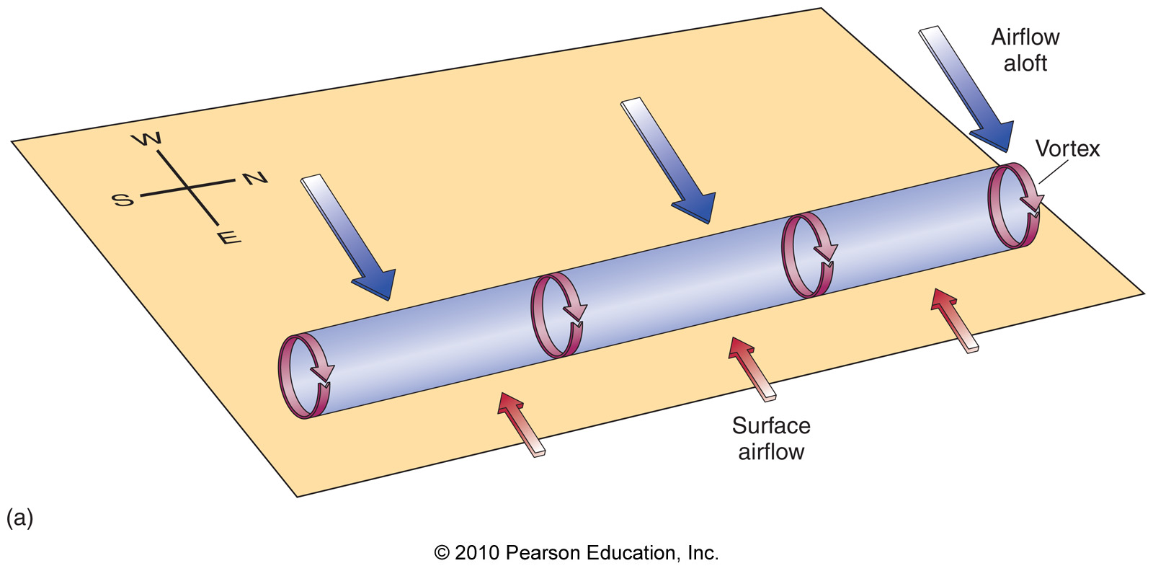
Tornado Formation
Primary ingredient necessary for tornadoes:
Vertical wind shear!!

Slide 98
Tornado Formation
Updraft

Slide 99
Tornado Formation
These vertical columns of rotating air make the entire storm rotate slowly

Slide 100
Tornado Formation
These vertical columns of rotating air make the entire storm rotate slowly
The slowly rotating thunderstorm is called a mesocyclone

Slide 101
Tornado Formation
These vertical columns of rotating air make the entire storm rotate slowly
The slowly rotating thunderstorm is called a mesocyclone
Mesoscylones often precede tornadoes by about 30 minutes

Slide 102
Tornado Formation
Stretching and narrowing of the mesocyclone increases rotational speed (conservation of angular momentum)

Slide 103
Tornado Formation
Stretching and narrowing of the mesocyclone increases rotational speed (conservation of angular momentum)
A wall cloud (lowered cloud base) usually accompanies mesocyclone intensification

Slide 104
Wall Clouds

Slide 105
Tornado Formation
A funnel cloud (rapidly rotating column of air) descends from the wall cloud

Slide 106
Tornado Formation
A funnel cloud (rapidly rotating column of air) descends from the wall cloud
When the funnel cloud touches the ground, it’s a tornado

Slide 107
Tornado Formation
A funnel cloud (rapidly rotating column of air) descends from the wall cloud
When the funnel cloud touches the ground, it’s a tornado
Roughly 20% of mesocylones form tornadoes

Slide 108
A Tornadic Supercell

Slide 109
Suction Vortices
The most intense tornadoes have several smaller, rapidly rotating vortices called suction vortices

Slide 110
Suction Vortices

Slide 111
Suction Vortices

Slide 112
Global Distribution of Tornadoes

Slide 113
U.S. Distribution of Tornadoes

Slide 114
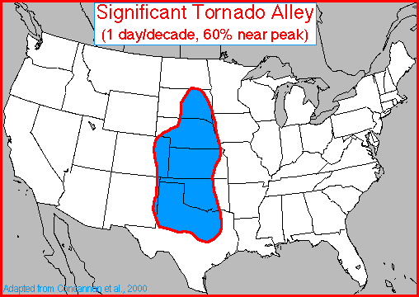
Tornado Alley

Slide 115
U.S. Distribution of Tornadoes

Slide 116
U.S. Distribution of Tornadoes

Slide 117
U.S. Distribution of Tornadoes

Slide 118
U.S. Distribution of Tornadoes

Slide 119
Tornado Damage
It used to be thought pressure differences associated with a tornado produced the most damage to structures

Slide 120
Tornado Damage
It used to be thought pressure differences associated with a tornado produced the most damage to structures
However, it has been discovered that flying debris is the major cause of damage

Slide 121
Tornado Classification
Tornadoes are classified according to the degree of damage they produce

Slide 122
Tornado Classification
Tornadoes are classified according to the degree of damage they produce
The scale used to classify tornadoes is called the enhanced Fujita scale

Slide 123
The Enhanced Fujita Scale

Slide 124
The Enhanced Fujita Scale
Relative frequency of tornadoes:
69% EF0-EF1 (weak)

Slide 125
The Enhanced Fujita Scale
Relative frequency of tornadoes:
69% EF0-EF1 (weak)
29% EF2-EF3 (strong)

Slide 126
The Enhanced Fujita Scale
Relative frequency of tornadoes:
69% EF0-EF1 (weak)
29% EF2-EF3 (strong)
2% EF4-EF5 (violent)

Slide 127
The Enhanced Fujita Scale
Relative frequency of tornadoes:
69% EF0-EF1 (weak)
29% EF2-EF3 (strong)
2% EF4-EF5 (violent)
Only about 1 violent tornado per year occurs in the U.S.

Slide 128
Tornado Deaths
90% of reported tornadoes don’t involve deaths

Slide 129
Tornado Deaths
90% of reported tornadoes don’t involve deaths
Tornado deaths have been steadily decreasing due to:

Slide 130
Tornado Deaths
90% of reported tornadoes don’t involve deaths
Tornado deaths have been steadily decreasing due to:
1) Stronger buildings

Slide 131
Tornado Deaths
90% of reported tornadoes don’t involve deaths
Tornado deaths have been steadily decreasing due to:
1) Stronger buildings
2) Better warnings

Slide 132
Tornado Deaths
90% of reported tornadoes don’t involve deaths
Tornado deaths have been steadily decreasing due to:
1) Stronger buildings
2) Better warnings
3) Better public broadcasting

Slide 133
Tornado Deaths

Slide 134
Tornado Deaths

Slide 135
Tornado Safety
Tornado safety rules:
1) Get indoors (interior room or
basement)

Slide 136
Tornado Safety
Tornado safety rules:
1) Get indoors (interior room or
basement)
2) If outside, lie flat on low ground

Slide 137
Tornado Safety
Tornado safety rules:
1) Get indoors (interior room or
basement)
2) If outside, lie flat on low ground
3) If driving, drive at right angles to
tornado to avoid it

Slide 138
Watches and Warnings
The National Weather Service (NWS) issues both severe thunderstorm and tornado watches and warnings

Slide 139
Watches and Warnings
The National Weather Service (NWS) issues both severe thunderstorm and tornado watches and warnings
A watch indicates conditions are expected to be favorable for severe thunderstorms or tornadoes

Slide 140
Watches and Warnings
The National Weather Service (NWS) issues both severe thunderstorm and tornado watches and warnings
A watch indicates conditions are expected to be favorable for severe thunderstorms or tornadoes
Watches usually last 4-6 hours and exist over many counties

Slide 141
Watches and Warnings
The National Weather Service (NWS) issues both severe thunderstorm and tornado watches and warnings
A watch indicates conditions are expected to be favorable for severe thunderstorms or tornadoes
Watches usually last 4-6 hours and exist over many counties
Watches are issued by the Storm Prediction Center (SPC)

Slide 142
Watches and Warnings
The National Weather Service (NWS) issues both severe thunderstorm and tornado watches and warnings
A watch indicates conditions are expected to be favorable for severe thunderstorms or tornadoes
Watches usually last 4-6 hours and exist over many counties
Watches are issued by the Storm Prediction Center (SPC)
Watches are based on model forecasts

Slide 143
Watches and Warnings
The National Weather Service (NWS) issues both severe thunderstorm and tornado watches and warnings
A warning indicates a severe thunderstorm or tornado is imminent

Slide 144
Watches and Warnings
The National Weather Service (NWS) issues both severe thunderstorm and tornado watches and warnings
A warning indicates a severe thunderstorm or tornado is imminent
Warnings usually last for about an hour and exist over smaller areas

Slide 145
Watches and Warnings
The National Weather Service (NWS) issues both severe thunderstorm and tornado watches and warnings
A warning indicates a severe thunderstorm or tornado is imminent
Warnings usually last for about an hour and exist over smaller areas
Warnings are issued by individual NWS offices

Slide 146
Watches and Warnings
The National Weather Service (NWS) issues both severe thunderstorm and tornado watches and warnings
A warning indicates a severe thunderstorm or tornado is imminent
Warnings usually last for about an hour and exist over smaller areas
Warnings are issued by individual NWS offices
Warnings are based on observations (“Warn-on-detection”)

Slide 147
SPC Convective Outlooks

Slide 148
Tornado Outbreaks
Tornado outbreak – A period of usually a day or two when a specific weather system spawns at least 6 tornadoes

Slide 149
Tornado Outbreaks
Famous Tornado Outbreaks
Tri-state Tornado (March 18, 1925)

Slide 150
Tornado Outbreaks
Famous Tornado Outbreaks
Tri-state Tornado (March 18, 1925)
Tornado begain in Missouri, went across Illinois, ended in Indiana

Slide 151
Tornado Outbreaks
Famous Tornado Outbreaks
Tri-state Tornado (March 18, 1925)
Tornado begain in Missouri, went across Illinois, ended in Indiana
Dealiest tornado ever (~700 deaths)

Slide 152
Tornado Outbreaks
Famous Tornado Outbreaks
Tri-state Tornado (March 18, 1925)
Tornado begain in Missouri, went across Illinois, ended in Indiana
Dealiest tornado ever (~700 deaths)
Tornado traveled about 219 miles

Slide 153
Tornado Outbreaks
Famous Tornado Outbreaks
Tri-state Tornado (March 18, 1925)
Tornado begain in Missouri, went across Illinois, ended in Indiana
Dealiest tornado ever (~700 deaths)
Tornado traveled about 219 miles
Tornado was on ground for ~3 hours

Slide 154
Tornado Outbreaks
Famous Tornado Outbreaks
Tri-state Tornado (March 18, 1925)
Tornado begain in Missouri, went across Illinois, ended in Indiana
Dealiest tornado ever (~700 deaths)
Tornado traveled about 219 miles
Tornado was on ground for ~3 hours
Tornado was likely an F5

Slide 155
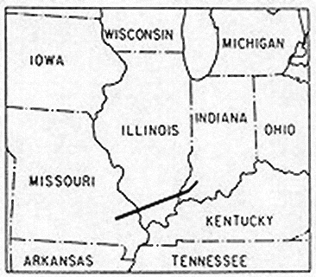
The Tri-state Tornado

Slide 156
Tornado Outbreaks
Famous Tornado Outbreaks
2) The super outbreak (April 3-4, 1974)

Slide 157
Tornado Outbreaks
Famous Tornado Outbreaks
2) The super outbreak (April 3-4, 1974)
148 tornadoes occurred over 24-hour period in 13 U.S. states and Canada

Slide 158
Tornado Outbreaks
Famous Tornado Outbreaks
2) The super outbreak (April 3-4, 1974)
148 tornadoes occurred over 24-hour period in 13 U.S. states and Canada
~320 deaths

Slide 159
Tornado Outbreaks
Famous Tornado Outbreaks
2) The super outbreak (April 3-4, 1974)
148 tornadoes occurred over 24-hour period in 13 U.S. states and Canada
~320 deaths
30 F4 or F5 tornadoes

Slide 160
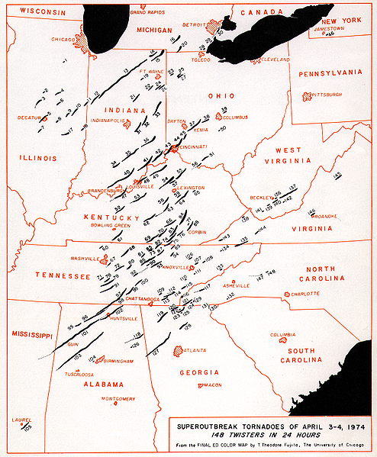
The Super Outbreak

Slide 161
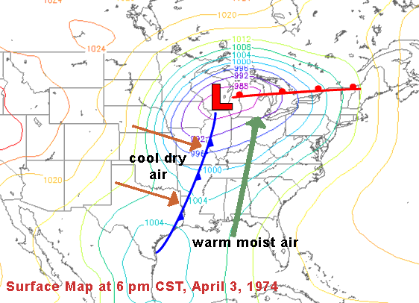
The Super Outbreak

Slide 162
Tornado Outbreaks
Famous Tornado Outbreaks
3) The May 1999 outbreak
140 tornadoes occurred over a 72-hour period in 4 U.S. states
50 deaths

Slide 163
The May 1999 Tornado Outbreak

Slide 164
Waterspouts
Waterspouts – A vortex over water similar to tornadoes, but generally weaker and smaller

Slide 165
Waterspouts

Slide 166
Tornado Research
Efforts to understand tornadoes focus on directly observing them:

Slide 167
Tornado Research
Efforts to understand tornadoes focus on directly observing them:
Totable Tornado Observatory (Toto, 1980) – observation station placed in path of tornado

Slide 168
Tornado Research
Efforts to understand tornadoes focus on directly observing them:
Totable Tornado Observatory (Toto, 1980) – observation station placed in path of tornado
Turtles (1980s) – smaller, more stable instrument package

Slide 169
Tornado Research
Efforts to understand tornadoes focus on directly observing them:
Totable Tornado Observatory (Toto, 1980) – observation station placed in path of tornado
Turtles (1980s) – smaller, more stable instrument package
Portable Doppler radars (late 1980s-now)

