Slide 1
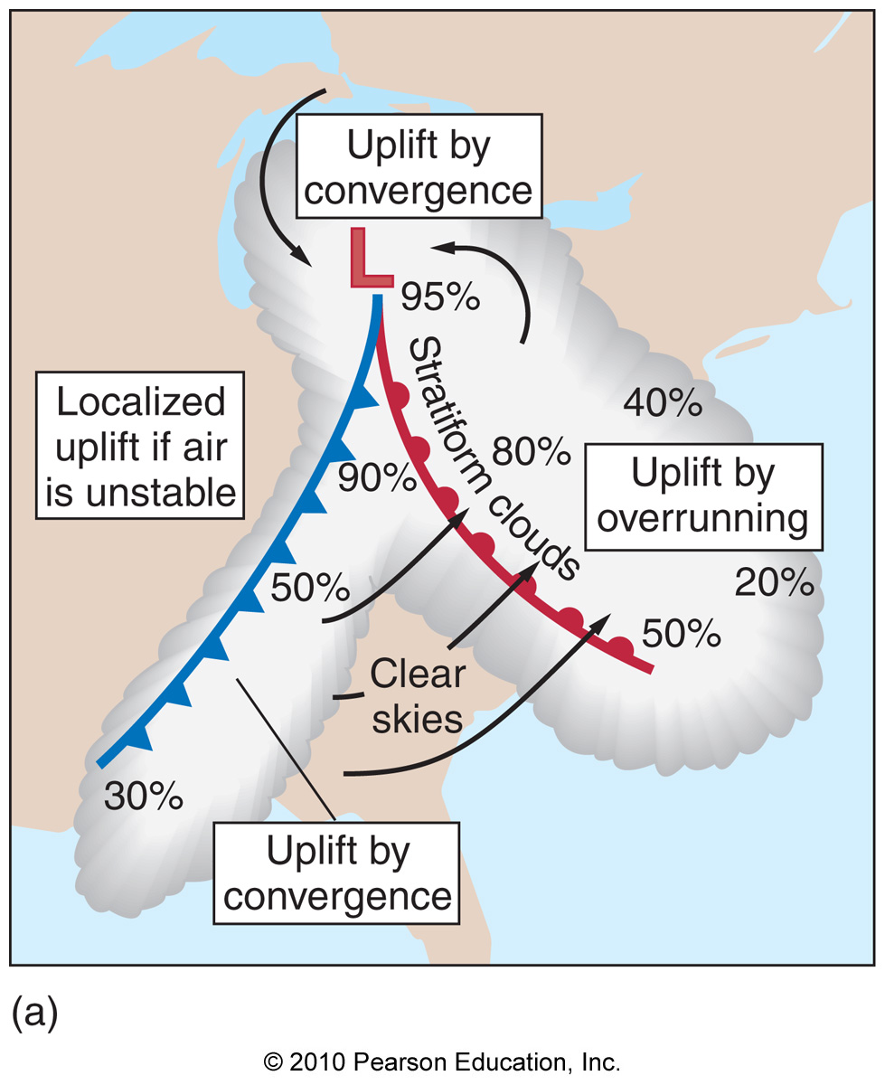
Chapter 10 – Midlatitude Cyclones

Slide 2
The Origin of the Theory of Midlatitude Cyclones
The polar front theory (Norwegian cyclone model) – description of the formation, life, and dissipation of a midlatitude cyclone (center of low pressure) that forms along a front

Slide 3
The Origin of the Theory of Midlatitude Cyclones
The polar front theory (Norwegian cyclone model) – description of the formation, life, and dissipation of a midlatitude cyclone (center of low pressure) that forms along a front
Cyclones are important! They travel far (thousands of miles), they travel big (hundreds of miles wide), they travel tough (precipitation, winds, severe weather)

Slide 4
The Life Cycle of Midlatitude Cyclones
Cyclogenesis – the formation of a midlatitude cyclone

Slide 5
The Life Cycle of Midlatitude Cyclones
Cyclogenesis – the formation of a midlatitude cyclone
Cyclones often form at fronts (just like the Norwegian cyclone model states)

Slide 6
The Life Cycle of Midlatitude Cyclones

Slide 7
The Life Cycle of Midlatitude Cyclones

Slide 8
The Life Cycle of Midlatitude Cyclones

Slide 9
The Life Cycle of Midlatitude Cyclones

Slide 10
The Life Cycle of Midlatitude Cyclones

Slide 11
The Life Cycle of Midlatitude Cyclones
Mature cyclone – cyclone with active cold and warm fronts prior to occlusion

Slide 12
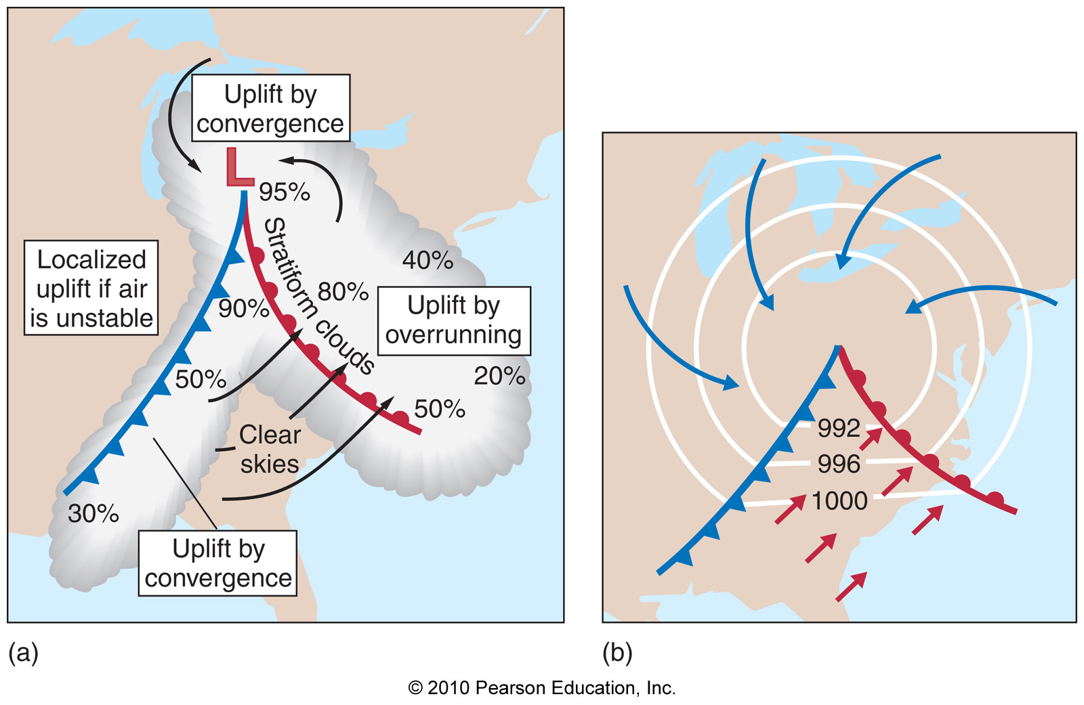
The Life Cycle of Midlatitude Cyclones
Mature cyclone – cyclone with active cold and warm fronts prior to occlusion

Slide 13
The Life Cycle of Midlatitude Cyclones
Occlusion – the end of the cyclone life cycle, associated with formation of occluded front

Slide 14
The Life Cycle of Midlatitude Cyclones
Occlusion – the end of the cyclone life cycle, associated with formation of occluded front

Slide 15
Cyclones
There are roughly 600 cyclones per year in the northern hemisphere

Slide 16
Cyclones
There are roughly 600 cyclones per year in the northern hemisphere
Cyclones generally travel from 0-100 mph

Slide 17
Cyclones
There are roughly 600 cyclones per year in the northern hemisphere
Cyclones generally travel from 0-100 mph
There are various regions that are favored for cyclogenesis:
1) Lee of the Colorado Rockies
2) Gulf of Mexico U.S. coastline
3) East coast
4) Gulf of Alaska

Slide 18
Typical Cyclone Tracks

Slide 19
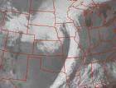
Satellite Images of Cyclones

Slide 20
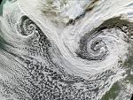
Satellite Images of Cyclones

Slide 21
Satellite Images of Cyclones

Slide 22
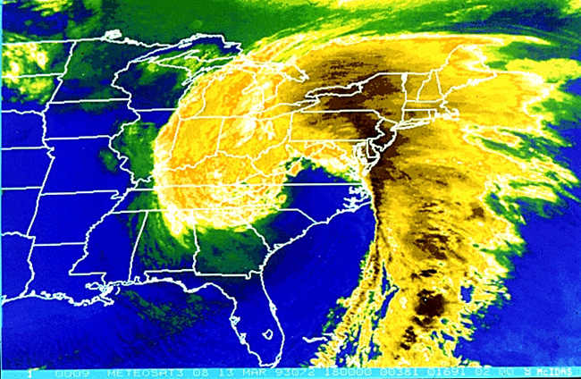
Satellite Images of Cyclones

Slide 23
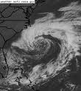
Satellite Images of Cyclones

Slide 24
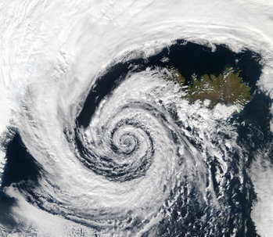
Satellite Images of Cyclones

Slide 25
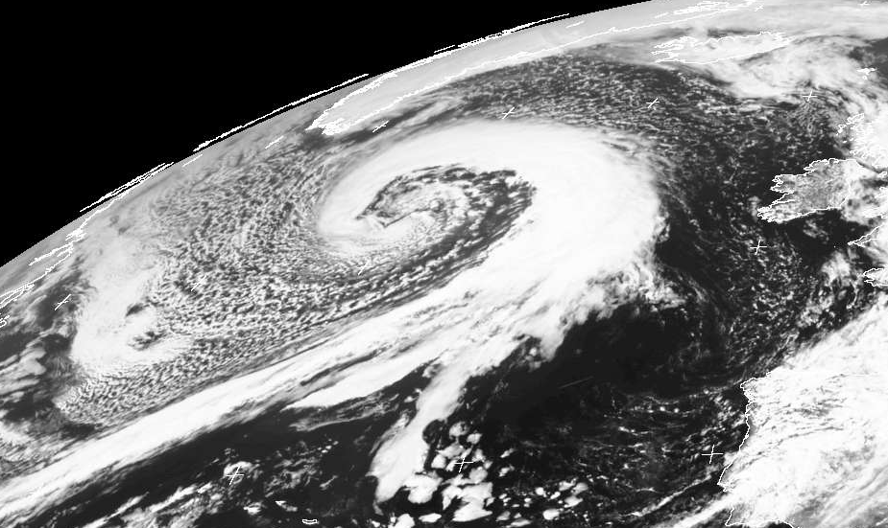
Satellite Images of Cyclones

Slide 26
But How do Cyclones Form???
Up to this point, we have only described midlatitude cyclones with no idea why they exist

Slide 27
But How do Cyclones Form???
Up to this point, we have only described midlatitude cyclones with no idea why they exist
Midlatitude cyclones owe their life to the jet stream!!!

Slide 28
The Jet Stream: Divergence and Convergence
Convergence and divergence is caused by the jet stream in 2 ways:

Slide 29
The Jet Stream: Divergence and Convergence
Convergence and divergence is caused by the jet stream in 2 ways:
1) Vorticity – the “spin” of the atmosphere

Slide 30
The Jet Stream: Divergence and Convergence
Convergence and divergence is caused by the jet stream in 2 ways:
1) Vorticity – the “spin” of the atmosphere
2) Jet streaks – localized regions of
maximum wind speeds along the jet
stream

Slide 31
Vorticity
Regions downwind of positive (CCW) vorticity experience divergence

Slide 32
Vorticity
Regions downwind of positive (CCW) vorticity experience divergence
Regions downwind of negative (CW) vorticity experience convergence

Slide 33
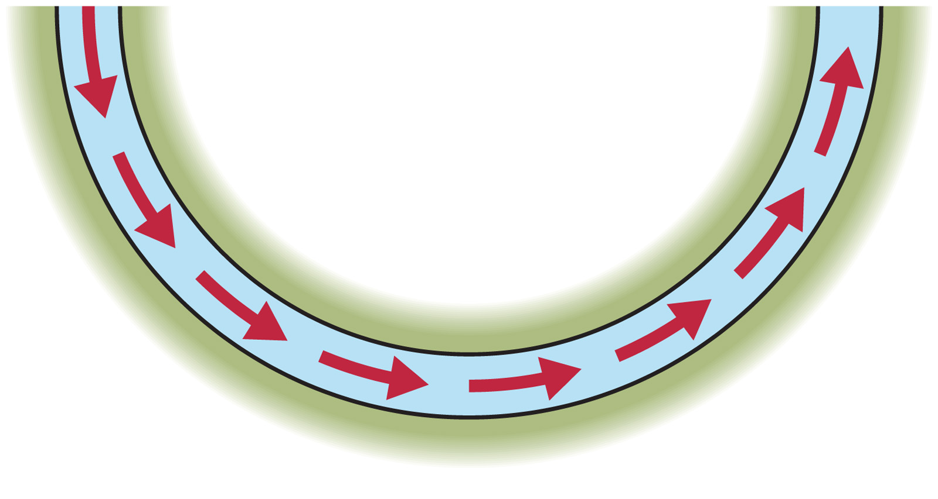
Vorticity
Regions downwind of positive (CCW) vorticity experience divergence
Regions downwind of negative (CW) vorticity experience convergence

Slide 34
Vorticity
Convergence
Divergence
Convergence
Divergence

Slide 35
Jet Streaks
Jet streaks cause convergence and divergence due to:
1) Confluence/diffluence

Slide 36
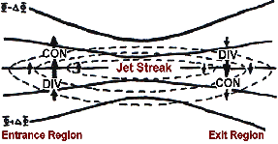
Jet Streaks
Jet streaks cause convergence and divergence due to:
1) Confluence/diffluence

Slide 37
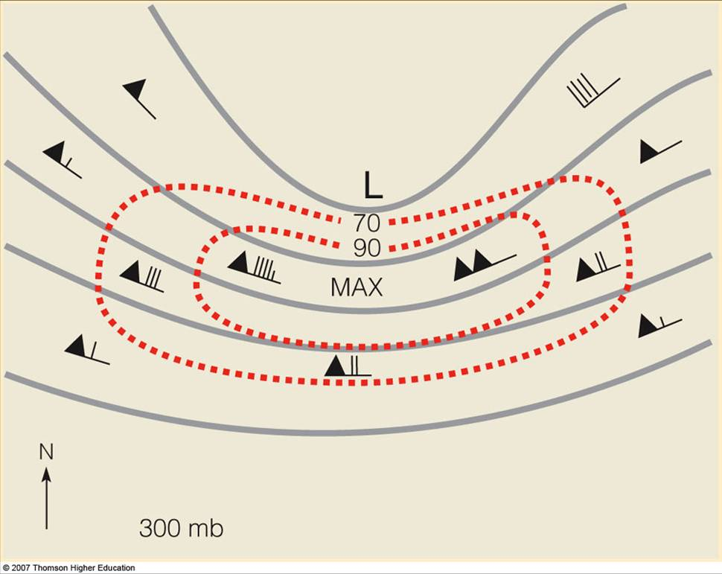
The Jet Stream: Divergence and Convergence
Strongest divergence and convergence occurs when both vorticity and jet streak effects occur simultaneously:

Slide 38
The Jet Stream: Divergence and Convergence
Strongest divergence and convergence occurs when both vorticity and jet streak effects occur simultaneously:
Strong Convergence
Strong Divergence

Slide 39
Convergence/Divergence and Vertical Motion
In the upper atmosphere:
Convergence -> sinking motion
Divergence -> rising motion

Slide 40
Convergence/Divergence and Vertical Motion
In the upper atmosphere:
Convergence -> sinking motion
Divergence -> rising motion
Strong Convergence
Strong Divergence

Slide 41
Convergence/Divergence and Vertical Motion
In the upper atmosphere:
Convergence -> sinking motion
Divergence -> rising motion
Sinking Motion
Rising Motion

Slide 42
The Connection between the Jet Stream and the Surface

Slide 43
The Connection between the Jet Stream and the Surface
Positive feedback causes growth of cyclones…

Slide 44
Cyclone Motion
Since cyclones are linked with jet stream troughs, they move with jet stream troughs

Slide 45
Cyclone Motion
Since cyclones are linked with jet stream troughs, they move with jet stream troughs
Jet stream troughs are waves in the jet stream, and thus troughs move along the jet stream

Slide 46
Cyclone Motion
Since cyclones are linked with jet stream troughs, they move with jet stream troughs
Jet stream troughs are waves in the jet stream, and thus troughs move along the jet stream
The jet stream thus outlines the storm track

Slide 47
Cyclones: An Example
Surface Weather – Day 1

Slide 48
Cyclones: An Example
Surface Weather – Day 2

Slide 49
Cyclones: An Example
Surface Weather – Day 3

Slide 50
Cyclones: An Example
500-mb flow/fronts – Day 1

Slide 51
Cyclones: An Example
500-mb flow/fronts – Day 2

Slide 52
Cyclones: An Example
500-mb flow/fronts – Day 3

Slide 53
Cyclones: An Example
IR satellite – Day 1

Slide 54
Cyclones: An Example
IR satellite – Day 2

Slide 55
Cyclones: An Example
IR satellite – Day 3

Slide 56
Cyclones and Climate Change
Climate change will likely be involved with changing temperature distributions globally

Slide 57
Cyclones and Climate Change
Climate change will likely be involved with changing temperature distributions globally
Since these temperature distributions force the position of the jet stream (and storm track), typical cyclone tracks will likely shift

Slide 58
Cyclones and Climate Change
Climate change will likely be involved with changing temperature distributions globally
Since these temperature distributions force the position of the jet stream (and storm track), typical cyclone tracks will likely shift
Shifting cyclone tracks will likely lead to changes in average temperature and precipitation over the midlatitudes

