Slide 1
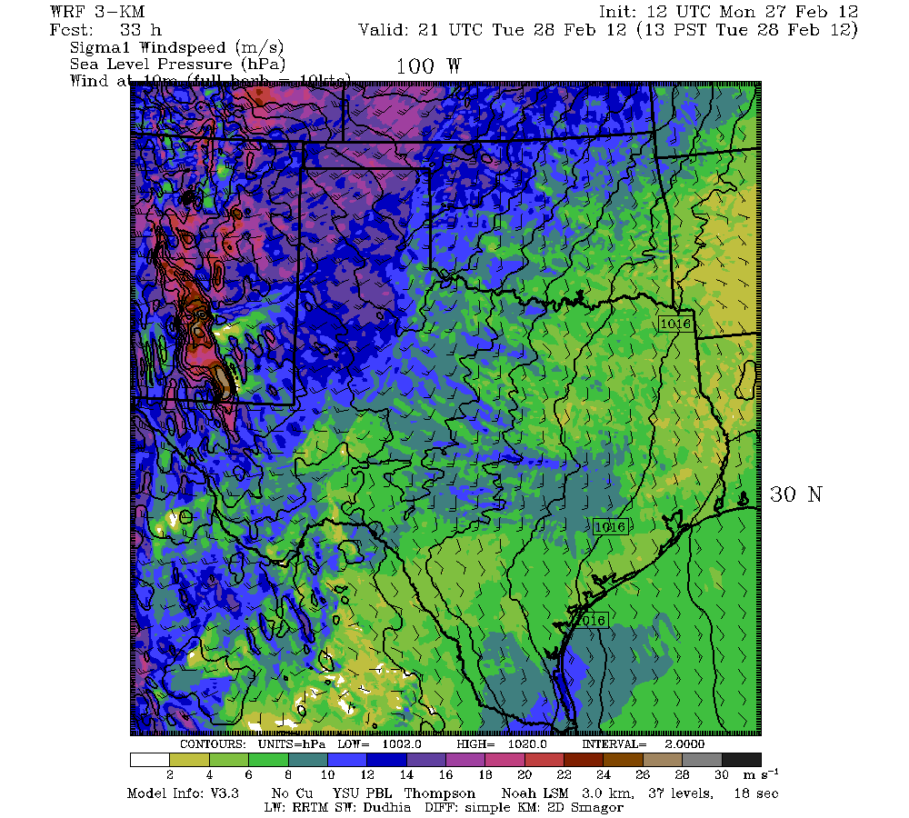
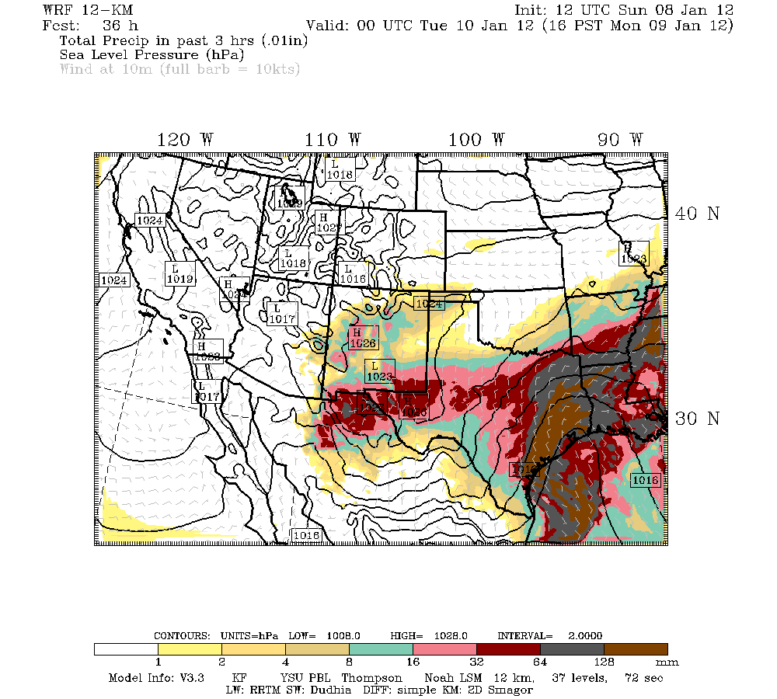
ATMO5332
WRF-ARW Tutorial
0.01”

Slide 2
Overview of WRF Modeling System
A bare-bones WRF run involves 4 major steps:
1) WRF Preprocessing System (WPS)
2) Initialization (real)
3) Numerical integration (WRF)
4) Visualization

Slide 3
Overview of WRF Modeling System
A bare-bones WRF run involves 4 major steps:
1) WRF Preprocessing System (WPS)
2) Initialization (real)
3) Numerical integration (WRF)
4) Visualization
Most steps above are capable of running
in parallel mode using multiple CPUs

Slide 4
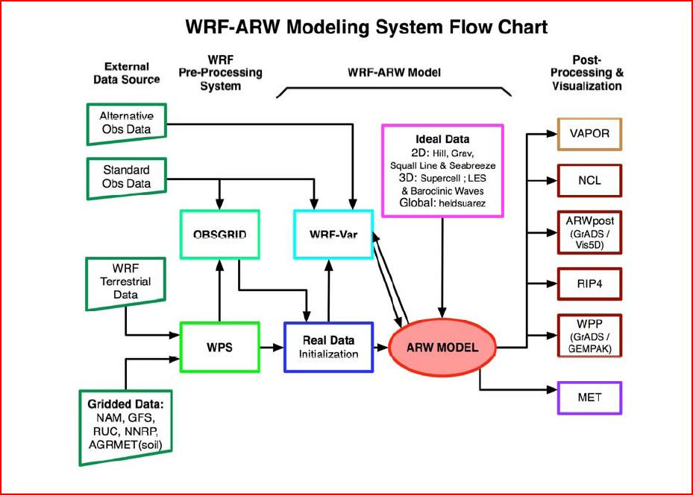
Overview of WRF Modeling System
Green boxes = Bare-bones run

Slide 5
WPS
WPS performs all preprocessing of data needed for a WRF numerical integration (define domains, get initial conditions…)

Slide 6
WPS
WPS performs all preprocessing of data needed for a WRF numerical integration (define domains, get initial conditions…)
WPS is controlled through a user-defined namelist called namelist.wps

Slide 7
WPS
WPS performs all preprocessing of data needed for a WRF numerical integration (define domains, get initial conditions…)
WPS is controlled through a user-defined namelist called namelist.wps
WPS is composed of three programs:
1) geogrid
2) ungrib
3) metgrid

Slide 8
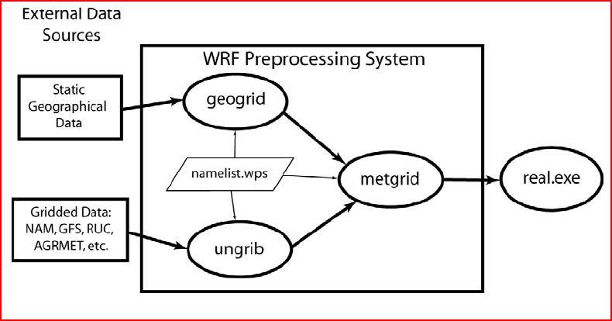
WPS

Slide 9
WPS - geogrid
Geogrid has the following purposes:
1) Define simulation domain (size, location,
horizontal resolution)

Slide 10
WPS - geogrid
Geogrid has the following purposes:
1) Define simulation domain (size, location,
horizontal resolution)
2) Indicate which geographical data will be
used (30-second, 2-minute)

Slide 11
WPS - geogrid
Geogrid has the following purposes:
1) Define simulation domain (size, location,
horizontal resolution)
2) Indicate which geographical data will be
used (30-second, 2-minute)
3) Choose map projection (lambert
conformal, polar stereographic,
mercator, lat/lon)

Slide 12
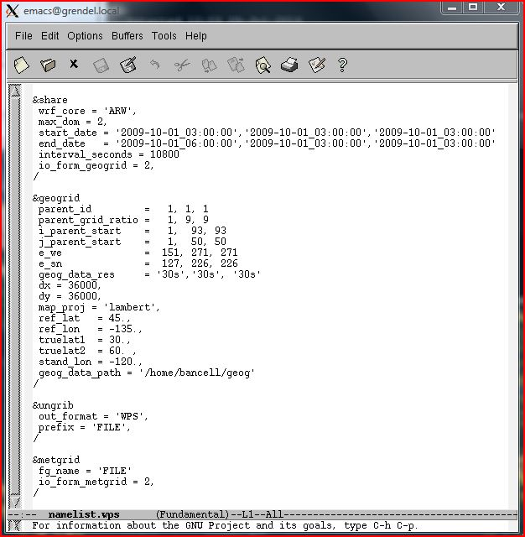
namelist.wps

Slide 13
namelist.wps (geogrid)

Slide 14
namelist.wps (geogrid)
(Each column represents a different domain)

Slide 15
WPS - geogrid
Input files needed to run geogrid:
1) Geographical data
(/lustre/research/bancell/geogV4/WPS_GEOG)
2) namelist.wps

Slide 16
WPS - geogrid
Input files needed to run geogrid:
1) Geographical data
(/lustre/research/bancell/geogV4/WPS_GEOG)
2) namelist.wps
Output from geogrid:
1) geo_em.d01.nc (would also have
geo_em.d02.nc for 2nd domain…)
2) geogrid.log files

Slide 17
WPS - geogrid
Final Notes on geogrid
geogrid only needs to be run once for the same domain
Like most of the WRF system output, geo_em.d0X.nc files are netcdf files
Nest parameters must be carefully set in namelist.wps for geogrid

Slide 18
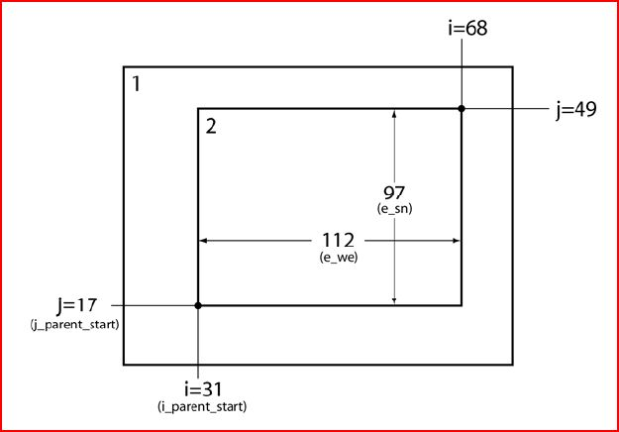
WPS - geogrid

Slide 19
namelist.wps (geogrid)
(Each column represents a different domain)

Slide 20
WPS - ungrib
ungrib has the following purpose:
1) Extract fields from external grib files
(such as a GFS forecast) and write this
information to WPS file format

Slide 21
namelist.wps (ungrib)

Slide 22
namelist.wps (ungrib)

Slide 23
WPS - ungrib
Input files needed to run ungrib:
1) External grib files
2) namelist.wps
3) A file called Vtable (instructs ungrib to
pull specific variables from various grib files)

Slide 24
WPS - ungrib
Input files needed to run ungrib:
1) External grib files
2) namelist.wps
3) A file called Vtable (instructs ungrib to
pull specific variables from various grib files)
Output from ungrib:
1) WPS format files called FILE:date
2) ungrib.log file

Slide 25
WPS - metgrid
metgrid has the following purpose:
1) Interpolate external meteorological data
(originally from grib files, now in WPS
format through program ungrib)
horizontally to defined grid points

Slide 26
namelist.wps (metgrid)

Slide 27
namelist.wps (metgrid)

Slide 28
WPS - metgrid
Input files needed to run metgrid:
1) FILE:date files from ungrib
2) geo_em.d0X.nc files from geogrid
3) namelist.wps

Slide 29
WPS - metgrid
Input files needed to run metgrid:
1) FILE:date files from ungrib
2) geo_em.d0X.nc files from geogrid
3) namelist.wps
Output from metgrid:
1) A set of files called met_em.d01.date.nc
(and met_em.d0X for nests)
2) metgrid.log files

Slide 30
WPS - metgrid
Final Notes on metgrid and WPS
met_em.d0X.date.nc files are netcdf files
All 3 WPS programs are run in the same directory (/lustre/work/your_userID/WPSV4)
Make sure to clean up files before each new WPS run

Slide 31
WRF Initialization (real)
real has the following purposes:
1) Create vertical model levels

Slide 32
WRF Initialization (real)
real has the following purposes:
1) Create vertical model levels
2) Interpolate meteorological data to vertical
model levels

Slide 33
WRF Initialization (real)
real has the following purposes:
1) Create vertical model levels
2) Interpolate meteorological data to vertical
model levels
3) Create input files (initial and boundary
conditions) for numerical integration

Slide 34
real
Input files needed to run real:
1) met_em.d0X.data.nc files from metgrid
2) namelist.input (parameter file for real
and wrf)

Slide 35
real
Input files needed to run real:
1) met_em.d0X.data.nc files from metgrid
2) namelist.input (parameter file for real
and wrf)
Output from real:
1) wrfinput_d01 and wrfbdy_d01
(additional wrfinput_d0X files if more
than 1 domain)
2) Log files (rsl.out.XXXX, rsl.error.XXXX)

Slide 36
namelist.input
real runs using parameters from the text file namelist.input, which has the following basic sections:
1) time_control
2) domains
3) physics
4) dynamics
5) bdy_control

Slide 37
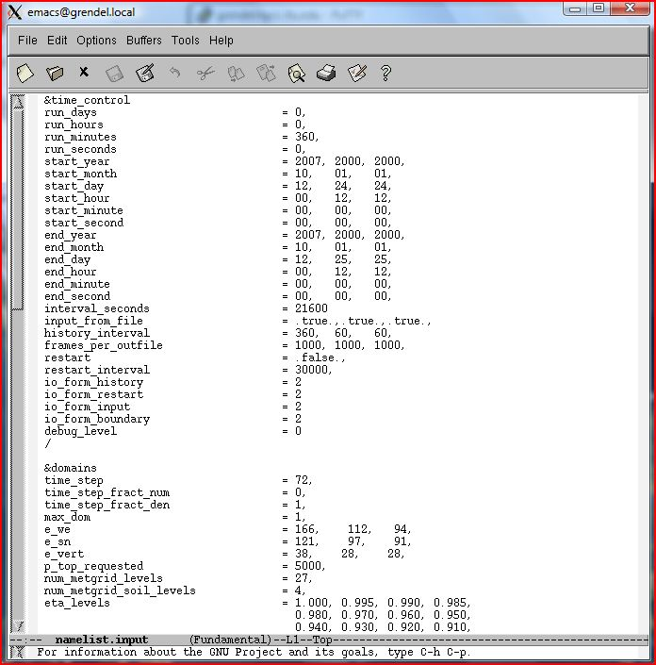
namelist.input
Much More

Slide 38
namelist.input – time_control

Slide 39
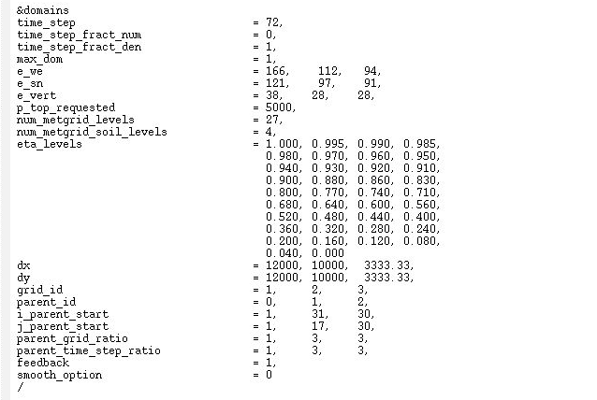
namelist.input – domains

Slide 40
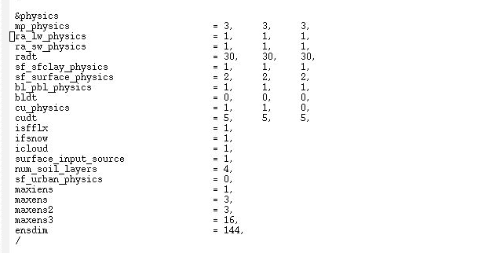
namelist.input – physics

Slide 41
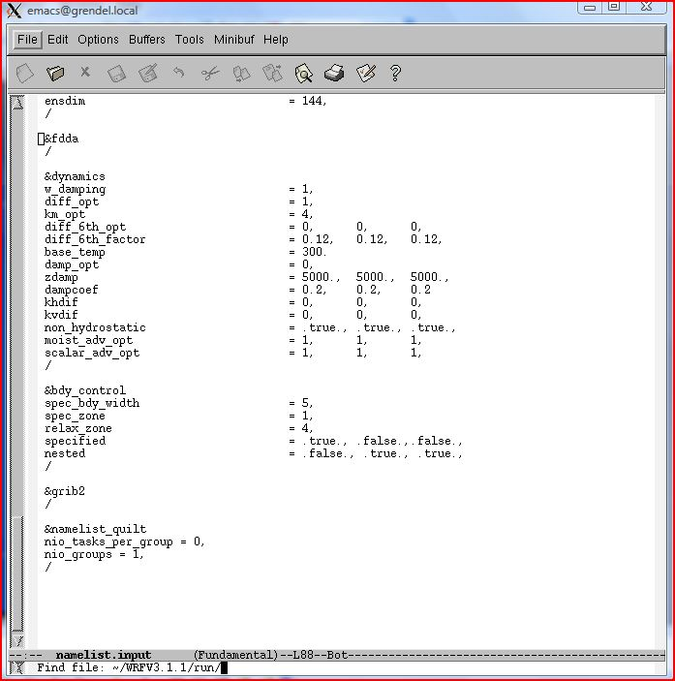
namelist.input – dynamics

Slide 42
namelist.input – bdy_control

Slide 43
WRF Numerical Integration (wrf)
wrf has the following purpose:
1) Numerically approximate the solutions to
the model equations to produce a
forecast!!!! Finally!!!!

Slide 44
wrf
Input files needed to run wrf:
1) wrfinput_d01 (and wrfinput_d0X for
nests), wrfbdy_d01 files from real
2) namelist.input (parameter file for real
and wrf)

Slide 45
wrf
Input files needed to run wrf:
1) wrfinput_d01 (and wrfinput_d0X for
nests), wrfbdy_d01 files from real
2) namelist.input (parameter file for real
and wrf)
Output from wrf:
1) wrfout_d01.date.nc (wrfout_d0X.date.nc
for more than one domain)
2) Log files (rsl.out.XXXX, rsl.error.XXXX)

Slide 46
real and wrf
Final Notes on real and wrf
All output files from real and wrf are netcdf files, and the contents of netcdf files can be viewed with the command:
ncdump –h filename
To view the contents of a single variable in a netcdf file, such as the variable “Times”, type
ncdump –v Times filename
→ First type “module load gcc/10.1.0 openmpi/4.0.4”
netcdf-c/4.7.3-mpi netcdf-fortran/4.5.2-mpi hdf5/1.10.6-mpi”

Slide 47
real and wrf
Final Notes on real and wrf
Make sure to check the log files after a real and a wrf run to make sure your model run actually ran

Slide 48
real and wrf
Final Notes on real and wrf
Make sure to check the log files after a real and a wrf run to make sure your model run actually ran
real and wrf are run in the same directory:
/lustre/work/your_userID/WRFV4/run

Slide 49
real and wrf
Final Notes on real and wrf
Make sure to check the log files after a real and a wrf run to make sure your model run actually ran
real and wrf are run in the same directory:
/lustre/work/your_userID/WRFV4/run
Look at file README.namelist in /lustre/work/your_userID/WRFV4/run for a description of all namelist variables

Slide 50
real and wrf
Final Notes on real and wrf
Make sure to check the log files after a real and a wrf run to make sure your model run actually ran
real and wrf are run in the same directory:
/lustre/work/your_userID/WRFV4/run
Look at file README.namelist in /lustre/work/your_userID/WRFV4/run for a description of all namelist variables
For one-way nests that are run after the parent domain, the program ndown must be run to get the initial and boundary conditions for a nested run…

Slide 51
Visualization (RIP)
RIP has the following purpose:
1) Forecasts have been made, now we have
to look at them – RIP produces plots of
desired forecast variables

Slide 52
Visualization (RIP)
RIP has the following purpose:
1) Forecasts have been made, now we have
to look at them – RIP produces plots of
desired forecast variables
RIP runs using 2 programs:
1) ripdp_wrfarw – data preparation
2) rip - plotting

Slide 53
ripdp_wrfarw
ripdp_wrfarw is run on the command line with 3 arguments:
ripdp_wrfarw data/wrftemp all wrfout_file
ripdp_wrfarw execute command
3) wrfout file from program WRF
1) Location where intermediate RIP data will go from ripdp_wrfarw
2) Tells ripdp_wrfarw to process all variables

Slide 54
rip
rip is run on the command line using 2 arguments:
rip data/wrftemp sfct.in
rip execute command
2) rip input file that tells rip what to plot
1) Temporary data name and location from ripdp_wrfarw

Slide 55
The rip input file
A formatted file with the “.in” extension (e.g. slp.in) tells rip what to plot and how to plot it

Slide 56
The rip input file
A formatted file with the “.in” extension (e.g. slp.in) tells rip what to plot and how to plot it
There are 3 sections to every .in file:
1) User input section
2) Color table
3) Plot specification table

Slide 57
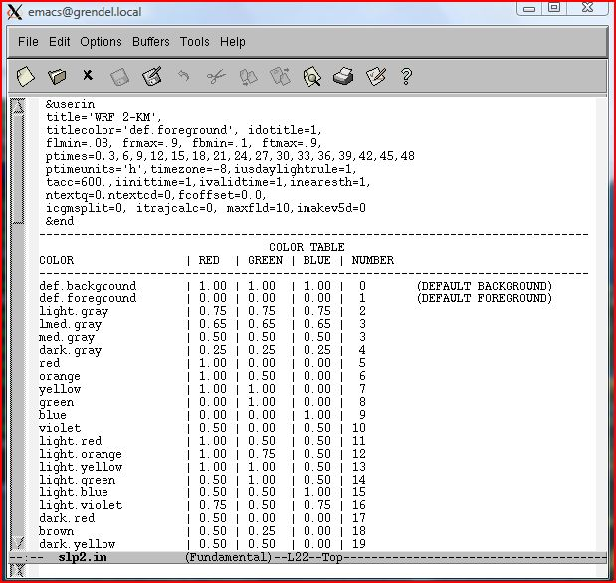
slp2.in
Much More

Slide 58
User Input Section

Slide 59
Color Table
Much More

Slide 60
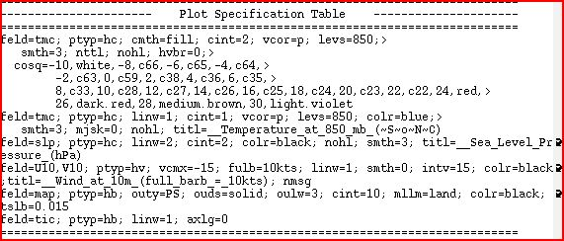
Plot Specification Table

Slide 61
rip
Output from rip is a computer graphics metafile (file with extenstion “.cgm”) that can be viewed with the idt image display tool or converted into .gif image files

Slide 62
Running WPS/WRF/RIP
Running WPS, real, WRF, and RIP requires a variety of scripts that must be submitted to the quanah queue at the HPCC to run

Slide 63
Running WPS/WRF/RIP
Running WPS, real, WRF, and RIP requires a variety of scripts that must be submitted to the quanah queue at the HPCC to run
The following is a step-by-step guide on how to setup the required directories, get the required files, and run WPS/real/WRF/RIP from your own directory

Slide 64
Required WPS Directory
Go to directory /lustre/work/your_userID
Type
“cp –r /lustre/research/bancell/atmo5332/WPSV4 ./WPSV4”
- This copies the WPS directory structure to
your work directory
- This is where you will run the WPS programs
(in /lustre/work/your_userID/WPSV4)

Slide 65
Required real/WRF Directory
Go to directory /lustre/work/your_userID
Type
“cp –r /lustre/research/bancell/atmo5332/WRFV4 ./WRFV4”
- This copies the real and WRF directory structure to your work directory
- This is where you will run real and wrf
(in /lustre/work/your_userID/WRFV4/run)

Slide 66
Required RIP directory
Go to directory /lustre/work/your_userID
Type
“cp –r /lustre/research/bancell/RIPatmo5332 ./RIP”
- This copies the RIP directory structure to
your work directory
- This is where you will run RIP
(in /lustre/work/your_userID/RIP)

Slide 67
Required Submission Script Directory
Go to directory /lustre/work/your_userID
Type
“cp –r /lustre/research/bancell/atmo5332/SUB ./sub”
- This copies the directory structure containing
the HPCC submission scripts to your work
directory
- This is where you will submit the scripts that
run the MPI WPS programs, real, and wrf (in
/lustre/work/your_userID/sub)

Slide 68
Running WPS
geogrid
Modify the namelist.wps for your case in /lustre/work/your_userID/WPSV4)
Go to /lustre/work/your_userID/sub
Modify geogrid.scr for the correct directory paths
Type “sbatch geogrid.scr”
Make sure output files geo_em.d0X are generated in /lustre/work/your_userID/WPSV4
Check geogrid log files in the WPS directory and error_out_geogrid, submit_out_geogrid files in the sub directory if you have problems

Slide 69
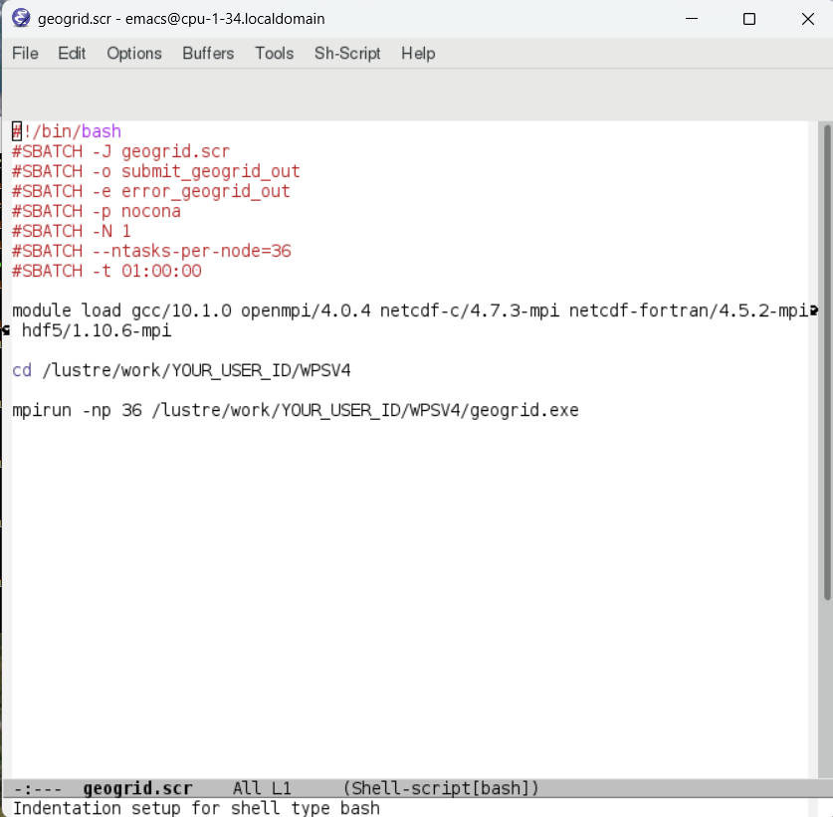

Slide 70
Running WPS
geogrid – Viewing your domain
To view the domain(s) you want to create with geogrid, use the plotgrids_new.ncl utility by following these steps:
1) Go to an interactive node on quanah (type “interactive -p quanah”)
2) Make sure you are in /lustre/work/your_userID/WPSV4
3) Type “module load singularity ncl”
4) Make sure Xming or MobaXterm is running
5) Type “ncl.img ncl util/plotgrids_new.ncl”
After running plotgrids_new.ncl, a picture of your domain should pop up on your screen (as specified by your namelist.wps)
Use this utility to tinker with your domain until it looks how you want it to look, then run geogrid.exe

Slide 71
Running WPS
ungrib
GFS files for the homework are in /lustre/work/your_userID/WPSV4/data
Start a terminal instance on a nocona core like this:
“interactive –p nocona”
Go to /lustre/work/your_userID/WPSV4 and then type “./link_grib.csh data/gfs*”
- This links files to the GFS files in /data

Slide 72
Running WPS
ungrib cont’d
Load the appropriate modules with
“module load gcc/10.1.0 openmpi/4.0.4 netcdf-c/4.7.3-mpi netcdf-fortran/4.5.2-mpi hdf5/1.10.6-mpi”
Type “./ungrib.exe” to run ungrib on the command line (it’s a single processor job)
Make sure all FILE:date files exist in /lustre/work/your_userID/WPSV4, check ungrib.log file in that directory if there are problems

Slide 73
Running WPS
metgrid
Go to /lustre/work/your_userID/WPSV4
(while still on the nocona core terminal instance)
Type “./metgrid.exe”
Make sure all met_em.d0X files exist in /lustre/work/your_userID/WPSV4, check metgrid log file in that directory if there are problems

Slide 74
Running real
Exit the terminal instance (it’s no longer needed)
Go to /lustre/work/your_userID/WRFV4/run
Copy all met_em.d0X files from the WPS directory to the above WRF directory
Modify the file namelist.input for your case
Go to /lustre/work/your_userID/sub
Modify real.scr for the correct directory paths
Type “sbatch real.scr”

Slide 75
Running real cont’d
Make sure the files wrfinput_d0X and wrfbdy_d01 exist in /lustre/work/your_userID/WRFV4/run, check rsl log files in that directory as well as submit_out_real, error_out_real log files in the sub directory if you have problems

Slide 76
Running wrf
Go to /lustre/work/your_userID/sub
Modify wrf.scr for the correct directory paths
Type “sbatch wrf.scr”
Make sure the file wrfout_d0X.date.nc exists in /lustre/work/your_userID/WRFV4/run, check rsl log files in that directory as well as submit_out_wrf, error_out_wrf log files in the sub directory if you have problems
Make sure your run finished by looking at the end of the rsl.out.0000 file in the WRF directory

Slide 77
Running RIP
RIP will be run on a terminal instance on quanah
(type “interactive -p quanah”)
Go to /lustre/work/your_userID/RIP
Load the following modules by typing
“module load intel netcdf-serial xanim”
Set the following environmental variables by typing the following three commands:
“export RIP_ROOT=.”
“export NCARG_ROOT=/home/bancell/ncl_ncarg”
“export LD_LIBRARY_PATH=/home/bancell/netpbm/lib:$LD_LIBRARY_PATH

Slide 78
Running RIP cont’d
Copy the wrfout files from the wrf run to your RIP directory
Type “./ripdp_wrfarw data/wrftemp all wrfout*” → this runs ripdp_wrfarw and prepares data for rip and puts it in the data directory (make sure to process one domain at a time)
If ripdp_wrfarw fails, try to process fewer files, or run a submitted script from quanah using more memory
Modify /lustre/work/your_userID/RIP/slp2.in for your desired plot

Slide 79
Running RIP cont’d
Type “./rip data/wrftemp slp2.in” – this runs rip and produces a single .cgm file
Convert the single file slp2.cgm to gif files valid at each time by typing “./cgmtogif slp2.cgm”
You can look at the gif images with the command “xanim slp2.frame001.gif” (or loop through all images with “xanim *.gif”)
You can see several examples of rip .in files in the /exampleripfiles directory of your RIP directory

Slide 80
Final WPS/WRF/RIP Notes
Clean up all files before your next run!!!! (WPS, real, wrf, RIP, and sub)
Programs fail for many reasons – carefully examine your log files to figure out why before asking for help

Slide 81
First Things First
To run WPS/WRF/RIP at HPCC on a shell using a PC, you need to download 2 things:
- Putty (gives you the shell, make sure to enable
X11 forwarding at Connection→SSH→X11), use
address login.hpcc.ttu.edu
- MobaXterm (gives ability to bring up external windows for graphics and text editing, for example with emacs) – this needs to be active to bring up external windows

Slide 82
First Things First
On a Mac, no downloads needed! Just bring up a shell and ssh to RedRaider with:
ssh –X your_userID@login.hpcc.ttu.edu
Note: When you login to RedRaider, you’ll be in your
home directory (/home/your_userID)
disk space limit on /home/your_userID: 150 GB
disk space limit on /lustre/work/your_userID: 700 GB

Slide 83
First Things First
A common problem is the display variable for new users, if your plotgrids program does not work or if you can’t enable external windows (e.g. with emacs), contact hpccsupport@ttu.edu right away!

