Slide 1



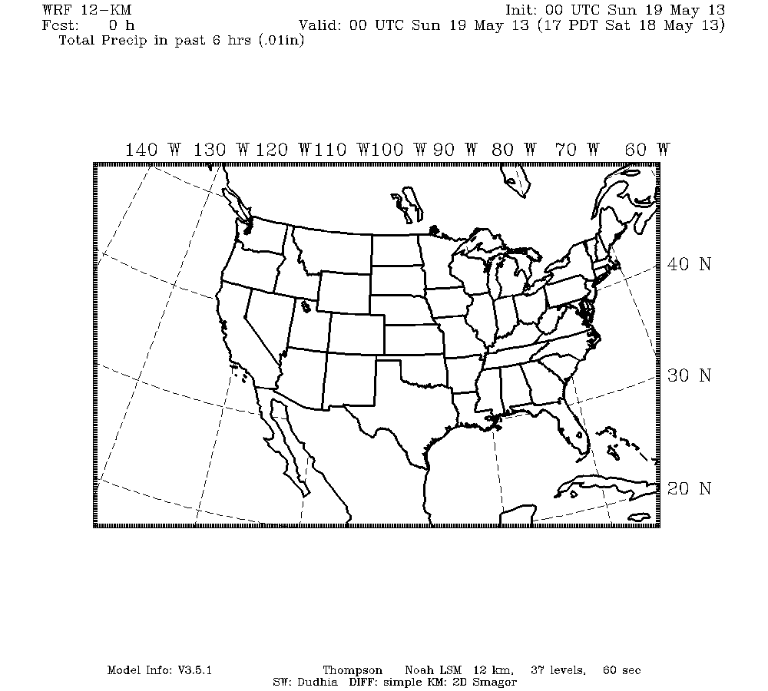
Chaos Seeding and its Effects on Numerical Perturbation Experiments
?

Slide 2
Discovering Chaos Seeding
Inadvertent Weather Modification Project Goal
Determine the atmospheric effects at a range of temporal and spatial scales from irrigation, wind farms, and urban development
Local Modification: Observational/modeling evidence for modification of temperature, moisture, precipitation, wind, pressure
Nonlocal Modification: Substantially less clear, and prior studies suggest significant downstream modification might occur…

Slide 3
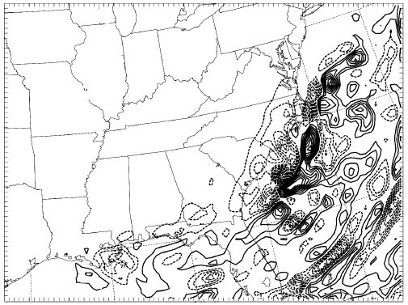
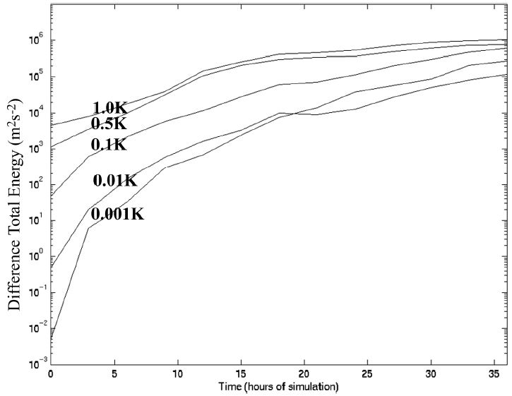
Discovering Chaos Seeding
Inadvertent Weather Modification Project Goal
Determine the atmospheric effects at a range of temporal and spatial scales from irrigation, wind farms, and urban development
Local Modification: Observational/modeling evidence for modification of temperature, moisture, precipitation, wind, pressure
Nonlocal Modification: Substantially less clear, and prior studies suggest significant downstream modification might occur…
36-hr accum. precipitation difference
(contour interval=0.5 cm)
Perturbation energy growth
Zhang et al. 2003, JAS

Slide 4
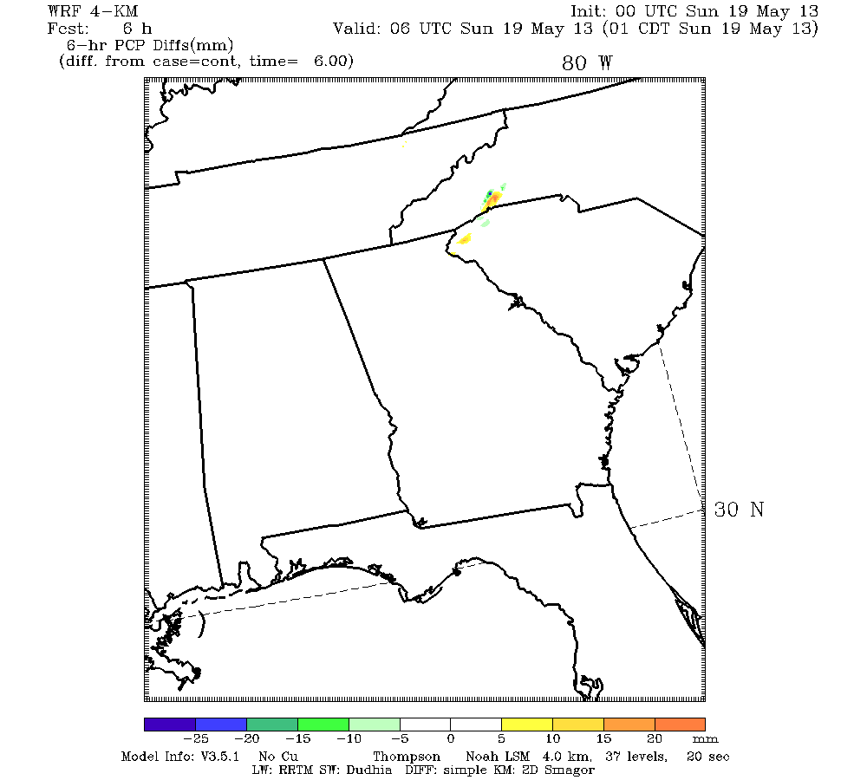
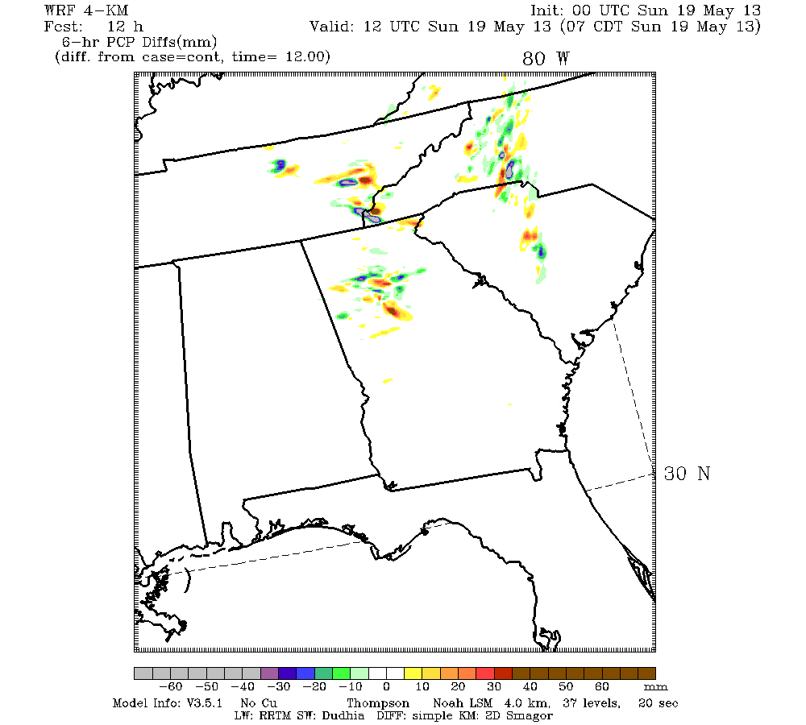
Discovering Chaos Seeding
→ WRF perturbation experiments were conducted, and it was quickly found that tiny perturbations propagated at unrealistic speeds
6 HR
Initial Soil Moisture Perturbation
12 HR
4km
12km
mm
PCP DIFFERENCE LAST 6 HRS

Slide 5
Discovering Chaos Seeding
→ WRF perturbation experiments were conducted, and it was quickly found that tiny perturbations propagated at unrealistic speeds
6 HR
Initial Soil Moisture Perturbation
12 HR
4km
12km
mm
PCP DIFFERENCE LAST 6 HRS

Slide 6
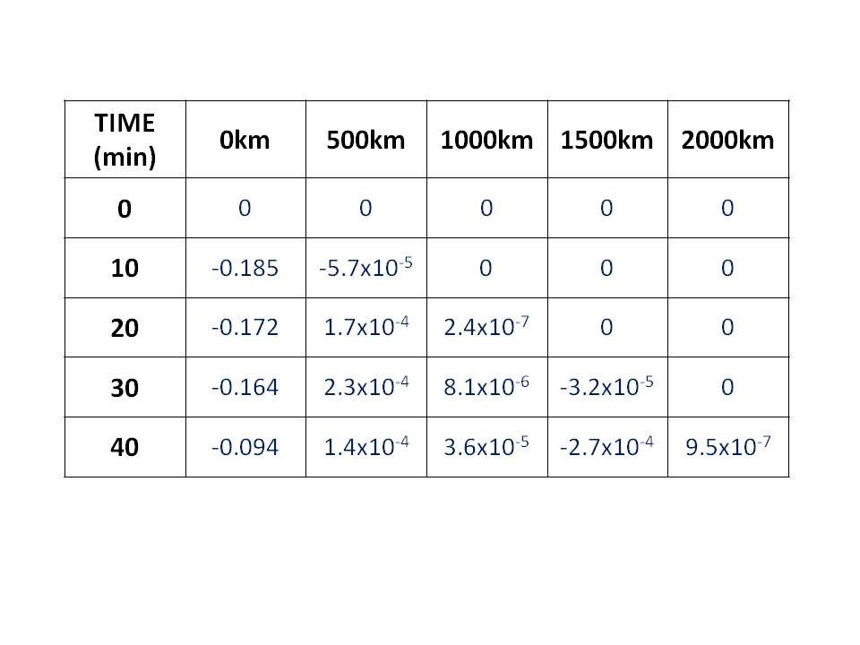
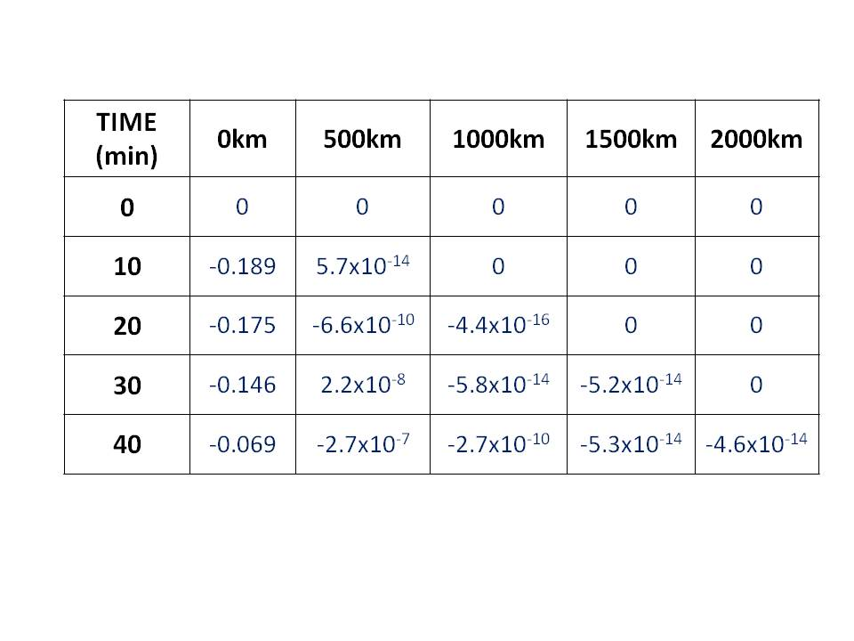
Chaos Seeding
Propagation of Perturbations to Surface Potential Temperature
WRF Single Precision
Propagation Speed
3600 km/hr!!
WRF Double Precision

Slide 7
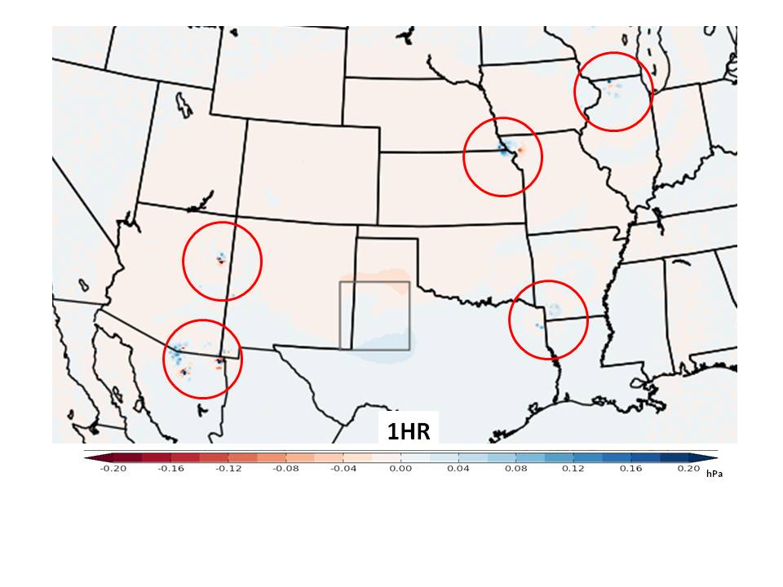
Chaos Seeding
Surface pressure differences due to wind farm aggregate in box

Slide 8
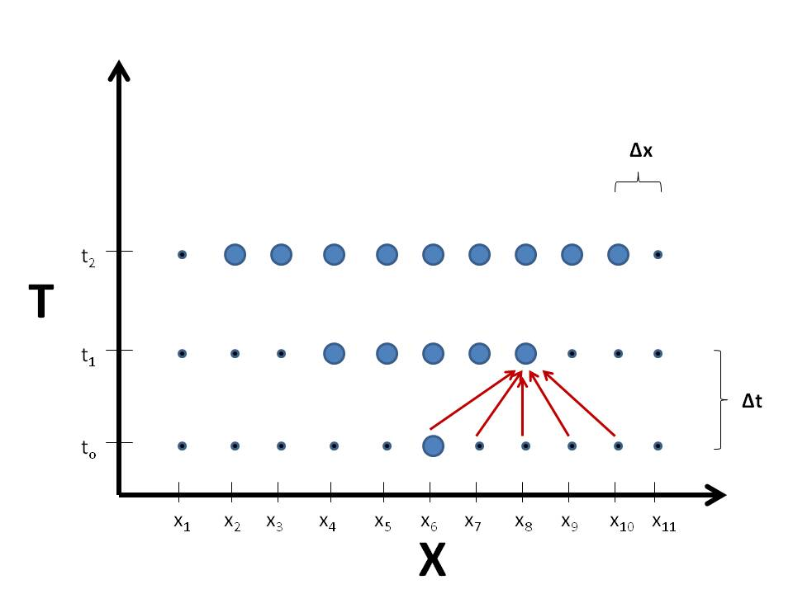
Chaos Seeding
These unrealistically fast perturbation propagation speeds are due to errors communicated through spatial discretization schemes…

Slide 9
Chaos Seeding
These unrealistically fast perturbation propagation speeds are due to errors communicated through spatial discretization schemes…
→ The expansion of the numerical domain of influence far exceeds that of any realistic dynamical influence

Slide 10
Chaos Seeding
Chaos Seeding Characteristics:
Independent of variable (all variables affected)
Propagates three-dimensionally
Rapidly seeds entirety of most mesoscale modeling domains with 1-2 hrs
A universal problem
    - Hohenegger and Schar 2007 → grid point model
    - Hodyss and Majumdar 2007 → spectral model

Slide 11
Chaos Seeding
Chaos Seeding Characteristics:
Independent of variable (all variables affected)
Propagates three-dimensionally
Rapidly seeds entirety of most mesoscale modeling domains with 1-2 hrs
A universal problem
    - Hohenegger and Schar 2007 → grid point model
    - Hodyss and Majumdar 2007 → spectral model
→ What are the consequences?

Slide 12
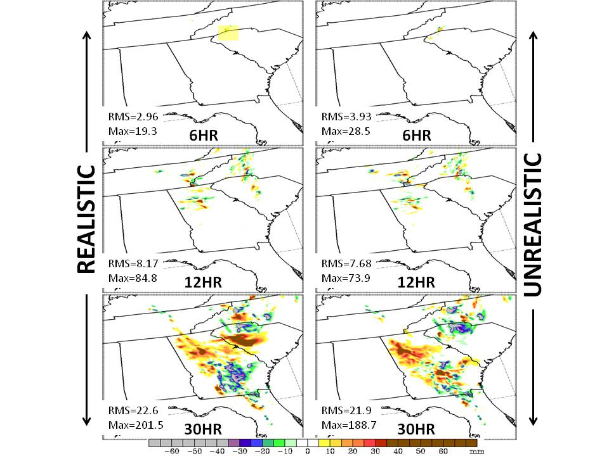
Chaos Seeding: Consequences
Perturbation Below Precipitation
Perturbation in California

Slide 13
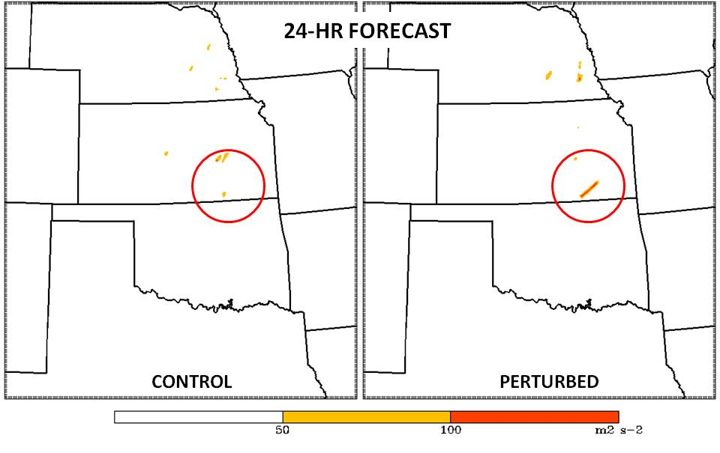
Chaos Seeding: Consequences
Perturbation in California
2-5km Updraft Helicity Tracks (maximum last hour)

Slide 14
Chaos Seeding: Consequences
Key Issue: Chaos seeding excites ALL possible growth EVERYWHERE, but realistic processes are substantially more limited

Slide 15
Chaos Seeding: Consequences
Key Issue: Chaos seeding excites ALL possible growth EVERYWHERE, but realistic processes are substantially more limited
Dire Consequence: Chaos seeding can lead to misinterpretation of experimental results
Chaos seeding unknown: Evolution of differences attributed completely to prescribed perturbation
Chaos seeding known: Separation of realistic signal from growth of “seeds” required

Slide 16
Chaos Seeding: Consequences
Key Issue: Chaos seeding excites ALL possible growth EVERYWHERE, but realistic processes are substantially more limited
Dire Consequence: Chaos seeding can lead to misinterpretation of experimental results
Chaos seeding unknown: Evolution of differences attributed completely to prescribed perturbation
Chaos seeding known: Separation of realistic signal from growth of “seeds” required
Can Affect the Following Types of Experiments
Observation impact/data assimilation
Assessing the effects of boundary conditions
Examination of the effects of model parameterizations
Any initial condition perturbation experiment in a twin model framework

Slide 17
Chaos Seeding: Mitigation
Comparison of realistic vs. chaos seeding spatial patterns

Slide 18
Chaos Seeding: Mitigation
Comparison of realistic vs. chaos seeding spatial patterns
Ensemble sensitivity analysis to distinguish trends not caused by chaos seeding

Slide 19
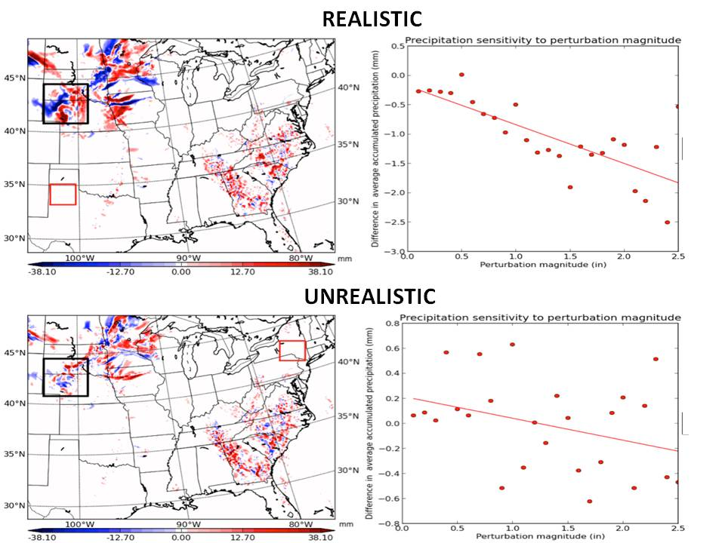
Chaos Seeding: Mitigation
Comparison of realistic vs. chaos seeding spatial patterns
Ensemble sensitivity analysis to distinguish trends not caused by chaos seeding

Slide 20
Chaos Seeding: Mitigation
Comparison of realistic vs. chaos seeding spatial patterns
Ensemble sensitivity analysis to distinguish trends not caused by chaos seeding
EOF analysis to reveal the leading modes of variability of atmospheric variables

Slide 21
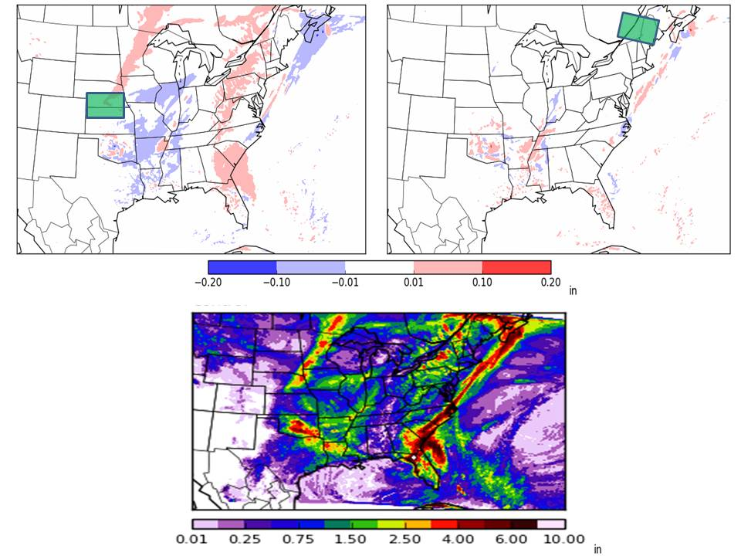
Chaos Seeding: Mitigation
Difference in Leading EOFs (Control-Perturbed)
REALISTIC
UNREALISTIC
96-hr Accumulated Precipitation

Slide 22
Chaos Seeding: Mitigation
Comparison of realistic vs. chaos seeding spatial patterns
Ensemble sensitivity analysis to distinguish trends not caused by chaos seeding
EOF analysis to reveal the leading modes of variability of atmospheric variables
The use of double precision?

Slide 23
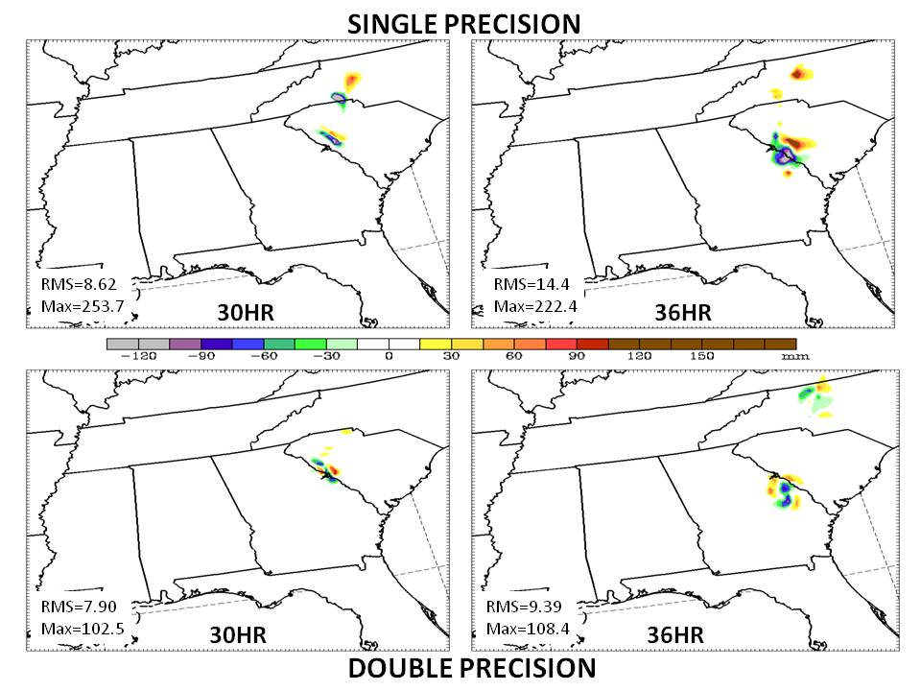
Double Precision?

