Slide 1
Review

Slide 2
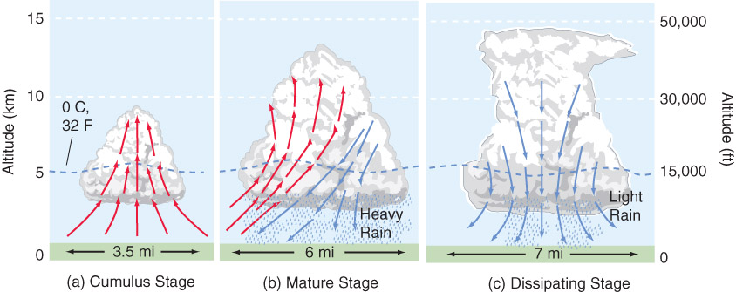
1) Briefly describe the three stages of thunderstorm development.
All updrafts
Updrafts & Downdrafts
All downdrafts

Slide 3
2) What is required for a thunderstorm to be considered severe? If it is severe, who releases warnings and/or surveys the damage for storm ratings? How are tornadoes rated?
Severe: 58 mph winds, 1 inch hail, tornado/funnel
NWS releases warnings, surveys damage
Tornadoes currently rated on the Enhanced Fujita scale, based on damage accounting for different construction types to estimate wind speeds

Slide 4
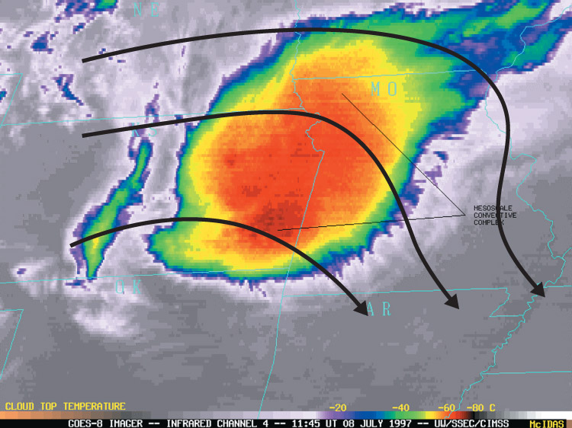
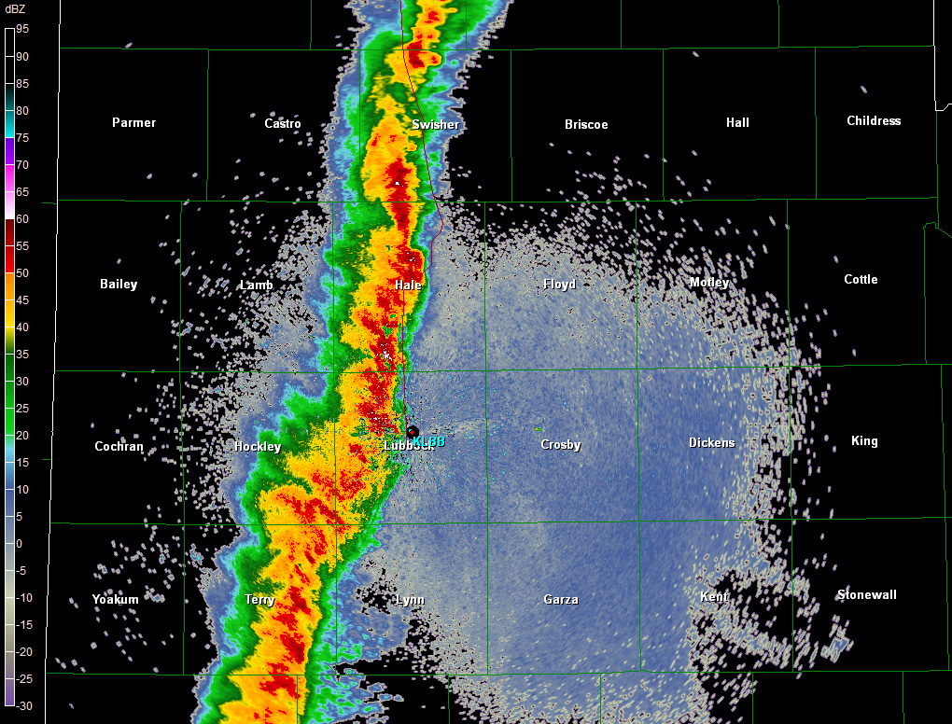
3) What is a multicell storm? What different modes did we talk about and how are they different?
Cluster of cells in different stages in the same region
MCS – organized multicell storms, wind risk
MCC – roughly circular
Squall Line – roughly linear
Bow Echo – curved deviation from linear, wind threat
Derecho – extremely severe, long lasting squall line, wind threat

Slide 5
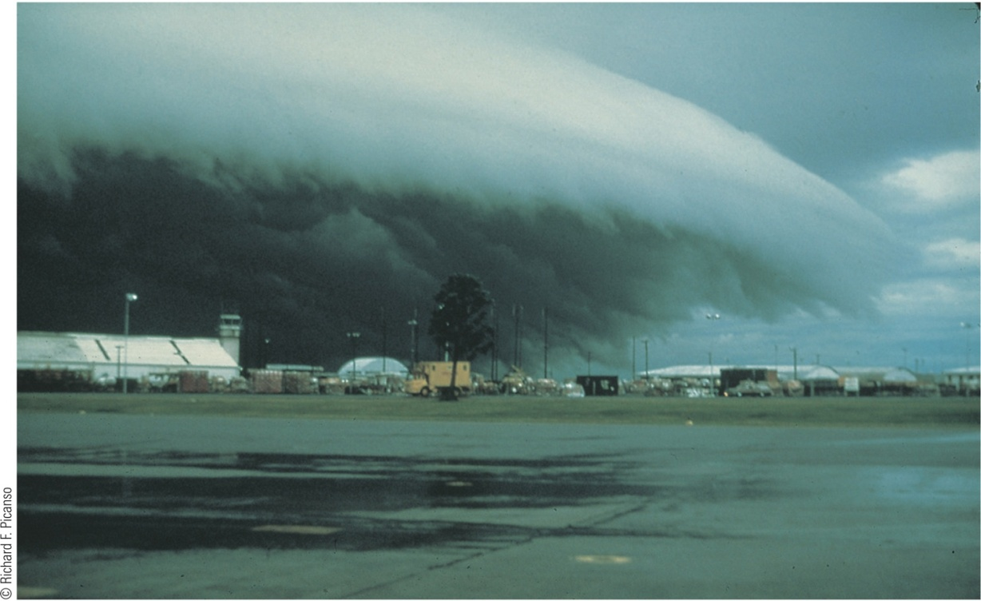
4) What is a gust front? Why do gust fronts matter (what other things do we associate with gust fronts)? How is this different than a microburst?
Gust front: cold outflow air from a thunderstorm
Can initiate more storm cells (can organize convection), shelf clouds, haboobs, strong straight-line winds
Microbursts are smaller and less sustained.

Slide 6
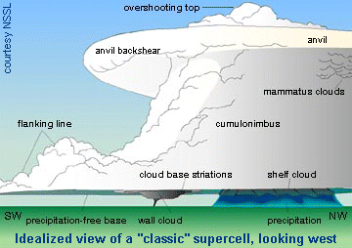
5) Describe the overall structure of a supercell. How do the different types vary? Where would you expect any tornadoes to form? What other risks are there?
LP – no rain in updraft, high cloud base
HP – rain obscuring the updraft
Classic – between LP and HP
Tornadoes form in the updraft – in the mesocyclone, under the wall cloud
Flooding, hail, strong winds, lightning

Slide 7
6) How can you tell the distance to a lightning flash?
Count the seconds between visible flash and thunder
Divide by 5
Results in the miles to the flash

Slide 8
7) Briefly describe the stages of a tornado. What are most tornadoes rated? Which do the most damage?
Organizing – funnel and debris cloud
Mature – peak intensity, often largest
Rope/Dissipating – rope-like, lose of warm buoyant air
Most tornadoes: EF0-EF1
Most damage: EF4-EF5

Slide 9
8) What scale is used to rate tornadoes? What are some of its limitations?
Enhanced-Fujita scale
EF scale measures the structure damage, NOT the wind speeds
Limitations:
Tornadoes don’t always hit structures
Building codes vary
Debris may damage structures too, not just the wind
Surveyors are subjective
Can’t verify the ratings with wind speed data, need mobile radars for this

Slide 10
9) Briefly describe the weather forecasting methods we discussed.
Persistence – tomorrow = today
Climatology – tomorrow = what average weather for tomorrow’s date is
Trend – whatever is upstream will be advected downstream (short term forecasts)
Analog – whatever most similarly happened in the past will happen again
NWP – computation of equations to determine forcings and resulting weather

Slide 11
10) What are the steps in running a weather model? What does each one give us? What are the main error sources?
Data assimilation – find the most likely state given observations and previous model
NWP – calculates the equations of state at each grid point
Post processing – creates images, statistics from the model output
Interpretation – the human factor, how well did the model do?
Error: physics, initial conditions

Slide 12
11) What are some of the steps/tools forecasters use in the weather analysis phase? What do these different tools reveal to a forecaster?
Observations
Weather maps (surface and aloft)
Reveal what is ‘actually’ going on, so they don’t rely just on models
How are the models currently different from reality? Says something about if the model is realistic or not

Slide 13
12) What are some of the ways we can investigate past climates? What are some of the larger natural impacts on climate? What about anthropogenic?
Tree rings, ice bubbles, carbon dating, sediment
Natural: Solar cycles, volcanic activity, current disruption, movement of plate and land surfaces
Anthropogenic: Urban heat island, land surface changes, emissions

Slide 14
Chapter 11
Needed for intense thunderstorms: instability, lifting, wind shear
Most thunderstorms – weak single/multi-cell
Highest concentration of severe threats – supercells
Lifecycle
Cumulus – updrafts
Mature – both updrafts and downdrafts
Dissipating – downdrafts

Slide 15
Severe requirements
58 mph winds
1 in hail
Tornado/funnel
Mesoscale Convective Systems – wind produces
Squall line
Mesoscale Convective Complex
Gust front
cool, outflow air
Shelf cloud, haboobs
Can aid in the production of new cells
Downburst – localized downdraft
Microburst – small, short-lived downdraft

Slide 16
Supercells
Most intense land-based convection
Characterized by mesocyclone (rotating updraft) and strong vertical wind shear
Abundant severe-weather producers
Overshooting top –clouds above the tropopause due to a strong updraft
Tropopause co-located with the anvil
Wall cloud – lowering in the updraft due to inflow into the storm, occurs in the “hook” of the storm

Slide 17
Supercells
Characterized by amount of precip around the updraft
High precipitation: obscured base, obscured tornadoes, scud clouds, hail
Low precipitation: rain-free base, typical of drier environments (dryline, upslope), low tornado threat
Classic: between Low and High precip supercells

Slide 18
Floods – largest toll on life, more rain for longer time = more likelihood of flooding
Lightning
Charging in cloud from collisions of different precip particles, especially when ice is involved
Stepped leader – initial part of a flash
Return stroke – occurs if leader reaches the ground
Thunder – the shock wave from the pressure changes associated with the high temperature of the lightning
Distance to lightning (miles) = seconds between flash and thunder / 5
Bolt from the Blue – lightning that strikes the ground from the side of the cloud, not the bottom
More IC’s than CG’s

Slide 19
Tornadoes
Violently rotating column of air in contact with the ground
Funnel – one that does not reach the ground
Most formed by supercells in a lowering of the wall cloud, short-lived, less than 1 mile wide
Tri-state Tornado – longest path recorded (MO, IL, IN)
El Reno – largest diameter recorded
Largest outbreak – SE in late April 2011
Joplin, MO 2011 - costliest

Slide 20
Tornadoes
Stages
Organizing – funnel + debris cloud
Mature – peak intensity, typically largest size
Shrinking / Rope – lose warm inflow
Typically cannot be seen with the national radars – they show the mesocyclone not tornadic circulations due to their resolution
Tend to form in storms moving to the right of average motion

Slide 21
Tornadoes
Fujita scale – developed to rank tornados based on max damage observed
most tornadoes rated as weak (F0-F1)
Most deaths in violent tornadoes (F4-F5)
Enhanced-Fujita scale (2007) – takes different types of structures into account before ranking the damage
Tornado Alley – region in the Southern Plains were the highest concentration of tornadoes occur on average

Slide 22
Tornadoes
Dixie Alley – region with the most tornado deaths on average
Harder to spot – typically in HP supercells, hills and trees
Happen more often overnight than in other locations
Fast moving
High population density as compared to the plains
Large number of manufactured homes

Slide 23
Tornado structure – low pressure at center, strong inflow at surface, upward motion in vortex, can have multiple vortexes around the periphery
Highest threat – flying debris
Watch – favorable conditions for given weather (hours before)
Warning – given weather indicated or observed, immediate action
Safest place – indoors, underground, away from walls/windows
Landspout – non-supercell tornado, usually short-lived, rapidly formed
Waterspout – non-supercell rotation over water

Slide 24
Chapter 13
Persistence forecast – uses repeat of today’s weather
Climatology forecast – uses average weather for a given day of the year
Trend forecast – uses direct advection of upstream weather
Analog forecast – uses historic, similar case
Nowcasting – forecasting immediate weather changes (few hours), observation based
Numerical Weather Prediction – computer models, solutions of governing equations

Slide 25
NWP
Analysis
Combination of previous forecast and observations (data assimilation)
Tries to find the most likely state of the atmosphere
Prediction
Solutions to equations at grid points
High use of computing power
Deterministic: single forecast
Probabilistic: many deterministic forecasts ran, ensemble (mean and probabilities) used, expresses the uncertainty of the analysis and the solution
Errors: initial conditions and physics of the model

Slide 26
NWP
Post-processing
Graphics
Statistical bias of model (MOS – model output statistics)
Eventually human interpretation
Comparing to observations – know what data / interpretations of the atmosphere we can use

Slide 27
Chapters 14/15/16
Climate – lots of controlling factors!
Classified on the Koppen Scheme (temperature pattern, when rainfall happens)
Lubbock is midlatitude, steppe, semi-dry
Globally these line up with the global wind pattern
Changed throughout history, our ability to monitor it has improved greatly in the past hundred years

Slide 28
Past climates and how / why they change studied through things like ice cores, fossils, sediment, tree rings, pollen, radiocarbon dating
Natural impacts
Orbit (Milankovitch cycles – precession, obliquity, eccentricity)
Solar changes
Tectonics (movement of the crust)
Volcanic activity (aerosols can reflect incoming radiation)
Asteroids
Sea levels and disruption of currents

Slide 29
Anthropogenic concerns
Enhanced greenhouse effect (CO₂) – global warming
Increasing Earth temperatures
Increased CO₂ since Industrial Revolution
We help produce CO₂ that wouldn’t be in the environment otherwise
We can model impacts to prove that it is likely that extra human production of CO₂ has aided in the increased temperature
We cannot create another Earth and test the theory just like we cannot change the entire atmosphere to create/destroy a tornado, so there is uncertainty in these models, but they describe things to the best of our current understanding
Air pollution – acid rain
Land surface changes
Desertification
Urban heat island

Slide 30
IPCC – Intergovernmental Panel on Climate Change: developed different scenarios / mitigations and researched possible impacts globally
Impacts if temperatures increase by a few degrees globally
Elevated extinction threats of species
Less redistribution of energy from meridional motion
Higher probability of extreme events (large heat waves, etc.) but no conclusion on hurricane activity

Slide 31
Mitigation – limiting emissions to lessen the worst case scenario
Adaption – adjusting our society to better handle changes in climate
Kyoto Protocol – attempt to limit emissions
Copenhagen Accord – attempt to limit warming to 2 C
Carbon trading – limits overall emission
Carbon tax – charges per unit of emission
Interest in Green Renewable Energy (Wind, Water, Solar)
Geoengineering – anthropogenically modifying the environment to counteract anthropogenic changes

