Slide 1
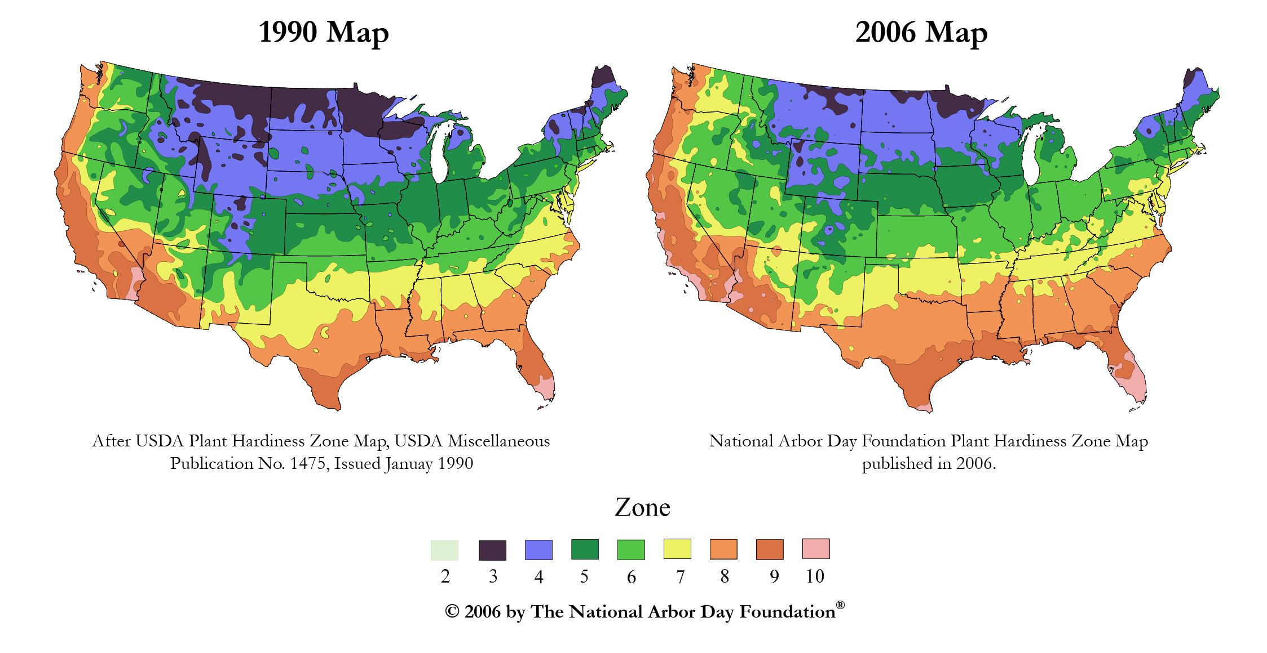
Past, Present, and Future Climate
Chapters 14-16
ccrm.vims.edu

Slide 2
Redefining Climate
Climate is the long term behavior:
Over a defined location
For a defined time
Of averages and extreme variables
Climates usually remain the same over the course of a lifetime, but they have changed a lot over Earth’s lifetime.

Slide 3
Climate Controls
Several processes “control” climate → they change or maintain it.
Latitude
Elevation
Topography
Water
Prevailing winds
Natural events (volcanic eruptions, earth’s orbit)
Human activities (building cities, burning fossil fuels)

Slide 4
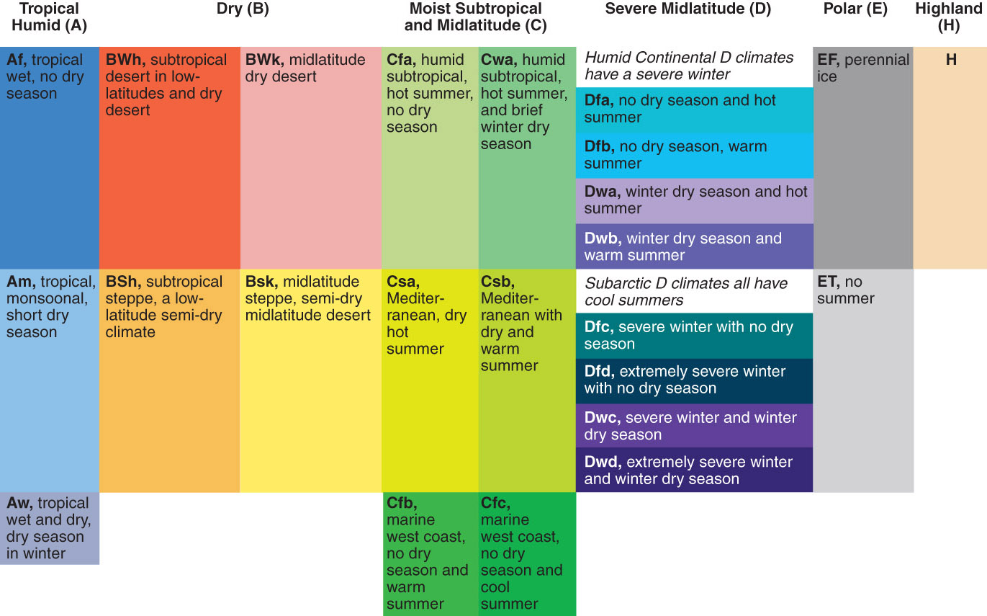
Climate Classification
We use the Koppen Scheme to define Climates:

Slide 5
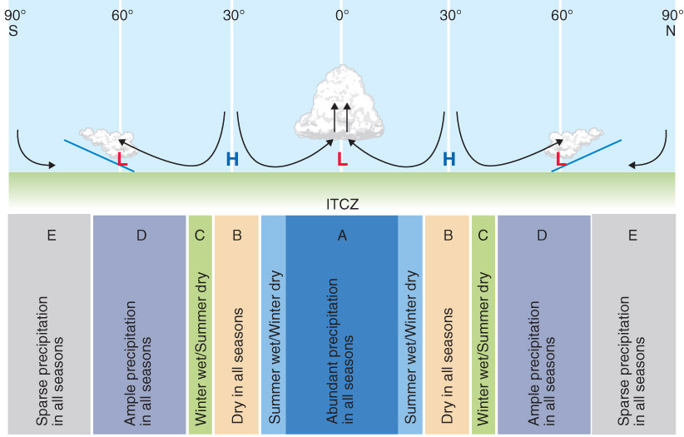

Slide 6
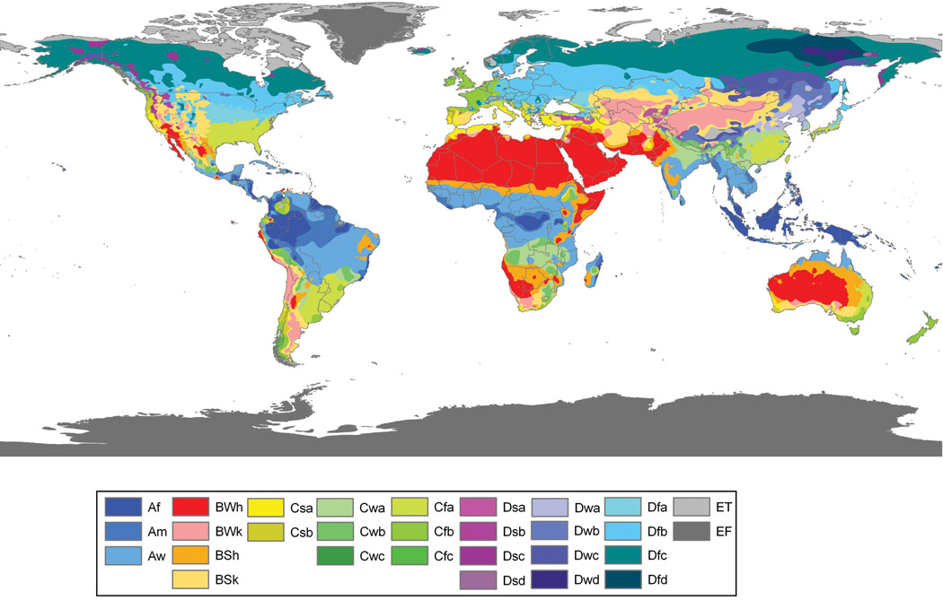
Hasn’t always been this way…

Slide 7
Past Climate
Climate has changed since the beginning of Earth ~4 billions years ago
Humans have been around ~2 million years
We have only lived during a very small percentage
Good world-wide measurements only since 1970’s (satellite)
Good recorded temperature measurements world-wide since 1850’s
Written record dates to 484 BCE (Iron Age) – freeze dates, river heights, disease outbreaks
Oral tradition before that

Slide 8
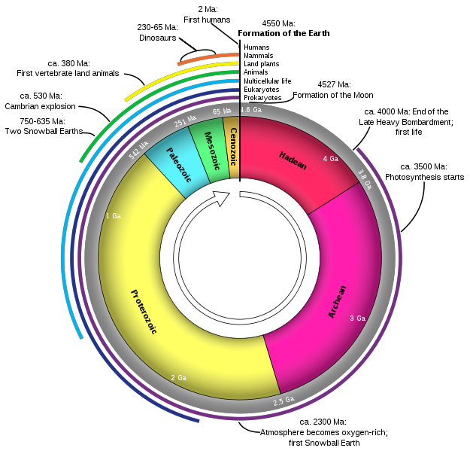

Slide 9
Paleoclimatology
The study of climates of the distant past and the causes of their variations.
How do we investigate?
Ice cores, types of fossils, marine sediment, etc
Tells us amount of CO₂ and O₂ in the atmosphere
More recently
Tree rings (precipitation / temperature records)
Pollen sediments
Radiocarbon dating

Slide 10
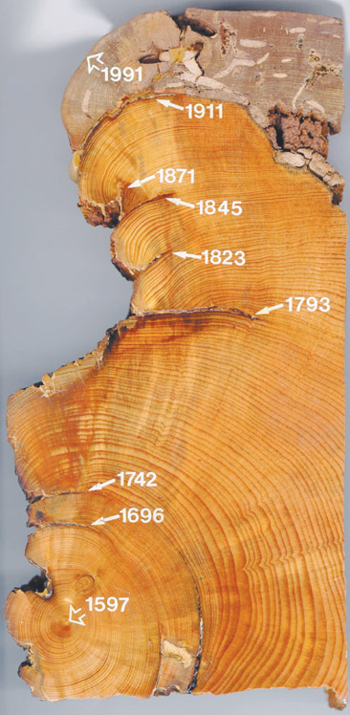
Some Examples
Tree rings: Dendochronology
Tree’s ring width indicates how fast the tree grew during a particular time period.
Growth rate is a function of rain/temperature
Not only do we know how long the tree has been around, but we can also infer precip patterns
Varies by species (rain/temperature)

Slide 11
Some Examples
Isotopes: Radiocarbon Dating and Uranium.
Look at the ratio of isotopes (which have a specific half life). Based on the decay of the isotopes, we can date organic matter back 50K years (with 15% uncertainty) and rocks back to ~4.5 billion years (thanks to uranium).
Pollen: The types of sedimented pollen in lakes varies with which type of tree grew well that year in those conditions
Different trees = different climates = different temp/precip patterns
Ice cores: Air bubbles trapped in glaciers and ice sheets provide a record of the concentration of atmospheric gases.

Slide 12
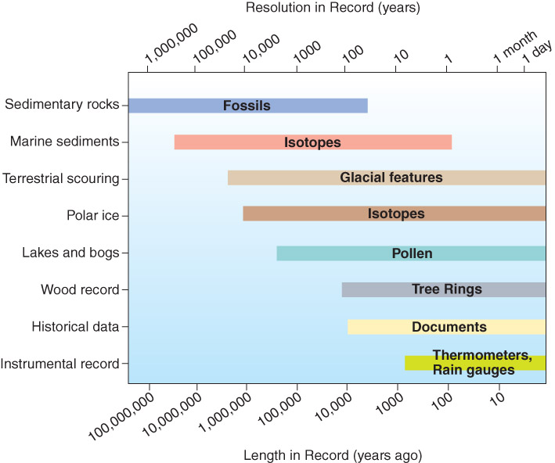

Slide 13
Causes of Global Climate Change
Earth’s Orbit
Solar radiation changes
Tectonics
Volcanic activity
Asteroid impacts
Sea level falls
Changes in currents
Humans

Slide 14
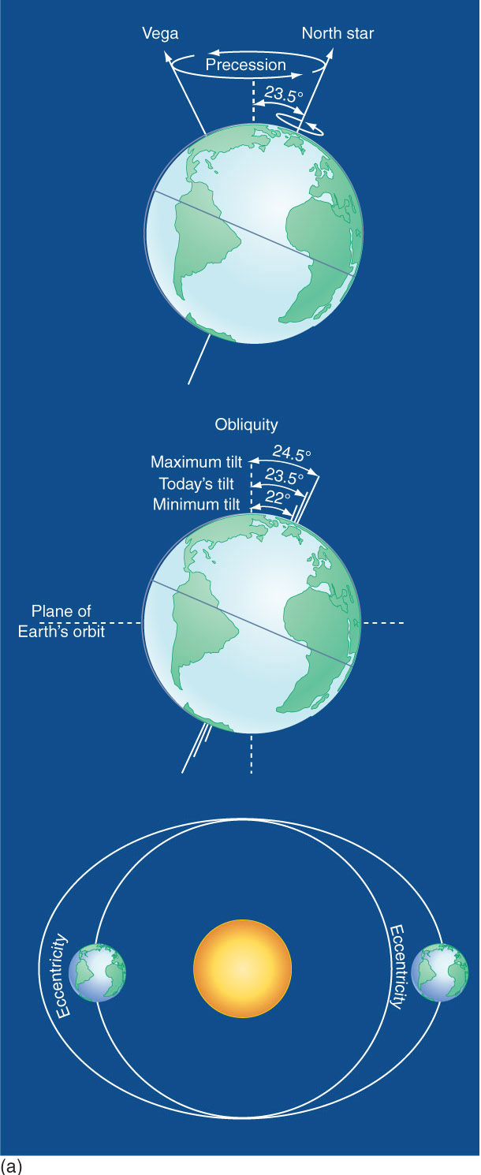
Milankovitch Cycles
Precession: wobbling on the axis https://en.wikipedia.org/wiki/Precession#/media/File:Gyroscope_precession.gif
27,000 years
Obliquity: Tilt of Earth
41,000 years
Moves from 22 to 24.5 degrees
Eccentricity: Shape of orbit
100,000 years
Perihelion can align with summer

Slide 15
Plate Tectonics
Definition: Modern theory of continental movement. Earth’s crust is broken up into plates that “float around” on the molten rock beneath.
The movement of these plates creates seismic and volcanic activity.
Over millions of years, these plates move to different latitudes, thus affecting climate.

Slide 16
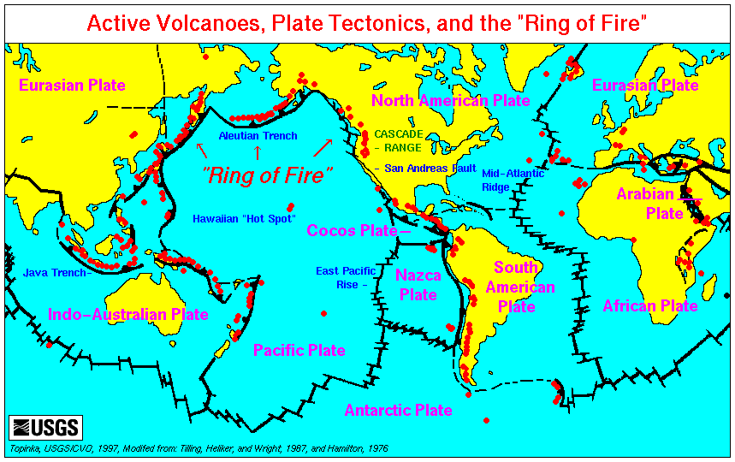

Slide 17
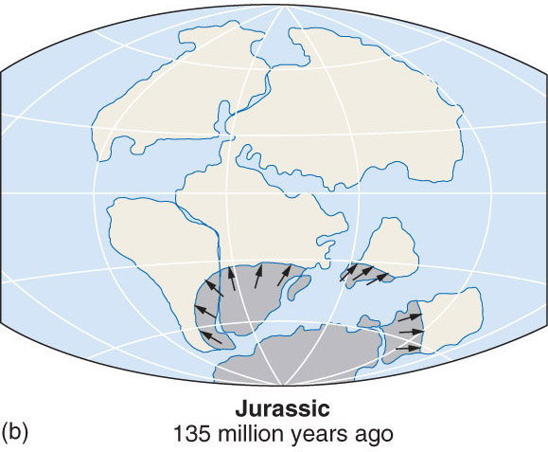
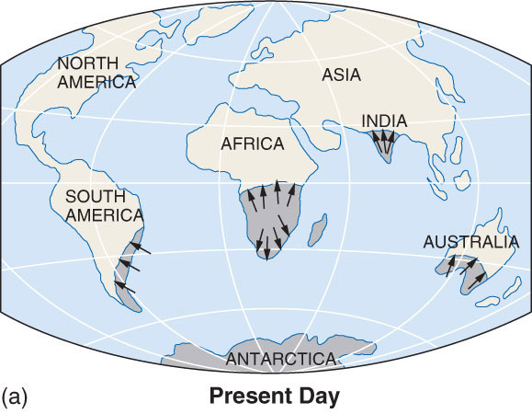
Plate Tectonics

Slide 18
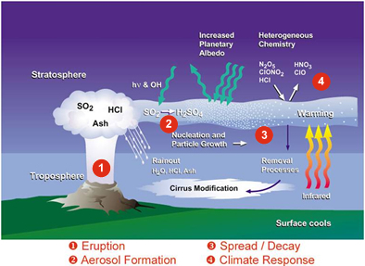
Volcanic activity
Amount of particles released into stratosphere
Year without a summer: 1815 with the eruption of Tambora.
Resulted in global cooling and famine.

Slide 19
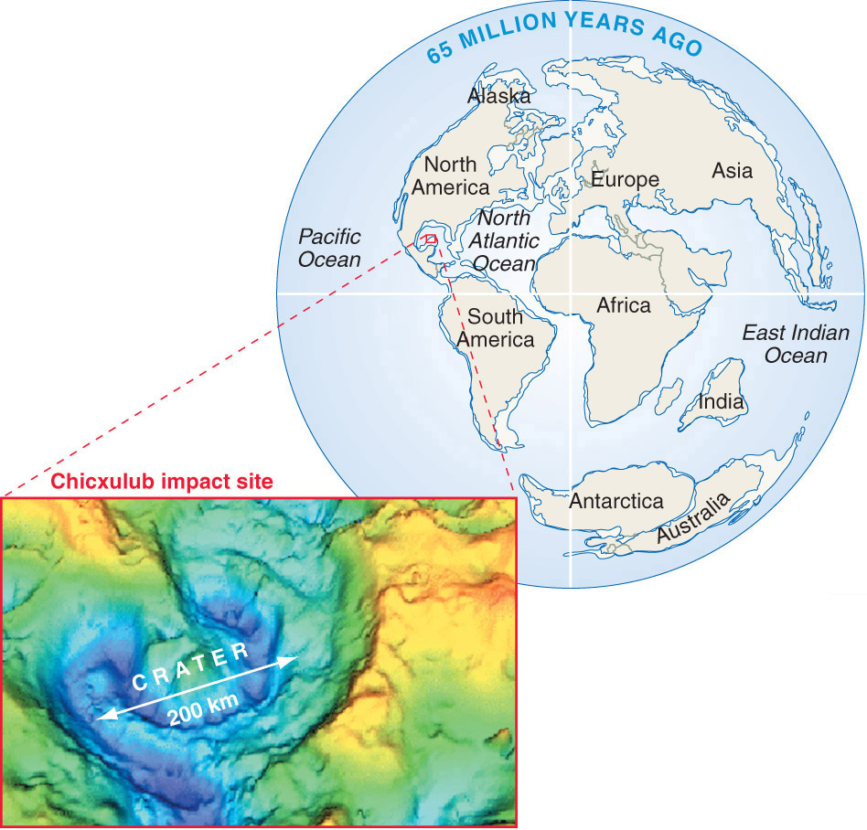
Asteroid Impacts
Can cause cooling of global climate and wide spread extinctions.

Slide 20
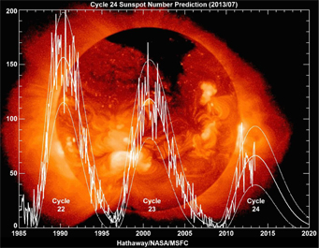
Even more…
Variability in received solar radiation
Sunspot activity (or lack of → Mauder Minimum) may have been responsible for the Little Ice Age from 1400-1850.
11 year cycle as the sun flips its magnetic poles
Currently smallest cycle in 100 years!
Peak activity
More Northern Lights
Disruption of radio waves
Spots themselves are cool
Increased magnetic activity
http://www.skyandtelescope.com/astronomy-news/the-weakest-solar-cycle-in-100-years/
http://www.spaceweather.com/

Slide 21
Even more…
Changes in ocean circulation patterns.
The melting/freezing of large ice sheets can disrupt the “normal” circulation patterns.
Ex: Disruption of Gulf Stream to Europe causes cooler temperatures over Europe

Slide 22
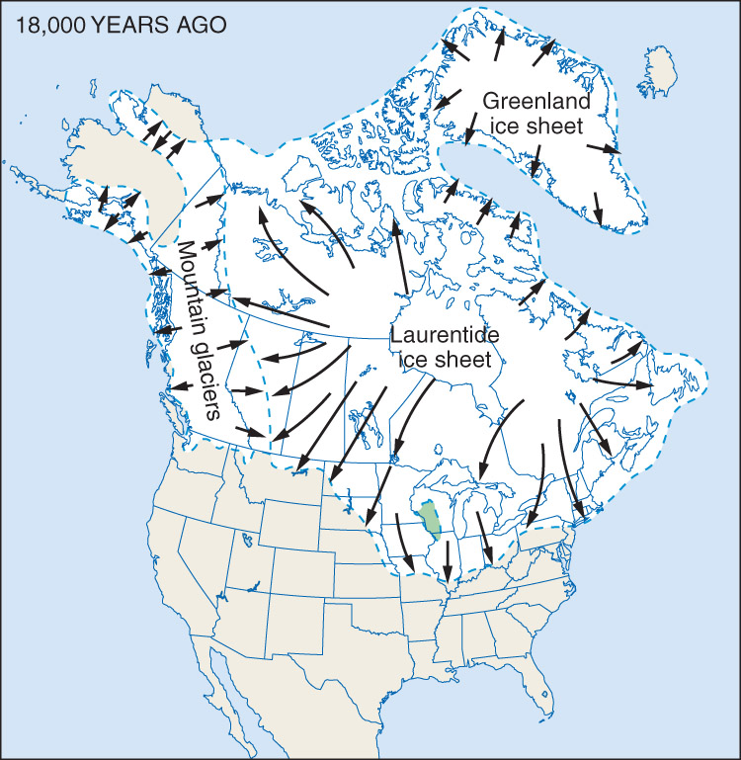
Changes in ice sheets
High albedo (reflective)
Limits the amount of incoming shortwave radiation that can be absorbed by the Earth
Keeps Earth cooler

Slide 23
Human (Anthropogenic)
Goes beyond the enhanced greenhouse effect (adding CO₂ through the burning of fossil fuels).
Humans affect the climate in several ways:
Air pollution
Gases, aerosols, acid rain, CFCs
Changing Land Surfaces
Desertification, Urban Heat Islands
Global Warming

Slide 24
Air Pollution
Through many different processes (industry, transportation, etc) we release harmful gases and aerosols into the atmosphere.
Examples include
Carbon Monoxide (the incomplete burning of fossil fuels
Lead (treated gasoline…less of a problem now)
Oxides of sulfur → Acid rain
Oxides of Nitrogen → Smog
Hydrocarbons → Smog

Slide 25
Air Pollution
We’ve made some improvements:
But we still have along way to go. Many of these gases (like smog) affect respiration, while CO can lead to less oxygen in your blood, and lead hurts brain function.
Pollutants can indirectly hurt climate…

Slide 26
Acid Rain
Sulfur Trioxide combines readily with water vapor to form droplets of sulfuric acid.
This creates acid rain
We measure the acidity of a substance based on the pH scale:
Pure water is neutral @ 7
Below 7 is acidic
Above 7 is base
The pH of rain is typically ~ 5.5 (slightly acidic)

Slide 27
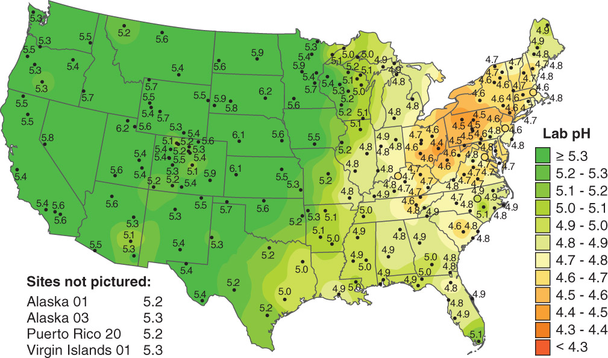

Slide 28
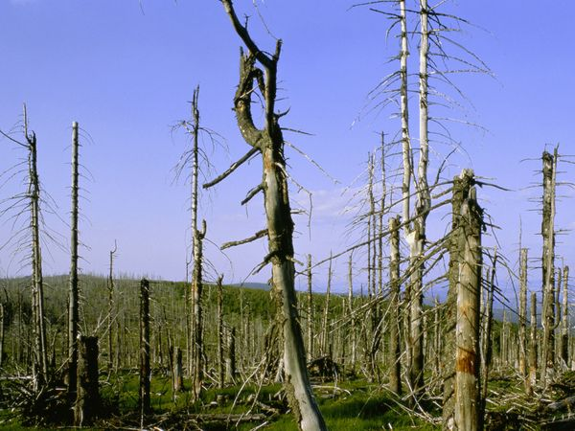
Acid Rain
The acidic rainwater will accumulate in lakes and streams. This hurts aquatic life.
It gets absorbed into the soil and may be hurting coniferous forests.
http://environment.nationalgeographic.com/environment/global-warming/acid-rain-overview/

Slide 29
Ozone Hole
There is a seasonal drop in the concentration of ozone over the polar (mostly Antarctic) regions.
Related to polar stratospheric clouds (or nacreous clouds, natural), CFCs (anthropogenic) and the sun.
As the solar angle starts increasing in the southern hemisphere, we see the reactions rapidly increase and deplete the ozone.
This is the “hole” in the ozone layer we see every October.

Slide 30
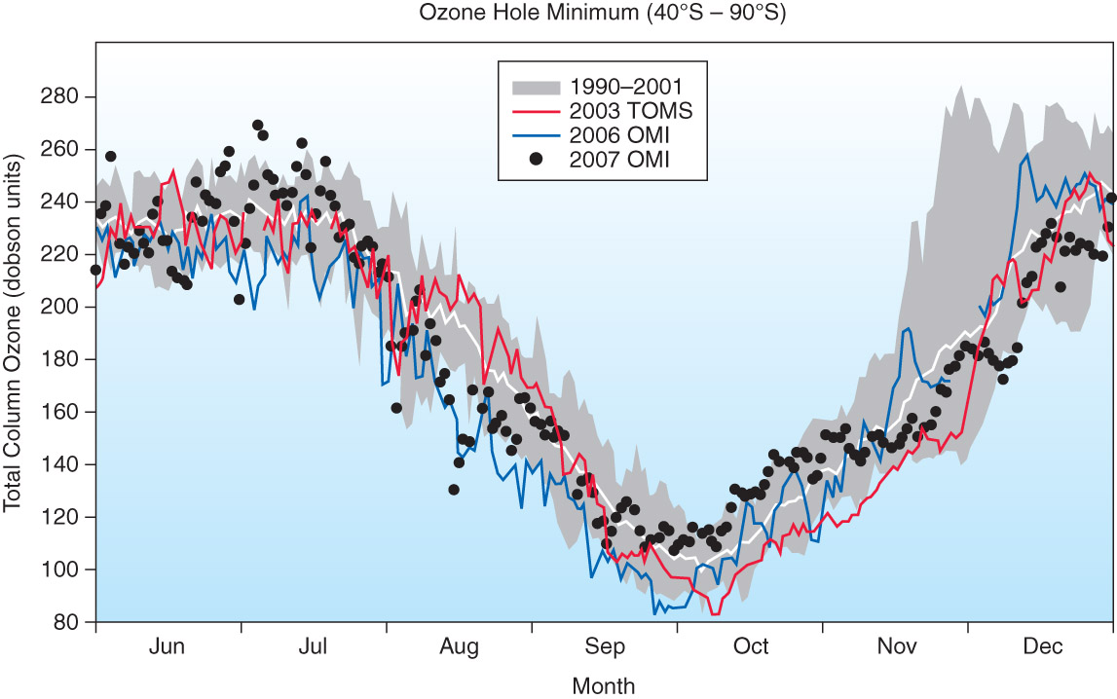

Slide 31
Ozone Hole
The emission of CFCs has been greatly reduced thanks to global bans.
However, concentrations are just now peaking; CFCs will likely remain in the atmosphere through the end of the century.

Slide 32
Changing Land Surfaces
The misuse of water for irrigation and other purposes has led to desertification – the spreading of a desert region due to climate and / or human influences.
Examples:
The Sahel (sub-Sahara) Region. Anomalous lack of rainfall (climate) and overgrazing (human) lead to desertification and famine
The Aral Sea in central Asia

Slide 33
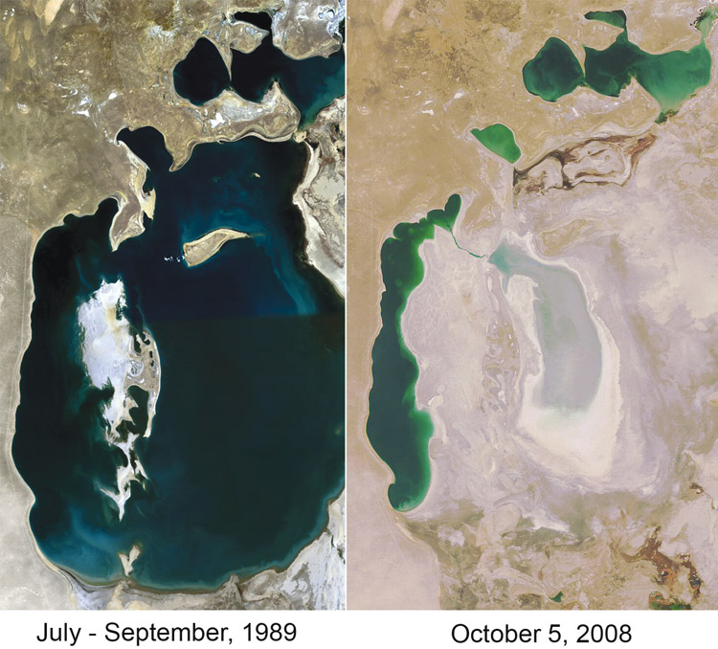

Slide 34
Changing Land Surfaces
Urban Heat Island – the effect of temperatures within cities being warmer than the surrounding rural environments.
Increase of absorptive surfaces (asphalt, roofs, etc), heat from industrial activity, lack of transpiration from plants, all contribute to warmer city temperatures.

Slide 35
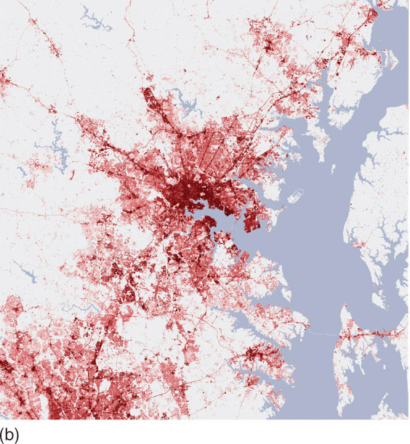
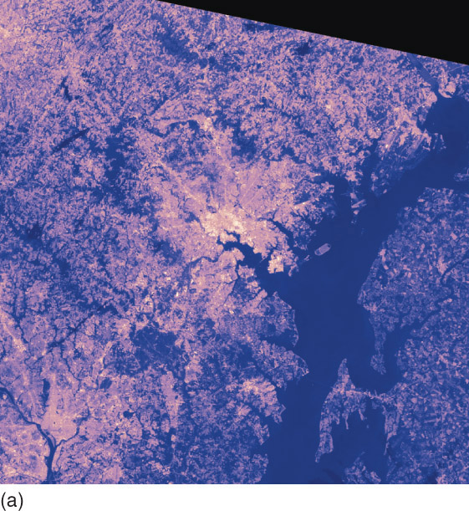

Slide 36
Airplane Contrails
Clouds that form from warm, humid exhaust mixes with the cold, dry air aloft
Can increase cloud cover if there is a large amount of air traffic
COULD cause lower daytime temperatures, warmer nighttime temperatures, highly debated, only one scientific study supports this and it was not statistically significant

Slide 37
Global Warming
Refers to the increase of temperature across the global due to the enhanced greenhouse effect.
The enhanced greenhouse effect is an above normal heating of the planet as a result of increases in atmospheric CO₂ since Industrial Revolution
Two things we have to prove:
The Earth is warming
It’s warming because of more CO₂

Slide 38
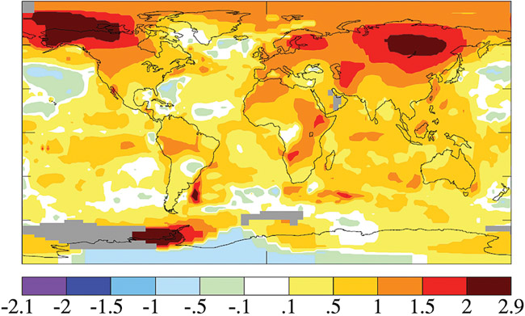
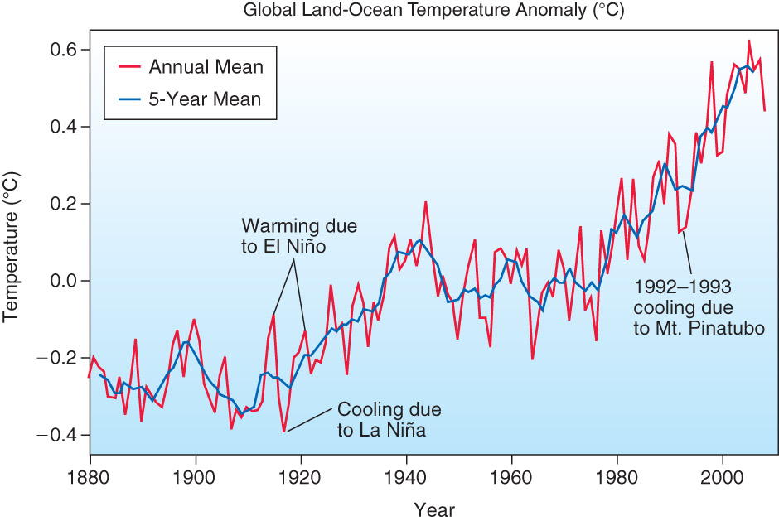
A Warming Earth – 1955-2005
Years of scientific research have unequivocally shown the earth is warming at a faster rate than before.

Slide 39
A Warming Earth
The global average temperature increased 0.59° between 1955 and 2005, but warming has not been universal across the globe.
We see other evidence of increasing global temperatures:
Glacial Retreat
Reduction of ice and snow coverage
Rise in sea level (1.7 inch increase from 93-08)
Expanded growing seasons.

Slide 40
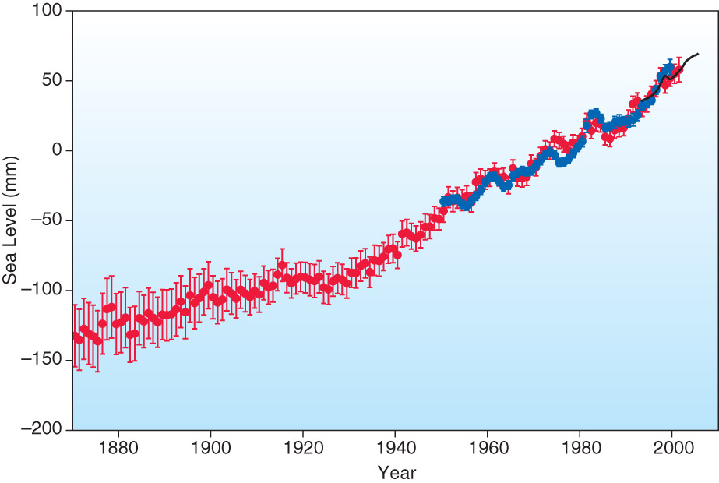
Sea level rise come from thermal expansion AND the melting of LAND ice. Sea ice already contributes to the height of sea level.

Slide 41
Carbon Dioxide Observations
Observations from multiple locations indicate that CO₂ levels are increasing.
We base our knowledge of previous CO₂ levels on the things we discussed previously (ice cores, etc).
We know we are contributing to the increase.

Slide 42
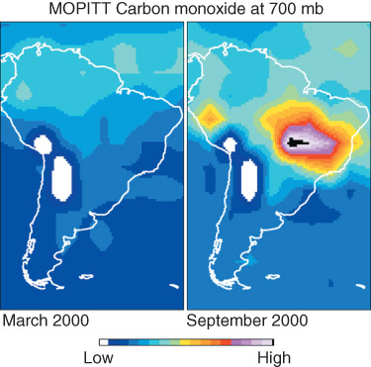
Burning of fuels/plants contributes more CO₂
Increased vegetation and algae decrease CO₂

Slide 43
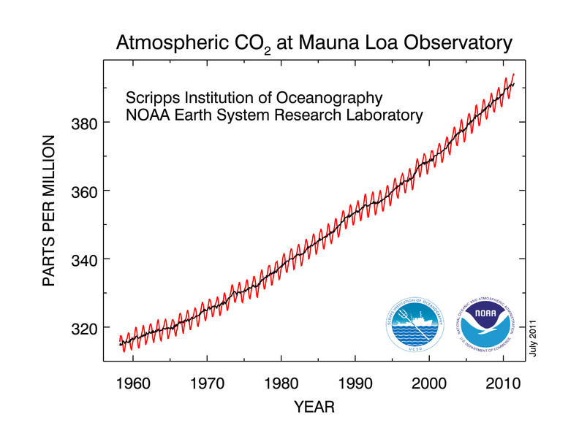

Slide 45
GCMs: Global Climate Models
We can also run computer models to predict future climates.
These models are similar to weather forecasting models, but they have much coarser resolutions and take into account other “spheres.”
These models are far from perfect, but can be used (in addition to observations) to predict future climates.

Slide 47
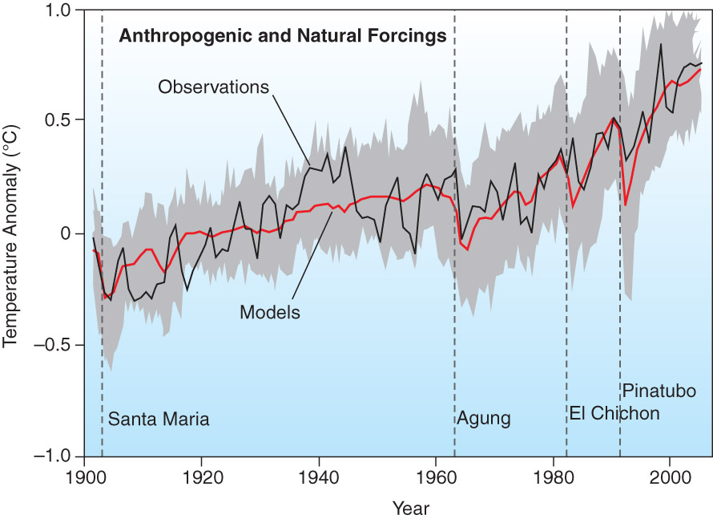

Slide 48
IPCC
Taking into account GCMs and observations , the IPCC (Intergovernmental Panel on Climate Change) has issued four reports since 1991 on climate change.
The have developed several different scenarios of future climates based on the amount of global warming and efforts to mitigate it.

Slide 49
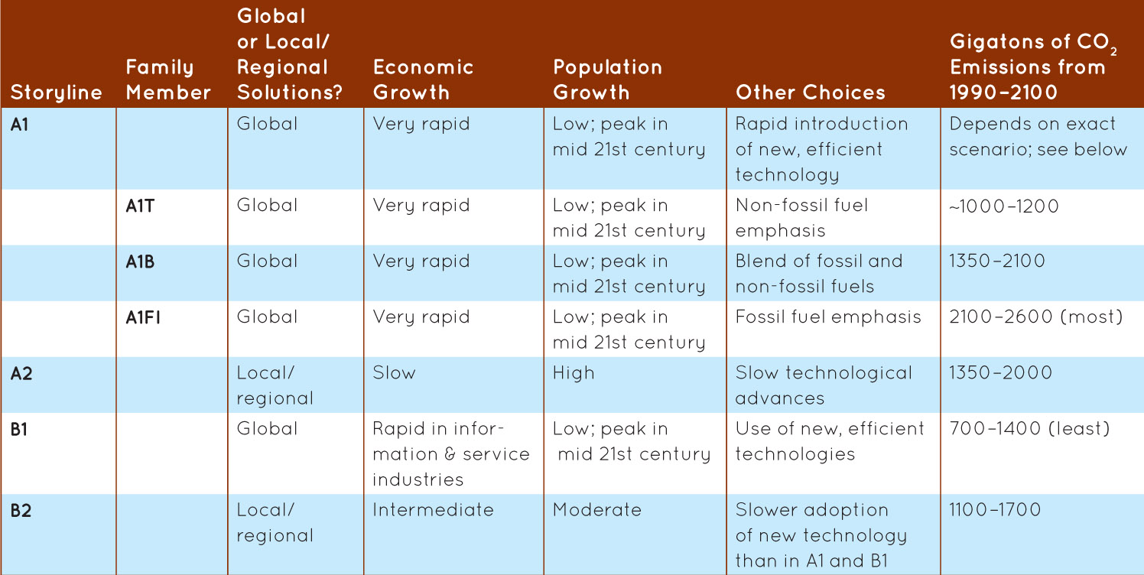
IPCC

Slide 50
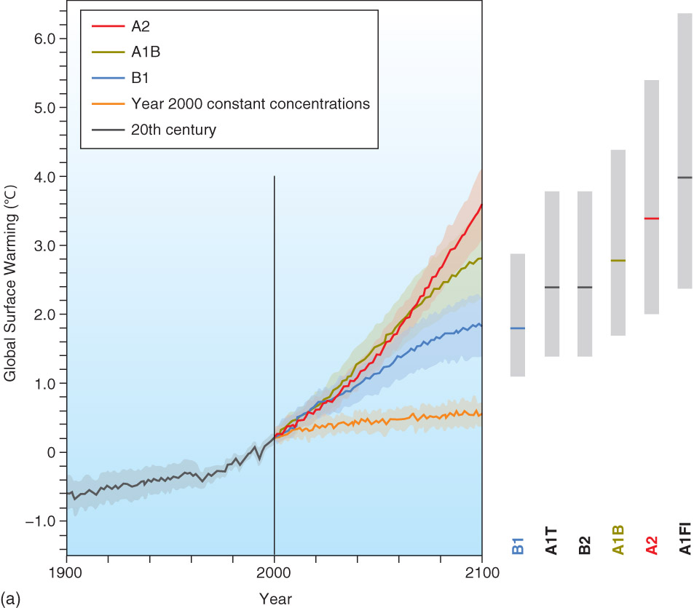

Slide 51
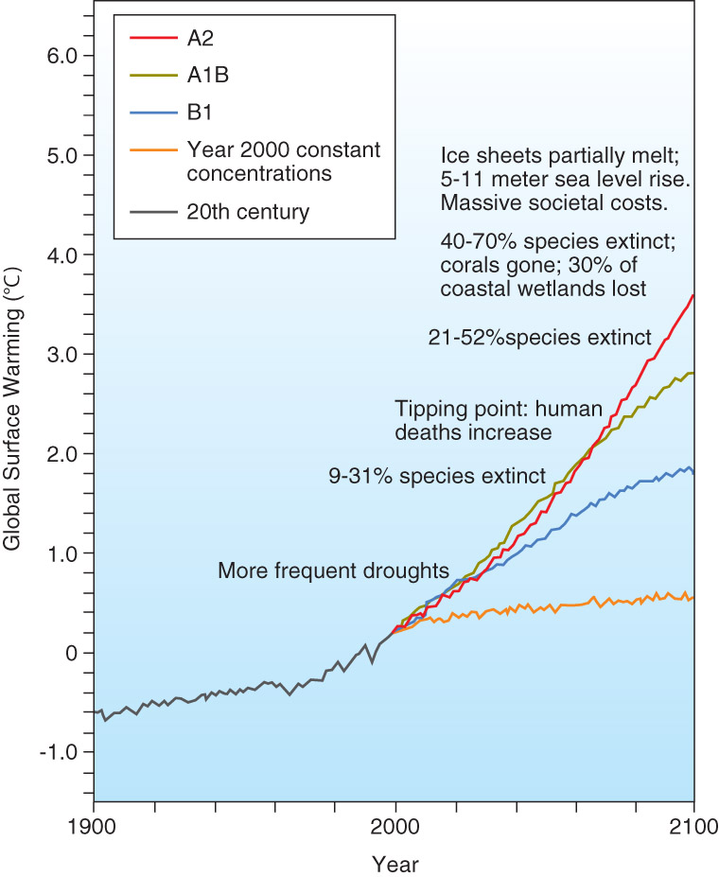

Slide 52
Possible Effects
20 to 30 % of all species have an elevated risk of extinction if global temps rise 1.5 to 2.5 C
40 to 70% if global temps rise above 3.5 C
Meridional overturning circulation will slow down (troughs and ridges, less energy balance)
Extreme events will occur more readily

Slide 53
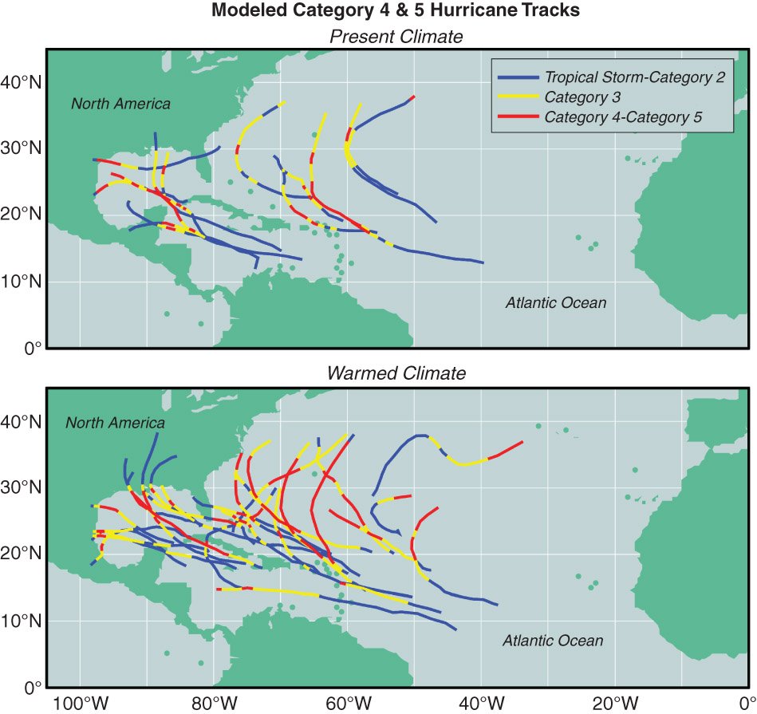

Slide 54
Possible Effects
However, GCMs have too coarse a resolution to “see” hurricanes.
Still much debate on the impact of a warmer earth on hurricane activity.

Slide 55
What Now?
Mitigation: a response that seeks to limit the increase in greenhouse gases so that the worst impacts of global warming do not occur.
Adaptation: A complementary societal response. Refers to steps taken to reduce our vulnerability to climate change.

Slide 56
What has been done
Kyoto Protocol
Limit greenhouse emissions by 5.2% of 1990 level
Phase 1 expired in 2012
Slight effect
Copenhagen Accord
Agrees with scientists that warming needs to be kept below 2 C.
Not legally enforceable
US to cut 17% below 2005 levels by 2020

Slide 57
What is being done
Federal regulations considered:
Carbon trading / cap – limit the total amount of carbon being released
Carbon tax – charge companies / residents / power grids by the amount of carbon released
Theoretically this money would go towards mitigation such as increased vegetation, physical trapping or research and development of alternatives

Slide 58
What is being done
Green Renewable Energy (emission-wise):
Wind – great for places with commonly high winds, only effective when there is wind, currently expensive to maintain and large investment, damaging to bat/bird populations and possibly humans
Water – great where there is running water, but historically has required dams which change the flow and temperature of the water, block migrations
Solar – great in sunny areas, easily installed, requires use of mined resources, large arrays can impact local areas
Sustainability – not just environmental, social and financial sustainability must also be considered, this is why nuclear energy is popular

Slide 59
Geoengineering

Slide 60
Should action be taken?
 | Actually at least partly anthropogenic | Not anthropogenic
Take action | Costly in the short term, mitigate future impacts | Costly, does not matter
Don’t take action | Save money in the short term, adapt to the consequences later (agriculture, energy production) | Nothing unusual happens

Slide 61
What can you do?
Reduce, Reuse and Recycle
Limit energy use from climate control, “vampire electronics”
Use less water
Practice responsible landscaping / building
Use fuel efficient vehicles wisely
Support R&D of more sustainable technologies (personally or politically)
Try to make smart choices when purchasing goods (production methods, materials, transport, etc.) and services

Slide 62
Recap
Climate – lots of controlling factors!
Classified on the Koppen Scheme (temperature pattern, when rainfall happens)
Lubbock is midlatitude, steppe, semi-dry
Globally these line up with the global wind pattern
Changed throughout history, our ability to monitor it has improved greatly in the past hundred years

Slide 63
Past climates and how / why they change studied through things like ice cores, fossils, sediment, tree rings, pollen, radiocarbon dating
Natural impacts
Orbit (Milankovitch cycles – precession, obliquity, eccentricity)
Solar changes
Tectonics (movement of the crust)
Volcanic activity (aerosols can reflect incoming radiation)
Asteroids
Sea levels and disruption of currents

Slide 64
Anthropogenic concerns
Enhanced greenhouse effect (CO₂) – global warming
Increasing Earth temperatures
Increased CO₂ since Industrial Revolution
We help produce CO₂ that wouldn’t be in the environment otherwise
We can model impacts to prove that it is likely that extra human production of CO₂ has aided in the increased temperature
We cannot create another Earth and test the theory just like we cannot change the entire atmosphere to create/destroy a tornado, so there is uncertainty in these models, but they describe things to the best of our current understanding
Air pollution – acid rain
Land surface changes
Desertification
Urban heat island

Slide 65
IPCC – Intergovernmental Panel on Climate Change: developed different scenarios / mitigations and researched possible impacts globally
Impacts if temperatures increase by a few degrees globally
Elevated extinction threats of species
Less redistribution of energy from meridional motion
Higher probability of extreme events (large heat waves, etc.) but no conclusion on hurricane activity

Slide 66
Mitigation – limiting emissions to lessen the worst case scenario
Adaption – adjusting our society to better handle changes in climate
Kyoto Protocol – attempt to limit emissions
Copenhagen Accord – attempt to limit warming to 2 C
Carbon trading – limits overall emission
Carbon tax – charges per unit of emission
Interest in Green Renewable Energy (Wind, Water, Solar)
Geoengineering – anthropogenically modifying the environment to counteract anthropogenic changes

