Slide 1
Chapter 9 Air Masses and Fronts
ATMO 1300
Summer II 2017
Notes:
Slide1.mp3
Anyone who has ever seen a surface weather map on TV or perhaps in a newspaper has seen symbols denoting a front, for example a blue line with triangles on it representing a cold front. In this lesson we will describe what a front is and the different types of fronts.

Slide 2
Air Mass
A large body of air in which there are similar horizontal temperature and moisture properties.
Properties largely acquired from underlying surface
Air masses can cover thousands of miles
Air masses form when air stagnates over one region for a long time (or moves very slowly)
Longer the air remains over an area, the more likely it will acquire the characteristics of the underlying surface
Notes:
Slide2.mp3
To understand what fronts are, you must first understand what an air mass is because a front separates different air masses. An air mass is a large body of air in which there are similar horizontal temperature and moisture properties. An air mass tends to take on the characteristics of the underlying surface, be it land or water.

Slide 3
Air Mass
Air mass over cold ground
Cold and dry… Example: winter time in Canada
Air mass over tropical waters
Warm and moist
How does water temp affect moisture?
Example: Gulf of Mexico
Notes:
Slide3.mp3
For example, if a large mass of air remains over the cold ground of northern Canada for any length of time it will tend to acquire the temperature and moisture properties of the underlying surface. In that case the air mass will be cold and dry. Dry meaning little water vapor. If an air mass remains over a large body of water for a period of time it will become more moist.

Slide 4
Air Mass
How do they acquire their temperature and moisture properties?
Temperature properties: sensible heating through conduction and eventually convection
Moisture properties: acquires water vapor through evaporation and transpiration
Notes:
Slide4.mp3
Sensible heating through the energy transfer process of conduction is how an air mass takes on the temperature characteristic of an underlying surface. An air mass acquires water vapor through the process of evaporation.

Slide 5
Why do we care?
Extremely warm air masses can lead to heat waves (see Box 9-1 in the book).
Extremely cold air masses can be just as deadly and costly.
The “clashing” of different air masses can produce regions of severe weather.
Notes:
Slide3.mp3
For example, if a large mass of air remains over the cold ground of northern Canada for any length of time it will tend to acquire the temperature and moisture properties of the underlying surface. In that case the air mass will be cold and dry. Dry meaning little water vapor. If an air mass remains over a large body of water for a period of time it will become more moist.

Slide 6
Air Mass Classification
Temperature:
Tropical – Warm, within about 30˚of equator
Polar – Cold, poleward of 60˚
Arctic – Very cold; formed over the arctic
Moisture:
Continental – Dry, formed over large land masses
Maritime – Moist, formed over oceans
(These regions can overlap!)
Notes:
Slide5.mp3
Air masses can be classified according to their temperature and moisture properties. In terms of temperature, an air mass can be warm in which case it is called a tropical air mass. A cold air mass is called a polar air mass and if temperatures are very cold it is called an arctic air mass.
In terms of moisture, an air mass can contain a little or a lot of water vapor. Dry air masses containing limited water vapor are termed continental. A moist air mass, meaning the air has a higher water vapor content is termed moist.

Slide 7
Air Mass Designation
cP = Continental Polar
cT = Continental Tropical
mP = Maritime Polar
mT = Maritime Tropical
A = Arctic air masses, much colder than other classes
First letter denotes land type (ocean or land), second letter the origin latitude (polar or tropical)

Slide 8
Source Region
A region on the earth where air masses tend to form.
Need a uniform surface.
Light winds are preferable.
Time for air to take on the temperature and moisture properties from surface
Where is a good example of a source region? Hint: think back to last lecture when discussing surface wind flow regimes around the globe
What location might be a poor source region?
Notes:
Slide6.mp3
A region on Earth where air masses form, that is to say where they acquire their temperature and moisture characteristics, is called a source region.

Slide 9
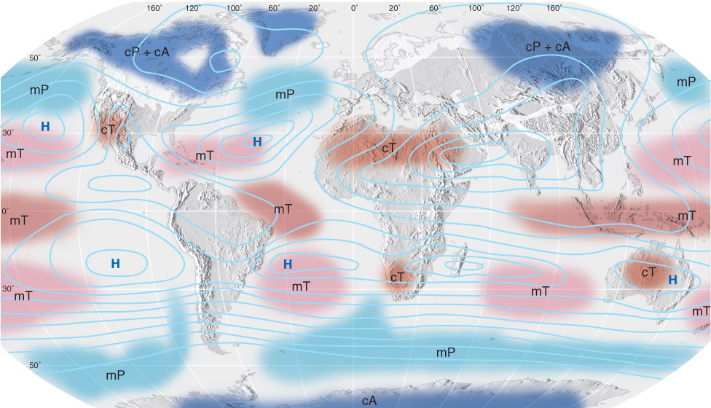
Source Regions
Fig. 9-3, p. 278
Notes:
Slide7.mp3
This map shows the major source regions of air masses affecting the United States. For this lesson we will focus on only three: continental polar, continental tropical and maritime tropical.

Slide 10
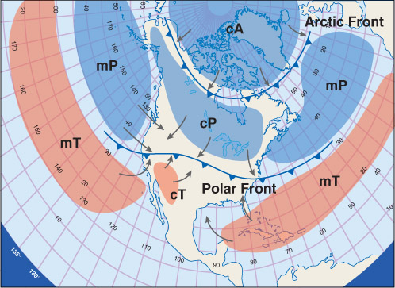
Source Region
Notice that most air masses originate under regions of surface high pressure
Stagnant air ; not much wind = little pressure gradients
Eventually
they move
Fig. 9-4, p. 279

Slide 11
Maritime Polar (mP)
Forms over the oceans at high latitudes
Moist
Cold
Can contribute to significant snowfall events in mid-Atlantic
Nor’easters
Low pressure systems draw air counter clockwise around them, bringing mP air from the Atlantic toward New England
Notes:
Slide8.mp3
Continental polar air masses, abbreviated cP, form over northern Canada and Alaska. Continental means the air mass is dry and polar means the cold air mass is cold. These air masses move southward into the United States bringing colder and drier air.

Slide 12
Continental Polar (cP)
Forms over the northern continental interior (e.g., Canada, Alaska)
Figure from apollo.lsc.vsc.edu/classes/met130
Fig. 9-6, p. 280
Notes:
Slide8.mp3
Continental polar air masses, abbreviated cP, form over northern Canada and Alaska. Continental means the air mass is dry and polar means the cold air mass is cold. These air masses move southward into the United States bringing colder and drier air.

Slide 13
Continental Polar (cP)
Winter time cP air masses are cold and dry
They require long, cold, clear nights
Strong radiational cooling allows surface temperatures to fall quickly
Can form faster over snow pack
Air above the surface is not cooled as quickly, which can lead to an inversion (temperature increasing with height)
When cP air masses are formed in the summer they are generally cool and dry

Slide 14
Arctic (A,cA)
Similar to cP, but forms over very high latitudes (arctic circle)
Dry
Extremely cold
Not very deep (less than 600 m)
Little vertical motion and little precipitation
Responsible for record cold temperatures over the mid-latitudes
Figure from apollo.lsc.vsc.edu/classes/met130
Notes:
Slide8.mp3
Continental polar air masses, abbreviated cP, form over northern Canada and Alaska. Continental means the air mass is dry and polar means the cold air mass is cold. These air masses move southward into the United States bringing colder and drier air.

Slide 15
Continental Tropical (cT)
Forms over southwest U.S. & Northern Mexico
Source region includes West Texas
Dry, limits cloud formation
Warm
Limited water bodies and vegetation limits effect of evaporation and transpiration
Notes:
Slide9.mp3
Continental tropical air masses, abbreviated cT, are warm and dry because they form over the southwestern United States and northern Old Mexico. The higher terrain in this region provides an excellent heating source.

Slide 16
Maritime Tropical (mT)
Forms over Gulf of Mexico as well as subtropical Atlantic and Pacific Oceans
Moist
Warm
Responsible for hot humid weather across the southern US during the summer
Figure from apollo.lsc.vsc.edu/classes/met130
Notes:
Slide10.mp3
Maritime tropical air masses, abbreviated mT, form over the Gulf of Mexico as well as the southeast Pacific Ocean. These are warm air masses having a higher water vapor content than continental air masses.

Slide 17
Air Mass Modification
Air masses can be modified once they leave their source region.
Temperature & moisture content can increase or decrease
Two basic modification mechanisms:
Heat / moisture exchange with the surface
Mechanical lifting (forcing)
Notes:
Slide31.mp3
Once an air mass leaves its source region the temperature and moisture properties the air mass has acquired can be modified. Temperatures as well as the moisture content in an air mass can increase or decrease. So how are air masses modified?

Slide 18
Air Mass Modification: Surface Exchange
Heat and moisture exchanges at the surface
Moisture: evaporation
Temperature: conduction
The greater the difference between the properties of the air mass and the underlying surface, the greater the exchange rate
Exchange of moisture is greatest when air mass is dry and the surface is wet
Example: cold cP air mass moves over a warm body of water, Large temperature difference allows for rapid evaporation. The moisture content is increased (dewpoint goes higher) and we get saturation and fog
Example is common over the Great Lakes (steam fog)

Slide 19
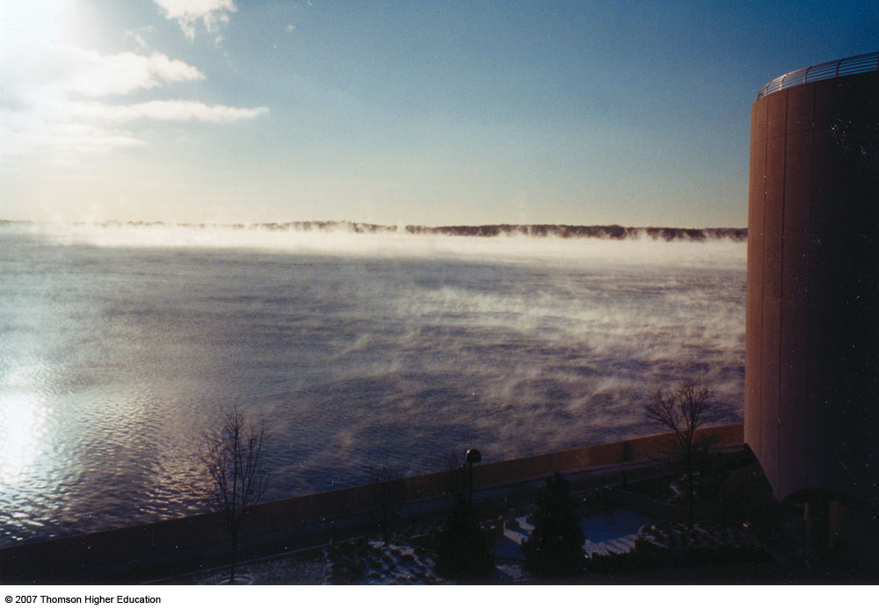
Air Mass Modification Figure from ww2010.atmos.uiuc.edu
Move over a large body of water
Fig. 9-10, p. 283
Notes:
Slide33.mp3
An air mass can also be modified when it moves over a large body of water. If the same continental polar air mass continued to move south over Texas and then out over the Gulf of Mexico, the water vapor content of the air mass would increase due to evaporation. Eventually this modified continental polar air mass over the Gulf of Mexico that is now warmer and more moist than it was over its source region may move north depending on the winds in the air mass.

Slide 20
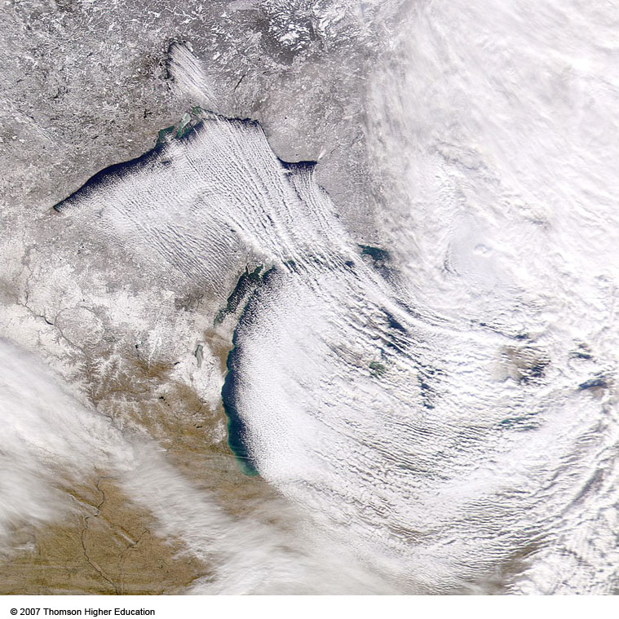
Air Mass Modification Figure from ww2010.atmos.uiuc.edu
As cold air flows over warm water, the air near the water warms and becomes unstable
This can produce tremendous amounts of lake effect snow
Fig. 9-12, p. 264
Notes:
Slide33.mp3
An air mass can also be modified when it moves over a large body of water. If the same continental polar air mass continued to move south over Texas and then out over the Gulf of Mexico, the water vapor content of the air mass would increase due to evaporation. Eventually this modified continental polar air mass over the Gulf of Mexico that is now warmer and more moist than it was over its source region may move north depending on the winds in the air mass.

Slide 21
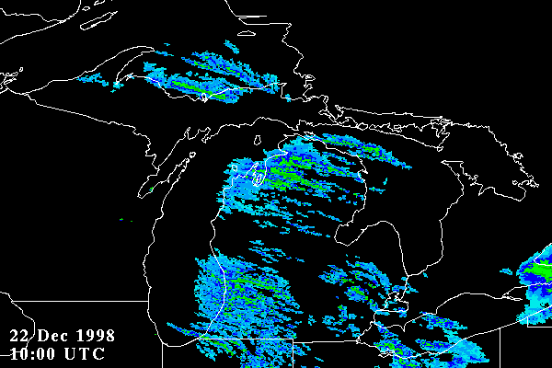

Slide 22
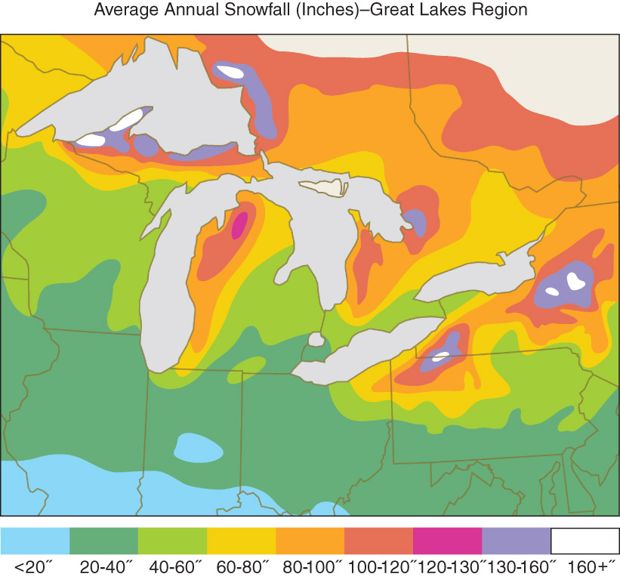

Slide 23
Air Mass Modification Figure from ww2010.atmos.uiuc.edu
Move over warmer or colder ground
Notes:
Slide32.mp3
One way is for an air mass to move over warmer or colder ground. For example, consider a continental polar air mass that has formed over southern Canada in the late fall. If this air mass moves south through the central United States and into the southern plains for example, the air mass will be moving over ground whose temperatures are warmer than in the air mass itself. Through the energy transfer process of conduction, temperatures in the lower part of the air mass increase.

Slide 24
Air Mass Modification: Mechanical Lifting Figure from www.usatoday.com/weather/wdnslope.htm
Move over a mountain range; Consider the upper Northwest coast:
Notes:
Slide34.mp3
Lastly, an air mass can be modified as it crosses a mountain barrier such as the Rocky Mountains. An air mass moving east across the western United States eventually reaches the Rockies that act as a barrier to the eastward movement of the air mass. The air is forced to rise on what is called the windward side of the mountains resulting in orographic lift or upslope flow. If the air mass contains sufficient water vapor, clouds or precipitation may form.

Slide 25
Air Mass Modification: Mechanical Lifting
Stability of the air mass can also be modified
Changing the environmental temperature profile
Increasing or decreasing the temperature of the air near the surface alters the environmental temperature profile
Notes:
Slide36.mp3
Regardless of how an air mass is modified, changing the temperature and moisture properties of the air will change the stability of the air mass. Recall that stability may change if the environmental temperature lapse rate changes. Increasing or decreasing the temperature of the air near the surface would indeed alter the environmental lapse rate.

Slide 26
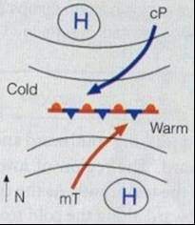
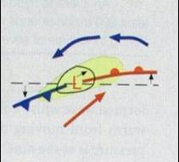
General Circulation of the Atmosphere
Remember, air flows counterclockwise around areas of low pressure. Now, combine this circulation with air masses:

Slide 27
Fronts
Air masses move from source region through advection
Air masses do not readily mix together
Front – A boundary between two different air masses
Can be hundreds of miles long
Notes:
Slide11.mp3
Air masses move away from their source region due to changing wind patterns in the atmosphere. Air masses with different temperature and moisture properties do not readily mix together which means there is a boundary between different air masses. That boundary is known as a front. A front represents a boundary between air masses with different densities.

Slide 28
Fronts
Area where the front meets the ground is called the frontal zone, which is what is depicted on surface weather maps
Front is not a line, but a zone a few miles across where the air mass properties change (gradients)

Slide 29
Fronts
Frontogenesis – strengthening of gradients along a front
Fronts tend to form in regions of lower pressure. Air near the surface generally blows toward lower pressure. Convergence helps to intensify temp / moisture gradients thus creating / sustaining fronts.
Frontolysis – weakening of gradients along a front

Slide 30
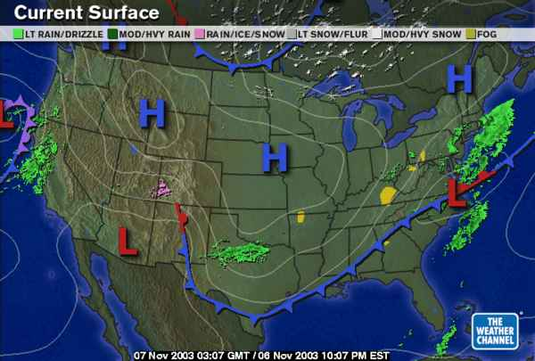
Notes:
Slide13.mp3
On this surface weather map a continental polar air mass has settled over much of the country from the Rockies eastward except for the southeastern U.S. High pressure is a reflection of the cold air. The leading edge of this continental polar air mass is called a cold front which can be seen extending from the eastern seaboard into south Texas then curves into far west Texas and eastern New Mexico near the mountains. This front separates continental polar air north of the front from maritime tropical air south of the front.

Slide 31
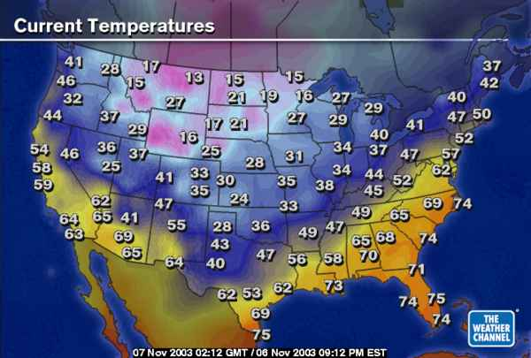
Notes:
Slide14.mp3
This map shows a dramatic temperature contrast along and near the front. Since a front is a transition zone between two different air masses, we should expect to see a marked temperature gradient in the vicinity of the front.

Slide 32
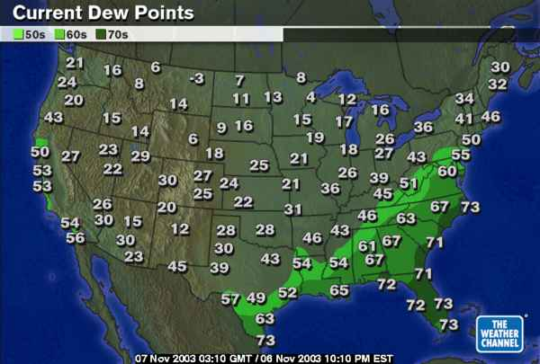
Notes:
Slide15.mp3
The moisture differences between these two air masses can be seen in this map showing surface dew points. Remember dew point is an indicator of the actual water vapor content of the air. Note the higher dew points in the maritime tropical air mass south of the frontal boundary across the southeastern United States. Dew points in the dry continental polar air mass are much lower.

Slide 33
Types of Fronts
Cold Front
Warm Front
Stationary Front
Occluded Front
Notes:
Slide16.mp3
Here are the four types of fronts seen on a surface weather map: Cold, warm, stationary and occluded. We’ll now describe each type of front in detail.

Slide 34
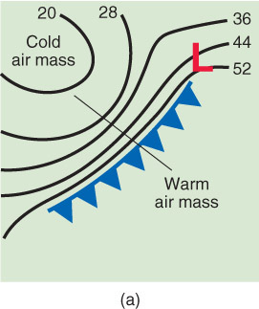
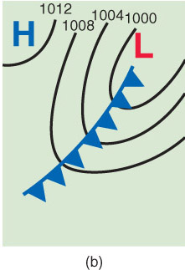
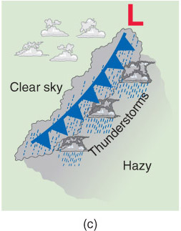
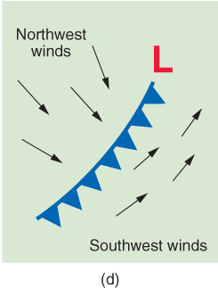
Cold Front
Fig. 9-12, p. 287
Cold air advances, replaces warm air at the surface
Change in wind direction/speed
Minimum in atmospheric pressure
Blue triangles point in the direction of motion.
Notes:
Slide17.mp3
A cold front is the leading edge of an advancing cold air mass. As the front moves through an area cold air replaces the warm air at the surface. There is often an abrupt change in the wind direction and speed as the front passes a particular location. The cold front symbol, usually colored blue, has triangles evenly spaced along the front that point in the direction the front is moving.

Slide 35
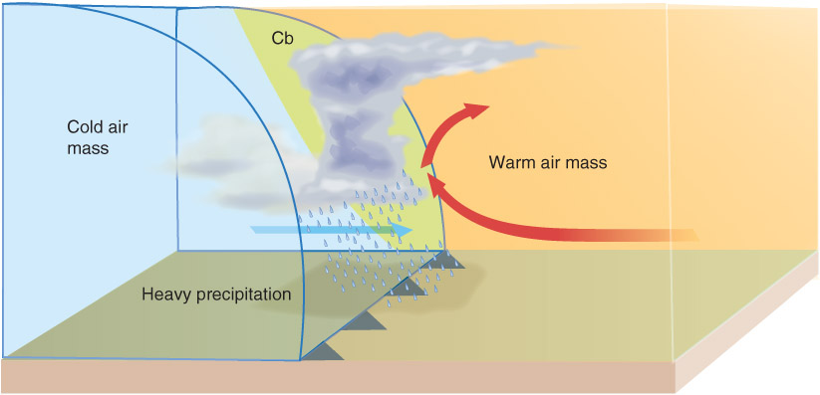
Cold Front Cross Section
Fig. 9-13, p. 288
A front is a 3-D boundary
Front slopes back over the cold air mass
Warm, less dense air is lifted
Clouds/precipitation associated with a front depend on stability and moisture
Sharp vertical motion at cold front can force thunderstorm activity
Notes:
Slide18.mp3
An important concept to understand is that a front is not just a blue line on a surface weather map. A front is a three-dimensional feature because an air mass extends upward as well as horizontally. So the temperature and moisture differences between air masses can be observed above the ground as well as at the surface. Think of this boundary between air masses as a three-dimensional surface that slopes back over the cold air mass.

Slide 36
Typical Cold Front Weather
Weather | Before | While | After
Winds | Southerly | Gusty, shifting | Northerly
Temperature | Warm | Sudden drop | Steady fall
Pressure | Steady fall | Minimum, sharp rise | Steady rise
Clouds | Cirrus, cirrostratus, tcu, cb | Tcu, cb | Cumulus
Precipitation | Showers | Thunderstorms, heavy showers, heavy snow | Clearing
Dewpoint | High | Sharp drop | Lowering

Slide 37
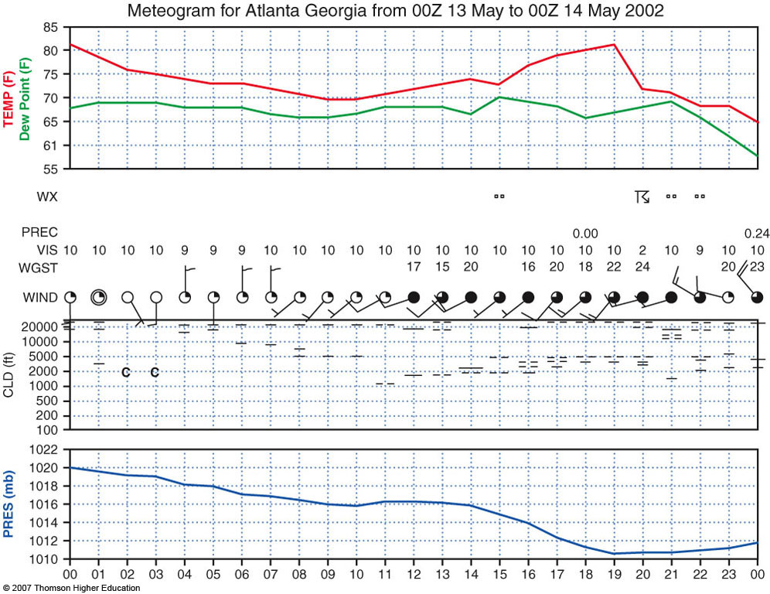
Fig. 9-16, p. 267

Slide 38
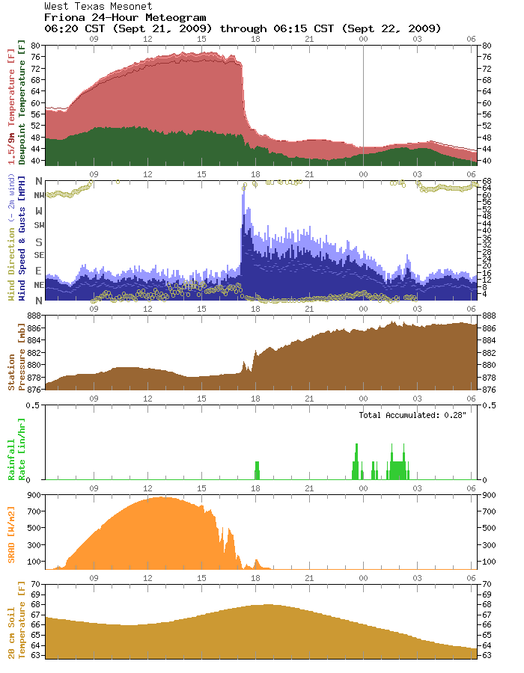

Slide 39
Slope of a Front
Depends on temperature and wind differences between the two air masses
Shallow vs. steep slope
http://twister.ou.edu/DensityCurrent/D2L01a.gifs/D2L01a.html
Notes:
Slide21.mp3
The slope of a cold front, or any front for that matter, varies depending on the difference in temperature and wind between the two air masses. Some fronts have a very shallow slope while others have a steep slope. The slope of a front can have an effect on the type of weather associated with the front.

Slide 40
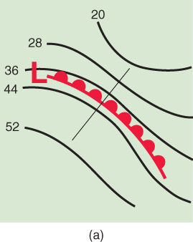
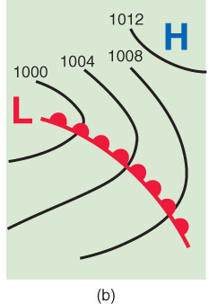
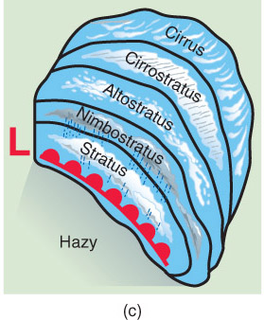
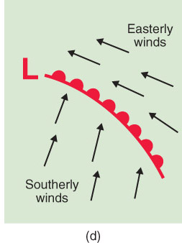
Warm Front
Fig. 9-16, p. 289
Warm air advances and replaces the cold air at the surface
Change in wind direction/speed, temperature, and dewpoint
Typically move slower than cold fronts.
Red semicircles point in the direction of motion
Notes:
Slide22.mp3
If the cold air mass retreats back to the north allowing the warm air mass to advance and replace the colder air at the surface the boundary between the air masses is called a warm front. As a warm front passes through some location there is not only a change in temperature and dew point but also a change in the wind direction. Winds often shift from a northeast or east direction to more of a southerly direction after the front passes. A warm front is depicted on a weather map by a red line with half-circles drawn indicating the direction of movement.

Slide 41
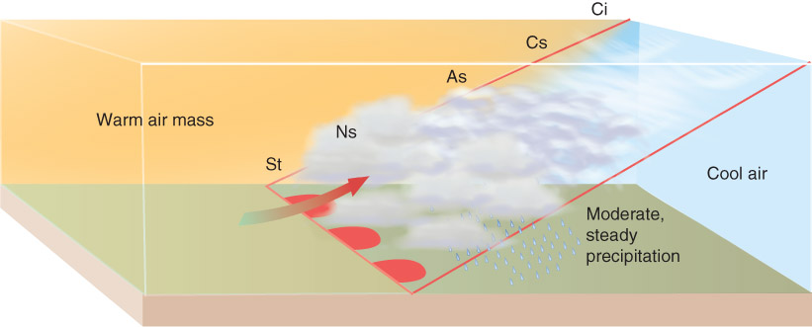
Warm Front Cross Section
Front slopes back over the cold air mass
Slope is more gentle than with a cold front (less thunderstorm activity)
Warm, less dense air lifted over the cold air (called overrunning)
Clouds/precipitation depend on moisture and stability, usually follow a set progression with an increase in altitude
More stratiform clouds
Responsible for a lot of hazardous winter weather
Notes:
Slide23.mp3
Similar to a cold front, the warm frontal surface or boundary slopes back over the colder air mass. As the warmer less dense air moves toward the front, the warm air is lifted over the cold air which may result in clouds and precipitation. Again, the type of clouds and character of precipitation depend on the moisture content as well as the stability of the warm air mass.

Slide 42
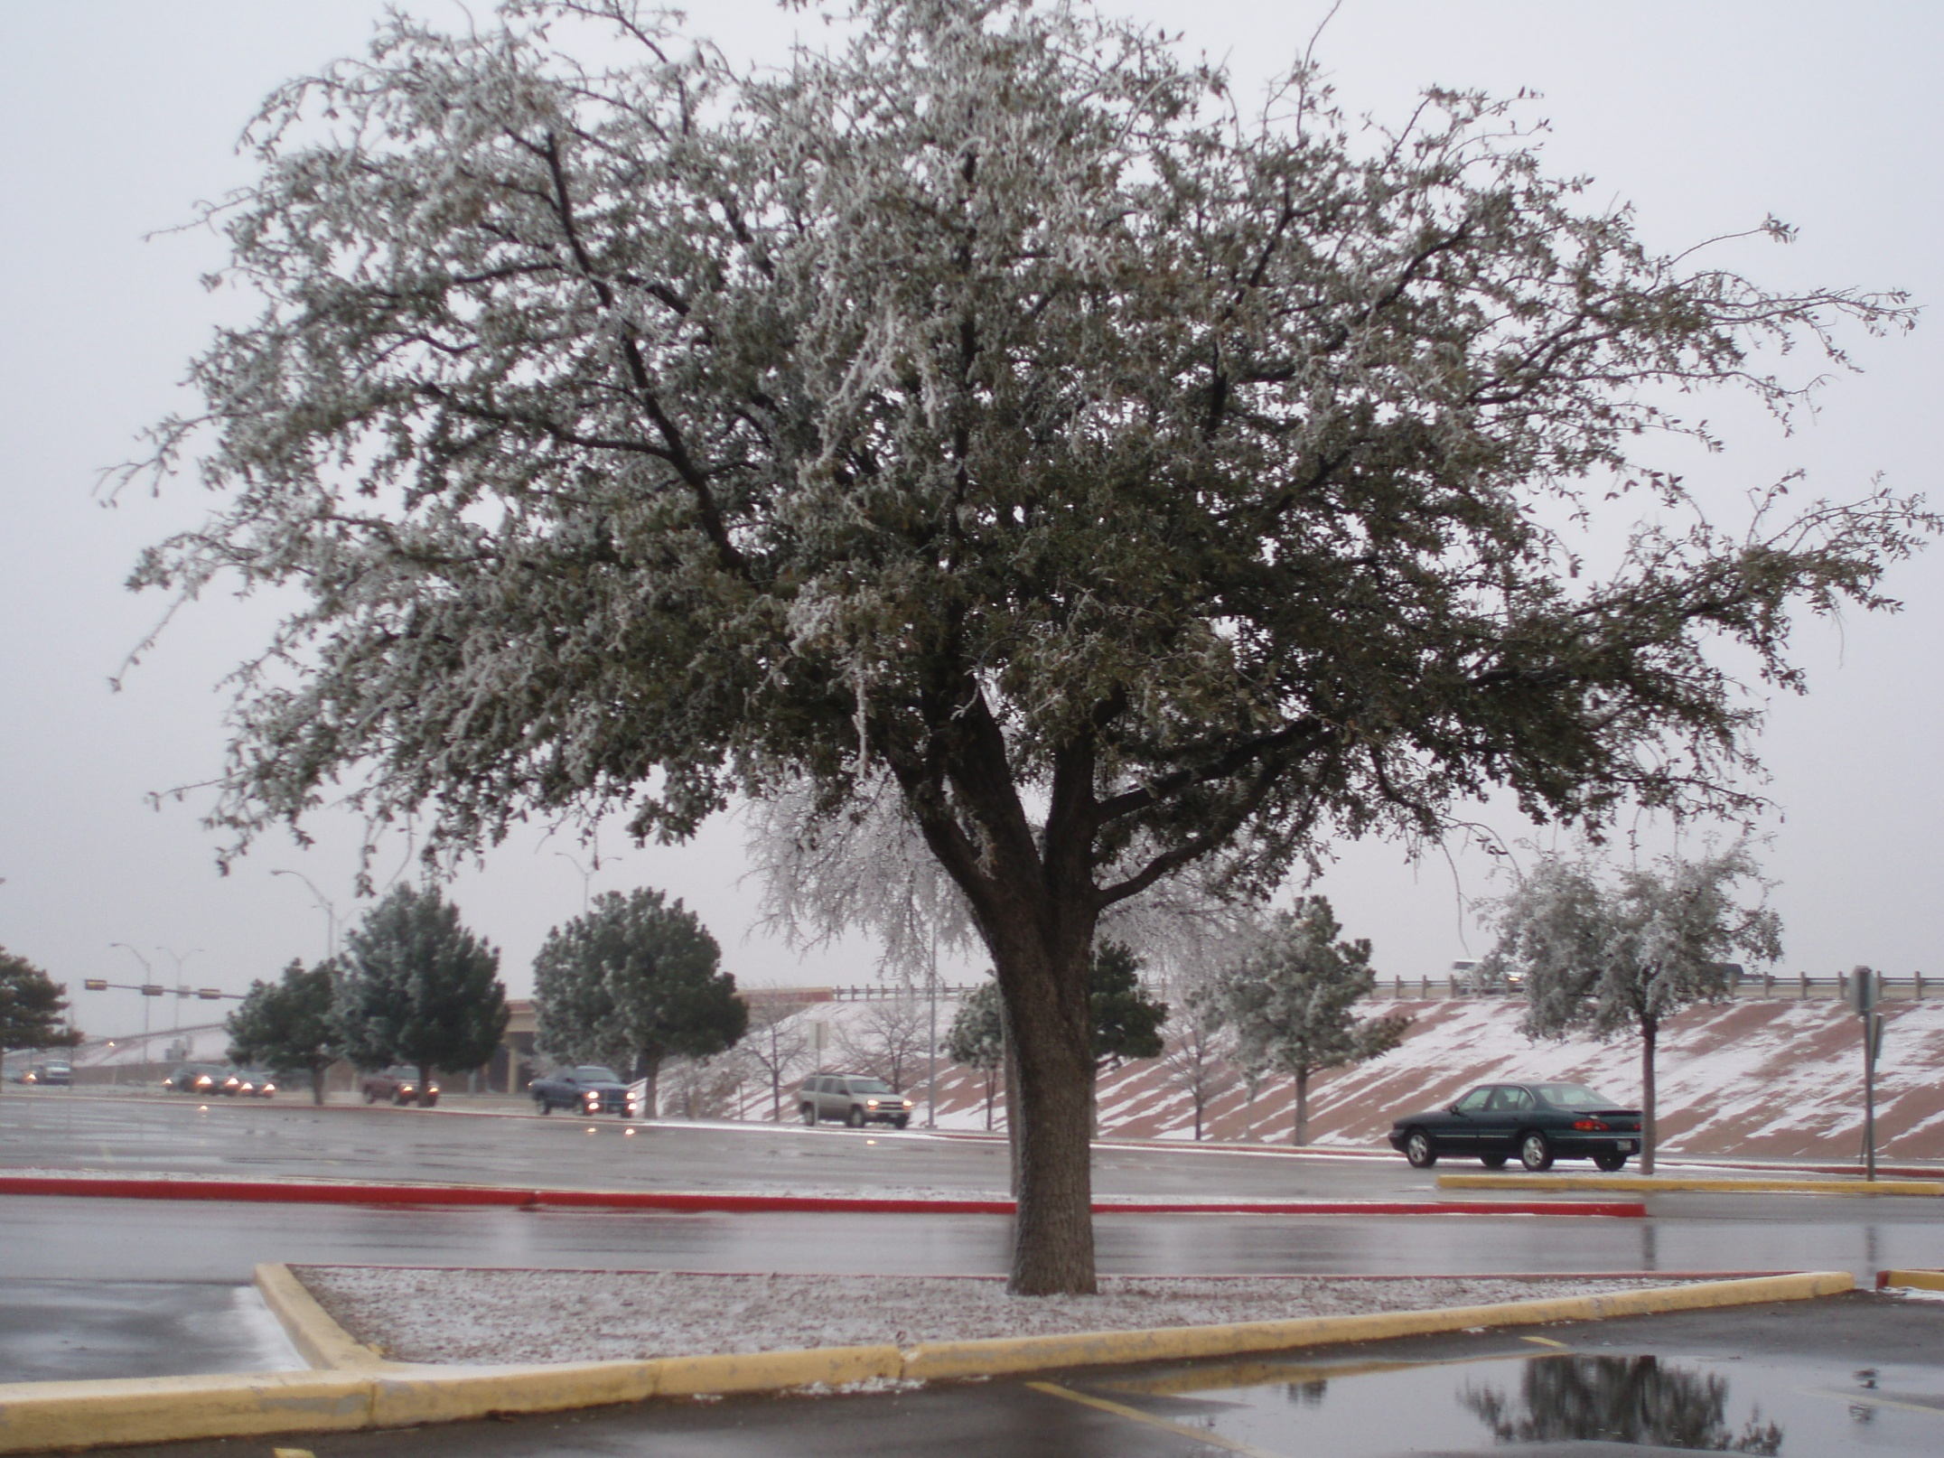

Slide 43
Typical Warm Front Weather
Weather | Before | While | After
Winds | South-southeast | Light variable | South-southwest
Temperature | Cool/cold | Steady rise | Warmer then steady
Pressure | Falling | Leveling off | Slight rise
Clouds | Stratus/fog | Status type | Towering cu (spring/summer), clearing
Precipitation | Light precip | Little to none | Showers, thunderstorms
Dewpoint | Steady rise | Steady | Rise then steady

Slide 44
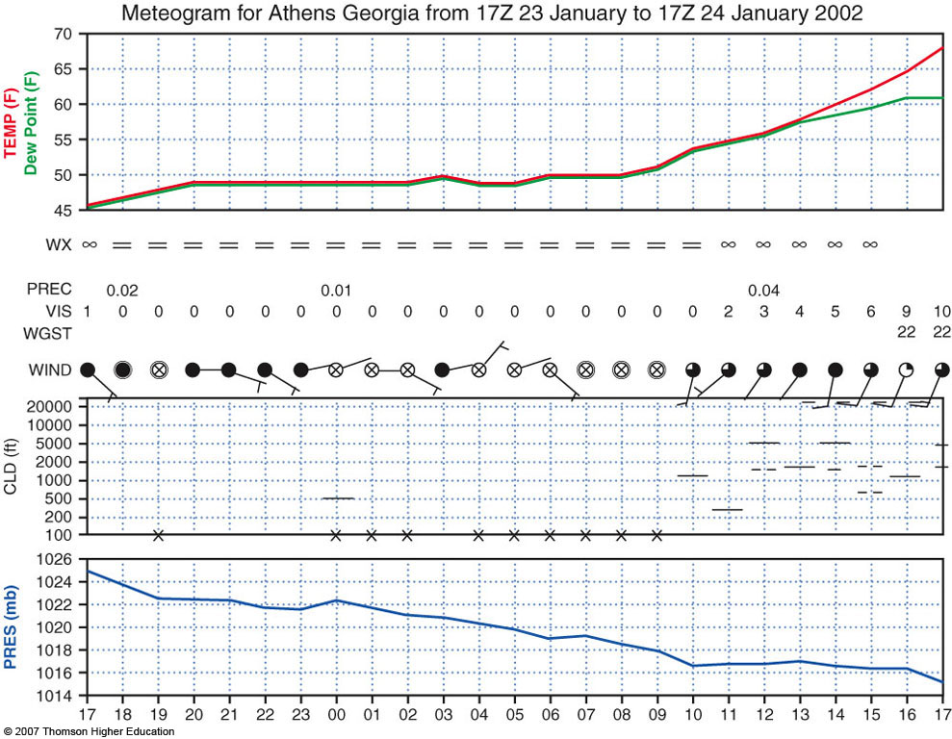
Fig. 9-19, p. 270

Slide 45
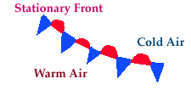
Stationary Front
Air masses at surface do not move, so the front is stationary
Overrunning still occurring, so we often still see cloudiness
Wind blowing nearly parallel on either side of the front
Notes:
Slide25.mp3
A stationary front defines a boundary between two air masses that are not moving. This can happen when the winds in the cold air mass blow parallel rather than toward the front. So the cold air mass is neither advancing nor retreating. Clouds and precipitation may occur with a stationary front. A stationary front is depicted on a weather map with alternating triangles and half circles on opposite sides of the line. It is often colored with alternating red and blue line segments.

Slide 46
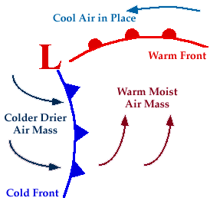
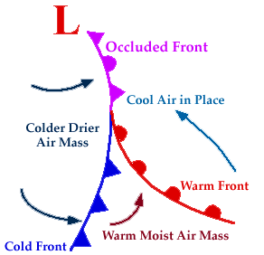
Development of Occluded Front Figures from ww2010.atmos.uiuc.edu
Notes:
Slide27.mp3
The common explanation given for the development of an occluded front is that the cold front advances faster than the warm front. In time the cold front catches up with and overtakes the warm front. If you look at the diagram on the left you will see a low pressure system on a surface weather map with its attendant cold and warm fronts. Remember the air circulates counterclockwise around the low pressure system in the Northern Hemisphere. The area just to the east and southeast of the low center is where the cold front would initially overtake the warm front.

Slide 47
Occluded Front
Separates cool air from relatively colder air at the surface
Sometimes thought of as the “cold front catching up to warm front”
The warm air mass is found above the ground
Two types:
Cold-type occluded front
Warm-type occluded front
Figure from ww2010.atmos.uiuc.edu
Notes:
Slide26.mp3
An OCCLUDED FRONT is a little more complex than a cold or warm front. An occluded front at the surface separates two air masses that are both colder than the warm air mass, but one of the air masses is not as cold as the other. An occluded front is depicted on a weather map by a solid line with alternating triangles and half circles both pointing in the direction the front is moving. It is usually colored purple. There are two types of occluded fronts: cold-occluded and warm-occluded.

Slide 48
Cross Section of Occluded Front
Cold Type Occlusion
Warm Type Occlusion
Notes:
Slide29.mp3
The top figure shows a cross section of a cold type occlusion. Note the warm air mass is found above the ground and at the surface the occluded front separates cold air from not as cold air. The lower diagram is a cross section of a warm type occlusion. Note the locations of the cold and not as cold air are reversed from the cold type occlusion. Warm occlusions occur in the Pacific Northwest when colder air is in place over the land and milder air moves inland from the Pacific Ocean.

Slide 49
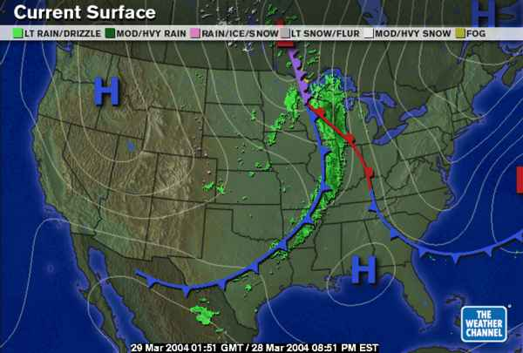
Occluded Front
Notes:
Slide30.mp3
This is an example of a surface weather map showing a cold, warm and occluded front.
There are processes other than the one just described that can lead to the formation of an occluded front. But the important point to remember is that with an occluded front, the warm air mass is no longer found at the surface but rather is found aloft.

Slide 50
Dryline
Dry air (lower dewpoint temperatures) found to west, moist air (higher dewpoint temperatures) found to east
Temperature change is rather limited across the boundary
Common in the southern plains during the spring
It is a convergence line for wind at the surface, and is therefore responsible for initiating many of our tornadic thunderstorms in the south Plains
Motion is tied strongly to insolation, and typically exhibits a diurnal “sloshing” motion (moving eastward during the day, westward at night)
Notes:
Slide38.mp3
Meteorologists analyze dew points on a surface weather map to locate dry lines because dew point readings will be considerably lower in the dry air mass as compared to the moist air mass.
The dry line is commonly found in the southern plains states during the spring and summer months.

Slide 51
Typical Dryline Weather
Weather | Before | While | After
Winds | S / SE | Gusty / shifting | W / SW - gusty
Temperature | Warm | Steady increase | Hot/steady
Pressure | Slight fall | Steady | Steady
Clouds | Tcu, cumulus | tcu | Clear
Precip | Tstms? | Tstms? | None
Dewpoint | High/stead | Sharp drop | Steady

Slide 52
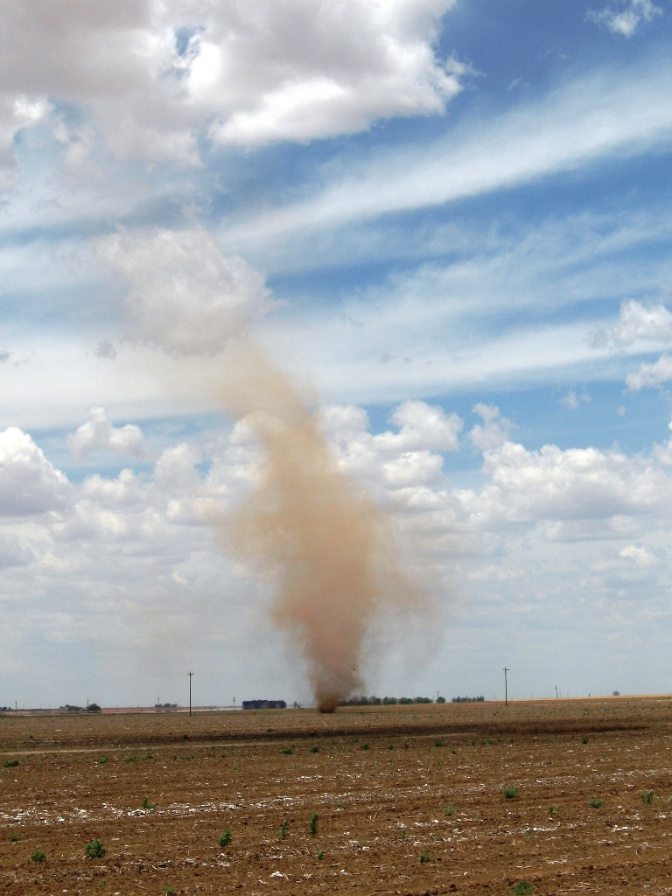
http://www.mesonet.ttu.edu/cases/Dustdevil_061109/20090611.html

Slide 53
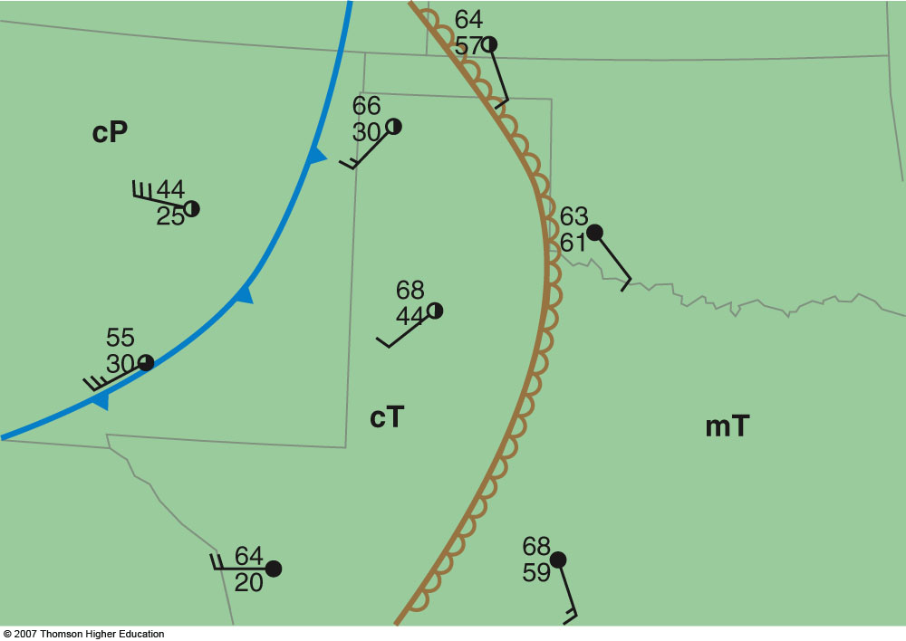
2nd Edition: Fig. 9-21, p. 272

Slide 54
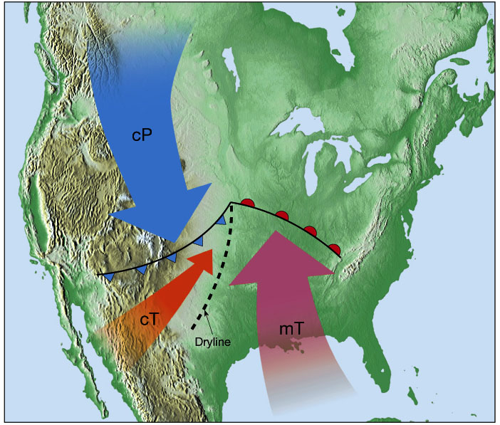
Air Masses with the Dryline www.geog.umn.edu/faculty/klink/geog1425/images/front/dryline_airmass.jpg
Notes:
Slide39.mp3
Maritime tropical air moving northward from the Gulf of Mexico is juxtaposed with continental tropical air from northern Old Mexico. Maritime tropical air is warm and moist while continental tropical air is warm and dry.

Slide 55
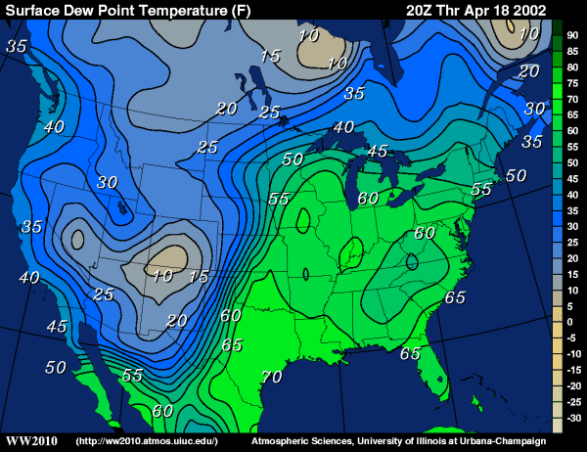
Surface Dew Points
Notes:
Slide40.mp3
This map shows lines connecting points of equal dew point temperatures. They are called isodrosotherms. Note the area from west Texas north into Kansas where the lines are very close together. That indicates a large gradient or horizontal change in dew points and hence in the moisture content of the air. That is the location of the dry line. The area to the east over the remainder of Texas and Oklahoma has fairly uniform dew points in the 60s while the area to the west, over Colorado and New Mexico, has dew points from 10 to 20 degrees.

Slide 56
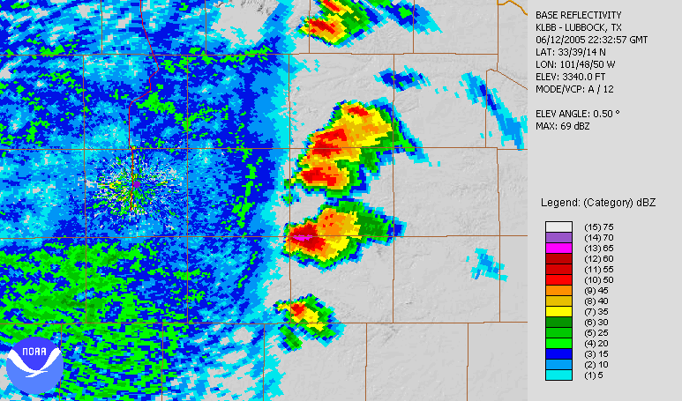
Dryline
Tornadic cell

Slide 57
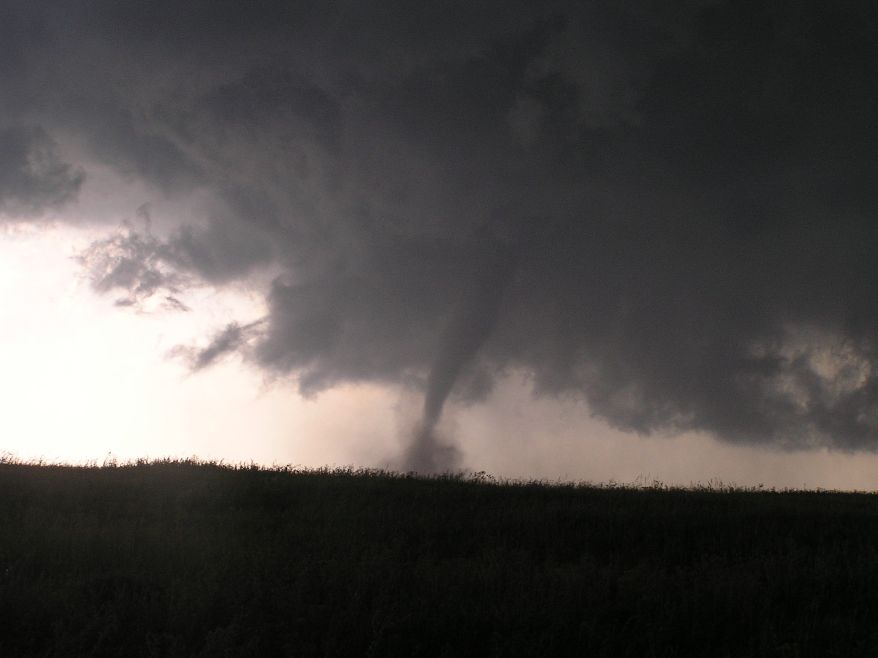

Slide 58
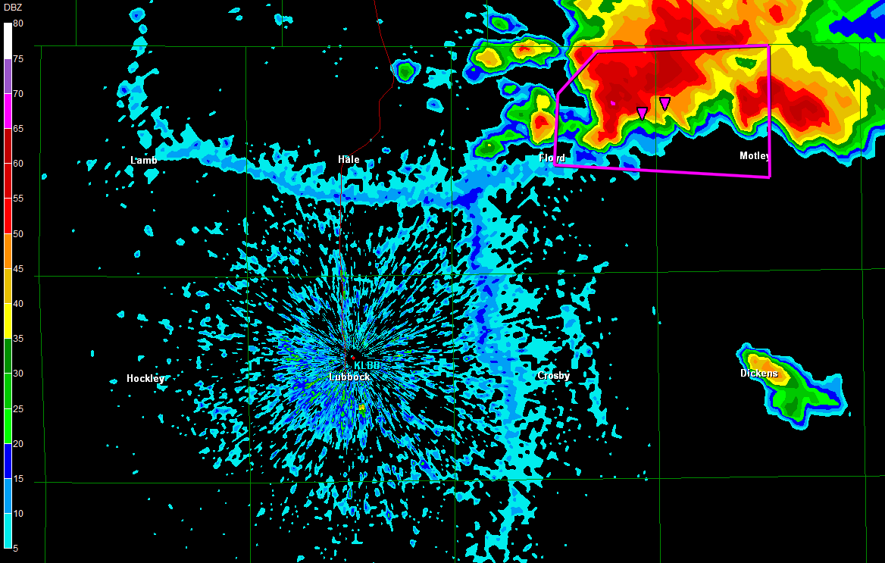

Slide 59
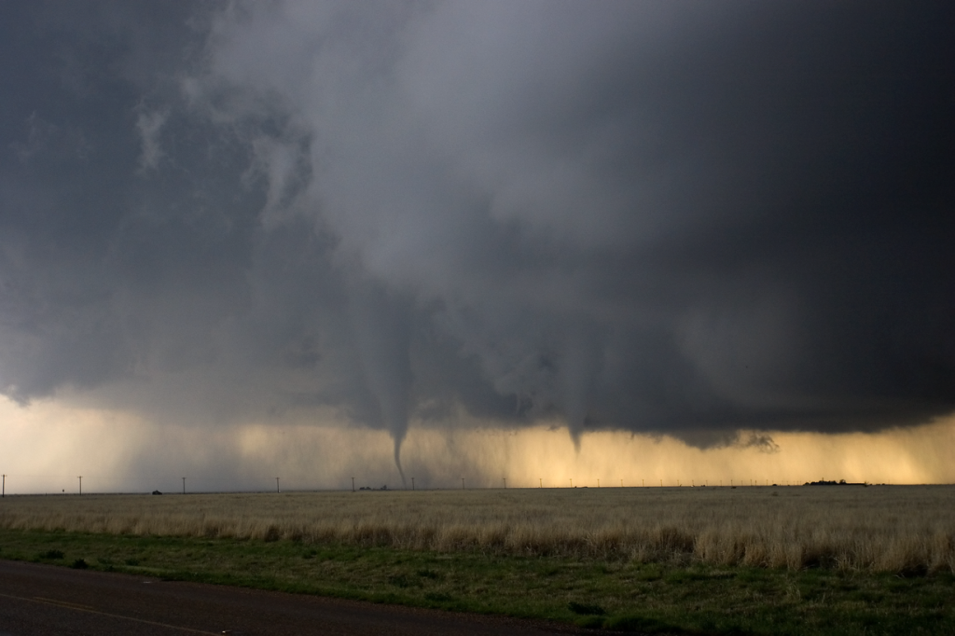

Slide 60
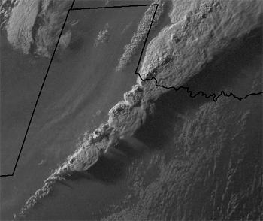
Notes:
Slide42.mp3
In this visible satellite image, observe the thin line of clouds extending north to south over west central Texas. Those are cumuliform clouds that have formed along the dry line.

Slide 61
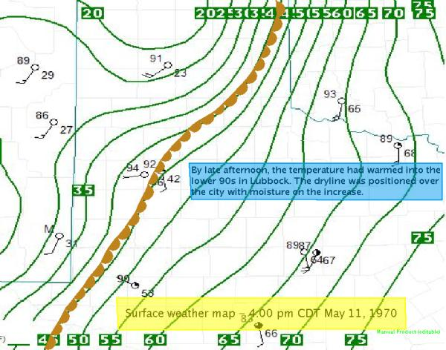
Lubbock Tornado - 1970

Slide 62
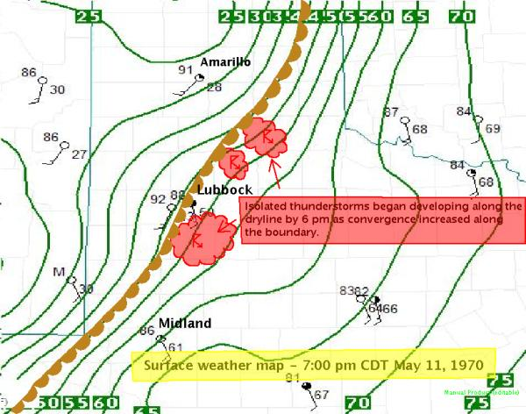
Lubbock Tornado - 1970

Slide 64
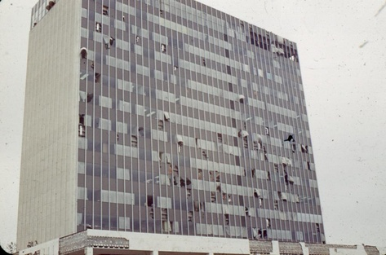
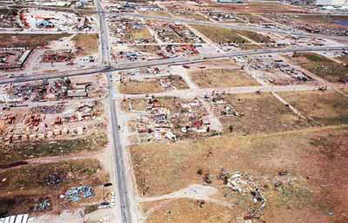

Slide 65
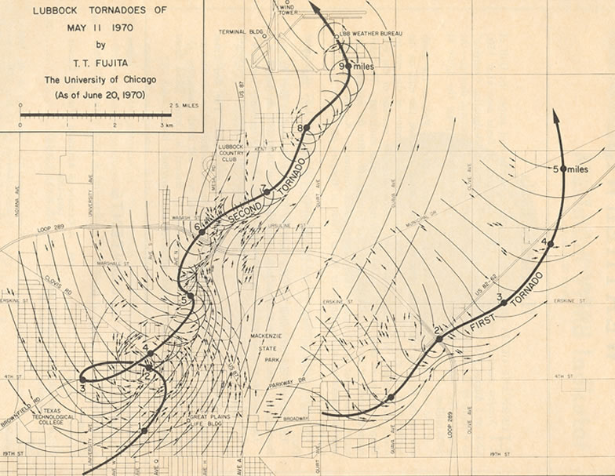
I-27
Loop 289

Slide 66
Important Concepts
Air mass – large, characterized by temperature and moisture acquired from the surface through sensible heating, evaporation and transpiration (tropical, polar, arctic; continental, maritime)
Know where each one comes from and their characteristics
Air masses can be modified over other surfaces through heat and moisture exchange or mechanical lifting (dry air masses modified faster)

Slide 67
Front
Boundary between air masses – referred to by which one is advancing
Frontogenesis vs Frontolysis
Understand the different characteristics of each type of front (temperature changes, slope, wind and pressure changes, motion) and be able to identify by cross section or meteogram or by combination of air masses
Dryline – moisture boundary common in spring/summer in southern plains

