Slide 1
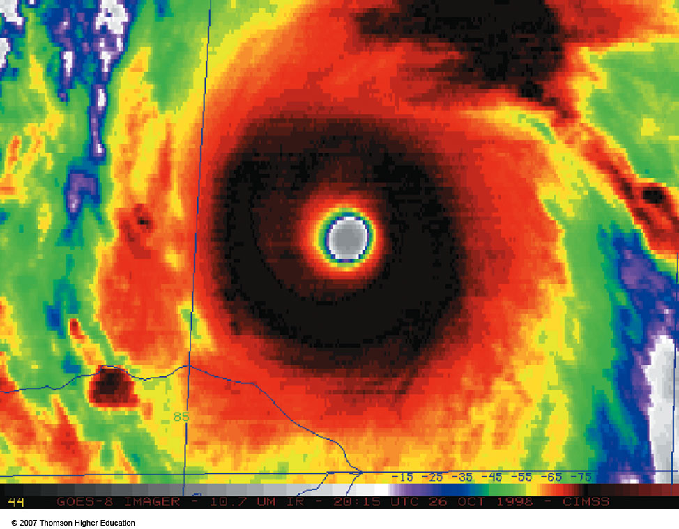
Chapter 8
Atmosphere-Ocean Interactions: El Nino and Tropical Cyclones
ATMO 1300
Spring 2017

Slide 2
Chapter 8
Atmosphere-Ocean Interactions: El Nino and Tropical Cyclones
ENSO Cycle
Energy Budgets with Oceans
Tropical Cyclone Structure
Tropical Cyclone Impacts
ATMO 1300
Spring 2017

Slide 3
Introduction
Atmosphere-ocean interaction is very important. Over 70% of Earth’s surface is covered by water!
The transfer of heat and moisture from the ocean is of prime importance for tropical cyclone formation.
To understand the impact of the ocean on the atmosphere, we must first have an understanding of how the ocean works. We call this science oceanography.

Slide 4
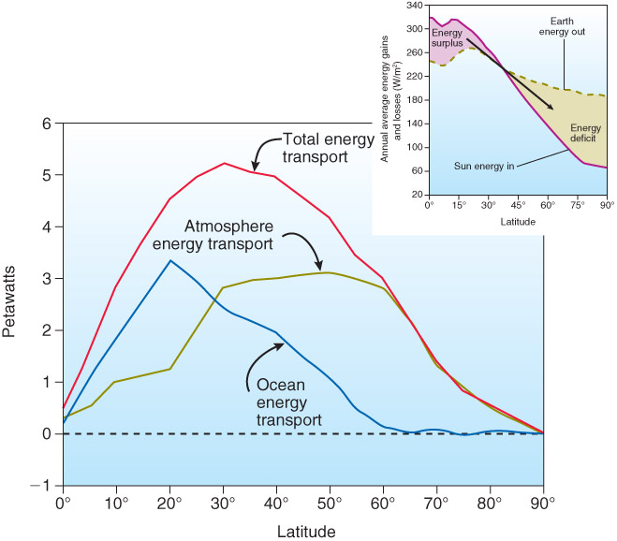
Fig. 8-2, p. 233

Slide 5
Ocean / Atmosphere Interaction
In terms of interaction with the atmosphere, the oceans do 3 main jobs:
  They are a source of atmospheric water vapor (by what process?)
  They exchange energy with the atmosphere (by what process?)
  They transfer heat poleward.

Slide 6
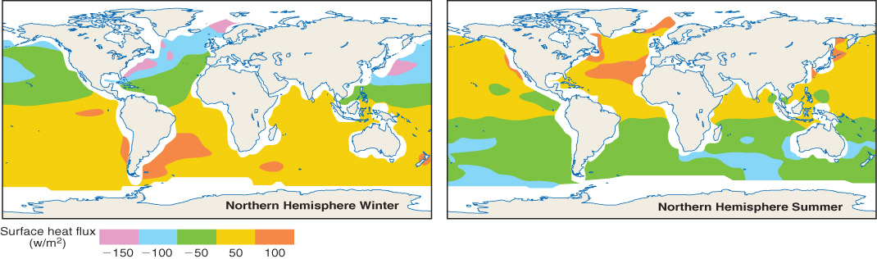
Ocean Heat Budget
Summer hemispheric oceans have net gain of heat: positive heat flux.
Winter hemispheric oceans have net loss of heat: negative heat flux.
True for moisture too (recall the relationship between temp and RH).
Fig. 8-1, p. 232

Slide 7
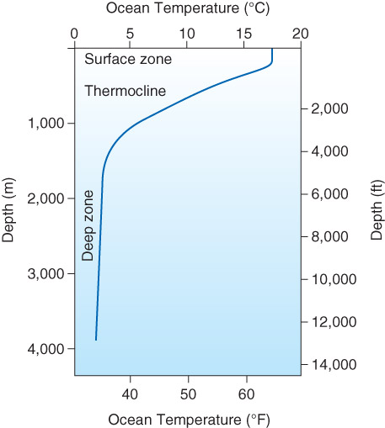
Ocean Temperatures
Surface zone
  Top 100 m
  Constant temperature (waves mix this layer)
Deep zone
  Beyond 1000 m deep
  ~constant temperature (little insolation)
Thermocline
  Transition region between the surface zone and deep zone.
Fig. 8-3, p. 233

Slide 8
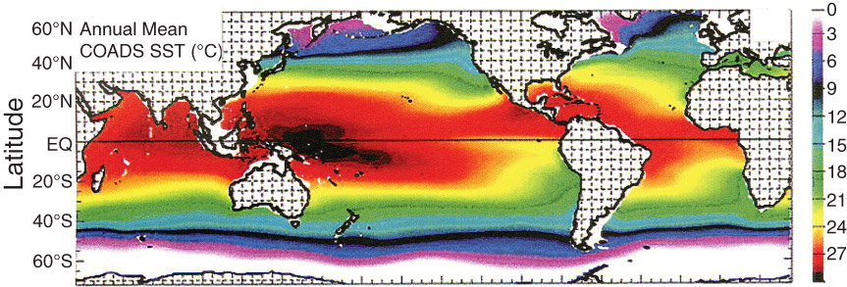
Sea Surface Temperature
Mid-latitudes:
  West coasts of land masses have cold water
  East coasts have warmer water
Polar regions: East coasts cool
Tropics: West coasts warm
Fig. 8-5, p. 234

Slide 9
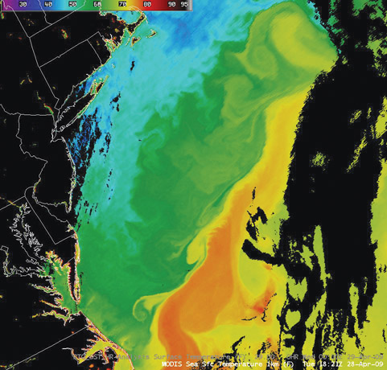
Fig. 8-7, p. 235

Slide 10
Ocean Currents
To understand why we have these temperature anomalies, we must understand ocean currents
An ocean current is a narrow concentrated horizontal flow of water associated with wind patterns at the ocean surface. Similar to jet streams, but much slower.

Slide 11
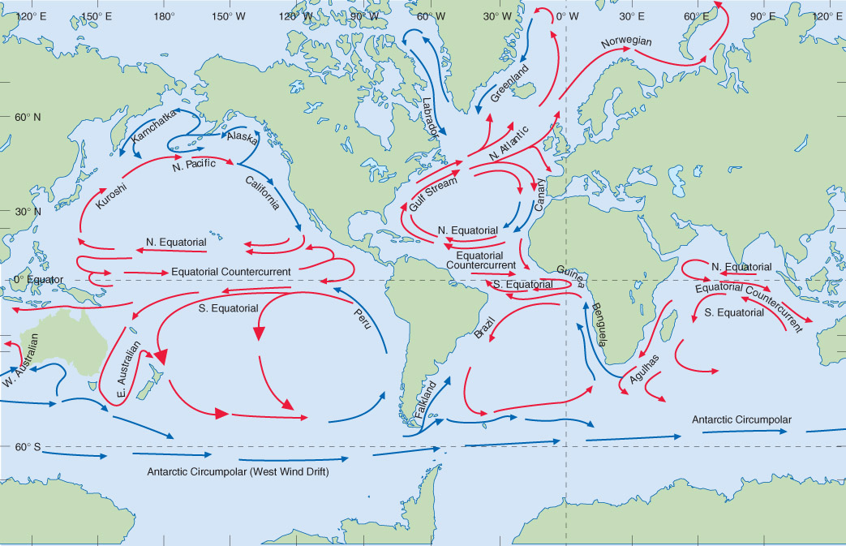
Primary Ocean Currents
Fig. 8-6, p. 214

Slide 12
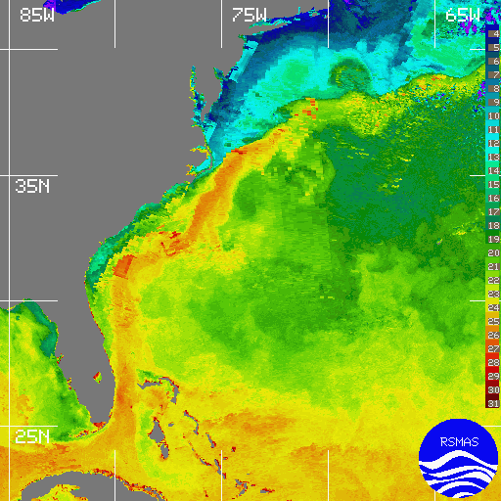
Gulfstream along the US east coast
Transports warm water northward

Slide 13
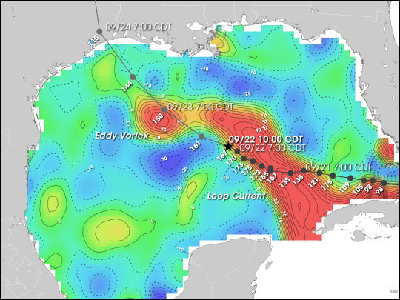
Loop Current – Gulf of Mexico

Slide 14
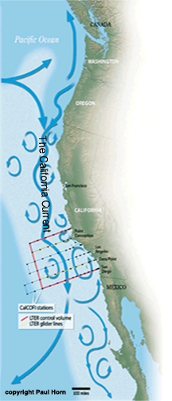
California Current
Southward flowing current along the coast of California
Brings cool water along the coast
Responsible for moderating temperatures along the west coast

Slide 15
Primary Ocean Currents
Gyres – Large oceanic circulations that rotate clockwise (counter-clockwise) in the northern (southern) hemisphere.
This sense of rotation brings warm water from the equator poleward along the eastern coasts of land masses and cold water from the pole equatorward along the western coasts (in the northern hemisphere).
The rotation matches the circulation around anticyclones in each hemisphere…

Slide 16
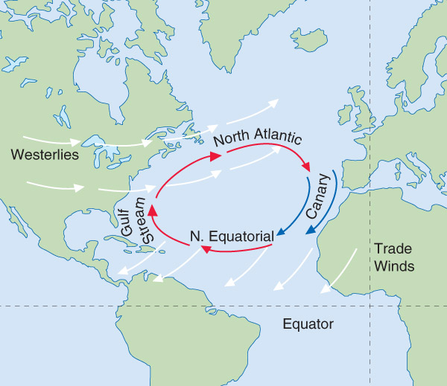
Influence of Wind on Ocean Current
Ocean currents driven by prevailing westerlies in mid-latitudes and trade winds in the equatorial region
Coriolis force deflects ocean currents to right, just like the wind
Ocean current directed 45 degrees to the right/left of the surface wind in the northern/southern hemisphere
What about water below the surface?
H
Fig. 8-8, p. 236

Slide 17
Influence of Wind on Ocean Current
Ekman Spiral: The progressive turning of ocean currents from the surface down to ~ 100 m because of the wind pushing the water AND Coriolis.
Ekman Transport: The net effect of the Ekman spiral; Water masses move at a right angle to the direction of the surface wind (to the right in the Northern Hemisphere).

Slide 18
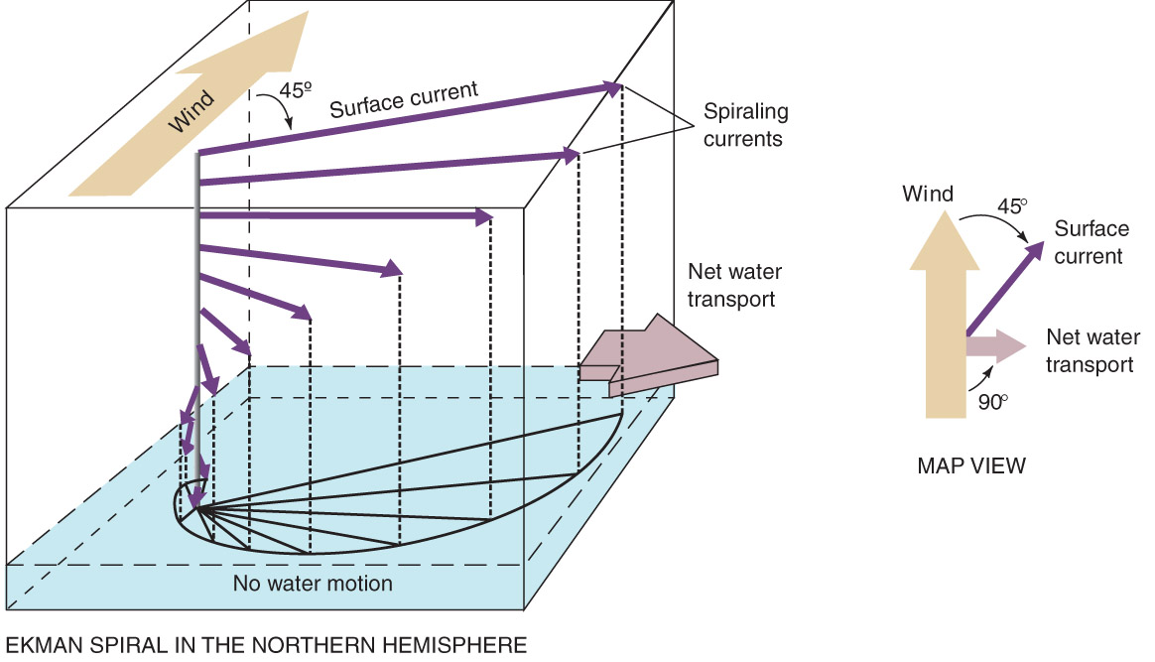
Influence of Wind on Ocean Current
Fig. 8-8, p. 215
Fig. 8-9 p. 237

Slide 19
Upwelling
For flow parallel to the coast (land to the left following air parcel motion), surface current is AWAY from the land (NH)
The only way for water to be replenished in this region is for it to ascend from below. We call this motion upwelling.
Responsible for dramatic cooling of waters off of U.S. Pacific coast.

Slide 20
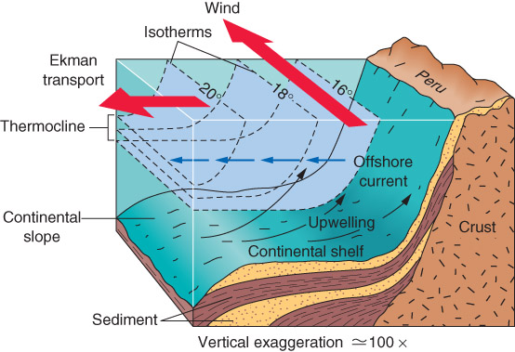
SOUTHERN HEMISPHERE!
Coriolis turns things to the left instead!
Fig. 8-10 p. 237

Slide 21
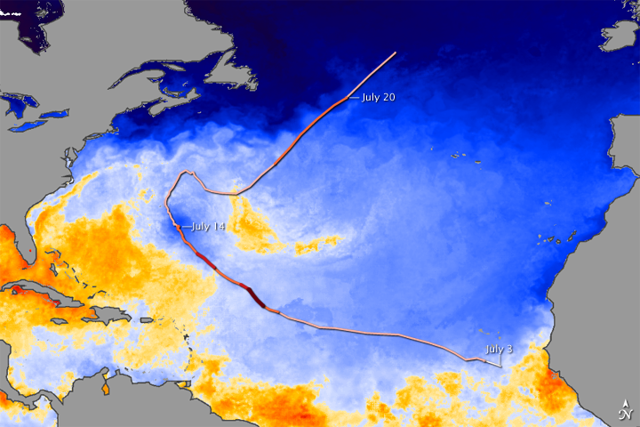
Upwelling

Slide 22
Upwelling
A phenomena tied to the presence/absence of upwelling: El Nino

Slide 23
El Nino
Fig. 8-6, p. 235
Upwelling ceases and the water off the western coast of South America warms.
El Nino: a warming of at least 0.5 °C of the east-central Pacific.

Slide 24
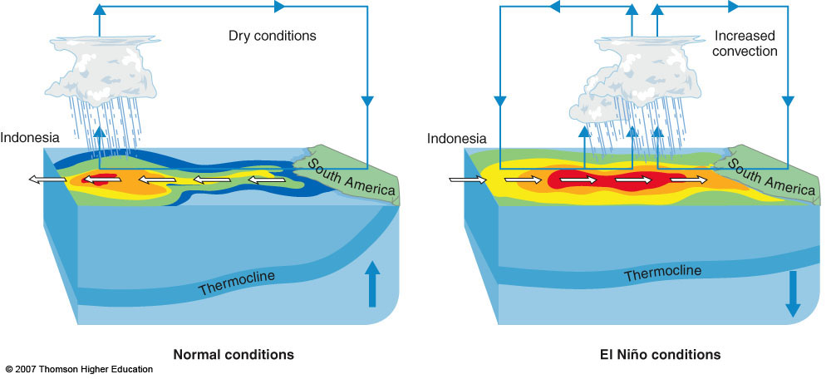
El Nino
During El Nino events, easterly trade winds subside, and a westerly current develops.
Huge economic impacts for South American fishing industry as thermocline subsides (nutrient-rich waters exist deeper in the ocean, on which fish feed).
Fig. 8-12, p. 239

Slide 25
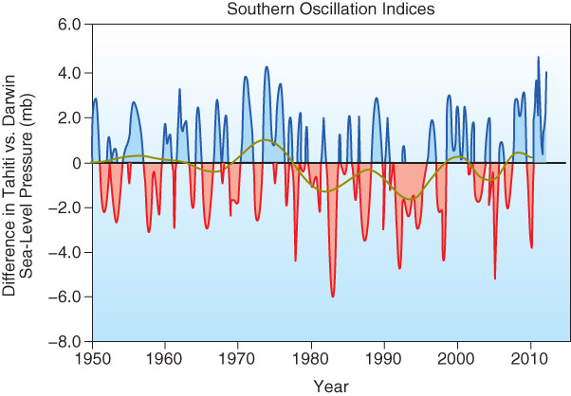
The Southern Oscillation
An oscillation in the atmospheric pressure over the eastern equatorial Pacific Ocean and the Indonesia/Australia region often associated with El Nino.
Pressure difference referred to as the Southern Oscillation Index (SOI)
Since pressure difference changes, the PGF changes, and trade winds are greatly affected.
Fig. 8-16, p. 242

Slide 26
The Southern Oscillation
A high positive SOI indicates surface pressure is unusually low in the western Pacific, and high in the Eastern Pacific. This results in strong trade winds.
High negative values indicate the opposite…lower pressure in the eastern Pacific and higher pressure in western Pacific. This results in a relaxation of the trade winds.
The SO and El Nino frequently happen together, but can happen separately.
When they do happen together, we call it ENSO (El Nino – Southern Oscillation).

Slide 27
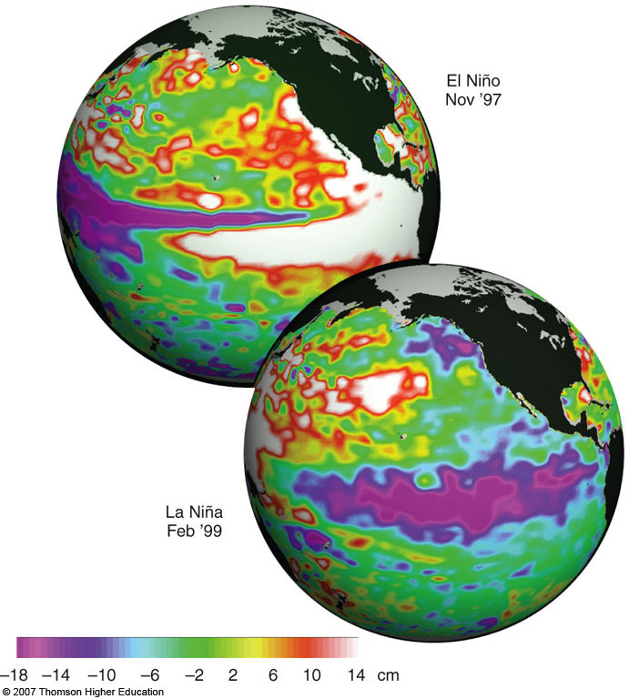
The Other Half: La Nina
Easterly trade winds strengthened
Strong upwelling
Colder than normal waters in eastern Pacific
Generally, contributes to a dry pattern over the southwestern U.S.
Fig. 8-13, p. 229

Slide 28
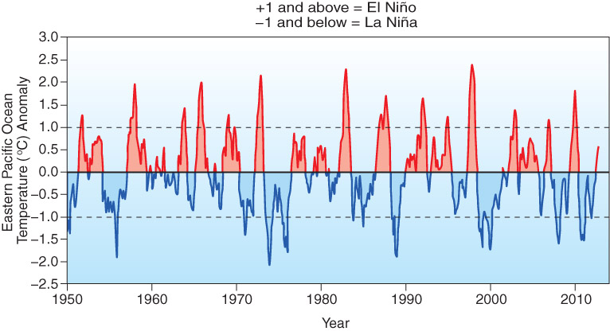
Fig. 8-11, p. 236

Slide 29
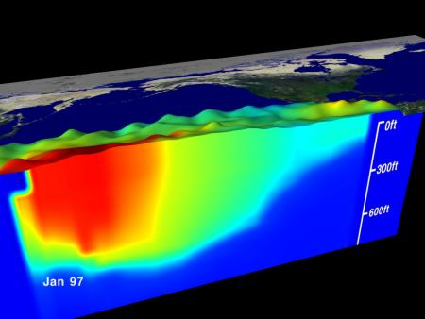
NORMAL CONDITIONS

Slide 30
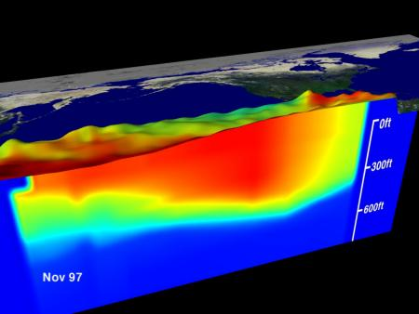
El Nino Conditions

Slide 31
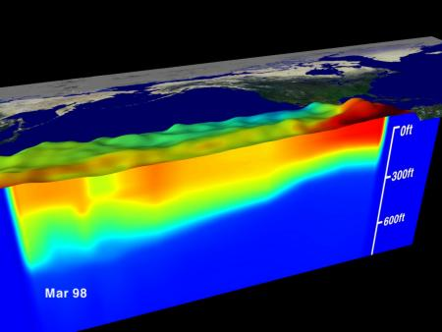
Developing La Nina

Slide 32
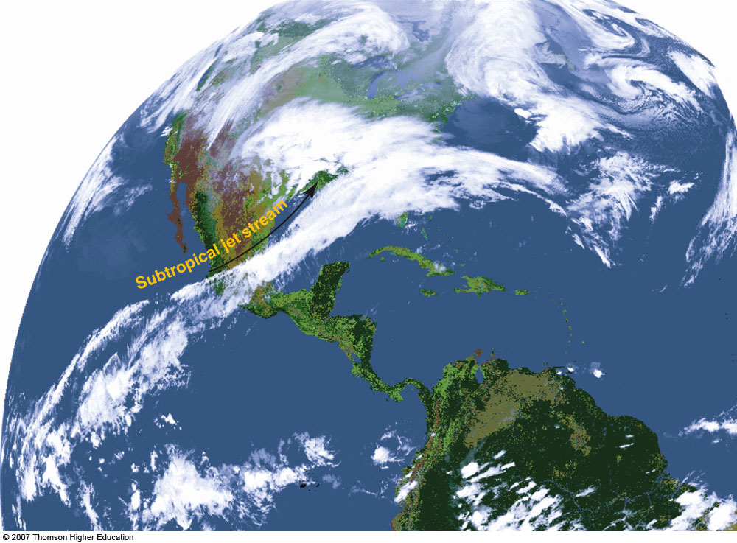
Effects of El Nino
Location of heavy precipitation changes in Pacific
Subtropical jet stream is affected (strengthened). This affects weather in the midlatitudes as well as tropics.
Fig. 7-9, p. 195

Slide 33
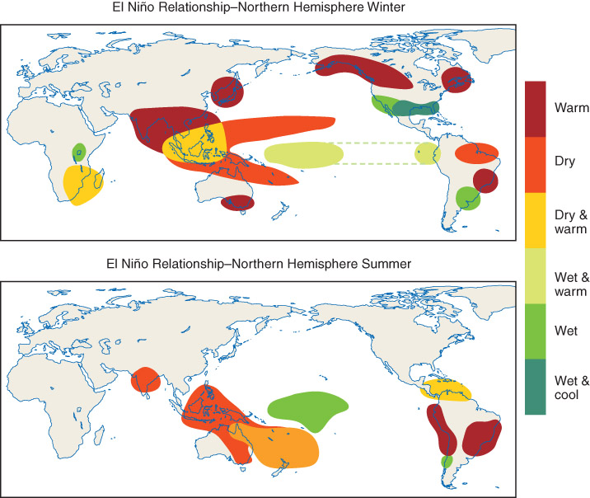
El Nino
Fig. 8-14, p. 240

Slide 34
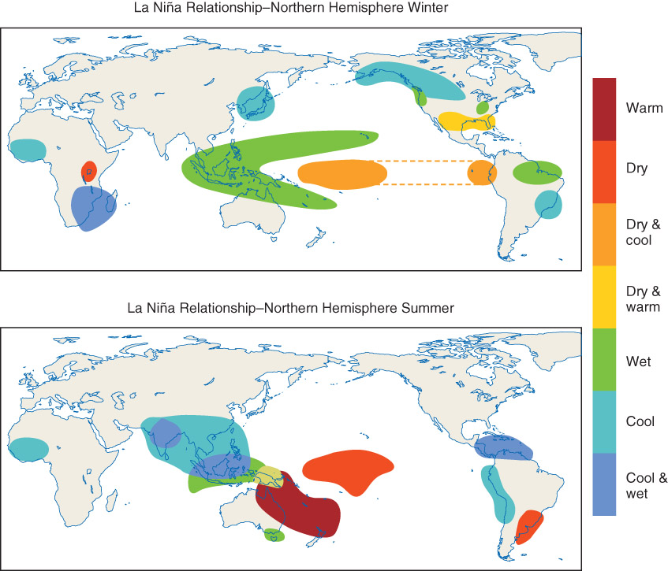
La Nina
Fig. 8-17, p. 243

Slide 35
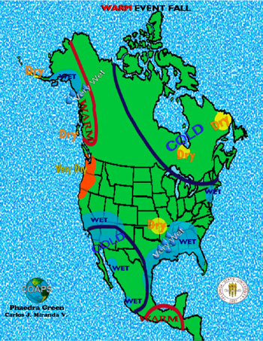
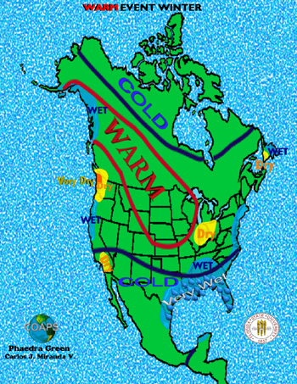
El Nino Impacts on North America: Fall / Winter

Slide 36
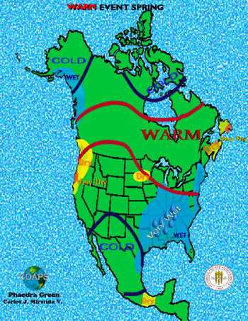
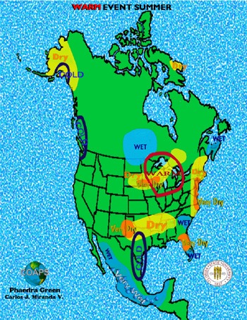
El Nino Impacts on North America: Spring / Summer

Slide 37
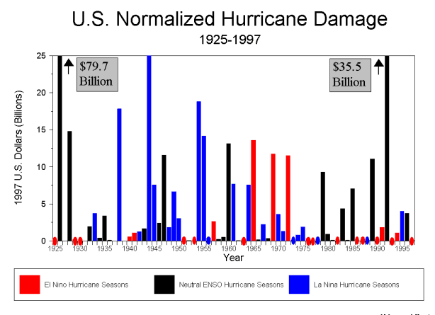
El Nino and hurricane frequency

Slide 38
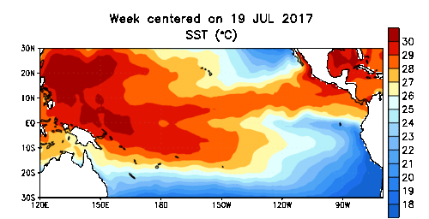
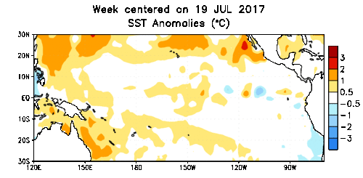
Current Conditions
http://www.cpc.noaa.gov/products/precip/CWlink/MJO/enso.shtml
Notes:
38

Slide 39
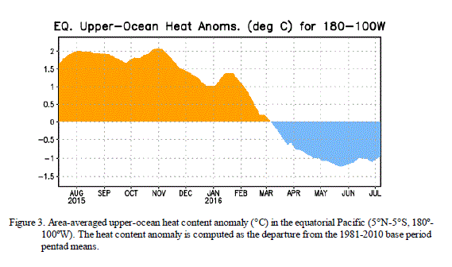
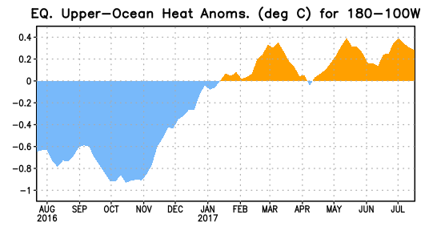
Current Conditions

Slide 40
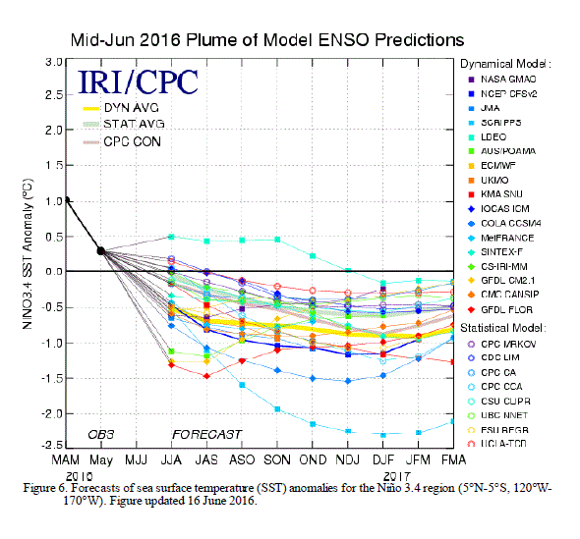
Last Year at This Time
Neutral or La Nina forecast going into winter…

Slide 41
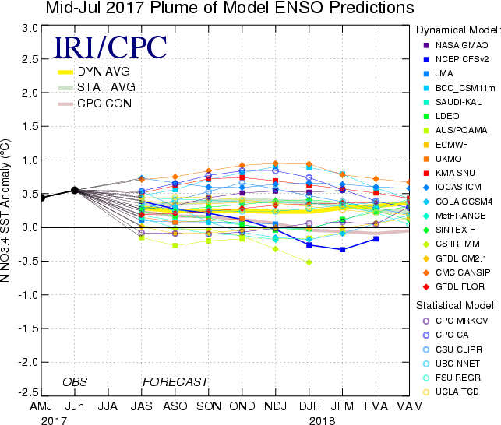
Current Forecasts…
Nearly all climate and ENSO prediction models predict a neutral ENSO through the winter

Slide 42
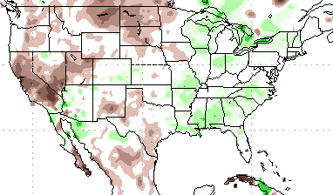
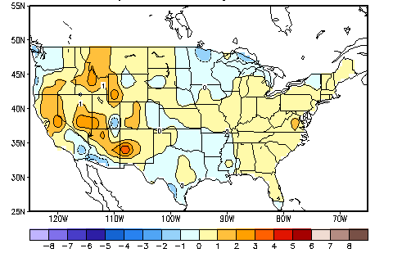
Current Impacts
Last 90 days
Percent of Average Precipitation
Temperature Departures (degree C)
2 of 2

Slide 43
Other Oscillations
Pacific Decadal Oscillation (PDO) – similar to the Southern Oscillation, but over north Pacific
North Atlantic Oscillation (NAO) – difference in pressure between Iceland and Bermuda. This can affect the jet stream position.
Though El Nino draws most of the attention, the interaction of all of these oscillations is of importance for the study of climate.

Slide 44
All for Today…

Slide 45
Ocean patterns
Earth is mostly water = huge impact on weather
Surface zone / Deep zone / Thermocline
Know impact of currents (which warm/cold current impact the US?)
Gyres – large clockwise circulation in northern hemisphere (warm water along the east coast, cold on the west), due to westerlies and trade winds
Upwelling – movement of cold water upward

Slide 46
El Nino – Southern Oscillation
Westerly winds reduce upwelling on Pacific coast of South America – warmer waters = El Nino
SOI – Changes in pressure over the Pacific, causes changes in wind, negative values = lower pressure in eastern Pacific = relaxation of trade winds, commonly associated with El Nino
La Nina – stronger than normal trade winds, strong upwelling, colder water temperatures
Know how the pattern influences this area
Not the only oscillation that matters!

Slide 47
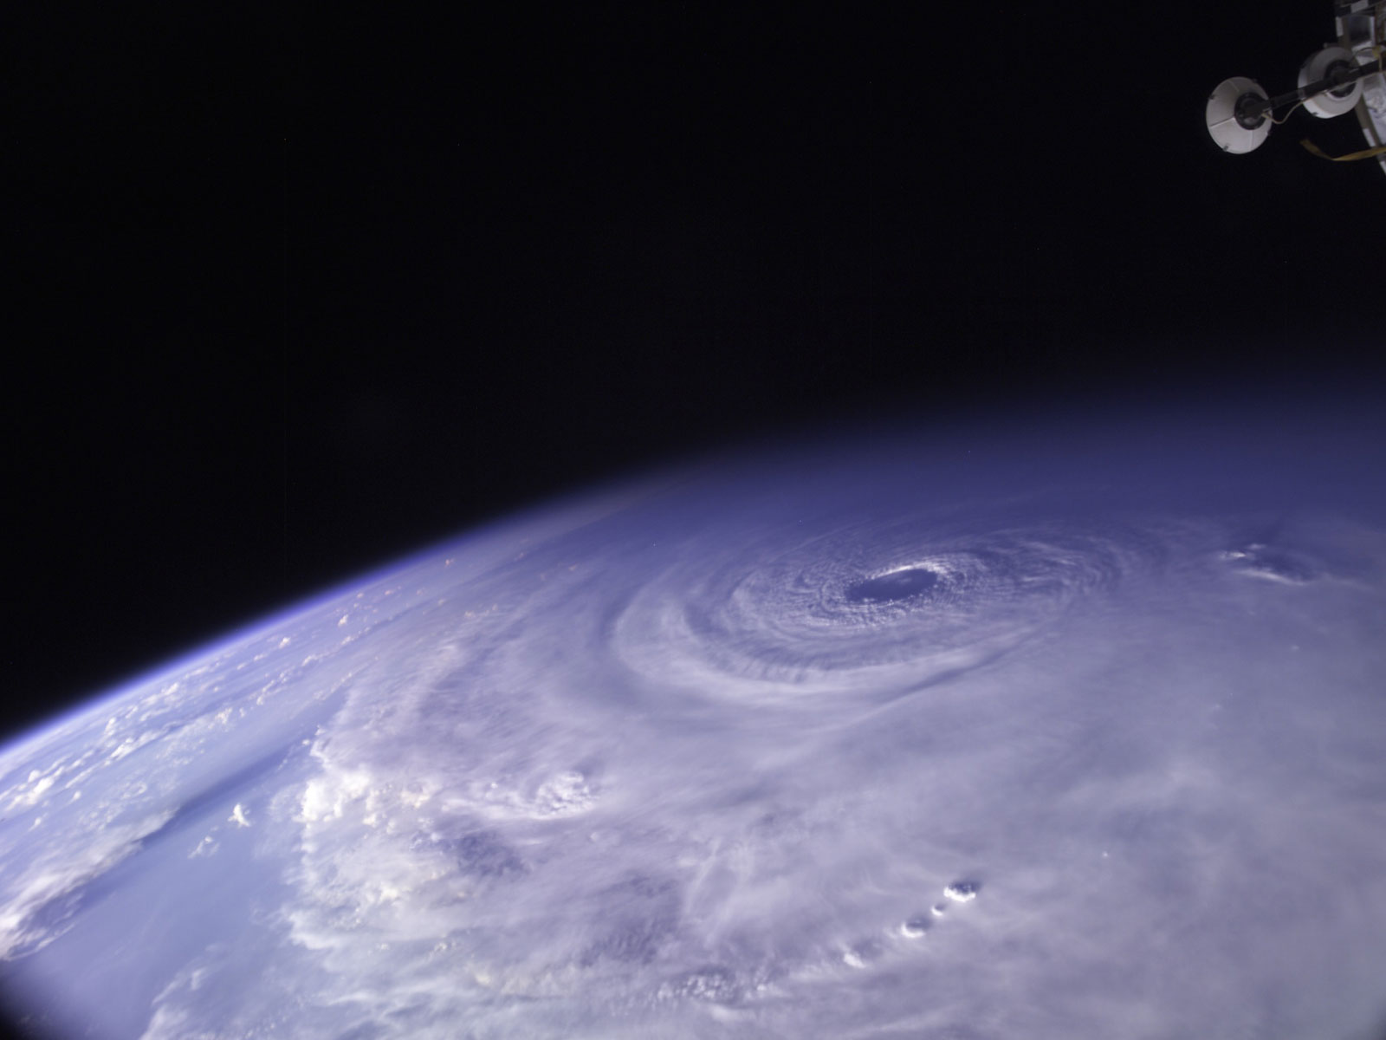
Tropical Cyclones
Hurricane Ivan - 2004
Photo: NASA

Slide 48
Tropical Cyclones
Very intense water-based convective systems capable of widespread destruction due to:
  Wind (sustained and gusts)
  Flooding (storm surge and freshwater flooding)
Strongest of these cyclones referred to as hurricanes (east of international date line) and typhoons (west of international date line)
Can also be referred to as cyclones in the Southern Hemisphere

Slide 49
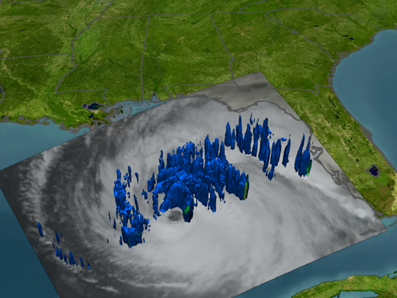
Hurricane Structure Basics
The center of the hurricane, often void of cloud cover, is called the eye.
Immediately around the eye is the eye wall, which contains the strongest convection. Winds are usually highest in the eye wall.

Slide 50
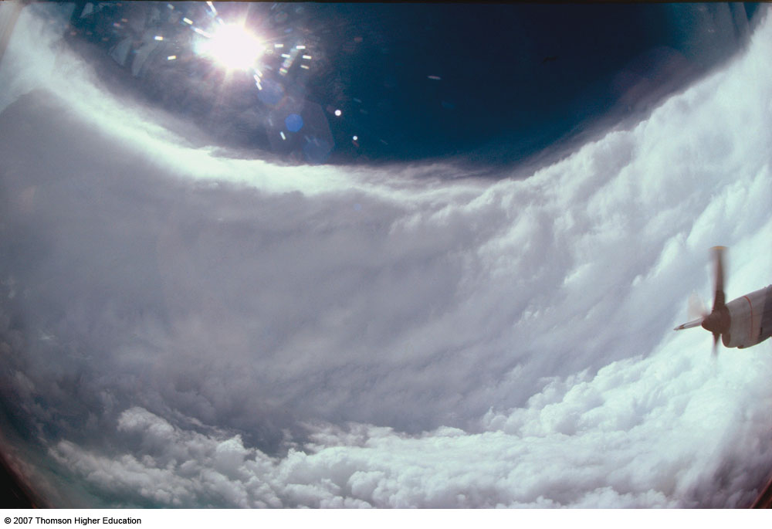
2nd Edition: Fig. 8-21, p. 227

Slide 51
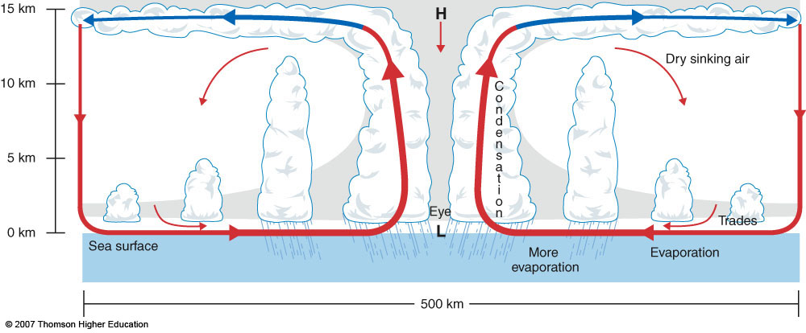
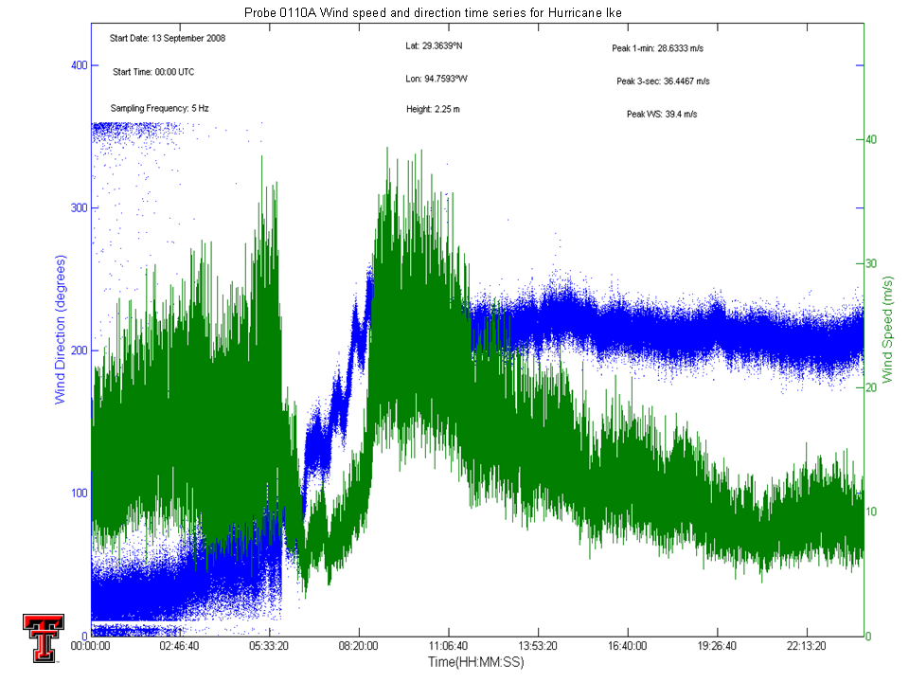
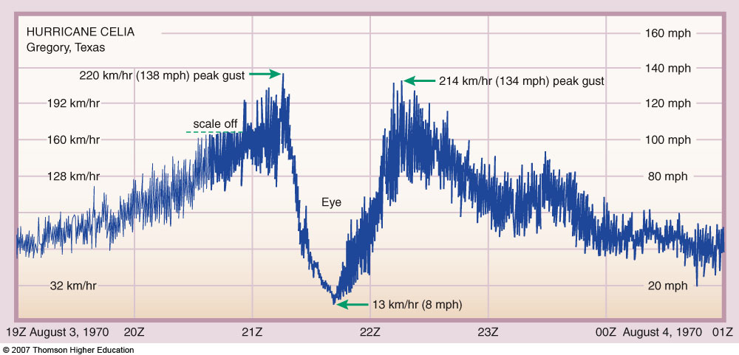
2nd Edition: Fig. 8-22, p. 227

Slide 52
2nd Edition: Fig. 8-22, p. 227
In the eye, air actually sinks due to the presence of an anticyclone aloft. (Think about the similarities with an extratropical cyclone). Therefore, eye is largely cloudless (what kind of vertical motion is necessary for cumulus clouds?)
Rapid ascent occurs in eyewall. This ascending air is driven outwards quickly by the anticyclone aloft, keeping air pressure low in the eye.
In regions of strong vertical wind shear (increases in wind speed with height), the
anticyclone is compromised aloft, usually weakening the hurricane).
Peripheral rainbands, are usually responsible for any tornadic activity.

Slide 53
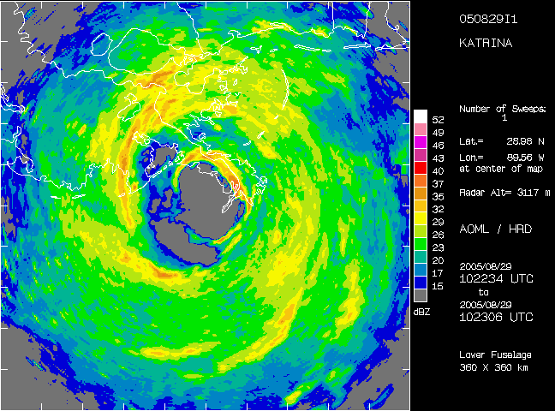

Slide 54
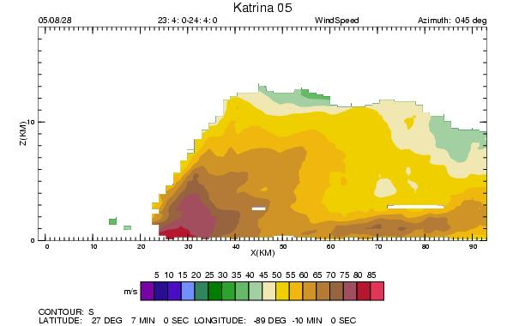

Slide 55
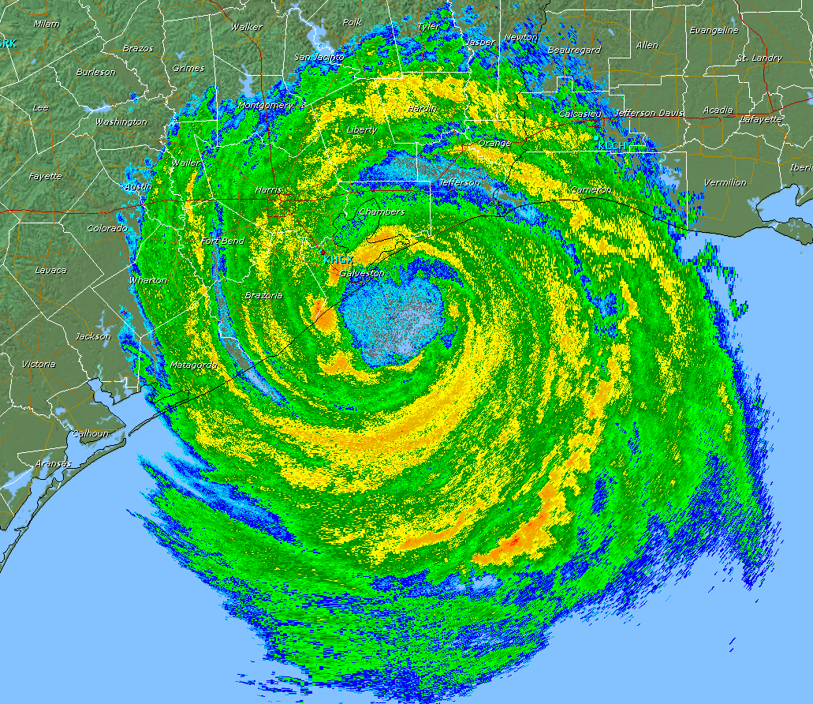

Slide 56
Tropical Cyclone Formation
The key…LATENT HEAT RELEASE!
Oceans evaporate plentiful moisture into lower atmosphere.
Substantial energy released when this water vapor condenses during thunderstorm development.

Slide 57
Tropical Cyclone Formation
2nd Edition: Fig. 8-22, p. 227
Once low pressure is established in center, wind accelerates towards eyewall.
Stronger winds = more evaporation of warm waters = more water vapor that condenses with ascent in thunderstorms = more latent heat release! (WISHE; Wind Induced Surface Heat Exchange)

Slide 58
How low can you go?
Top 10 Lowest Barometric Pressures Recorded In Atlantic Hurricanes
Rank | Hurricane Name | Year | Category | Pressure
1 | Hurricane Wilma | 2005 | 5 | 882 mb
2 | Hurricane Gilbert | 1988 | 5 | 888 mb
3 | Florida Keys (Labor Day) | 1935 | 5 | 892 mb
4 | Hurricane Rita | 2005 | 5 | 895 mb
5 | Hurricane Allen | 1980 | 5 | 899 mb
6 | Hurricane Katrina | 2005 | 5 | 902 mb
7 | Hurricane Camille | 1969 | 5 | 905 mb
8 | Hurricane Mitch | 1998 | 5 | 905 mb
9 | Hurricane Dean | 2007 | 5 | 905 mb
10 | Hurricane Ivan | 2004 | 5 | 910 mb
Lowest pressure ever recorded: Typhoon Tip (1979) – 870 mb

Slide 59
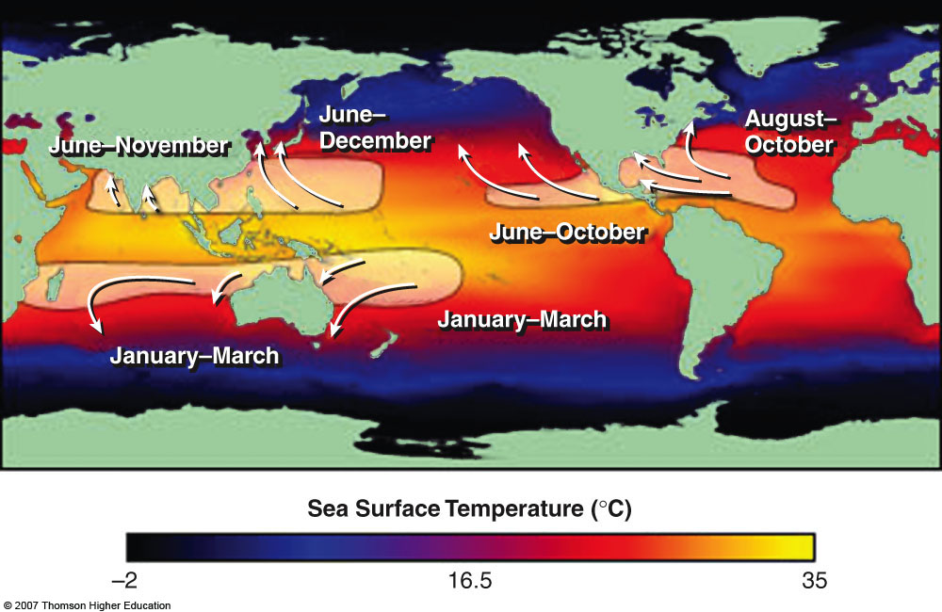
Tropical Cyclone Formation Regions
Fig. 8-23, p. 247
Tropical cyclones can form when the sea surface temperature is > 80 deg F
Why? How is evaporation affected by temperature? Recall saturation vapor
pressure. Evaporation rates increase rapidly as temperature increases.
Coriolis force is important for hurricane balance (gradient wind balance). What
restriction does this fact place on formation regions?

Slide 60
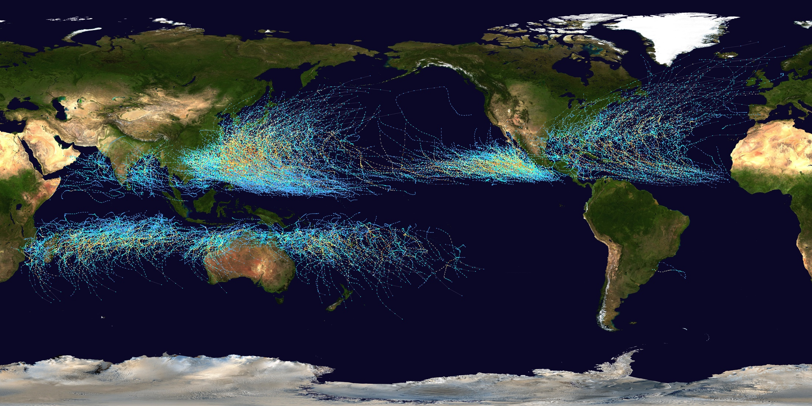
All cyclone paths from 1985-2005

Slide 61
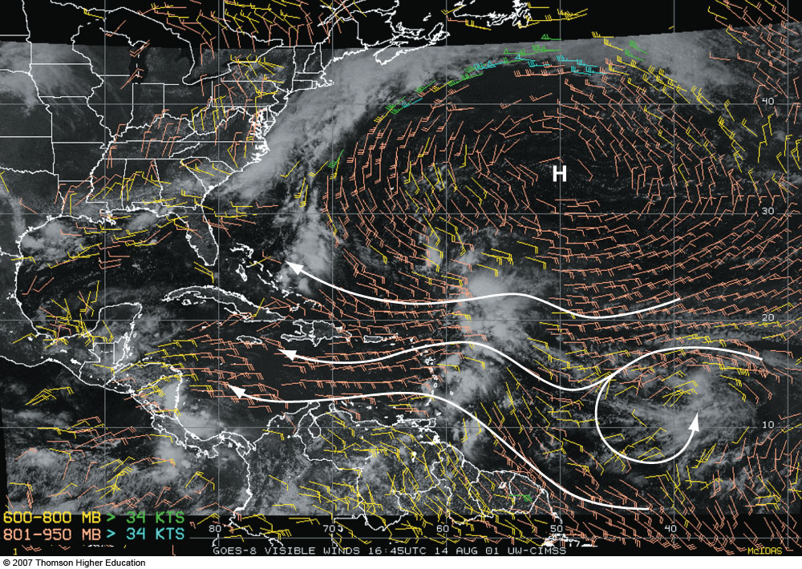
Stages of Development
Tropical disturbances
  Disorganized clusters of convection without any significant areas of low pressure.
  Often associated with tropical waves
Fig. 8-29 p. 253

Slide 62
Stages of Development
Tropical Depression
  More organized than a tropical disturbance
  Accompanied by an area of weak low pressure and a CLOSED circulation
  Assigned a number (e.g., TD #5)
Fig. 8-29 p. 253

Slide 63
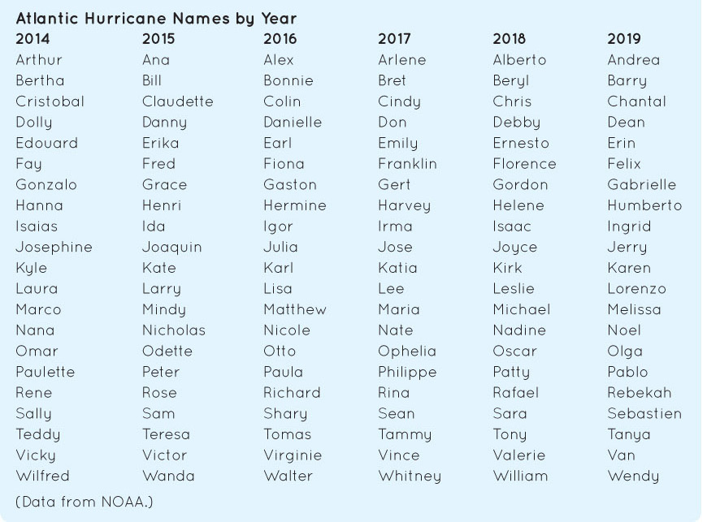
Stages of Development
Tropical Storm
  Sustained (1-min average) winds of 39-73 MPH (35-65 kts)
  Central pressure < 1000 mb
  Given a name
Box 8-2, p. 252

Slide 64

Stages of Development
Hurricane / Typhoon
  Sustained (1-min average) winds of > 74 MPH (65 kts)
  Central pressure < 990 mb
  Typhoons with sustained winds > 150 MPH called supertyphoons
Fig. 8-30, p. 252

Slide 65
Tropical Cyclone Dissipation
Occurs when cyclone is removed from its heat/moisture source
  Colder waters
  Landfall
Occurs when tropical cyclone encounters stronger wind shear
  Often becomes an extratropical cyclone, very much the same as the cyclones we have already discussed.

Slide 66

Effect of SST on Hurricane Intensity
Short term variations in hurricane intensity can be explained by SST
Example (to left): Katrina
Fig. 8-32, p. 255

Slide 67
Eyewall Replacement Cycles
Often established hurricanes undergo a cyclic process of replacing their eyewall structure
A primary rainband eventually intensifies and contracts inward
This eventually chokes off the inner-eyewall’s fuel supply and the outer eyewall takes over
Storms have exhibited as many as 3 distinct eyewall ring structures
Eyewall replacement cycles can cause temporary weakening
What controls their frequency and timing is currently unknown – VITAL TO FORECASTING HURRICANE INTENSITY

Slide 68



Slide 69

Hurricane Motion and Wind Speed
Following the motion of the hurricane, winds will be strongest to the right
To the right, motion adds to existing wind speed
To the left, motion subtracts from existing wind speed
Same principle applies for tornadoes
Fig. 8-278 p. 251

Slide 70


Slide 71
Tools for Observing Hurricanes
Satellite imagery (active and passive)
Microwave instruments
Aircraft reconnaissance
53rd Weather Reconnaissance Squadron
NOAA WP-3D Research Aircraft
NOAA Gulfstream IV Research Aircraft
NASA Global Hawk (unmanned drone!)
WSR-88D Coastal Doppler Radars
ASOS Stations
Mobile Instrument Platforms (TTU, FCMP, LSU)
Mobile Doppler Radars (TTU, UAH, CSWR, OU)

Slide 72












Slide 73

The 2005 Season
27 tropical cyclones
15 hurricanes
7 major hurricanes
(cat 3 or higher)
Lowest pressure for an Atlantic Hurricane
(Wilma – 882 mb)

Slide 74


Slide 75
Hurricane Hazards
Wind
Sea water (“surge”)
Fresh water (rainfall)
Also
  Tornado
  Lightning

Slide 76

Hurricane Hazards: Wind
Most extreme winds in the eyewall
Wind is what categorizes hurricanes using the Saffir-Simpson Scale
Texas Tech has an extensive history of research in the area of hurricane wind damage.

Slide 77
Texas Tech Hurricane Research Team
Began in 1998 with the focus of collecting high-resolution wind data from landfalling tropical cyclones
Started with two ruggedized trailer-mounted towers
Wind Engineering Mobile Instrument Tower Experiment (WEMITE)

Slide 78
Texas Tech Hurricane Research Team
Has intercepted 29 tropical cyclone since the program began
Notables: Hurricane Georges ’98, Hurricane Floyd ’99, Hurricane Lilli ’02, Hurricane Isabel ’03, Hurricane Charley ’04, Hurricane Frances ’04, Hurricane Ivan ’04, Hurricane Katrina ’05, Hurricane Rita ’05, Hurricane Ike ’08, “Superstorm” Sandy ‘12.

Slide 79


Slide 80









Slide 81
Texas Tech Hurricane Research Team
Why do we do this???
Typical observing stations (ASOS) have an 80% failure rate in sustained winds of 55 mph
We need scientific observations to accurately document the event
From an engineering perspective, we must understand the variability in the wind field to understand the damage
Understanding how winds change at the coastal interface

Slide 82

H*Wind Analysis from Hurricane Ike
Peak winds at landfall based on TTUHRT
Observations!

Slide 83
From The National Hurricane Center Official Hurricane Ike Cyclone Report
“…A 1-minute sustained wind of 71 kt was recorded by a Texas Tech University Hurricane Research Team (TTUHRT) anemometer near Winnie, Texas, between Houston and Beaumont. A 3-second gust of 95 kt was reported by a separate TTUHRT sensor near Hankamer, Texas. The pressure of 950 mb at landfall is based on a minimum pressure of 950.7 mb reported by a TTUHRT sensor at Port Bolivar near the entrance to Galveston Bay and a pressure of 951.7 mb reported at the Galveston Pleasure Pier.”

Slide 84




Slide 85
Texas Tech Hurricane Research Team
Some interesting facts
Texas Tech was the first to deploy a mobile instrument platform into a land-falling hurricane (Hurricane Bonnie 1998)
Highest winds measured by a TTU platform were: sustained 94.2 mph (Hurricane Rita), 3-sec gust 116.4 mph
Texas Tech platforms recorded the only complete wind record from Katrina’s eyewall during the Mississippi landfall
Texas Tech was the first to document the effects of storm-surge flooding on surface friction

Slide 86




Slide 87

2nd Edition: Fig. 8-32, p. 239

Slide 88





Slide 89

Table 8-3, p. 240

Slide 90
Limitations of the Saffir-Simpson Scale
Based on 1-minute peak sustained wind anywhere in the storm
Problem: Hard to measure, probably occurs over water (remember, less friction)
Storm Surge Estimate not “calibrated”
Hurricane Katrina and Hurricane Ike showed that Cat 4-5 type storm surges can occur without Cat 4-5 type wind speeds

Slide 91
Hurricane Tornadoes
Usually relatively weak
Form due mainly to strong vertical wind shear in the hurricane environment.

Slide 92

IVAN
Courtesy: E. McCaul, Jr.

Slide 93

Tornado from Ivan, Panama City, FL, 15 Sep 2004
(US Navy photo)
Courtesy: E. McCaul, Jr.

Slide 94
Video
http://www.youtube.com/watch?v=y9HERT_1u_4
120 tornadoes!

Slide 95





Slide 96


Slide 97

Notes:
97

Slide 98

Hurricane Hazards: Seawater
The “storm surge” is one of the primary threats posed to coastal areas.
Water “piles up” along coast due to counter-clockwise rotation.
Storm surge is highly dependant on coastal bathymetry (Shape of the coastline)

Slide 99

Storm Surge
Viewing from behind (following the storm motion), the area affected by storm surge will be to the right of the hurricane eye.
The “right front quadrant”

Slide 101


Slide 102





Slide 103

Hurricane Hazards: Rainwater
Even the weakest of tropical storms can produce devastating rainfall
Generally a larger threat for slower-moving tropical systems
Responsible for most hurricane related deaths

Slide 104
Hurricane Hazards: Rainwater
Tropical Storm Allison – June, 2001
Worst flooding ever recorded in the Houston metro area
Over 35 inches of rain fell in a 6 day period
$5.5 Billion in damage

Slide 105




Slide 106

Fig. 8-34, p. 242

Slide 107
Ocean patterns
Earth is mostly water = huge impact on weather
Surface zone / Deep zone / Thermocline
Know impact of currents (which warm/cold current impact the US?)
Gyres – large clockwise circulation in northern hemisphere (warm water along the east coast, cold on the west), due to westerlies and trade winds
Upwelling – movement of cold water upward

Slide 108
El Nino – Southern Oscillation
Westerly winds reduce upwelling on Pacific coast of South America – warmer waters = El Nino
SOI – Changes in pressure over the Pacific, causes changes in wind, negative values = lower pressure in eastern Pacific = relaxation of trade winds, commonly associated with El Nino
La Nina – stronger than normal trade winds, strong upwelling, colder water temperatures
Know how the pattern influences this area
Not the only oscillation that matters!

Slide 109
Tropical Cyclones
AKA hurricanes or typhoons
Eye – center, lowest pressure, but often has sinking air because of the convection in the eyewall
Eyewall – around the eye, most intense convection, highest winds
Formation all due to latent heat release
  Evaporation from surface of ocean (more effective over warm water)
  Condensation in clouds = releases energy = warming
  Low pressure develops at center = increasing winds at surface = increasing evaporation

Slide 110
Tropical Cyclones
Disturbances – no significant area of low pressure
Depression – more organized, CLOSED circulation, numbered
Storm – sustained winds 39-73 MPH, pressure below 1000 mb, named
Hurricane – sustained winds greater than 74 MPH, pressure below 990 mb
Dissipation – cold waters, landfall, too much wind shear
Eyewall replacement cycle – cyclic process where outer bands choke off inflow to the eyewall, weakens the hurricane WHILE it’s occurring

Slide 111
Tropical Cyclones
Winds stronger on the right side of motion
Winds used to rate hurricanes using the Saffir-Simpson Scale
Winds in the eyewall typically cause the most damage
Tornadoes typically occur in outer rain bands, usually weak
Storm surge – water pushed inland by the wind (also worse on the right side typically)
Inland flooding – causes most deaths, bigger risk for slower-moving systems

