Slide 1
Last Time…
How do we measure/sense the atmosphere?
Directly vs. Indirectly
  Direct: measurements are in contact with the variables they are attempting to measure
    E.g. Surface stations, ASOS, TTU West Texas Mesonet
  Indirect: measurements are gathered at a distance from the variables
    E.g. Radars (static and mobile) and Satellites
    Active (sends and receives signals) vs. passive (waits for energy to arrive at instrument)

Slide 2
Last Time…
Direct (e.g. surface observations)
  Temperature, Pressure, Humidity, Rainfall, Snowfall, Wind speed and direction
  Radiosondes are direct measurements but aloft in the atmosphere
  We can visualize direct measurements on meteograms

Slide 3
Last Time…
Satellites
  Geostationary orbit: very high up, only ‘see’ one location of the globe
  Low-earth orbit: closer to the surface than GEO satellites, orbit around the poles, see the entire globe after a few passes around it
  US operates the Geostationary Operational Environment Satellites (GOES)
  Visible, Infrared, Water Vapor images from satellites

Slide 4
Last Time…
Radar
  Sends an EM wave and receives backscattered energy from particles in the atmosphere
  Amount of energy received back relates to size of particles
    More energy = bigger particles!
  WSR-88D network and mobile radars
  WSR-88D: national network, low resolution, large area covered
  Sees rain, hail, snow, birds, insects, bats, debris, wind turbines and motion of these things to/from the radar (radially)
  Does not see air movement or things close to the ground
Mobile research radars – much higher detail, closer to the surface, mobile, can see much smaller scatterers
Profilers – used to map vertical profiles of wind speeds and directions

Slide 5
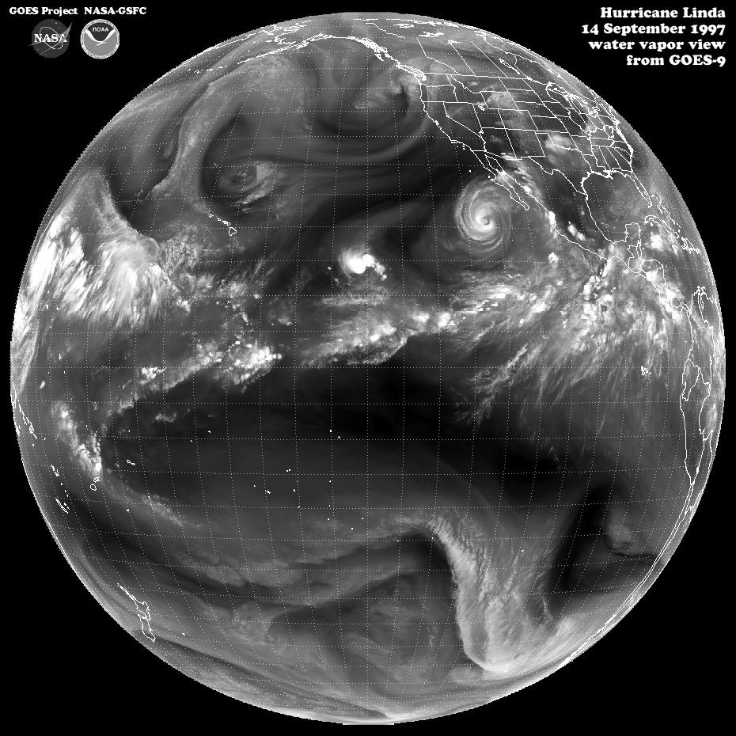
Global Circulation
Chapter 7
ATMO 1300
Summer II 2017

Slide 6
Global Circulation
Chapter 7
Circulation Models
Jet Stream
Three-cell Model
Wave Patterns
Local Winds
ATMO 1300
Summer II 2017

Slide 7
General Circulation of the Atmosphere
Represents the average wind flow around the globe…Winds at any one place may vary substantially from this average
We want to understand / explain:
  Why some regions experience steady winds
  Why some regions lack wind
  Precipitation patterns
  Global pattern of cloudiness
  The existence of jet streams:
    Jet stream: A narrow region of relatively strong winds usually located in the upper troposphere.

Slide 8
General Circulation of the Atmosphere
Underlying cause of the general wind pattern around the globe is the unequal heating of the Earth’s surface
Remember: Energy surplus at the equator compared to the poles!
Circulation patterns develop in an attempt to achieve balance
  Can drive how tropical cyclones form and move
  Don’t forget about ocean currents re-distributing energy!

Slide 9
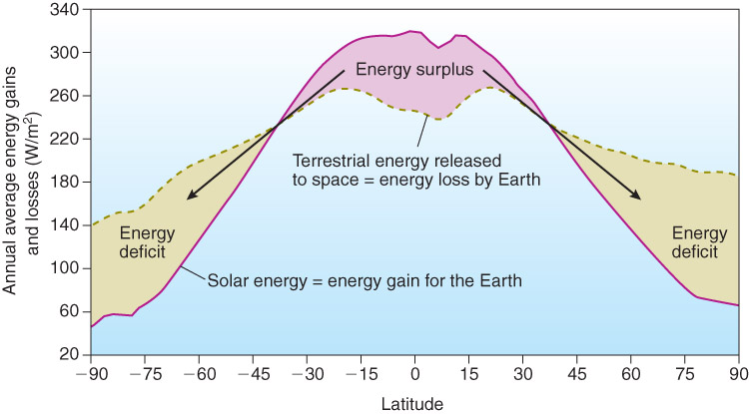
Result of Uneven Heating
Re-distribution of energy by:
a. Cyclones
b. Ocean currents
Fig. 2-21, p. 58

Slide 10
General Circulation of the Atmosphere
Flow of air across the globe is quite complex
Can be viewed in the form of conceptual models
Simplified examples of the flow of air

Slide 11
Single-Cell Model
Assumptions :
  Earth’s surface is uniformly covered by water
  The Sun is always directly over the equator
  The Earth is not rotating
So… the only force we have to consider is pressure gradient (no rotation = no Coriolis)

Slide 12
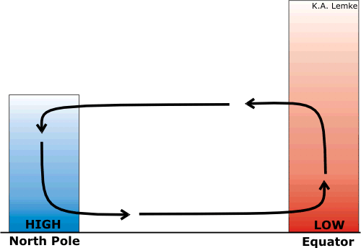
Single-Cell Model
Divergence and sinking motion at the surface
Convergence and rising motion at the surface

Slide 13
Hadley Cell
Thermally driven convective cell.
Energy surplus at the equator creates an area of rising motion and thus low pressure at the surface near the equator
At the poles, the energy deficit creates sinking motion and high pressure near the surface
Pressure gradient force is directed southward (northern hemisphere) from the pole toward the equator (remember no Coriolis)

Slide 14
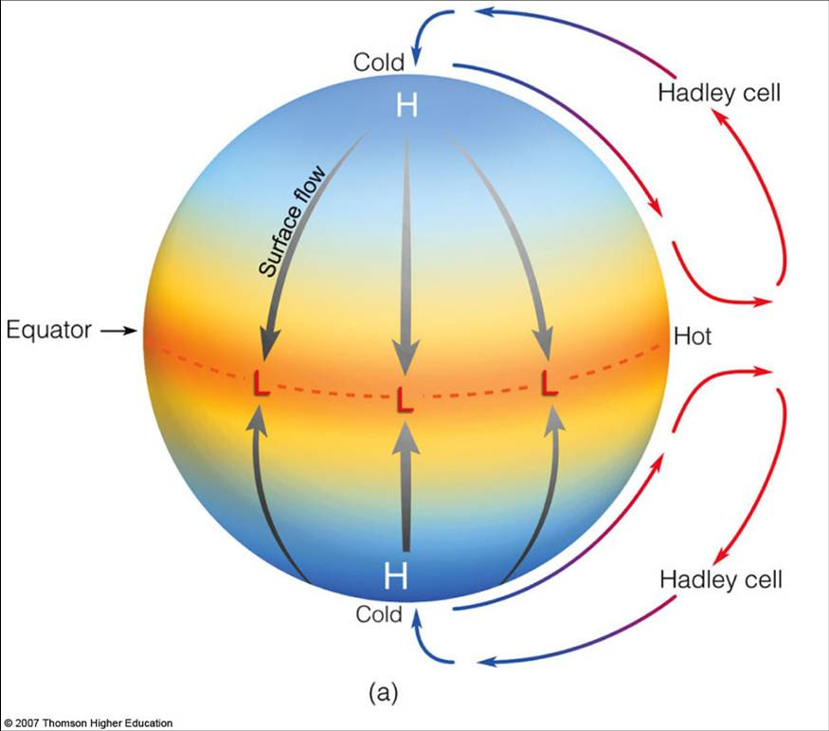
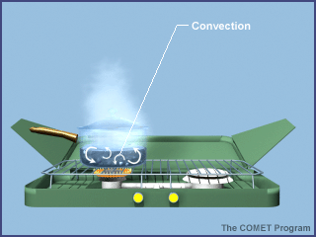
Single-Cell Model
Single-cell model referred to as Hadley cell

Slide 15
Hadley Cell
At the upper-levels the flow of air is reversed
  Air flows from the equator toward the poles
Through this manner, some of the excess of energy in the tropics is transported as sensible and latent heat to the regions where there is an energy deficit (poles)
Closed circuit of air
Does not happen on Earth, Earth is rotating
So what does the Earth’s rotation do???

Slide 16
Three-Cell Model
Allow the Earth to rotate now (and we’ll ignore the southern hemisphere).
The simplified convective cell is now broken down into 3 cells.
Remember: Distribution of energy hasn’t changed:
  Broad trough still located at the equator
  Broad ridge located near the poles

Slide 17
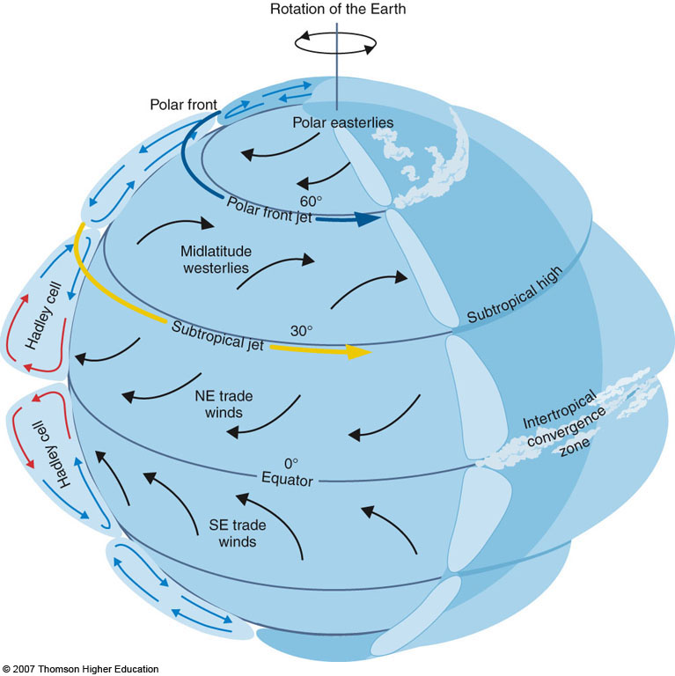
#3
#2
#1
Fig. 7-6, p. 214

Slide 18
Three-Cell Model: #1
Between 0˚ and 30˚ of latitude the convective cells resemble our Hadley Cell (Single Cell model)
Over equatorial oceans, air is warm and pressure gradient is relatively weak. Therefore surface winds are generally light. Referred to as the Doldrums
Often warm air rises into deep towering cumulus clouds, can be referred to as “Hot Towers” due to the enormous amount of Latent Heat that is released

Slide 19
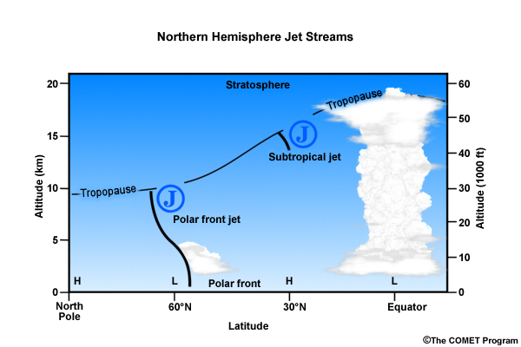
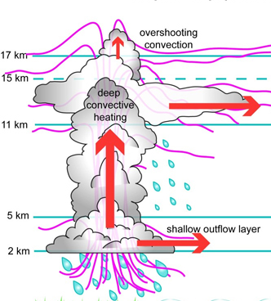

Slide 20
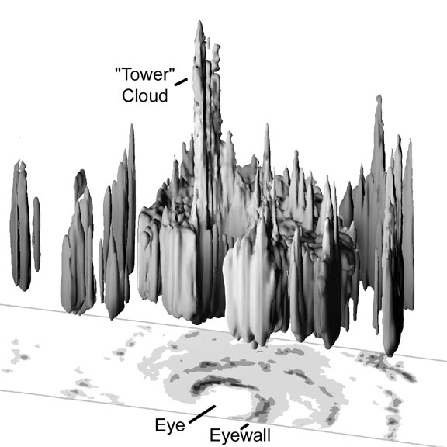

Slide 21
Three-Cell Model: #1
The latent heat released within tropical convection aids in strengthening the Hadley Cell due to enhanced rising motion over the tropics
As the rising air reaches the top of the troposphere it spreads out poleward
Coriolis now deflects the flow to the right (northern hemisphere)
The Coriolis effect now produces westerly winds aloft in both hemispheres…however these winds are really fast.

Slide 22
Fig. 7-6, p. 214

Slide 23
Sub-Tropical Jet
Forms along the northern side of the Hadley Cell circulation
Warm air carried poleward by the Hadley Cell produces sharp temperature contrasts
Sharp temperature contrasts produce sharp pressure gradients and therefore stronger winds

Slide 24
Jet Streams
Another mechanism can produce strong westerly flow aloft (other than temperature gradients)
Air on the earth moves in a circular pattern due to the Earth’s rotation and therefore has angular momentum
Angular momentum is dependant on: Mass, Speed, and distance (radius) between the blob of air and the axis about which it rotates:
Angular Momentum = mVr
So if there are no external forces at work on the rotating system… angular momentum is conserved or does not change
If we decrease distance or radius… Speed must increase to compensate.

Slide 25
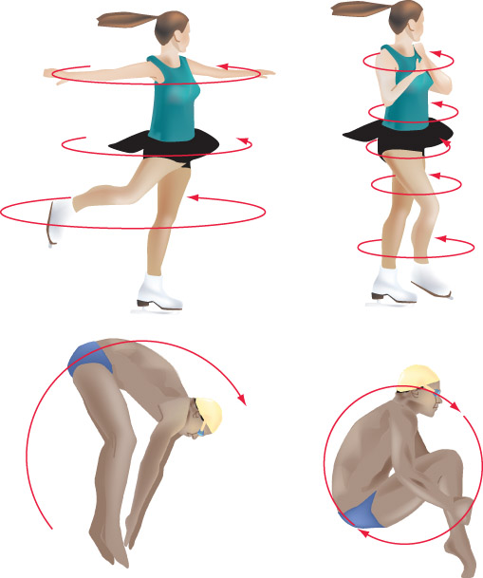
Fig. 7-8, p. 215

Slide 26
Conservation of Angular Momentum and Jet Streams
Consider heated parcels or blobs of air rising from the equator…
The air parcels rise and reach the tropopause, they spread out and head poleward
The air as it moves poleward gets closer to the axis of rotation of the earth (e.g. radius of the earth gets smaller with increasing latitude
Because angular momentum is conserved, the speed of the parcels must increase (mass of the air is unchanged)

Slide 27
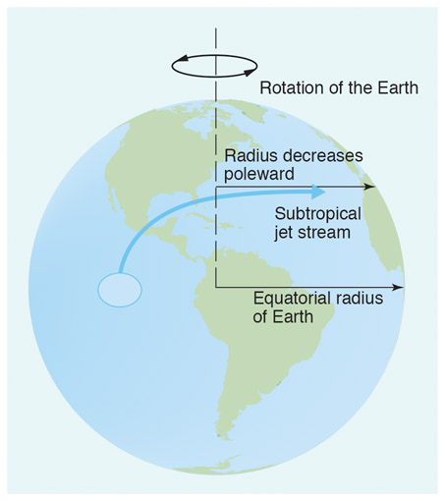
Fig. 7-7, p. 214

Slide 28
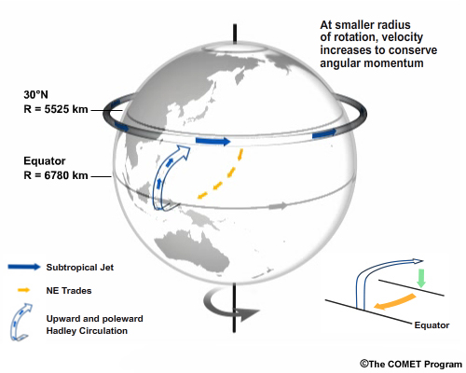

Slide 29
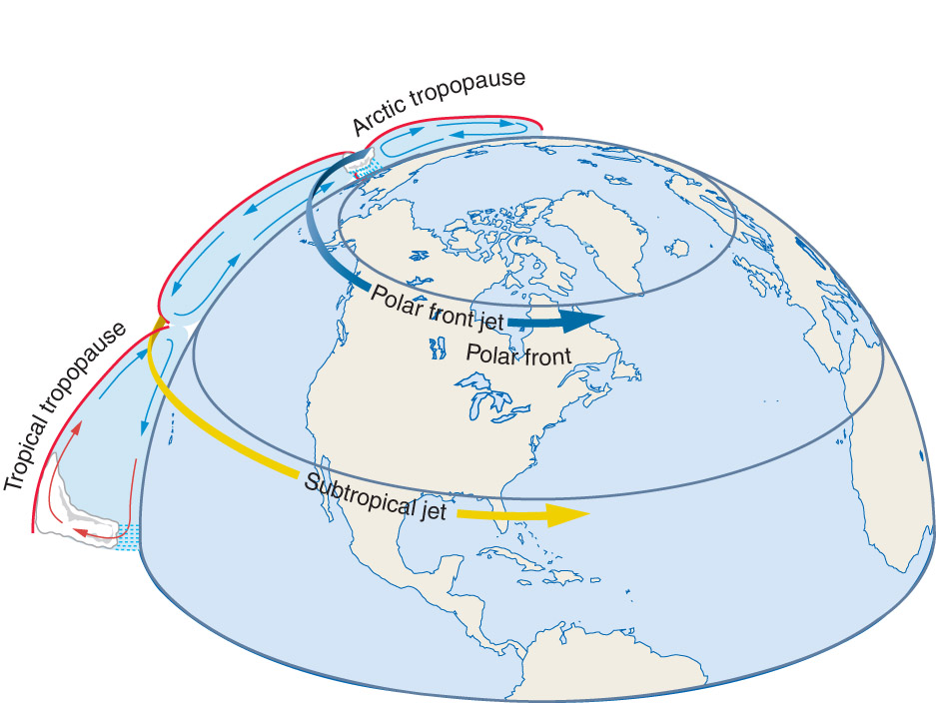
H
H
H
H

Slide 30
Three-Cell Model: #1
As air moves poleward it cools and converges ( in part with subtropical jet stream) as it approaches the middle latitudes
The convergence leads to a piling up of air aloft, and increases the pressure at the surface (more stuff now above)
Creates sub-tropical highs
The converging air aloft leads to sinking motion beneath the sub-tropical highs. The subsiding air warms and produces generally clear skies and warm surface temperatures
This is what produces the worlds deserts
Over the oceans, the center of the subtropical highs produce weak winds, referred to as “Horse Latitudes”

Slide 31
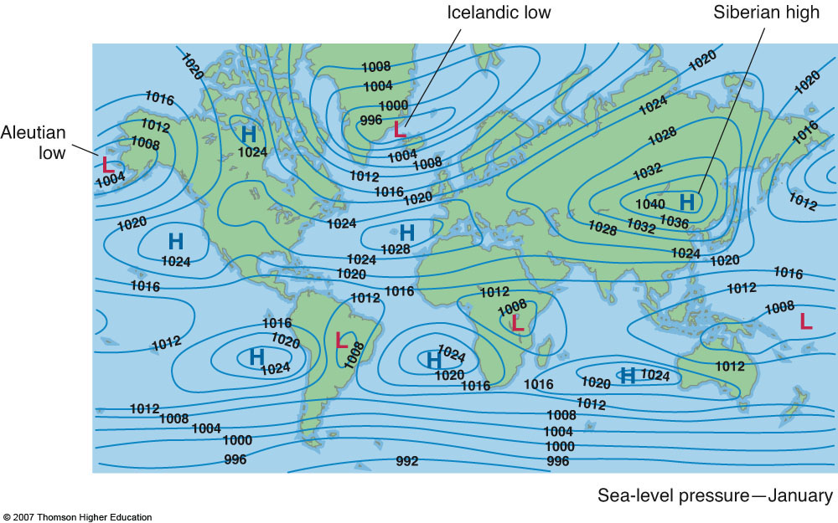
Fig. 7-11a (1), p. 218

Slide 32
Three-Cell Model: #1
From the Horse Latitudes some of the surface air flows back toward the equator
Coriolis deflects this air creating our low-level easterlies or trade winds
Air moves from the northeast in the northern hemisphere and the southeast in the southern hemisphere
These are fairly steady surface winds and provided sailing ships with an ocean route to the Americas. Hence the title “Trade Winds”
Near the equator the trade winds in each hemisphere collide creating a large area of surface convergence, Inter-Tropical Convergence Zone (ITCZ) → more tall thunderstorms!

Slide 33
#3
#2
#1
Fig. 7-6, p. 214

Slide 34
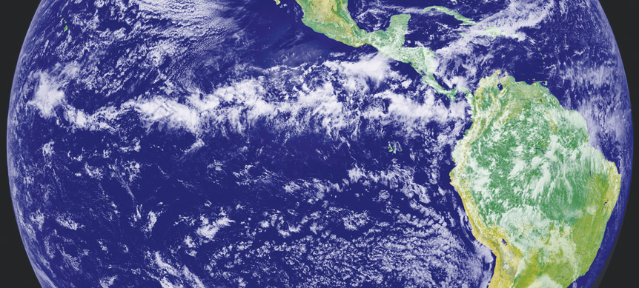
The ITCZ

Slide 35
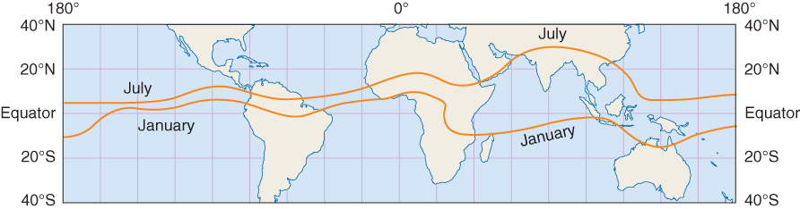
Typical Locations of the ITCZ
ITCZ varies little by the season, due to the required energy to change the temperature
of water
Fig. 7-20, p. 224

Slide 36
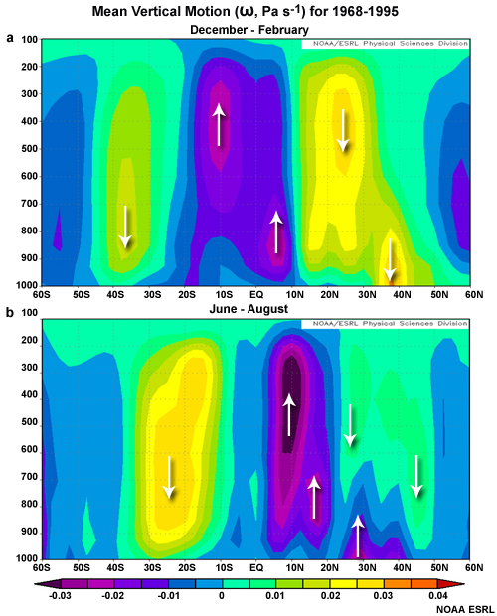

Slide 37
Hadley Cell (#1) Summary:
  Air rises near the equator and begins to move poleward.
  The air accelerates due to conservation of angluar momentum forming the subtropical jet stream.
  Slower poleward moving air aloft converges with the subtropical jet stream around 30° N and is forced to sink.
  Sinking air produces high pressure at the surface, warm temps, and little precip at the surface. These surface high pressure systems are responsible for:
    A majority of the worlds deserts
    The horse latitudes
  Some air from high pressure area flows south, and Coriolis bends it to the right. This forms the easterlies, or trade winds.
  The trade winds from the northern hemisphere converge with those of the southern hemisphere forming the ITCZ near the equator.
  The air at the equator is relatively calm and this region is called the Doldrums.

Slide 38
#3
#2
#1
Fig. 7-6, p. 214

Slide 39
Three-Cell Model: #2
Back to 30˚ Latitude… not all the surface air moves toward the equator, some move towards the poles
This is warm, energy rich air from the subtropics. We are transporting this warmer air to the poles to balance out the energy budget.
The poleward moving air is deflected by Coriolis creating middle latitude westerly winds at the surface

Slide 40
Three-Cell Model: #2
This flow is not consistent as migrating areas of surface high and low pressure break up the flow pattern
As the air travels poleward it encounters cold air moving equatorward from the poles. The two airmasses (more later) do not mix readily (think density differences)
The boundary between these air masses is referred to as the Polar Front
Another upper-level Jet Stream resides in this area: we call it the polar jet, or polar front jet.

Slide 41
Polar Jet
Both the intensity and location of the polar jet change with the seasons.
In the winter the Polar Jet is typically stronger and located further south
In the summer the jet is weaker and retreats well into the higher latitudes (less temperature gradient, less pressure gradient)

Slide 43
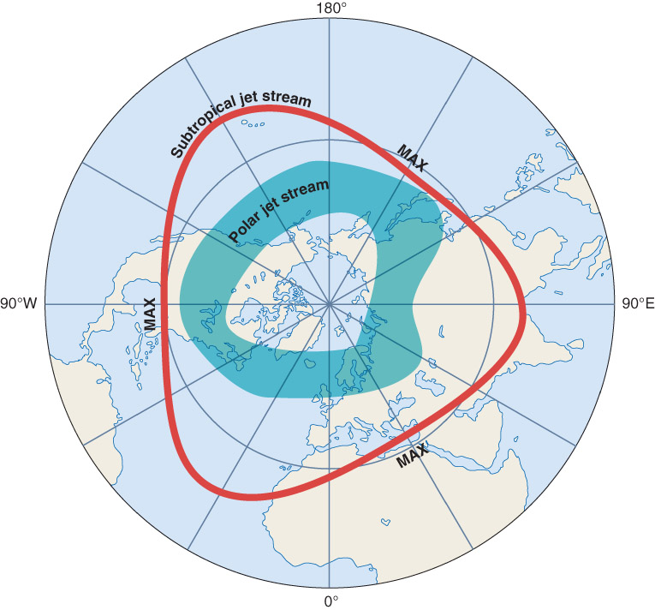
Fig. 7-13b, p. 220

Slide 45
Three-Cell Model #2 Summary:
Air traveling north from the subtropics is turned to the right by the Coriolis force. This produces the midlatitude westerly winds.
The warmer poleward moving air clashes with cold polar air moving south to form the polar front.
The combination of the different air masses produces the polar front jet stream.

Slide 46
#3
#2
#1
Fig. 7-6, p. 214

Slide 47
Three-Cell Model: #3
Referred to as the Polar cell. Cold air above the poles sinks and warms adiabatically.
The (slightly) warmer air over the cold polar surface is a temperature inversion – this results in very little precipitation near the poles.
After sinking, the air has no where to go but south.
As in the other cases, this southward moving air is deflected to right by Coriolis forming the polar easterlies.
Eventually the air must rise (at the polar front) and return poleward to replace the sinking air.
This explains the last of our average global circulations and precip patterns:
  Polar easterlies and the Arctic / Antarctic deserts (very little precipitation)

Slide 48
General Circulation of the Atmosphere
What happens in the “Real World”?
A few areas of semi-permanent highs and lows
In the eastern Atlantic we see the Bermuda-Azores high, drives tracks of tropical cyclones
Counterpart in the Pacific, Pacific High
Islandic Low, Aleutian Low occur where we expect the polar front to lie.
Siberian High

Slide 49
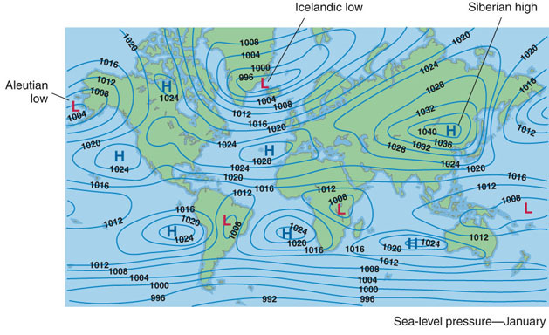
Fig. 7-11a, p. 218

Slide 50
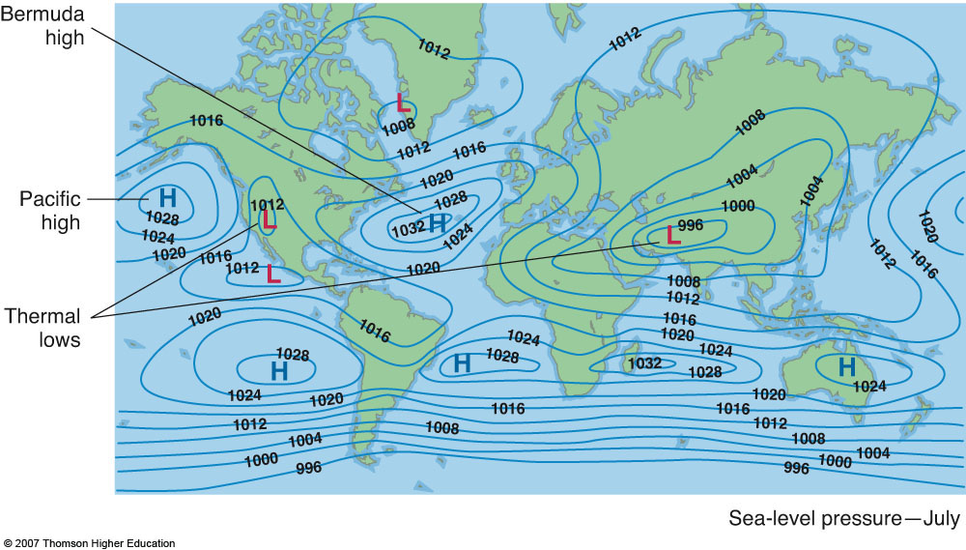
Fig. 7-11a (2), p. 218

Slide 51
General Circulation of the Atmosphere
Thermal lows lead to monsoon circulations
Leads to moist flow off the oceans onto the adjacent land surfaces.
Often responsible for large percentage of precipitation in these regions
  Monsoon: season reversal of winds

Slide 52
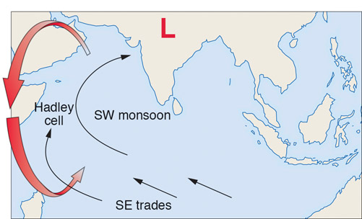
Fig. 7-21, p. 227

Slide 53
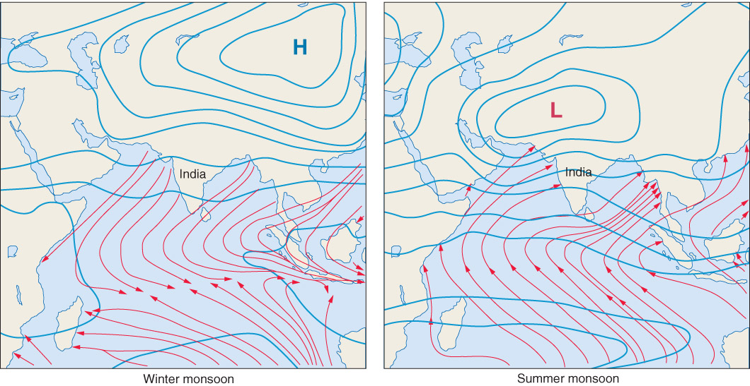
Fig. 7-22, p. 227

Slide 54
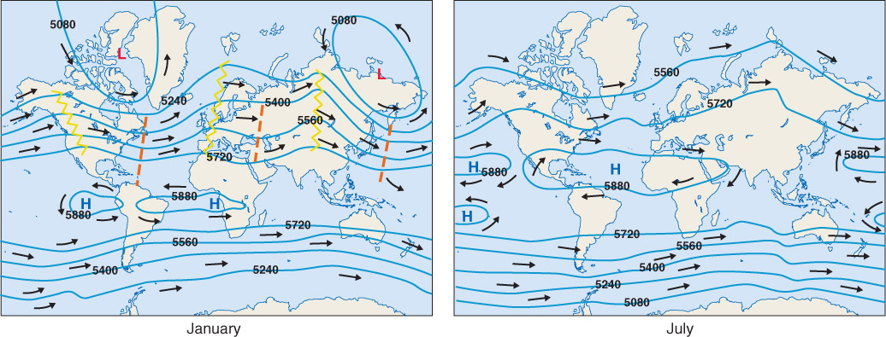
Average Wind Flow and Pressure Patterns Aloft
Fig. 7-14, p. 221

Slide 55
Average Wind Flow and Pressure Patterns Aloft
In both hemispheres, the air is warmer over the low latitudes and colder over the high latitudes
This creates a temperature gradient which leads to a pressure gradient which causes our generally westerly flow in the mid-latitudes
Temperature gradients are steeper in winter than summer. Consequently the winds aloft are stronger during the winter than summer
In the mid and high latitudes wind speeds will continue to increase above 500 mb (no slowing due to surface friction)

Slide 56
Average Wind Flow and Pressure Patterns Aloft
Geostrophic wind is related to the pressure gradient but also inversely proportional to density (higher density = less wind)
Density decreases with altitude in the atmosphere, therefore a given pressure gradient will result in stronger winds with altitude.
We see concentrated bands of strong winds near the top of the troposphere – The Jet Stream

Slide 57
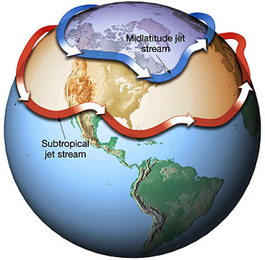
Jet Stream
High speed “rivers” of wind
Several thousand km long but only a few km deep
Wind speeds can often exceed 100 kts (115 mph)
Polar Jet (near the polar front)
Sub-tropical Jet (over the subtropical high)

Slide 58
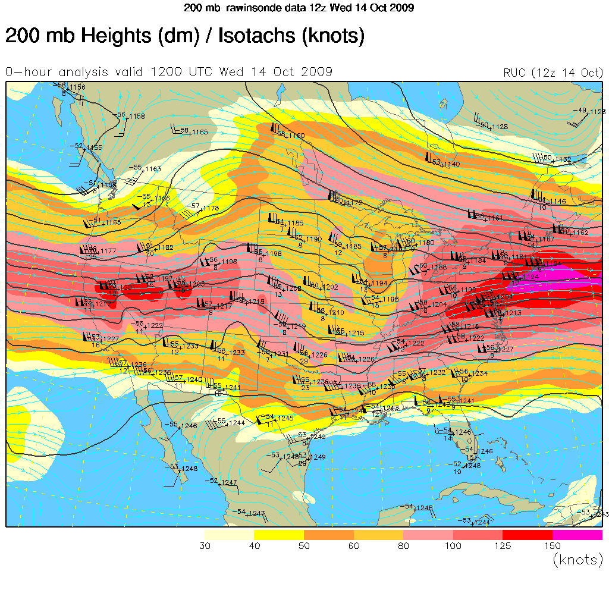

Slide 59
General Circulation of the Atmosphere
We know that the winds in the upper-atmosphere (troposphere) flow in a wave-like pattern with troughs and ridges
These features move cold air equatorward and warm air poleward
The northern hemisphere is typically encircled by several of these waves at any given time
These waves are called long-waves or Rossby Waves (named for Carl Gustav Rossby)

Slide 60
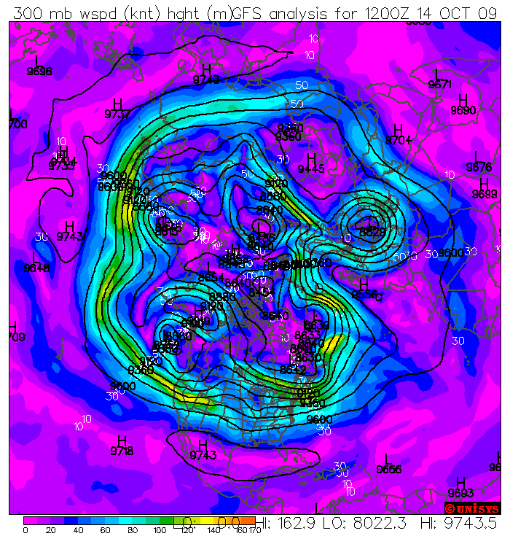
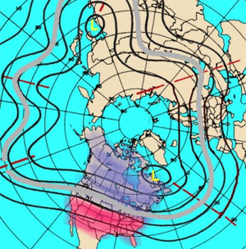

Slide 61
General Circulation of the Atmosphere
Just like electromagnetic waves, waves in the atmosphere have a wavelength, amplitude and period (time between waves)
Describing the movement of these waves is a key component in weather forecasting because there are vertical motions associated with troughs and ridges (low pressure=rising motion, high pressure=sinking)
These longwaves (Rossby waves) have 3 distinct flow patterns: Zonal, Meridional, and Split flows.

Slide 62
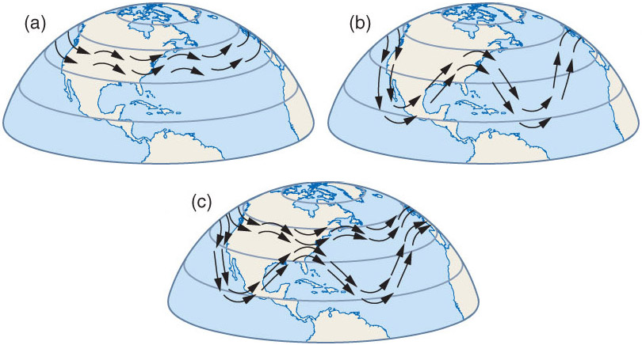
General Circulation of the Atmosphere: Zonal Flow
Small amplitude waves result in a nearly zonal flow (west to east flow pattern). The flow is nearly parallel to lines of latitude.
In this regime cold air tends to remain poleward.

Slide 63
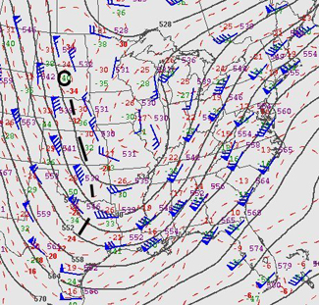
General Circulation of the Atmosphere: Meridional Flow
Meridional flow pattern means highly amplified troughs and ridges
In this pattern, cold air flows toward the equator and warm air flows poleward

Slide 64
General Circulation of the Atmosphere: Split Flow
Split flows occur when you have zonal flow near the poles and meridional pattern further south.
Air masses can become “cutoff” when this happens producing cutoff lows / highs.

Slide 65
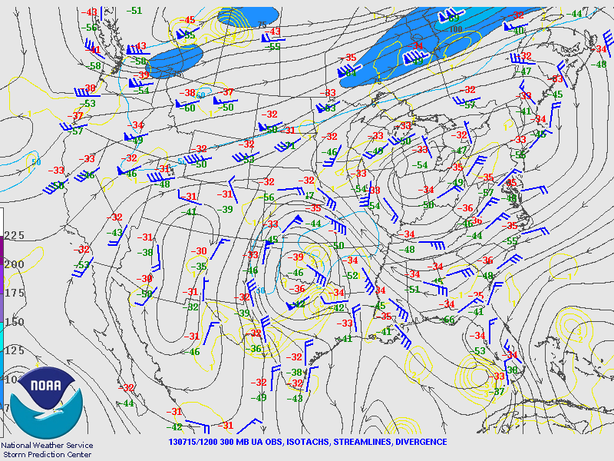
General Circulation of the Atmosphere: Split Flow
Split flows occur when you have zonal flow near the poles and meridional pattern further south.
Air masses can become “cutoff” when this happens producing cutoff lows / highs.

Slide 66
General Circulation of the Atmosphere
Superimposed on the long-waves or Rossby waves are smaller features called “short-waves”
These features travel quickly through the Rossby waves
Difficult to observe and track, adds to uncertainty in weather forecasts
Can be foci for severe weather

Slide 67
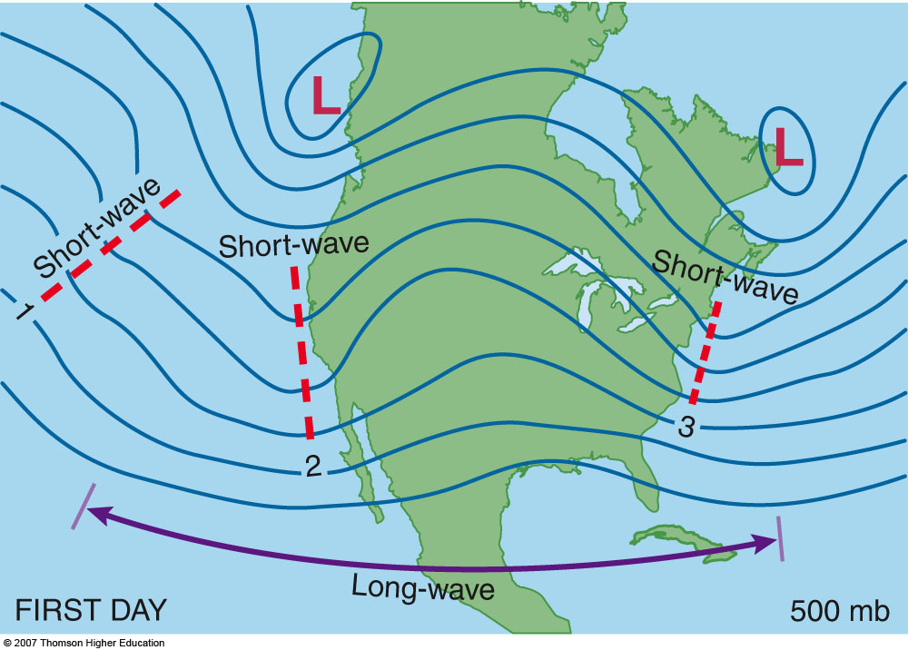
2nd edition: Fig. 7-18a, p. 202

Slide 68
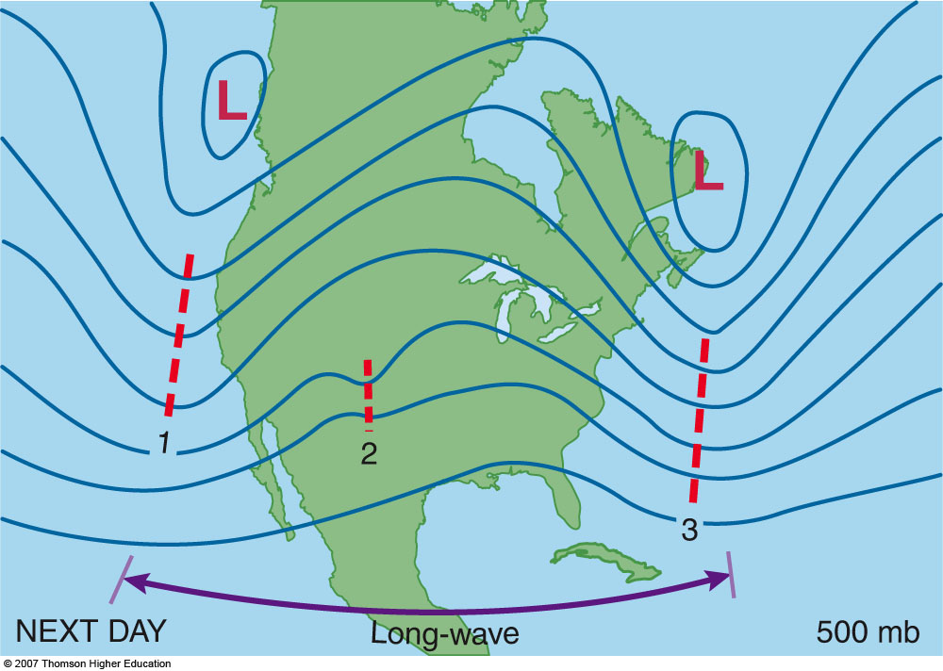
2nd Edition: Fig. 7-18b, p. 202

Slide 69
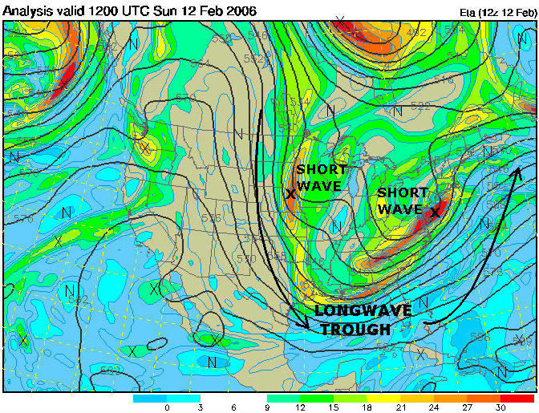

Slide 70
General Precipitation Patterns
On the global scale… we expect abundant rainfall where we see general rising motion.
Thus over the tropics, there are areas of high precipitation due to the ITCZ
Also high precipitation between 40˚ and 55˚ latitude where mid-latitude storms and the polar front force air upward
Areas of low precipitation are found near sinking air: 30˚ latitude in the vicinity of sub-tropical highs and the polar regions

Slide 71
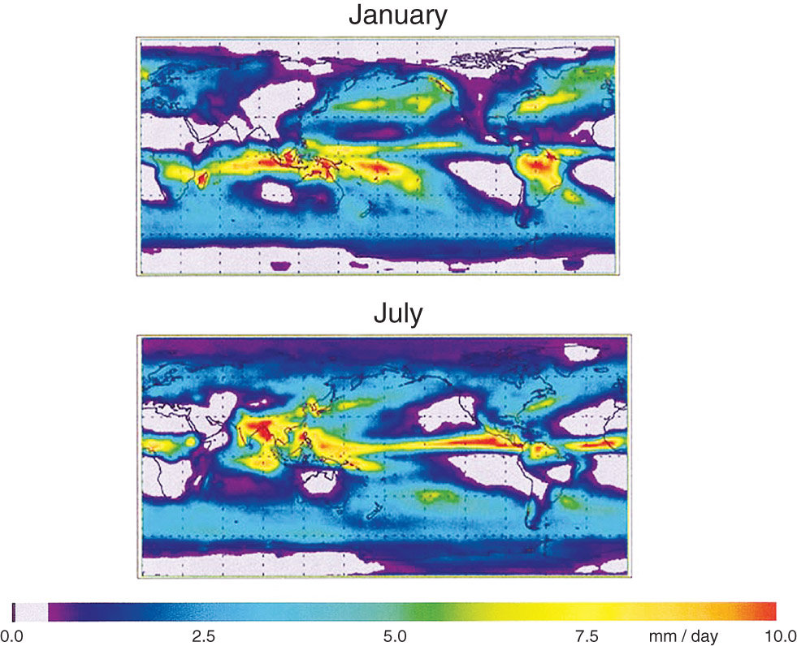
Fig. 7-4, p. 212

Slide 72
Other Types of Jet Streams
Tropical Easterly Jet
Stratospheric polar night jet
Low-level Jet

Slide 73
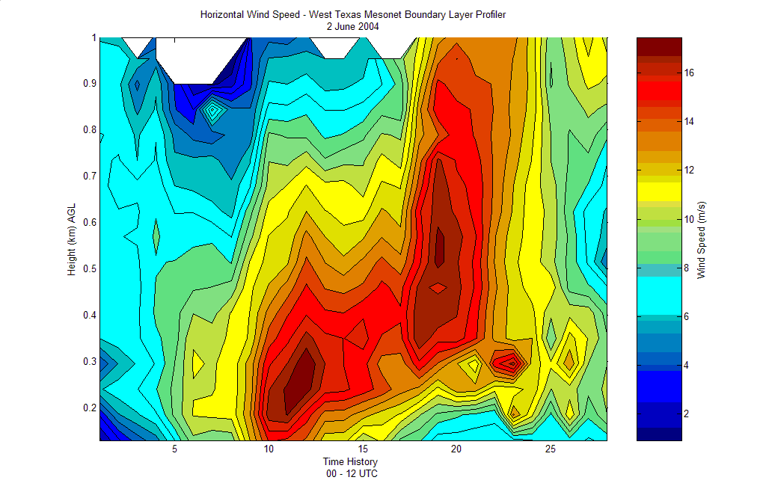
Low-Level Jet
Common over the Great Plains of the US
Can reach 50-60 kts only a few hundred meters above the surface
Surface winds remain light
Atmosphere is effectively “decoupled” during the night from surface friction effects
Sloping terrain east of the Rockies also plays a role

Slide 74
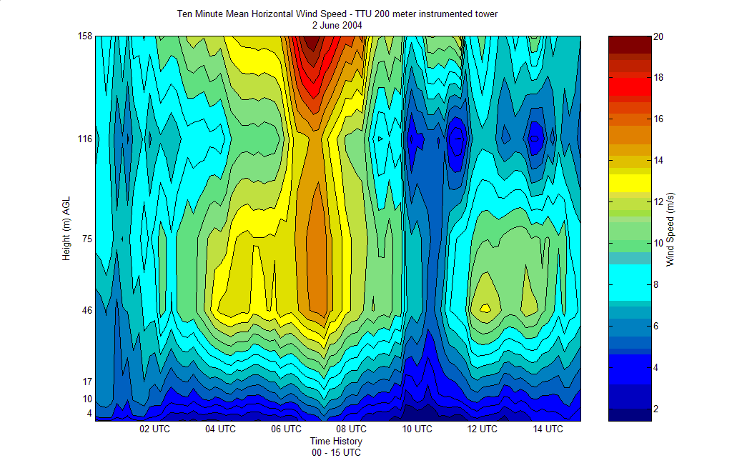

Slide 75
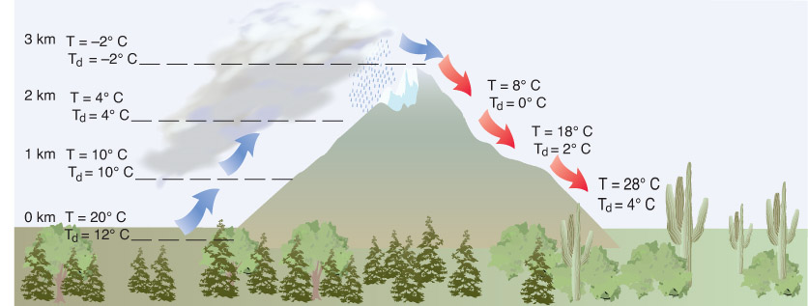
Before we leave the topic of common winds….
Box 7-2, p. 223

Slide 76
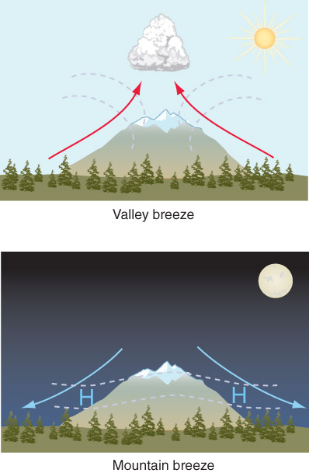
Before we leave the topic of common winds….
Box 12-13, p. 392
Purely orographic:
  Mountain winds – due to cold mountains / plateaus, air cools and sink rapidly at night, these can be extremely strong
  Valley winds – warm valley air rises up the side of the mountain during the day

Slide 77
Before we leave the topic of common winds….
Orographic + Forcing: Chinook Winds – northern Great Plains, very dry and warm from adiabatic compression of air forced down the Rocky Mountains (record of 49 °F change in temperature in two minutes)
Land/Sea Breeze also applies to large lakes – Lake breeze

Slide 78
Important Concepts
Jet stream – region of fast winds in the upper troposphere
Wind patterns result from uneven heating of the Earth’s surface
Hadley / single cell model
  Cold, high pressure over poles – sinking motion
  Warm, low pressure over equator – rising motion
  Low level winds from poles to equator, upper level opposite, transporting latent and sensible heat
  Doesn’t apply to the atmosphere since the Earth is rotating (Coriolis)

Slide 79
Three-Cell
0 °
  Light surface winds – Doldrums
  Convection “Hot Towers” which strengthens the pressure gradient – Inter-Tropical Convergence Zone, lots of rain
  Motion spreads outward at the top of the troposphere
0 ° -30°
  Strong, warm westerlies aloft from 0°
  Generally steady easterlies at the surface – Trade Winds because air is moving from 30° to 0°
30 °
  Large temperature and pressure gradients aloft – subtropical jet
  Sinking motion – sub-tropical highs: warm, weak surface winds, Horse Latitudes and deserts

Slide 80
Three-Cell
30 °-60°
  Warm westerlies at the surface from 30° encounters cold air from the poles
  Aloft air moves south
60°
  Polar front at the surface from mix of warm southern air and cold polar air
  Polar front jet aloft
  Upward motion and rain
60 ° -90°
  Surface Polar Easterlies as air move south
  Aloft air moves north
90 °
  High pressure, sinking air, little precip over poles

Slide 81
Three-Cell
Realistically, the boundaries shift depending on season, land-mass
Some semi-permanant highs/lows exist (be able to identify these) which create monsoon circulations
Larger changes in temperature and pressure during winter – stronger winds
Stronger winds with altitude and latitude
Rossby Waves in upper-levels transport cold air away from poles and warm air towards the poles

Slide 82
Wave Patterns
Zonal – west-east flow, cold air stays poleward
Meridional – north-south, large ridges/troughs, transports air
Split flow – Zonal flow closer to the pole, meridional further from the pole, “cutoff” lows/highs
Short-waves – small features, important for forecasting and changing the overall flow, but difficult to identify

Slide 83
Local common winds
Low-level jet – strong nocturnal winds not far above the surface
Mountain winds – cold air sinking rapidly off high altitudes (opposite of valley winds)
Combining orographic influences and large scale forcing can result in strong winds and large changes in weather (ex: Chinooks)

