Slide 1
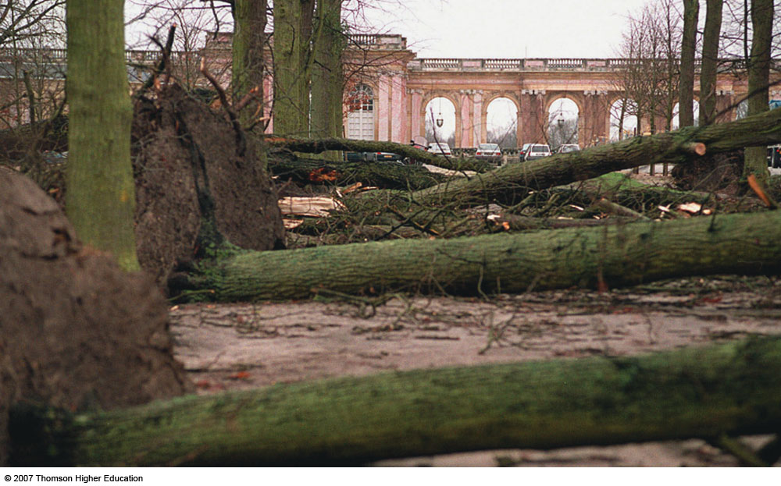
Chapter 6
Atmospheric Forces and Wind
ATMO 1300
SUMMER 2017

Slide 2
Last Time
Temperature
  How is it measured
  Diurnal, annual, interannual cycles
  Diurnal cycle depends on:
    Solar radiation and longwave radiation, balance
  Annual variations depend on:
    Latitude
    Surface type/bodies of water
    Elevation/aspect
    Cloud cover
  Interannual
    Climate patterns (El Nino/ La Nina)
    Greenhouse Gases
    Volcanic Eruptions

Slide 3
Last Time
Stability
  Determines vertical motion tendency
  Determines type of cloud that may form
  Related to buoyancy
    Positive buoyancy → Unstable
    Negative buoyancy or neutral buoyancy → Stable
  Compare the temperature of a parcel of air to that of the environment
  T_{p} > T_{e} → unstable
  T_{p} < T_{e} → stable
  Neutral when equal

Slide 4
Last Time
Stability
  4 types of stability (3 for now)
    Absolutely unstable, absolutely stable, neutrally stable
  Environmental temperature profiles measured with weather balloons and radiosonde instruments
Temperature inversions
  Impacts on severe storms and agriculture
  Radiation induced or geographically (i.e. mountain valley cold-air draining)
Wind chill and the heat index

Slide 5
Chapter 6
Atmospheric Forces and Wind
ATMO 1300
SUMMER 2017

Slide 6
Chapter 6
Atmospheric Forces and Wind
Motions
Balance of Forces
Atmospheric Maps
High and Low Pressure

Slide 7
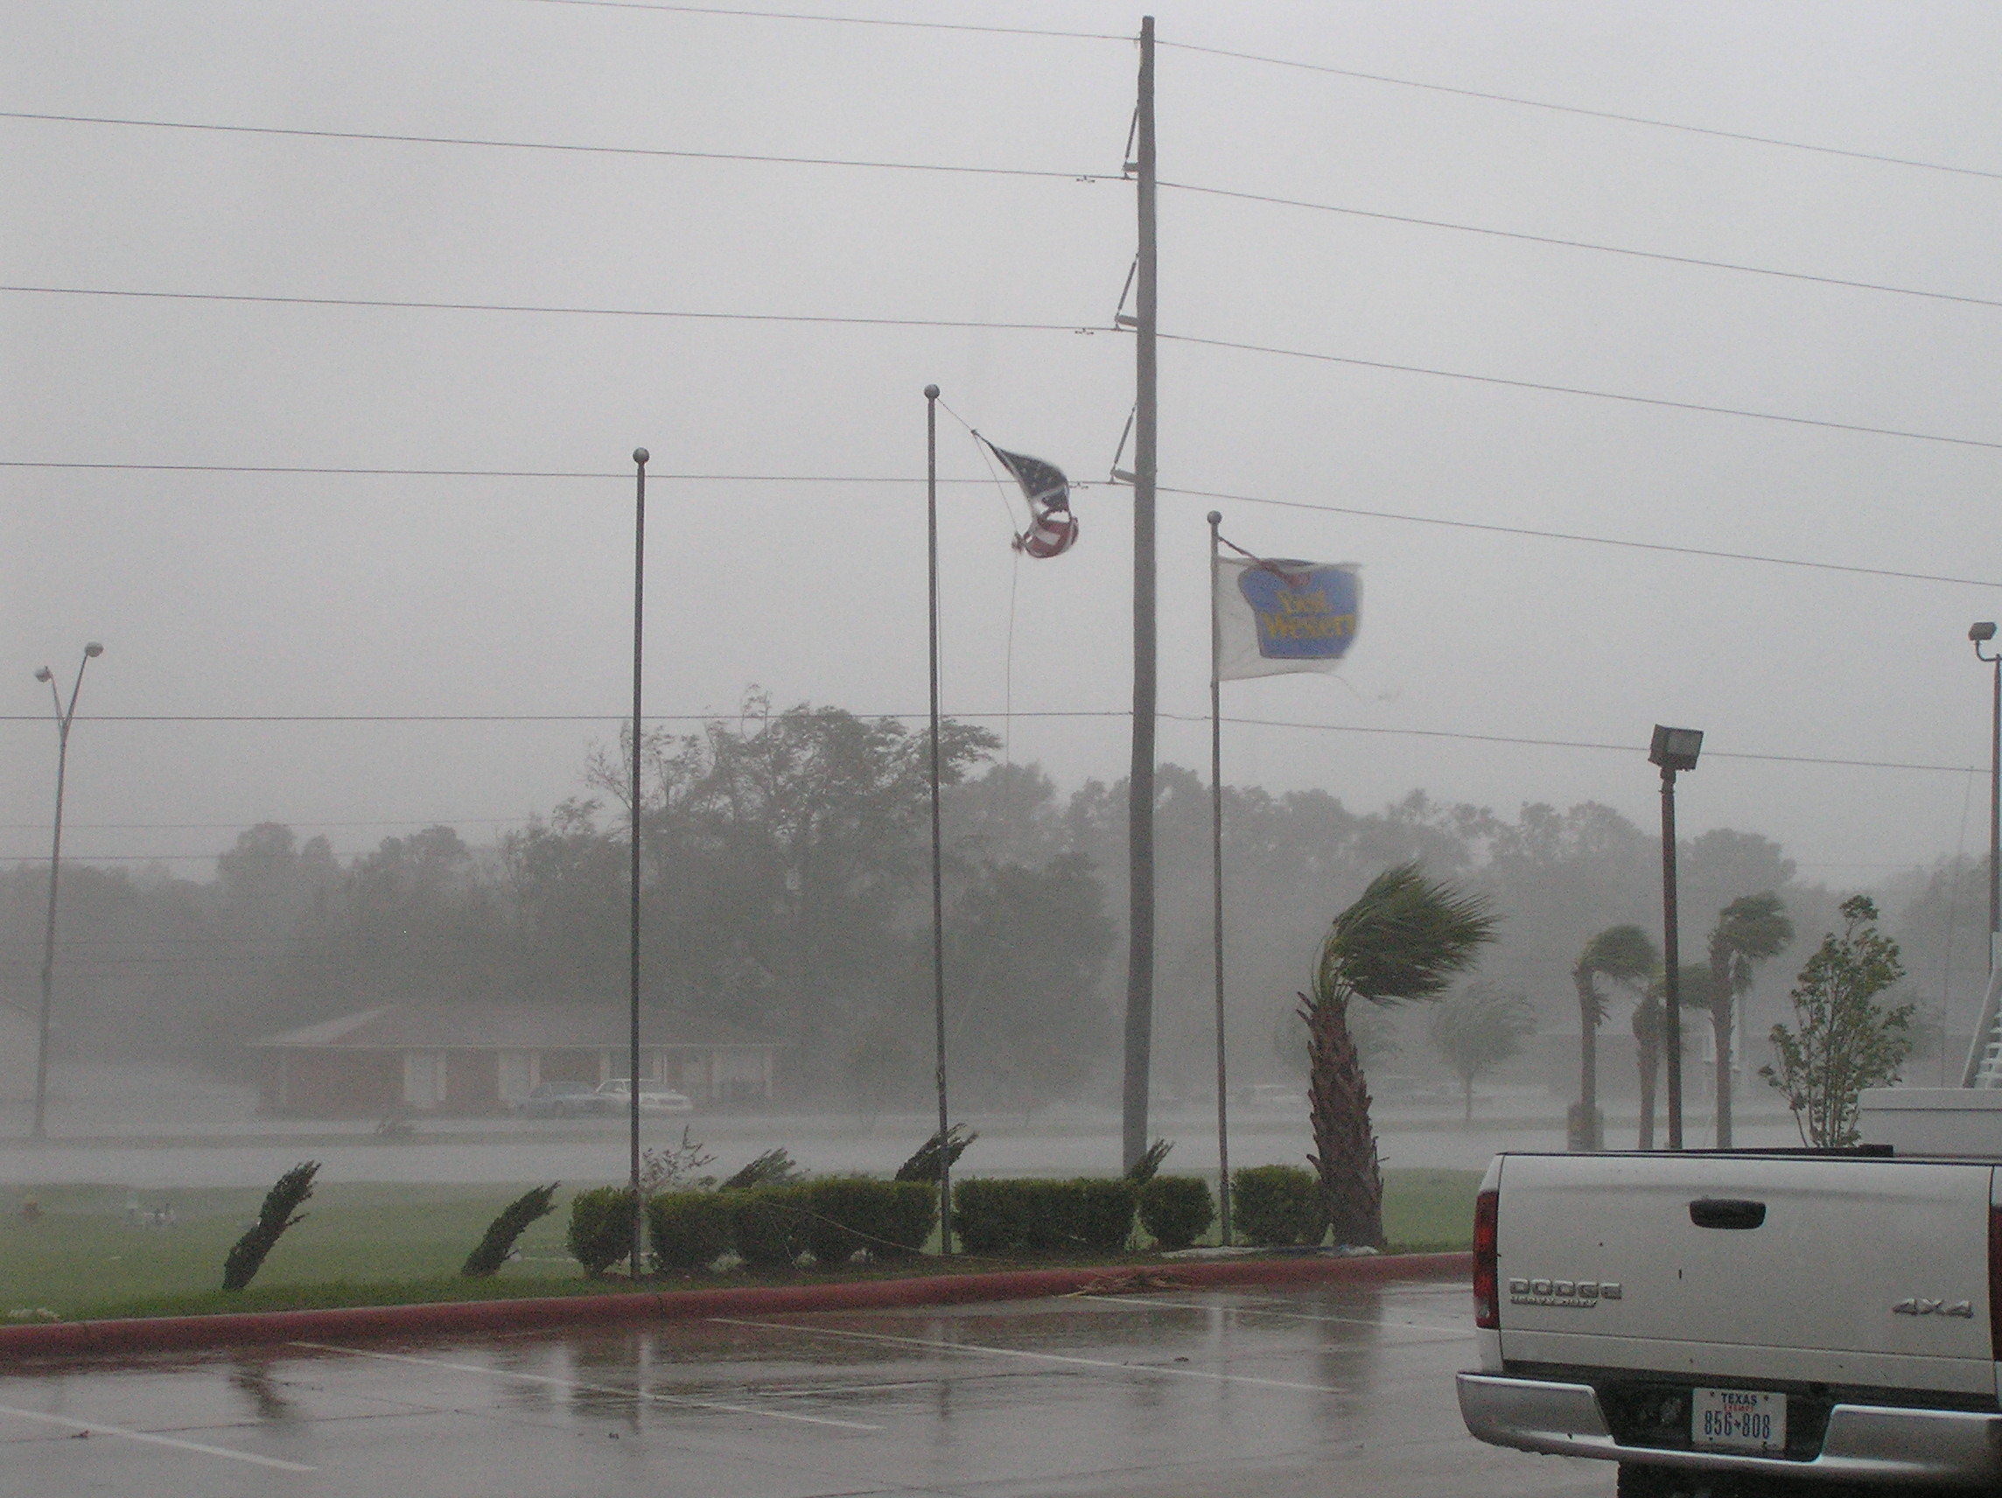
First…what is wind?
The large-scale motion of air molecules (i.e., not thermal motion)
It is a vector: in that it has a speed and direction.
Speed can be measured as:
  Miles per hour (mph)
  Nautical miles per hour (knots, kts)
  Meters per second (m/s)

Slide 8
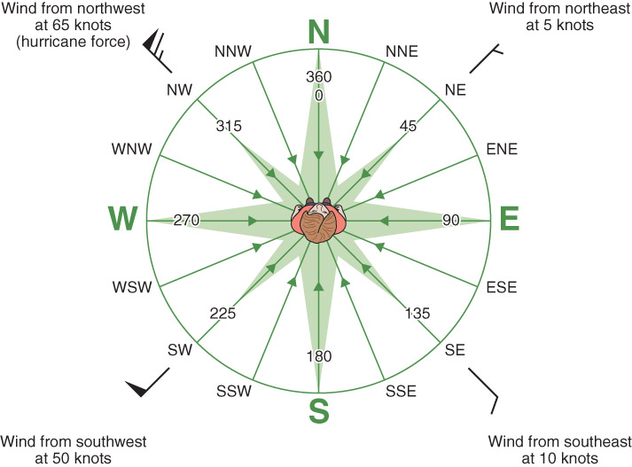
Fig. 6-1, p. 180

Slide 9
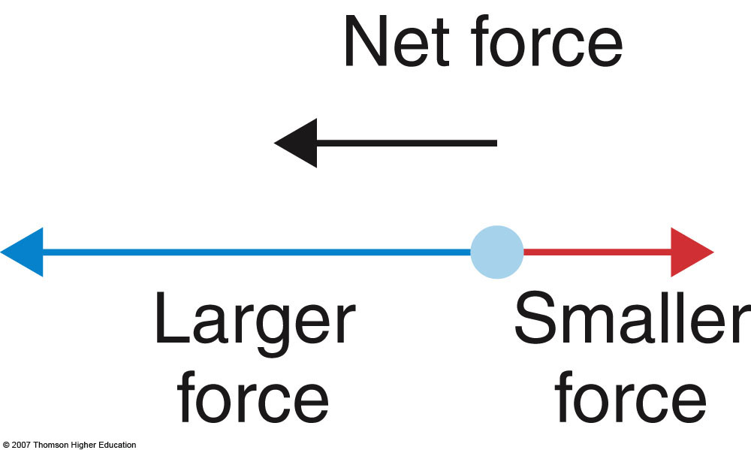
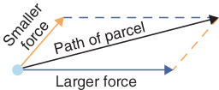
Force
Newton’s Second Law of Motion:
F = ma
Force = mass x acceleration
Imbalance of forces causes net motion
Notes:
Slide23.mp3
What do we mean by a force? According to Newton’s second law of motion a force is that which acts on an object with a certain mass to cause an acceleration. In mathematical form this law is expressed as
F = ma
where m is the mass and a is the acceleration. Acceleration is rate of change of the velocity.

Slide 10
Forces We Will Consider
Gravity
Pressure Gradient Force
Coriolis Force (due to Earth’s rotation)
Centrifugal Force / Centripetal Acceleration
Friction
Notes:
Slide22.mp3
We are now ready to begin a discussion of the forces that affect the movement of air. These are pressure gradient force, Coriolis force, the force due to friction, centrifugal force and the downward directed force of gravity. We will primarily discuss the first three.

Slide 11
Gravitational Force
Attraction of two objects to each other
Proportional to mass of objects
F = G ( ^{m1 x m2} / _{r * r} )
For us, gravity works downwards towards Earth’s surface

Slide 12

Pressure Gradient Force
Gradient – the change in a quantity over a distance
Pressure gradient – the change in atmospheric pressure over a distance
Pressure gradient force – the resultant net force due to the change in atmospheric pressure over a distance

Slide 13
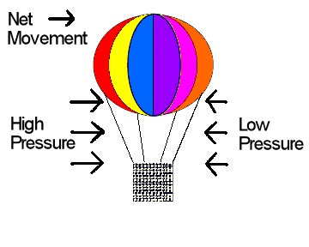
Pressure Gradient Force
Sets the air in motion
Directed from high to low pressure
Figure from www.met.tamu.edu/class/ATMO151
Notes:
Slide25.mp3
The pressure gradient force sets air in motion. Without horizontal differences in pressure there would be no wind. The pressure gradient force is directed from high to low pressure. An air parcel subjected to a horizontal pressure gradient would experience higher pressure on one side and lower pressure on the other side similar to the balloon in the figure. The air parcel, like the balloon, would move in a direction from high to low pressure. On a weather map, the pressure gradient force is always directed perpendicular to the isobars or contours toward lower pressure.

Slide 14
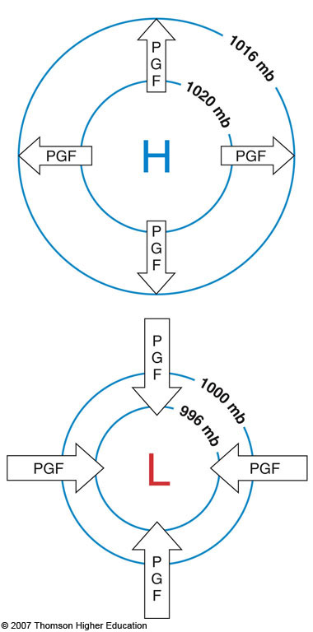
Pressure Gradient Force on the Weather Map
H = High pressure (pressure decreases in all directions from center)
L = Low pressure (pressure increases in all directions from center)
The contour lines are called isobars: lines of constant air pressure
Strength of resultant wind is proportional to the isobar spacing
Less spacing = stronger pressure gradient = stronger winds
Fig. 6-4, p. 161
Notes:
Slide26.mp3
The magnitude of the pressure gradient force is proportional to the isobar or contour spacing because the isobar or contour spacing represents how strong or weak the pressure gradient is. If the isobars or contours are closely packed together, the pressure gradient is higher and therefore the pressure gradient force is stronger. This would cause the wind speeds to be higher than in an area where the isobars or contours are farther apart.

Slide 15
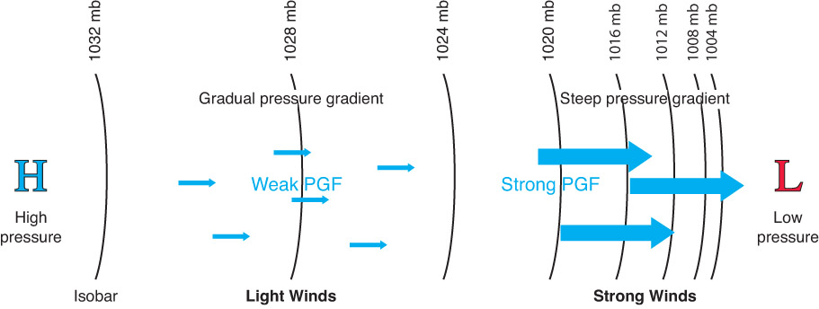
Fig. 6-4, p. 182

Slide 16
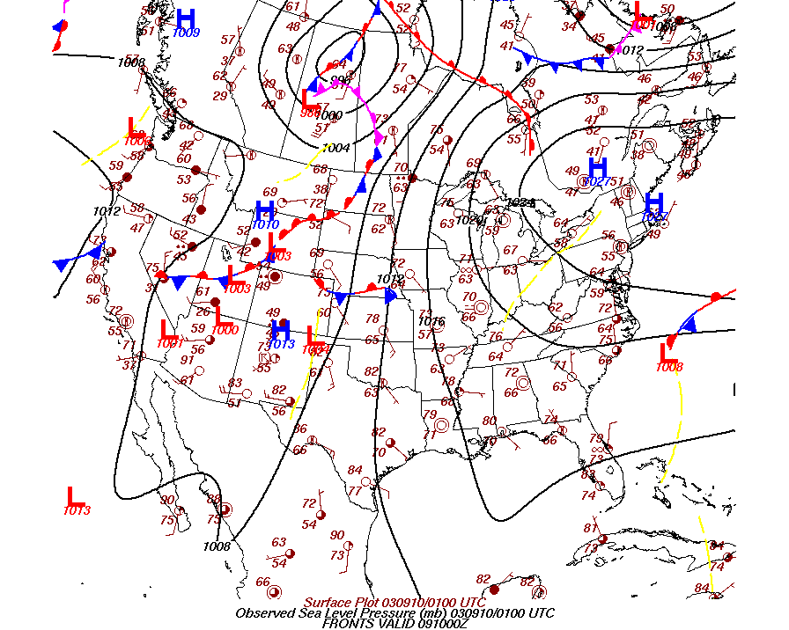
A Typical Surface Weather Map
Notes:
Slide27.mp3
On this surface weather map we would expect to have higher wind speeds over the eastern Dakotas and Minnesota than over Vermont and New Hampshire because the isobars are closer together across the eastern Dakotas and Minnesota.

Slide 17
A Typical Surface Weather Map
Strong P.G.
Weak P.G.
Weak P.G.
Notes:
Slide27.mp3
On this surface weather map we would expect to have higher wind speeds over the eastern Dakotas and Minnesota than over Vermont and New Hampshire because the isobars are closer together across the eastern Dakotas and Minnesota.

Slide 18
Pressure Measurements
Station Pressure – the pressure observed at some location. Depends on amount of mass above that location
Sea Level Pressure (SLP) – Station pressure converted to sea level. The pressure measured if the station were at sea level
Notes:
Slide19.mp3
There are two types of pressure measurements: Station pressure and sea level pressure. Station pressure is simply the pressure observed at some location. Recall from the lesson on weather observations that the collection of instruments widely used to measure weather elements at the surface is called ASOS. ASOS locations can be called weather stations. It is important to remember that station pressure depends on how much air is above that station.

Slide 19
Why SLP is Important
Pressure change in the vertical is much greater than in the horizontal.
Stations at a higher altitude will always record a lower pressure due to the vertical pressure change.
We are interested in horizontal pressure changes because they cause air to move
Notes:
Slide21.mp3
Why is sea level pressure important and why do we convert station pressures to sea level for any station not already at sea level? We have shown that pressure decreases with height. It does so at a greater rate in the lower atmosphere than in the upper atmosphere. This vertical change in pressure is much greater than pressure changes in a horizontal direction. But it’s the horizontal changes in pressure that we’re most interested in with regard to understanding why we have wind.

Slide 20
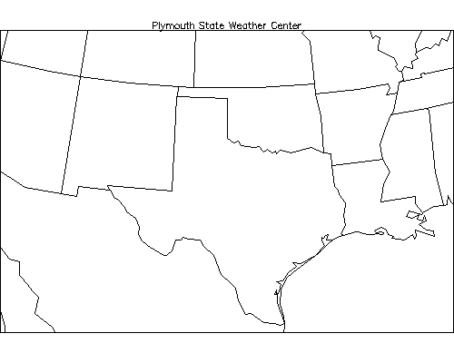
Why SLP is Important
Denver elevation – 5000 ft (~ 1 mile)
Galveston – close to Sea Level (~ 0 ft)
Denver
Galveston
Notes:
Slide23.mp3
To illustrate consider two stations: Denver, CO and Galveston, TX. The elevation of Denver is about 5000 feet while Galveston is very close to sea level. The higher you are in the atmosphere the lower the pressure since there is less air above you.

Slide 21
Why SLP is Important
Pressure decreases 10 mb/100 meters in elevation on average in lower troposphere
Must remove elevation factor to obtain a true picture of the horizontal pressure variations.
Notes:
Slide24.mp3
In the lower troposphere, on average, pressure decreases about 10 mb for every 100 meter rise in altitude. That is a substantial decrease and greatly overshadows any differences in pressure from one place to another due to atmospheric effects such as temperature changes. If we are going to realistically compare pressure from place to place we must remove this elevation factor so that the changes in pressure we observe are due to processes happening in the atmosphere.

Slide 22
Why SLP is Important
“Top of Atmosphere”
Denver
D
Galveston
5000
G
Sea Level
Remember, pressure is a measure of the amount of atmospheric mass that is above a particular location. Because there is less air above Denver, it will always have a lower pressure than Galveston regardless of what is happening in the atmosphere.
Notes:
Slide25.mp3
The figure on the right shows a cross section or vertical view of the atmosphere. As you can see there’s an additional 5000 feet of air above Galveston that’s not there above Denver. The station pressure at Denver will therefore be considerably lower than the station pressure at Galveston because there is a lesser amount of air above Denver. Remember the pressure at any altitude depends on the amount of mass above.

Slide 23
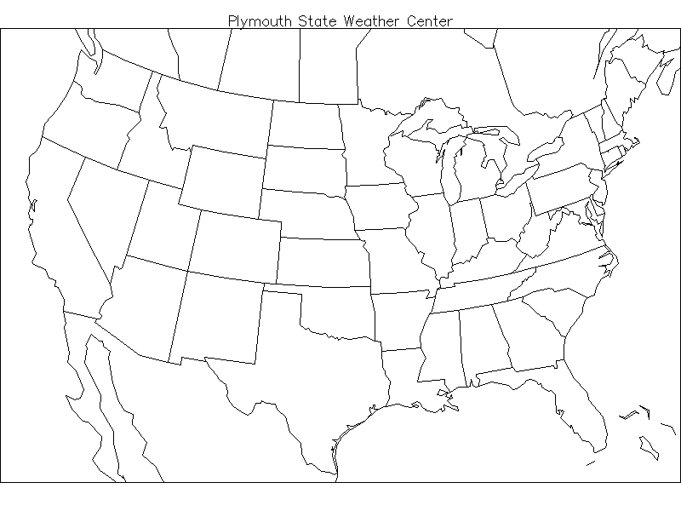
If Station Pressures Were Used
Lower pressure in mountain areas
Higher pressure in coastal areas
Not a true picture of atmospheric effects
L
L
L
H
H H
Notes:
Slide27.mp3
If station pressures at cities all over the nation were plotted on a map and analyzed, it would always show lower pressure in mountainous areas such as the Rockies and high pressure in coastal regions. This would not be a true picture of the horizontal variation in pressure. Differences in atmospheric pressure caused by changes occurring in the atmosphere would be masked by the elevation factor if station pressures were used.

Slide 24
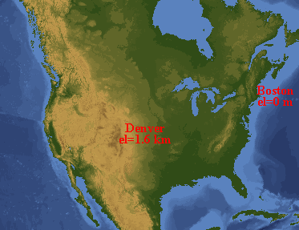
Sea Level Pressure
Must remove the elevation bias in the pressure measurements.
Method: Convert station pressure to sea level pressure (move the station to sea level)
Figure from apollo.lsc.vsc.edu/classes/met130
Notes:
Slide28.mp3
So how do we remove this elevation bias in pressure measurements? By converting station pressures to sea level pressures. The sea level pressure at some location, say Denver is the pressure that would be measured if Denver were at sea level. The method of converting station pressures to sea level pressures standardizes all the pressure reading to a common reference level which is sea level.

Slide 25
Converting to SLP
Standard Atmosphere
Rate of vertical pressure change is 10mb/100meters
5000 ft = 1524 meters
→ Increase station pressure by 152 mb to get SLP!
Denver
5000 ft
Sea Level
Notes:
Slide29.mp3
The method of converting to sea level pressure involves assuming what is called a standard atmosphere exists in the fictitious column of air between the station location and sea level. The standard atmosphere is an internationally agreed upon set of conditions that represent an average state of the atmosphere. In the standard atmosphere, the rate of pressure change in the vertical is 10 mb/100 meters as given earlier.

Slide 26
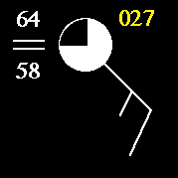
Station Model
Sea Level Pressure is given in millibars (mb).
In the figure to the right, the yellow number is a CODED value of pressure.
Figure from ww2010.atmos.uiuc.edu
Notes:
Slide31.mp3
Recall from the lesson on weather observations that sea level pressure is plotted on a surface weather map to the upper right of the station circle in the station model format

Slide 27
Surface Weather Map
In terms of pressure observations, all the stations are effectively at sea level.
Notes:
Slide32.mp3
In terms of pressure observations, the surface weather map is a constant level chart because all the stations are effectively at sea level. All the other weather elements such as temperature and wind are reported at the station location whatever its elevation might be.

Slide 28
Surface Weather Map
Notes:
Slide33.mp3
Drawing isobars, lines connecting equal values of sea level pressure, on a surface weather map graphically depicts the horizontal variation of pressure. Differences in pressure on this map help to reveal processes taking place in the atmosphere. The dark lines are isobars. The isobar pattern graphically depicts the horizontal pressure gradient.

Slide 29
Why Analyze SLP? (cont’d)
Helps identify the following features:
→ Low pressure center
→ High pressure center
→ Low pressure trough
→ High pressure ridge
Notes:
Slide37.mp3
Another reason that sea level pressures are analyzed by drawing isobars on a surface weather map is that the isobar pattern reveals important features in the pressure field. These features include a low pressure center, high pressure center, low pressure trough and high pressure ridge. Let’s see how these features are shown in the isobar pattern on a surface weather map.

Slide 30
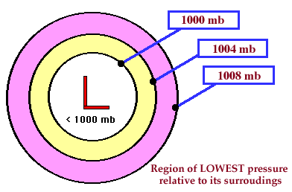
Low Pressure Center
Figure from ww2010.atmos.uiuc.edu
Center of lowest pressure
Pressure increases outward from the low center
Also called a cyclone
Notes:
Slide38.mp3
An “L” on a weather map with closed isobars around it represents the center of lowest pressure relative to the pressures surrounding it. Pressures increase in all directions from the center of the low. A low pressure center is sometimes called a cyclone.

Slide 31
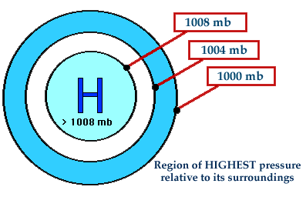
High Pressure Center
Figure from ww2010.atmos.uiuc.edu
Center of highest pressure
Pressure decreases outward from the high center
Also called an anticyclone
Notes:
Slide39.mp3
An “H” on a weather map with closed isobars around it represents the center of highest pressure relative to the pressures surrounding it. Pressures decrease in all directions from the center of the high. A high pressure center is sometimes called an anticyclone.

Slide 32
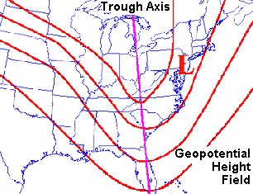
Low Pressure Trough
Figure from www.crh.noaa.gov/lmk/soo/docu/basicwx.htm
An elongated axis of lower pressure
Isobars are curved but not closed as in a low
1000
1004
1008
1012
Notes:
Slide40.mp3
A low pressure trough is an elongated axis of lower pressure. The isobars are curved but not circular. Pressure is lowest along the axis of the trough. Moving away from the trough in either direction, pressures increase.

Slide 33
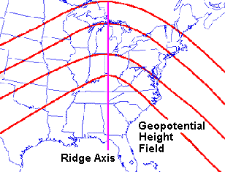
High Pressure Ridge
Figure from www.crh.noaa.gov/lmk/soo/docu/basicwx.htm
An elongated axis of higher pressure
Isobars are curved but not closed as in a high pressure center
1000
1004
1008
1012
Notes:
Slide41.mp3
A high pressure ridge is an elongated axis of higher pressure. Again, the isobars are curved but not circular. Pressure is highest along the axis of the ridge. Moving away from the ridge in either direction, pressures decrease.

Slide 34
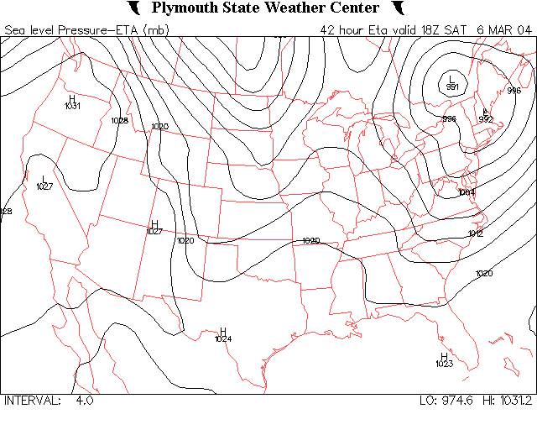
Surface Weather Map
Notes:
Slide42.mp3
On this analyzed surface weather map, a low pressure center is located over southern Quebec Canada with a trough extending southward into extreme eastern Pennsylvania, western North Carolina and into Alabama. A ridge extends from northern Arkansas into Wisconsin. Another trough extends from south central Canada southward into eastern Nebraska.

Slide 35
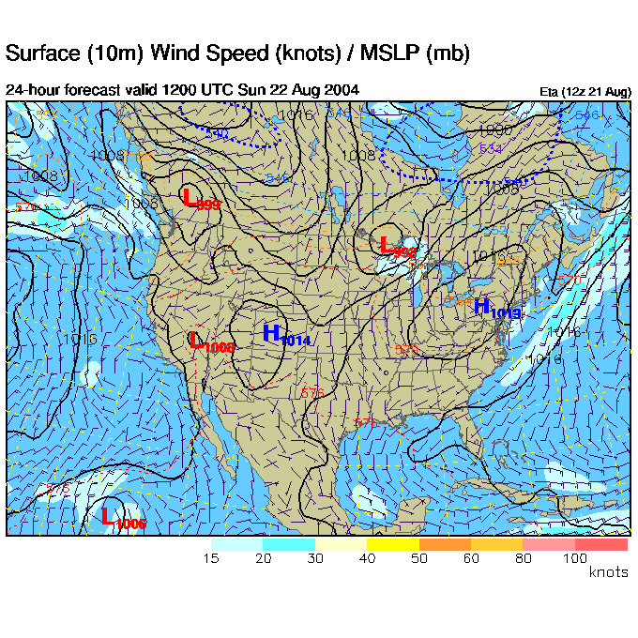
Surface Weather Map
Figure from www.rap.ucar.edu/weather/model
The surface weather map is essentially a constant level map!
How can we look at horizontal pressure differences farther up in the atmosphere?
Notes:
Slide7.mp3
The surface weather map, as far as depicting horizontal pressure gradients is concerned, is really a constant level map since all the station pressures have been converted to sea level. To represent horizontal pressure gradients in the upper atmosphere we could use constant level maps such as a 5 km map or an 8 km map. However that is not what is done.

Slide 36
Constant pressure maps
Notes:
Slide4.mp3
We’ll begin part 2 by describing how horizontal pressure gradients are depicted in the upper atmosphere through the use of constant pressure maps. Then we’ll focus on the primary forces in the atmosphere that govern air movement. Lastly we will explain how the horizontal movement of air can result in rising or sinking air we generally term vertical motion.

Slide 37
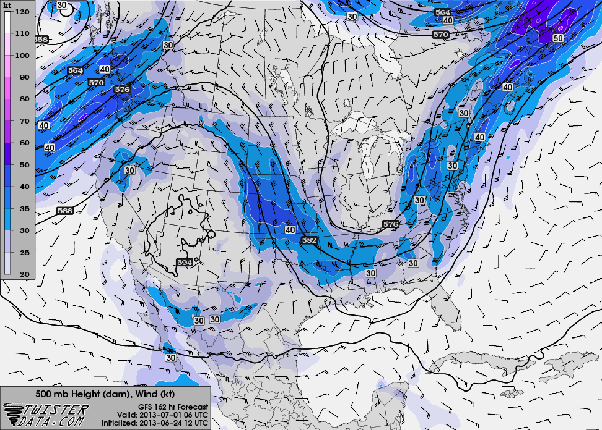
Constant Pressure Map
Above the surface, we reverse the approach and look at the altitude of a given pressure surface, e.g. at what height is the pressure 500 mb?
We call these isobaric charts (or maps, surfaces, levels, etc).
So, why would the height of a pressure level change?
Notes:
Slide8.mp3
Instead of constant level maps we use what are called constant pressure maps such as the one you see here. You might question how can horizontal differences in pressure be depicted on a map called a constant pressure map. If something is constant how can it vary. On a constant pressure map the pressure is the same everywhere. What changes from place to place is the height in the atmosphere where some value of pressure is observed.

Slide 38
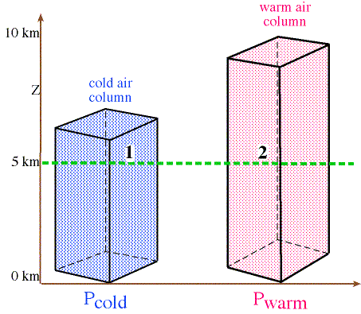
Temperature & Pressure
Listed to the side are two columns containing air of different temperature
The total number of molecules is identical in each column
At 5 km, will the pressure be higher at Point 1 or Point 2?
Figure from apollo.lsc.vsc.edu/classes/met130
Notes:
Slide5.mp3
To understand horizontal differences in pressure in the upper atmosphere and how we represent those differences on weather maps, we need to return to an earlier discussion of how temperature affects density and pressure. Recall in this illustration where we have two columns of air, one colder than the other, that at a height of 5 km the pressure will be higher in the column on the right than in the colder column of air on the left. Why? Because there is more air above point 2 than above point 1.

Slide 39
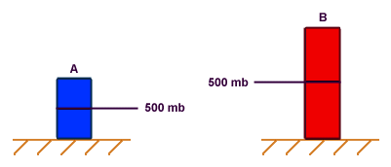
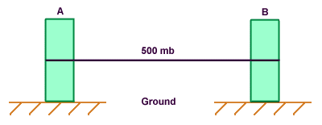
Effect of Temperature on Pressure
Figure from ww2010.atmos.uiuc.edu
Notes:
Slide9.mp3
To explain constant pressure maps let’s look at the influence of temperature on pressure using this figure. On the left are two columns of air, A and B, both having the same average temperature. Given that the same amount of mass is in both columns, the density in both columns must be the same since the height of both columns is the same. Remember density is mass per unit volume. Since the density is the same in both, the rate at which pressure decreases with height is the same.

Slide 40
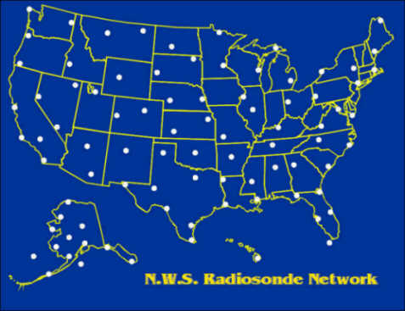
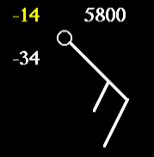
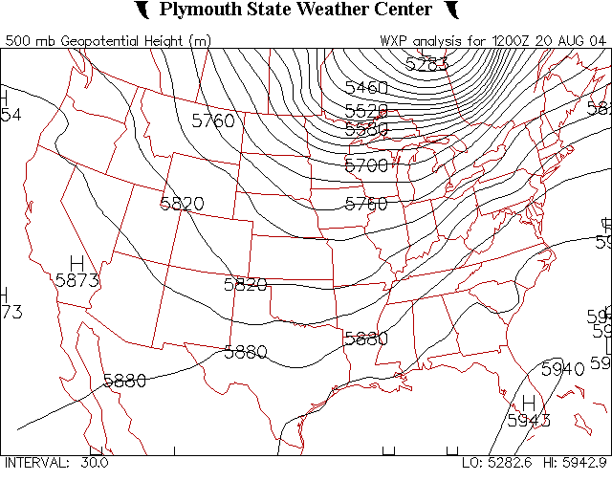
Construction of a 500 mb Map upper left map from www.srh.noaa.gov/bmx/upperair/radiosnd.html
1
3
2
500
4
500
500
500
Notes:
Slide16.mp3
Let’s see how a 500 mb map would be constructed. Twice a day at locations over the U.S. (as seen in fig. 1) a radiosonde is launched that measures pressure, temperature, humidity and wind at various altitudes. At all these locations, the altitude at which the radiosonde measures a pressure of 500 mb is determined (fig 2). That altitude can vary from place to place because of horizontal variations in temperature.

Slide 41
Constant Pressure Map
Differences in height of a given pressure value = horizontal pressure gradient
Contour lines connect equal height values.
Contours can be thought of in the same way as isobars on a surface weather map
Notes:
Slide18.mp3
As we have demonstrated, in areas where there is a difference in the height of a particular pressure value such as 500 mb, place to place there is also a horizontal difference in pressure or in other words a horizontal pressure gradient. So contours on a 500 mb map or any constant pressure map can be thought of in the same way as isobars on a surface weather map.

Slide 42
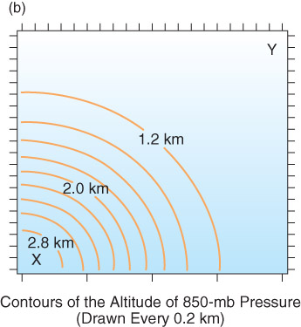
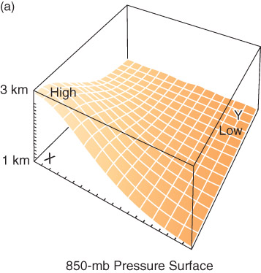
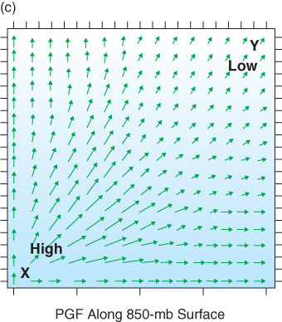
Fig. 6-7, p. 184

Slide 43
Pressure variations on a constant height surface (e.g., sea level) =
Height variations on a constant pressure surface (e.g., 500 mb)
L
H
Notes:
Slide13.mp3
Focus on the two columns of air on the right and note the horizontal line labeled 500 mb in column A. We’ve extended that line through column B. That line represents a constant height or level in the atmosphere. At that level in column A the pressure is 500 mb. At that same height in column B the pressure would be greater than 500mb because you would have to go up a certain distance to measure 500 mb. Remember pressure decreases with height.

Slide 44
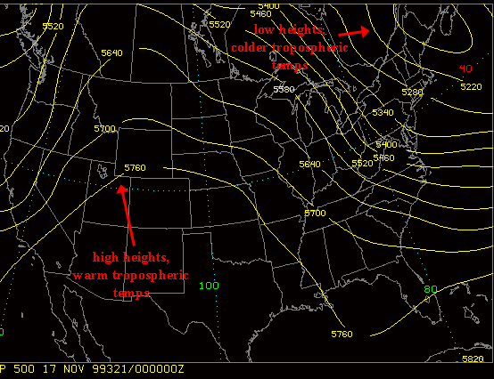
A 500 mb Map
Figure from apollo.lsc.vsc.edu/classes/met130
Notes:
Slide19.mp3
This is a 500 mb map with contour lines drawn on it. The contours actually show variations in the height of the 500mb pressure surface. By surface we don’t mean a solid surface like the surface of the ground. Think of it as a three dimensional imaginary surface up in the atmosphere where everywhere on that surface a barometer would indicate a pressure of 500 mb. This imaginary surface can vary in height because of horizontal temperature gradients.

Slide 45
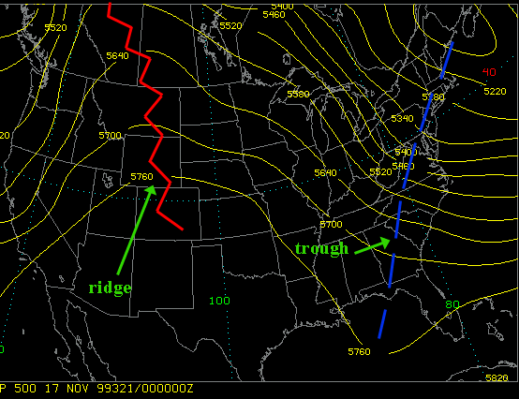
500 mb Chart
Notes:
Slide21.mp3
Highs, lows, troughs, and ridges are features seen in the contour pattern similar to isobars on a surface weather map.

Slide 46
Constant Pressure Maps
Standard constant pressure maps:
  200 mb ~ 39,000 ft
  250 mb ~ 34,000 ft
  300 mb ~ 30,000 ft
  500 mb ~ 18,000 ft
  700 mb ~ 10,000 ft
  850 mb ~ 5,000 ft
Each level can highlight certain features in the atmosphere. For instance, 200 – 300 mb is used to analyze the jet stream.
Notes:
Slide15.mp3
A constant pressure map is constructed by first selecting a particular value of pressure. The pressure values that are routinely used are 850 mb, 700 mb, 500 mb, 300 mb, and 200 mb. The approximate height (in feet) of these pressure values are shown to give you an idea of where they are found in the atmosphere.

Slide 47
Vertical Pressure Gradient
There is a pressure gradient force directed upward
Pressure gradient force is much larger in the vertical than in the horizontal
Why doesn’t all air get sucked away from the Earth?
Notes:
Slide29.mp3
The horizontal pressure gradient force affects the horizontal movement of air we call wind. A pressure gradient force also exists in the vertical direction. It is directed upward since pressure decreases with height. This vertical pressure gradient force is much greater than any horizontal pressure gradient force because the vertical change in pressure is much greater than pressure changes in the horizontal. Why then don’t we observe air rapidly moving upward all the time?

Slide 48
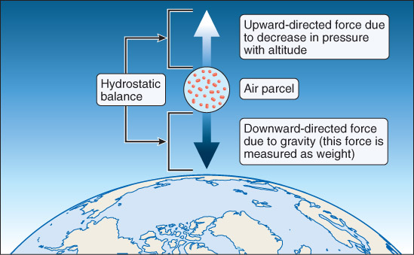
Hydrostatic Equilibrium
Fig. 6-13, p. 192
Notes:
Slide30.mp3
The downward acting force of gravity balances the upward directed pressure gradient force. The balance between these two forces is called hydrostatic balance or hydrostatic equilibrium. If there is a balance of forces there can be no net vertical accelerations. The atmosphere is not always in hydrostatic equilibrium. For example, in thunderstorms very strong upward acceleration of the air exists due to buoyancy forces.

Slide 49
Centrifugal Force / Centripetal Acceleration
Due to change in direction of motion
Example: Riding in a car, sharp curve, which direction are you pushed?
OUTWARDS! Your body still has momentum in the original direction. This “force” is an example of centrifugal force.
Need sharp curvature in flow for this force to be important (examples?)

Slide 50
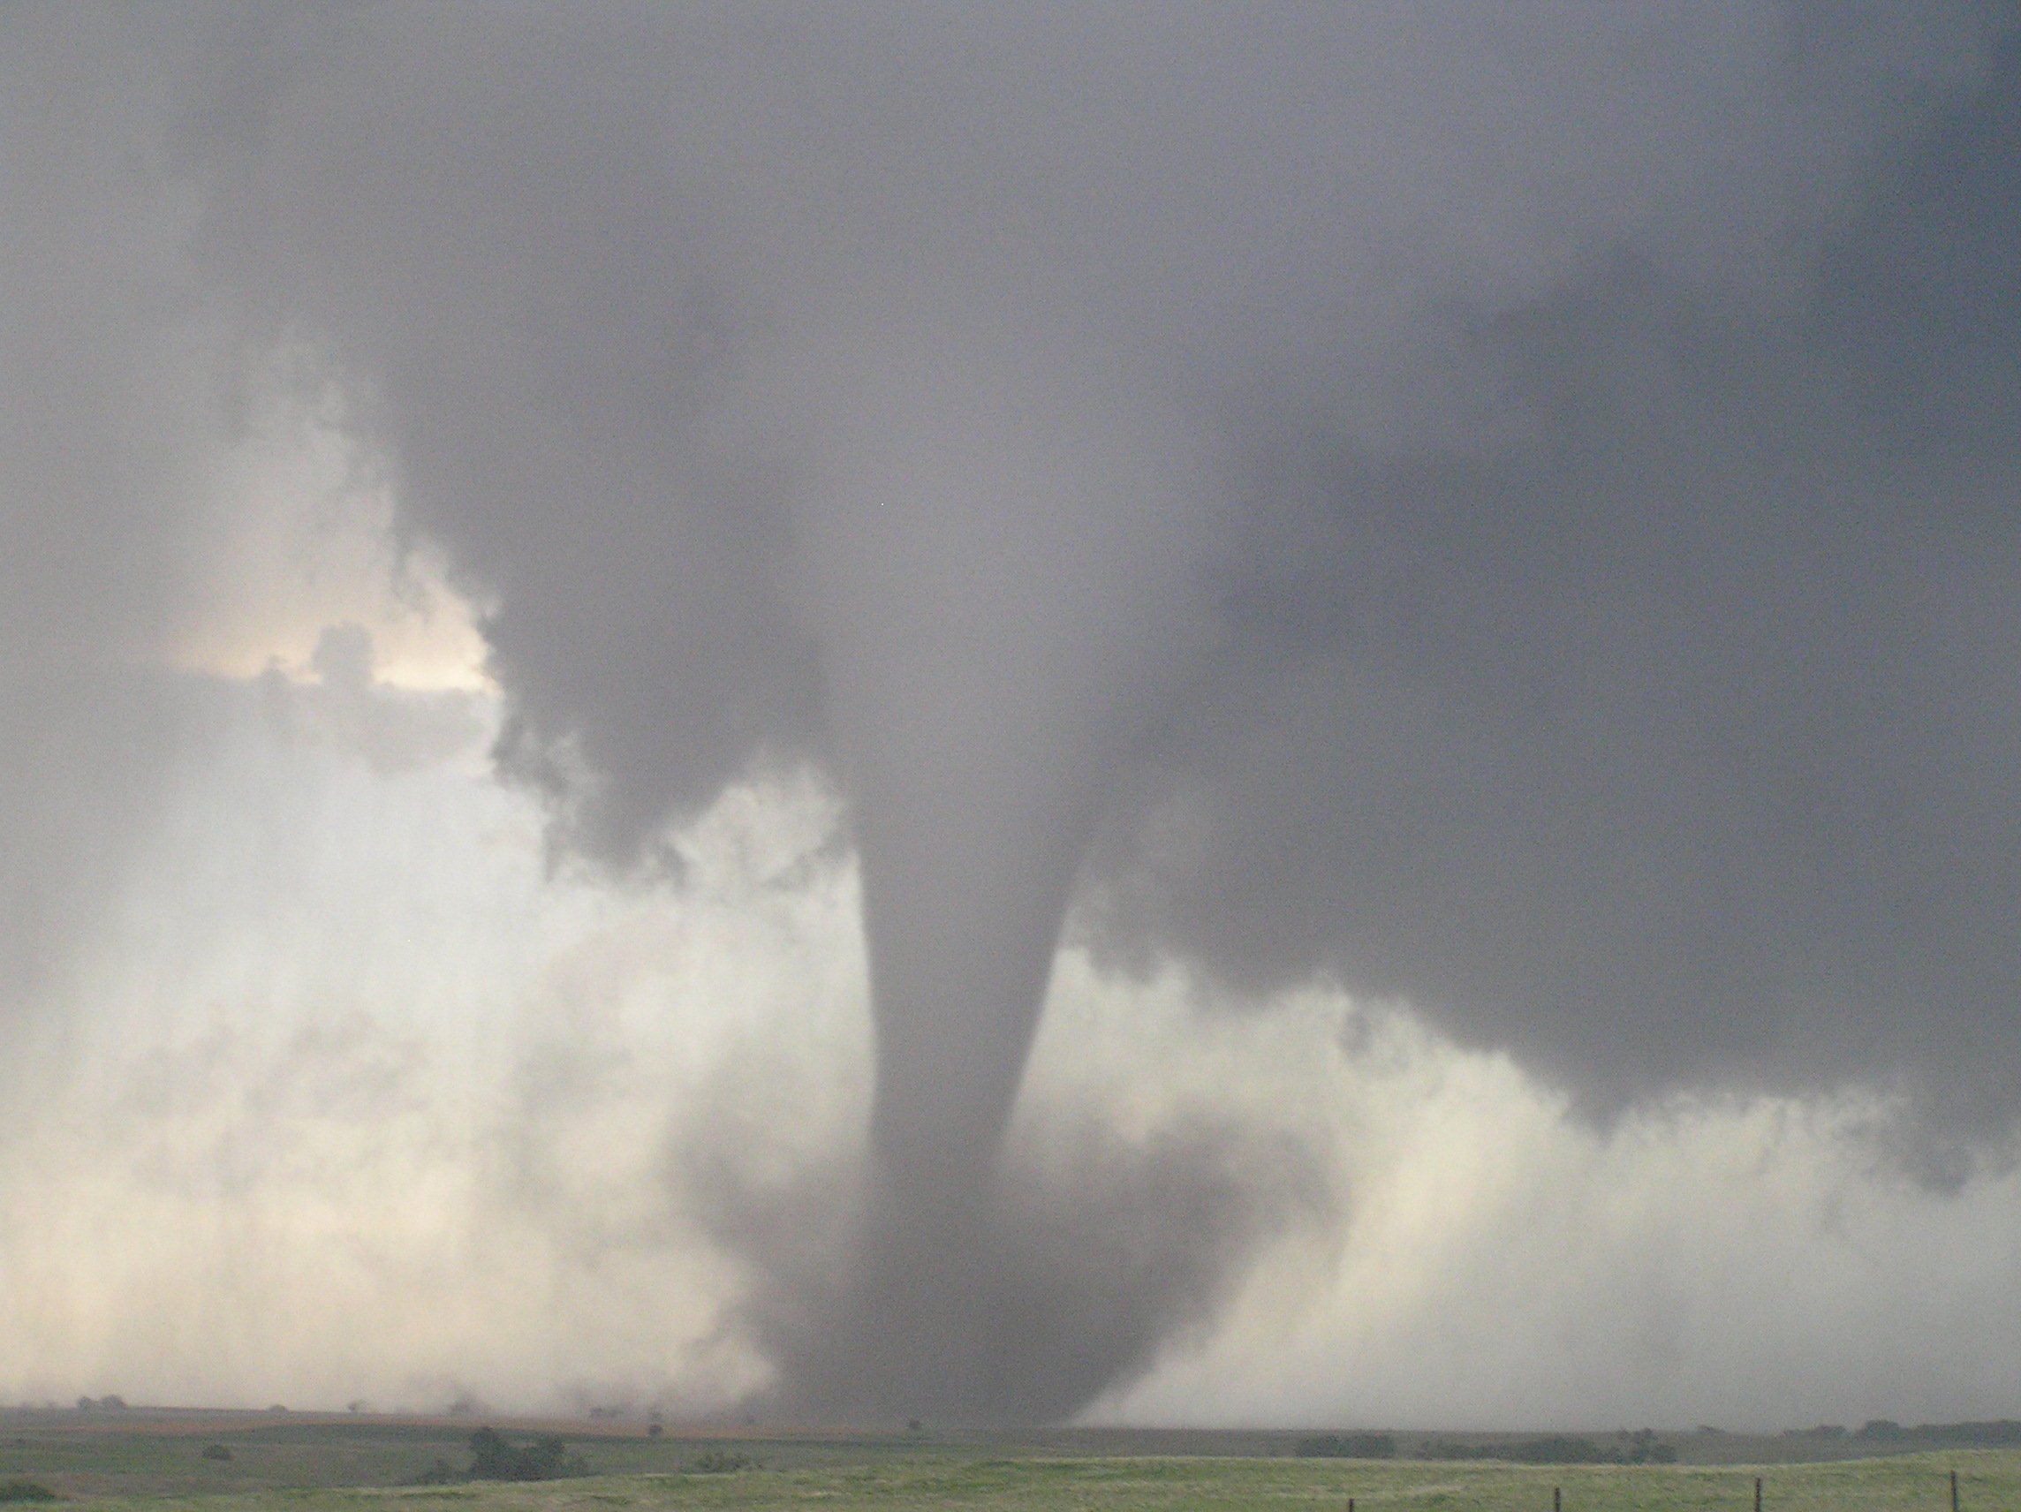

Slide 51
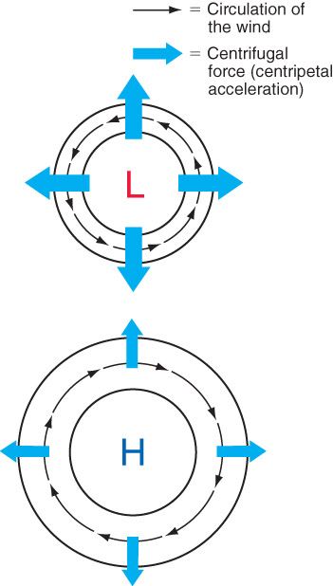
Fig. 6-8, p. 185

Slide 52
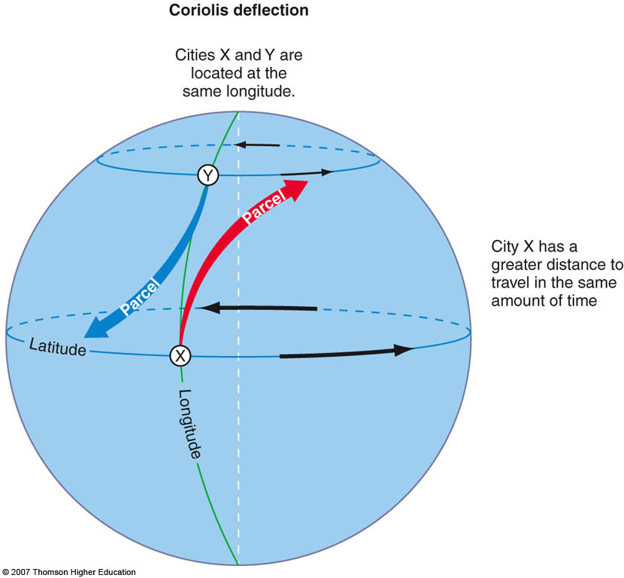
Coriolis Force
Due to the rotation of the Earth
Objects appear to be deflected to the right (following the motion) in the Northern Hemisphere
Speed is unaffected, only direction
2nd Edition: Fig. 6-9, p. 165
Notes:
Slide31.mp3
The second force that governs air motion is the Coriolis force, named after a 19th century French scientist. The Coriolis force is due to the rotation of the earth. It is called an “apparent” force because unlike pressure gradient force, the Coriolis force would not be a factor if the earth did not rotate.

Slide 53
Coriolis Force
Magnitude depends on 2 things:
Wind speed
Latitude
Stronger wind → Stronger Coriolis force
Zero Coriolis force at the equator; maximum at the poles
Notes:
Slide33.mp3
The magnitude of the Coriolis force depends on how strong the wind is blowing and the location on earth in terms of latitude. If air is not moving, the Coriolis force is zero. The faster the air is moving, the stronger is the Coriolis force. The magnitude of the Coriolis force varies with latitude. It is zero at the equator and a maximum at the poles.

Slide 54
Coriolis Force (cont’d)
Acts at a right angle to the wind
In the Northern Hemisphere, air is deflected to the right of the direction of motion.
Only changes the direction of moving air, not the wind speed
Only an “apparent” force since we observe from a rotating body (consider motion from space)
Notes:
Slide34.mp3
The direction of the Coriolis force is always at a right angle to the direction of the moving air. Coriolis acts to deflect air to the right of the direction of motion in the Northern Hemisphere. In the Southern Hemisphere, objects are deflected to the left of the direction of motion. Coriolis force only changes the direction of moving air; it does not change how fast the air is moving.

Slide 55
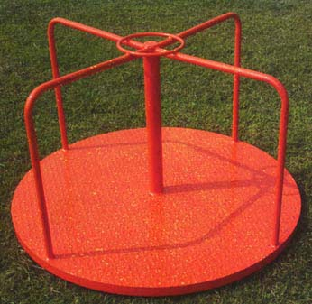
Apparent Force?
Think Merry-Go-Round…
https://www.youtube.com/watch?v=GiMi-QPt1Xk

Slide 56
Coriolis Force (cont’d)
MYTH: Water drains from a bathtub or sink with a certain rotation due to the Coriolis force.
FACT: Coriolis force is too small to have any noticeable influence on water draining out of a tub or sink.
=> CORIOLIS WORKS ON LARGE TEMPORAL AND SPATIAL SCALES
Notes:
Slide35.mp3
The idea that water drains out of a bathtub or sink in a spiraling motion because of the Coriolis force is incorrect. The Coriolis force is so small that in order for it to have any significant effect on moving objects Coriolis must be acting over a fairly long period or time and over large distances. A more complete discussion of this fact can be found at the web site you see here.

Slide 57
Friction
Loss of momentum during travel due to roughness of surface
Air moving near the surface experiences frictional drag, decreasing the wind speed.
Friction is important in the lowest 1.5km of the atmosphere.
Friction is negligible above that layer

Slide 58
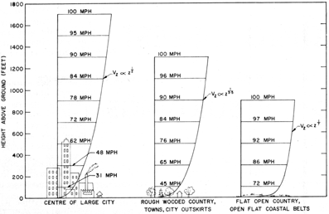
Friction: F = -kV

Slide 60
Recap
Winds – large scale motion of air that is the result of forces in the atmosphere, labeled by the direction they come from
Forces
  Depend on mass and acceleration
  Have direction and magnitude
  Total force is the sum of all the forces

Slide 61
Forces
Gravity – acts downward towards the surface
PGF
  From H -> L pressure
  Stronger for larger changes (gradients) in pressure (or height on a constant pressure chart) with distance, greatest in the vertical
Coriolis
  Deflects wind to the right of motion (NH)
  Applies to large time and space scales
  Stronger for higher winds and latitudes (closer to the pole)
Centrifugal
  Outward from curved flow
  Stronger for faster motion or tighter rotation
Friction – opposes flow near the surface, weaker over a smooth surface
We’ll cover force balances next time

Slide 62
Constant Level Maps vs. Constant Pressure Maps
Lets look at the two column, one warm and one cold, again…

Slide 63
Temperature & Pressure
Listed to the side are two columns containing air of different temperature
The total number of molecules is identical in each column
At 5 km, will the pressure be higher at Point 1 or Point 2?
Figure from apollo.lsc.vsc.edu/classes/met130
Notes:
Slide5.mp3
To understand horizontal differences in pressure in the upper atmosphere and how we represent those differences on weather maps, we need to return to an earlier discussion of how temperature affects density and pressure. Recall in this illustration where we have two columns of air, one colder than the other, that at a height of 5 km the pressure will be higher in the column on the right than in the colder column of air on the left. Why? Because there is more air above point 2 than above point 1.

Slide 64
Pressure variations on a constant height surface (e.g., sea level) =
Height variations on a constant pressure surface (e.g., 500 mb)
L
H
Notes:
Slide13.mp3
Focus on the two columns of air on the right and note the horizontal line labeled 500 mb in column A. We’ve extended that line through column B. That line represents a constant height or level in the atmosphere. At that level in column A the pressure is 500 mb. At that same height in column B the pressure would be greater than 500mb because you would have to go up a certain distance to measure 500 mb. Remember pressure decreases with height.

Slide 65
Atmospheric Force Balances
First, MUST have a pressure gradient force (PGF) for the wind to blow.
Otherwise, all other forces are irrelevant
Already discussed hydrostatic balance, a balance between the vertical PGF and gravity. There are many other balances that describe atmospheric flow…

Slide 66
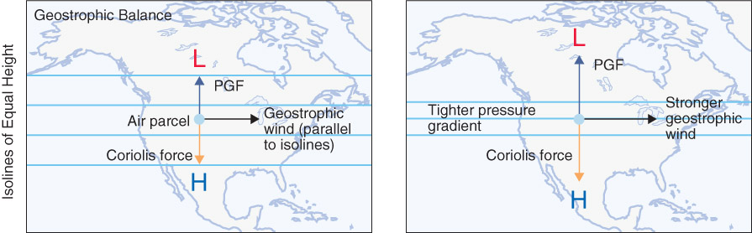
Geostrophic Balance
Fig. 6-14, p. 193

Slide 67
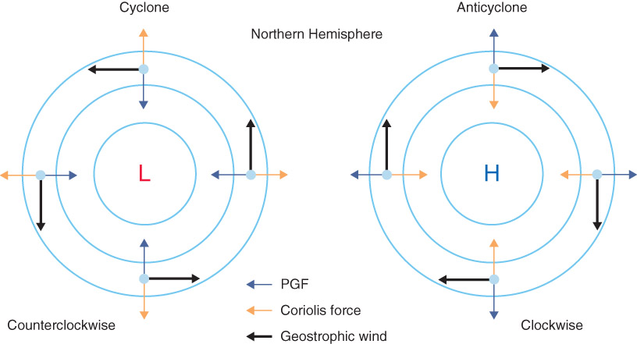
Geostrophic Balance
Balance between PGF and Coriolis force
Fig. 6-15, p. 193

Slide 68
Geostrophic Balance
Therefore, wind blows parallel to isobars, which is useful to consider when looking at weather maps.
In geostrophic balance, wind blows with low pressure to the LEFT (as viewed from behind the air parcel).
Remember, Coriolis force must be relevant for this balance to exist. Need large time and length scales, for example, a mid-latitude cyclone (i.e., a “storm system” or low pressure center like that seen on the evening weather map…more later)

Slide 69
Winds in Upper Atmosphere
Winds in upper atmosphere are largely geostrophic
Wind flows in a counterclockwise sense around a low or trough
Wind flows in a clockwise sense around a high or ridge
Winds near the surface are not geostrophic. What force must be considered here?
Where else might geostrophic balance not hold?

Slide 70
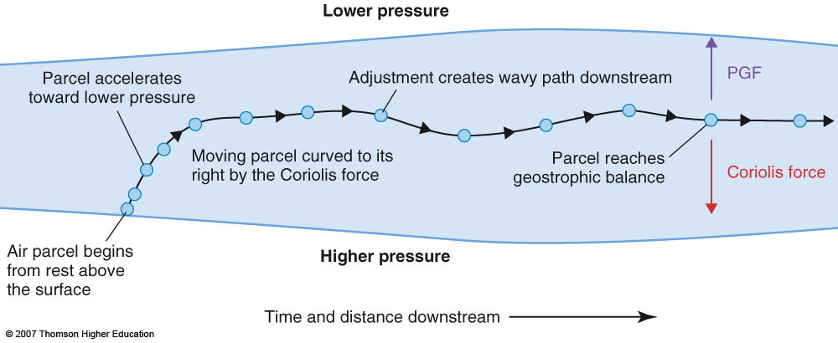
Geostrophic balance does not occur instantaneously…
Fig. 6-17, p. 195

Slide 71
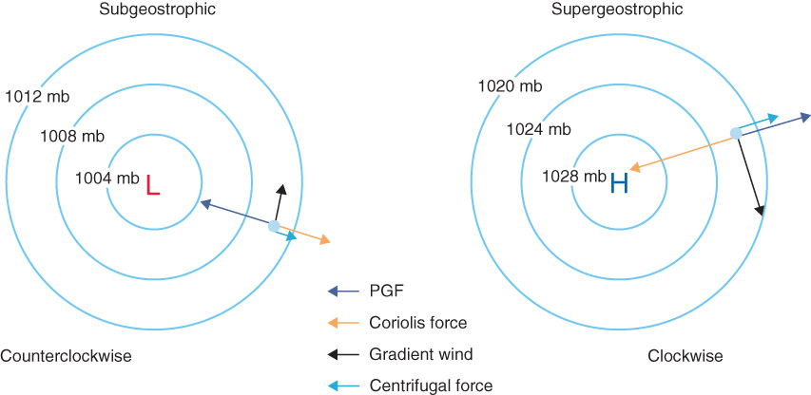
Gradient Wind Balance
Balance between PGF, Coriolis force, and centrifugal force
Examples: hurricanes
Fig. 6-16, p. 194

Slide 72
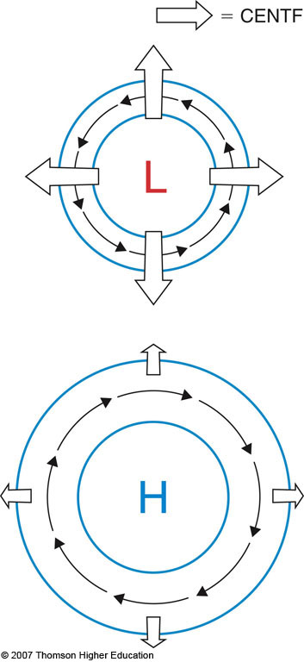
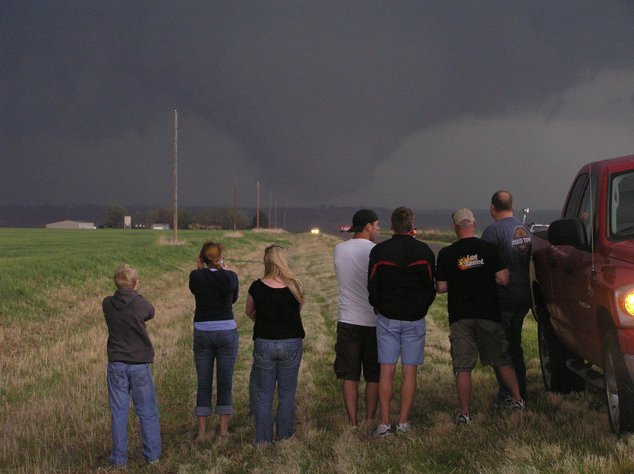
Cyclostrophic Balance
Balance between PGF and centrifugal force
Coriolis force not important
Example: tornadoes

Slide 73
Surface Winds
Friction slows the wind
Coriolis force (dependent on wind speed) is therefore reduced
Pressure gradient force now exceeds Coriolis force
Wind flows across the isobars toward lower pressure
Called Guldberg-Mohn Balance

Slide 74
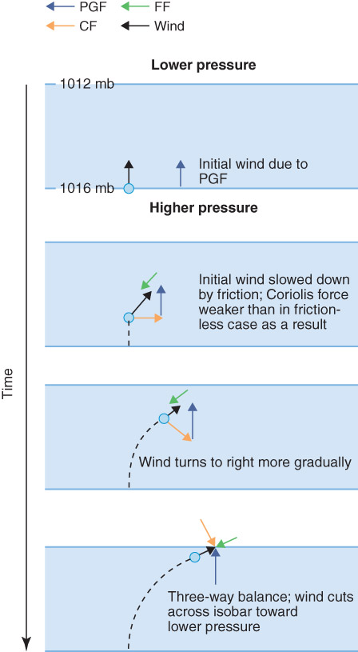
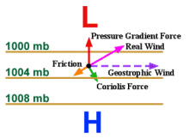
Near Surface Wind
Fig. 6-18, p. 196

Slide 75
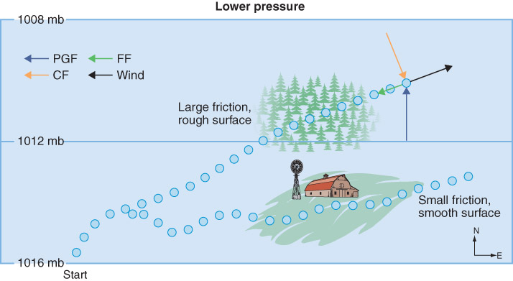
Fig. 6-19, p. 197

Slide 76
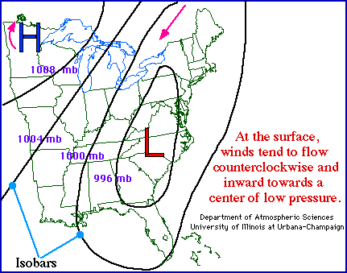
Surface Winds

Slide 77
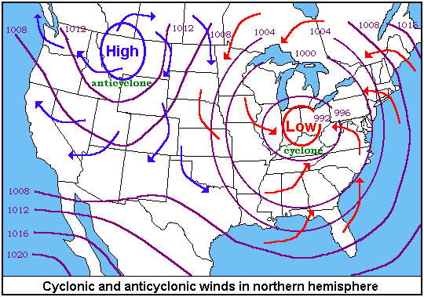
Surface Winds
Figure from physics.uwstout.edu/wx/Notes/ch6notes.htm

Slide 78
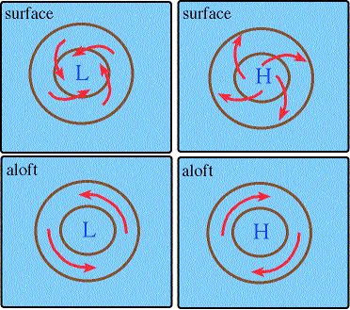
Comparison

Slide 79
Surface Winds & Vertical Motion
Vertical motion (rising or sinking air) is a very important factor in weather.
Rising air is needed to form clouds and precipitation.
How are surface winds related to vertical motion?

Slide 80
Surface Winds & Vertical Motion
Horizontal movement of air (wind) can result in convergence or divergence.
Areas of convergence at the surface are areas of rising air
Areas of divergence at the surface are areas of sinking air

Slide 81
Convergence
Convergence -- the net horizontal inflow of air into an area.
Results in upward motion
Convergence occurs in areas of low pressure (low pressure centers and troughs)
Lows and troughs are areas of rising air

Slide 82
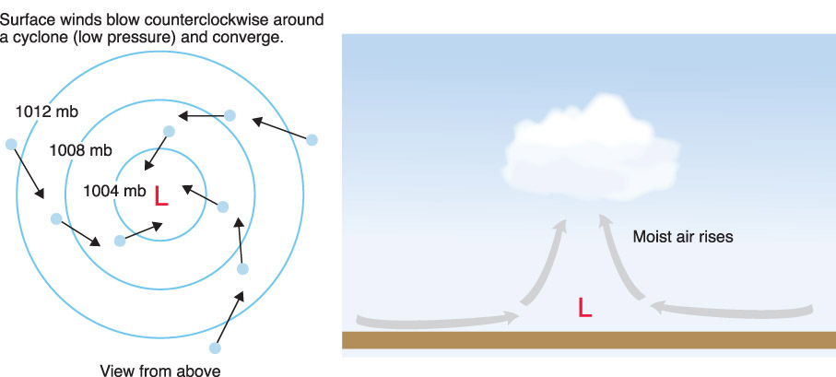
Convergence
Fig. 6-24b, p. 202

Slide 83
Divergence
Divergence -- the net horizontal outflow of air from an area.
Results in downward motion (subsidence)
Divergence occurs in areas of high pressure (high pressure centers and ridges)
Highs and ridges are areas of sinking air (subsidence)

Slide 84

Divergence
Fig. 6-24a, p. 181

Slide 85

Sea Breeze
Land heats more rapidly than water
Lower pressure develops over land
  Remember that an excess of energy at the surface requires vertical motion to balance out the energy
  Upward motion associated with low pressure at surface
Higher pressure over the water, relative to land
An onshore flow results due to the PGF
Sea Breeze is a thermally induced circulation
Let’s now complete the circulation…what happens at the top?

Slide 86
Flashback
Notes:
Slide13.mp3
Focus on the two columns of air on the right and note the horizontal line labeled 500 mb in column A. We’ve extended that line through column B. That line represents a constant height or level in the atmosphere. At that level in column A the pressure is 500 mb. At that same height in column B the pressure would be greater than 500mb because you would have to go up a certain distance to measure 500 mb. Remember pressure decreases with height.

Slide 87

Fig. 6-25, p. 203

Slide 88

Fig. 6-26a, p. 204

Slide 89

Fig. 6-26b, p. 204

Slide 90

Fig. 6-26c, p. 204

Slide 91

Fig. 6-26d, p. 204

Slide 92

Land Breeze
Land cools more rapidly than water at night
Higher pressure develops over land
Lower pressure over water
Offshore flow results due to PGF

Slide 93

Fig. 6-27, p. 205

Slide 94
Recap
Winds – large scale motion of air that is the result of forces in the atmosphere, labeled by the direction they come from
Forces
  Depend on mass and acceleration
  Have direction and magnitude
  Total force is the sum of all the forces

Slide 95
Important forces in the atmosphere
Gravity – acts downward towards the surface
PGF
  From H -> L pressure
  Stronger for larger changes (gradients) in pressure (or height on a constant pressure chart) with distance, greatest in the vertical
Coriolis
  Deflects wind to the right of motion (NH)
  Applies to large time and space scales
  Stronger for higher winds and latitudes (closer to the pole)
Centrifugal
  Outward from curved flow
  Stronger for faster motion or tighter rotation
Friction – opposes flow near the surface, weaker over a smooth surface

Slide 96
Balances in the atmosphere
Geostrophic
  Horizontal Coriolis & PGF
  Upper atmosphere
Gradient
  Horizontal Coriolis & PGF & Cetrifugal
  Results in higher wind speeds around highs than lows
Hydrostatic
  Vertical PGF & Gravity
  Keeps the air from leaving the atmosphere or compressing to the surface
Near surface (Guldberg-Mohn)
  Horizontal PGF & Coriolis & Friction
  Results in wind blowing across isobars towards lower pressure

Slide 97
More things to remember
Wind generally blows parallel to isobars with lower pressure on the left, but at the surface
  Low pressure -> convergence -> upward motion
  High pressure -> divergence -> downward motion -> clear skies
Sea level pressure – correction of station pressure based on the altitude and the standard atmosphere in order to compare horizontal changes (~10 mb for 100 m)
Common features:
  High pressure center (closed) vs ridge (open), clockwise motion
  Low pressure center (closed) vs trough (open), counterclockwise
Constant pressure map – height at which the given pressure is reached
Warmer column = higher pressure at a given height = higher height of a given pressure level

Slide 98
Recap
Winds – large scale motion of air that is the result of forces in the atmosphere, labeled by the direction they come from
Forces
  Depend on mass and acceleration
  Have direction and magnitude
  Total force is the sum of all the forces

Slide 99
Forces
Gravity – acts downward towards the surface
PGF
  From H -> L pressure
  Stronger for larger changes (gradients) in pressure (or height on a constant pressure chart) with distance, greatest in the vertical
Coriolis
  Deflects wind to the right of motion (NH)
  Applies to large time and space scales
  Stronger for higher winds and latitudes (closer to the pole)
Centrifugal
  Outward from curved flow
  Stronger for faster motion or tighter rotation
Friction – opposes flow near the surface, weaker over a smooth surface

Slide 100
Balances
Geostrophic
  Horizontal Coriolis & PGF
  Upper atmosphere
Gradient
  Horizontal Coriolis & PGF & Cetrifugal
  Results in higher wind speeds around highs than lows
Hydrostatic
  Vertical PGF & Gravity
  Keeps the air from leaving the atmosphere or compressing to the surface
Near surface (Guldberg-Mohn)
  Horizontal PGF & Coriolis & Friction
  Results in wind blowing across isobars towards lower pressure

Slide 101
More things to remember….
Wind generally blows parallel to isobars with lower pressure on the left, but at the surface
  Low pressure -> convergence -> upward motion
  High pressure -> divergence -> downward motion -> clear skies
Sea level pressure – correction of station pressure based on the altitude and the standard atmosphere in order to compare horizontal changes (~10 mb for 100 m)
Common features:
  High pressure center (closed) vs ridge (open), clockwise motion
  Low pressure center (closed) vs trough (open), counterclockwise
Constant pressure map – height at which the given pressure is reached
Warmer column = higher pressure at a given height = higher height of a given pressure level

