Slide 1
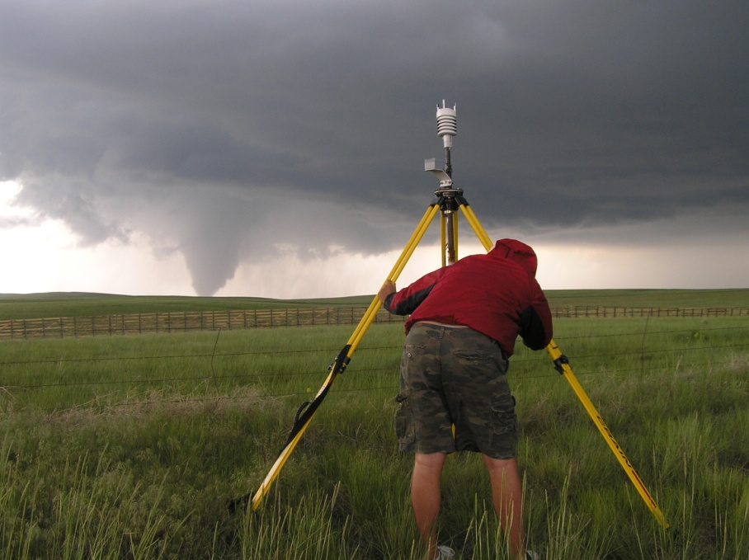
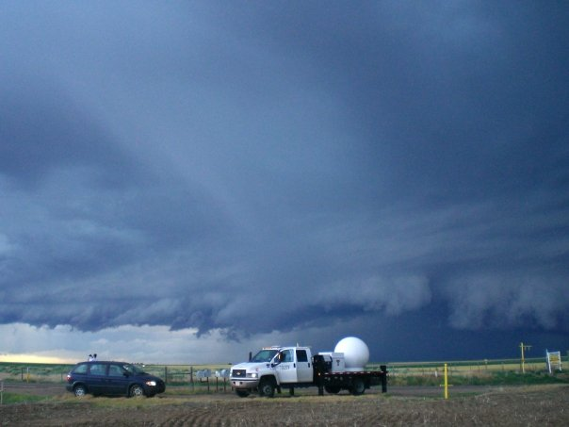
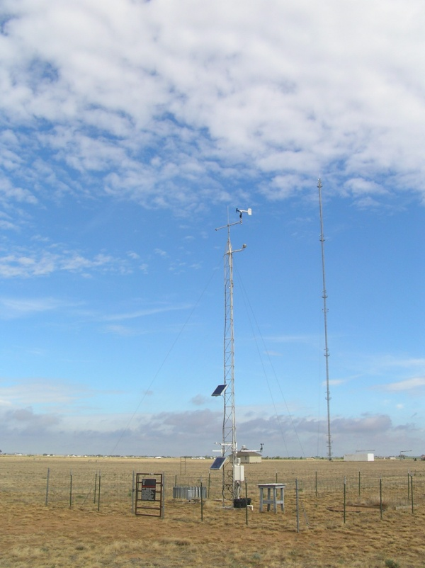
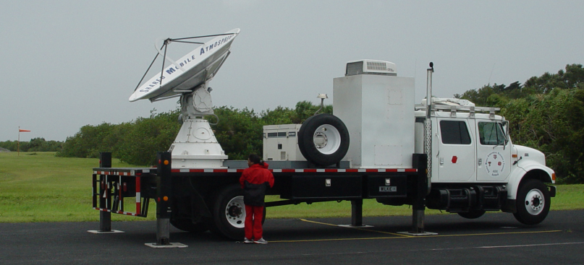
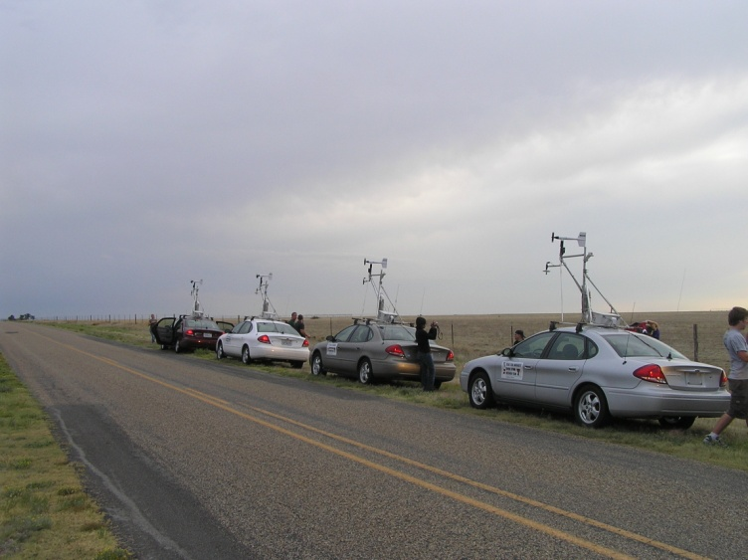
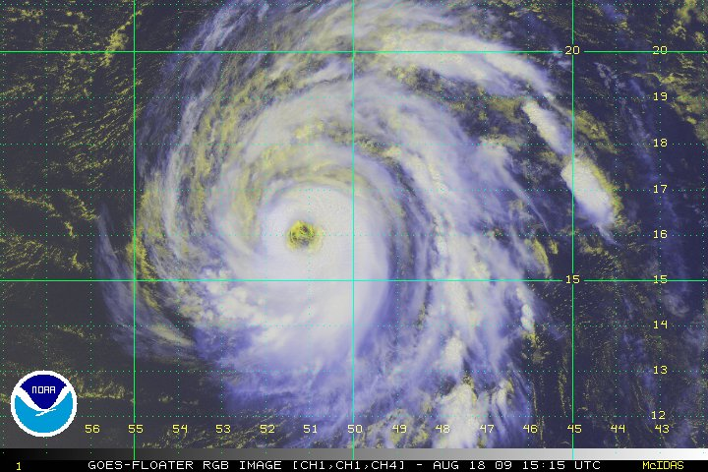
Chapter 5 Observing the Atmosphere
ATMO 1300
Summer II 2017

Slide 2
Chapter 5 Observing the Atmosphere
Measurement Types
Satellites
Radars
ATMO 1300
Summer II 2017

Slide 3
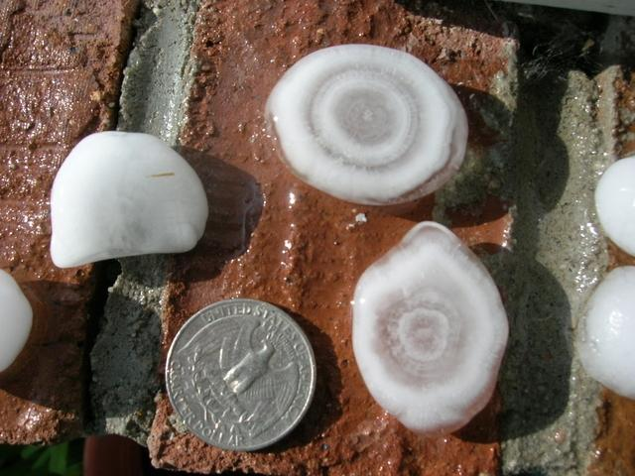
A couple notes on hail formation
http://www.thedenverchannel.com/weather/viewers-june-storm-photos

Slide 4
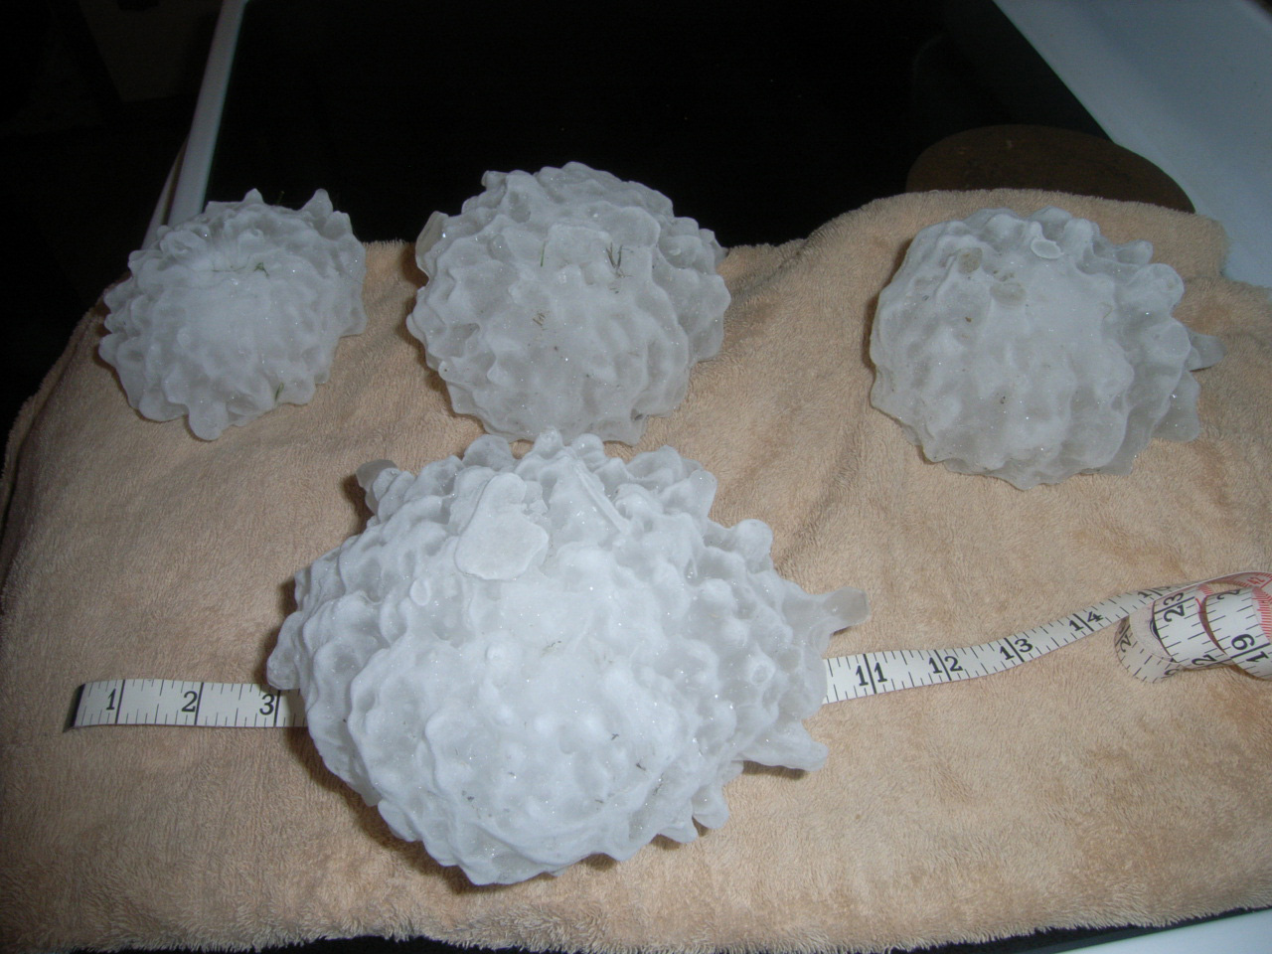
http://www.noaa.gov/features/02_monitoring/images/hail2.jpg

Slide 5
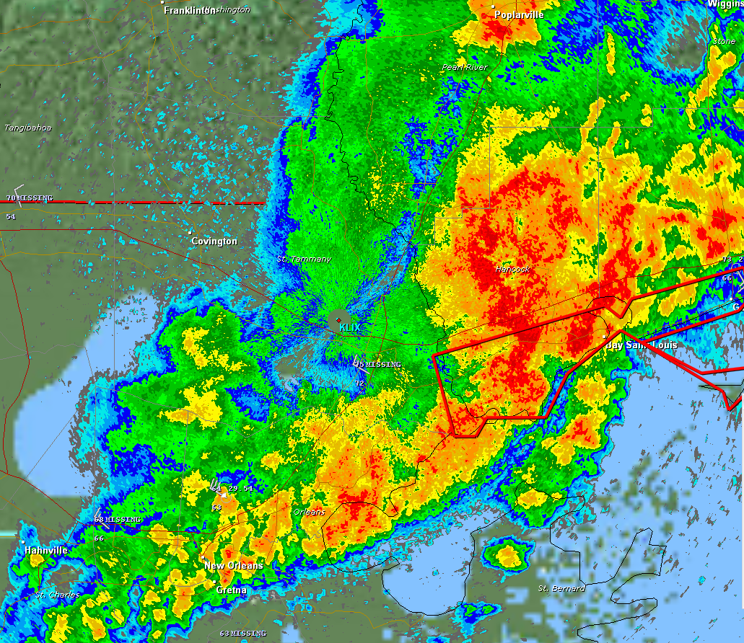
Two Types of Measurements
Direct Methods
Taken in place, instruments in direct contact with atmospheric property you are trying to measure
Indirect Methods
Atmospheric properties measured from a distance (i.e., no direct contact).
Also referred to as remote sensing.

Slide 6
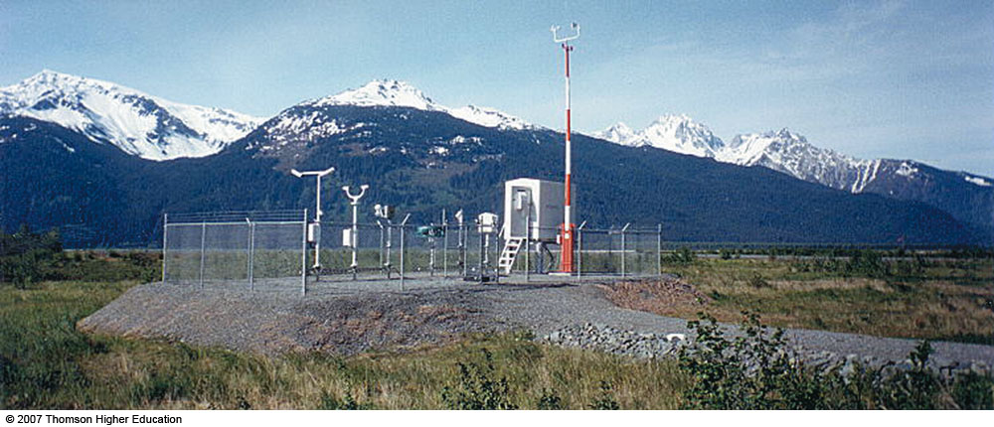
Direct Measurements
Automated Surface Observing System (ASOS) – Typically located at airports

Slide 7
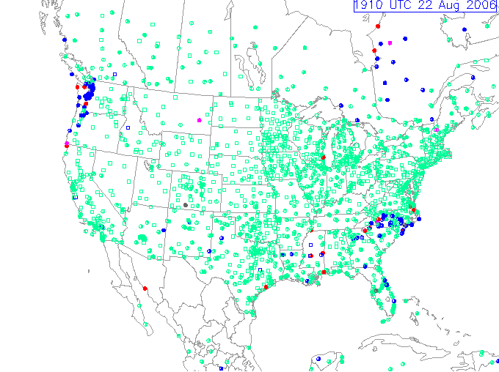
Automated Surface Observing System(ASOS)
Over 600 ASOS sites across North America
Measures and reports standard atmospheric variables with a frequency of 1-60 minutes
Temperature
Dew point temperature
Pressure
Wind direction/speed
Rainfall
Cloud height
Visibility

Slide 8
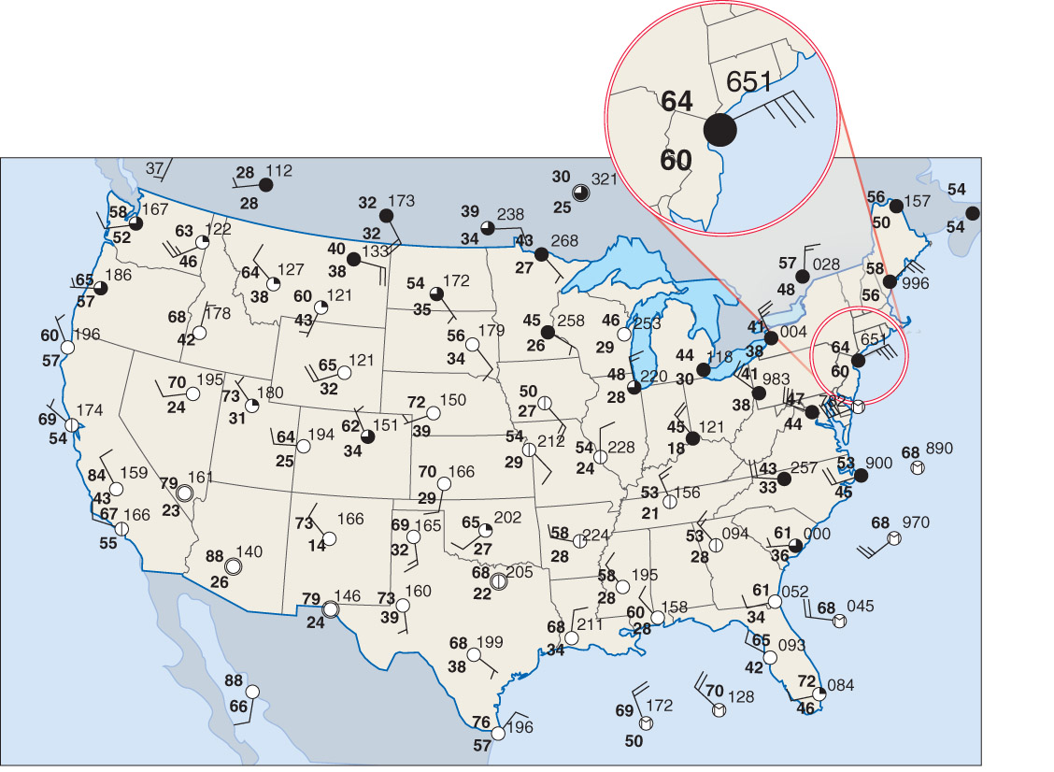
Displaying Surface Observations
Fig. 1-18, p. 25

Slide 9
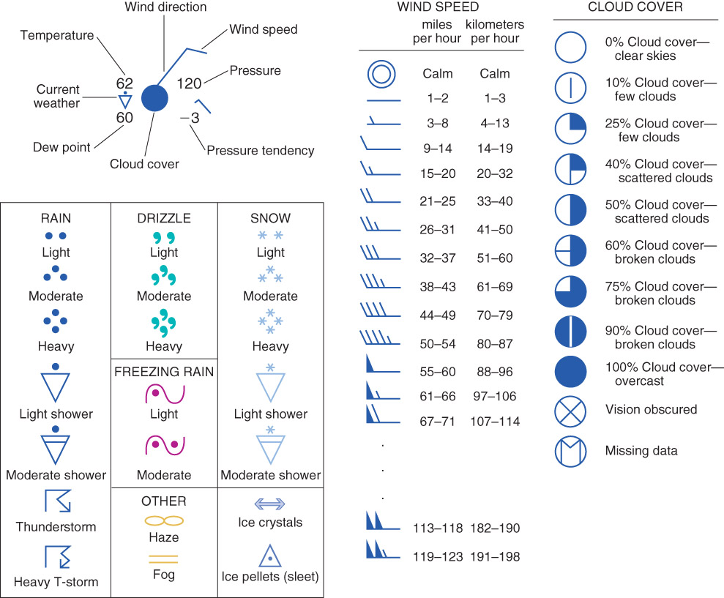
Station Model
Fig. 1-17, p. 23

Slide 10
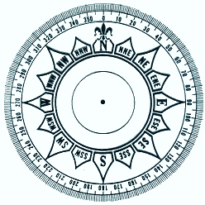
Wind Direction
We describe the wind direction as where the wind is coming from.
For example, a north wind blows from the North, or 0°
The degrees increase from north to east.
So if the wind direction is 270°, what cardinal direction is that?

Slide 11
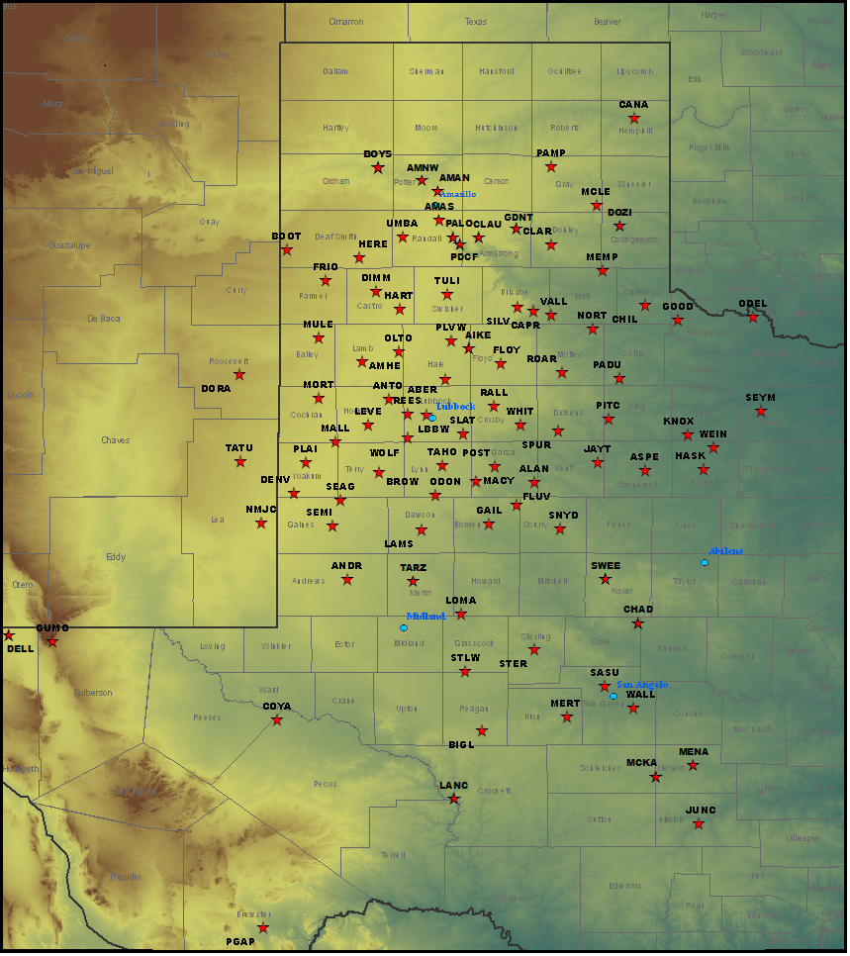
West Texas Mesonet
www.mesonet.ttu.edu

Slide 12
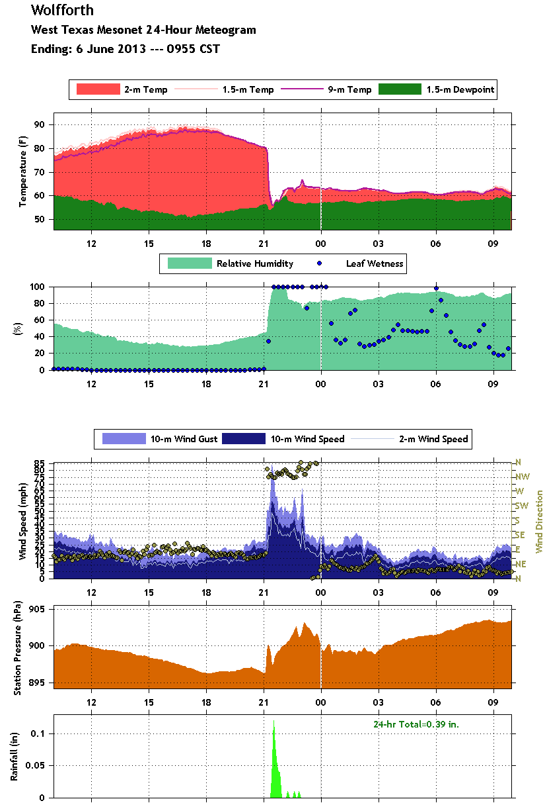
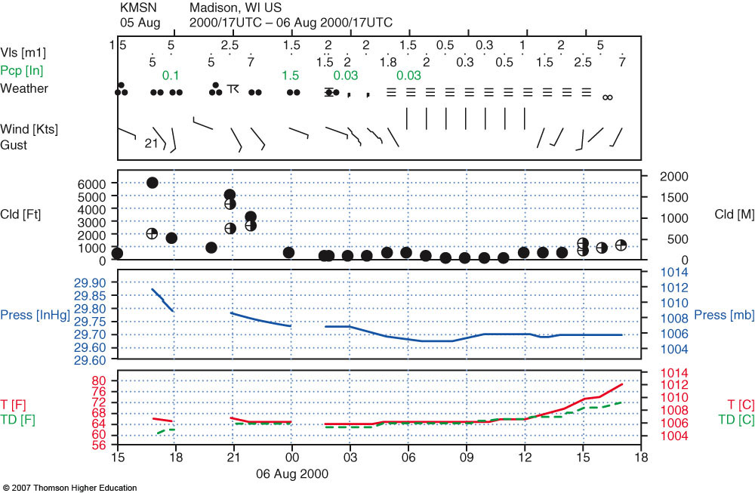
Meteogram
Displays a time series of meteorological variables for a single station
Box 5-1, p. 128

Slide 13
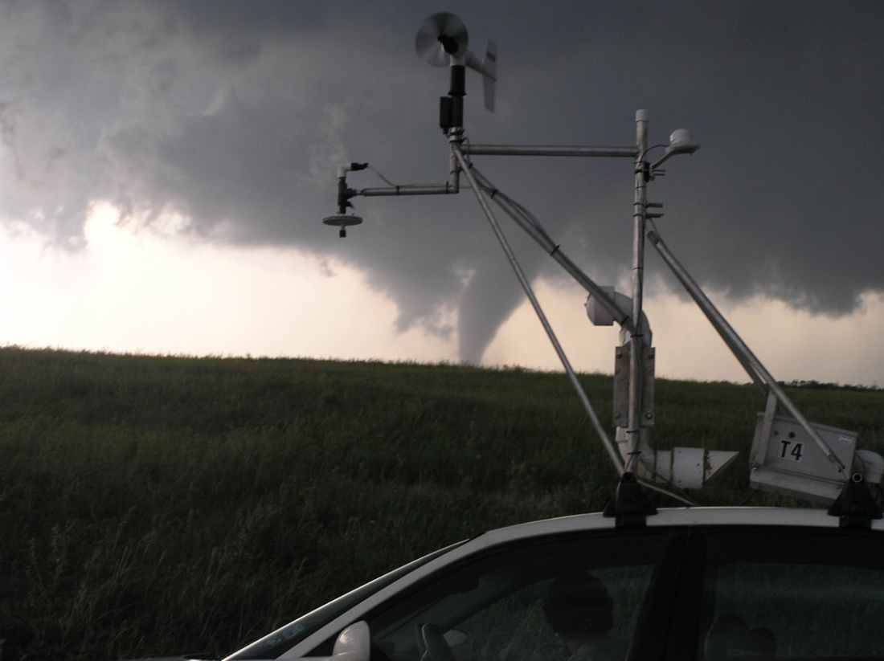
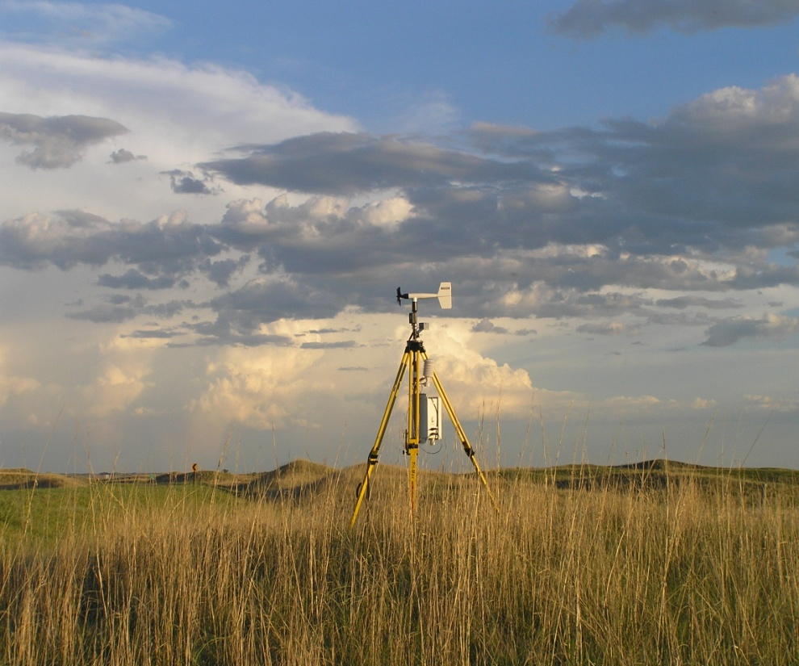
How are atmospheric variables measured?
Unique instrumentation exists for each variable

Slide 14
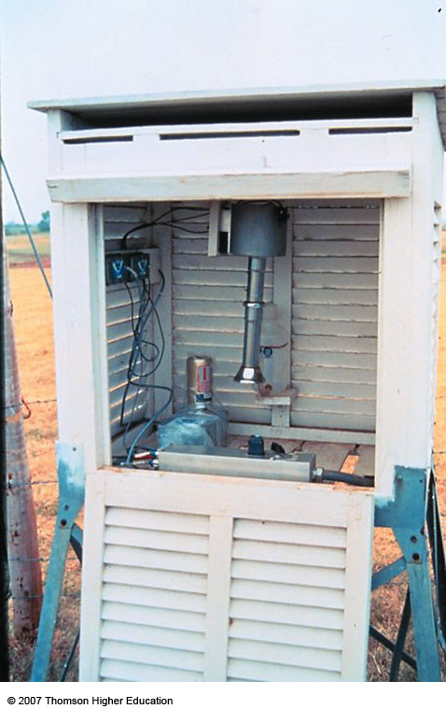
Temperature
ASOS uses resistance thermometers, which measure the change in electrical resistance of a piece of metal (a function of temperature)
Often sheltered by a white “Stevenson Screen”, protecting thermometer from direct solar irradiation
Well ventilated
Fig. 5-2, p. 146

Slide 15
Humidity
Hygrometers – An instrument that measures humidity
ASOS: Capacitance (cheap, accurate, easy) – the ability of an object to store charge varies with relative humidity
Psychrometer – finds the temperature something can be cooled to due to evaporation (depends on temperature and moisture content, known as the wet bulb temperature) which can be compared to temperature to find humidity values
GPS – measure the delay of a radio wave (which travels slower through water vapor)

Slide 16
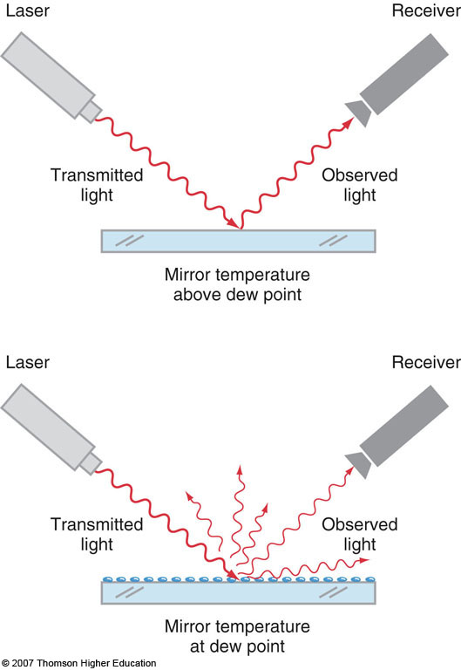
Humidity
Dew point hygrometer
Also called a “chilled mirror sensor”
A clean mirror will exactly reflect laser light to the receiver
Temperature of mirror is decreased incrementally until water vapor condenses on it. Laser light scattered by the water droplets, reduction in intensity at receiver, dewpoint temperature reported.
2nd Edition: Fig. 5-3, p. 130

Slide 17
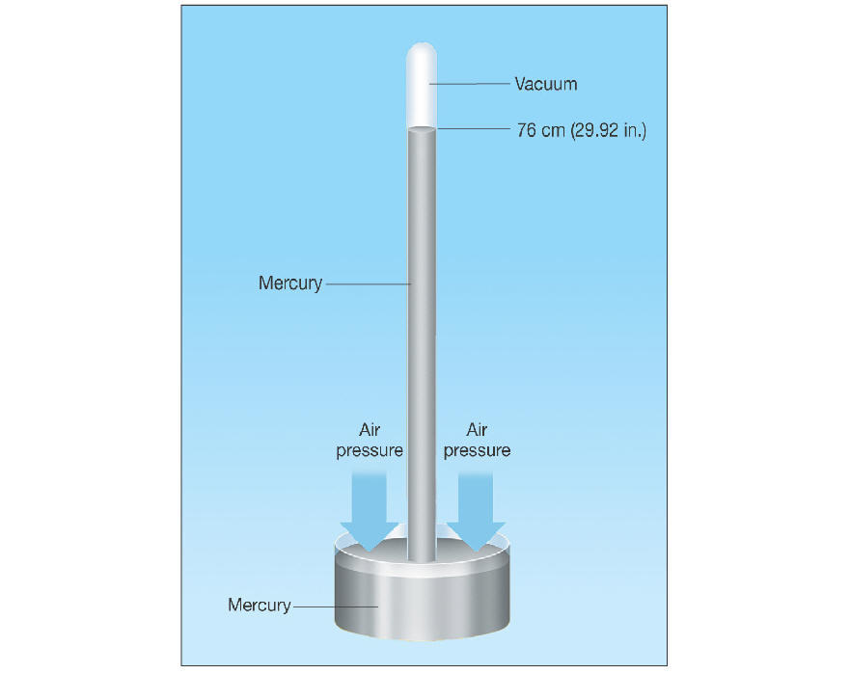
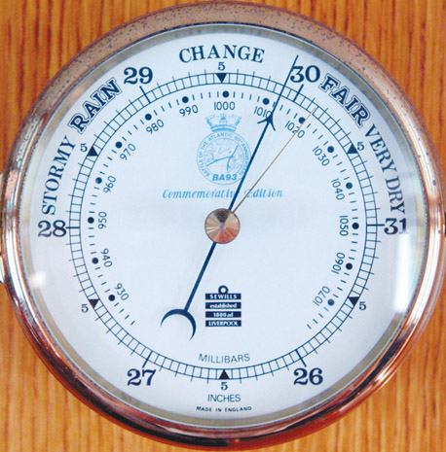
Pressure
Mercury barometers (top) and aneroid barometers (bottom) are what we are used to.
ASOS uses electronic barometers.
Fig. 5-3, p. 147

Slide 18
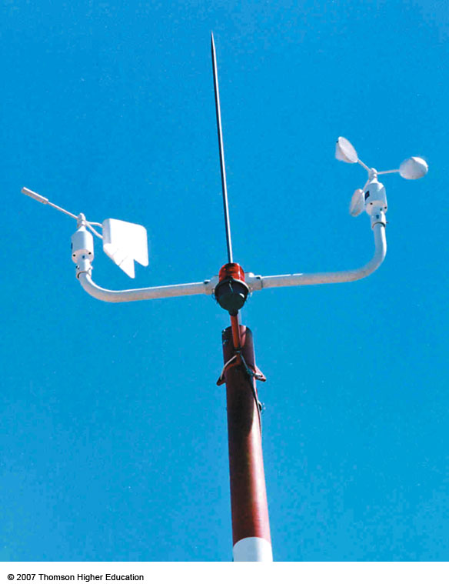
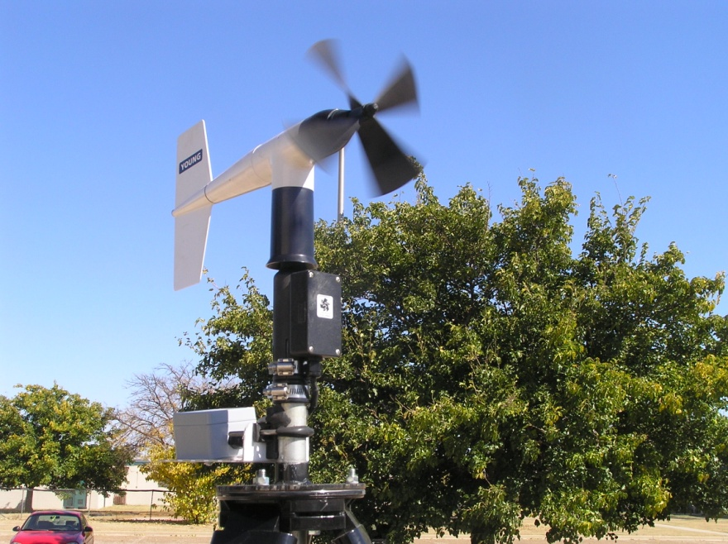
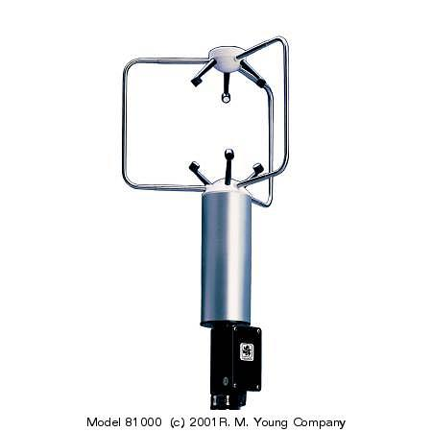
Wind Direction / Speed
Cup anemometer used to measure wind speed
Wind vane used to measure wind direction
Also, there are sonic anemometers (below), which measure how wind affects the propagation of acoustic energy (no moving parts!)

Slide 19
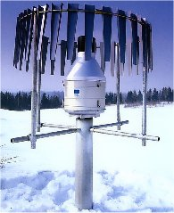
Precipitation
Tipping bucket rain gauge
Upper heated collector (melts frozen precipitation)
Collector empties into bucket underneath, which tips and empties after every 0.01” of precipitation is collected.
Wind guard around outside to keep precipitation from blowing across opening.

Slide 20
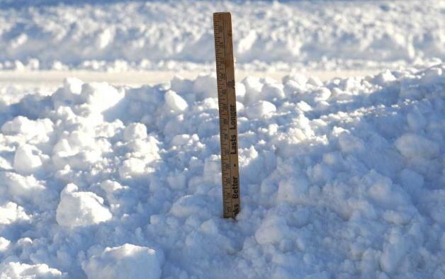
Snow accumulation
Not automated!
Carefully hand measured
Generally 12 in of snow = 1 in of rain when melted, but this number varies greatly!
Source: www.stamfordadvocate.com

Slide 21
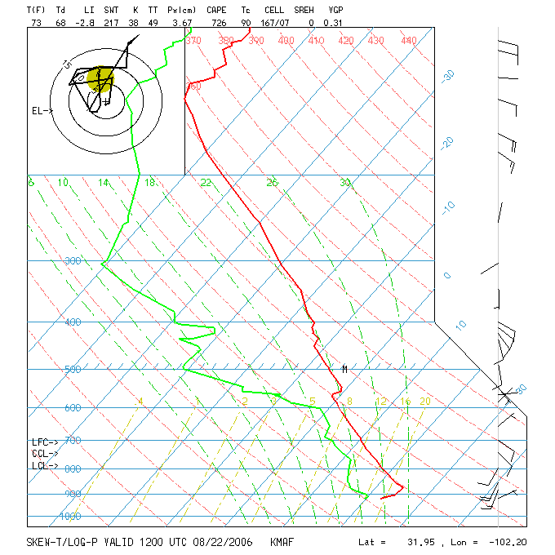
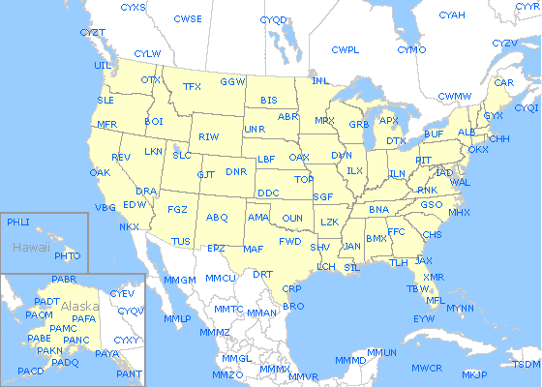
Measuring the Upper Atmosphere
Upper atmosphere is sorely undersampled
These measurements needed for improved model forecasts!
Radiosondes released twice a day from stations spaced far apart

Slide 22
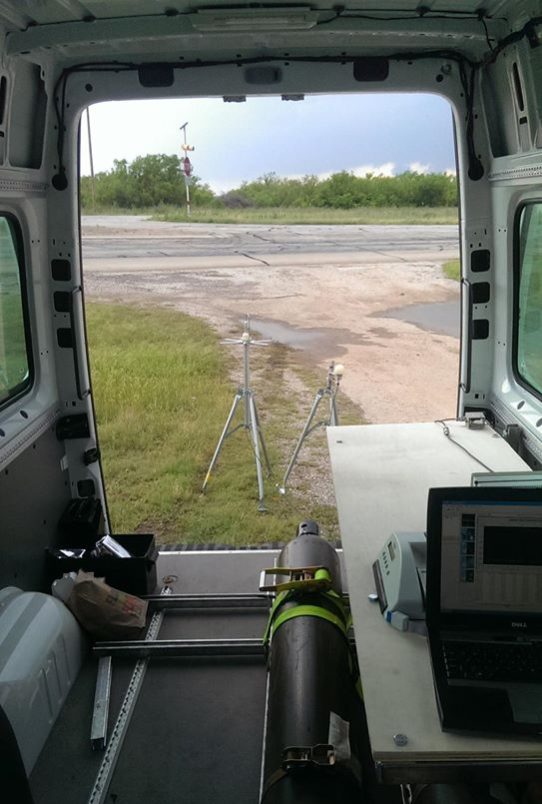
Radiosondes

Slide 23
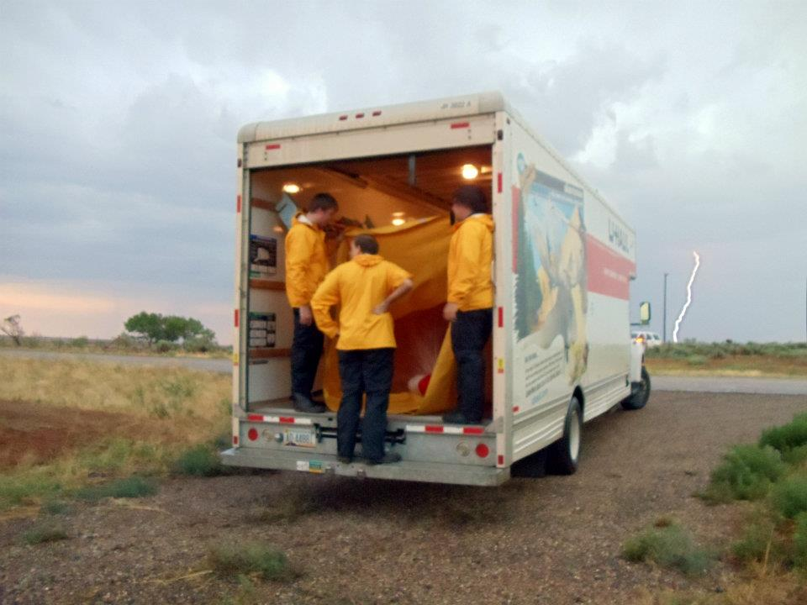
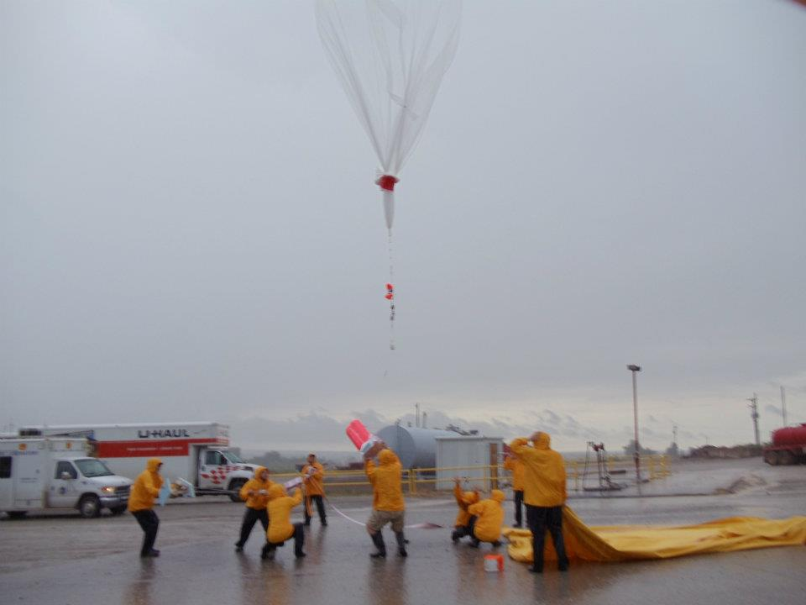
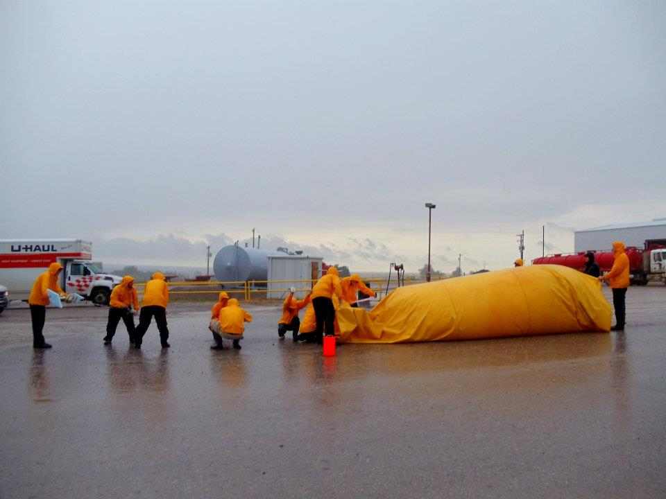
Radiosondes – and more!

Slide 24
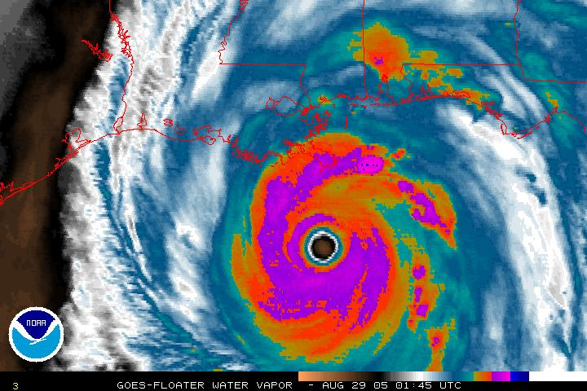
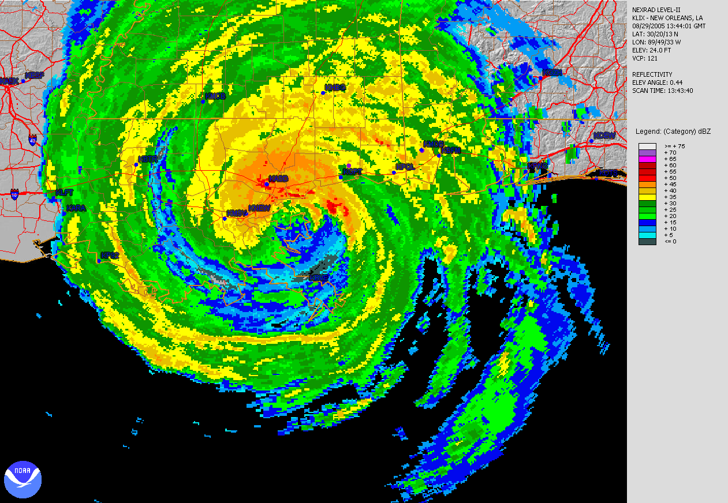
Indirect Measurements
Two forms:
Active sensors – transmit and receive energy
Passive sensors – just receive energy
Examples?

Slide 25
Satellite Observations
Two orbits for satellites
Geosynchronous or Geostationary orbit – 36,000 km above Earth’s surface.
Satellite rotates at same rate that the planet does. Therefore, the satellite constantly views the same footprint on Earth.
Good for constructing animations to determine motion of atmospheric features .
Low earth orbit (~ 500 miles above the surface)
Satellite rotates faster than the planet
Therefore, this strategy is good for scanning many portions of the planet
Usually, scans are from pole to pole

Slide 26
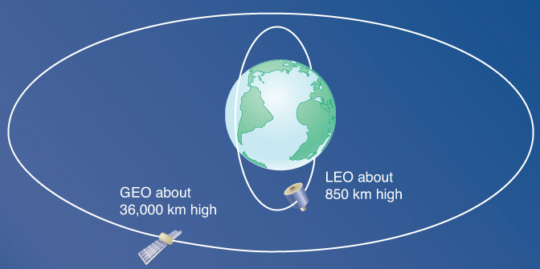
Fig. 5-13, p. 157

Slide 27
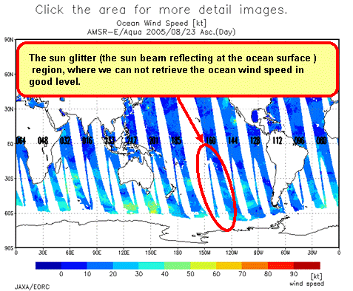
Typical coverage for a low-earth orbit
http://sharaku.eorc.jaxa.jp/AMSR/ocean_wind/manual/images/sunglitter_e.bmp

Slide 28
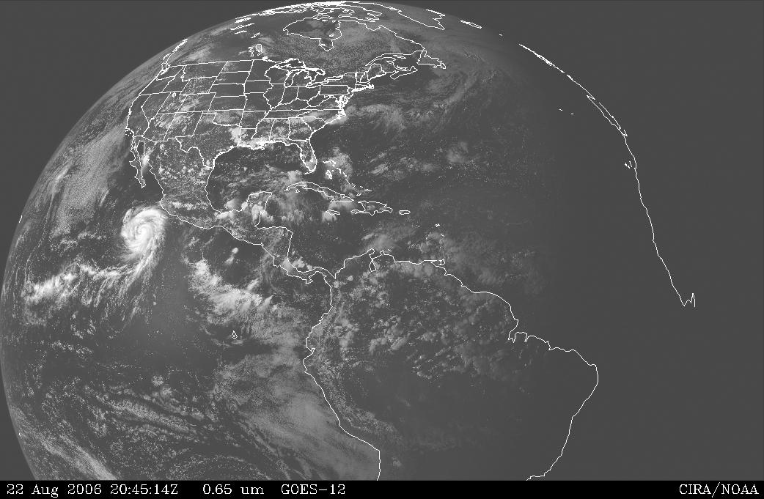
Operational U. S. Satellites
Geostationary Operational Environmental Satellite (GOES)

Slide 29
Types of Satellite Imagery
Visible
What we have seen thus far
Solar radiation reflected/scattered by earth and atmosphere
Infrared
Allows us to visualized how much infrared energy the earth and atmosphere are emitting
Tells us the temperature of the emitting substance
For clouds, this information is valuable for determining altitude of cloud tops!

Slide 30
Visible Satellite Animations
http://weather.cod.edu/satrad/
http://weather.cod.edu/satrad/exper/?parms=northcentral-02-24-1

Slide 31
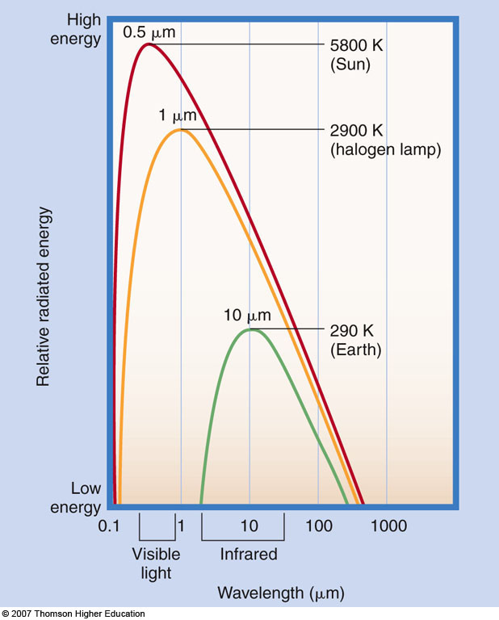
Recall Wien’s Law
λ_{max} = C / T
The wavelength of maximum emission is inversely proportional to temperature
Graphic from www.cira.colostate.edu/ramm/goes39
Fig. 2-8, p. 36

Slide 32
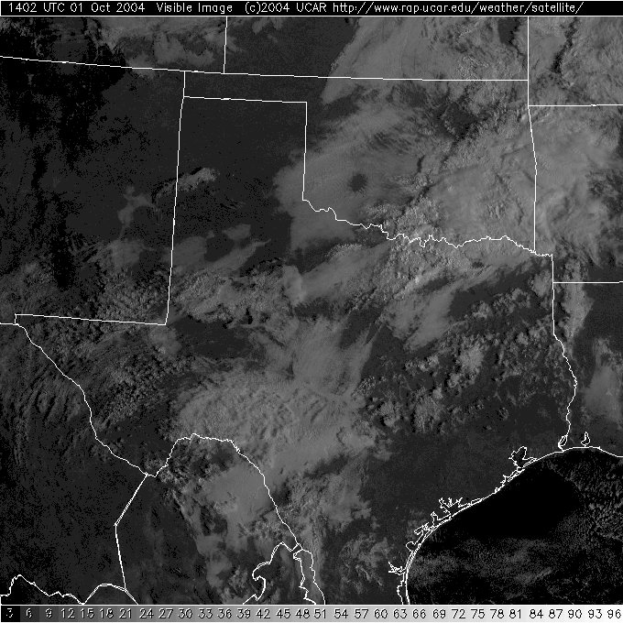
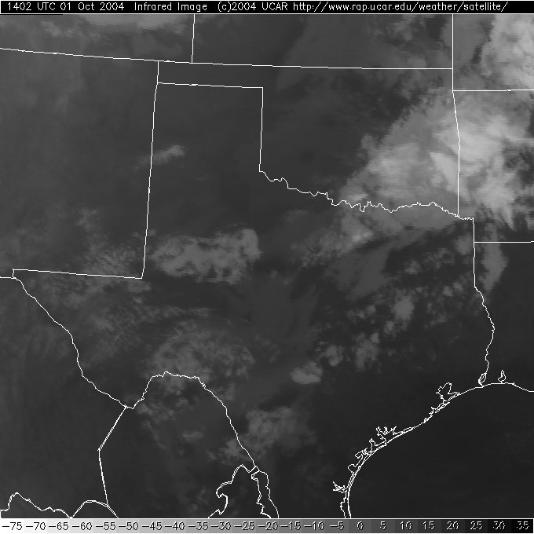
Visible vs. Infrared
X
X
X
X
cold
warm
VISIBLE satellite image
INFRARED satellite image

Slide 33
Types of Satellite Imagery
Water Vapor
Tracks infrared emission primarily from water vapor (6.5-7 mm)
Altitude of emission: 300-600 mb
Can track upper-atmospheric flow
Useful for diagnosing upper-air weather pattern (e.g., troughs, ridges…more later)
Since water vapor exists in some proportion everywhere across the globe, continuous surveillance of flow is possible (do not need to have clouds)

Slide 34
Sensing Lightning
Lightning is very hot (3x hotter than the surface of the sun) -> emits a large amount of radiation
Ground strike data – passive sensors using a wide range of wavelengths such as NLDN (National Lightning Detection Network): http://www.lightningstorm.com/explorer.html
In cloud – Lightning Mapping Arrays: passive sensors using wavelengths in radio bands, more dense network of stations

Slide 35
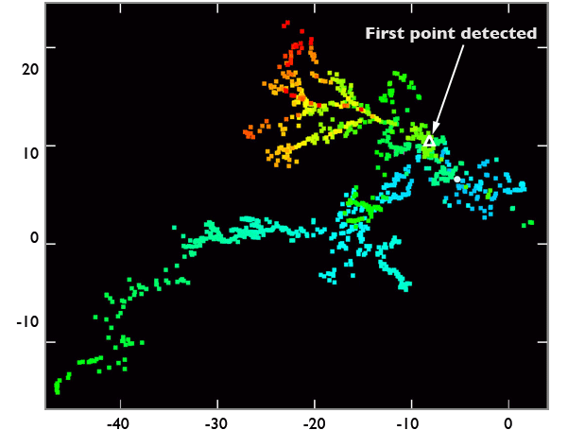
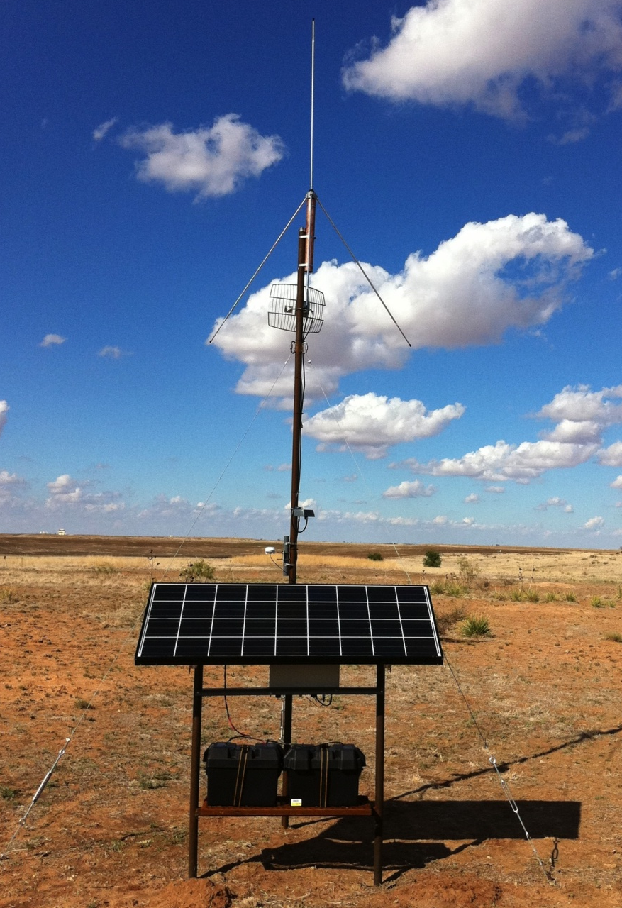
http://pogo.tosm.ttu.edu/about/

Slide 36
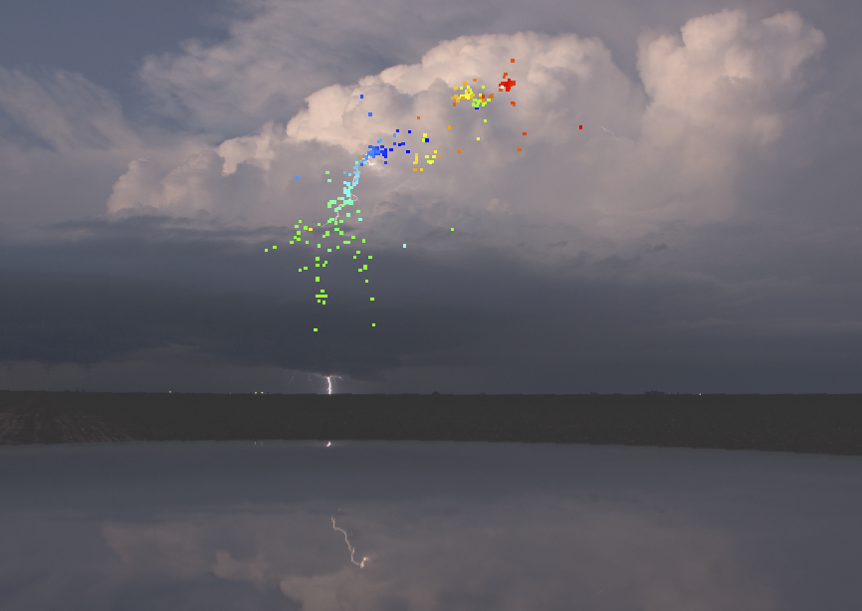
Photo and analysis courtesy of: Eric Bruning, Pat Skinner

Slide 37
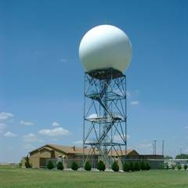
Radar (Radio Detection and Ranging)

Slide 38
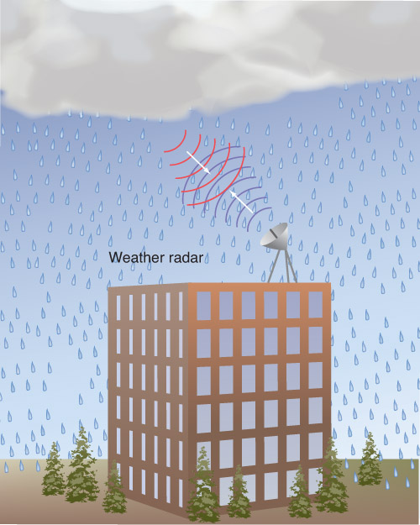
RADAR basics
Electromagnetic energy transmitted into atmosphere
Backscattered energy (“radar echo”) measured by radar and displayed
The larger the object, the more energy that is returned. Therefore, the intensity of the radar echo tells us how much precipitation is falling
Sources of backscattering: raindrops, hail, snow, bugs, dust, ground targets, debris
Fig. 5-19, p. 162

Slide 39
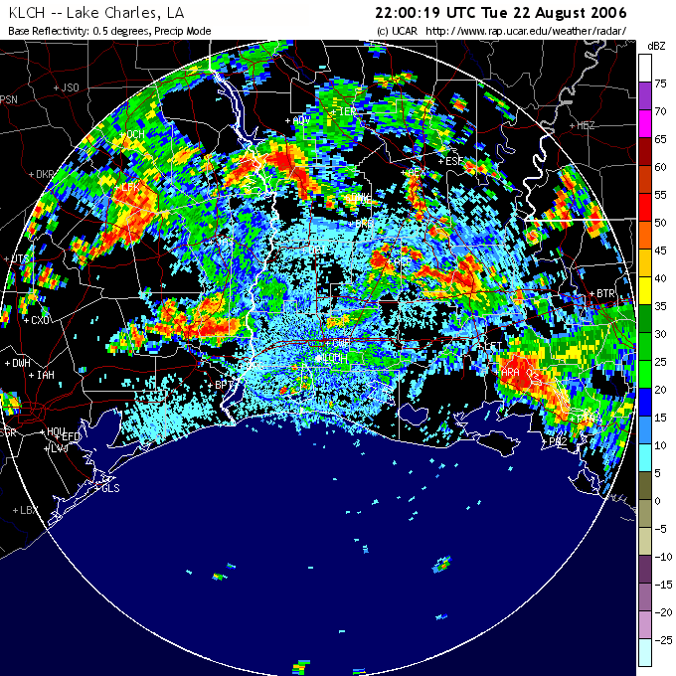
Example of Radar Reflectivity
0.5 degree elevation

Slide 40
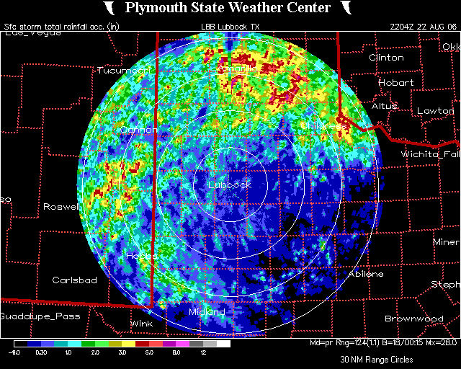
Storm Total Precipitation

Slide 41
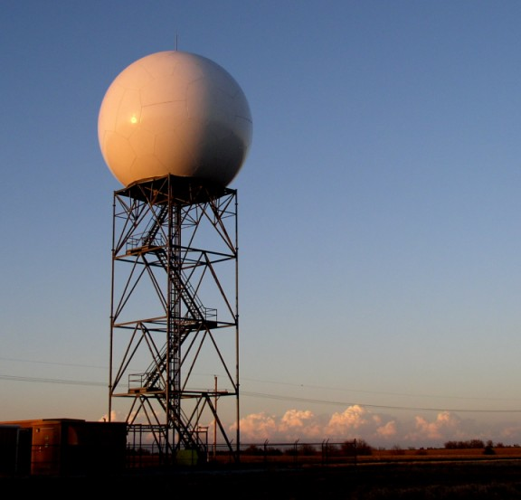
WSR-88D Doppler Radar

Slide 42
Doppler Effect
Johann Christian Doppler (1803-1853)
Apparent frequency of radiation is affected by motion of emitting source
Frequency increases for motion towards observer
Frequency decreases for motion away from observer
Can use this effect to deduce motion of scatterers in atmosphere (driven by wind)

Slide 43
Doppler Effect Animation
https://www.youtube.com/watch?v=a3RfULw7aAY
Fig. 5-21, p. 164

Slide 44
Radar Technology
The National Weather Service has installed and operates / maintains a network of large scale Doppler radars.
The are for “surveillance” purposes, not necessarily research. So they are designed to see a long way, but with low resolution.
We can see:
Reflectivity – the raindrops in a storm; gives an idea of storm shape and structure
Radial velocity – The RADIAL motion of the raindrops.
Whether the objects are larger in the horizontal or vertical
We can’t see:
Tornadoes
The actual wind speed/ dir.
Close to the ground

Slide 46
WSR-88D Network

Slide 47
Research Radars
Doppler on Wheels (DOW) –
Center for Severe Weather Research
Shared Mobile Atmospheric Research
and Teaching Radar (SMART-R) –
Texas Tech, Texas A&M,
University of Oklahoma,
National Severe Storms Laboratory
Last but not least….
University of Massachusetts Tornado Radar

Slide 48
TTU-Ka Mobile Doppler Radars

Slide 49
….and recently upgraded – larger dish = higher sensitivity

Slide 50
Mobility
With a small dish and transmitter, we can put the whole ensemble on the bed of a truck. This allows us to:
Drive to what ever phenomena we are interested in
Obtain measurements very close to the surface.

Slide 51
Differences in resolution

Slide 52
TTUKa Tornado Radar Data 15 April 2012
Reflectivity
Velocity

Slide 53
UMass Tornado Radar Data 3 May 1999
Reflectivity
Velocity

Slide 54
But why 2 radars?
We can use the data from both radars in a dual-Doppler synthesis to retrieve the actual wind speed and direction

Slide 55
Wind Profilers
Wind direction and speed inferred from three separate radar beams (one vertical, two orthogonal oblique)
Vertical profiling
Image from B. Geerts
Univ. of Wyoming

Slide 56
Fig. 5-24, p. 167

Slide 57
Other Methods
SODAR – SOund Detection And Ranging
LIDAR – LIght Detection And Ranging
Often used similar to profilers

Slide 58
Things to Remember
Direct measurements (in contact) vs Indirect (remote sensing)
ASOS – official surface measurements
Know how to decode a surface observation
Meteogram – pictorial time series of observations from one station
Know which instrument measures which property of the atmosphere
Direct measure of upper
atmosphere: radiosonde

Slide 59
Passive Indirect Measurements
Satellite
Geosynchronis – high altitude, always point at the same side of the Earth (ex: GOES)
Low earth orbit – rotate typically pole to pole and cover the whole globe (ex: TERRA)
Three commonly used types of imaging
Visible
Infrared - temps of clouds
Water vapor - upper air motions
Lightning systems
Ground-strike data
In-cloud mapping

Slide 60
Active Indirect Measurements
RADAR
Emits EM wave, measures echo of EM wave, larger object = larger return - can be used to estimate total amount of rainfall
Doppler effect – the change of the frequency of the EM wave due to the radial motion of the things scattering the energy – higher frequency by something moving towards the radar
WSR-88D: national network, low resolution, large area covered
Sees rain, hail, snow, birds, insects, bats, debris, wind turbines and motion of these things to/from the radar (radially)
Does not see air movement or things close to the ground
Mobile research radars – much higher detail, closer to the surface, mobile, can see much smaller scatterers
Profilers – used to map vertical profiles of wind speeds and directions

