Slide 1
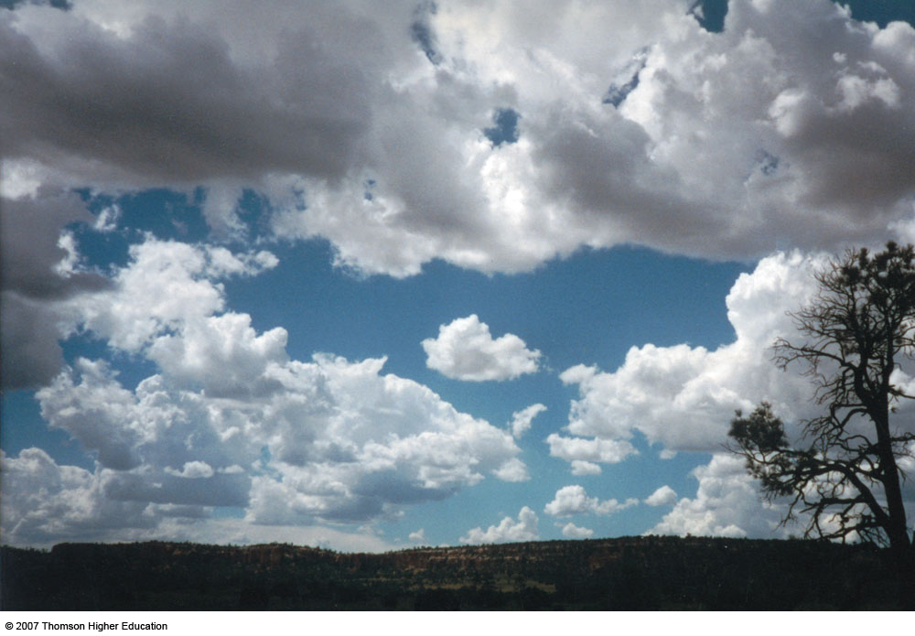
Chapter 4 Water in the Atmosphere
ATMO 1300
Summer II 2017

Slide 2
Chapter 4 Water in the Atmosphere
Water Vapor
Cloud Formation
Nucleating Processes
Stability and Clouds
Cloud Types
Precipitation Growth

Slide 3
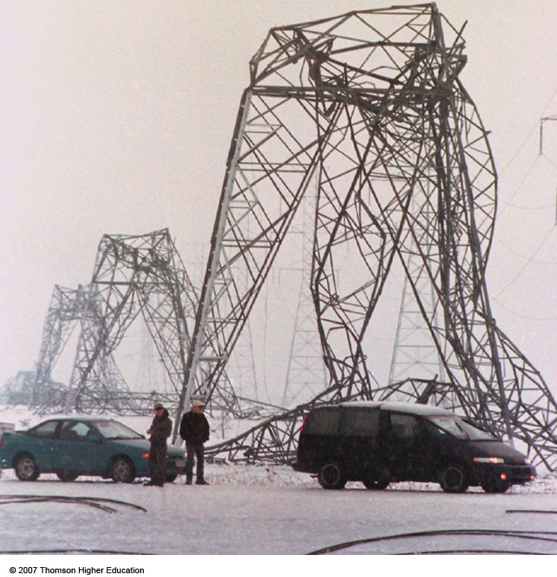
p. 83

Slide 4
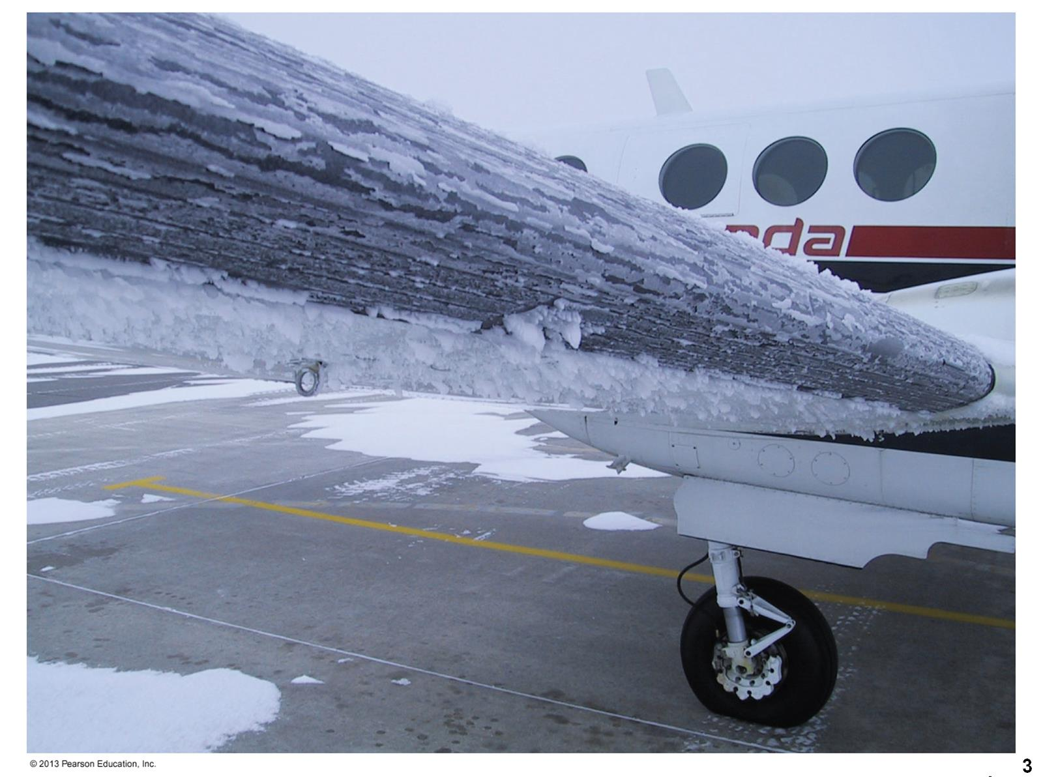

Slide 5
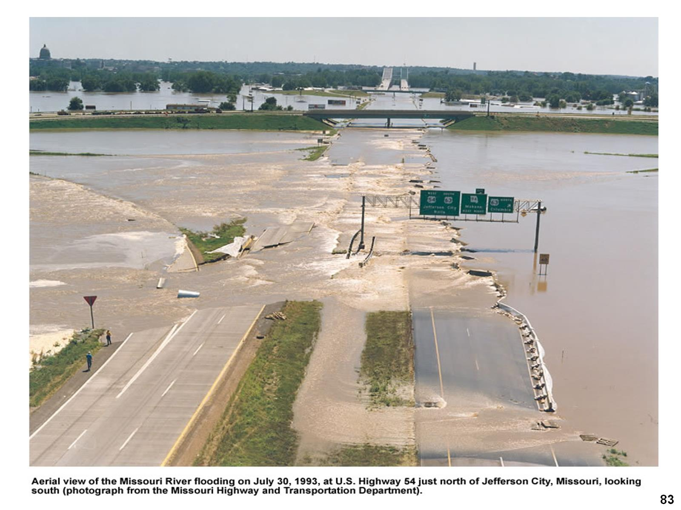

Slide 6
Overview
Moist air is air that contains water vapor
Water vapor – one of the variable gases in atmos.
Varies in space and time
Greenhouse gas (impacts temperature)
Highest concentration in lower atmosphere (lower troposphere)
Needed for clouds to form
How do we get water vapor?
Notes:
Slide2.mp3
Moisture in the atmosphere refers to the water vapor content of the air. So moist air is air that contains some measure of water vapor.
Water vapor is one of the invisible gases found in the atmosphere and is highly variable in both space and time.
The highest concentration of water vapor in the atmosphere is found near the earth’s surface. This is because water vapor gets into the atmosphere primarily through evaporation from bodies of water such as oceans and lakes and to a certain degree through transpiration by plants.

Slide 7
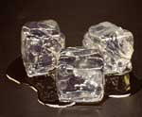
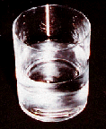
Three States of Matter
Solid (ice), Liquid, Gas (water vapor)

Slide 8
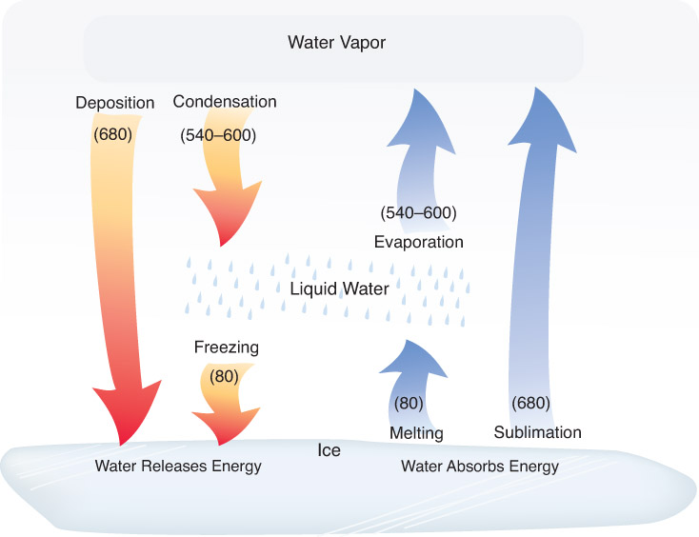
Fig. 2-5, p. 40

Slide 9
Evaporation
Evaporation
Latent heat is absorbed from environment (cooling process)
Think of how sweat and misters are cooling
Condensation: warming process, latent heat is released into the environment

Slide 10
What happens once there is water vapor?
How do we account for the water vapor content in the atmosphere?
What is saturation and how does the air reach saturation?
What happens once air is saturated?
How do clouds form?
Notes:
Slide4.mp3
In this lesson you will learn how we account for the water vapor content of the air. We will also discuss a very important concept called saturation. And you will discover how humidity, which refers to the water vapor content of the air, is actually measured. The discussion of water vapor and saturation will help you understand how clouds form in the atmosphere.

Slide 11
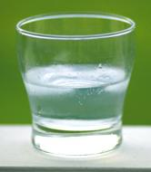
Saturation Photo from www.cgl.uwaterloo.ca/ ~csk/water.html
Notes:
Slide8.mp3
Something that is very important in our discussion of atmospheric moisture and cloud formation is the concept of saturation. What do we mean by saturation? Consider a glass that is partially filled with water. Imagine that a cover is placed over the top of this glass.
There will be some water vapor molecules in the air space between the surface of the water and the top of the container. Let’s take a microscopic view of the surface of the water and see what’s happening to the water molecules.

Slide 12
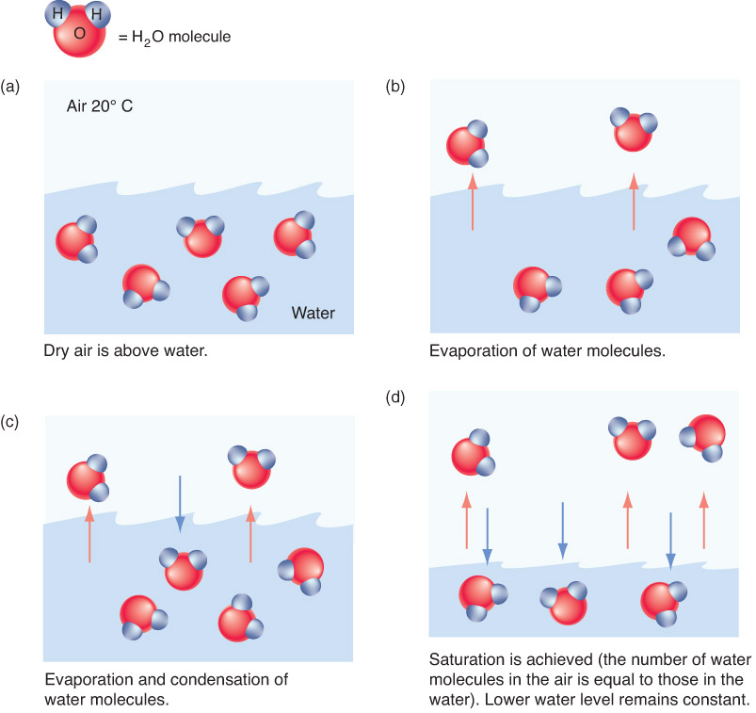
Saturation: When the rate of evaporation = rate of condensation
Depends on temperature
Fig. 4-1, p. 99

Slide 13
More on Evaporation

Slide 14
Indices of Water Vapor Content
Humidity – general term for the amount of water vapor in the air
Humidity is commonly expressed by:
Mixing Ratio
Vapor Pressure
Relative Humidity- we hear this one a lot
Dew Point Temperature
Notes:
Slide12.mp3
Since water vapor is such an important component of the atmosphere in meteorological processes, we need to define some indices to account for the water vapor content of the air.
Humidity is a general term used to refer to the amount of water vapor in the air. Specifically, humidity is expressed using the following terms: vapor pressure, mixing ratio, relative humidity and dew point temperature. There are other terms such as absolute humidity and specific humidity, but we will only consider these four.

Slide 15
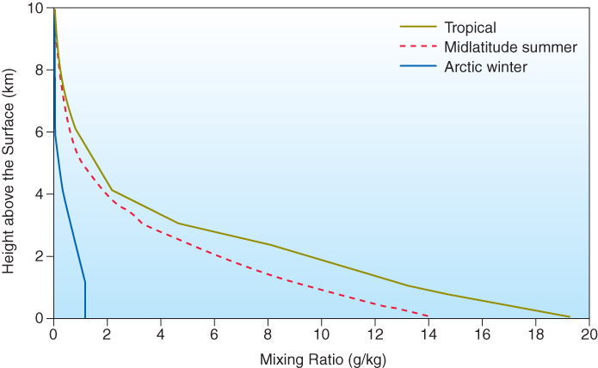
Mixing Ratio
Just like a recipe: ratio of weight of water vapor to weight of all atmospheric molecules
Typical value ~ 10 g water vapor / 1 kg dry air
Does not depend on temperature or pressure
Fig. 4-2, p. 101
Notes:
Slide18.mp3
A more commonly used expression for humidity is the relative humidity. Relative humidity is a ratio of the actual water vapor content to the maximum water vapor content possible at a given temperature. It is expressed as a percentage. The maximum water vapor content possible refers to how much water vapor would be required for saturation. So we can express relative humidity as a ratio of the actual vapor pressure to the saturation vapor pressure.

Slide 16
Vapor Pressure
Just like regular atmospheric pressure, but in this case, the pressure exerted SOLELY by water vapor molecules.
Expressed in millibars (mb)
Typically < 40 mb
Saturation vapor pressure – the pressure exerted by water vapor molecules at saturation
Saturation vapor pressure increases as temperature increases
“Warm air holds more water vapor” – sort of.
Notes:
Slide18.mp3
A more commonly used expression for humidity is the relative humidity. Relative humidity is a ratio of the actual water vapor content to the maximum water vapor content possible at a given temperature. It is expressed as a percentage. The maximum water vapor content possible refers to how much water vapor would be required for saturation. So we can express relative humidity as a ratio of the actual vapor pressure to the saturation vapor pressure.

Slide 17
Relative Humidity
Ratio of actual water vapor content to the maximum water vapor content possible (at saturation).
Expressed as a percentage
RH = 100% x (^{VAPOR PRESSURE}/_{SATURATION VAPOR PRESSURE})
NOT a sole measure of atmospheric moisture (therefore, can be very misleading)
Notes:
Slide18.mp3
A more commonly used expression for humidity is the relative humidity. Relative humidity is a ratio of the actual water vapor content to the maximum water vapor content possible at a given temperature. It is expressed as a percentage. The maximum water vapor content possible refers to how much water vapor would be required for saturation. So we can express relative humidity as a ratio of the actual vapor pressure to the saturation vapor pressure.

Slide 18
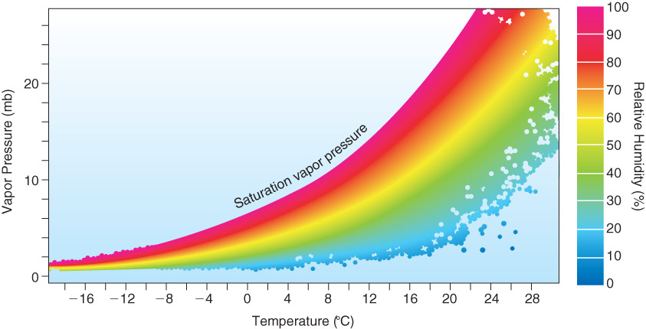
Relative Humidity
Fig. 4-3, p. 102

Slide 19
Relative Humidity
Depends on 2 variables:
1. actual water vapor present
2. temperature*
*Max water vapor content possible depends on temperature
Notes:
Slide19.mp3
Relative humidity depends on two variables: the actual water vapor content and the temperature (since saturation vapor pressure is a function of temperature). Thus, relative humidity can change if there is an increase or decrease in the amount of water vapor in the atmosphere or if there is a change in temperature. Since relative humidity depends on two variables, it is not an indicator of the actual water vapor content.

Slide 20
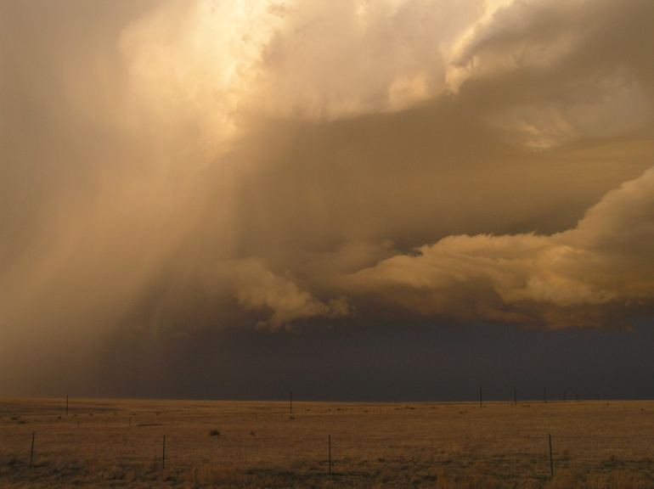
Ways to Achieve Saturation (RH=100%)
Add water vapor
Evaporation
Example: Bathroom shower (foggy!), Rain falling into dry air
Notes:
Slide4.mp3
There are three processes than can ultimately lead to saturation.
One is to add water vapor to the air. As discussed earlier, the process of adding water vapor to the air is called evaporation. Plants can also add water vapor to the air. If enough water vapor is added, the air becomes saturated. This can happen when rain falls into air that is very cold.

Slide 21
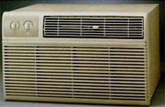
Ways to Achieve Saturation (RH=100%)
Cool the air
(reduces sat.
vapor pressure)
Examples:
Condensation on outside of cold glass
Air conditioners
Notes:
Slide5.mp3
A second method is to mix cold air with warm, moist air. If you have ever breathed outdoors on a very cold day, you saw a tiny cloud being produced in your exhaled air. The moist air you exhale mixes with the cold outside air resulting in saturated conditions.
The third method for achieving saturation is cooling the air. This is the predominant method in the atmosphere leading to cloud formation and so is the one we shall investigate more thoroughly.

Slide 22
Relative Humidity vs. Temp
With NO change in water vapor content,
RH increases as temperature decreases
RH decreases as temperature increases
Notes:
Slide21.mp3
Remember saturation vapor pressure changes with temperature. So relative humidity will change inversely as temperature changes even though the actual water vapor content may stay the same. Relative humidity will increase as temperature decreases and it will decrease as temperature increases.

Slide 23
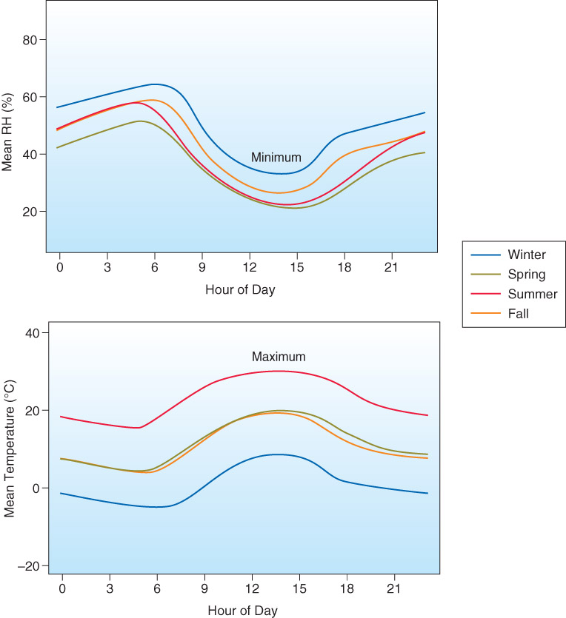
Relative Humidity vs. Temp
http://www.mesonet.ttu.edu/meteograms/meteo_REES.png
Fig. 4-4, p. 105
Notes:
Slide22.mp3
In this graph the red curve shows how relative humidity typically changes from early morning to late at night. The blue curve shows how temperature changes.
It is common to observe the highest relative humidity around sunrise when the lowest temperature for the day often occurs and the lowest relative humidity in the afternoon when the highest temperature typically occurs.

Slide 24
Use of Relative Humidity
Relative humidity is inversely related to the rate of evaporation
Saturated air = 100% RH
Heat Index – a measure of “apparent temperature” (how hot you feel) based on combined effects of temperature and RH
Notes:
Slide22.mp3
Relative humidity is inversely related to the rate of evaporation. The lower the relative humidity the higher is the rate of evaporation. On a hot, summer day in locations where the relative humidity is high you feel uncomfortable outside because the rate of evaporation of perspiration from your skin, which helps to cool the body, is low. The Heat Index, a number computed from the ambient temperature and relative humidity, is often used to indicate an apparent temperature.

Slide 25
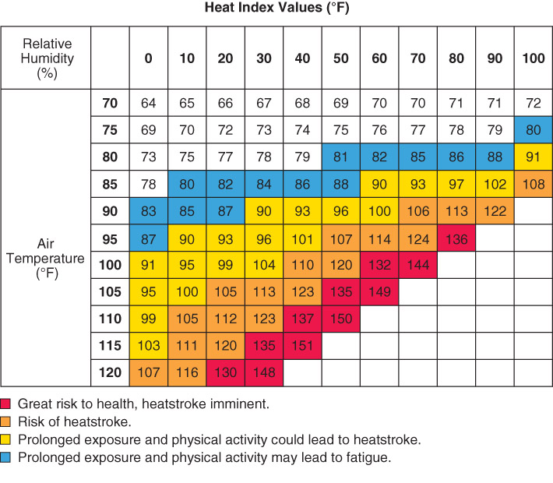
Box 4-1, p. 103

Slide 26
Dewpoint Temperature
Temperature to which air must be cooled to reach saturation (at constant pressure)
Like vapor pressure and mixing ratio, dewpoint temperature is an indicator of the actual water vapor content
Higher dew point = more water vapor (saturation: T_{d} = T_{a})
Notes:
Slide24.mp3
Another commonly used term to refer to humidity is the dew point temperature or just dew point. The dew point is the temperature to which the air must be cooled at constant pressure and water vapor content to reach saturation. Unlike relative humidity, dew point is a good indicator of the actual water vapor content.

Slide 27
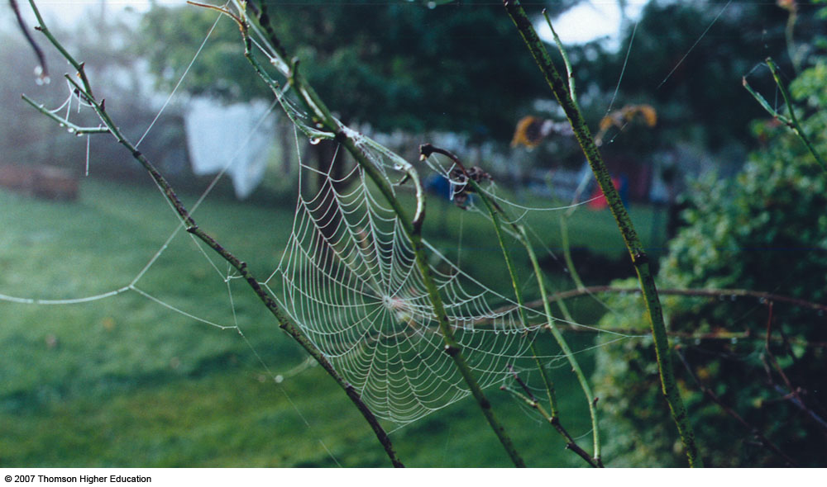
Fig. 4-5, p. 106

Slide 28
Dew Photo from lynmillett.com/archives/2003

Slide 29
Frost Photo from www.ashland-city.k12.oh.us/ahs/classes/hort

Slide 30
Temp-Dew Point Spread

Slide 31
Example

Slide 32
Example

Slide 33
Example (cont’d)

Slide 34
Example (cont’d)

Slide 35
If only forming raindrops were as simple as saturating the air…

Slide 36
Overview
Clouds composed of tiny liquid water drops and/or ice crystals
Diameter of average cloud droplet = .0008 inches which is about 100 times smaller than an average raindrop
Notes:
Slide4.mp3
Clouds are composed of tiny liquid water droplets and/or ice crystals. The diameter of an average cloud droplet is .0008 inches. This is about 100 times smaller than an average raindrop. The tiny cloud droplets or ice crystals that make up clouds are too small to overcome the updraft and fall as precipitation.

Slide 37
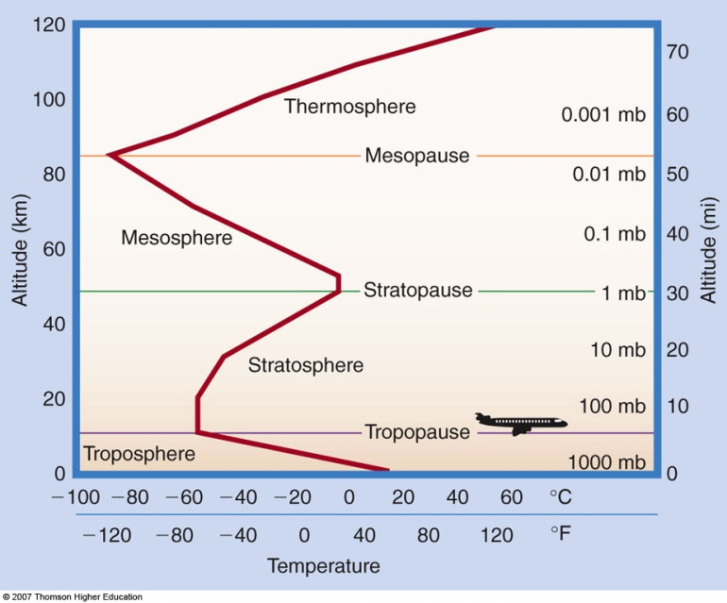
How do droplets form?
1) Homogeneous Nucleation
Water vapor molecules simply bond together
Even moderate molecular kinetic energy will break bonds, so must have very cold temperatures (< -40 deg C)
-40 deg C not generally seen in
most of the troposphere.
MUST BE ANOTHER WAY!

Slide 38
How do droplets form?
2) Heterogeneous Nucleation
Water molecules bond to non-water particles (e.g., aerosols) in the atmosphere called condensation nuclei.
Why is nucleation easier?
For hygroscopic nuclei (where water dissolves agent), due to SOLUTE effect
For hydrophobic nuclei (where water does not dissolve agent), due to CURVATURE effect

Slide 39
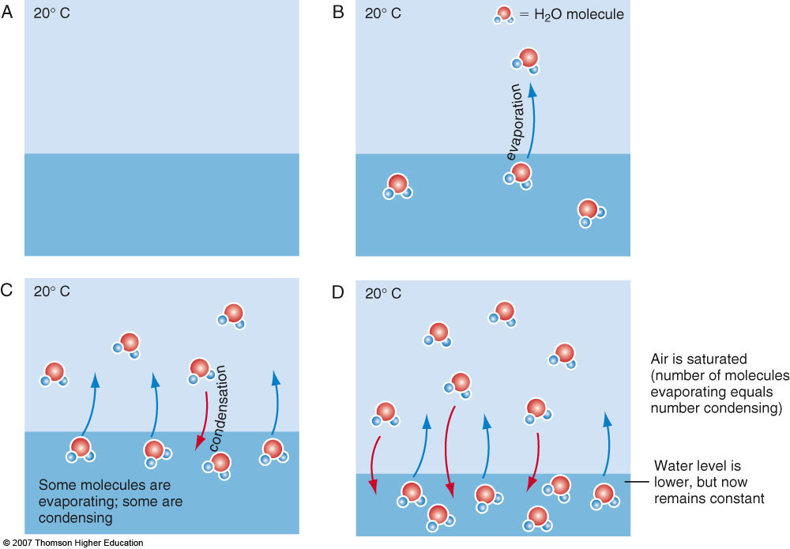
SOLUTE EFFECT
Nucleus attracts water molecules, keeping them from evaporating.
Therefore, saturation vapor pressure decreases.
Read another way, less water vapor is required to make droplet grow!
X
X
N

Slide 40
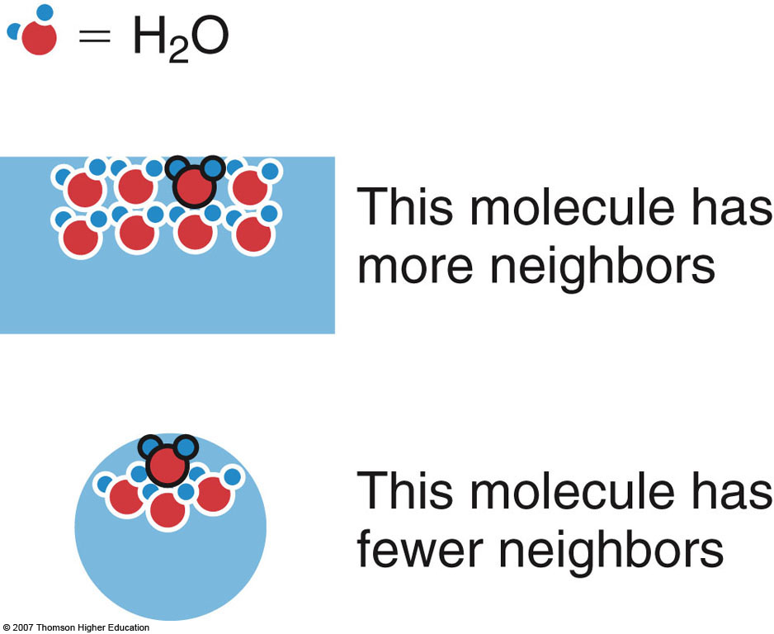
CURVATURE EFFECT
With fewer neighbors, less attraction amongst water molecules (surface tension).
Therefore, molecules more readily evaporate into air.
To keep saturation, must increase rate of condensation (saturation vapor pressure must be increased)
Read another way, increasing the size of a raindrop (less curvature), allows for droplet growth (due to lower saturation vapor pressure).
Hydrophobic condensation nuclei increase size of raindrop (water wets outside of aerosol)
2nd Edition: Fig. 4-7, p. 93

Slide 41
Examples of Condensation Nuclei
Clay
Salt
Silver iodide
Pollution
Bacteria

Slide 42
How Do Ice Crystals Form?
Deposition onto ice nuclei
Spontaneous freezing (no ice nuclei)
(need VERY cold temps – much below
0 deg C)
What happens if insufficient ice nuclei are present (very common)? Water exists below 0 deg C, but is not frozen. Called supercooled water.
Notes:
Slide14.mp3
Ice crystals can form either by deposition onto an ice nuclei, or when a supercooled water drop comes in contact with an ice nuclei and freezes, or by spontaneous freezing in which no ice nuclei are required. The third process occurs at temperatures near -40 deg Celsius or colder.

Slide 43
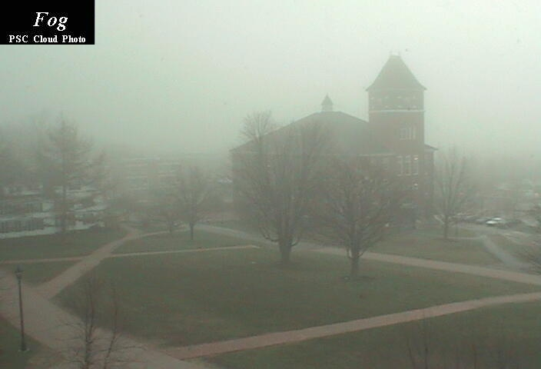
Let’s start at the surface
Fog is a cloud whose base is at the ground
How is saturation achieved? Just like anywhere else:
Increasing water vapor
Decreasing temperature
(think of ways we can do either of these at the surface of Earth)
Notes:
Slide25.mp3
We have seen that the predominant mechanism for cloud formation in the atmosphere is adiabatic cooling due to air being forced to rise. In certain situations, diabatic cooling can lead to saturation and cloud formation. Diabatic cooling operates in the formation of certain types of fog. Fog is simply a cloud whose base is at the ground. There are two types of fog that form from diabatic cooling. These are radiation fog and advection fog.

Slide 44
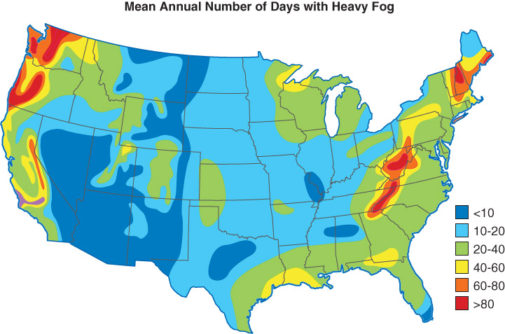
Fig. 4-9, p. 110

Slide 45
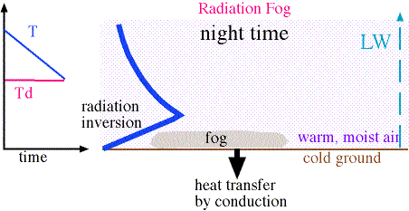
Radiation Fog
Clear skies/light wind
Ground cools by radiation
Air in contact with ground cools by conduction.
Figure from apollo.lsc.vsc.edu/classes/met130
Notes:
Slide26.mp3
Radiation fog forms at night when the sky is clear, the wind is light and a shallow layer of moist air is in contact with the ground. The ground cools at night due to loss of energy through radiation. The shallow moist layer of air in contact with the ground cools by the energy transfer process called conduction. If the air cools sufficiently, saturation occurs and fog forms.

Slide 46
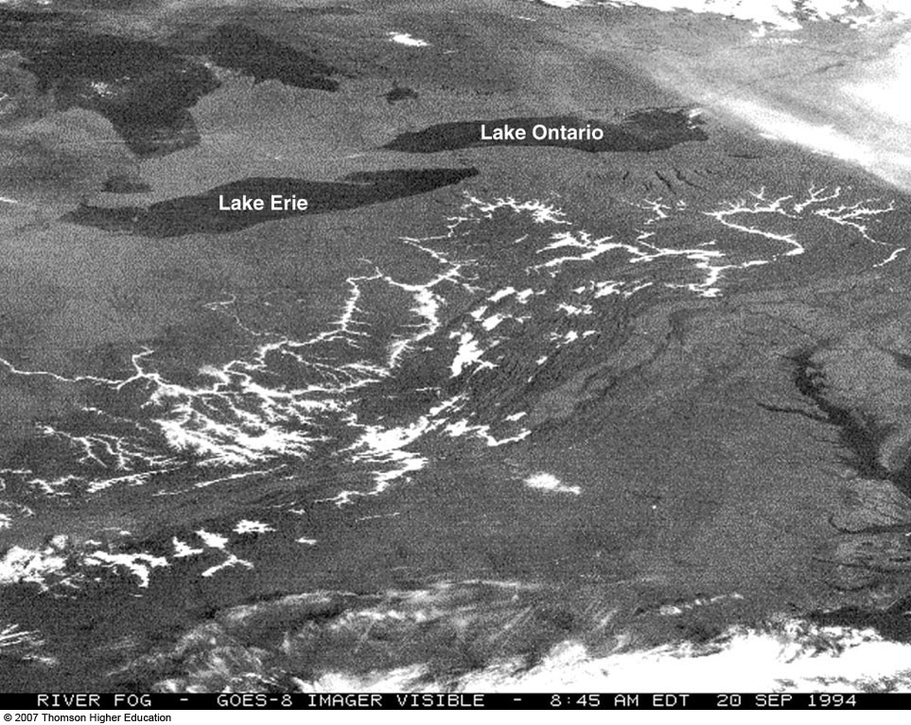
Valley Fog
Fig. 4-10, p. 111

Slide 47
Advection Fog
Warm, moist air moves over a colder surface.
Heat transferred from the air to surface, thus air cools
Figure from www.rap.ucar.edu/staff/tardif/Documents/CUprojects/
ATOC5600
Notes:
Slide27.mp3
Advection fog forms when warm, moist air moves over a colder surface. The surface may be land that has been cooled by radiation, or it may be water that is colder than the air moving over it. In either case, the air cools by conduction. If enough cooling takes place, the air can become saturated and a fog develops.

Slide 48
Advection Fog
Due to warm Pacific air advected over cold coastal waters
Fig. 4-11, p. 111

Slide 49
Upslope Fog
Moist air carried upslope by the wind.
Air cools by adiabatic expansion
Called orographic lift
Figure from www.rap.ucar.edu/staff/tardif/Documents/CUprojects/
ATOC5600
Notes:
Slide28.mp3
Another type of fog is upslope fog. Upslope fog can form when moist air is forced to rise as air flows toward higher and higher terrain. Air flowing toward a mountain barrier is forced to rise. As the air rises it cools adiabatically. If sufficient cooling occurs the air becomes saturated and a cloud forms. Someone on the side of the mountain within the cloud would observe it as fog.

Slide 50
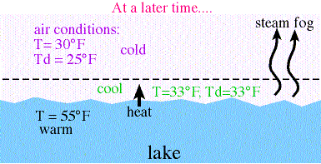
Evaporation Fog
Evaporation occurs (adding water vapor)
Cold air over warmer water
Figure from apollo.lsc.vsc.edu/classes/met130
Notes:
Slide29.mp3
The fourth type of fog is evaporation fog, sometimes called steam fog. This type of fog forms when water evaporates into and mixes with colder, drier air. Colder air flowing over warmer water can cause steam fog. In the diagram above, note the water temperature is greater than the air’s temperature. The shallow layer of air at the water’s surface is warmed and gains moisture through evaporation. If enough mixing occurs, the air becomes saturated.

Slide 51
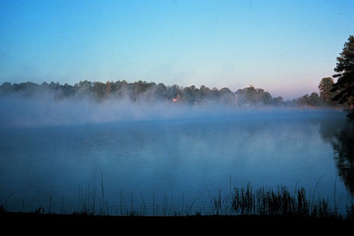
Evaporation Fog
Notes:
Slide30.mp3
This photograph shows steam fog appearing to rise above the water surface.
You may also have seen steam fog over an asphalt road surface that has become wet from rain. Once the clouds dissipate, the sun heats the asphalt causing the water to evaporate into and mix with the cooler air above the asphalt surface.

Slide 52
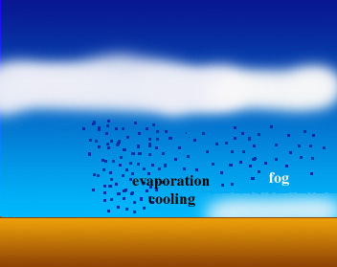
Precipitation Fog
Precipitation fog
Warm rain falls into colder air
Evaporation and mixing occur
Figure from www.rap.ucar.edu/staff/tardif/Documents/CUprojects/
ATOC5600
Notes:
Slide31.mp3
Evaporation fog can also form when warm rain falls into a layer of colder air. The raindrops evaporate and if enough mixing occurs fog forms. This type of evaporation fog is known as precipitation fog and is sometimes observed to the north of a warm front.

Slide 53
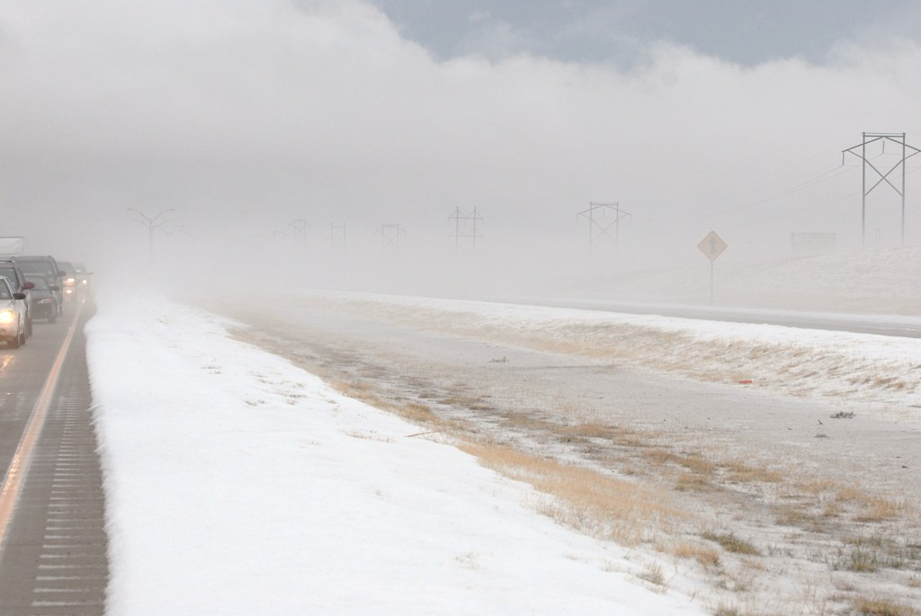
Hail Fog
Hail begins to evaporate into the air above
Lots of moisture content available with hail
Saturates the air above the ground → Fog
Notes:
Slide31.mp3
Evaporation fog can also form when warm rain falls into a layer of colder air. The raindrops evaporate and if enough mixing occurs fog forms. This type of evaporation fog is known as precipitation fog and is sometimes observed to the north of a warm front.

Slide 54
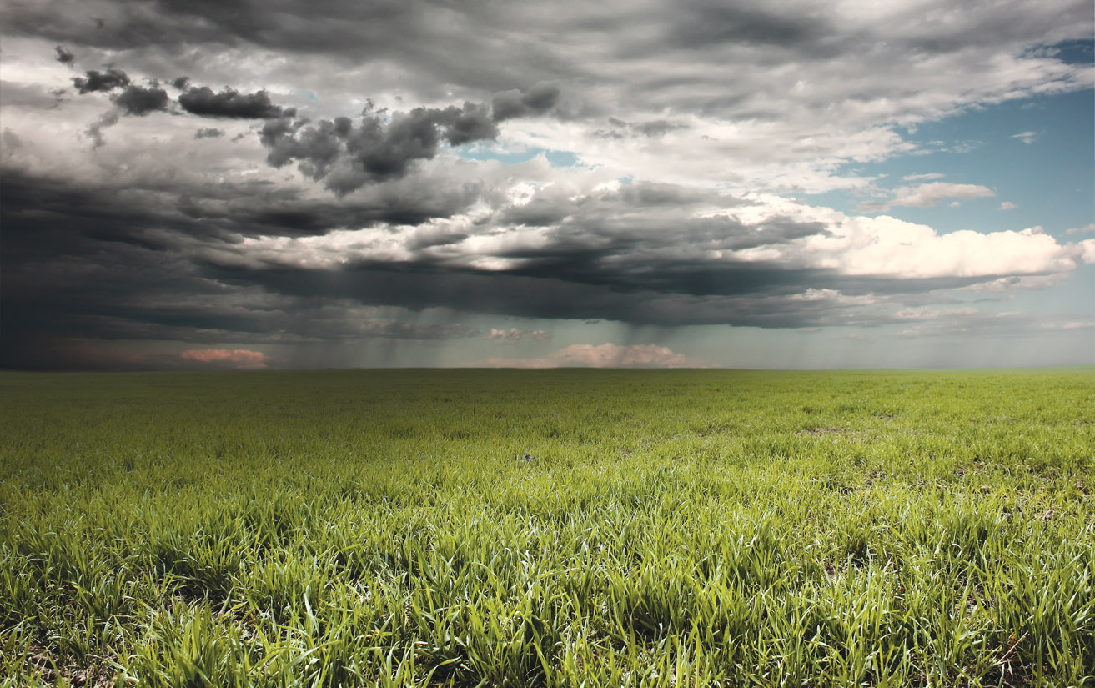
Finally looking at water vapor possibilities as air moves upwards from the surface…

Slide 55
Dry Adiabatic Lapse Rate
Recall: Lapse rate is a decrease of temperature with height
The rate of cooling of dry (unsaturated) air as it rises is a constant:
~10 ºC / km
Don’t confuse with the environmental lapse rate (radiosonde observation), we’re talking about our parcel (blob) of air
Notes:
Slide11.mp3
Since we are talking about cooling the air leading to saturation, let’s return to the process of adiabatic cooling.
A lapse rate is a decrease of temperature with height. When a parcel of air rises in the atmosphere it expands and cools. In other words its temperature decreases with height. As long as the parcel is not saturated, its temperature cools at a constant rate known as the Dry Adiabatic Lapse Rate. Its value is 1 deg C per 100 meters or about 5.5 deg F per 1000 feet. Note that the term “dry” refers to the parcel being unsaturated, not the absence of water vapor.

Slide 56
What have we learned so far?
A parcel of air cools adiabatically as it rises.
Is the water vapor content changing?
Is the temperature changing?
Is the RH increasing or decreasing?
Notes:
Slide13.mp3
What have we learned so far? If a parcel of air rises in the atmosphere it will cool adiabatically. As long as the air is not saturated, meaning the relative humidity is less than 100%, the parcel will cool at the dry adiabatic lapse rate. As an unsaturated parcel of air rises does the water vapor content change? The water vapor content, and hence the mixing ratio, remains constant. How is the temperature in the parcel changing and what effect does that have on relative humidity?

Slide 57
What have we learned so far?
Temperature decreases
Relative Humidity increases
What happens when RH = 100%?
The air is saturated.
Once the air is saturated, condensation (or deposition) occurs and a cloud begins to form. This is “Cloud Base” AKA the Lifted Condensation Level (LCL)
Notes:
Slide14.mp3
The temperature drops which causes the relative humidity of the parcel to increase.
What happens when the relative humidity reaches 100%?

Slide 58
Cloud Development Photo from apollo.lsc.vsc.edu/classes/met130
Temp and dew point in rising saturated air are the same
Water vapor condenses into liquid water
Notes:
Slide23.mp3
As long as the saturated parcel continues to rise, the cloud will develop vertically. The temperature and dew point of the parcel remain equal, otherwise you wouldn’t have saturated conditions. The dew point drops at a greater rate than in unsaturated air because not only is dew point changing with pressure, but the water vapor content in the parcel is decreasing since water vapor is condensing into liquid water drops

Slide 59
Cloud Development Photo from apollo.lsc.vsc.edu/classes/met130
These clouds are composed of tiny liquid water drops
Notes:
Slide24.mp3
A cloud, therefore, is composed of tiny liquid water drops that form when water vapor condenses onto condensation nuclei once the air becomes saturated. In actuality, condensation may begin even before the relative humidity reaches 100% due to the hygroscopic nature of condensation nuclei. At very cold temperatures deposition may occur and a cloud composed of ice crystals forms. We’ll discuss the various types of clouds later.

Slide 60
LCL
Lifting Condensation Level
The height at which a rising parcel of air becomes saturated due to adiabatic cooling.
Where a cloud begins to form in rising air
Notes:
Slide20.mp3
Once the parcel becomes saturated, condensation occurs on condensation nuclei and a cloud begins to form. The level at which the parcel becomes saturated is called the Lifting Condensation Level abbreviated LCL. It is the level at which condensation begins due to lifting a parcel of air. The base of a cloud is at this level.

Slide 61
What Happens Above the LCL?
The air still expands and cools as it rises
The cooling rate is slowed due to release of latent heat of condensation
The cooling rate is called the Saturated Adiabatic Lapse Rate
~6 ºC / km (approx.)
Notes:
Slide21.mp3
What happens if the saturated parcel of air continues to rise above the LCL? The parcel still expands and cools, but the cooling rate is no longer according to the dry adiabatic lapse rate. The reason is once condensation occurs, energy is released to the parcel which slows the cooling rate. This release of energy is called the latent heat of condensation. Remember condensation is a warming process.

Slide 62
Moist Adiabatic Lapse Rate
-10 deg C/km DRY ADIABATIC L.R.
+4 deg C/km due to latent heat release.
+ _________________________________
-6 deg C/km is the MOIST ADIABATIC L.R.
Air is unsaturated – cools at Dry Adiabatic LR
Air is saturated – cools at Moist Adiabatic LR
Notes:
Slide23.mp3
Take a look at this example. In the column labeled ENVIRON are temperatures obtained from a radiosonde observation. They are just the air temperatures at the given altitudes. This column represents the environmental lapse rate. Now we are going to see what would happen if a parcel of air at the surface with a temperature of 70 deg were forced to rise in the atmosphere. We’ll assume the parcel is not saturated.

Slide 63
Determining Stability
Compare environmental & parcel temp
HEIGHT ENVIRON PARCEL (T/Td)
3 km AGL 8 deg C ?
2 km AGL 15 deg C ?
1 km AGL 22 deg C ?
SFC 30 deg C 30/20
In reality, Td (dewpoint temperature) of parcel will decrease slowly as it is lifted. For our calculations in this course, we will assume the dewpoint remains constant.
Where is LCL?
How is stability affected by saturation point?
9/9
14/14
20/20
Notes:
Slide23.mp3
Take a look at this example. In the column labeled ENVIRON are temperatures obtained from a radiosonde observation. They are just the air temperatures at the given altitudes. This column represents the environmental lapse rate. Now we are going to see what would happen if a parcel of air at the surface with a temperature of 70 deg were forced to rise in the atmosphere. We’ll assume the parcel is not saturated.

Slide 64
Four Types of Stability
Absolutely Stable
Stable for saturated and unsaturated ascent
Absolutely Unstable
Unstable for saturated and unsaturated ascent
Neutral Stability
Neither stable or unstable, no net acceleration
Conditionally Unstable
Stable for unsaturated parcel, unstable for saturated parcel
Notes:
Slide26.mp3
Using this method of determining the stability of a parcel of air, we can define four types of stability that might characterize any given layer in the atmosphere. A layer just means a certain vertical depth. For example, the layer could be from the surface to 10,000 feet or from the surface to 30,000 feet. These 4 types of stability are: absolutely unstable, absolutely stable, neutrally stable and conditionally unstable.

Slide 65
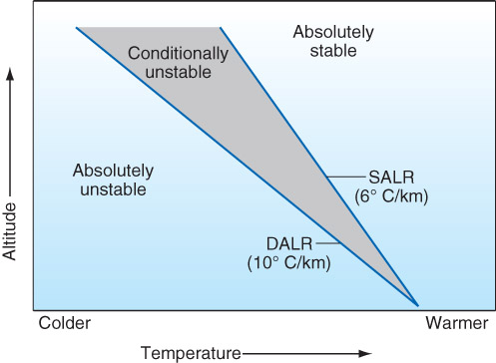
Fig. 4-15, p. 115

Slide 66
Level of Free Convection
The altitude in a conditionally unstable atmosphere above which a parcel becomes warmer than the environment.
Above the LFC the parcel acquires a positive buoyant force
Notes:
Slide42.mp3
The Level of Free Convection is the altitude above which a parcel becomes warmer than the environment in a conditionally unstable atmosphere. Above the LFC the parcel acquires a positive buoyant force and the parcel accelerates upward.

Slide 67
Conditionally Unstable Layer
HEIGHT ENVIRON PARCEL (T/Td)
3 km AGL 6 deg C 8
2 km AGL 14 deg C 14 - LFC
1 km AGL 22 deg C 20/20 - LCL
SFC 30 deg C 30/20
How do we overcome negative buoyancy? FORCED LIFT!
Notes:
Slide30.mp3
This table illustrates an absolutely stable layer. Note that at each level, the parcel temperature is colder than the environmental temperature regardless of whether the parcel is saturated or not. The parcel at each level is stable meaning there will be a resistance to vertical displacement. No where in this layer does the parcel become unstable.

Slide 68
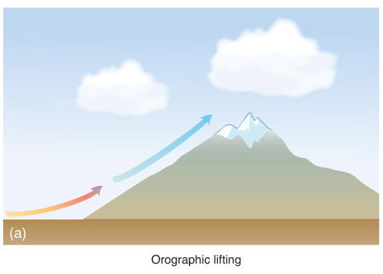
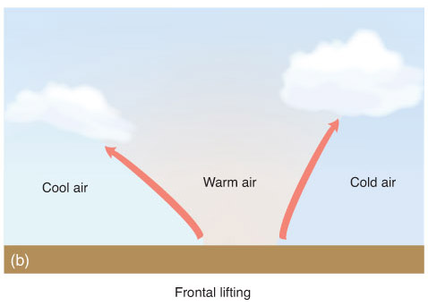
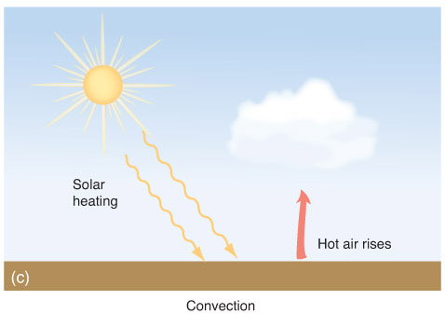
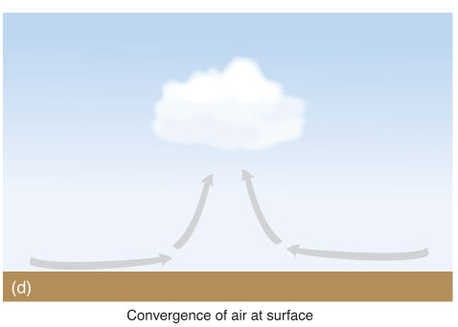
Cloud production due to lift
Fig. 4-13, p. 113

Slide 69
How Stability Changes
Change the Environmental Lapse Rate
For a given atmospheric layer:
→ Cooling (warming) the lower (upper) part
will stabilize the layer.
→ Warming (cooling) the lower (upper) part
will destabilize the layer.
Notes:
Slide25.mp3
How does stability change? Recall that stability is determined by comparing the environmental lapse rate to either the dry or moist adiabatic lapse rate, depending on whether the air parcels are saturated or not. If the environmental lapse rate changes then the stability changes. For a given layer in the atmosphere, cooling the lower part of the layer and warming the upper part of the layer will make that layer more stable. On the other hand, warming the lower part of the layer and cooling the upper part will make the layer more unstable.

Slide 70
What Processes Cause This?
Insolation during the day
Radiational cooling at night
Temperature advection at different levels
Notes:
Slide28.mp3
Warmer or colder air being brought in by the winds at different levels (known as warm or cold advection) can cause a change to the environmental lapse rate and thus will change the stability.

Slide 71
All for Today…

Slide 72
Ch 4
Water vapor supplied by evaporation/transpiration (cooling)
Saturation: rate of evaporation = rate of condensation
Know how humidity is measured and how saturation could be expressed in each
Mixing ratio: g of water vapor / kg of air (pure measure)
Vapor pressure: pressure of only water vapor (pure measure)
Relative humidity: ratio of vapor pressure to saturation vapor pressure (depends on temperature and moisture content, ex: decreased temperature = increased RH)
Dew point: the temperature at which cooled air would reach saturation (depends on pressure but not temperature)
Dew: condensation caused on a surface when saturation is reached
Frost: deposition on a surface when saturation is reached below freezing
Higher dew point = higher water content
Lower spread between dew point and temperature = higher RH

Slide 73
Ch 4
Homogeneous nucleation: condensation of water directly in the air, cold temperatures, not common
Heterogeneous nucleation: condensation with other particles (CCN)
Solute effect: reduce evaporation from drops, faster droplet formation
Curvature effect: increases starting curvature
Ice formation
Spontaneous freezing, also not common
Deposition onto ice nuclei
Fog: formation of cloud droplets at the surface from increased moisture or decreased temperature
Radiation cooling – cooling to dew point due to loss of radiation
Advection – warm moist air cooled by a cold surface
Upslope – from cooling air pushed up in elevation
Steam – from warm water with cool air above it
Precipitation – from warm precip into cold air

Slide 74
Ch 4
LCL (lifted condensation level): height where a parcel becomes saturated, cloud base
Saturated lapse rate (6 K / km): decreased lapse rate due to the condensation of water vapor and release of latent heat
Conditionally unstable: stable for unsaturated ascent, unstable for saturated ascent
LFC (level of free convection): height where a parcel become unstable

Slide 75
Chapter 4 Water in the Atmosphere
Tuesday July 18th

Slide 76
Chapter 4 Water in the Atmosphere
Water Vapor
Cloud Formation
Nucleating Processes
Stability and Clouds
Cloud Types
Precipitation Growth
Yesterday

Slide 77
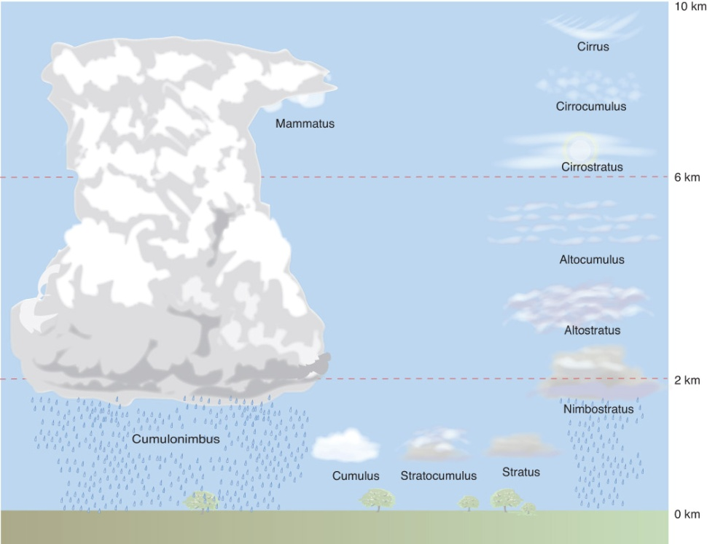
Four Cloud Groups
Two considerations
1) Altitude:
High clouds (Cirrus, Cirro_____)
Middle clouds (Alto_____)
Low clouds (Stratus, Strato____)
2) Stability:
Stable – layered clouds (____stratus)
Unstable – convective clouds (_____cumulus)
Clouds with extensive vertical development (inherently convective) are termed either cumulus or cumulonimbus, depending on whether an anvil cloud exists.
Fig. 4-16, p. 116
Table 4-3, p. 103
Notes:
Slide4.mp3
Clouds can be classified into four groups based on the height of the cloud base. These four groups are high clouds, middle clouds, low clouds and clouds with extensive vertical development.

Slide 78
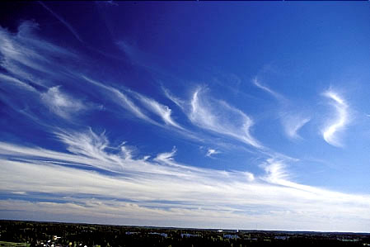
Cirrus Clouds
Notes:
Slide6.mp3
This is an example of cirrus clouds. Note the thin, wispy nature to their appearance. The long streamers are sometimes called “mares’ tales”.

Slide 79
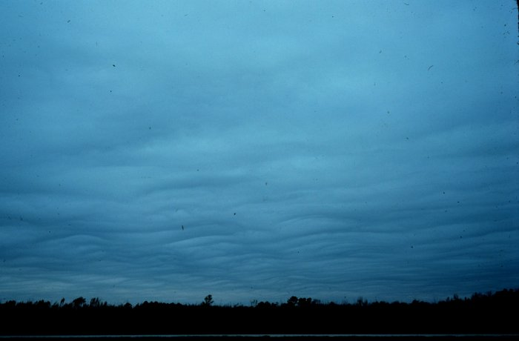
Stratus Clouds
Notes:
Slide12.mp3
Stratus clouds have the appearance of a solid layer covering most if not all of the sky. They often have a grayish color. They usually form when a layer of stable air is lifted. Since the air is stable, the vertical motion is very weak.

Slide 80
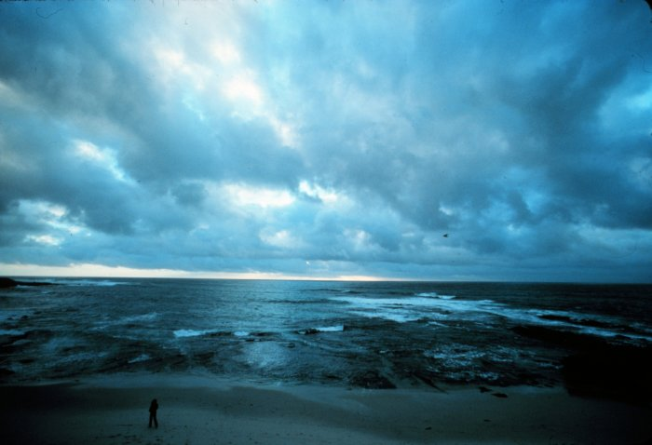
Stratocumulus
Notes:
Slide13.mp3
Stratocumulus clouds are not a solid sheet of clouds like stratus, but rather are broken up somewhat into individual cloud elements. Blue sky or higher clouds can be seen in the breaks. They have a little more vertical development than stratus because the atmosphere in which these clouds form is slightly more unstable.

Slide 81
Cumulus
Notes:
Slide16.mp3
These puffy clouds are sometimes called fair weather cumulus. They are often seen on a summer afternoon as warm, buoyant air rises. They obviously do not show much vertical development because the air above the top of the clouds is more stable preventing the clouds from continuing to grow upward. If the atmosphere is conditionally unstable and parcels reach the LFC, continued vertical growth occurs.

Slide 82
Cumulus Congestus
Notes:
Slide17.mp3
These are cumulus congestus clouds otherwise known as towering cumulus.

Slide 83
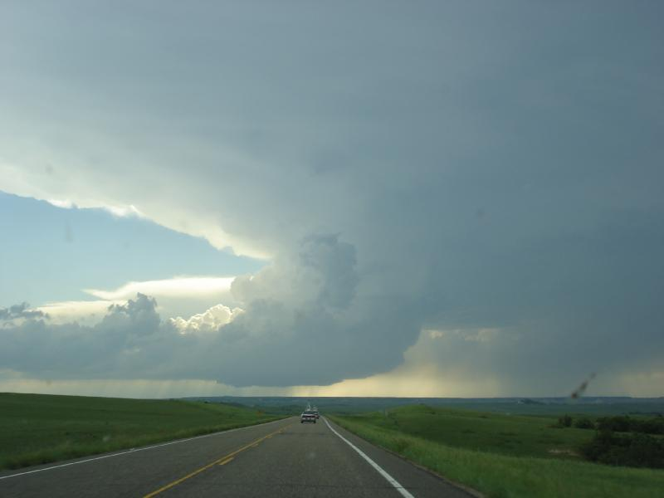
Anvil Cloud
Cirrus clouds at the top of cumulonimbus clouds (i.e., thunderstorms)
Represent the “exhaust” of the updraft causing the clouds
Notes:
Slide5.mp3
High clouds are cirrus, cirrostratus and cirrocumulus. Their bases occur at altitudes of about 20,000 feet or higher. The air is so cold at these high altitudes that the clouds are almost always composed of ice crystals.

Slide 84
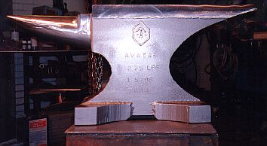
Fig. 4-21, p. 120

Slide 85
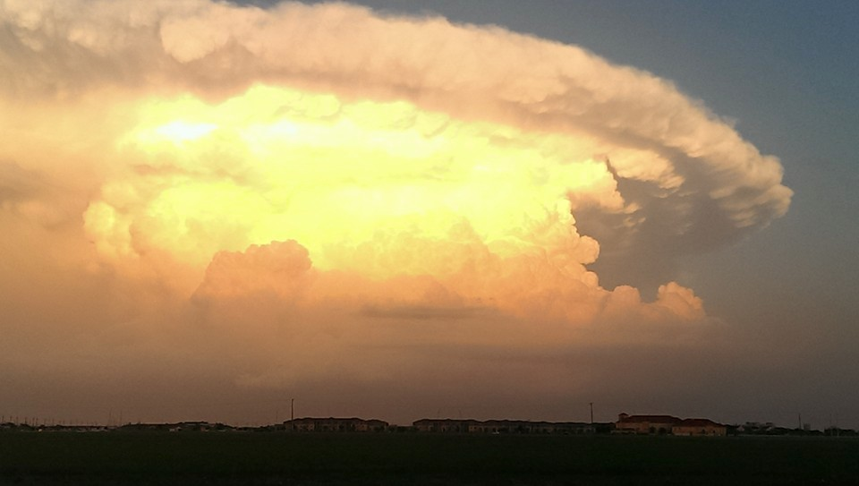
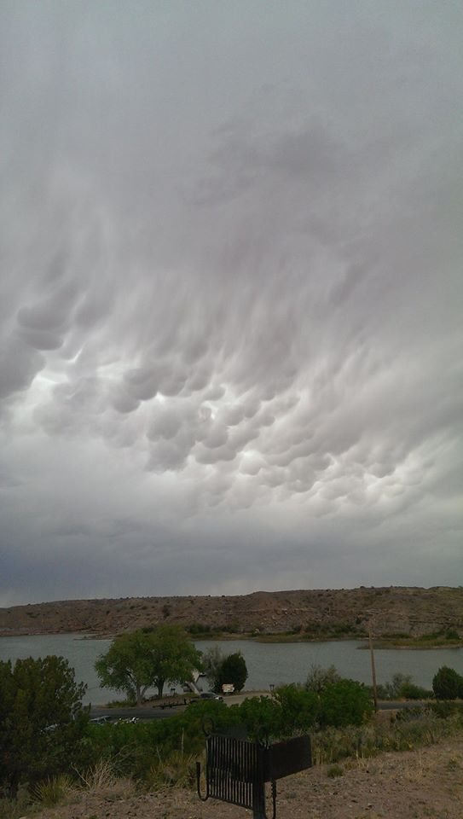
Mammatus
Anvil

Slide 86
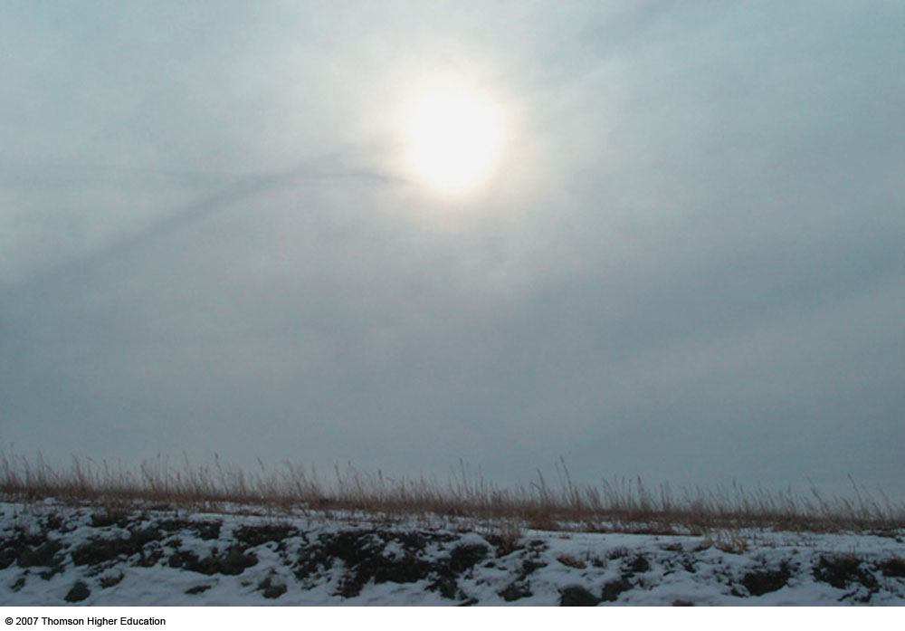
Altostratus
Fig. 4-23, p. 121

Slide 87
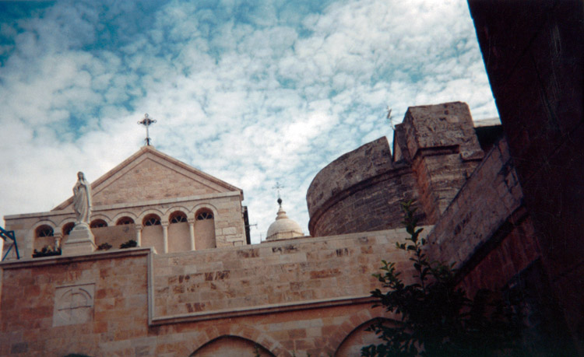
Altocumulus
Fig. 4-24, p. 121

Slide 88
Cirrocumulus
Fig. 4-25, p. 122

Slide 89
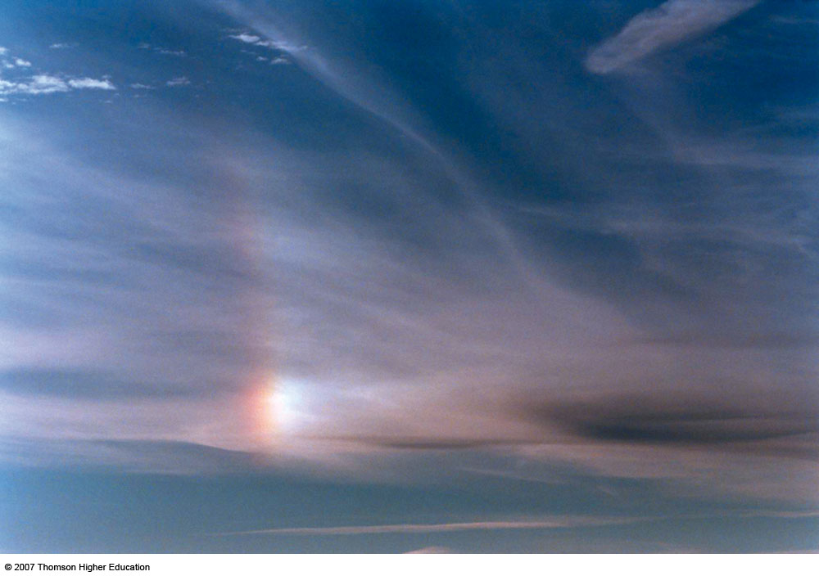
Cirrus
2nd Edition: Fig. 4-27, p. 110

Slide 90
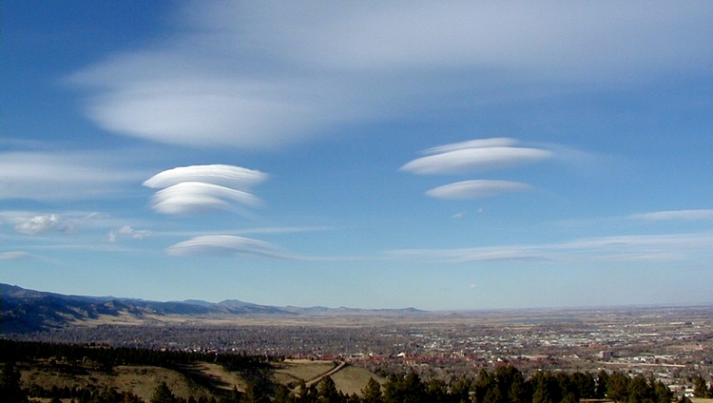
Lenticular Clouds
Notes:
Slide20.mp3
Clouds can take on unusual appearances like these lenticular clouds, so named for their lens-shape appearance. These clouds are associated with mountain waves that can form when air flows over a mountain barrier.

Slide 91
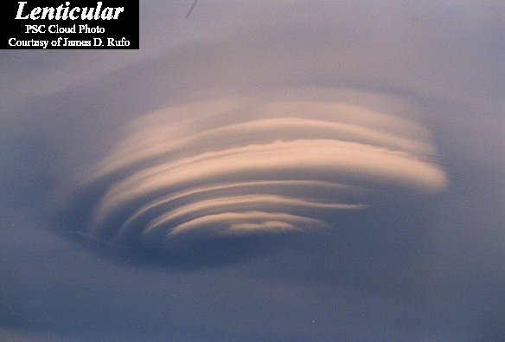
Lenticular Cloud
Notes:
Slide21.mp3
Another striking example of a lenticular cloud.

Slide 92
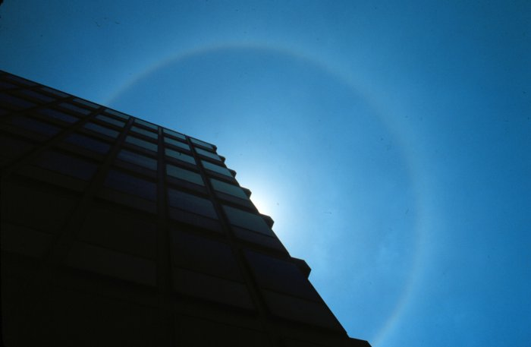
Halo in Cirrostratus
Notes:
Slide22.mp3
Clouds can sometimes interact with sunlight to produce spectacular optical effects such as halos and sundogs. These occur when sunlight is refracted by ice crystals and thus are seen predominately in the presence of cirrostratus clouds. Halos can encircle the sun or the moon.

Slide 93
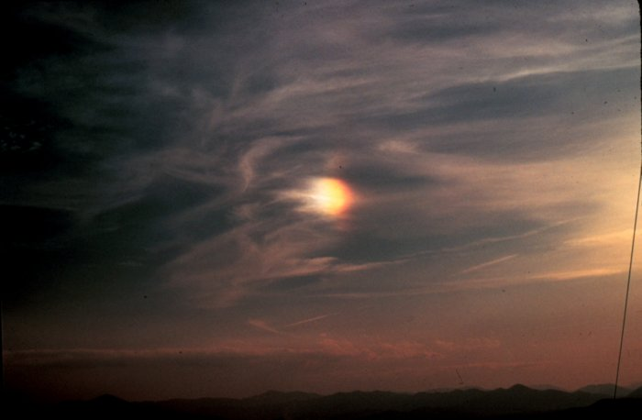
Sundog Photo from www.photolib.noaa.gov
Notes:
Slide23.mp3
This brilliant spot is a sundog and is located to the left of the sun in this photograph. Another spot is usually seen to the right of the sun as well. Sundogs occur when sunlight is refracted by ice crystals composing cirrus clouds when the sun is a few degrees above the horizon.

Slide 94
But halos can also happen when the clouds are below you, opposite the sun!

Slide 95
Undulatus Asperatus Photo from www.photolib.noaa.gov
https://www.youtube.com/watch?v=Jz7BgxrVmiQ#action=share

Slide 96
How do we go from clouds to precipitation?
Clouds composed of tiny liquid water drops and/or ice crystals
Diameter of average cloud droplet = .0008 inches which is about 100 times smaller than an average raindrop
Notes:
Slide4.mp3
Clouds are composed of tiny liquid water droplets and/or ice crystals. The diameter of an average cloud droplet is .0008 inches. This is about 100 times smaller than an average raindrop. The tiny cloud droplets or ice crystals that make up clouds are too small to overcome the updraft and fall as precipitation.

Slide 97
How do we go from clouds to precipitation?
How do these cloud droplets grow large enough to fall as precipitation?
Precipitation – liquid/solid forms of water falling from a cloud
What forms can precipitation take?
Notes:
Slide5.mp3
We know, of course, that not all clouds produce precipitation. Precipitation is liquid or solid forms of water that fall from a cloud.
So the question this lesson addresses is how do the liquid water droplets and ice crystals grow large enough within the cloud to fall as some form of precipitation. We will also look at the various forms of precipitation.

Slide 98
Growth Processes
The growth process largely depends on the temperature in the cloud.
Clouds can be termed either warm or cold
Notes:
Slide6.mp3
There are two growth processes that operate in clouds that can ultimately lead to precipitation. Which process is operating depends largely on the temperature within the cloud. This leads to classifying clouds as either warm or cold.

Slide 99
Growth in Warm Clouds
Warm clouds: Temperatures are above freezing (0ºC) throughout the cloud.
The growth process leading to precipitation is called
collision-coalescence
Notes:
Slide7.mp3
Warm clouds are clouds in which the temperature throughout the cloud is greater than 0 deg Celsius.
The growth process leading to precipitation in a warm cloud is called the collision-coalescence process.

Slide 100
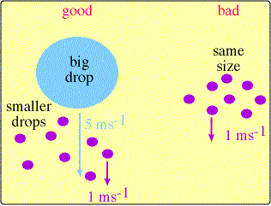
Collision-Coalescence
Larger droplets fall faster and collide with smaller droplets.
Coalescence is the merging of cloud droplets by collision.
Figure from apollo.lsc.vsc.edu/classes/met130
Notes:
Slide8.mp3
In the collision-coalescence process there must be a variation in the size of the cloud droplets. This allows the larger droplets to fall faster and collide with the smaller droplets. If all the droplets that make up a warm cloud were the same size there would be little opportunity for collisions. When the larger drops, called collector drops, collide with smaller drops they merge or coalesce, resulting in a larger size drop. Believe it or not, it takes about
1 million cloud droplets to make an average size raindrop.

Slide 101
Collision-Coalescence
Factors favoring growth by this process:
1. Numerous liquid water drops of
different size
2. Large vertical depth of cloud
3. Strong updrafts
Stratiform versus cumuliform clouds
Notes:
Slide9.mp3
The collision-coalescence process operates more effectively in clouds with a high concentration of liquid water drops. Also a thick cloud and stronger updrafts will favor this process because these factors allow a cloud drop to remain in the cloud for a longer period of time, thus giving it more opportunity to grow larger. For these reasons the collision-coalescence process produces greater rainfall rates in cumulus clouds than in stratus clouds.

Slide 102
Growth in Cold Clouds
Cold clouds: Temperatures in all or part of the cloud are below 0ºC.
Recall: Liquid water existing at temperatures below 0ºC is called supercooled water
Cold clouds can be composed of supercooled water and ice crystals
Ice crystals in cold clouds can grow through
Accretion/Riming
Aggregation
Bergeron-Wegener process
Notes:
Slide10.mp3
The second category of clouds is cold clouds. Cold clouds are clouds in which temperatures in all or part of the cloud are below 0 deg Celsius. The growth process leading to precipitation in cold clouds is called the Bergeron process, named after a Swedish meteorologist Tor Bergeron. It is also known as the ice crystal process.

Slide 103
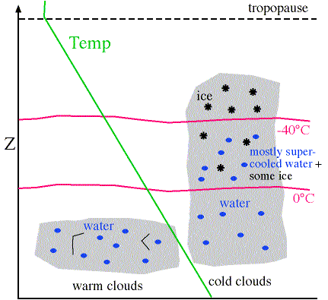
Cold Clouds Figure from apollo.lsc.vsc.edu/classes/met130
Notes:
Slide12.mp3
This diagram represents a side view through the troposphere. The green sloping line shows the normal decrease of temperature with height. Below the red line labeled 0 deg Celsius, temperatures are warmer than 0 deg Celsius. Above that line, temperatures are colder than 0 deg Celsius. In a cold cloud, such as shown on the right, liquid water droplets are found where temperatures are above 0 deg Celsius.

Slide 104
Riming
The collision of ice crystals with supercooled water drops
Causes further growth of
ice crystals
Result: Graupel
Fig. 4-30, p. 128
Notes:
Slide23.mp3
There are two other processes that act to further the growth of ice crystals. The first is called riming. Riming occurs when an ice crystal collides with a supercooled water drop. The liquid water freezes onto the ice crystal causing the ice crystal to grow. The ice particle that results from riming is called graupel or sometimes snow pellets.

Slide 106
Aggregation
The collision of ice crystals (snowflakes) with other ice crystals to form a larger snowflake.
Fig. 4-31, p. 129
Notes:
Slide24.mp3
The second process that increases the growth of an ice crystal is called aggregation. This occurs when an ice crystal collides with and sticks to other ice crystals forming a snowflake.

Slide 107
Bergeron Process
In a cloud where ice crystals and supercooled drops coexist at same temp:
Evaporation occurs from the supercooled droplet
Deposition occurs on the ice crystal
Notes:
Slide18.mp3
Now, we are ready to explain the Bergeron, or ice crystal process. In a cloud in which both ice crystals and supercooled water coexist at the same temperature, evaporation will occur from the supercooled water droplet while deposition occurs onto an ice crystal. Why does this happen?

Slide 108
Bergeron Process (cont’d)
Reminder: Saturation – number of molecules evaporating equals number condensing.
Fewer molecules sublimating from / depositing on the ice crystal compared to that evaporating from / condensing on the supercooled water drop.
So more water vapor surrounds the supercooled drop than the ice crystal (higher saturation vapor pressure)
Fig. 4-32, p. 129
Notes:
Slide19.mp3
In a cloud the air is saturated meaning the number of water molecules leaving the surface of an ice crystal or a supercooled drop equals the number of molecules returning. But due to the stronger molecular bonds within the ice crystal, there are going to be fewer molecules leaving the surface of the ice than leaving the supercooled water drop. This means there will be more water vapor molecules surrounding the supercooled water drop than surrounds the ice crystal.

Slide 109
Fig. 4-32, p. 130

Slide 110
Bergeron Process
To summarize:
Ice crystals grow at the expense of the supercooled water droplets.
Notes:
Slide22.mp3
So the Bergeron process can be described this way: The ice crystals grow at the expense of the supercooled water droplets. This growth process leading to precipitation is very important in cold clouds outside of the tropics.

Slide 111
Types of Precipitation
Snow
Rain
Hail
Sleet
Freezing Rain
Which type depends largely on how
temperature changes with height
Notes:
Slide25.mp3
Collision-coalescence, the Bergeron process along with riming and aggregation are important processes leading to the development of precipitation. Precipitation can be in the form of snow, rain, hail, sleet or freezing rain. Which type of precipitation reaches the ground largely depends on how temperature changes from the ground up through the cloud.

Slide 112
Snow
Snow forms from the growth of ice crystals
Temperatures from the ground up through the cloud are below 0ºC.
Myth: “it is too cold to snow”
Fig. 4-36, p. 132
Notes:
Slide28.mp3
Snow is not frozen rain. Snow forms from the growth of ice crystals. The temperature-height diagram you see here shows a typical temperature profile (in purple) from the ground up through the cloud that would support snow. Notice that temperatures remain below 0 deg Celsius which would not allow the snowflakes to melt as they fall to the ground.
Have you every heard the statement, “It’s too cold to snow”? It is never too cold to snow, but it may be too cold to snow very much. At colder temperatures there is less water vapor in the air which would limit the formation
of ice crystals.

Slide 113
Rain
Rain may begin as ice crystals in the cloud.
Ice crystals melt as they fall.
Drizzle: small drops reaching the ground
Fig. 4-36, p. 132
Notes:
Slide29.mp3
Rain can fall from warm clouds where temperatures remain above 0 deg C or from cold clouds. In the latter case, rain may actually begin as snow in the upper portion of the cloud where temperatures are below 0 deg C and then melt as they fall into air where temperatures are above 0 deg C. If the diameter of the rain drops are very small (less than 0.5 mm or .02 inches) it is called drizzle.

Slide 114
Rain
Virga: rain that evaporates before reaching the ground
Notes:
Slide30.mp3
When the relative below the base of the cloud is low the rain drops evaporate before reaching the ground. This phenomena is called virga (from the Latin word for “streak”) and is a common occurrence in arid and semi-arid regions such as the southwestern United States where the bases of the clouds can be several thousand feet above the ground and the humidity can be quite low near the ground.

Slide 115
Virga
Notes:
Slide31.mp3
The picture you see here is virga. Note the precipitation streaks falling from the cloud but not reaching the ground.

Slide 116
Shape of Raindrop Figures from www.eng.vt.edu/fluids/msc
Notes:
Slide33.mp3
By the way, contrary to popular depiction, raindrops are not shaped like a teardrop. The smaller raindrops are spherical in shape while larger raindrops are shaped much like you see on the right. They look more like a hamburger bun. This is due to the greater wind resistance on the raindrop as it falls.

Slide 117
Shape of a Raindrop Photo from www.ems.psu.edu/~lno/Meteo437
Notes:
Slide34.mp3
This is an actual photograph of a large water drop in freefall.

Slide 118
Hail
Generated by convective clouds (i.e., thunderstorms)
Ice pellets that grow in layers.
Water freezes on an ice particle as it moves through the cloud
Hail size depends on strength of updraft
Photo from Bruce Haynie
Notes:
Slide35.mp3
Hailstones are chunks of ice that fall from cumulonimbus clouds. As ice particles, such as graupel, are carried through the cloud, they encounter supercooled drops. The liquid freezes onto the ice particle causing the ice to grow. Stronger updrafts within the thunderstorm can support the growth of hailstones to golfball size or larger. Obviously hailstones of his magnitude can inflict considerable damage.

Slide 119
Hailstones Photo from www.crh.noaa.gov/mkx
Notes:
Slide36.mp3
As the hailstones move both horizontally and vertically within the thunderstorm the freezing of liquid water onto their surface often causes alternate layers of opaque and transparent ice. These onion-like layers (or rings) can be seen if the hailstone is cut in two.

Slide 121
Over 1 ft of hail in Santa Rosa, NM, 2013:
Source: http://www.komonews.com/weather/blogs/scott/Massive-storm-dumps-nearly-2-feet-of-hail-in-New-Mexico-214299611.html

Slide 123
Sleet
Winter-time precipitation, often from stratiform clouds.
Very different from hail!
Also called ice pellets
Need an inversion
Begins as ice crystals
Ice crystals fall into a layer with temp >0ºC
Raindrops freeze before hitting the ground
Fig. 4-36, p. 132
Notes:
Slide38.mp3
Once the raindrops fall into the air that’s below 0 deg C they will either freeze before striking the ground or remain liquid in a supercooled state. This depends on the depth of the sub-freezing layer of air. If the raindrops freeze before hitting the ground it is called sleet or ice pellets.

Slide 124
Freezing Rain
Supercooled liquid drops that freeze upon contact with the ground
Similar to sleet sounding except the layer near ground where temp <0ºC is more shallow.
Fig. 4-36, p. 132
Notes:
Slide39.mp3
If the raindrops do not freeze before hitting the ground, they will freeze once they strike objects such as trees, roadways, power lines, etc. This condition is known as freezing rain. The layer near the ground where temperatures are below 0 deg Celsius in more shallow compared to that needed for sleet so the raindrops don’t have time to freeze before impacting the ground.

Slide 125
Ice Storm Photo from www.photolib.noaa.gov
Notes:
Slide40.mp3
Freezing rain can cause hazardous driving conditions, damage to trees and disruption of power.

Slide 126
The Progression of Precipitation Generation
Fig. 4-40, p. 136

Slide 127
Fig. 4-41, p. 137

Slide 128
Ch 4
Water vapor supplied by evaporation/transpiration (cooling)
Saturation: rate of evaporation = rate of condensation
Know how humidity is measured and how saturation could be expressed in each
Mixing ratio: g of water vapor / kg of air (pure measure)
Vapor pressure: pressure of only water vapor (pure measure)
Relative humidity: ratio of vapor pressure to saturation vapor pressure (depends on temperature and moisture content, ex: decreased temperature = increased RH)
Dew point: the temperature at which cooled air would reach saturation (depends on pressure but not temperature)
Dew: condensation caused on a surface when saturation is reached
Frost: deposition on a surface when saturation is reached below freezing
Higher dew point = higher water content
Lower spread between dew point and temperature = higher RH

Slide 129
Ch 4
Homogeneous nucleation: condensation of water directly in the air, cold temperatures, not common
Heterogeneous nucleation: condensation with other particles (CCN)
Solute effect: reduce evaporation from drops, faster droplet formation
Curvature effect: increases starting curvature
Ice formation
Spontaneous freezing, also not common
Deposition onto ice nuclei
Fog: formation of cloud droplets at the surface from increased moisture or decreased temperature
Radiation cooling – cooling to dew point due to loss of radiation
Advection – warm moist air cooled by a cold surface
Upslope – from cooling air pushed up in elevation
Steam – from warm water with cool air above it
Precipitation – from warm precip into cold air

Slide 130
Ch 4
LCL (lifted condensation level): height where a parcel becomes saturated, cloud base
Saturated lapse rate (6 K / km): decreased lapse rate due to the condensation of water vapor and release of latent heat
Conditionally unstable: stable for unsaturated ascent, unstable for saturated ascent
LFC (level of free convection): height where a parcel become unstable

Slide 131
Ch 4
Cloud types
Cumulus cloud – instability
Stratus – stable layer
High altitude: Cirrus, cirro_
Mid altitude: Alto_
Droplet/ice growth
Collision-coalescense: warm clouds, from droplets hitting and sticking, need variety of sizes, depth of cloud, vertical motions
Riming: collision of ice with supercooled water, results in graupel
Aggregation: collision of ice crystals
Bergeron process: growth of ice at the expense of supercooled water, very important
Precip profiles
Snow: completely below freezing
Sleet: shallow warm layer above the surface, melting and refreezing of precip
Rain: surface above freezing
Freezing rain: shallower cold layer at the surface than for sleet, precip becomes supercooled and freezes on contact with the surface

