Slide 1
Last Time…
Energy cannot be created nor destroyed, only transferred!
  Kinetic and Potential Energy
  Temperature vs. Heat
  Specific Heat
Energy Transfer Processes, 5 of them
  Advection, Convection, Conduction, Latent Heating, Radiation
Radiation
  Electromagnetic waves transfer energy
  Waves have an amplitude (intensity) and wavelength (size)
Radiation Laws
  Everything emits radiation if above 0 deg K!
  Stefan-Boltzmann Law (Intensity of emission)
  Wien’s Law (wavelength of emission)

Slide 2
Last Time…
Seasons
  Controlled by rotation around the sun and tilt of the Earth (23.5 degrees)
  Earth is closest to sun during Winter Solstice (Northern Hemisphere winter)
  Daylight constant at the equator, highly variable at the poles
Solar Zenith Angle
  Angle of departure from directly overhead
  Seasonal and daily variations
  Beam depletion and spreading, more weakening with larger zenith angle
ARTS: Absorption, Reflection, Transmission, Scattering
Scattering
  Rayleigh (small molecules), Mie (smoke, dust), Nonselective (water droplets, scatter all light)
Energy Budget
  Solar radiation reaching the surface is impacted by absorption, scattering, and reflection of particles through radiation traveling through atmosphere
  Longwave radiation is emitted by atmosphere and earth’s surface
  Net gain at the surface of radiation, net loss in atmosphere

Slide 3
Last Time…
Energy Budget
  Conduction/convection help to balance energy
  Evapo-transpiration also plays a role, as does latent heating thru condensing water vapor into liquid water
Energy Balance (globally)
  Net gain near the equator
  Net loss near the poles
  Energy surplus at equator is re-distributed poleward through ocean currents and tropical cyclones

Slide 4

Chapter 3
Temperature
ATMO 1300
Summer II 2017

Slide 5
Chapter 3
Temperature
Surface Energy Budget
Distribution of Temperature
Temperature Cycles
Stability
Measurements

Slide 6
RECALL
Temperature: A measure of the average kinetic energy of the molecules in a substance.
A change in the temperature of the air depends on: 1) net energy budget 2) Specific heat 3) whether or not a change of phase has occured

Slide 7
Measuring Temperature
Thermometers
  Based on expansion and contraction of liquid
Bimetallic Strips
  Based on different expansion and contraction rates of the solid strips
Thermistors
  Based on changes in resistance of electrical current proportional to the temperature

Slide 8
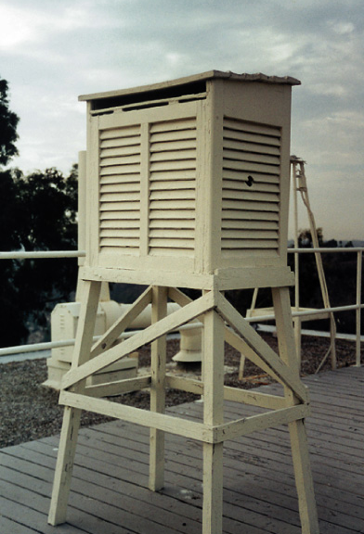
Temperature Shelters
Temperature is always measured in the shade, therefore a shelter is used.
  Painted white to increase albedo
  Paneled with slats to allow airflow
  Door mounted on north
  Standardized 1.5 m (~ 5 ft) height
  Temperatures at this level are referred to as “surface temperatures”

Slide 9
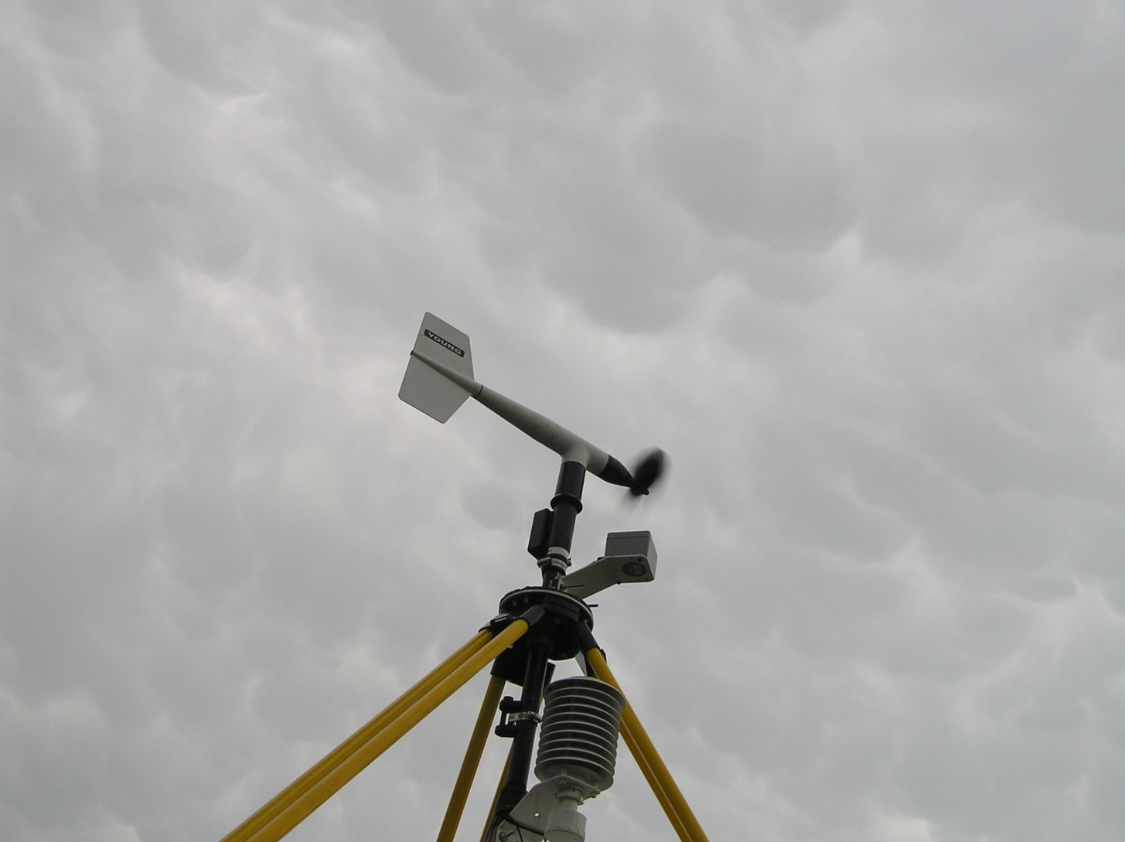
Measuring Temperature

Slide 10
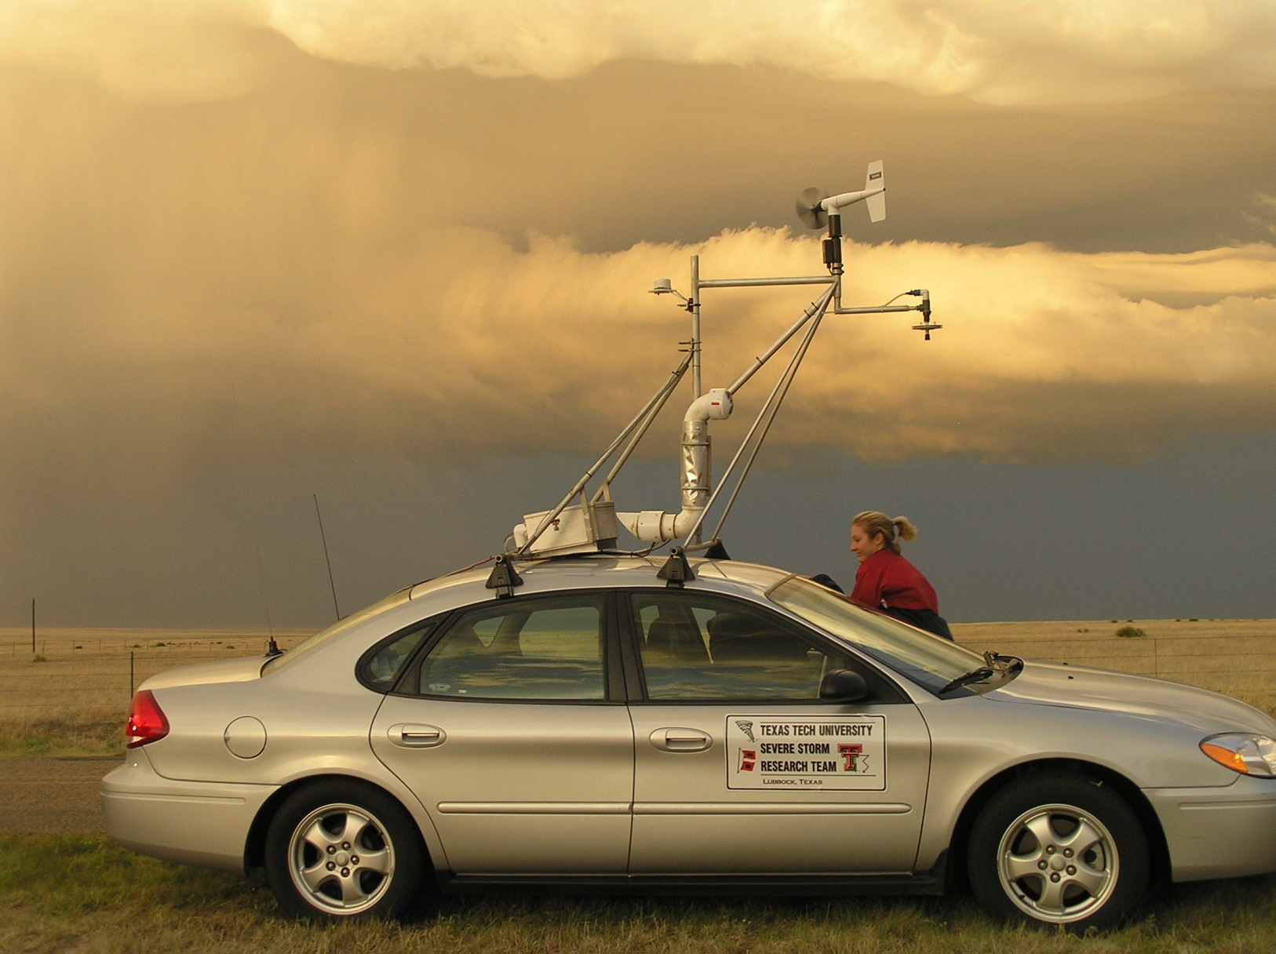
Measuring Temperature

Slide 11
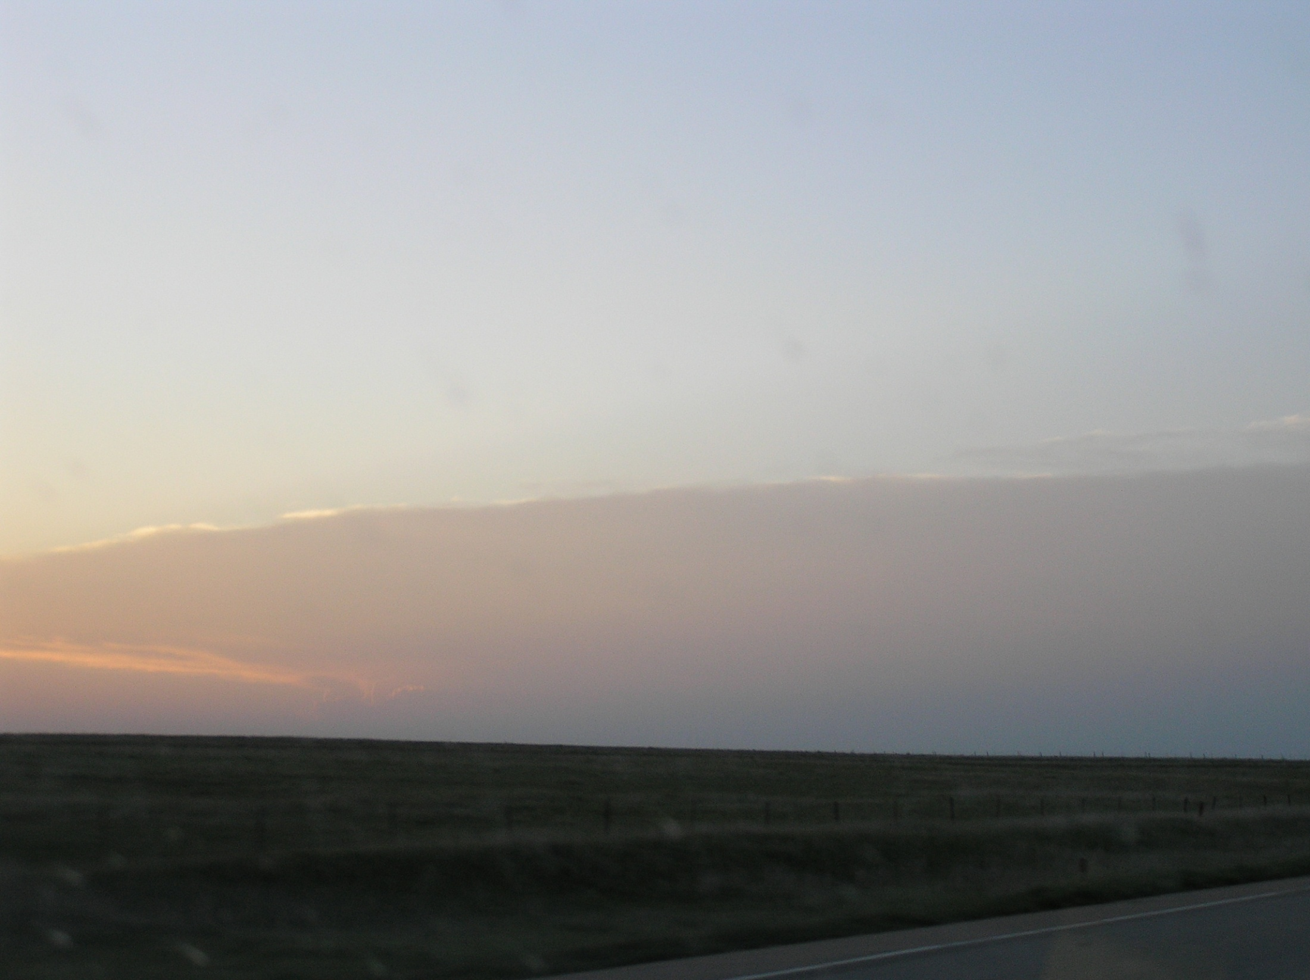
Recall the energy budget
Earth/Atmosphere system if averaged over ~ 1 year is in energy balance
However, on shorter time scales and localized regions this is not the case
When there is an imbalance, energy is either stored within or removed from the system
Energy gains exceed losses = Temperature Increase
Energy losses exceed gains = Temperature decreases

Slide 12
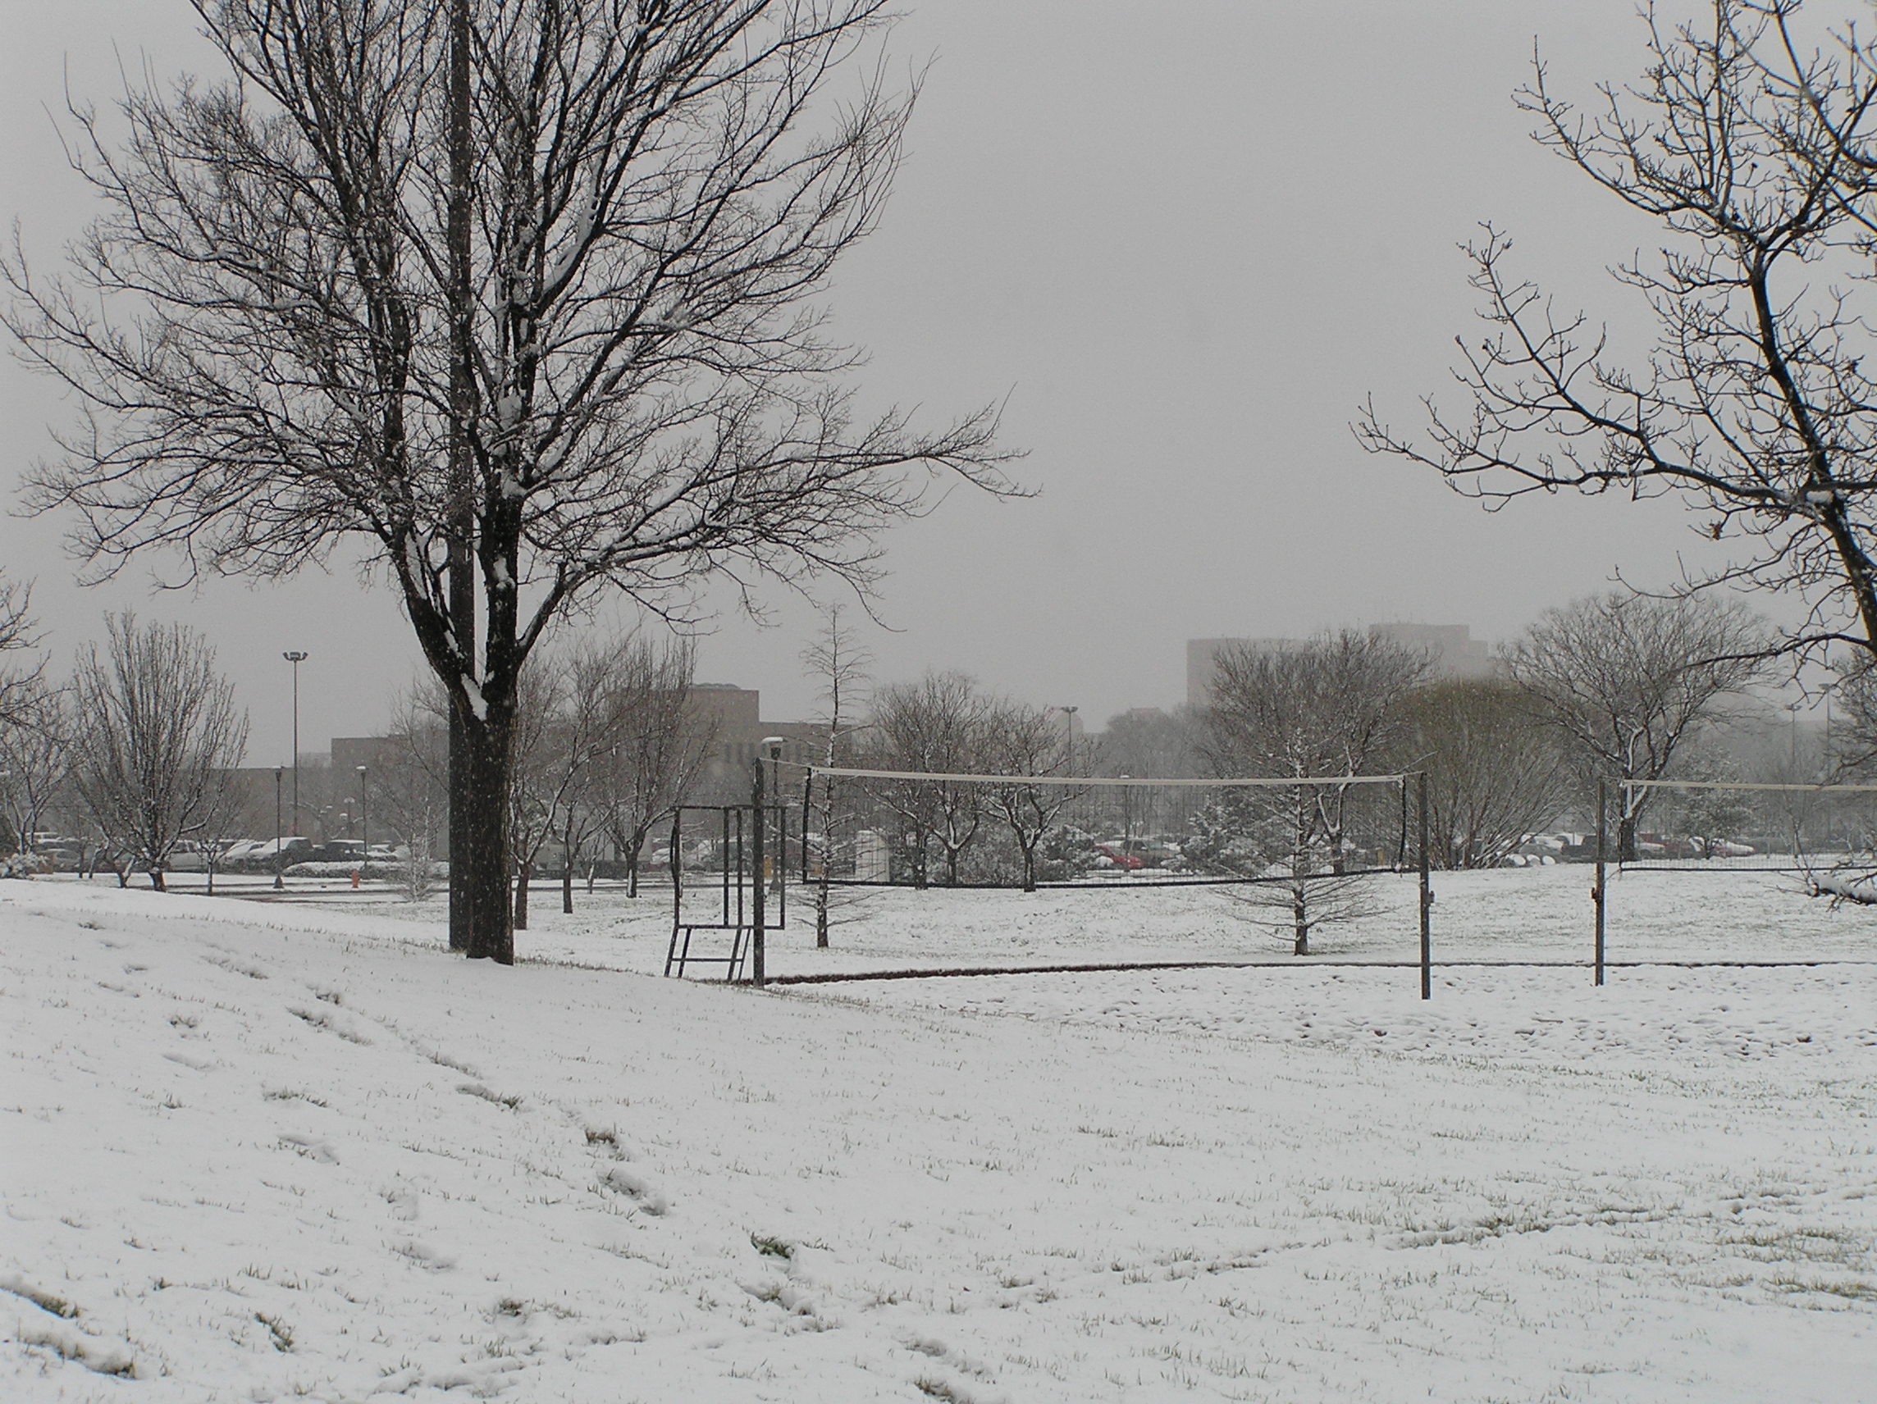
Temperature
Temperature near the ground (1.5 m) is controlled by energy exchanges with the surface
Conduction
Advection
Convection
Latent heat
Radiation
All play a role

Slide 13
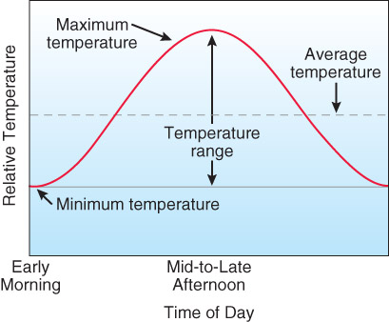
Temperature Cycles
Annual (seasonal) cycles: looking at temperature trends over the course of a year.
Interannual cycles: temperature trends over the course of multiple years.
Diurnal cycle: daily variation of temperature
Fig. 3-4, p. 67
Ex: http://www.mesonet.ttu.edu/meteograms/meteo_REES.png

Slide 14
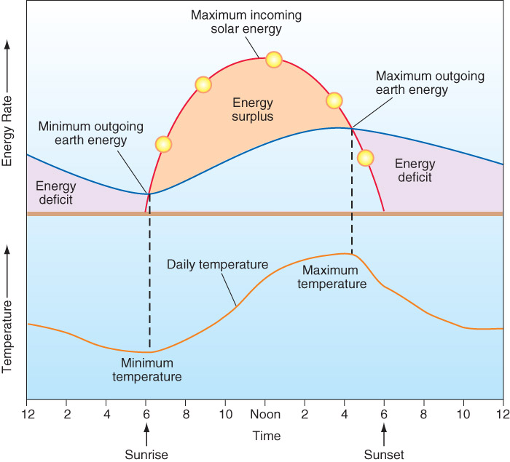
Diurnal Temperature Variations
Diurnal: daily; over a 24 hr period.
  Variations driven by Earth’s rotation.
Note the lag in the max SW received and the max temp.

Slide 15
Annual Temperature Variations
The annual average temperature is just the average (mean) of the monthly temperature averages.
Depends on:
  Latitude
  Surface type / Large bodies of water
  Elevation / aspect
  Cloud cover

Slide 16
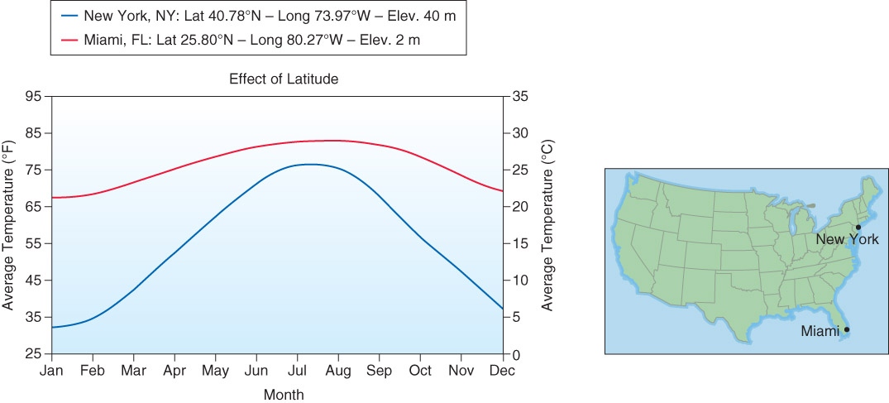
Annual Temperature Variations
By latitude
  Lower latitude will generally have higher annual temps.
  Less-direct sun angle as one heads farther from the equator
  The annual temperature range is also smaller for lower latitude…why?
Fig. 3-6, p. 69

Slide 17
Annual Temperature Variations
Remember what changes seasonally with latitude:
  Seasonal variation of insolation – more insolation in summer for higher latitudes
  The solar zenith angle -- constantly increasing through the summer in the higher latitudes
  Length of day – constantly increasing through the summer in the higher latitude.
In the lower latitudes (i.e. the tropics, 23.5 N – 0 N), these things stay relatively constant.

Slide 18
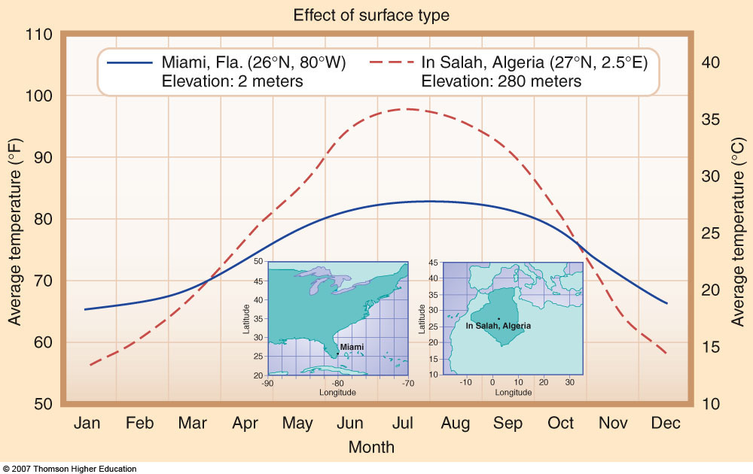
Annual Temperature Variations
2nd Edition: 3-8
By surface type
  Barren land will heat and cool more quickly than water (WHY?)
ANSWER: SPECIFIC HEAT
Water: 1 cal/g/C
Sand/Dirt: 0.2 cal/g/C
Evaporation of water reduces temperature extremes over and near lakes and oceans.
Solar radiation absorbed by water is distributed over a large depth, over land solar radiation is absorbed by the surface, so it can be quickly transferred to the air.
Vegetation also reduces the temperature range through transpiration.

Slide 19
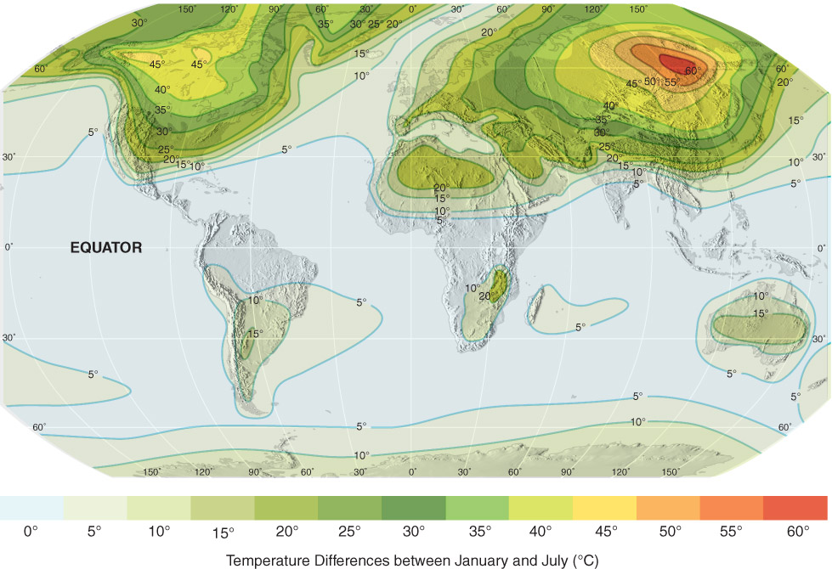
Fig. 3-5, p. 68

Slide 20
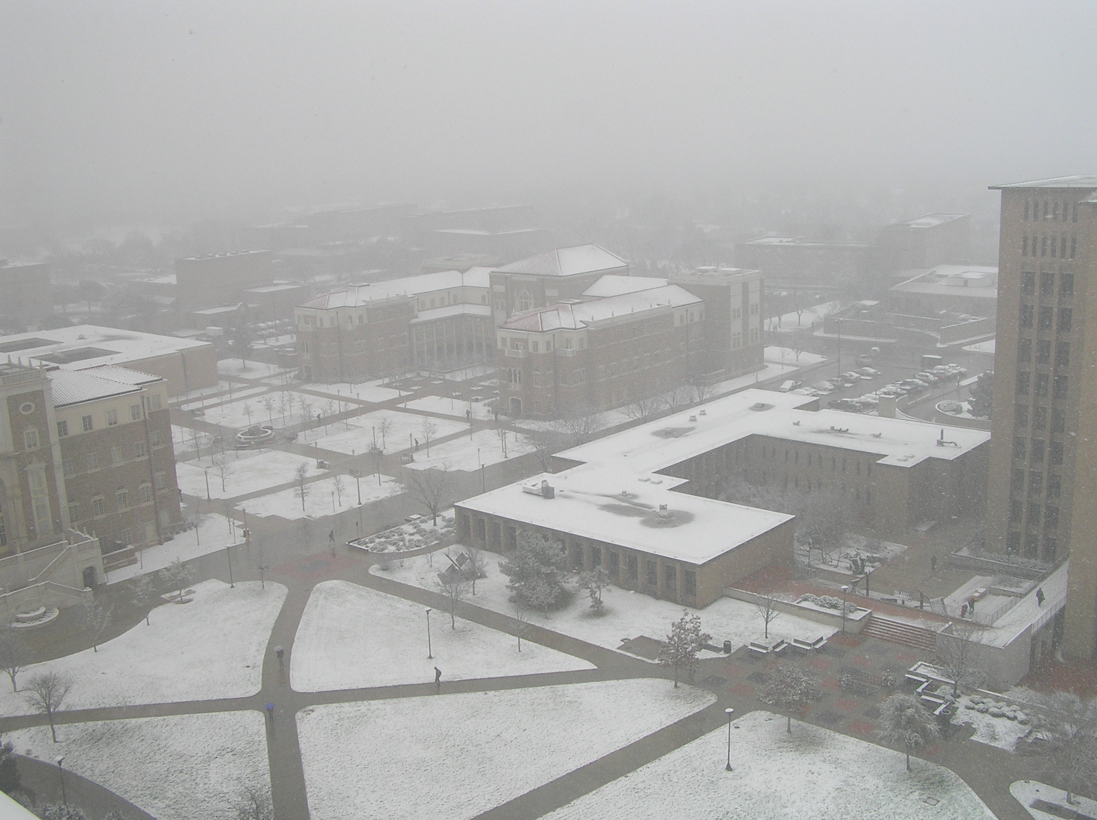
Sensible Heating
Adding energy to a substance usually causes an increase in temperature.
The magnitude of temperature increase depends on the specific heat of the substance.

Slide 21
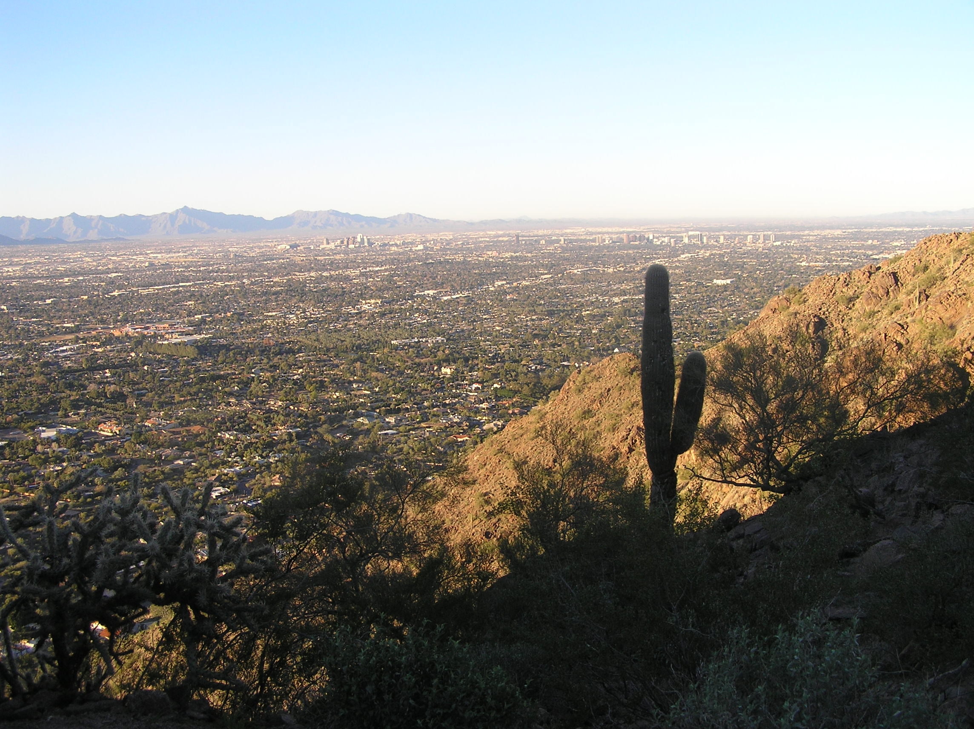
Example of Specific Heat
The specific heat of water is much greater than that of land.
Therefore water heats and cools much more slowly than does the same amount of land.
Water has a strong modifying effect on the weather and climate of coastal regions.
The coast of Western Europe is significantly warmer than the Eastern coast of North America…why?

Slide 22
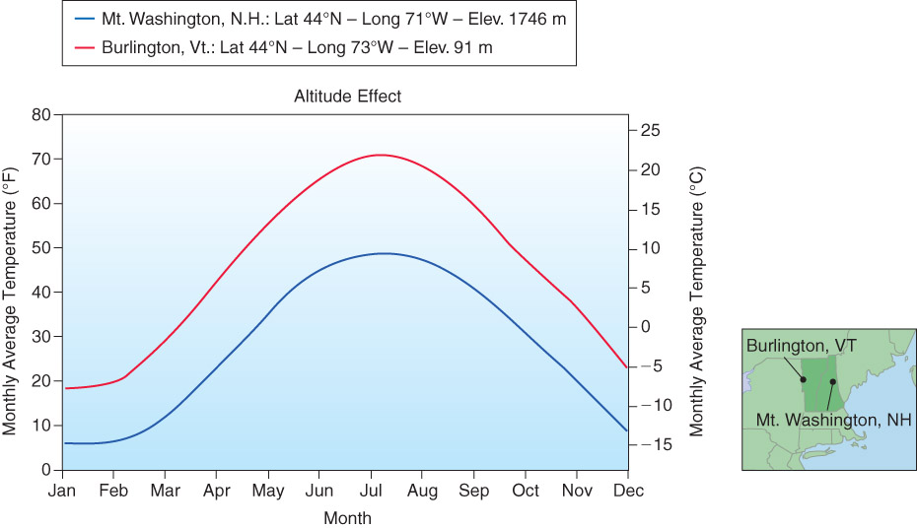
Temperature Variations
By elevation
  Less air molecules at higher elevation to absorb incoming solar radiation / outgoing terrestrial radiation
  Often, the saving grace for Lubbock in mid-summer compared to Oklahoma and east Texas! (Lubbock elevation = 3200 ft / 1000 m MSL)
Fig. 3-9, p. 71

Slide 23
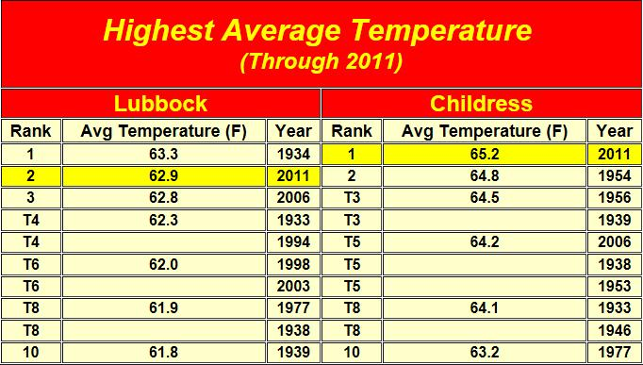
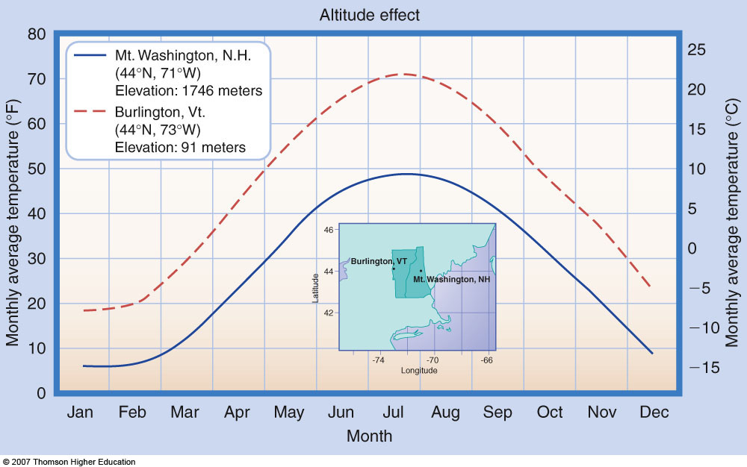
Annual Temperature Variations
By elevation
  Less air molecules at higher elevation to absorb incoming solar radiation / outgoing terrestrial radiation
  Often, the saving grace for Lubbock in mid-summer compared to Oklahoma and east Texas! (Lubbock elevation = 3200 ft / 1000 m MSL)
(3232 ft)
(1943 ft)

Slide 24
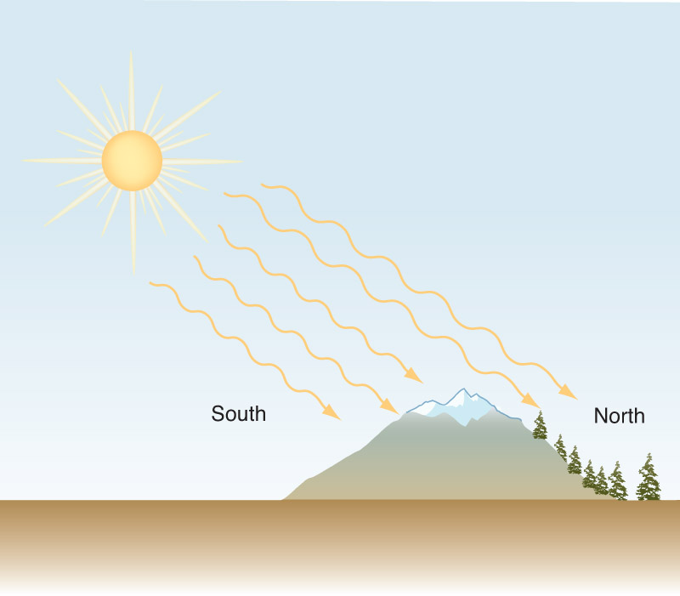
Annual Temperature Variations:
By Aspect:
  Aspect is the direction that a mountain slope faces (related to elevation)
  South facing slopes (northern hemisphere) will be warmer, drier and have less vegetation.

Slide 25
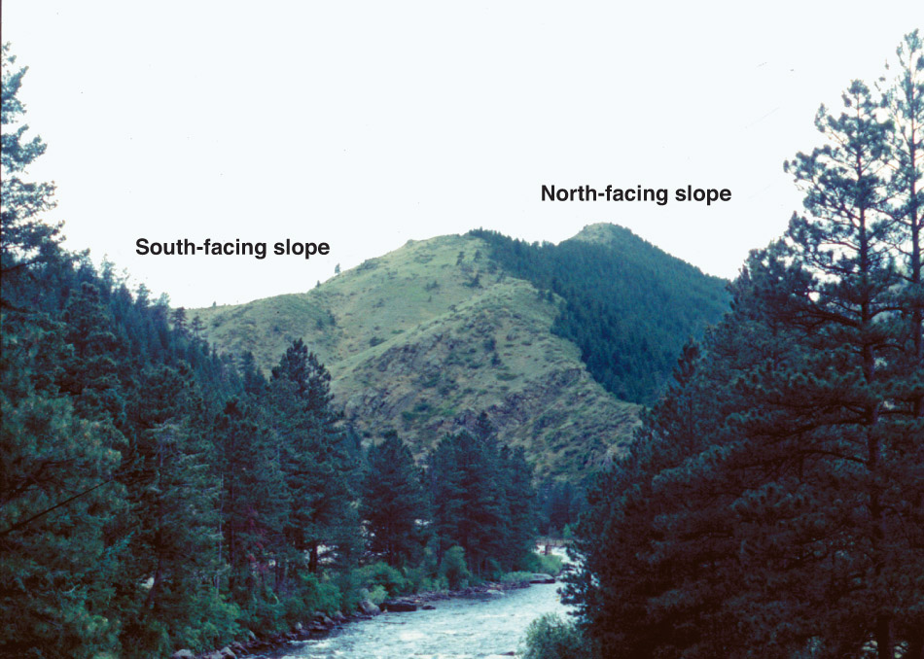
Annual Temperature Variations:
By Aspect:
  Aspect is the direction that a mountain slope faces (related to elevation)
  South facing slopes (northern hemisphere) will be warmer, drier and have less vegetation.

Slide 26
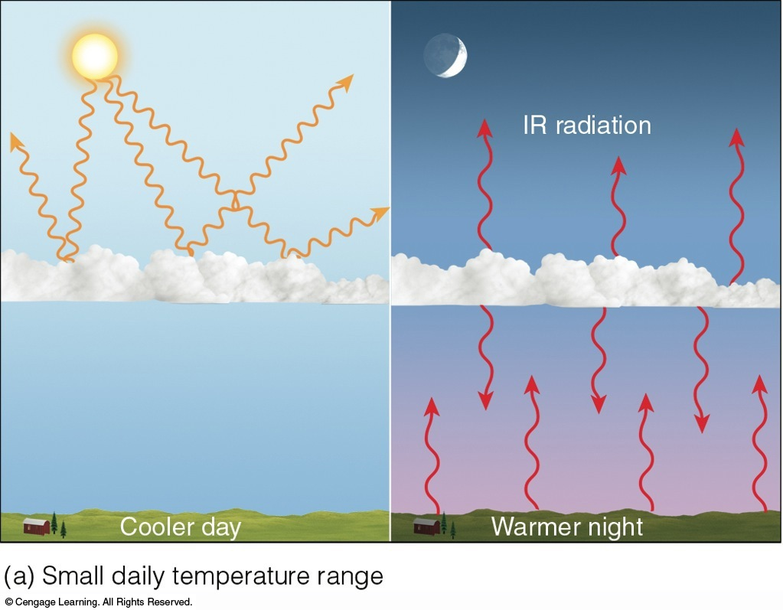
Radiation & Clouds
Shortwave reflection
IR absorption

Slide 27
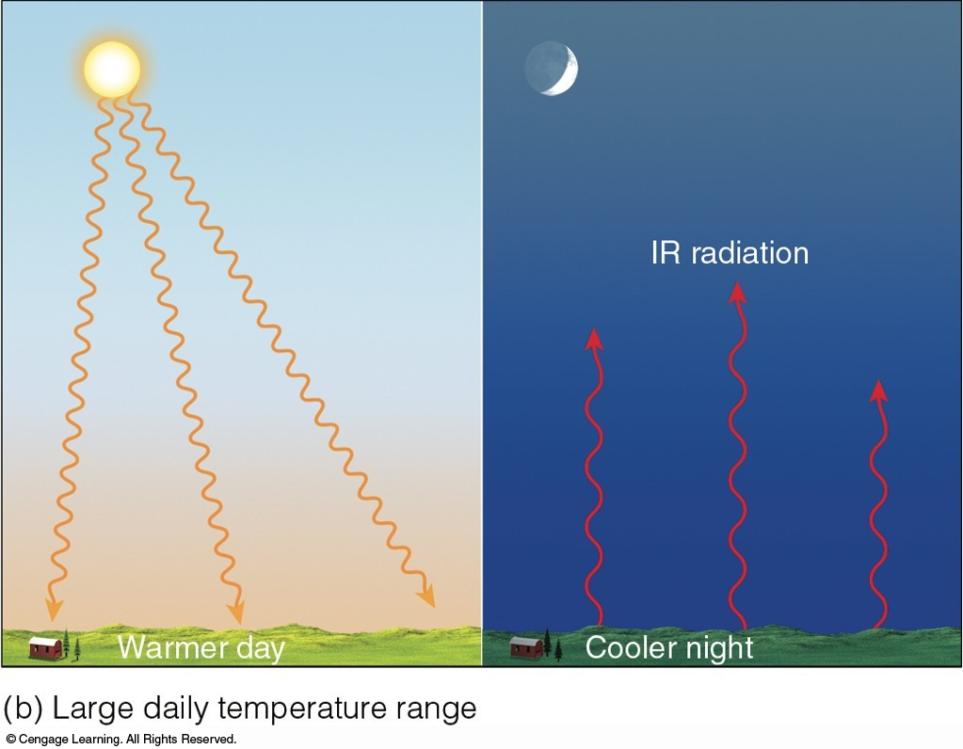
Radiation & Clouds

Slide 28
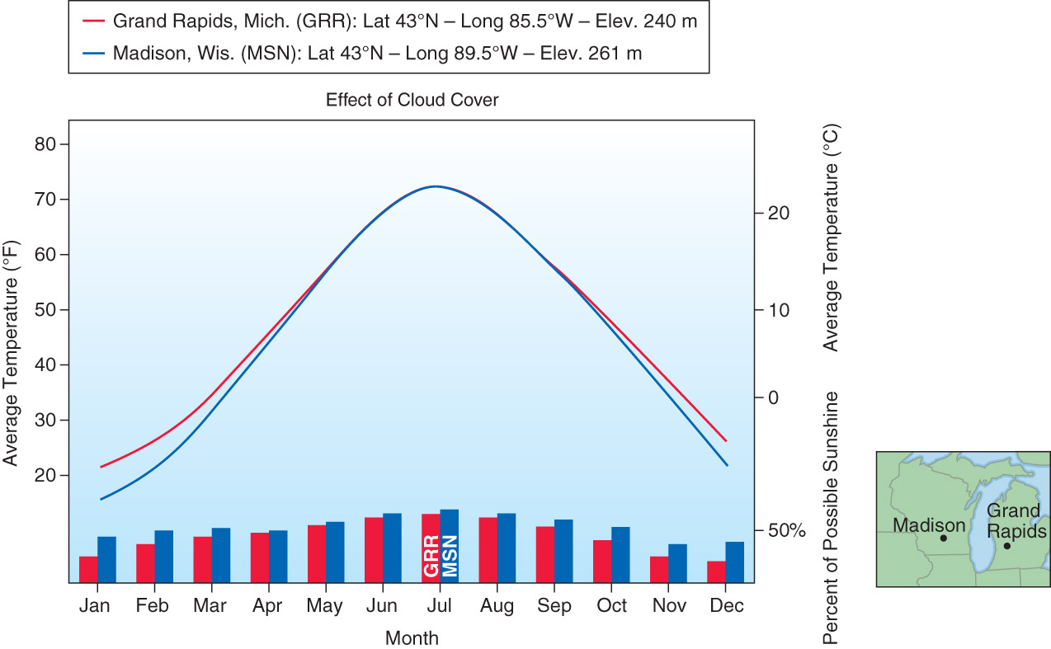
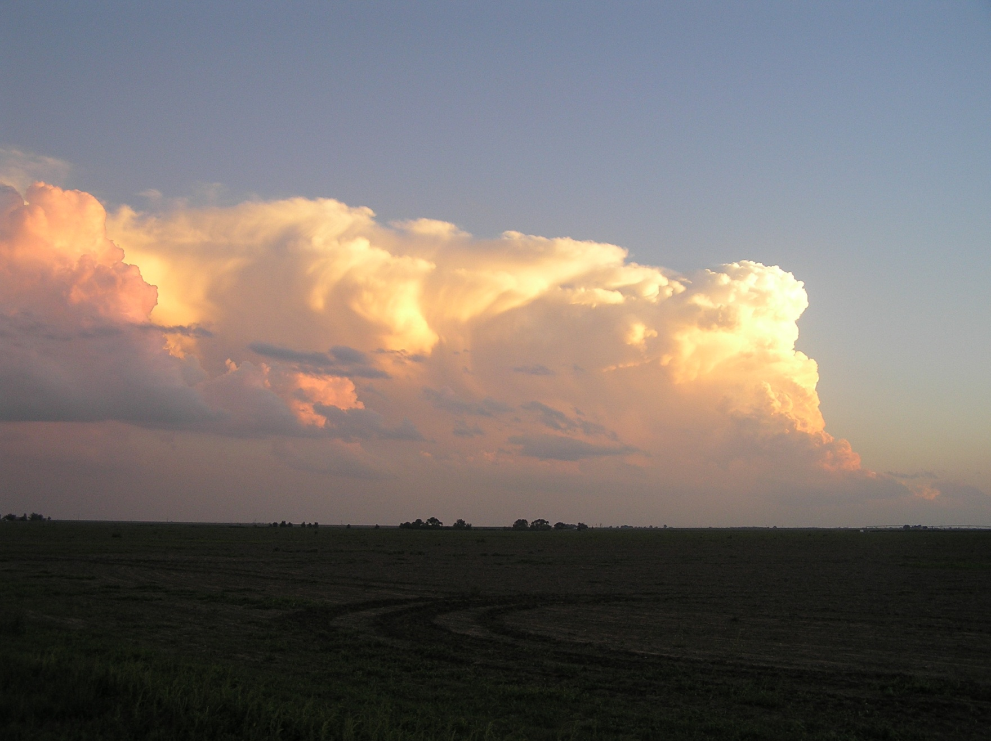
Annual Temperature Variations:
Clouds reflect solar energy above the cloud
and reduce warming below the clouds during the day
Clouds emit longwave energy and increase warming below the clouds. This effect is especially pronounced at night; a cloudy night will typically be warmer than a clear night in the absence of advection. What does this mean for annual temperatures?
Fig. 3-15, p. 75

Slide 29
Diurnal Temperature Variations
Daily temperature are also affected by:
  Latitude: Closer to the equator = warmer.
  Surface Type: Water reduces range, vegetation does too, but not as greatly. Also consider local advection
  Elevation and direction of slope: The higher the cooler (in general), northern slopes are cooler
  Cloud cover: Cooler during the day, warmer at night.
May not be that straightforward. For instance, Lubbock is at a higher elevation, but we have less vegetation and atmospheric moisture than Childress.

Slide 30
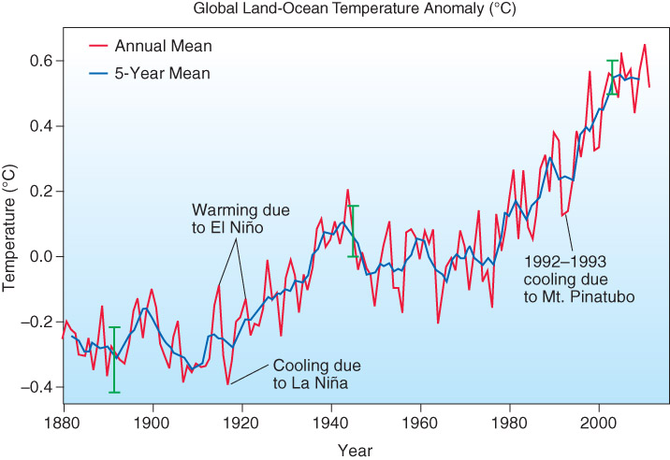
INTERannual Temperature Variations
Examples:
  El Nino / La Nina (more later). We are currently trending towards an El Nino
  Volcanic eruptions
  Greenhouse effect
  Solar cycle
Fig. 3-16, p. 76

Slide 31
Temperature
We’ve been talking about the mean diurnal, annual, and interannual temperatures at 1.5 m AGL.
The temperature profile in the lower part of the troposphere is also very important in both weather and climate.
We can use the temp profile to assess atmospheric stability
Notes:
Slide7.mp3
Atmospheric stability can be defined as a condition of the atmosphere that affects the strength of vertical motion. The stability of the air either hinders or favors vertical motion.
As we will demonstrate shortly, stability is related to the positive or negative buoyancy of a parcel of air.

Slide 33
Atmospheric Stability
• What is atmospheric stability, why is it important, and how is it determined?
Requires knowledge of the temperature profile → the vertical change in temp.
Warm
Cold
Stable
Unstable
Cold
Warm
Notes:
Slide6.mp3
There is a fourth ingredient that is very important in understanding cloud development and that is atmospheric stability. In this lesson we will discuss what atmospheric stability is, why it is important and how the stability of the atmosphere is determined.

Slide 34
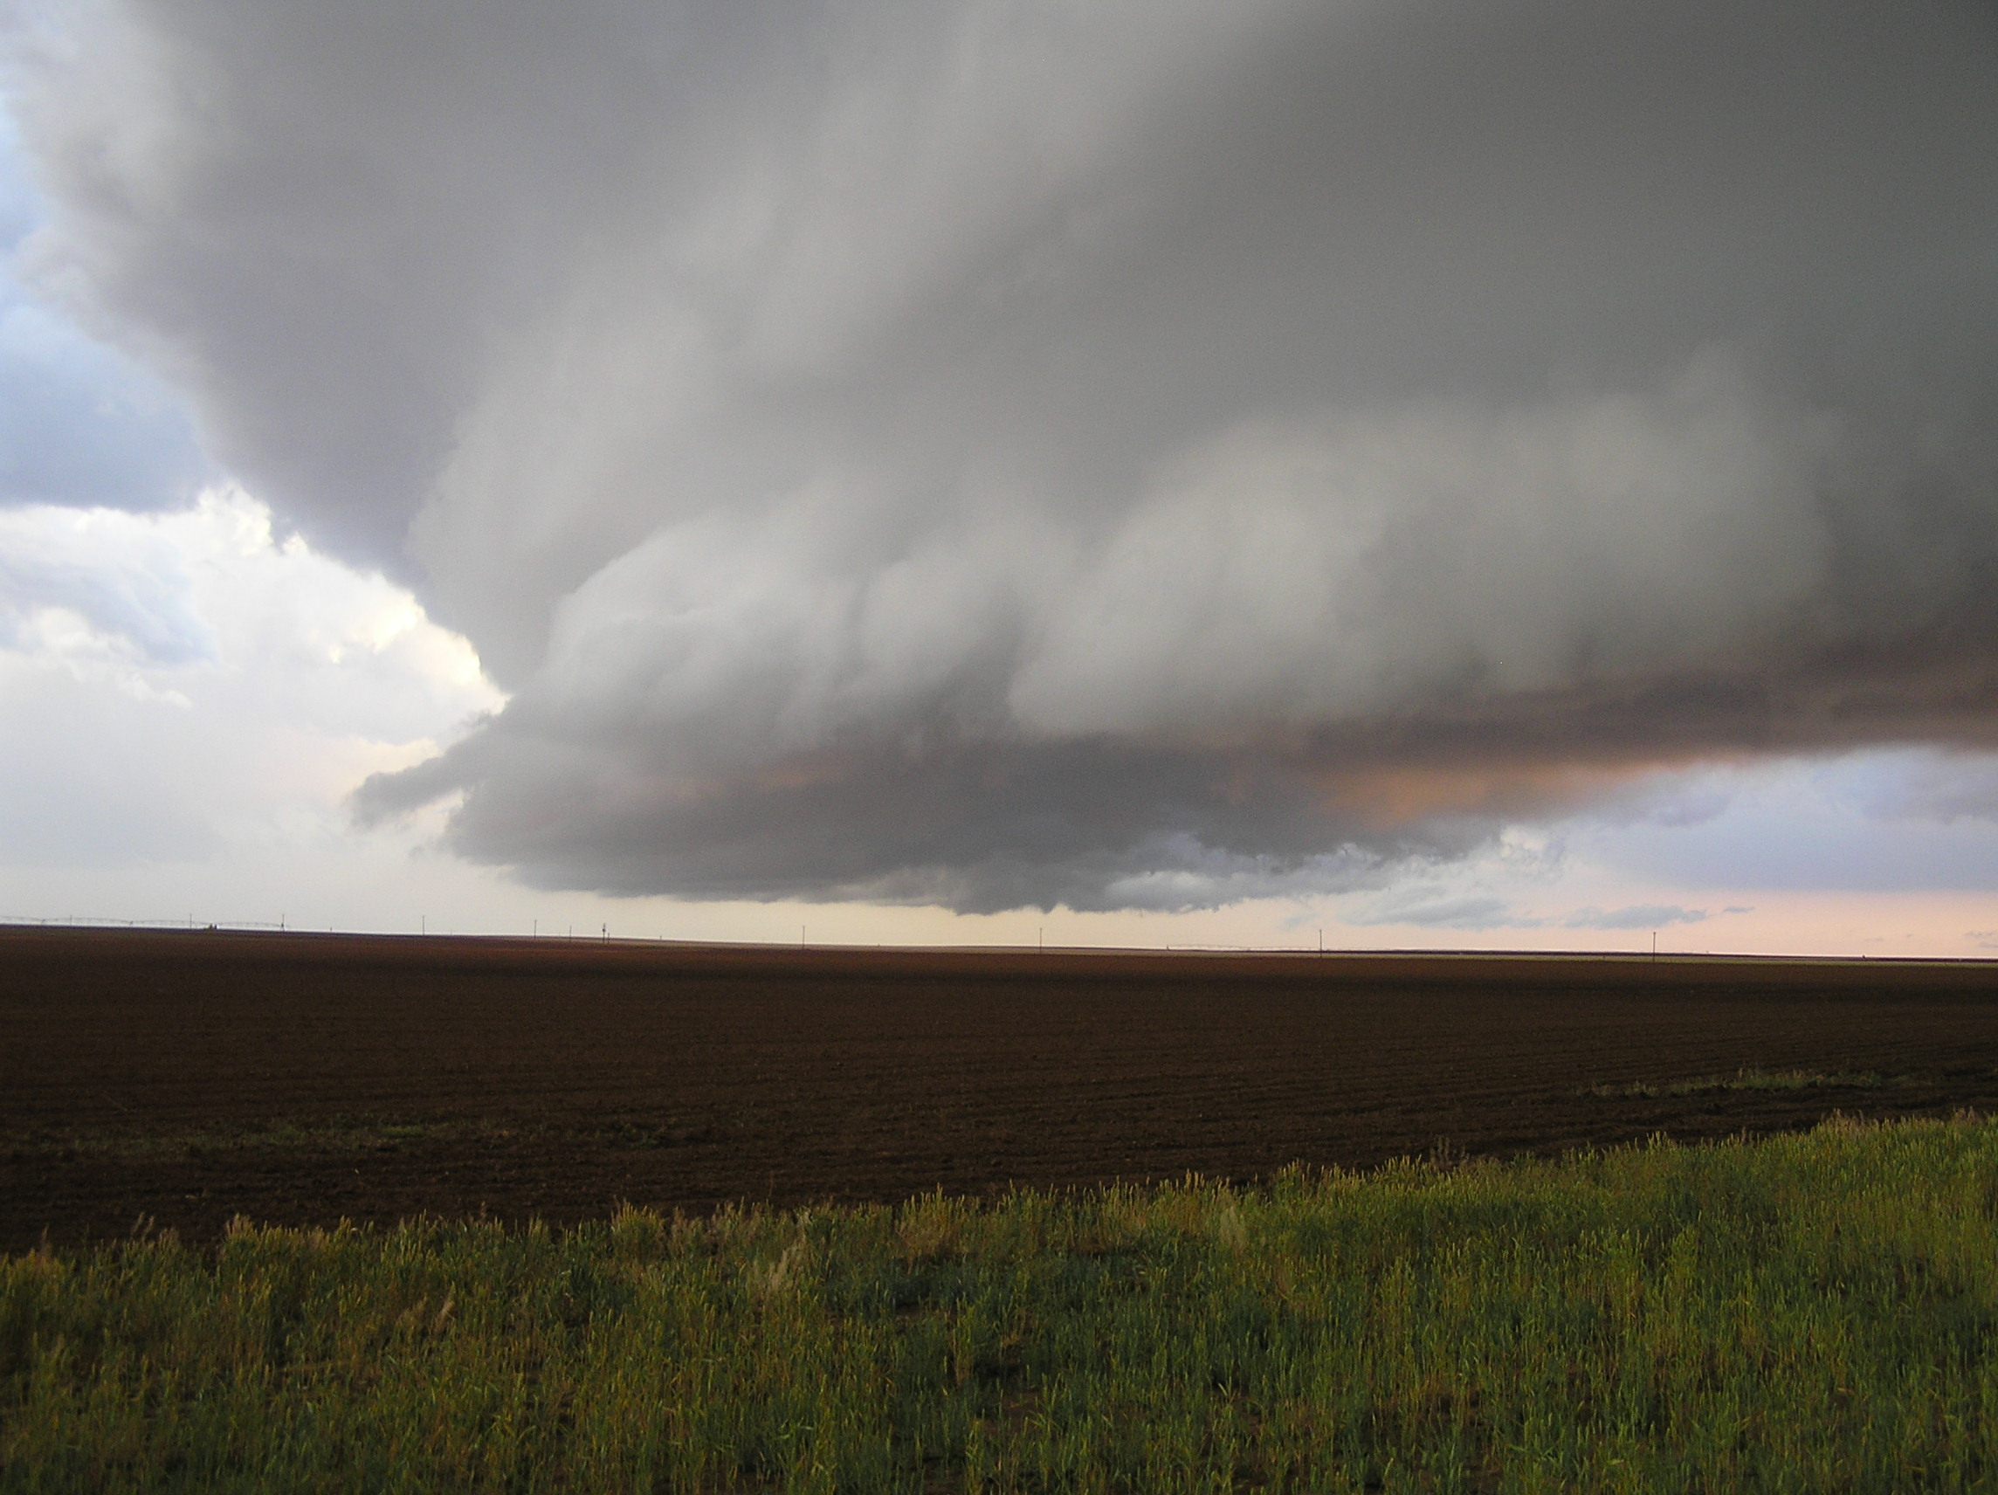
Atmospheric Stability
DEFINITION: A condition of the atmosphere that affects strength of vertical motion. (Hinders or favors vertical motion)
Related to positive or negative buoyancy of a parcel of air.
Notes:
Slide7.mp3
Atmospheric stability can be defined as a condition of the atmosphere that affects the strength of vertical motion. The stability of the air either hinders or favors vertical motion.
As we will demonstrate shortly, stability is related to the positive or negative buoyancy of a parcel of air.

Slide 35
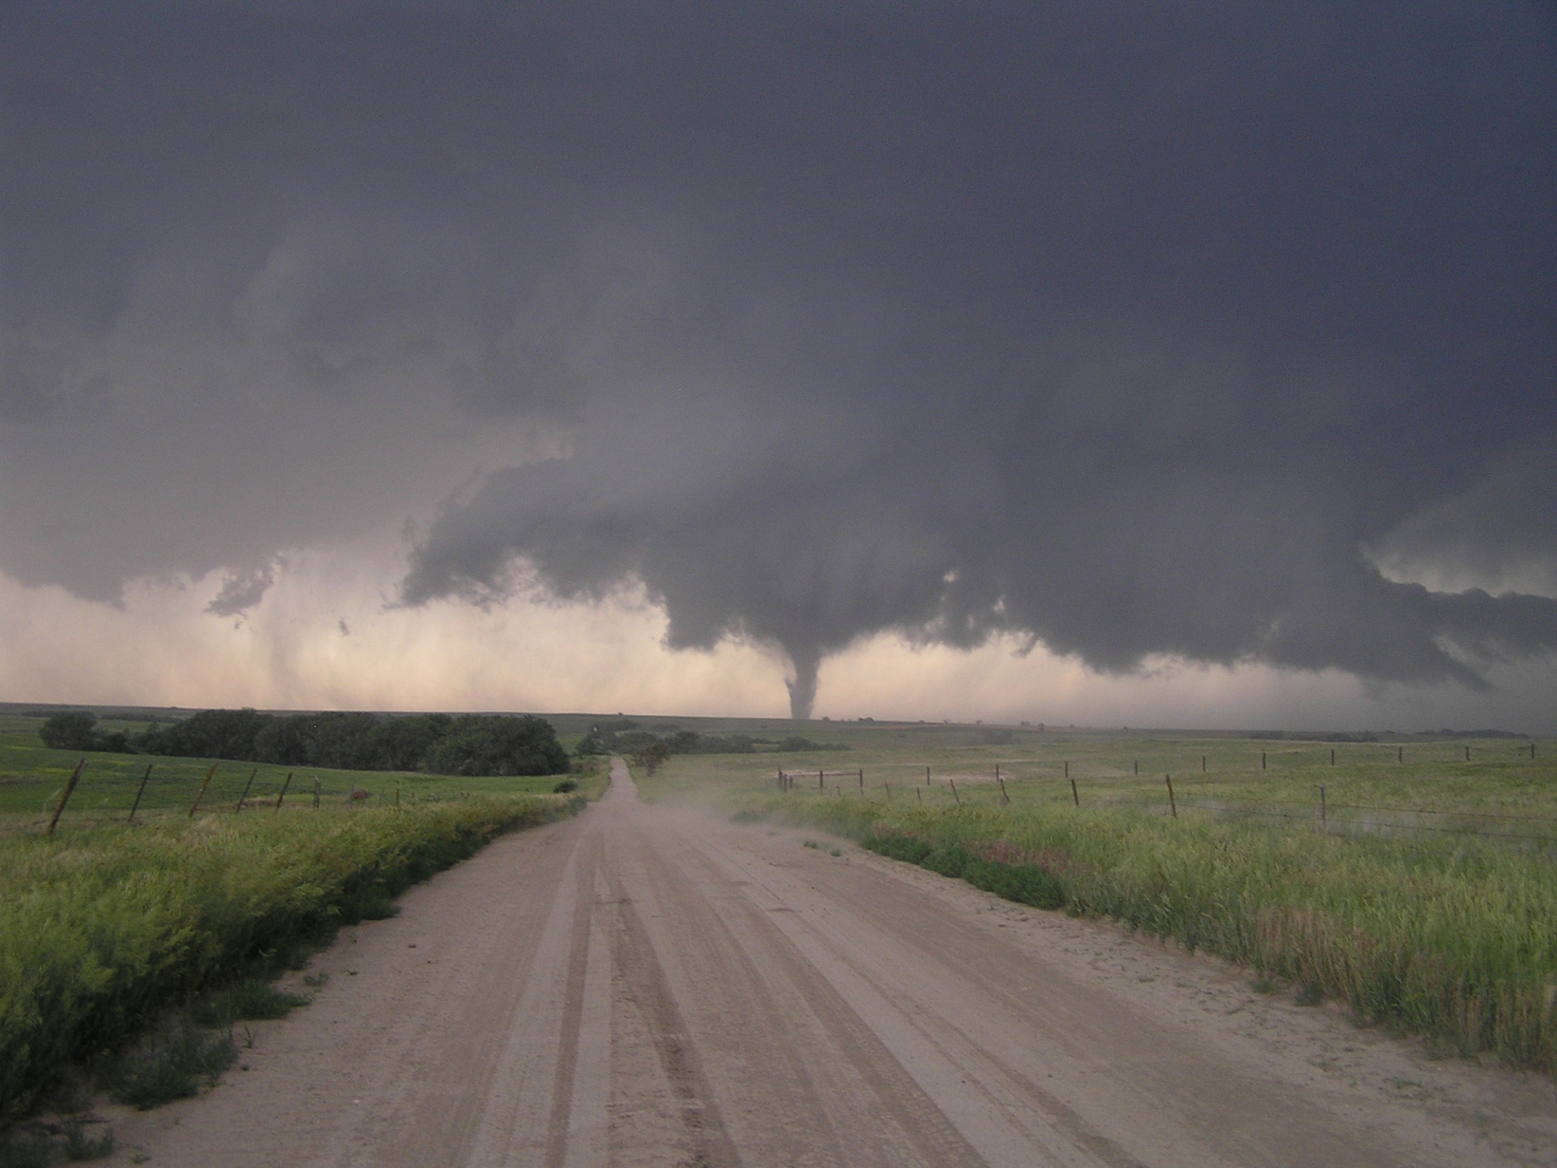
Atmospheric Stability
Why is stability important?
  Determines the nature of vertical motion.
  Determines what type of cloud (if any) forms in rising saturated air.
Cumuliform clouds – unstable air
Stratiform (layered) clouds – stable air
Notes:
Slide8.mp3
The stability of the atmosphere determines the type of cloud that forms in rising saturated air. Clouds that form in unstable air are called cumuliform clouds. Those that form in stable air are called stratiform clouds.

Slide 36
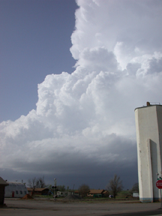
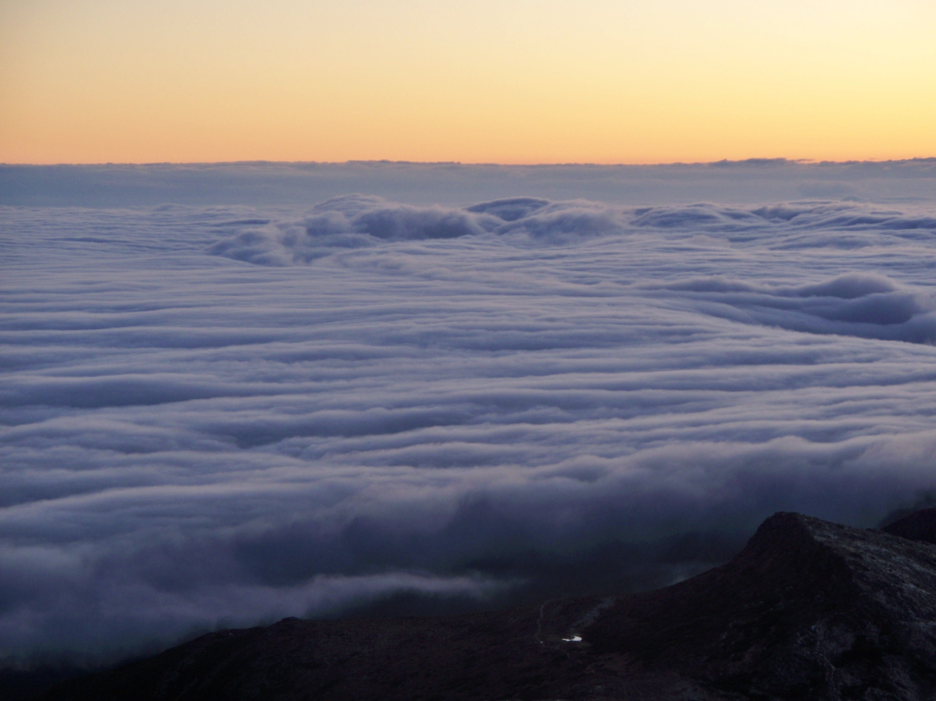
Cumulus(left)/Stratus(right)
Notes:
Slide9.mp3
The clouds you see in the left photograph are cumuliform clouds forming in air that is unstable. These clouds have extensive vertical development because the atmosphere is readily promoting upward vertical motion. The clouds in the right photograph are stratus clouds. These clouds appear as a solid layer of clouds and form in a more stable atmosphere that does not easily promote upward vertical motion.

Slide 37
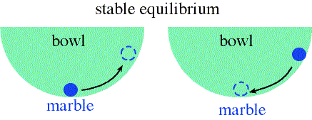
Stability and Motion apollo.lsc.vsc.edu/classes/met130
Notes:
Slide10.mp3
Stability is essentially an equilibrium condition. Think of a bowl with a marble resting at the base of the bowl. If the marble is displaced to a point on the side of the bowl and then released, the marble returns to its original position. The marble is in a stable equilibrium condition. Applying this to the atmosphere, suppose we could force a parcel of air to be displaced vertically and then we removed the forcing agent. If the air parcel returned to its original position we would say the air is stable. There is a resistance to vertical motion.

Slide 38
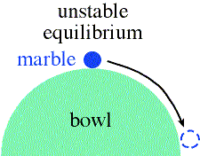
Stability and Motion
apollo.lsc.vsc.edu/classes/met130
Notes:
Slide11.mp3
Now suppose we invert the bowl and let the marble rest on top of the bowl. Given a slight nudge, the marble would roll down the side of the bowl never to return to its original position. The marble is in an unstable equilibrium condition. Again, applying this to the atmosphere, if a parcel of air were displaced vertically and the air parcel kept moving in the direction of the displacement, the air is said to be unstable. The atmosphere would be promoting or favoring vertical motion.

Slide 39
Stability & Buoyancy
Stability related to positive or negative buoyancy of the air
Depends on density of the parcel compared to density of surrounding air
Cold
More Dense
Warm
Less Dense
Notes:
Slide14.mp3
Earlier we stated that stability is related to the positive or negative buoyancy of an air parcel. Whether or not the parcel has a positive or negative buoyancy depends on the density of the air parcel compared to the density of the surrounding air. Consider this analogy: A rock placed in a container of water will sink to the bottom because its density is greater that the surrounding water. If you were to reach into the container and lift the rock up to a certain level and let go, the rock would sink back to the bottom. It has a negative buoyancy so it returns to its original position.

Slide 40
Atmospheric Stability
How is it determined?
Density related to temperature
P = ρRT
ρ = Density
P=pressure
T=temperature
R=constant
We determine stability by comparing the temperature of a rising parcel of air to that of the environment at a given altitude.
Notes:
Slide13.mp3
Stability is determined by comparing the temperature of a rising parcel of air to the temperature of the environment at a particular altitude. So we need to know two things: the temperature of the parcel and the temperature of the environment.

Slide 41
Determining Stability
Which is more dense, cold air or warm air?
ANS: COLD AIR
If T_{p} (parcel temp) is colder than T_{e} (environmental temp) ---- parcel will sink
The parcel is STABLE, negatively buoyant
Notes:
Slide16.mp3
Now which is more dense, cold air or warm air? The answer is cold air. If a parcel of air after being lifted to a certain altitude in the atmosphere is colder than the surrounding air (which we call the environment) the parcel will have a negative buoyancy and will try to sink because it is more dense than the surrounding air. It would be like the rock in water. The parcel is stable.

Slide 42
Determining Stability
If T_{p} warmer than T_{e} ------ parcel will rise
UNSTABLE
If T_{p} equals T_{e} ---- neutral
Parcel is positively buoyant
Te = 75º F
Tp = 84º F
Notes:
Slide17.mp3
If a parcel of air after being lifted to a certain altitude in the atmosphere is warmer than the environment the parcel will have a positive buoyancy and will continue to rise because it is less dense than the surroundings. It would be like the ice cube in water. The parcel is unstable.
If the parcel temperature and the environmental temperature are the same, the parcel is neutrally stable. The parcel has the same density as the surroundings and therefore it is neither stable nor unstable.

Slide 43
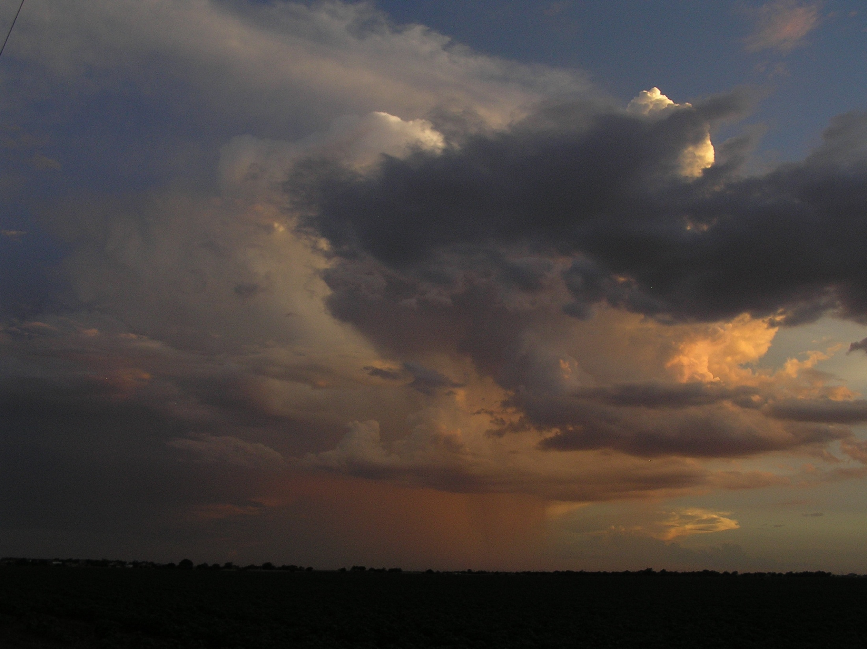
Interim Summary
Stability is determined by lifting a parcel of air to some altitude
Compare parcel temperature with the environmental temperature
So, what information do we need?
Temperature of parcel (T_{p})
Temperature of environment (T_{e})
Notes:
Slide18.mp3
So we see that the stability of a parcel of air is determined by lifting that parcel to a certain level and compare its temperature with the temperature of the surrounding environment. Of course we can’t go outside and physically lift a parcel of air and measure the temperature inside the parcel. But we can employ what we already know about temperature changes in rising air.

Slide 44
Question
How do you know what the temperature of the parcel is?
What happens to the temperature in a rising parcel of air?

Slide 45
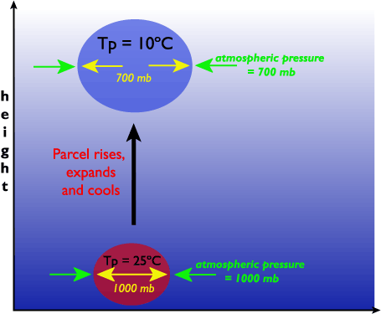
Parcel Temp: Adiabatic Cooling
Cools due to expansion as it rises
Cools at the Dry or Saturated Adiabatic Lapse Rate
(-10º C/km Dry)
(-6.5ºC/km Saturated)
(we’ll cover moisture in Ch. 4)
P = ρRT
PV = mRT
V=mRT/P
Remember: Pressure decreases with altitude
Notes:
Slide19.mp3
We know from a previous lesson that anytime air rises in the atmosphere it expands and cools adiabatically. If the parcel of air is not saturated the parcel temperature cools at the dry adiabatic lapse rate. That’s a constant value. If the parcel is saturated, its temperature cools at the saturated or moist adiabatic lapse rate.

Slide 46
Adiabatic Cooling
Increasing the volume requires work (Force x Distance)
Energy must be involved
Air molecules expending energy (Kinetic) to do the work for expansion
As the parcel rises… potential energy increases, Molecule’s kinetic energy is converted to potential energy
Remember: Less kinetic energy of molecules = lower temperature

Slide 47
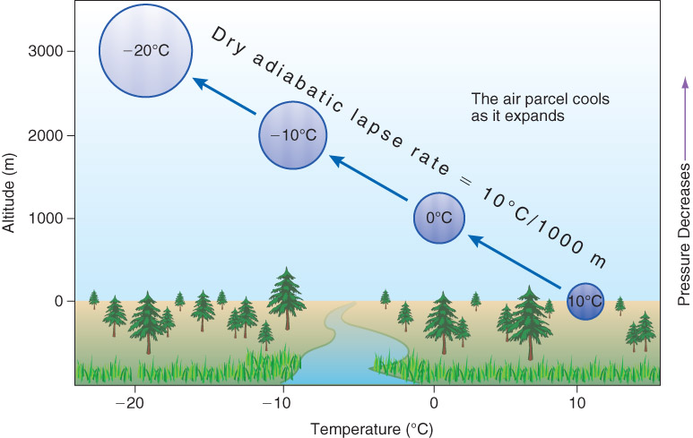
Fig. 3-19, p. 65

Slide 48
Adiabatic Warming
As a parcel sinks it warms
It also compresses
The compression increases the kinetic energy of the molecules and therefore the temperature increases

Slide 49
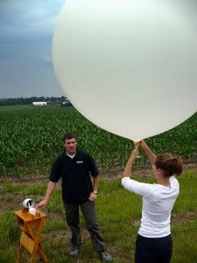
Another Question
How do we determine the environmental temperature?

Slide 50
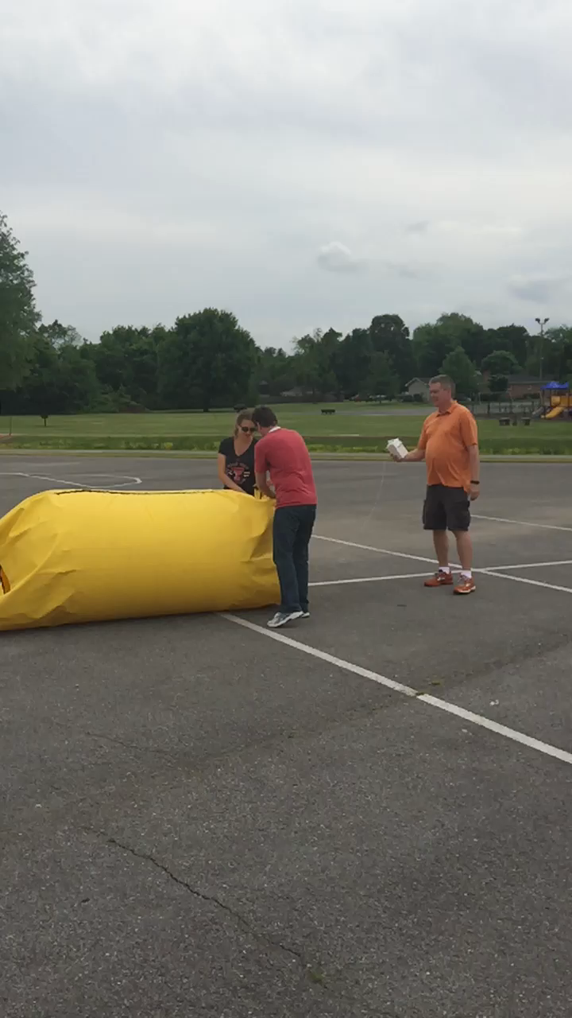
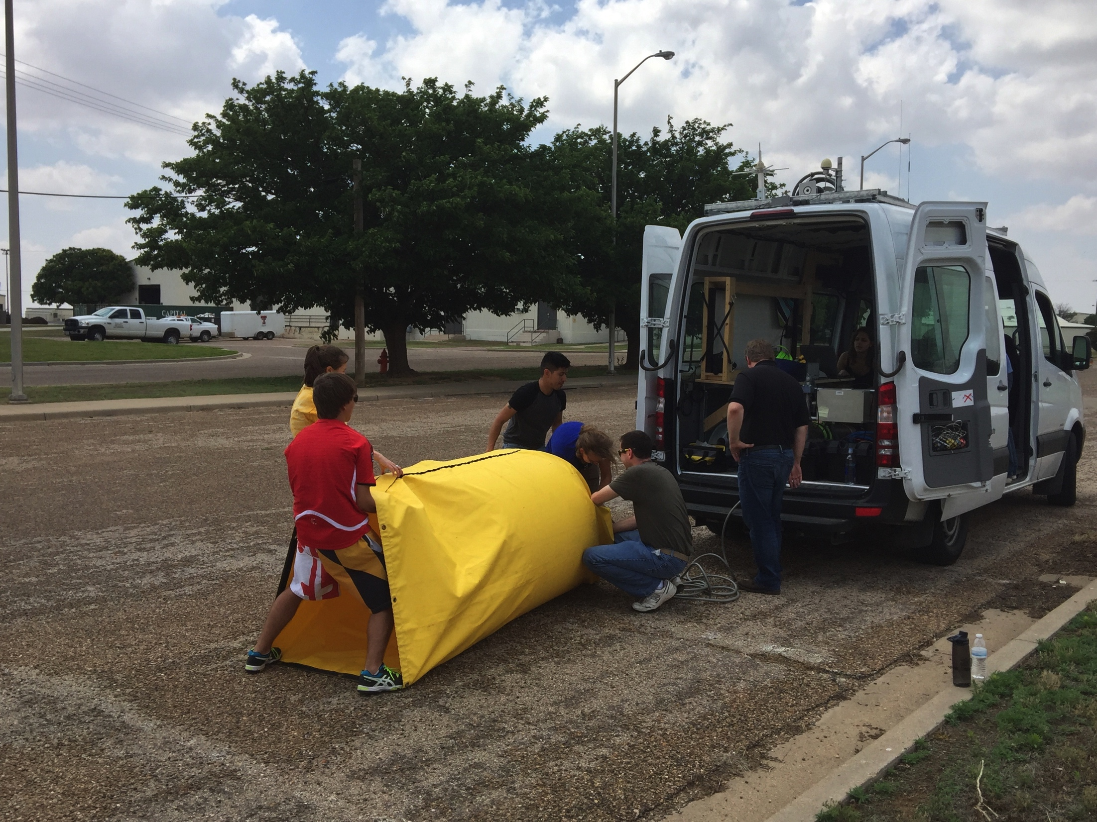
VORTEX-SE Project

Slide 51
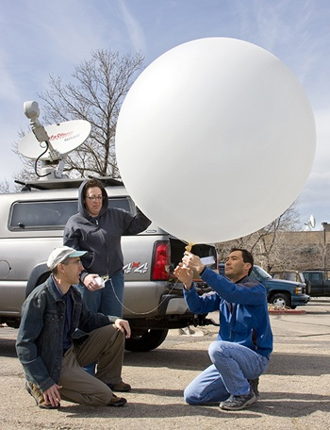
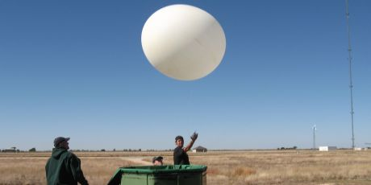
Radiosonde
Notes:
Slide21.mp3
In the lesson on surface and upper air observations, it was stated that the instrument used to measure temperature along with humidity, pressure and wind at various altitudes is called a radiosonde. As a balloon carries the radiosonde up through the troposphere and lower stratosphere, it measures these variables and sends the information back to a ground station.

Slide 52
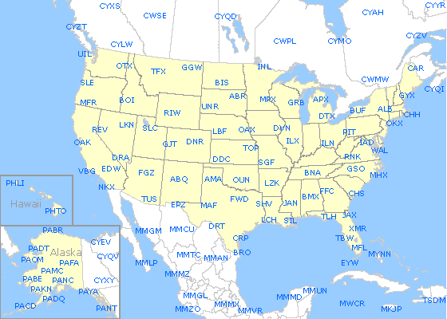
Measuring the Upper Atmosphere
Upper atmosphere is sorely under-sampled
These measurements are needed for improved model forecasts!
Radiosondes released twice a day from stations spaced too far apart

Slide 53
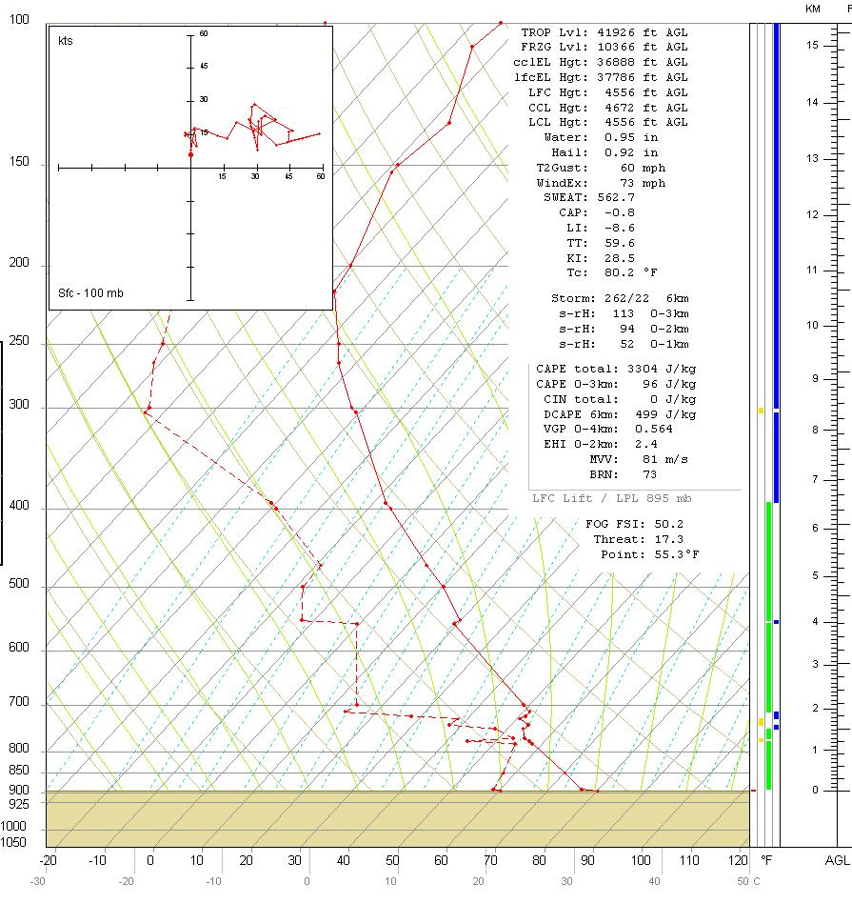
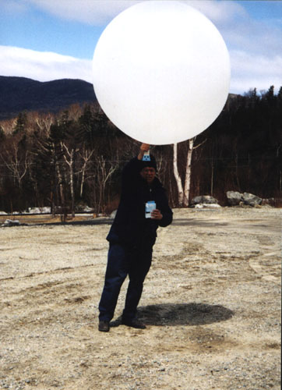
Radiosonde photo from apollo.lsc.vsc.edu/classes/met130 – diagram from kelvin.ou.edu/METR%202603/simple%20sounding
Notes:
Slide22.mp3
The data can then be plotted on a temperature-height diagram, called a thermodynamic diagram, giving a “picture” of the vertical change of temperature. The solid red line on this graph showing the vertical change of temperature is called the environmental lapse rate.
Once we know the environmental lapse rate, we can proceed with the method of determining stability.

Slide 54
Four Types of Stability
(we cover three of them here)
Absolutely Stable
  Stable for saturated and unsaturated ascent
Absolutely Unstable
  Unstable for saturated and unsaturated ascent
Neutral Stability
  Neither stable or unstable, no net acceleration
(So far, we have only considered unsaturated ascent)
Notes:
Slide26.mp3
Using this method of determining the stability of a parcel of air, we can define four types of stability that might characterize any given layer in the atmosphere. A layer just means a certain vertical depth. For example, the layer could be from the surface to 10,000 feet or from the surface to 30,000 feet. These 4 types of stability are: absolutely unstable, absolutely stable, neutrally stable and conditionally unstable.

Slide 55
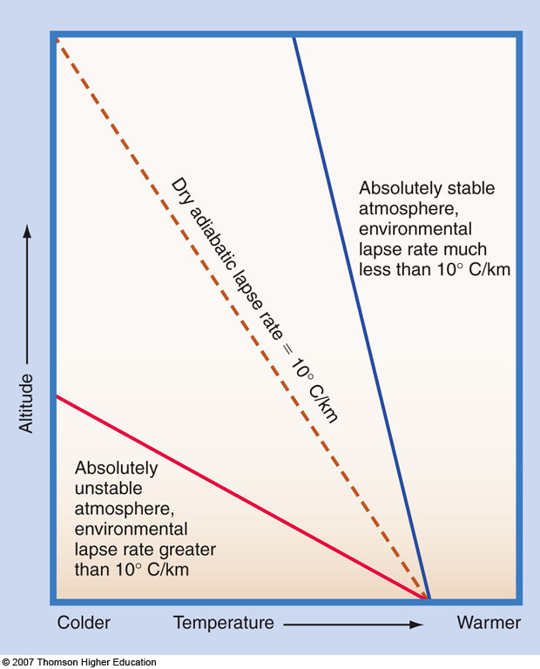
Fig. 3-18, p. 73

Slide 56
Determining Stability
Compare environmental & parcel temp
HEIGHT ENVIRON TEMP PARCEL TEMP
3 km AGL 8 deg C ?
2 km AGL 15 deg C ?
1 km AGL 22 deg C ?
SFC 30 deg C 30
What must the parcel temperature be so that it is unstable?
9
16
24
HAS TO BE WARMER THAN THE ENVIRONMENT
Notes:
Slide23.mp3
Take a look at this example. In the column labeled ENVIRON are temperatures obtained from a radiosonde observation. They are just the air temperatures at the given altitudes. This column represents the environmental lapse rate. Now we are going to see what would happen if a parcel of air at the surface with a temperature of 70 deg were forced to rise in the atmosphere. We’ll assume the parcel is not saturated.

Slide 57
Neutral Stability
HEIGHT ENVIRON TEMP PARCEL TEMP
3 km AGL 0 deg C ?
2 km AGL 10 deg C ?
1 km AGL 20 deg C ?
SFC 30 deg C 30
0
10
20
Notes:
Slide30.mp3
This table illustrates an absolutely stable layer. Note that at each level, the parcel temperature is colder than the environmental temperature regardless of whether the parcel is saturated or not. The parcel at each level is stable meaning there will be a resistance to vertical displacement. No where in this layer does the parcel become unstable.

Slide 58
Absolutely Stable Layer
HEIGHT ENVIRON TEMP PARCEL TEMP
3 km AGL 18 deg C ?
2 km AGL 22 deg C ?
1 km AGL 26 deg C ?
SFC 30 deg C 30
0
10
20
As we go up… parcel temperature is always colder than the environment. There is a resistance to vertical displacement…
Notes:
Slide30.mp3
This table illustrates an absolutely stable layer. Note that at each level, the parcel temperature is colder than the environmental temperature regardless of whether the parcel is saturated or not. The parcel at each level is stable meaning there will be a resistance to vertical displacement. No where in this layer does the parcel become unstable.

Slide 59
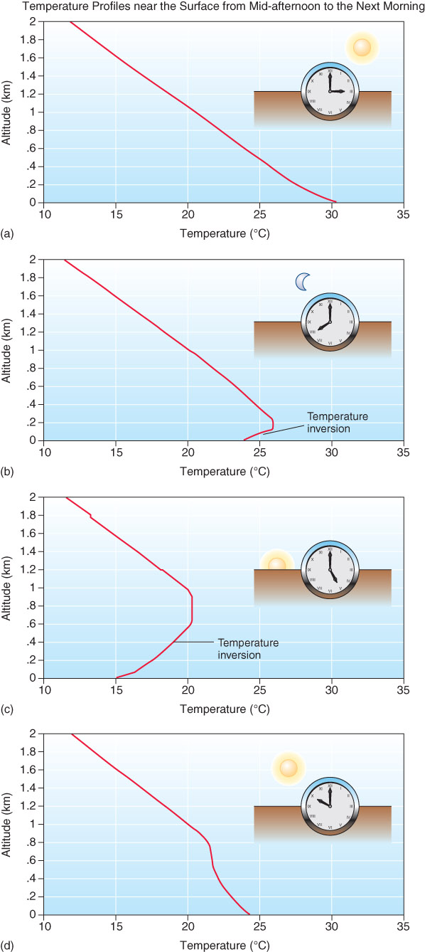
Temperature Inversion
Extremely Stable; inversions suppress the upward motion of air.
One type of inversion
  Radiation (nocturnal) Inversion
  Ground is cooling quicker than the air above it, as we have lost our solar radiation
Fig. 3-21, p. 88
Notes:
Slide36.mp3
Inversions can also be found near the surface of the earth. One type of inversion is a radiation inversion. It forms at night as the earth’s surface loses energy due to radiation. The ground cools and, in turn, the air directly in contact with the ground cools by conduction. Since air is a poor conductor of heat, the air temperature close to the ground falls more than the temperature a few thousand feet above the ground resulting in an inversion.

Slide 60
Temperature Inversion Layer
HEIGHT ENVIRON TEMP PARCEL TEMP
3 km AGL 36 deg C ?
2 km AGL 34 deg C ?
1 km AGL 32 deg C ?
SFC 30 deg C 30
0
10
20
Notes:
Slide30.mp3
This table illustrates an absolutely stable layer. Note that at each level, the parcel temperature is colder than the environmental temperature regardless of whether the parcel is saturated or not. The parcel at each level is stable meaning there will be a resistance to vertical displacement. No where in this layer does the parcel become unstable.

Slide 61
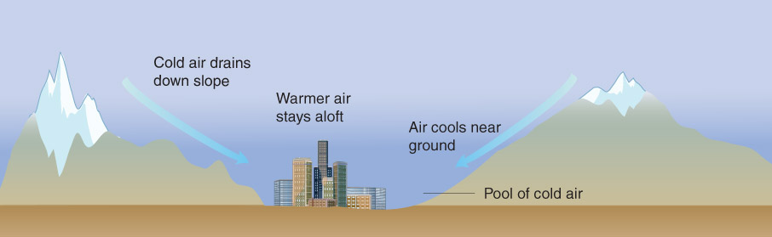
Fig. 3-23, p. 90

Slide 62
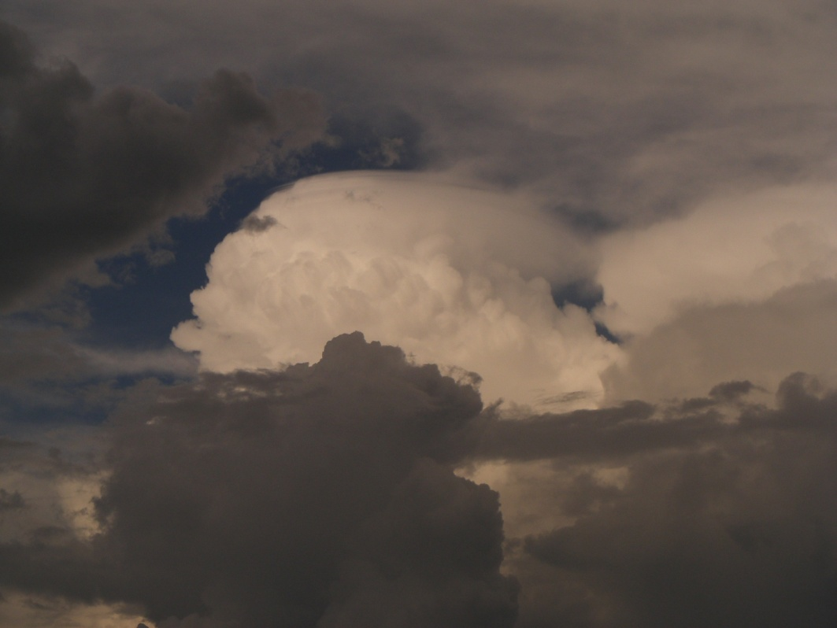
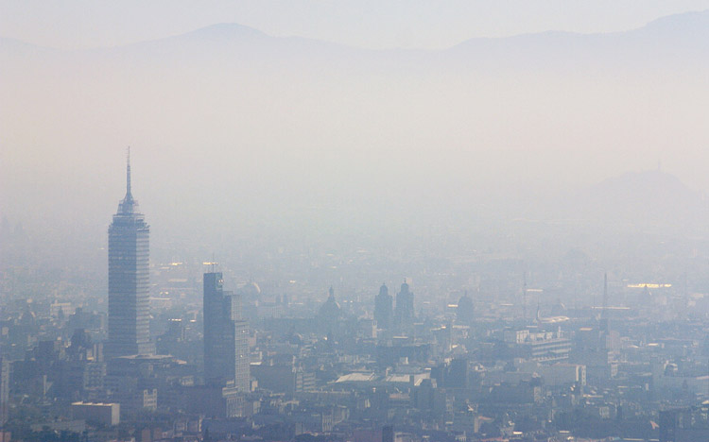
Since they suppress the upward motion of air, inversions can act as a “cap” or “lid”.
This has implications for pollution and severe storms
Fig. 3-22, p. 89

Slide 63
Inversions During Winter
VERY important to agriculture
If the inversion is shallow or temperatures will only be slightly below zero
  Trap long-wave radiation by covering plants
  Supply heat (fires/heaters) to help mix out the inversion, keep the surface warmer
  Mechanically mix air (fans, helicopters)
  Cover with ice (cover with water, water freezes, releases latent heat, keeps plants closer to freezing)

Slide 64
Wind Chill Temperature
Definition – The *apparent* decrease in air temperature due to the motion of air
For example, wind replaces warmer air near your skin (warmed by your body) with cold air MORE HEAT LOSS FROM YOUR BODY!
Notes:
Slide23.mp3
Take a look at this example. In the column labeled ENVIRON are temperatures obtained from a radiosonde observation. They are just the air temperatures at the given altitudes. This column represents the environmental lapse rate. Now we are going to see what would happen if a parcel of air at the surface with a temperature of 70 deg were forced to rise in the atmosphere. We’ll assume the parcel is not saturated.

Slide 65
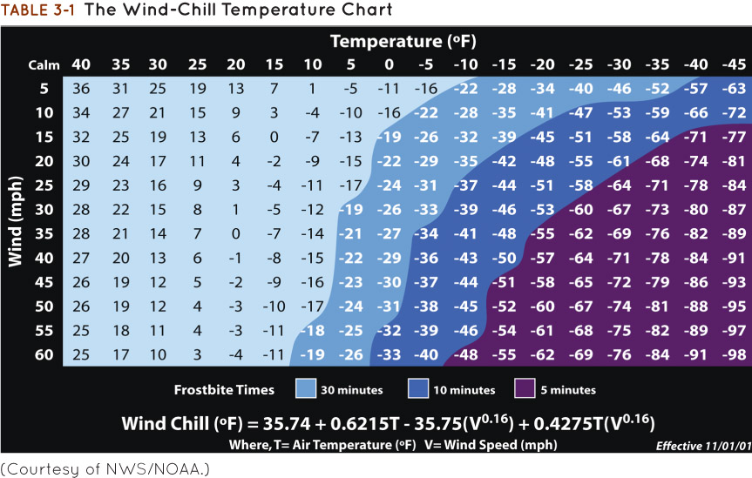
Table 3-1, p. 90

Slide 66
Heat Index
Heat Index – a measure of “apparent temperature” (how hot you feel) based on combined effects of temperature and Relative Humidity (a measure of moisture).
High temperature and high moisture content lead to a high heat index. It “feels” hotter because your body can’t cool by evaporation.
Notes:
Slide22.mp3
Relative humidity is inversely related to the rate of evaporation. The lower the relative humidity the higher is the rate of evaporation. On a hot, summer day in locations where the relative humidity is high you feel uncomfortable outside because the rate of evaporation of perspiration from your skin, which helps to cool the body, is low. The Heat Index, a number computed from the ambient temperature and relative humidity, is often used to indicate an apparent temperature.

Slide 67
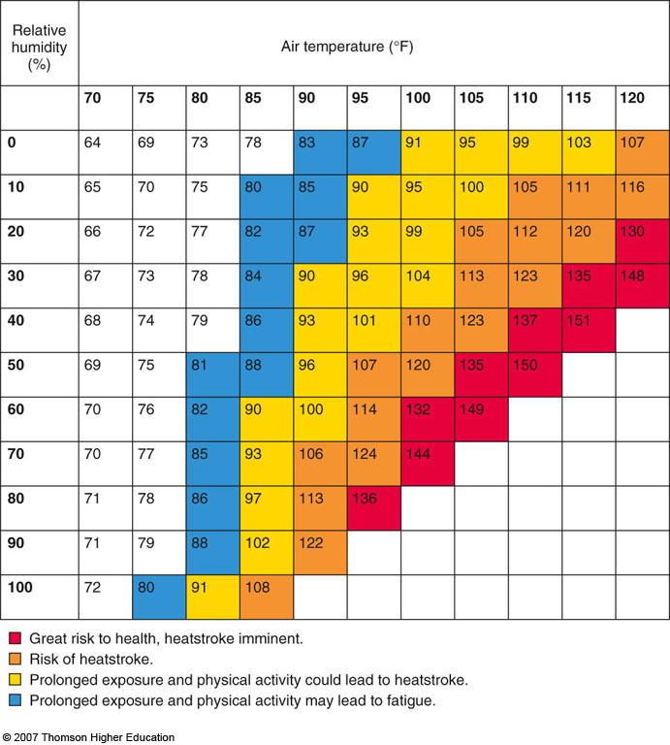
Box 4-1, p. 89

Slide 68
Recap
Temperature increases if there is a net energy surplus
Diurnal cycle influenced by solar radiation and longwave radiation
Annually
  Closer to the equator = higher temps, less range
  Surface type: water = less range than lower specific heat surfaces like sand
  Higher elevation = cooler temps
  Southern slopes = higher temps, more sunlight
  Cloud cover = warmer nights, cooler days
  Advection pattern
Interannually
  Climate pattern
  Greenhouse gases
  Volcanic eruptions

Slide 69
Recap
Stability: condition that affects vertical motion
Unstable: positive buoyancy of a parcel (parcel less dense than environment with warmer temperature or more moisture), positive vertical motion
Stable: sinking of a parcel, negative buoyancy (parcel more dense than environment with cooler temperature)
Adiabatic motion
  10 C / km (dry motion, moist adiabatic motion in Chapter 4)
  Energy used to lift parcel
  Parcel expands reducing pressure, kinetic energy transferred to potential
  Temperature cools
Stability determined by comparing parcel’s theoretical temperature to environmental temperature (determined by radiosonde measurement)

Slide 70
Recap
Absolutely stable: stable for both saturated and unsaturated ascent
Absolutely unstable: unstable for all ascent
Neutral stability: no motion
Inversion: extremely stable, temperature increases with height
  Can be caused by quick radiative cooling at night
  Traps pollution
  “Caps” storms

