Slide 1
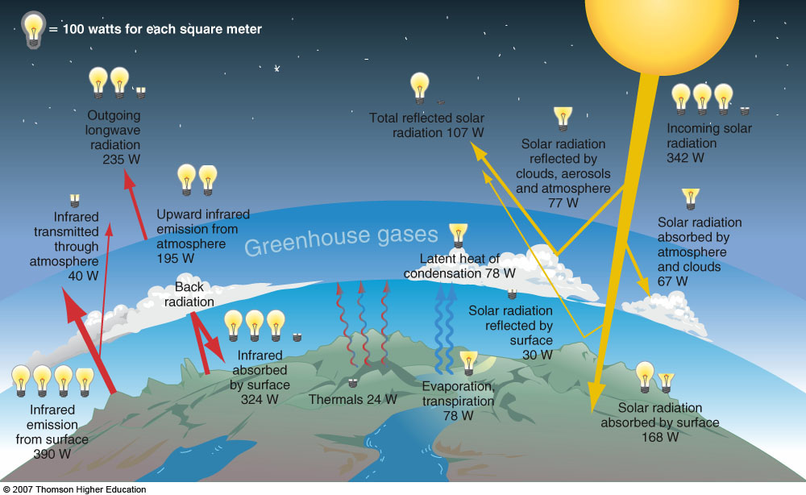
Chapter 2 The Energy Cycle
ATMO 1300
Summer 2017

Slide 2
Chapter 2 The Energy Cycle
TOPICS
Energy
Energy Transfer
Seasonal Changes
Atmosphere Radiation Properties
Energy Budget
ATMO 1300
Summer 2017

Slide 3
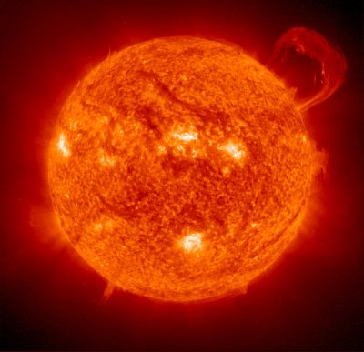
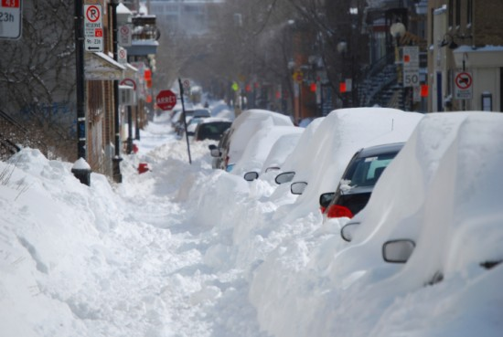
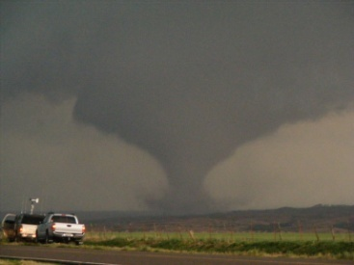
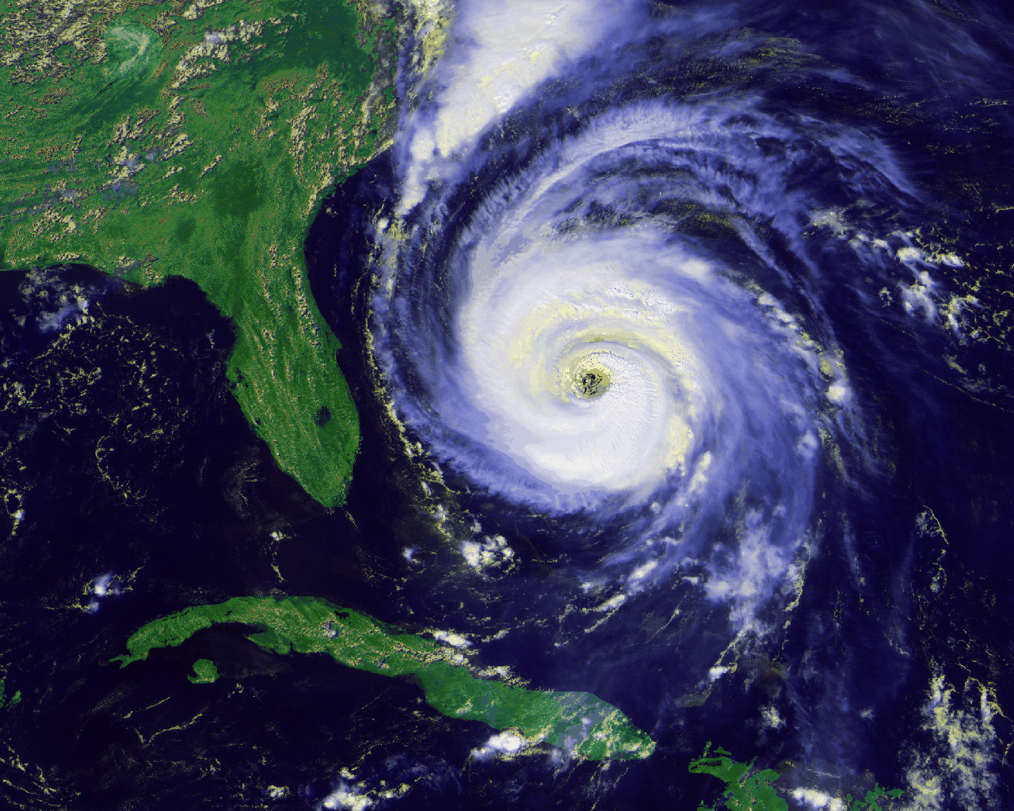
This sounds boring…why is it important?
The transfer of the sun’s energy through the atmosphere affects almost every aspect of weather (seasons, climate, severe weather, etc)
Important concepts:
the energy balance (what goes in/out?)
energy conversion
atmospheric motion

Slide 4
So what is “energy” ?
Energy is the ability or capacity to do work.
Work = Force x Distance
Law of Conservation of Energy:
Energy can neither be created nor
destroyed.
(F = ma)

Slide 5
Two Kinds of Energy
KINETIC ENERGY – energy due to motion… kinematics = “the wind”
Depends on mass and velocity
This is why trucks have lower gas mileage than scooters
POTENTIAL ENERGY – energy due to an object’s position or configuration.
Example: holding a rock over the edge of a cliff.
Example: a bomb before it explodes.
Stored energy
Constantly converting between these forms of energy (NOTE: energy is not being created, just converted)

Slide 6
Wind Energy

Slide 7
Temperature vs. Heat
Temperature: A measure of the average kinetic energy of the molecules of a substance.
Heat: The energy produced by the motion of those molecules.
Temperature scales:
⁰F - Fahrenheit
⁰C - Celsius
⁰K – Kelvin
Scale | Freezing Point | Boiling Point | Room Temp. | Body Temp.
F | 32 | 212 | 75 | 98.6
C | 0 | 100 | 24 | 37
K | 273 | 373 | 297 | 310.2

Slide 8
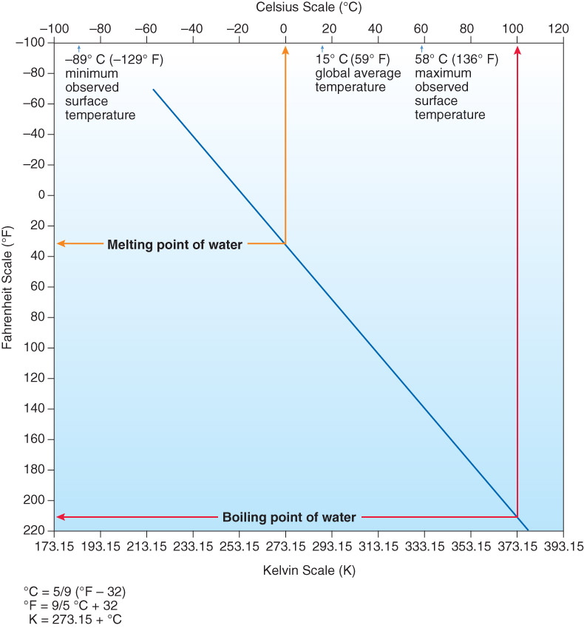
Fig. 2-1, p. 35

Slide 9
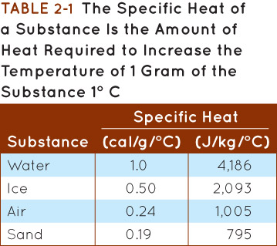
Specific Heat
The amount of energy needed to increase the temperature of 1 g of a substance by 1 deg Celsius
Varies widely from substance to substance
Difference between water and land is important!
Energy can be measured several ways: calories and Joules are the most common.
Same idea as food calories: 1 calorie = 1000 Dietary calories
Table 2-1, p. 36

Slide 10
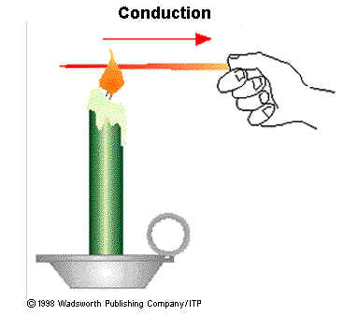
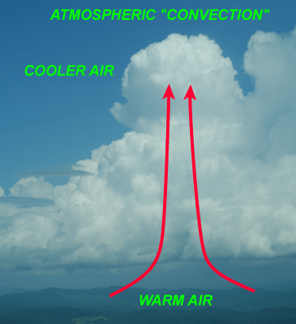
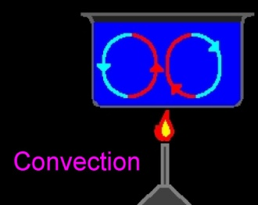
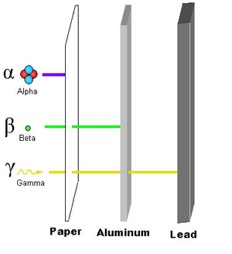
Energy Transfer Processes
CONDUCTION
ADVECTION
CONVECTION
LATENT HEATING
RADIATION

Slide 11
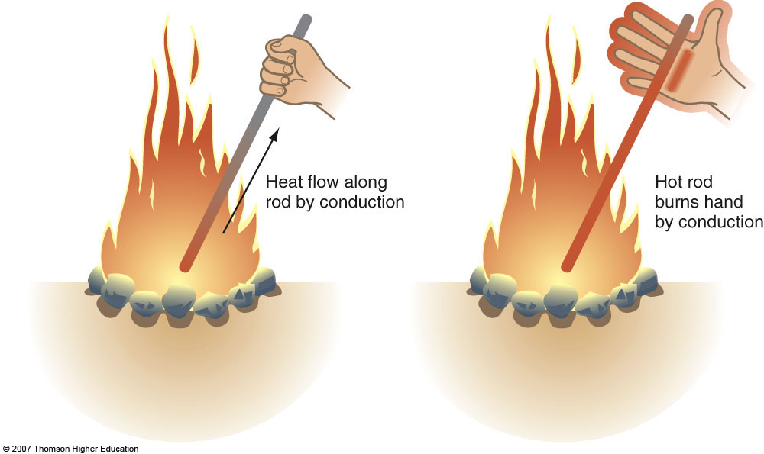
Conduction
Transfer of energy through molecular activity.
Within a substance or direct contact between two substances
Energy transferred from high to low temperature

Slide 12
Conduction Figure from www.ucar.edu/learn

Slide 13
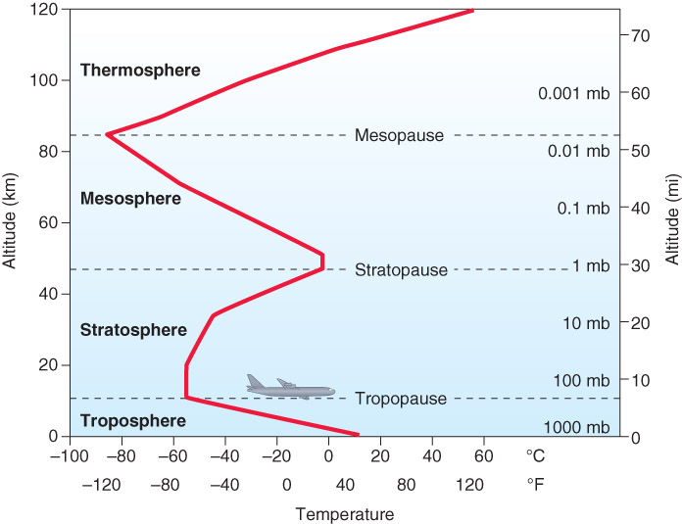
Apply to Atmosphere
Air close to the ground is heated or cooled by contact with the earth’s surface.

Slide 14
Energy Transfer Processes
CONDUCTION
ADVECTION
CONVECTION
LATENT HEATING
RADIATION

Slide 15
Advection
Advection is the horizontal (east-west or north-south) transport of some atmospheric property by the wind (example: temperature, moisture)
Fig. 2-4, p. 38
Fig. 2-4, p. 31

Slide 16
Energy Transfer Processes
CONDUCTION
ADVECTION
CONVECTION
LATENT HEATING
RADIATION

Slide 17
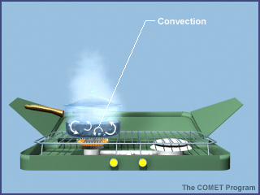
Convection Figure from www.ucar.edu/learn
Vertical transfer of energy by the movement of a fluid.
In meteorology-- vertical transport of energy
Fig. 2-3, p. 37

Slide 18
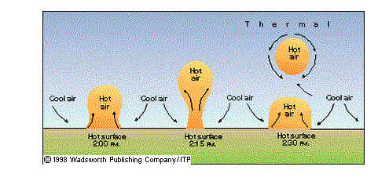
Convection
Air heated by Earth’s surface - conduction
Becomes buoyant and rises – convection
Figure from kelvin.ou.edu/thermal.jpg
Free vs. Forced convection
In Atmos. Sci. we call these air parcels (or thermals): bubbles of air separate from the environment

Slide 19
Energy Transfer Processes
CONDUCTION
ADVECTION
CONVECTION
LATENT HEATING
RADIATION

Slide 20
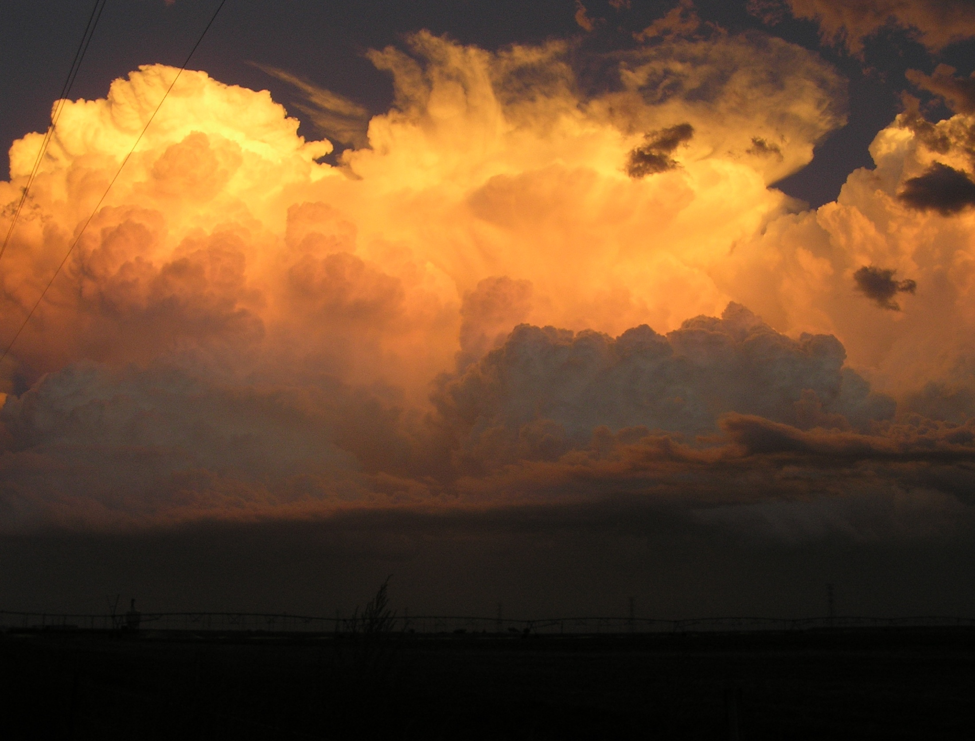
Latent Heating
Latent “heat” is energy needed (from the environment) to change the phase of a substance (ex: liquid to gas)
Latent means “hidden”
In the atmosphere, we’re most interested in the change of phase of water.
Energy is either absorbed or released when water changes phase
HUGE source/sink of energy an atmosphere!

Slide 21
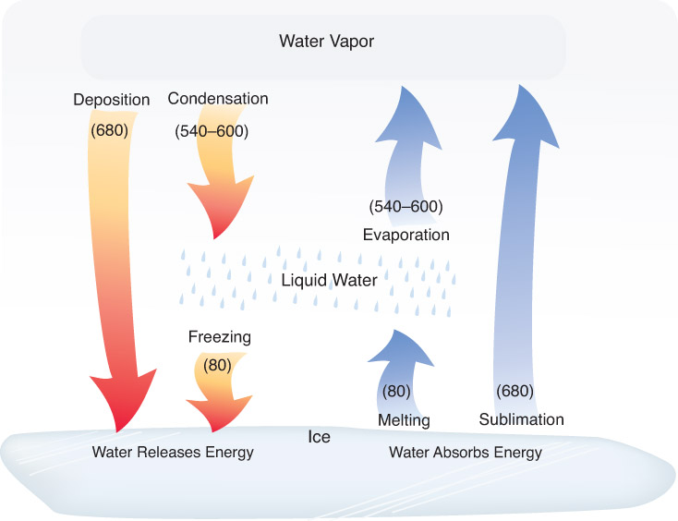
Energy given to atmosphere
Energy taken from atmosphere
Fig. 2-5, p. 40

Slide 22
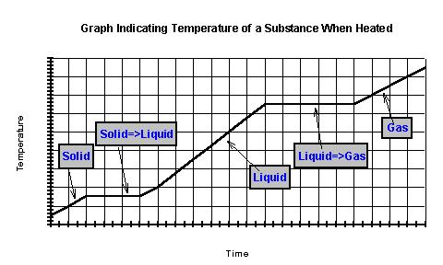
What Happens to Temp? Graph from www.reachoutmichigan.org/funexperiments

Slide 23
Energy Transfer Processes
CONDUCTION
ADVECTION
CONVECTION
LATENT HEATING
RADIATION

Slide 24
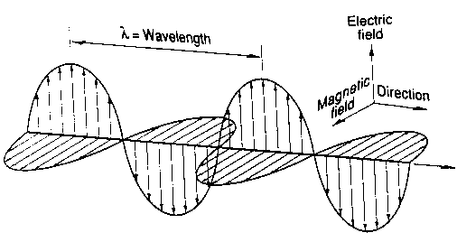
Radiation
The transfer of energy by electromagnetic waves
No material substance transferred
Absored, Reflected, Transmitted, Scattered
Figure from www.geo.mtu.edu/rs/back/spectrum

Slide 25
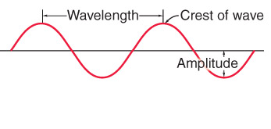
Properties of Waves
Trough
Fig. 2-6, p. 40
Wavelength = distance between crests / troughs
Amplitude = “intensity” of wave

Slide 26
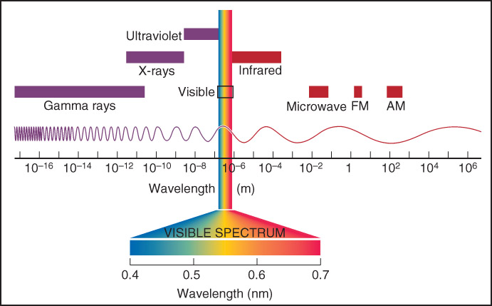
Electromagnetic Spectrum
Fig. 2-7, p. 41

Slide 27
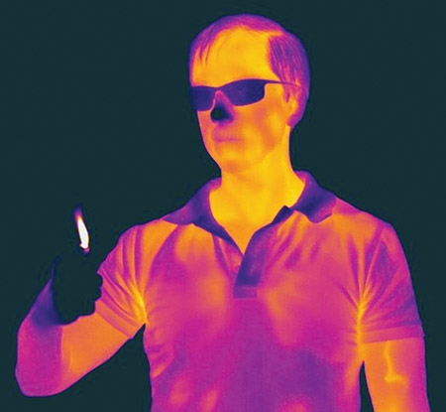
Radiation Law #1
ALL objects above 0 deg K (absolute zero) emit radiation!
Fig. 2-9, p. 43

Slide 28
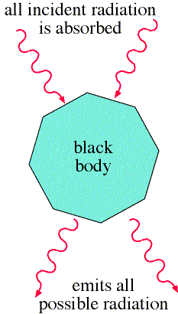
Laws Governing Radiation
Stefan-Boltzmann Law
Wien’s Law
Laws strictly apply to “black bodies” only
Figure from apollo.lsc.vsc.edu/classes/met130

Slide 29
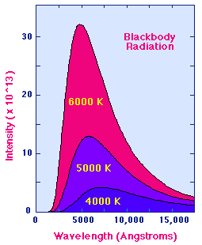
Stefan-Boltzmann Law
I = σ T ⁴
The total amount of energy emitted by an object is proportional to its temperature
Note exponential on T: if something is 20 times hotter, it emits (20)^4, or 160,000 times more energy.
Sun’s Temp:
5880 K

Slide 30
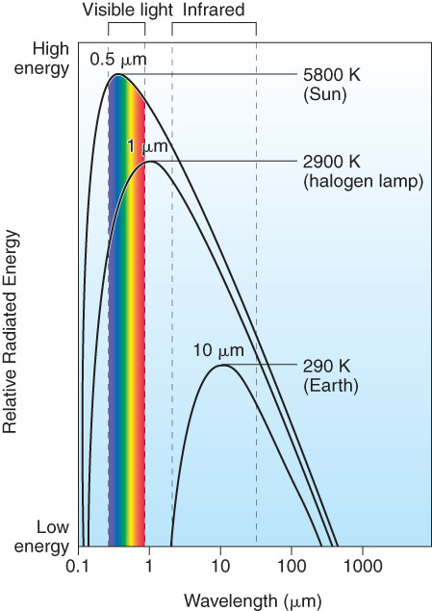
Wien’s Law
λ_{max} = C / T C=constant=2900
T=temperature (K)
The wavelength of maximum emission is inversely proportional to temperature
Graphic from www.cira.colostate.edu/ramm/goes39
Fig. 2-8, p. 42

Slide 31
What Wien’s Law Tells Us
For the sun: λ_{max} is in visible region (significant ultraviolet (UV) component)
Called shortwave radiation
For the earth: λ_{max} is in infrared region
Called longwave radiation

Slide 32
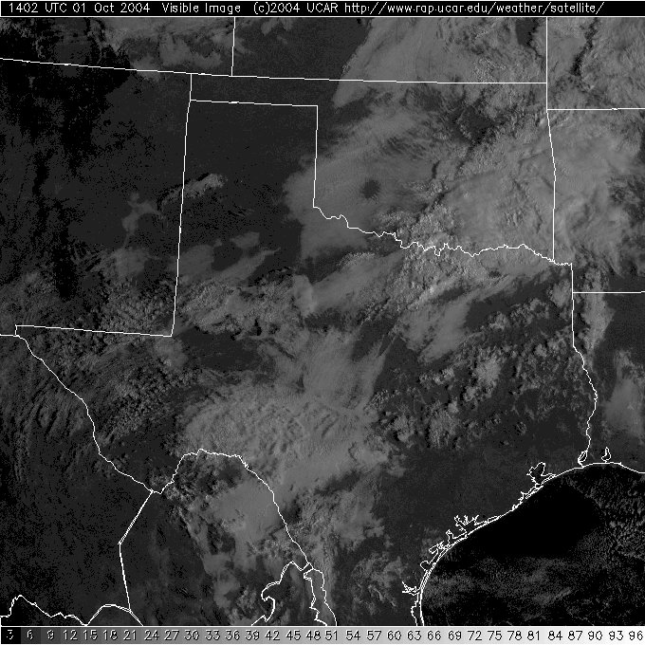
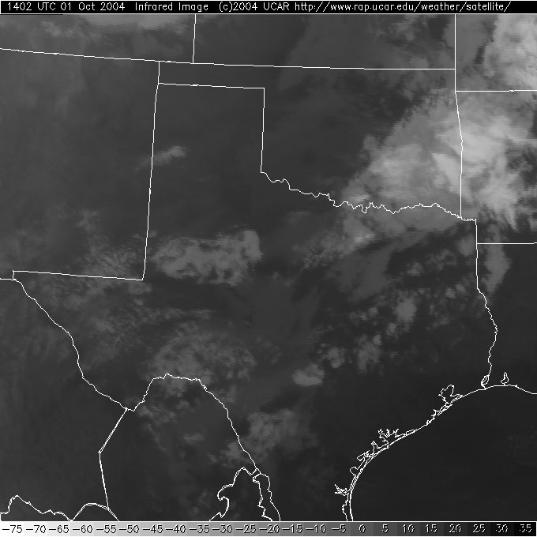
Application
X
X
X
X
cold
warm
VISIBLE satellite image
INFRARED satellite image

Slide 33
Insolation
Incoming solar radiation
Insolation is simply the amount of energy incoming from the sun per square area (W / m²)
• Depends on:
1. Length of day
2. Solar angle
Beam spreading
Beam depletion
3. Distance of earth from sun (minor)

Slide 34
Seasons
Length of day and solar angle are related to the seasons
Earth revolves around the sun
Earth is tilted on its axis 23 ½ degrees.
This tilt causes the 4 seasons.

Slide 35
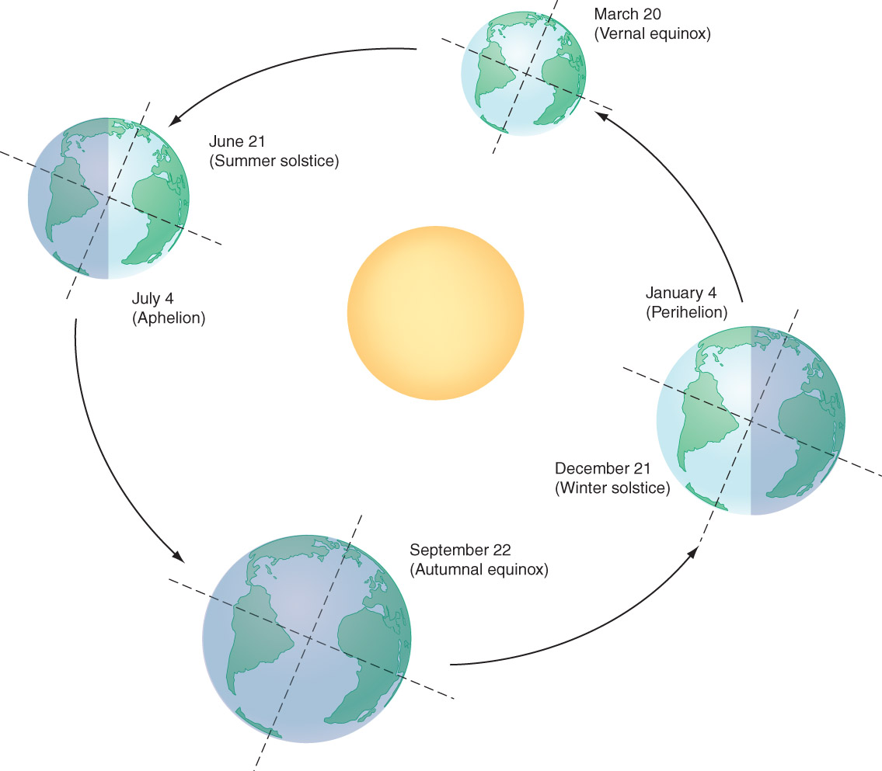
Earth-Sun Geometry
Closest to the sun
Farthest to the sun
http://apod.nasa.gov/apod/ap140319.html
Fig. 2-11, p. 48

Slide 36
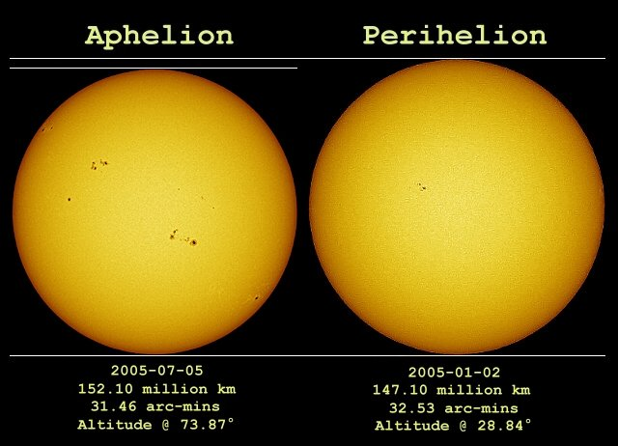
Earth – Sun Distance Figure from spaceweather.com/swpod2005/06jul05/Ayiomamitis1
Notes:
Aphelion is the term that describes the orbit of a planet when it is farthest from the sun. Perihelion is the term used to describe the closest position of a planet in orbit to the sun. The prefix “apo” means away, off or apart. The similar word apogee refers to when an object orbiting the earth is farthest away.

Slide 37
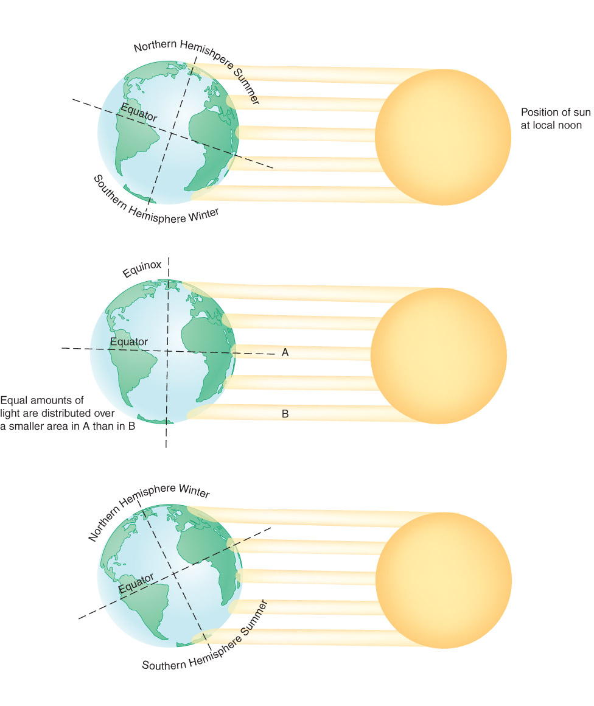
Northern hemisphere
summer solstice
spring, summer
equinox
winter solstice
Fig. 2-12, p. 50

Slide 38
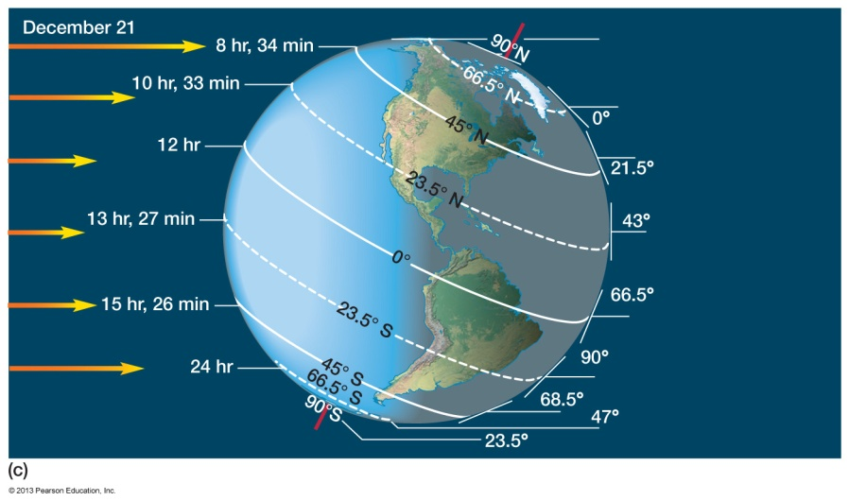
Period of Daylight
Winter solstice
Notes:
On December 21, our winter solstice, these effects are reversed as the earth tilts away from the sun. From the time of the autumnal equinox until December 21, the days will get progressively shorter in New York and the sun will set earlier. The shortest day of the year in the northern hemisphere occurs on the winter solstice. In South America the situation is again reversed, a city in Argentina will experience its summer solstice and the condition will be like they were in New York in June.

Slide 39
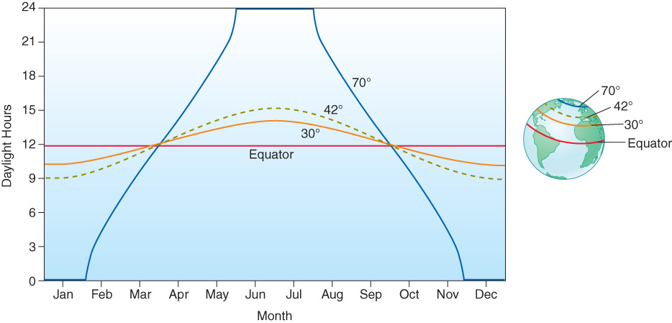
Amount of Daylight
Fig. 2-16, p. 50

Slide 40
Solar Zenith Angle
The sun’s angle of departure from directly overhead
Directly overhead = 0 deg
Horizon = 90 deg
Varies seasonally and daily
Related to beam spreading and beam depletion.

Slide 41
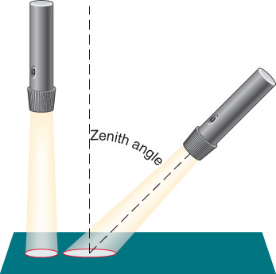
Beam Spreading Figure from www.geog.ucsb.edu/~joel/g110_w03/chapt02/sun_angle/agburt2_02_16.jpg
Fig. 2-14, p. 51

Slide 42
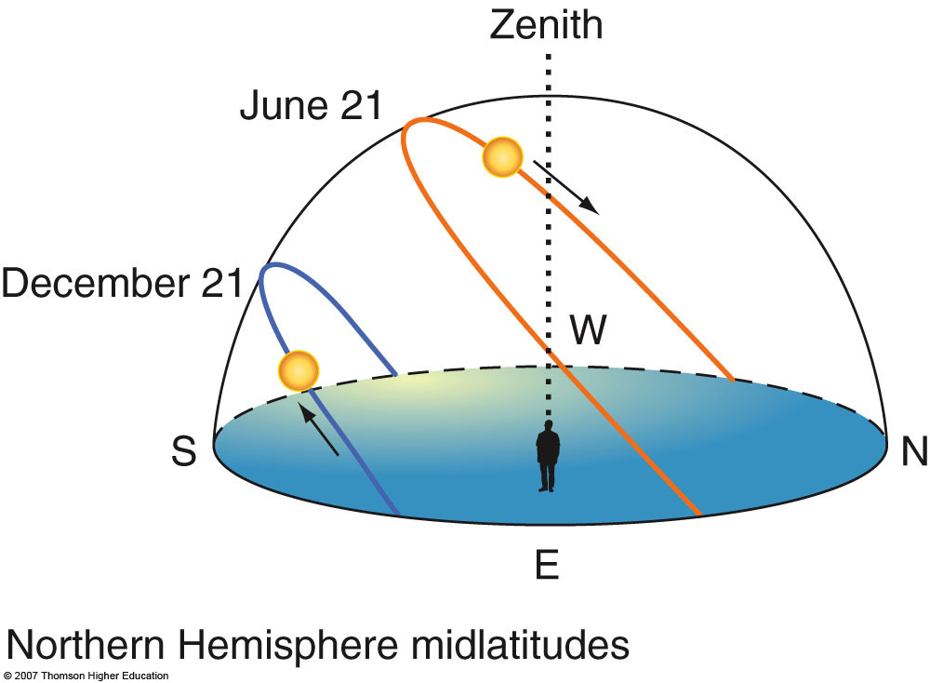
Seasonal Variation of Solar Zenith Angle
2nd edition: Fig. 2-14, p. 43

Slide 43
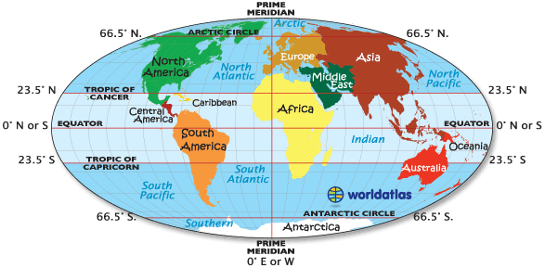
Winter Solstice in the Arctic. Fairbanks, Alaska. Time-lapse video. - YouTube

Slide 44
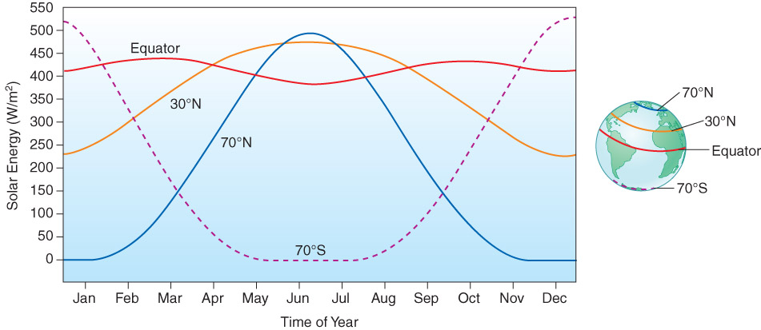
Energy at the Top of the Atmosphere
Fig. 2-17, p. 52

Slide 45
Beam Depletion
Refers to a weakening of solar energy as the sun’s rays pass through the atmosphere.
A greater amount of beam depletion occurs with a lower sun angle

Slide 46
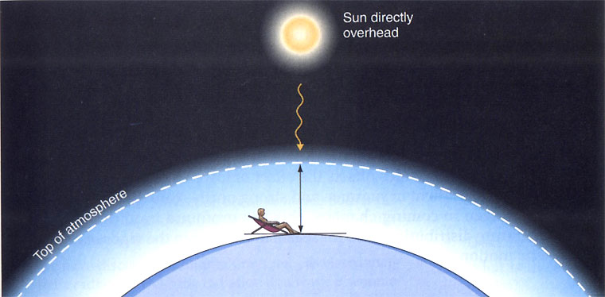
Beam Depletion Figure from www.geog.ucsb.edu/~joel/g110_w03/chapt02/sun_angle/agburt2_02_17a.jpg

Slide 47
Beam Depletion Figure from www.geog.ucsb.edu/~joel/g110_w03/chapt02/sun_angle/agburt2_02_17b.jpg

Slide 48
Overview
On average, there is a global energy balance between incoming solar radiation and outgoing terrestrial (from the earth) radiation.
We are going to investigate how this energy balance is achieved.

Slide 49
Interaction of Radiation with Earth’s Atmosphere
What happens to solar radiation as it passes through the atmosphere?
What happens to radiation emitted by the earth?
But first, …
A-R-T-S

Slide 50
Electromagnetic Spectrum
Fig. 2-7, p. 41

Slide 51
Processes Affecting Radiation
Absorption
Reflection
Transmission
Scattering (see pp.153-155)

Slide 52
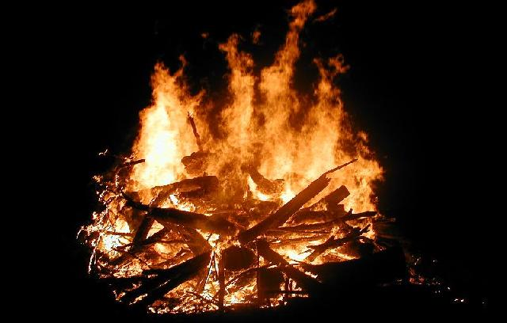
Absorption
Absorber gains energy.
Temperature usually increases.
Atmosphere absorbs infrared energy.
Photodissociation when UV radiation is involved (CFCs and ozone hole).
Graphic from: bufunation.com/images/monroe.html

Slide 53
Selective Absorption
Atmospheric gases absorb radiation only at certain wavelengths.
Gases in the atmosphere are not equivalent in their ability to absorb solar radiation
Solar radiation has a range of wavelengths

Slide 54
Fig. 2-19, p. 54

Slide 55
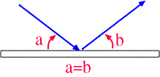
Reflection
Energy that is “sent back”; Mirrors are good reflectors as are clouds for solar radiation.
All substances reflect light with varying effectiveness
(the albedo of the substance)
Albedo describes the percentage of light that is reflected.
Fresh Snow = 90 %
Asphalt = 5%
figure from apollo.lsc.usc.edu/classes/met130

Slide 56
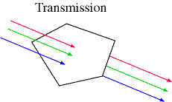
Transmission
The movement of EM radiation through the atmosphere without absorption or scattering.
The atmosphere is transparent to visible light.

Slide 57
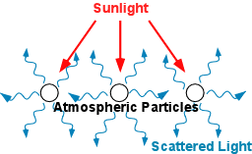
Scattering
Scattering is the redirection of energy; No energy is absorbed
Three types:
Rayleigh
Mie
Nonselective
figure from ww2010.atmos.uiuc.edu

Slide 58
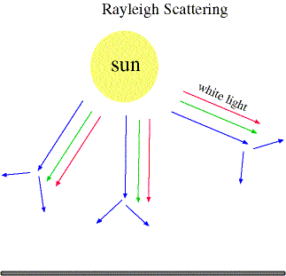
Rayleigh Scattering
Size of object is small compared to the wavelength of energy. Ex: O₂ and N₂ molecules (really, any gas).
More effective for shorter wavelengths.
Energy scattered forward and backward
Figure from apollo.lsc.usc.edu/classes/met130

Slide 59
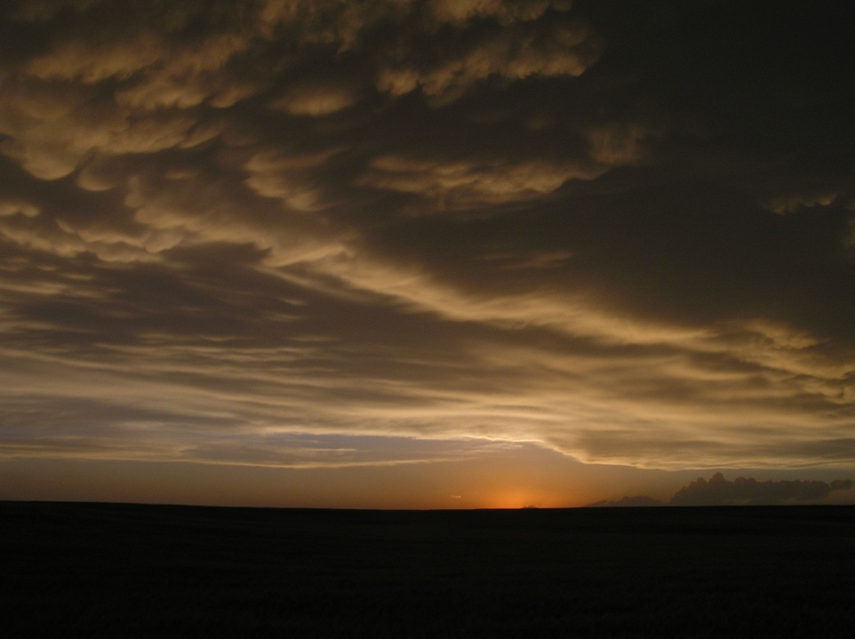
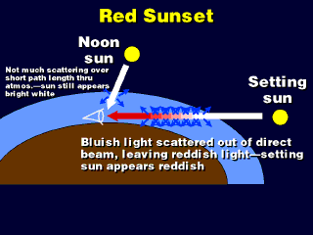
Application

Slide 60
Mie Scattering
Scattering by aerosols in atmosphere
Scatters forward predominately
Size of scattering object is comparable to wavelength
Non-selective scattering (relatively, compared to Rayleigh) - makes sky appear gray

Slide 61
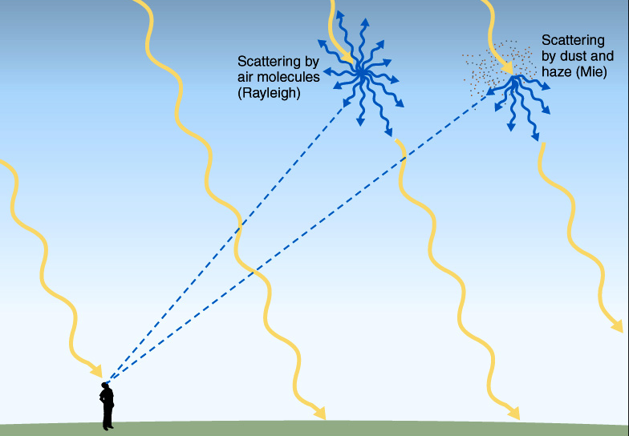

Slide 62
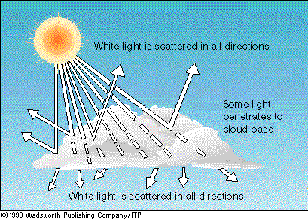
Nonselective Scattering
Also called “geometric scattering”
Due to water droplets found in clouds
Not as dependent on wavelength
→This is why clouds appear white or gray
Figure from apollo.lsc.vsc.edu/classes/met130

Slide 63
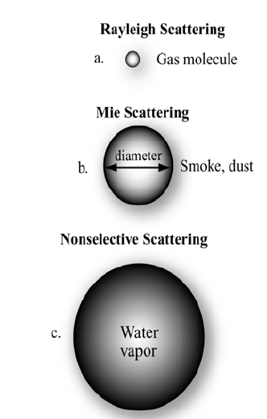
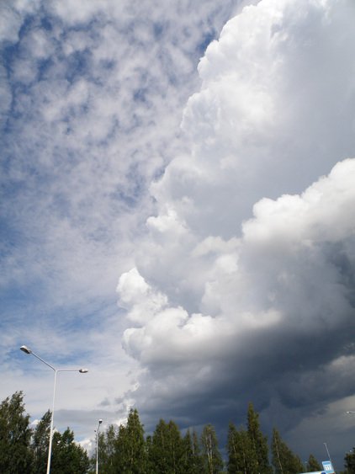
Scattering and Reflection
(O₂, N₂)
Water
Droplets
All wavelengths of light are scattered
Makes clouds appear white
www.topex.ucsd.edu
Notes:
This image shows that atmospheric scattering is a function of the wavelength of energy incident upon the earth from the sun and the size of the gas molecules, dust particles and water droplets encountered. Nonselective scattering affects all wavelengths of light and produces the white appearance we see in clouds.

Slide 64
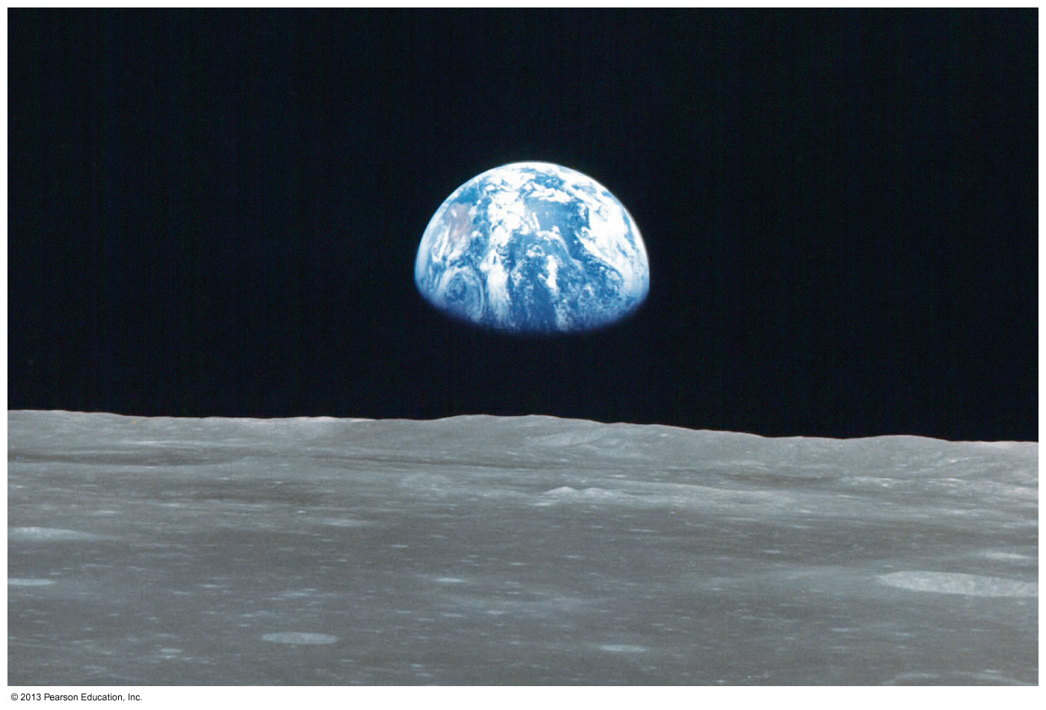
The Moon’s Sky is Black. Why???
no atmosphere = no scattering
Notes:
This picture of ‘earthrise’ from the surface of the moon was taken during the day and shows a black sky. The black sky of the moon is caused by the absence of an atmosphere and the lack of scattering of incoming solar radiation. The bluish tint to the earth is the result of Rayleigh scattering by the earth’s atmosphere.

Slide 65
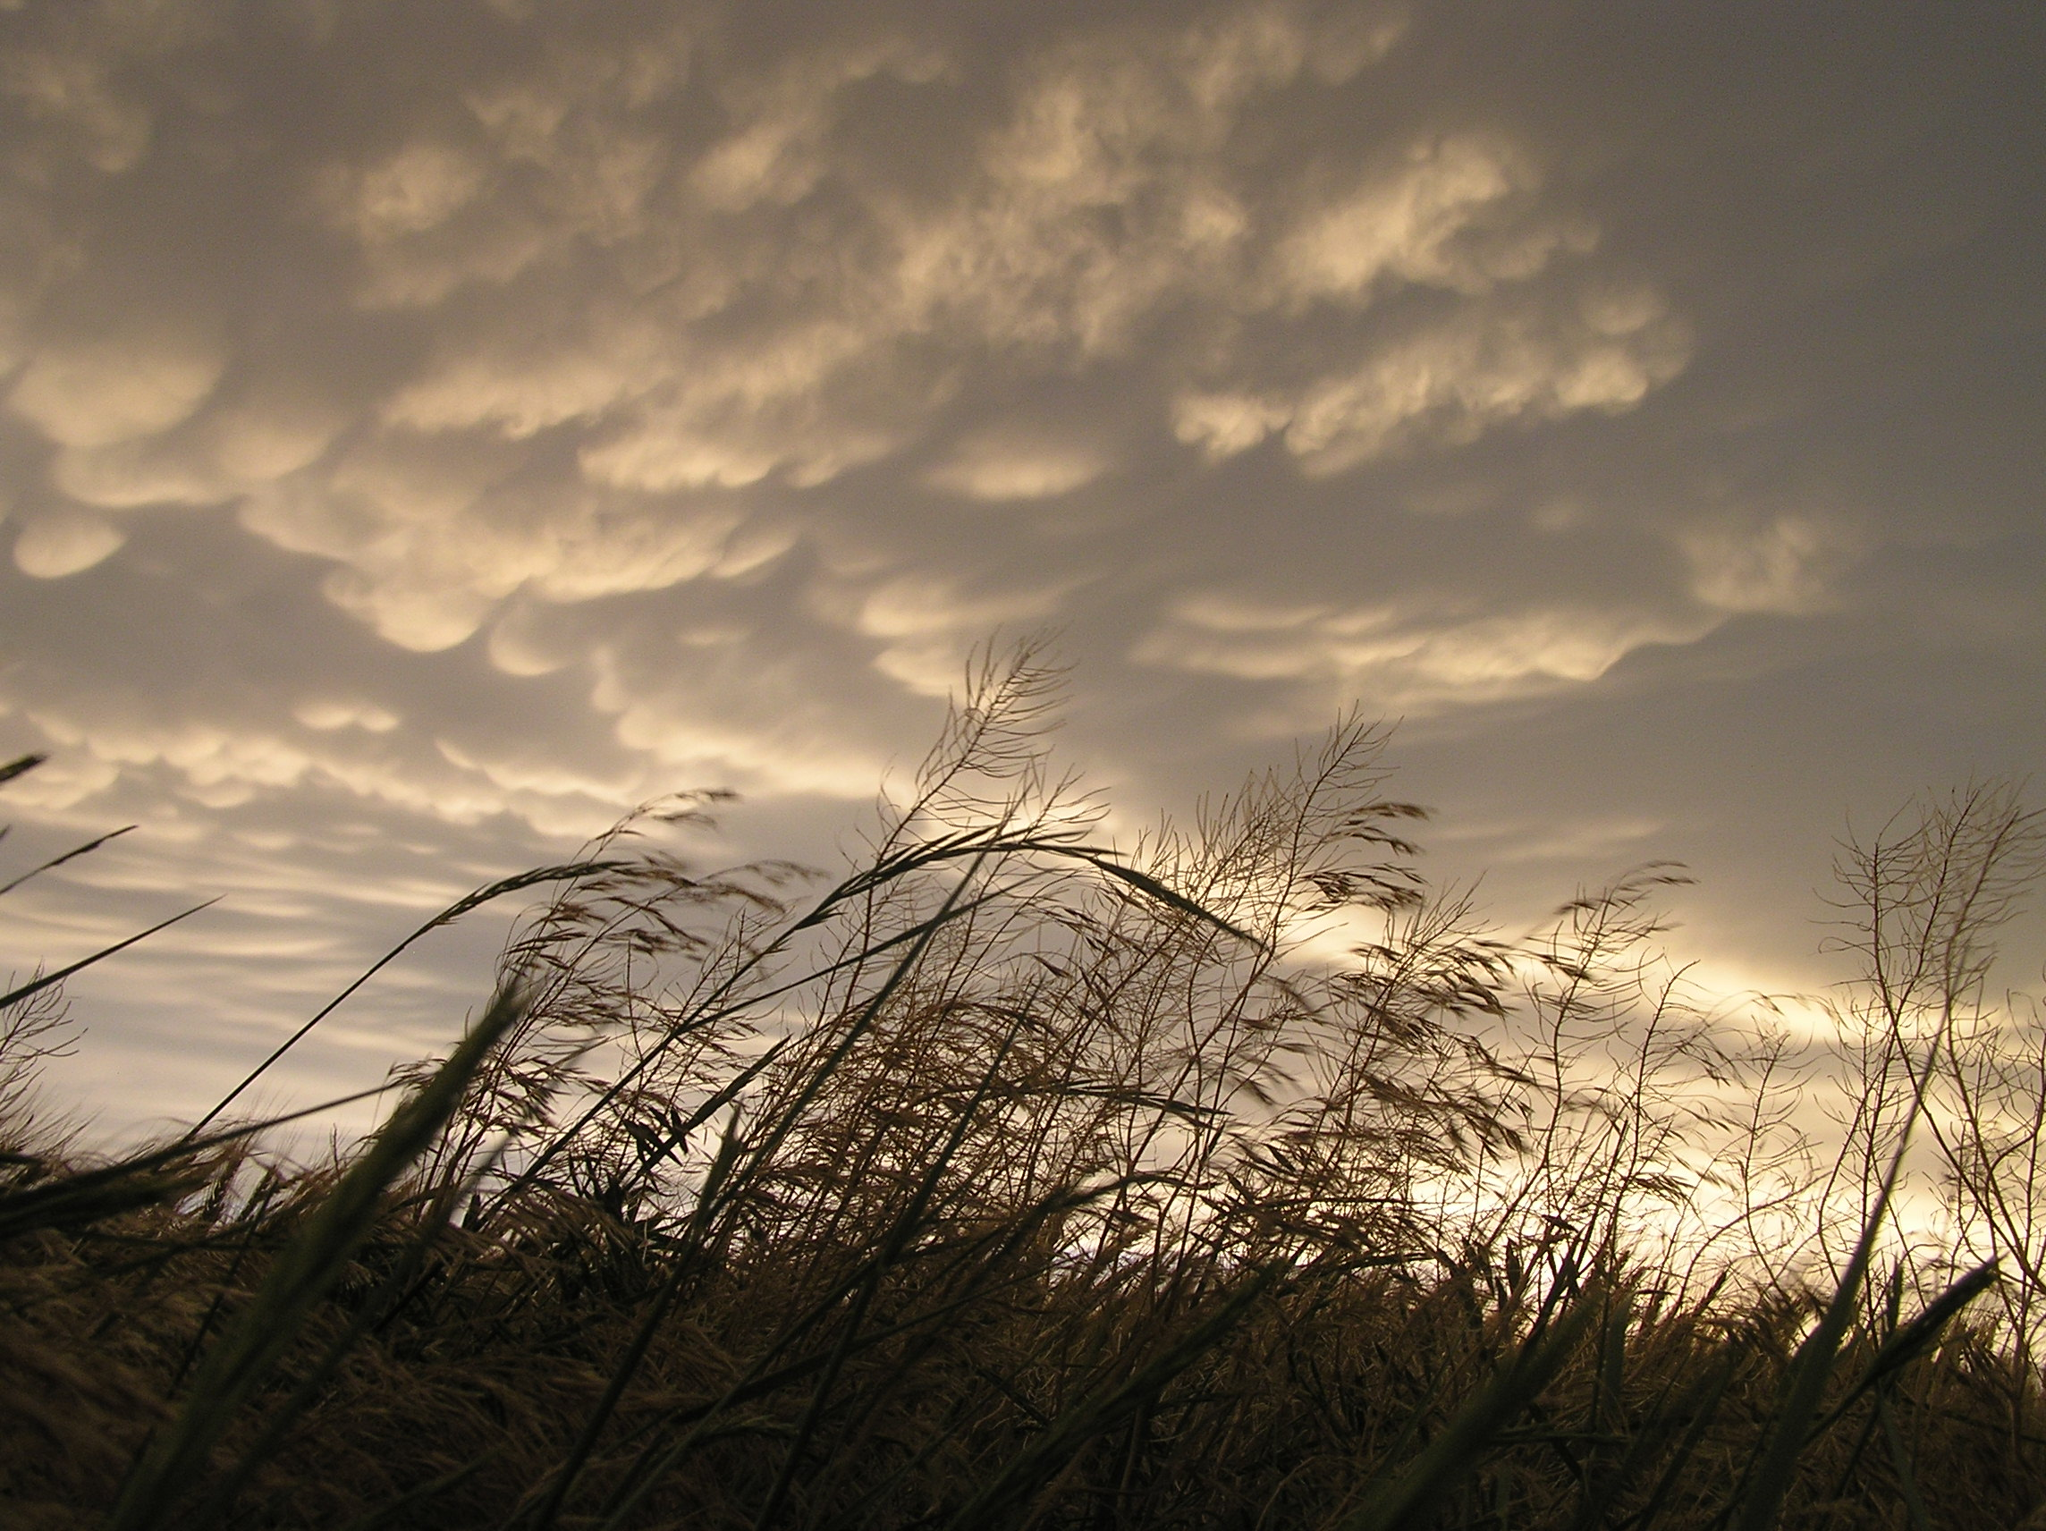
Okay, So What?
How do we apply these processes to help our understanding of the energy balance of the earth-atmosphere system?
Let’s look at what happens to solar radiation (shortwave radiation) and terrestrial radiation (longwave radiation).

Slide 66
Solar Radiation
When it enters the atmosphere…..
Absorbed by: gases (O₃, H₂O) and surface
Reflected by surface and cloud tops
Transmission: Visible part of the EM spectrum is transmitted
Scattered by gases, aerosols, clouds

Slide 67
Solar Radiation (cont’d)
The peak in solar radiation occurs in the visible part of the spectrum, but there is still plenty of energy in the ultraviolet (harmful! i.e. Sunburn, skin cancer etc…)
The atmosphere is nearly transparent to visible radiation…but not so much so for other wavelengths.

Slide 68
The Fate of Solar Radiation
100 Units Available
25 are absorbed by the atmosphere
19 are reflected by cloud cover into space
6 are reflected by the atmospheric gases and aerosols into space
5 are reflected into space by the ground
45 are absorbed by the surface
All are variable!

Slide 69
Terrestrial Radiation
The peak in terrestrial radiation occurs in the infrared region (Wien's Law) .
What happens to this outgoing longwave radiation emitted by earth?

Slide 70
Longwave Radiation
Most is absorbed by atmospheric gases, namely H₂O, CO₂. These are so-called “greenhouse gases”. The increase in CO₂ is linked to the “greenhouse effect”.
These gases also radiate infrared radiation
Clouds also absorb and radiate infrared radiation

Slide 71
IR Satellite Image

Slide 72
Energy Budget
We now know the factors that affect both solar and terrestrial radiation.
It is helpful to make a budget to understand the gains and losses. Net gains lead to warmer temps. Net losses lead to cooler temps.

Slide 73
Surface: 345.6 + 165 – 398 - 23 = 89.6
Net surplus at surface, net loss in atmos.

Slide 74
But, There’s a Problem
From these combined processes there is a net deficit of energy in the atmosphere and a net surplus at the surface.

Slide 75
But, There’s a Problem
From these combined processes there is a net deficit of energy in the atmosphere and a net surplus at the surface.
This imbalance is overcome through the vertical transport of sensible heat and latent heat.

Slide 76
Convection
Vertical transport of energy
Air heated at the surface becomes buoyant and rises.
Rising columns of warm air sometimes called thermals
Photo from www.soaringsports.com

Slide 77
Sensible Heating
Adding energy to a substance usually causes an increase in temperature.
Energy is transferred from the surface to the atmosphere by conduction, then is transported vertically by convection

Slide 78
Back to Heating the Atmosphere
Air heated near Earth’s surface by conduction
Energy transported vertically into the atmosphere by convection (bodily transport of mass)
Latent “heat” released in the atmosphere during condensation
Latent heating very important as an energy source in atmosphere

Slide 79
Convection

Slide 80
Recall the problem
From these combined processes there is a net deficit of energy in the atmosphere and a net surplus at the surface.
This imbalance is overcome through sensible heating and latent heating.

Slide 81
A True Balance!
Convection exists to eliminate the imbalance that gave rise to it in the first place!

Slide 82
Fig. 2-20, p. 57
Convection exists to eliminate the imbalance that gave rise to it in the first place!

Slide 83
Variations in Energy Balance
Net gains or losses between incoming and outgoing radiation vary with latitude.
Net gain near the equator
Net loss near the poles
Temperatures tend to decrease poleward in both hemispheres.
Stronger temperature gradients occur in the winter hemisphere
Isotherms (lines of constant temperature) shift poleward over land during the summer and equatorward over land during the winter
The Northern Hemisphere has a steep gradient compared to the Southern Hemisphere (WHY?)

Slide 84
Figure from www.atmos.washington.edu/2003Q3/101/notes

Slide 85
Figure from www.atmos.washington.edu/2003Q3/101/notes

Slide 86
Figure from www.atmos.washington.edu/2003Q3/101/notes

Slide 87
Result of Uneven Heating
Redistribution of energy by:
a. Cyclones
b. Ocean currents
Fig. 2-21, p. 58

Slide 88
Recap
Energy (the ability to do work) cannot be created or destroyed, only changes form
Kinetic: due to motion
Potential: due to position
Temperature (measure of the average motion of molecules, three different scales) vs. heat (energy produced by the motion)
Specific heat (amount of energy to increase T by 1 K for 1 g of a substance) is lower for sand than water

Slide 89
Recap
Energy transfer – ALWAYS from high to low energy
Conduction – through direct content
Convection – vertical motion of the air
Advection – horizontal motion of the air
Latent heating – required to change the phase of a substance (water)
Energy released: condensation, freezing, deposition (environment warms)
Energy absorbed: evaporation, melting, sublimating (environment cools)
Radiation – through EM waves, emitted by all substances above 0K
Stefan-Boltzmann Law: I = σT⁴ which means total energy emitted is proportional to temperature to the fourth power
Wien’s Law: λ_{max} = C/T which means the higher the temperature the shorter the wavelength of maximum emission
Sun: max in visible light (shortwave)
Earth: max in infrared (longwave)

Slide 90
Recap
Insolation: energy from sun per square area
Earth’s tilt: 23.5°
Solstice: when the Earth is tilted directly towards or away from the sun
Equinox: when the Earth is tilted perpendicular to the sun
The Earth is nearer the sun during NH winter but the distance has little impact on insolation
Length of day longest in summer solstice in NH due to tilt towards the sun = longest time period of insolation (varies greatly with latitude: equator always 12 hr, poles 0-24 hrs of sunlight)
Zenith angle (angle between directly above and the sun) is smaller in the NH during the summer = less beam spreading/depletion = more insolation (varies greatly with latitude, most direct light closer to the equator in general)

Slide 91
Radiation in the Atmosphere
Absorption – varies with the wavelength and composition, often increasing energy of the material absorbing it, UV absorbed in Stratosphere by ozone, infrared absorbed in Troposphere, very little visible light absorbed
Reflection – varies with albedo of substance, higher albedo = higher reflection of radiation
Transmission – no scattering/absorption of EM waves
Scattering – redirection of energy
Rayleigh: small molecules WRT wavelength, shorter wavelengths scatter more, why the sky is blue
Mie: molecules on the scale of the wavelength, acts on aerosols, why smog is white
Nonselective: larger raindrops, why clouds are white (or grey in shadow)

Slide 92
Radiation in the Atmosphere
25% solar radiation absorbed by atmosphere
19% reflected back by clouds
6% reflected back by aerosols/gases
5% reflected by Earth’s surface
25% absorbed by Earth’s surface: Emitted as longwave radiation, which can be absorbed and reemitted by clouds and greenhouse gases or released into space
Energy budget: results in a surplus of energy at the surface and a deficit in the atmosphere which causes
Conduction
Convection
Latent heat released by condensation
More surplus near the equator
The ultimate source of all weather

Slide 93
END OF CHAPTER 2
Hurricane Katrina-2005 from Gautier, MS… Texas Tech Hurricane Research Team. Photo by: Ian Giammanco

