Slide 1
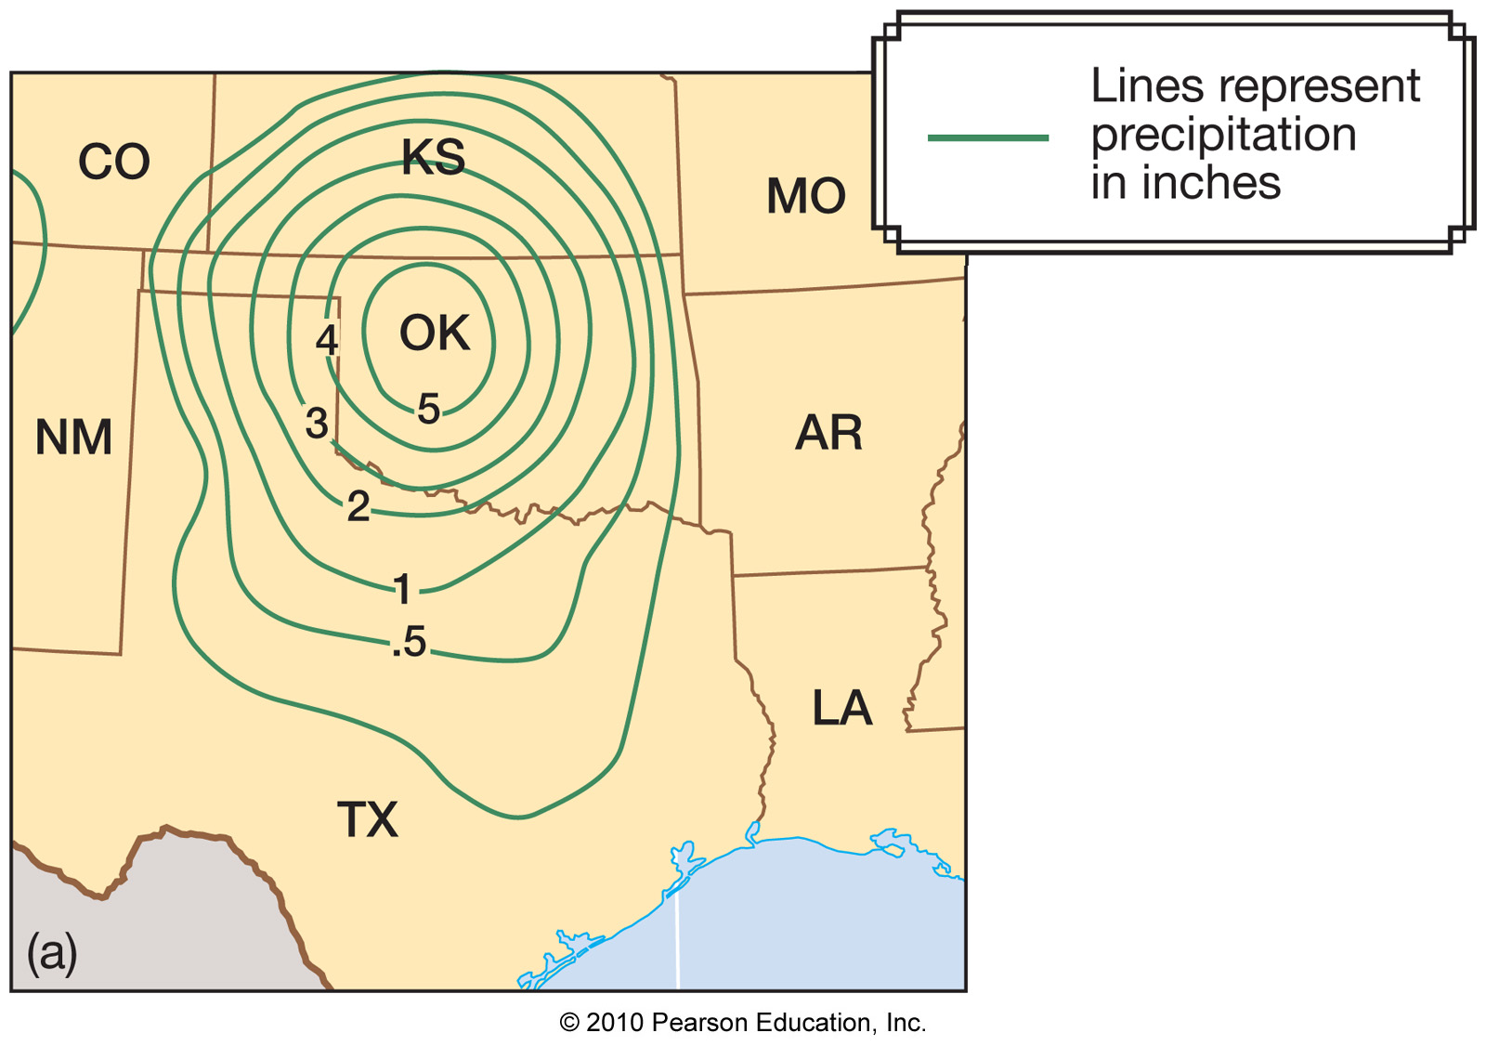
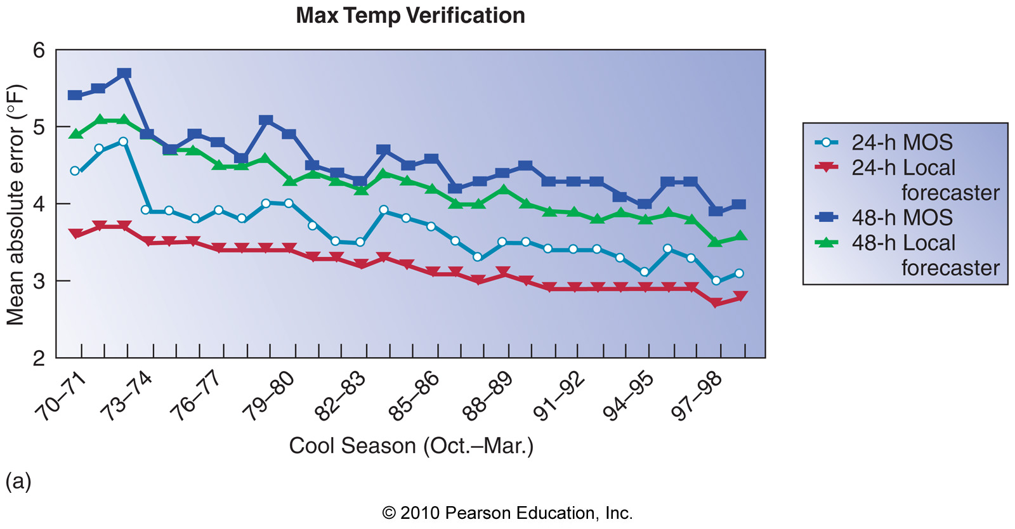
Chapter 13 – Weather Analysis and Forecasting

Slide 2
The National Weather Service
The National Weather Service (NWS) is responsible for forecasts several times daily
Different weather forecast offices (WFOs) are responsible for their specific region
WFOs are also responsible for warnings in their specific region
NWS forecasters rely heavily on the Advanced Weather Information Processing System (AWIPS) to understand current conditions and make forecasts
See: nws.noaa.gov

Slide 3
The National Weather Service

Slide 4
The National Weather Service

Slide 5
The National Weather Service

Slide 6
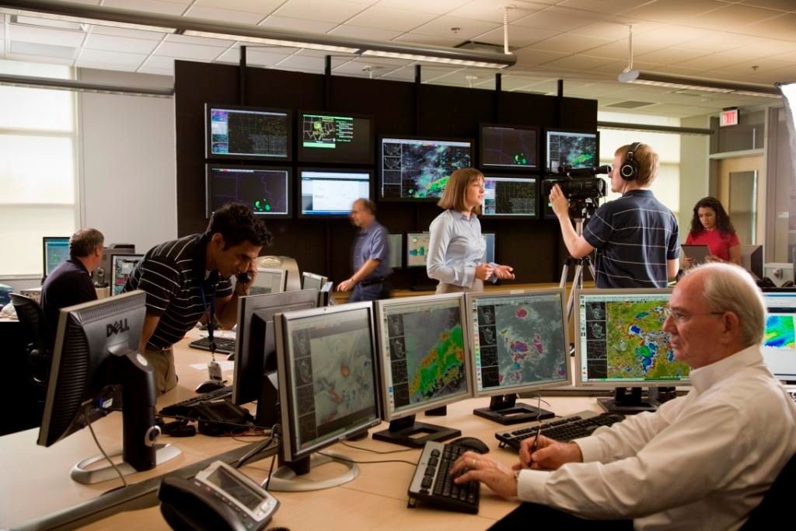

Slide 7
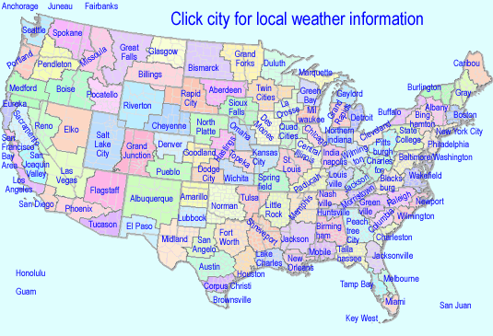
The National Weather Service WFOs

Slide 8
The National Weather Service
A variety of products are created at NWS WFOs
Short-term forecasts
7-day zone forecasts
Aviation forecasts
Marine forecasts
Hydrological forecasts (river heights)
Forecast discussions
Current Lubbock forecast discussion and 7-day zone forecast…

Slide 9
The easy way to forecast…
Persistence – the weather tomorrow will be like the weather today
Climatology – the weather tomorrow will be like the climate average for tomorrow
Trend – whatever is upstream in the wind field will impact our location in the same way an upstream location was impacted: nowcasting
Analog – the weather is change in the same way the weather in a historic, similar case changed

Slide 10
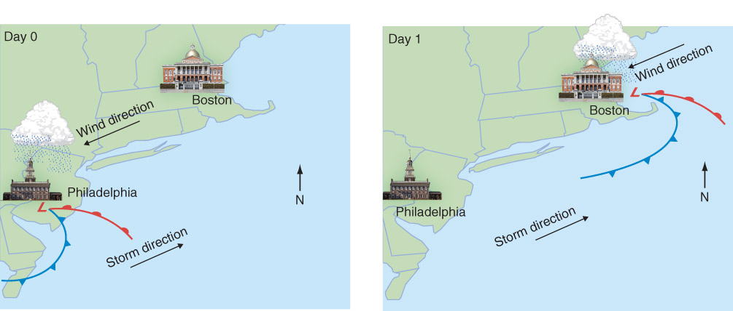
Trend Forecasting
The “let’s just move this downwind” method.
Fig 13-3, p 404

Slide 11
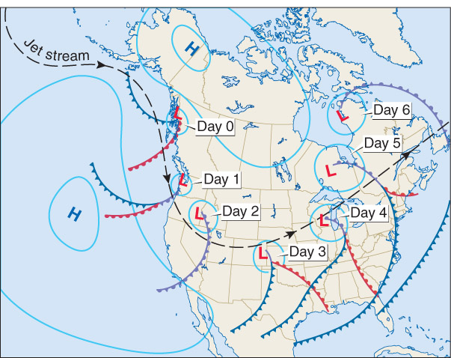
Analog
The “What does an fill-in-the-blank system normally do if the jet stream looks like this?” method
Can be a great starting point, but the atmosphere is chaotic = small changes in conditions result in large changes in the forecast
Fig 13-4, p 404

Slide 12
The Forecasting Process
Forecasts from now out to a few hours is called nowcasting
Strongly based on observations (radar, satellite images, surface observations)
Forecasts beyond about 6 hours is based mostly on numerical weather prediction (NWP) models

Slide 13
Numerical Weather Prediction
Numerical weather models operate in 3 main phases:
1) Analysis
2) Prediction
3) Post-processing

Slide 14
Numerical Weather Prediction – The Analysis Phase
A gridded, 3-dimensional analysis is produced with
1) A previous forecast
2) Observations
The process by which the above are combined is called data assimilation

Slide 15
Data Assimilation
Gridded atmospheric analyses are produced by combining the following:
A previous forecast – from model
Forecast uncertainty – what are the mathematical / computational errors of the model?
Observations – satellite, direct surface / upper air observations (surface stations, aircraft, radiosondes, buoy, etc), radar
Observation uncertainty – what are the errors of the instruments?

Slide 16
Data Assimilation
Temperature at a single point (Lubbock):
Previous forecast
from model
Observation
T = 80ºF
T_{error} = 1ºF
T = 86ºF
T_{error} = 10ºF

Slide 17
Data Assimilation
Temperature at a single point (Lubbock):
Previous forecast
from model
Observation
T = 80ºF
T_{error} = 1ºF
T = 86ºF
T_{error} = 10ºF
Analysis
T = 81ºF

Slide 18
Data Assimilation
Temperature at a single point (Lubbock):
Previous forecast
from model
Observation
T = 80ºF
T_{error} = 10ºF
T = 86ºF
T_{error} = 1ºF
Analysis
T = 85ºF

Slide 19
Data Assimilation
Temperature at a single point (Lubbock):
Previous forecast
from model
Observation
T = 80ºF
T_{error} = 5ºF
T = 86ºF
T_{error} = 5ºF
Analysis
T = 83ºF

Slide 20
Data Assimilation
The resulting analysis is the most likely state of the atmosphere based on the given information
Remember: Observations have lots of gaps spatially/temporally, so we need to use the model state in order to better approximate the entire atmosphere.

Slide 21
Data Assimilation
There are a variety of different modern methods of data assimilation
1) Three-dimensional variational data
assimilation (3DVAR)
2) Four-dimensional variational data
assimilation (4DVAR)
3) The ensemble Kalman filter (EnKF)

Slide 22
Numerical Weather Prediction – The Prediction Phase
The prediction phase of NWP involves calculating the future state of the atmosphere at each grid point (starting point = the analysis) under the following governing equations:
1) Conservation of momentum
2) Conservation of mass
3) Conservation of energy
Example: =
d(wind)
Sum of forces impacting the wind
dt

Slide 23
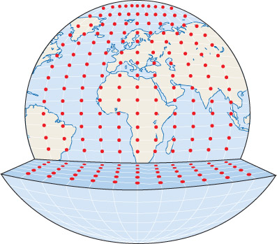
Grid Points
Varies per model (not all models use grids either)
Less spacing = higher resolution = more computation time
Fig 13-9, p 414

Slide 24
Numerical Weather Prediction – The Prediction Phase
NWP takes massive amounts of computing power!!!
1980s: U.S. nested grid model – 80-km
resolution over continental U.S.
(48-hr forecast runtime = hours)
Today: Weather Research and Forecasting
model – 12-km resolution over U.S.
(48-hr forecast runtime = 10 minutes)

Slide 25
Numerical Weather Prediction – The Prediction Phase
NWP can be classified in 2 ways:
1) Deterministic – a single forecast is
produced and relied upon
2) Probabilistic – many forecasts are
produced and forecast probabilities can
be generated (ensemble forecasting)

Slide 26
Deterministic vs. Probabilistic Forecasting
Time = 00-hr

Slide 27
Deterministic vs. Probabilistic Forecasting
Time = 00-hr
Time = 72-hr

Slide 28
Probabilistic Forecasting
10-day forecasts

Slide 29
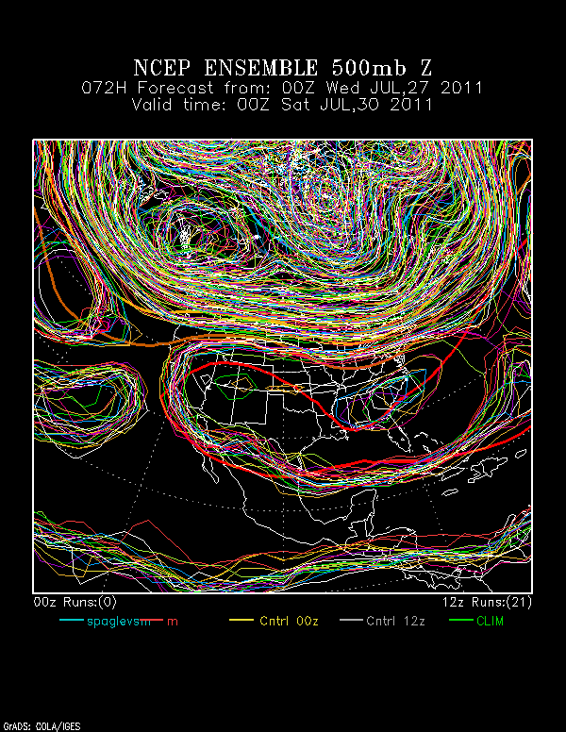

Slide 30
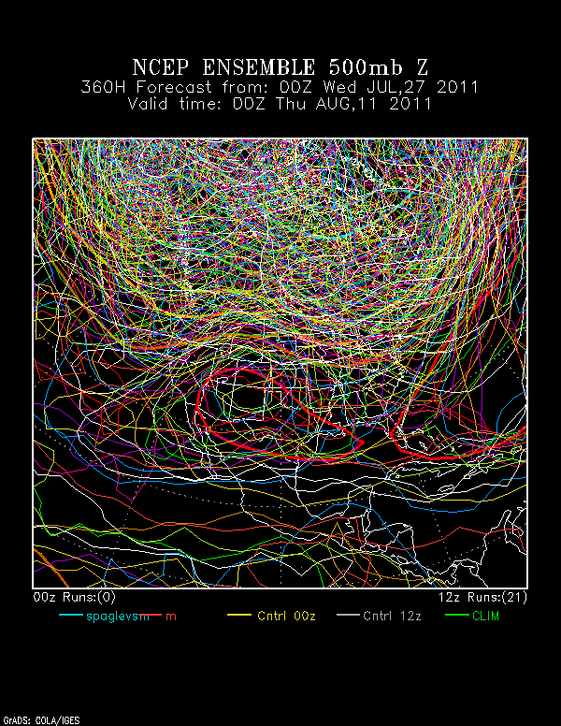
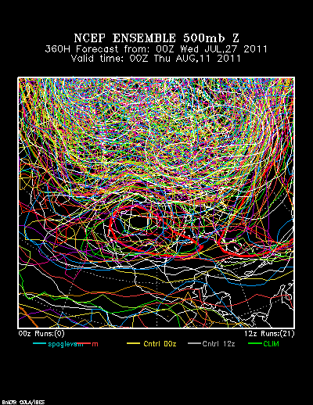

Slide 31
Probabilistic Forecasting
Main challenge = Expressing uncertainty to the public in a way it will be useful
- Do people want to hear what the high
temperature will be, or do they want to
know the possible range of high
temperatures? What does it mean to have a 50% chance of rain, anyway?

Slide 32
The Prediction Phase – How Can Forecasts Go Bad?
There are 2 main sources of error in NWP forecasts:
1) Initial condition error – errors in the
analysis of a NWP model
2) Physics errors – physics that are
wrong in the NWP model (mostly
associated with surface processes) Some of our equations do not have solutions!

Slide 33
Initial Condition Error
Initial condition errors are always present in NWP analyses
Because of chaos, errors in the analysis will eventually grow to be large (forget about 45-day forecasts!)
Whether or not initial condition error matters to short-range (0-72hr) forecasts is another question…

Slide 34
Initial Condition Error
L
Sensitivity of 24-hr cyclone position to SLP

Slide 35
Physics Errors
The physics in NWP models aren’t perfect
- Surface radiation processes
- Frictional turbulence of surface winds
- Convection
- Cloud processes

Slide 36
Physics Errors
Physics errors often lead to model biases – consistent errors in certain model variables (e.g. surface temperature)
- Documented biases of nested grid
model…

Slide 37
Recap
Persistence forecast – uses repeat of today’s weather
Climatology forecast – uses average weather for a given day of the year
Trend forecast – uses direct advection of upstream weather
Analog forecast – uses historic, similar case
Nowcasting – forecasting immediate weather changes (few hours), observation based
Numerical Weather Prediction – computer models, solutions of governing equations

Slide 38
NWP
Analysis
Combination of previous forecast and observations (data assimilation)
Tries to find the most likely state of the atmosphere
Prediction
Solutions to equations at grid points
High use of computing power
Deterministic: single forecast
Probabilistic: many deterministic forecasts ran, ensemble (mean and probabilities) used, expresses the uncertainty of the analysis and the solution
Errors: initial conditions and physics of the model

Slide 39
Numerical Weather Prediction – The Post-processing Phase
The post-processing phase of NWP involves creating graphics of the forecast:
1) 500-mb height
2) SLP
3) Surface wind
4) 3-hr precipitation
5) 1000-500mb thickness

Slide 40
NWP Post-processing

Slide 41
NWP Post-processing

Slide 42
NWP Post-processing
The final forecast product includes the human factor – judgments based on both a forecaster’s experience and NWP

Slide 43
NWP Post-processing

Slide 44
NWP Post-processing
Model Output Statistics (MOS) – a post-processing technique that correlates relationships between a model forecast and reality over many, many forecasts
MOS produces a forecast incorporating these statistical relationships - really good for common situations and models which haven’t changed in years, really bad for unusual events

Slide 45
Forecast Verification
Forecast verification is the process of measuring the skill of a forecast (model, human forecaster, MOS…)

Slide 46
Forecast Verification
Forecast verification is the process of measuring the skill of a forecast (model, human forecaster, MOS…)

Slide 47
Long-range Forecasts
The Climate Prediction Center (CPC) is responsible for forecasts valid more than 1 week into the future (numerical models and statistics)
Seasonal forecasts are also made by the CPC that indicate above or below probabilities of warm/cold or wet/dry seasons
CPC predictions for 2016…

Slide 48
Weather Analysis
Forecaster awareness is a major aspect of forecasting, and focuses on knowing the current atmospheric conditions using:
1) Observations (radar, satellite,
radiosondes, surface station obs)
2) Weather maps
- Surface
- Aloft (850, 700, 500, 300mb)
Why?
Better idea of what is actually happening in the atmosphere
What is the model overlooking? Is there anything too small for the model to reproduce?

Slide 49
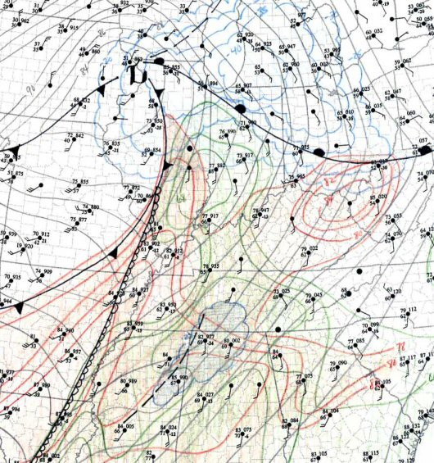
http://www.spc.noaa.gov/faq/tornado/sfcanls.htm

Slide 50
Observations
4 main observation types help forecasters familiarize themselves with current weather conditions:
1) Satellite images
2) Radar images
3) Thermodynamic diagrams from
radiosondes
4) Surface station plots

Slide 51
Satellite Images
Visible Satellite Imagery

Slide 52
Satellite Images
Infrared Satellite Imagery

Slide 53
Satellite Images
Water Vapor Satellite Imagery

Slide 54
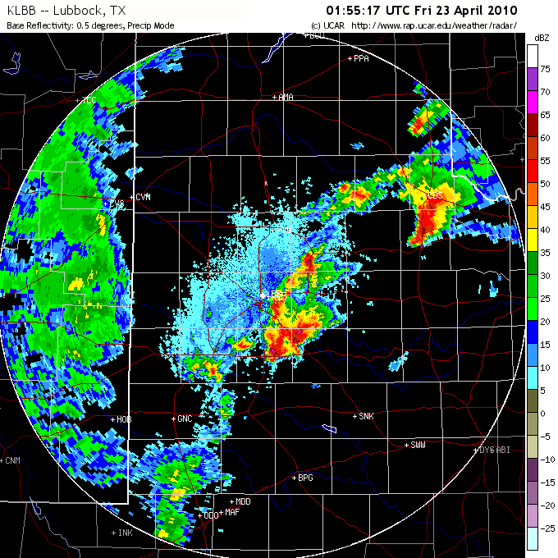
Radar Imagery (reflectivity)

Slide 55
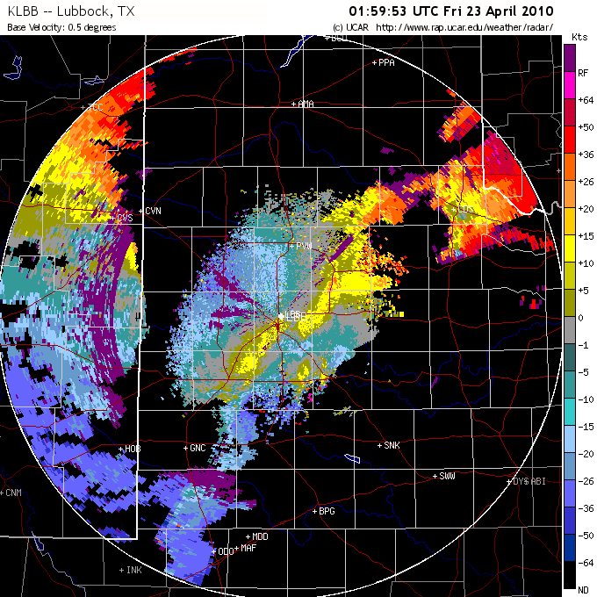
Radar Imagery (wind velocity)

Slide 56
Thermodynamic Diagrams

Slide 57
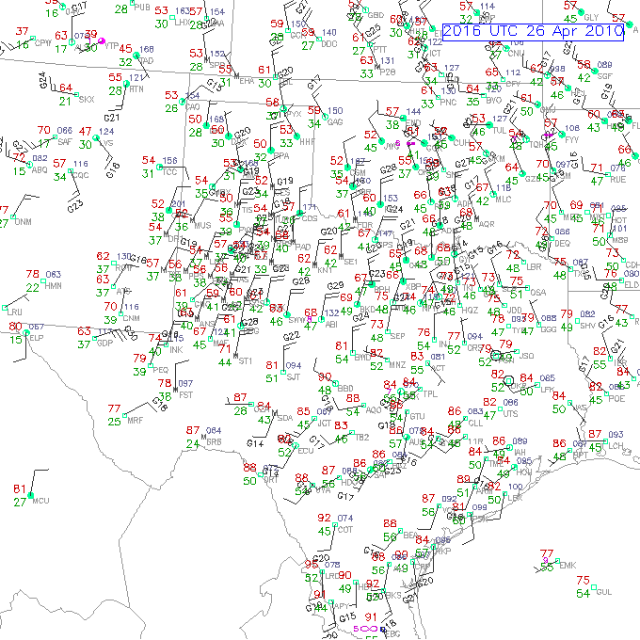
Surface Station Plots

Slide 58
Weather Maps
Surface maps – reveals locations of important things such as:
1) Fronts
2) Cyclones (low-pressure centers)
3) Anticyclones (high-pressure centers)
4) Pressure gradients

Slide 59
Surface Weather Map

Slide 60
Weather Maps
850-mb maps – reveals locations of important things such as:
1) Fronts
2) Warm and cold advection
3) High temperature forecast guidance
4) Winds just above the surface
5) Guidance on precipitation type

Slide 61
850-mb Weather Map

Slide 62
850-mb Weather Map
850-mb warm and cold air advection

Slide 63
Weather Maps
700-mb, 500-mb, and 300-mb maps – reveal locations of important things such as:
1) Jet stream position
2) Location of jet stream troughs and
ridges
3) Location of jet streaks
4) Location of warm/cold air aloft

Slide 64
500-mb Map

Slide 65
Other useful forecasting references
Storm Prediction Center: spc.noaa.gov
National Hurricane Center: nhc.noaa.gov
Local TTU WRF model: http://www.atmo.ttu.edu/bancell/real_time_WRF/ttuwrfhome.php
Nice compilation of national models: http://weather.cod.edu/forecast/
Nice compilation of observations: http://weather.rap.ucar.edu/
Learn more about how specific events are forecast: https://www.meted.ucar.edu/
Learn more about what’s going into a specific area’s forecasts in NWS’s forecast discussions
More links

Slide 66
Recap
Persistence forecast – uses repeat of today’s weather
Climatology forecast – uses average weather for a given day of the year
Trend forecast – uses direct advection of upstream weather
Analog forecast – uses historic, similar case
Nowcasting – forecasting immediate weather changes (few hours), observation based
Numerical Weather Prediction – computer models, solutions of governing equations

Slide 67
NWP
Analysis
Combination of previous forecast and observations (data assimilation)
Tries to find the most likely state of the atmosphere
Prediction
Solutions to equations at grid points
High use of computing power
Deterministic: single forecast
Probabilistic: many deterministic forecasts ran, ensemble (mean and probabilities) used, expresses the uncertainty of the analysis and the solution
Errors: initial conditions and physics of the model

Slide 68
NWP
Post-processing
Graphics
Statistical bias of model (MOS – model output statistics)
Eventually human interpretation
Comparing to observations – know what data / interpretations of the atmosphere we can use

