Slide 1
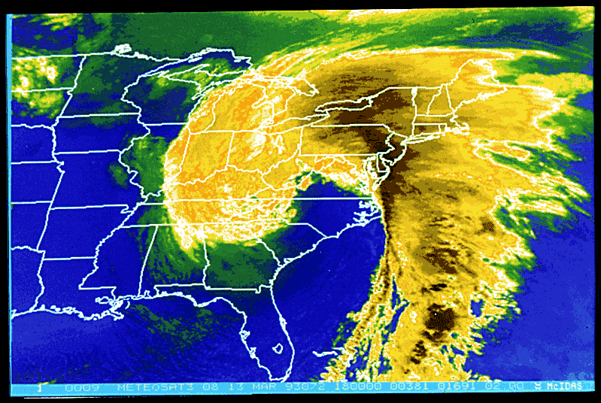
Extra-Tropical Cyclones and Anticyclones, Chapter 10
ATMO 1300
Summer II 2017

Slide 2
Extra-Tropical Cyclones and Anticyclones, Chapter 10
Norwegian Cyclone Model
Midlatitude Cyclone Lifecycle
Strengthening and failure mechanisms
ATMO 1300
Summer II 2016

Slide 3
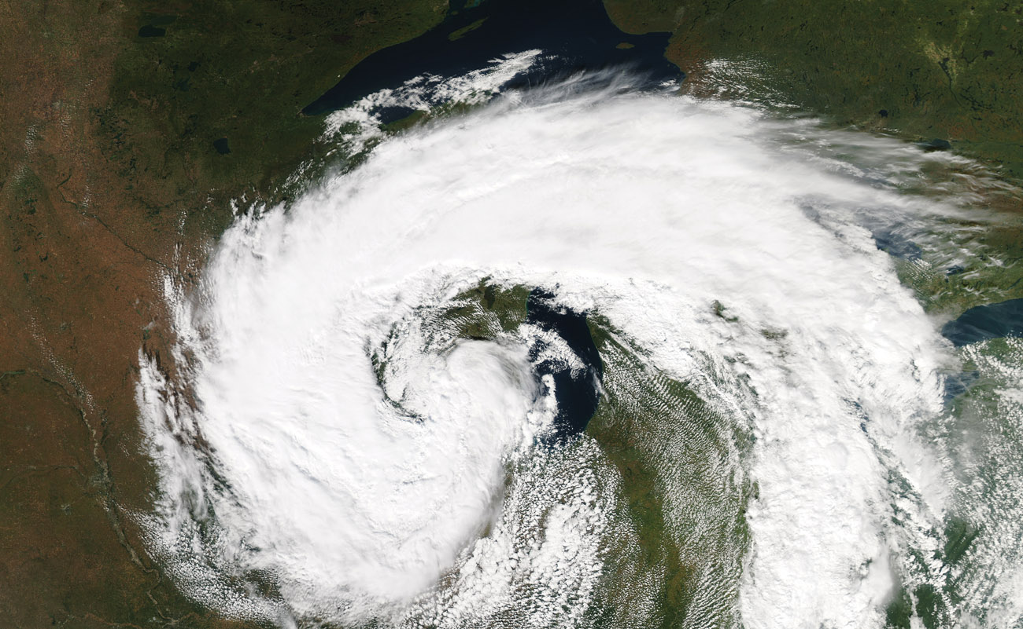
p. 298

Slide 4
Extratropical Cyclones (ETC)
Describes a cyclone outside of tropical regions.
Cyclone: Low pressure regions around which winds blow counterclockwise in the Northern Hemisphere and clockwise in the Southern Hemisphere.
Cyclones are usually associated with fronts. Hurricanes, which are cyclones inside of tropical regions, do not have fronts. This is mostly because there a no temperature gradients in the tropics.
Lifecycle of an ETC is described by the Norwegian cyclone model (Bjerknes)

Slide 5
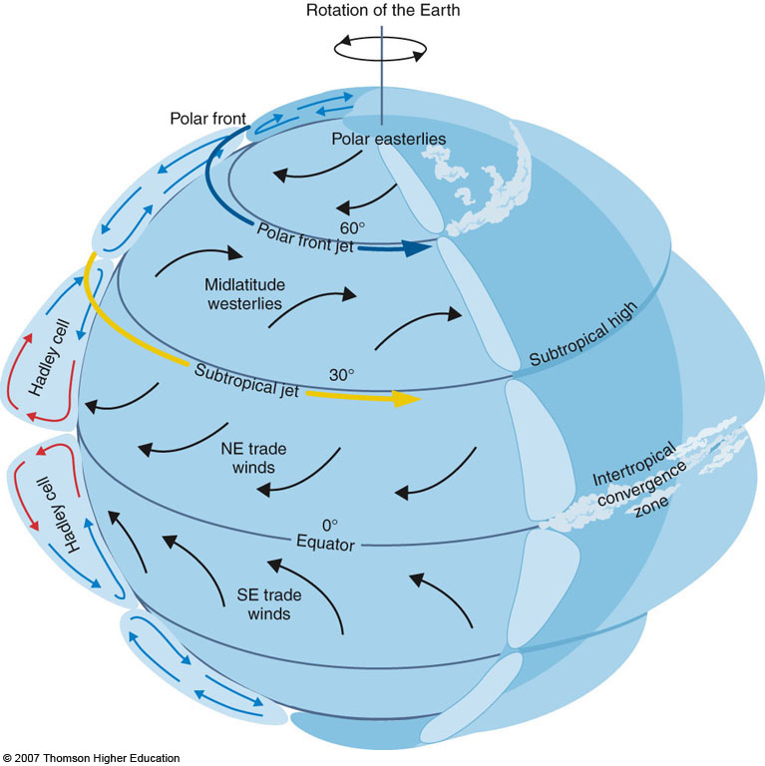
Norwegian Cyclone Model
We begin by looking at the polar front: Our virtually continuous boundary that separates cold polar air masses from the warm tropical air masses to the south.

Slide 6
Norwegian Cyclone Model
We will then assume the polar front is a stationary front along a trough of low pressure with higher pressures on either side of it

Slide 7
Norwegian Cyclone Model
Cold air is located to the north, warm air to the south
The wind flow is parallel to the front, but opposite directions
This creates an axis of wind shear.
Shear: Change in wind speed or direction over some distance (usually height).
In our case, the shear is cyclonic (counter-clockwise flow) and horizontal, not vertical

Slide 8
Visualizing Shear
If we stick a rotor in the middle of the flow, will it turn? Clockwise (anticyclonically) or counterclockwise (cyclonically)?

Slide 9
Norwegian Cyclone Model
This shear gives rise to a wave-like kink along the front. This is known as a frontal (open) wave
Formation is very similar to how waves form and break in the ocean
This is the beginning (birth) of the cyclone, or cyclogenesis.
At this point we call the system a frontal wave.
Moves with the upper level winds

Slide 10
Cyclone Source Regions
Any development or strengthening of a cyclone is called cyclogenesis
There are several regions across the US that are favorable for cyclogenesis to occur
Eastern Slope of the Rockies,
Great Basin
Gulf of Mexico
Just off the coast of the Carolinas

Slide 11
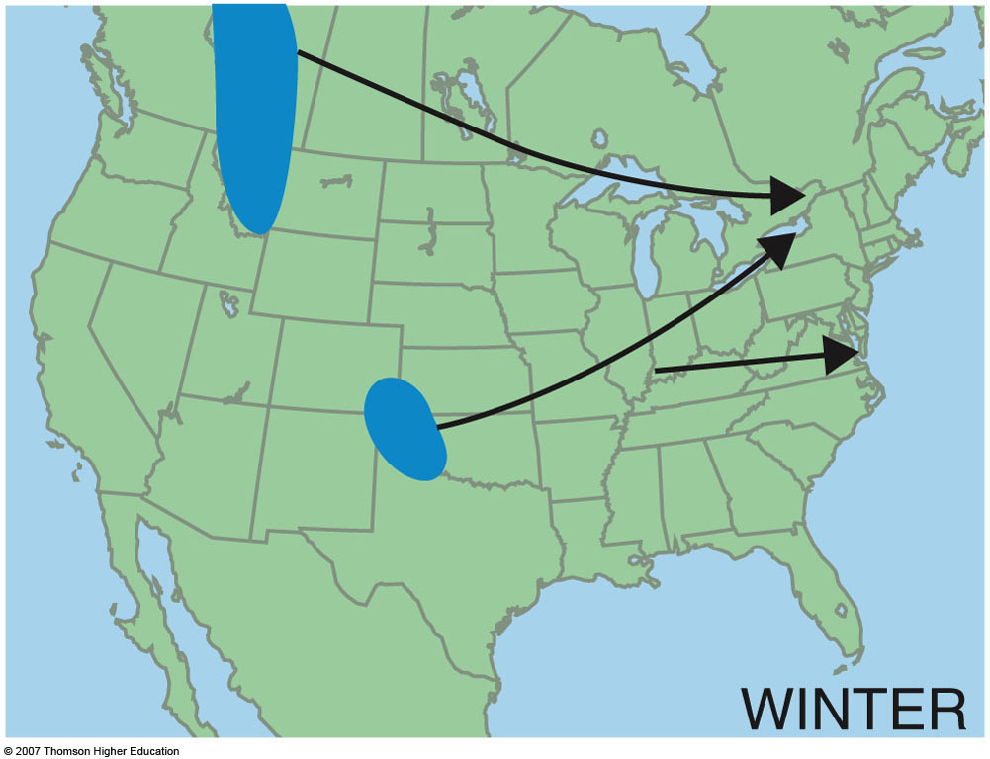
Alberta Clippers: Fast moving cyclones that develop in the lee of the Canadian Rockies. Frequently “Clip” the Great Lakes region
Nor’easters: Winter cyclones that develop off the eastern US coast.
Panhandle Hooks: Cyclones that develop in the OK/ TX panhandles.
3rd Edition: Fig. 10-6a, p. 281

Slide 12
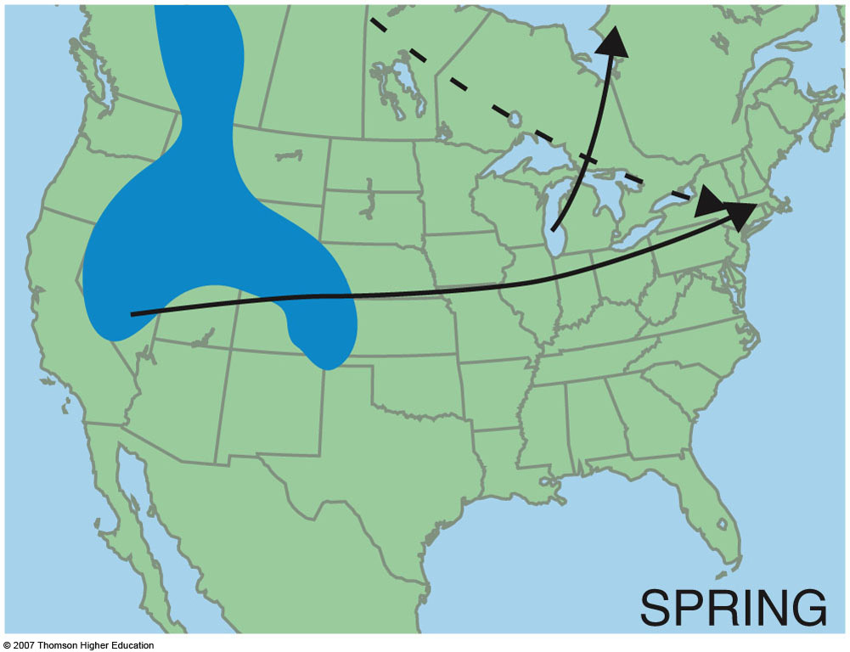
3rd Edition: Fig. 10-6b, p. 281

Slide 13
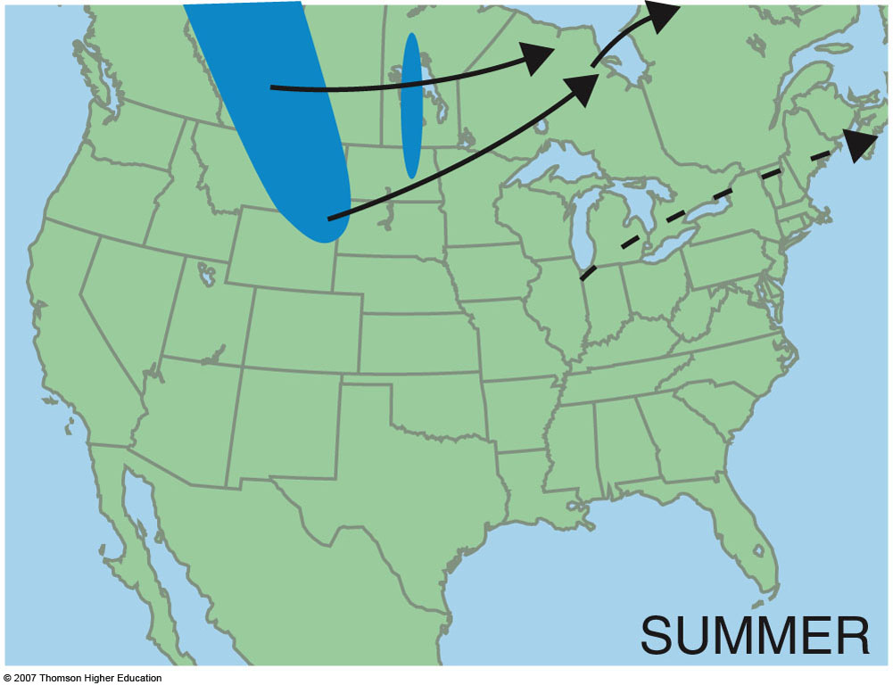
3rd Edition: Fig. 10-6c, p. 281

Slide 14
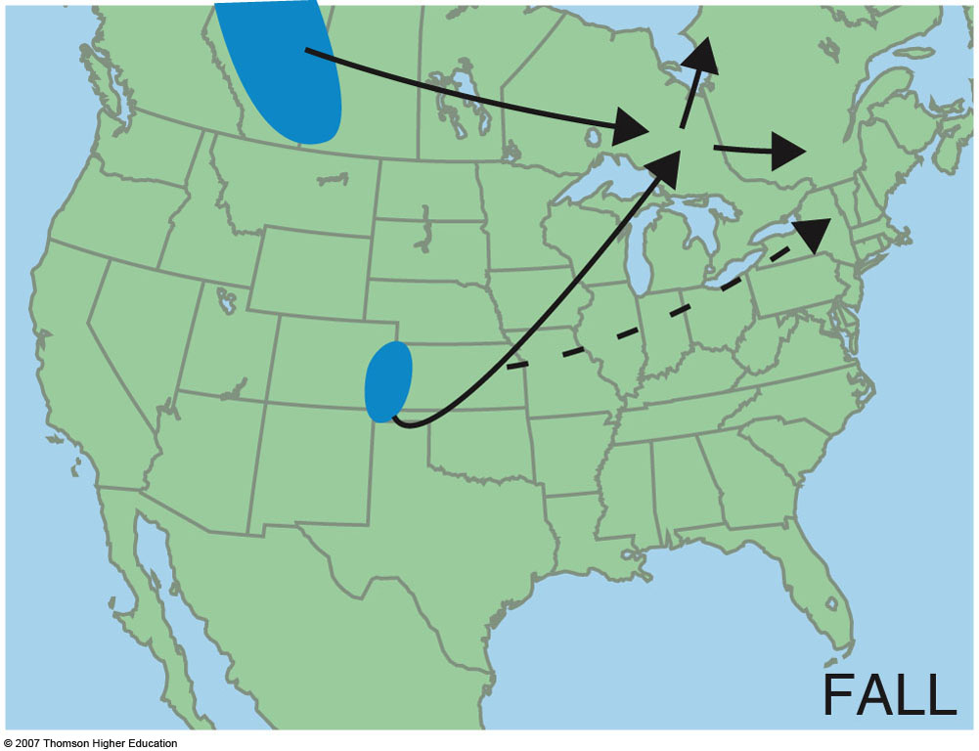
3rd Edition: Fig. 10-6d, p. 281

Slide 15
Norwegian Cyclone Model
The cyclone grows and strengthens (called deepening, as the pressure gets lower). Energy for this process comes from:
Temperature gradients (baroclinic instability)
Strong jet stream winds
Mountains
Strong cold and warm fronts have developed, but an occluded front hasn’t developed yet → open wave.

Slide 16
Norwegian Cyclone Model
The region of lowest pressure is now located at the intersection of the warm and cold fronts
Precipitation forms along the warm front – overrunning
Cold air displaces the warm, less stable air upwards along the cold front
The region between the warm and cold front is called the warm sector

Slide 17
Norwegian Cyclone Model
The growth of a cyclone is dependent upon the central pressure decreasing. So how can we lower the central pressure of the cyclone?
Convergence along the frontal boundaries → convergence leads to rising motion, which leads to lower pressure
As we lower pressure more air gets pulled inward (PGF, tighter pressure gradients = more wind = more convergence = more rising motion = more pressure falls)

Slide 18
Norwegian Cyclone Model
Condensation supplies energy to the system in the form of LATENT HEAT. The additional heat released allows air parcels to become more unstable. Increasing rising motion leads to a decrease in pressure at the surface.
This is especially true in the warm sector…this region typically has the most warm, moist unstable air.
We can also get help from the jet stream (later…)

Slide 19
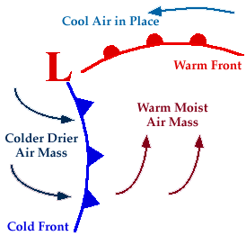

Slide 20
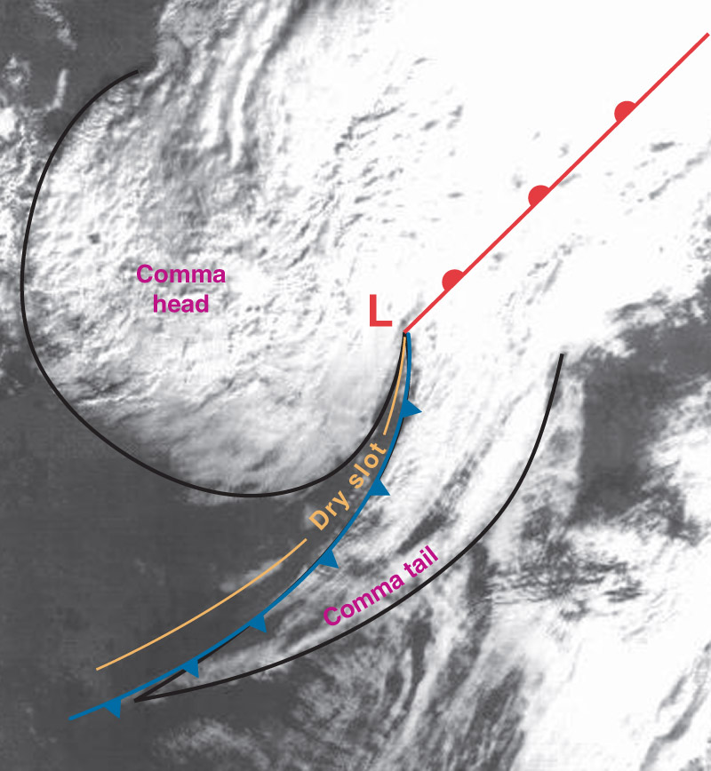
Norwegian Cyclone Model
At this point, the cyclone can take on a classic “comma” shape.

Slide 21
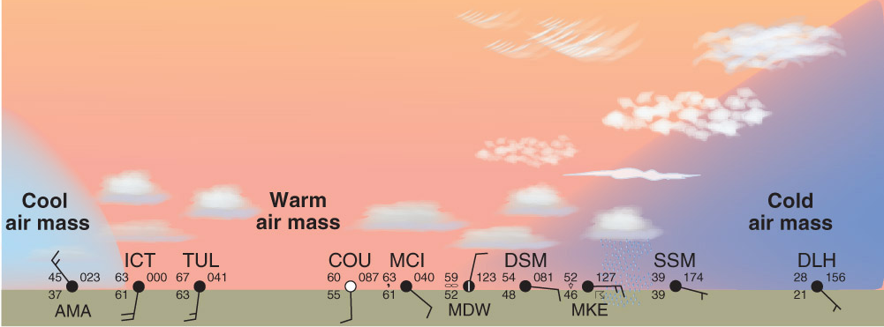
At the surface…

Slide 22
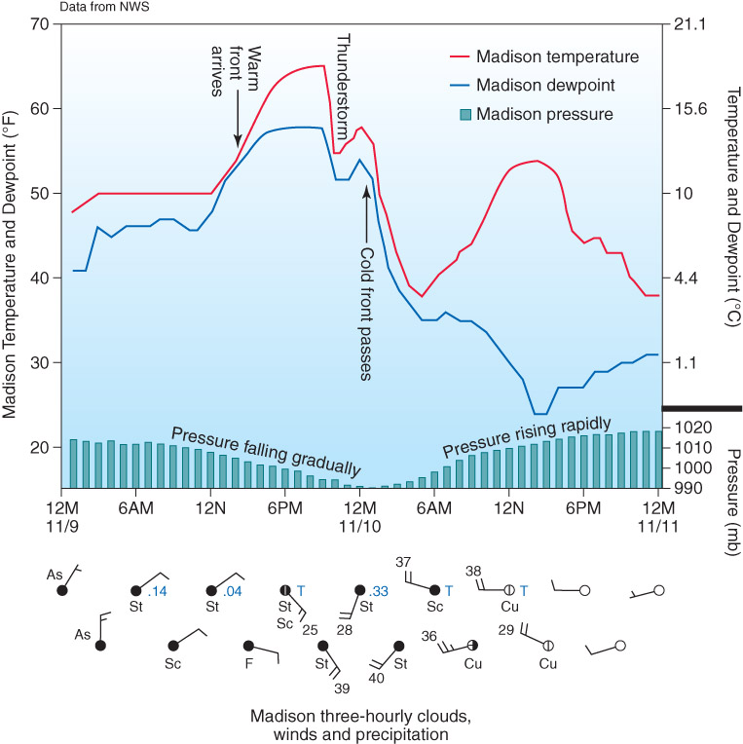

Slide 23
Norwegian Cyclone Model
As the system matures, an occluded front forms as the cold front outruns the warm front.
This usually marks the lowest pressure and strongest winds of the system.

Slide 24
Norwegian Cyclone Model
Now cooler air resides on both sides of the occluded front
The surface low pressure center has lost its supply of warm moist air
The rising motion begins to decrease and surface pressures start to rise, and the system eventually dissipates
Occasionally a secondary low will form at the triple point and intensify into another cyclone

Slide 26
Norwegian Cyclone Model
The Norwegian Cyclone model is a conceptual model.
Few systems follow the model exactly but most exhibit many characteristics of the model.
It serves as a good foundation for the understanding of mid-latitude storms.

Slide 28
Mid-Latitude Cyclones
Some storms make it all the way through the growth cycle.
Frontal waves that develop into huge storms are called unstable waves
These storms can last nearly a week
Other frontal waves that do not intensify are said to be stable waves
Why do some waves develop and other don’t???

Slide 29
Mid-Latitude Cyclones and the Jet Stream
The key to understanding which wave will develop and which will not lies in the upper-level wind pattern
We know we have a wavelike pattern in the upper-atmosphere (Remember Rossby waves and shortwaves)
Also, we have to think of the atmosphere in 3-D. Not only is there a low pressure center and fronts at the surface (surface low) , but we also have low pressure centers aloft (upper low/trough).

Slide 30
Upper Level
Failure to Intesify
L
Suppose the upper-low (or trough) is located right above the surface low (frontal wave)
Air at the surface converges and basically piles up. The mass increases and so does the pressure
There is no divergence aloft to spread out the air moving upward
The system will dissipate, or fill. We are adding mass, thus increasing the pressure.
Same idea applies for anticyclones
L
Surface

Slide 31
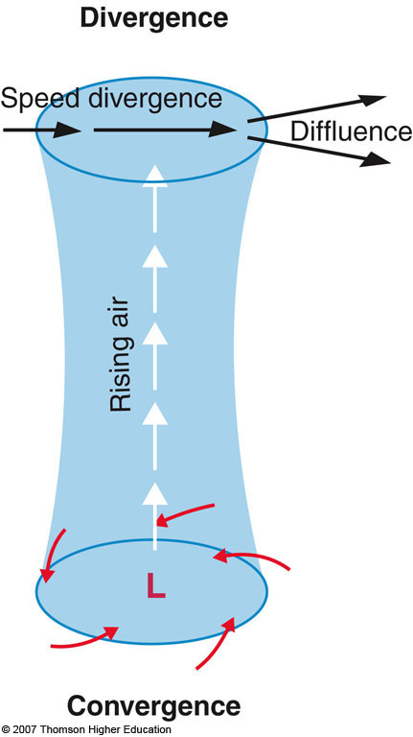
Divergence: The horizontal spreading out of wind. Will lead to sinking air if it occurs at the surface, but it will lead to rising air if it occurs aloft.
Diffluence: Divergence that occurs due to the spreading out of horizontal wind direction.
Speed Divergence: Divergence that occurs due to a downwind horizontal speed increase, but no change in wind direction.
Convergence: The horizontal coming together of air that can lead to rising motion at the surface.

Slide 32
Mid-Latitude Cyclones and the Jet Stream
We know that troughs in the upper-troposphere are generally associated with cold air
We have cold air at the surface behind a cold front and cold aloft
The upper-low is typically located behind the surface low (or to the west)
Directly above the surface low the air flow spreads out or diverges
Need this for deepening of the surface low!

Slide 33
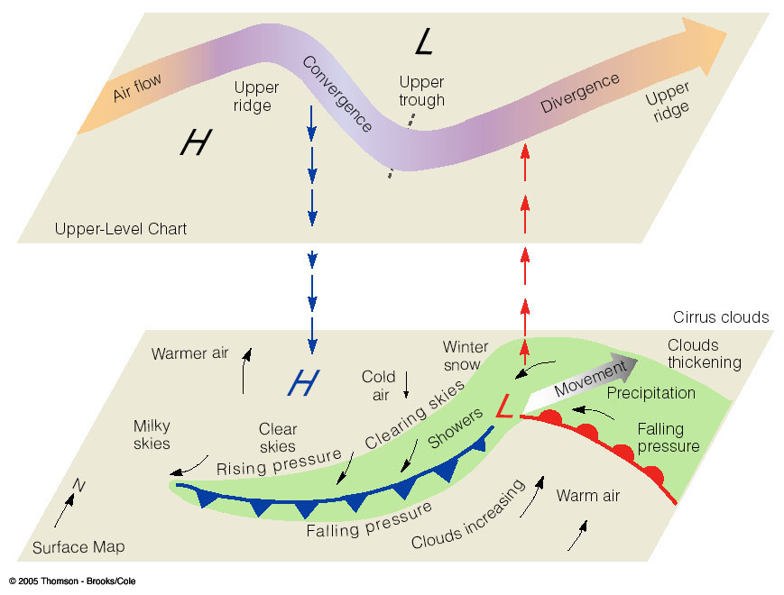

Slide 34
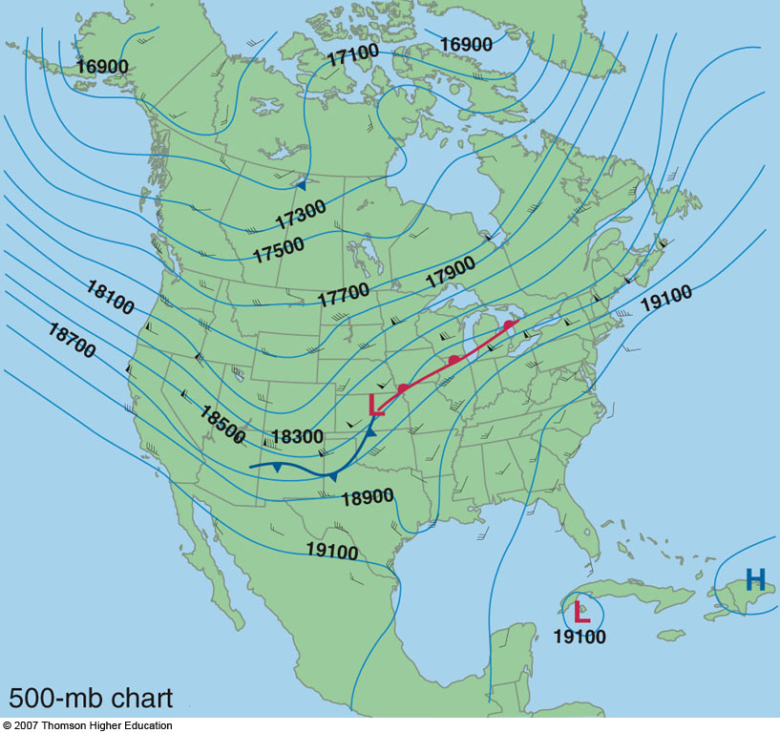

Slide 35
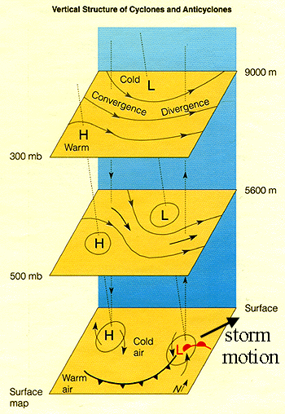
The diverging air aloft allows more air to flow upward from the surface
The divergence aloft acts as an exhaust system for the surface low
This is a mechanism for storm intensification

Slide 36
Mid-Latitude Cyclones and the Jet Stream
When divergence aloft exceeds convergence at the surface more air is removed at the top of the troposphere than can be moved upward
Surface pressure drops in response as mass is removed from the column of air
The surface low will intensify or deepen
When divergence aloft is less than the convergence at the surface, air cannot be removed quickly enough
Surface pressures rise and the system will weakens or fill.

Slide 37
Mid-Latitude Cyclones and the Jet Stream
Same applies to anticyclones as well, just in reverse
If divergence at the surface exceeds convergence aloft, the surface high will weaken
If convergence aloft exceeds surface divergence, the high pressure area at the surface will strengthen
These high pressure systems can also be extreme – stagnant motion, heat waves during summer, tend to be “large and blobby”

Slide 38
Supergeostrophic
Subgeostrophic

Slide 39
Faster winds
Get super / sub geostrophic flow
L
divergence
convergence
H
Slower winds

Slide 40
Mid-Latitude Cyclones
Winds aloft help steer surface pressure systems
Surface lows tend to move in the direction of the winds at 500 mb, but at about half the speed.
As the trough / ridge pattern changes, the steering flow will change. As a cyclone strengthens, it will sometimes “dig” or push further southward.

Slide 41
Mid-Latitude Cyclones
What we know:
We can have deep pressure systems at the surface and aloft
When the surface pressure system does not lie beneath the upper level system, the atmosphere can redistribute mass and help intensify the pressure system
Intensifying pressure systems tilt toward the west with increasing height
Surface cyclones are steered by winds aloft and move away from their development region

Slide 42
Upper-Level Waves and Surface Storms
Typically between 4 and 6 longwaves circling the globe at one time
Wavelength typically of 4000 – 8000 km
(2400 – 5000 miles)
The fewer the number of waves the longer the wavelength
Mountain ranges can disrupt the air flow through longwaves

Slide 43
Upper-Level Waves and Surface Storms
Due to the unequal heating of the Earth and its rotation we see a cycle of waves in the troposphere
Waves appear as troughs and ridges
We know we have long wave troughs and shortwave troughs

Slide 44
Upper-Level Waves and Surface Storms
Imbedded in the longwaves are shortwaves
Small ripples in the large-scale flow
The smaller the wavelength the faster they move
Shortwaves typically move at a speed proportional to the flow at the 700 mb level
Longwaves can move very slowly or remain stationary
Sometimes if the wavelength of a longwave is large enough, it can retrograde or move back westward

Slide 45
Upper-Level Waves and Surface Storms
Shortwaves typically deepen or intensify when they approach a longwave trough and weaken when they approach a longwave ridge
Shortwaves can also help deepen existing longwave troughs

Slide 46
Role of the Jet Stream
Jet streams play an additional role in developing a wave cyclone
Remember the polar jet lies very near the polar front
The region of strongest winds within the jet stream is called a jet streak
Jet streaks often form in the curved part of the flow through an upper trough where pressure gradients are tight

Slide 47
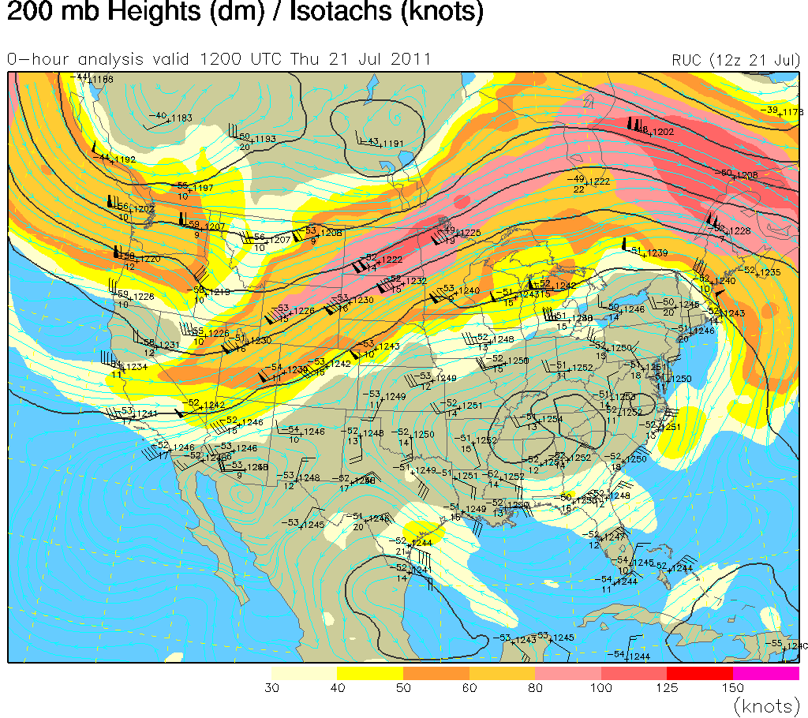

Slide 48
Role of the Jet Stream
The curving of the jet stream coupled with the changing wind speeds near a jet streak produces regions of strong convergence and divergence
The region of divergence draws surface air upward
This helps decrease surface pressures
Regions of convergence push air downward, which will increase surface pressures.

Slide 49
Role of the Jet Stream
Remember that the polar jet is strongest during winter
This is why we see more developed storms in the winter time
Polar jet helps remove air from the surface cyclone and supply it to the surface anticyclone

Slide 50
Vorticity – Another way to diagnose vertical motion
The measure of rotation is called vorticity
Spin of small air parcels
Remember the ice skater…
We can use vorticity to see where areas of convergence and divergence are in the atmosphere
Air spinning cyclonically (counter clockwise) has positive vorticity
Air spinning anticyclonically has negative vorticity

Slide 51
Vorticity
Because the Earth spins it has vorticity, called planetary vorticity.
The Earth’s vorticity is always positive because the Earth is spinning counter clockwise about its north pole axis
The amount of planetary vorticity varies by latitude
Planetary vorticity is zero at the equator and a maximum at the poles

Slide 52
Vorticity
Moving air also has vorticity (Example: Tornado)
This is called relative vorticity
Relative vorticity is the combination of two effects:
Curving of the air flow
Changing of the wind speed over a horizontal distance

Slide 53
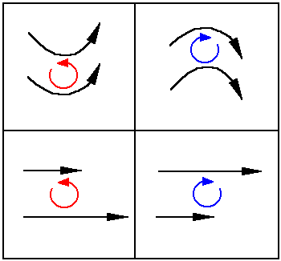

Slide 54
Vorticity
Air moving through a trough tends to spin cyclonically, which increases its relative vorticity
The spin in a ridge is typically anticyclonic
Whenever the wind blows faster on one side of an air parcel than the other, a shear force is applied to the parcel
The parcel of air will spin and gain or lose vorticity

Slide 55
At this position, the spin is anticyclonic
It counter acts the Earth’s rotation
At this position, the curvature is zero
Vorticity is simply due to the Earth’s rotation
L
H
Convergence
Divergence
At this position, the spin is cyclonic
And acts in addition to Earth’s rotation

Slide 56
Vorticity
Absolute vorticity is the sum of Planetary Vorticity and Relative Vorticity
Divergence and convergence are related to the change in Absolute Vorticity / Change in Time
Allows us to identify areas of convergence and divergence from upper-air maps
Remember why storms intensify!

Slide 57
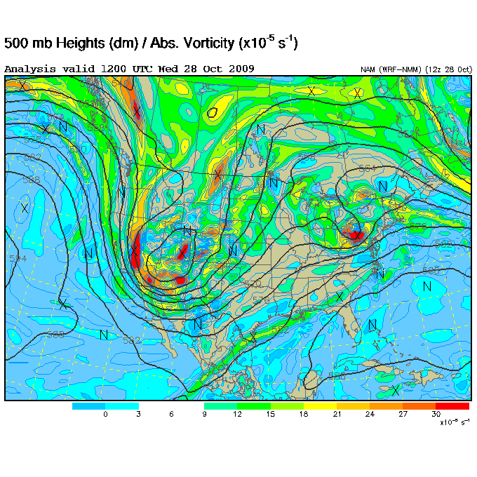

Slide 58
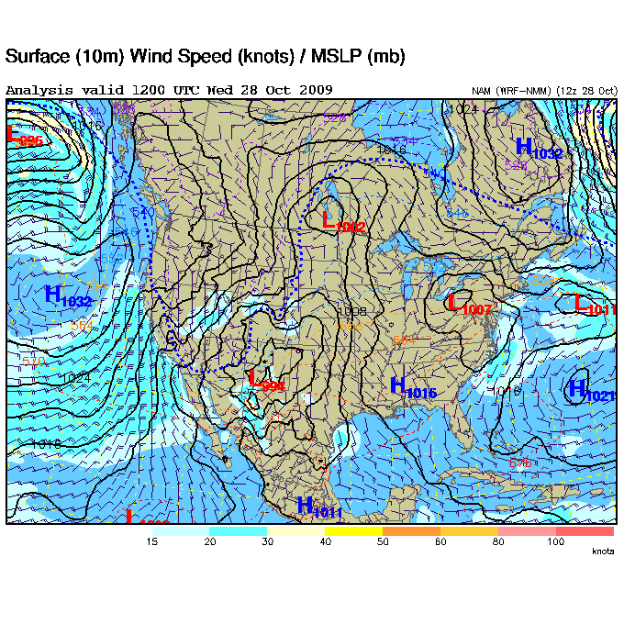

Slide 59
Vorticity
When relative/absolute vorticity decreases downstream we diverge
When relative/absolute vorticity increases downstream we converge
Upward motion and divergence at upper levels are associated with the region of maximum vorticity advection.
Downward motion and convergence at upper levels are associated with the region of minimum vorticity advection.

Slide 60
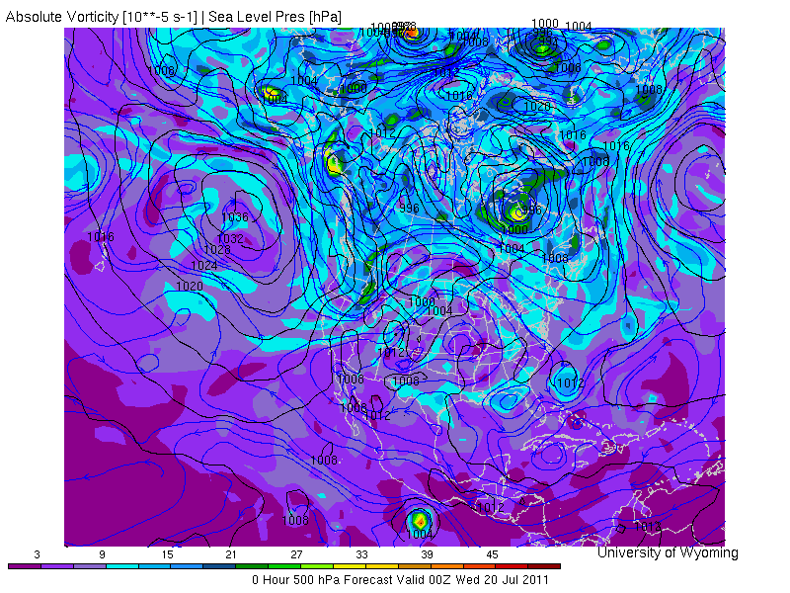

Slide 61
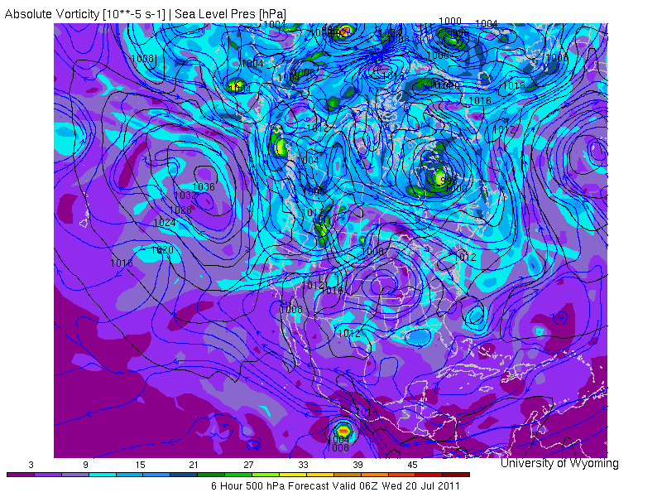

Slide 62
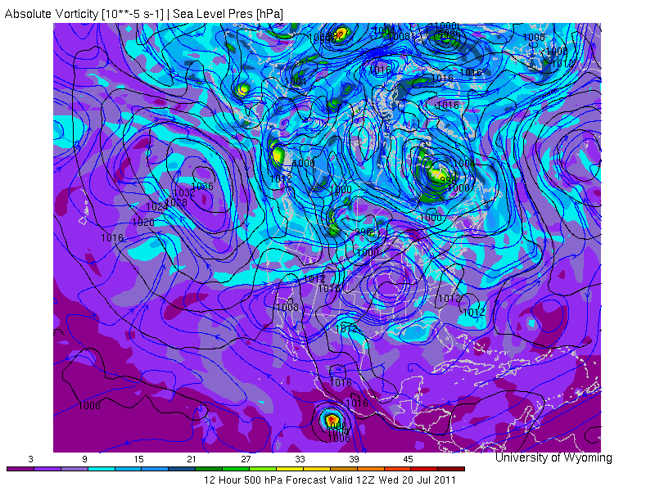

Slide 63
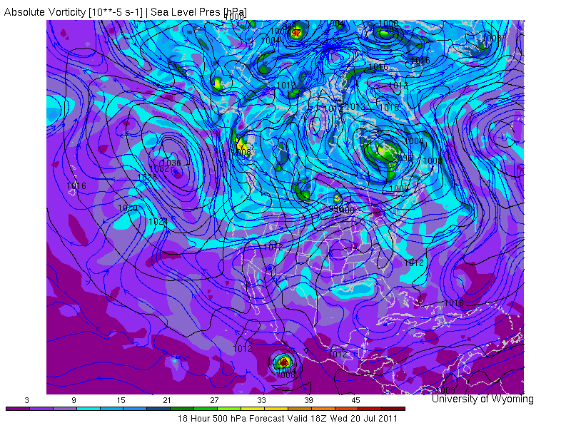

Slide 64
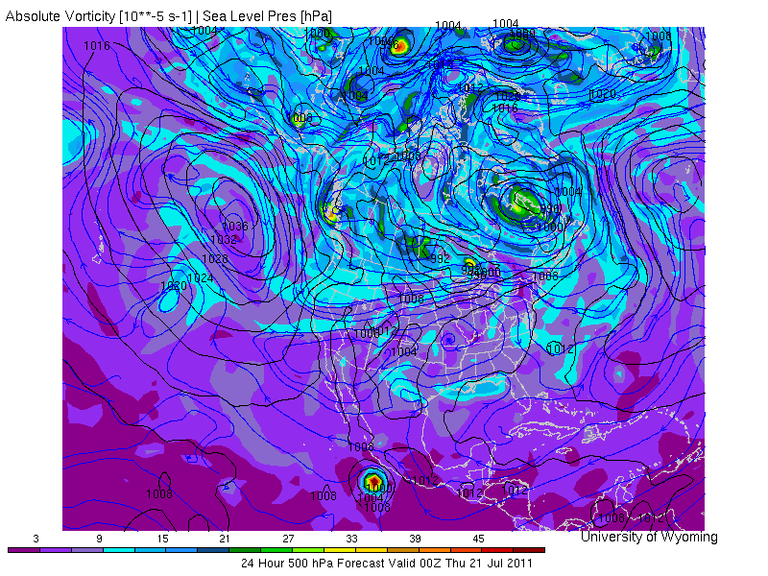

Slide 65
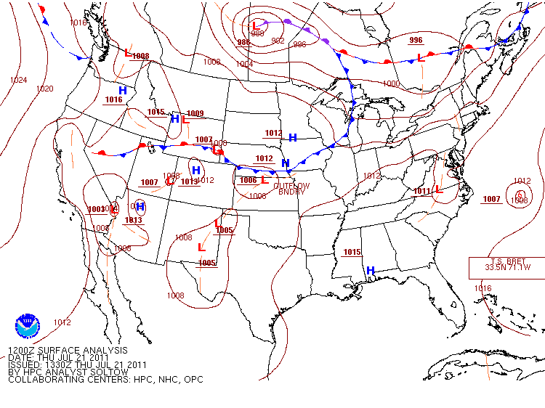

Slide 66
Summary
For a storm to intensify we need:
Upper trough to lie to the west of the surface low
Shortwave helps intensify the upper longwave trough
Polar jet exhibits waves and swings just south of the developing storm system
Zones of vertical motion provide energy conversions for the system’s growth

Slide 67
Summary
In regions where there is no upper trough or shortwave or strong jet streak, the motions at the surface are not sufficient enough for a frontal wave to intensify

Slide 68
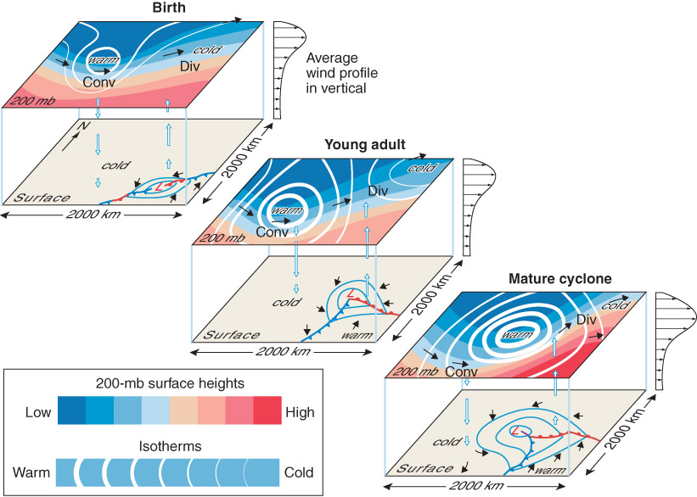
Fig. 10-12, p. 315

Slide 69
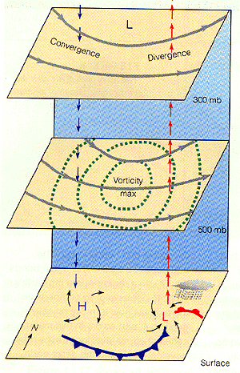
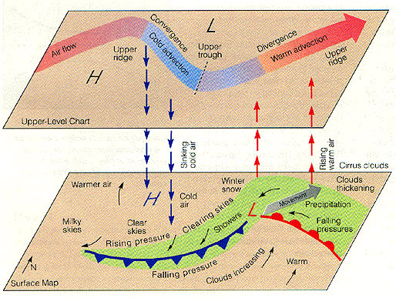

Slide 70
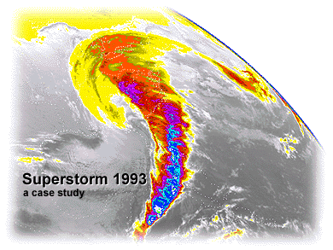

Slide 71
Super Storm 1993
Produced nearly a foot of snow from Alabama all the way to Maine
11 Tornadoes in Florida
Hurricane Force winds were reported from Florida to New Hampshire

Slide 72
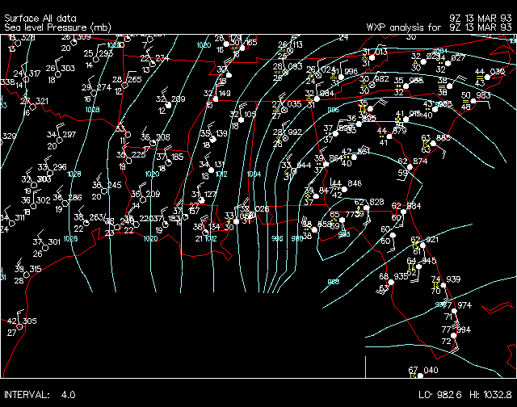
Super Storm 1993
Surface low developed as a frontal wave along a stalled front in the northern Gulf of Mexico
Strong trough approached from the west
Arctic air mass dove south over the Great Plains in association with the trough

Slide 73
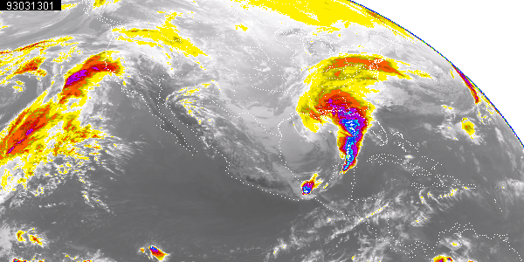
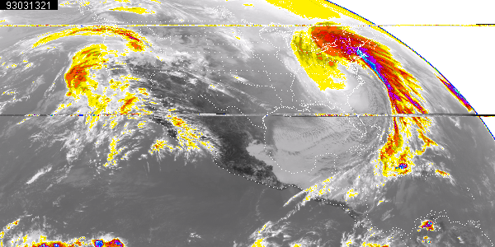

Slide 74
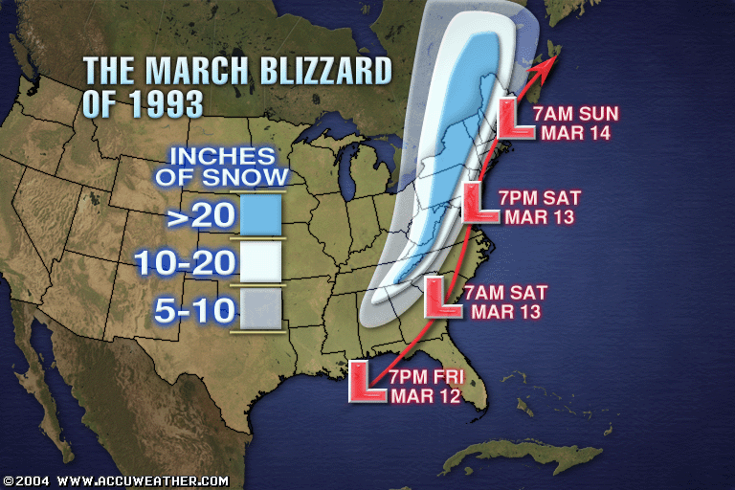

Slide 75
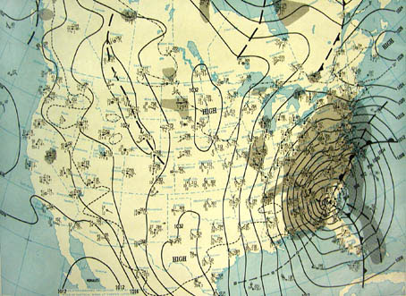

Slide 76
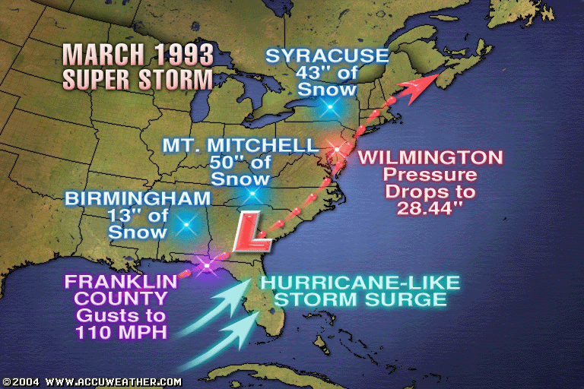

Slide 77
Super Storm 1993
This single mid-latitude storm system killed 270 people
Insured losses exceeded $3 Billion
26 States were impacted
Nearly half of the country’s population felt the effects of this storm

Slide 78
Norwegian cyclone model
AKA Bjerknes or Polar Front Theory
Birth/Cyclogenesis
Cyclonic wind shear along zonal front causes kink in flow
Frontal wave
Know the regions in the US where this happens and the common paths we covered
Deepening / Young Adult
Fronts are strong but no occlusion: open wave
Baroclinic instability, strong jet, mountains
Warm sector between cold and warm front
Lowering pressure of the cyclone

Slide 79
Norwegian cyclone model
Mature
Occluded Front
Lowest pressure and strongest winds
Death
Occlusion cuts off the center from warm sector air
Pressure begins to rise
Know the four lifecycle stages
Upper level influence:
If surface low pressure is directly underneath upper level low pressure then surface low will weaken
Divergence (spreading of air aloft) increases the surface low pressure
If upper low is west of the surface low the surface low typically can strengthen
Similar processes can impact surface highs

Slide 80
Other Concepts
Jet streak – region of strongest winds in the jet
Vorticity – measure of spin in the atmosphere (positive = cyclonic = counterclockwise)
A location experiencing an increase in vorticity also experiences divergence (at upper level = upward motion)

