Slide 1
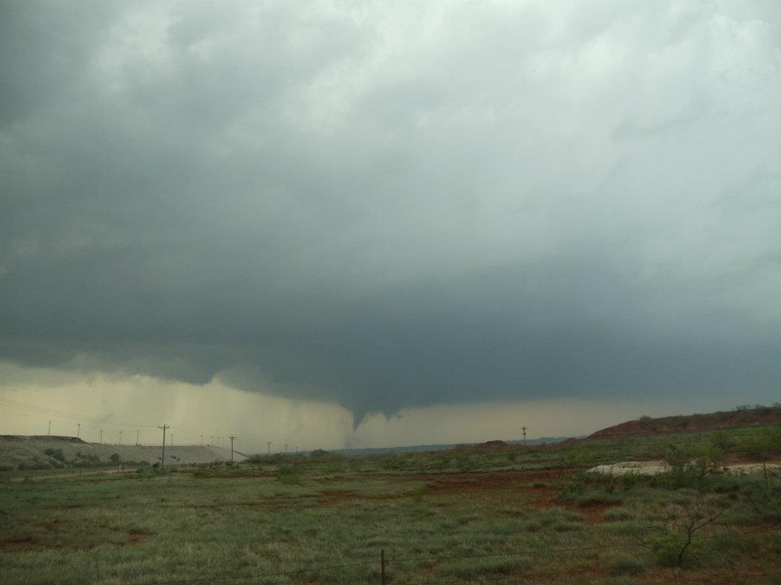
Welcome to
ATMO 1300
Summer II 2017
aaron.hill@ttu.edu

Slide 2
Weather Is Everywhere
University Studies/Global Studies
Climate change protocols
Fossil fuel consumption/climate change
Renewable energy reliance
Business/Finance/Marketing/Commerce
Selling/trading of futures based on weather trends
Selling/trading of renewable energy futures
Airline and trucking routes
Modeling of risk for insurers
PR/Technical Communication/Psychology
Social science aspect of good weather risk communication thru print, media, etc.
Effectively communicating warnings/watches

Slide 3
Weather Is Everywhere
Architecture/Design
Debris impact on structures (National Wind Institute)
Designing/Engineering structures to withstand wind/damage (Galloping Gertie)
Teaching/Education
Weather/science education
Engineering/Wind
Wind energy
Solar energy
Aerodynamic testing (Boeing)
Others
Forensic meteorology
Farming/agriculture

Slide 4
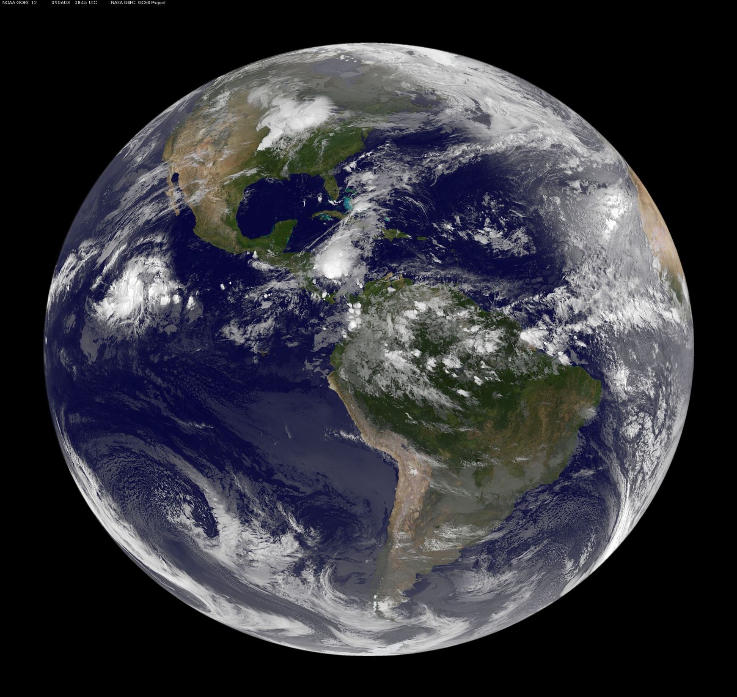
Chapter 1 Introduction to the Atmosphere
TOPICS
Weather and Climate
Atmospheric Composition
Atmosphere Properties
Atmosphere Structure

Slide 5
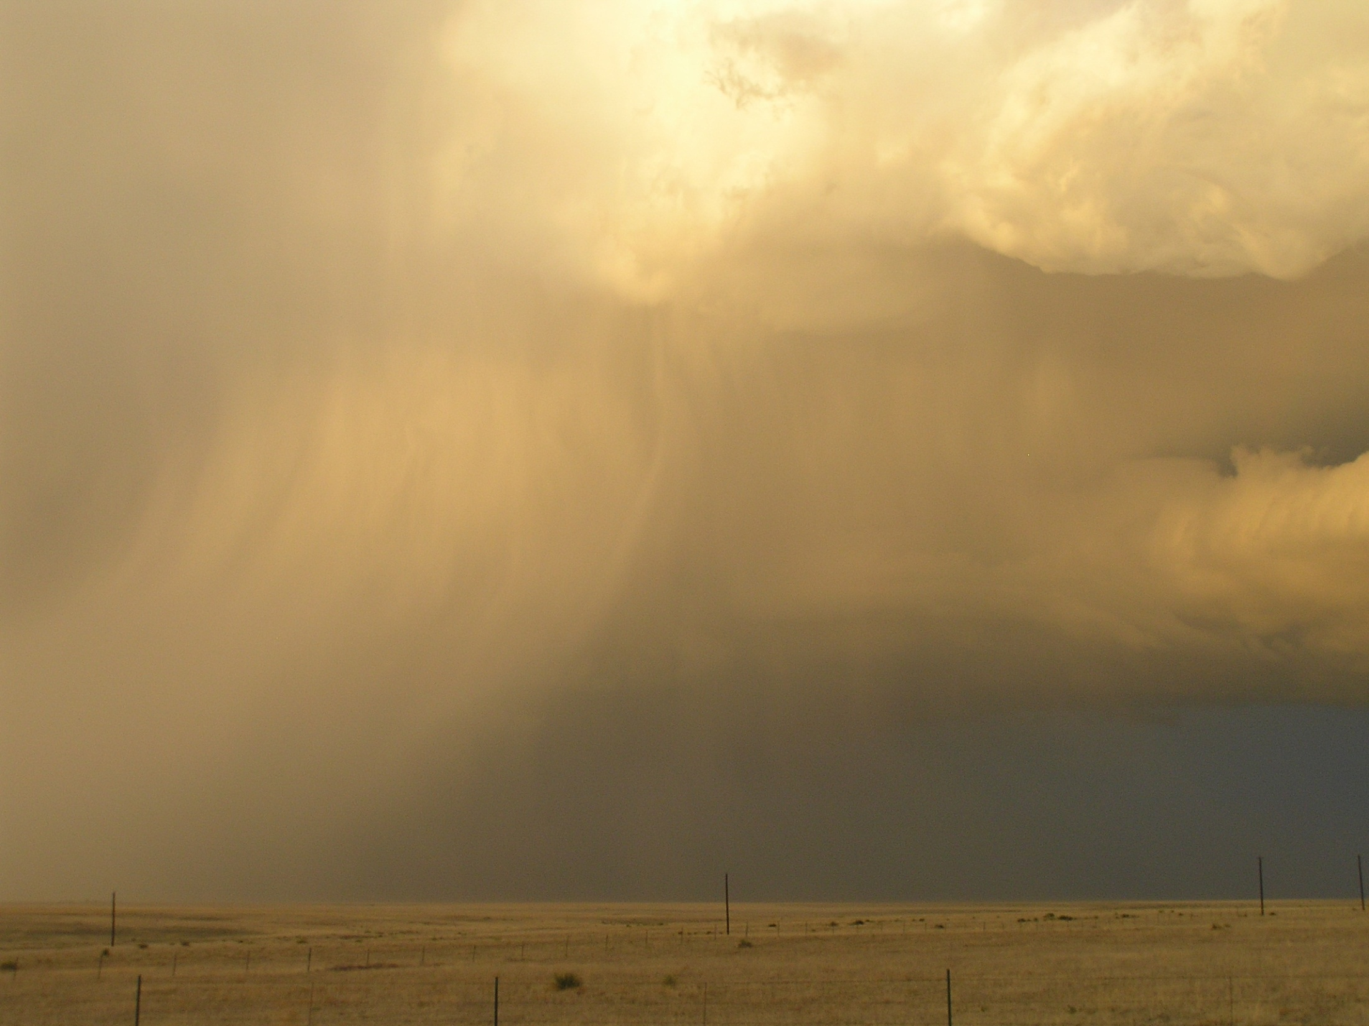
“Weather” vs. “Climate”
Weather – Short-term variations in the sensible state of the atmosphere (e.g., hot today, rain over the weekend, etc…)
Or, the condition of the atmosphere at a particular location and moment.
METEOROLOGY – The study of weather; Greek: meteoron (thing high up) + logia (study of).

Slide 6
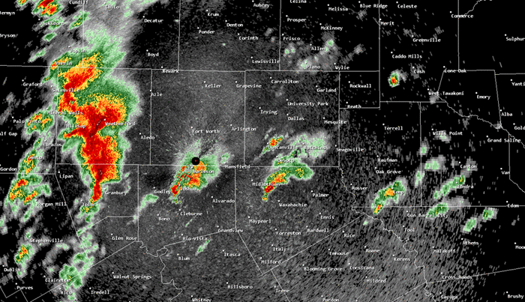
Weather
Examples: Thunderstorms, snow accumulation, wind gusts
3 April 2012, north Texas Tornado Outbreak – NWS Fort Worth
Notes:
We consider weather to the be a short-term phenomena, measured in hours and weeks. A radar loop depicting the development and decay of individual storms is a good example. Individual images are ~5 minutes apart.

Slide 7
“Weather” vs. “Climate”
Climate – Long-term state of the atmosphere (e.g., global warming)
Or, the condition of the atmosphere at a particular location over many years.
CLIMATOLOGY – The study of climate

Slide 8
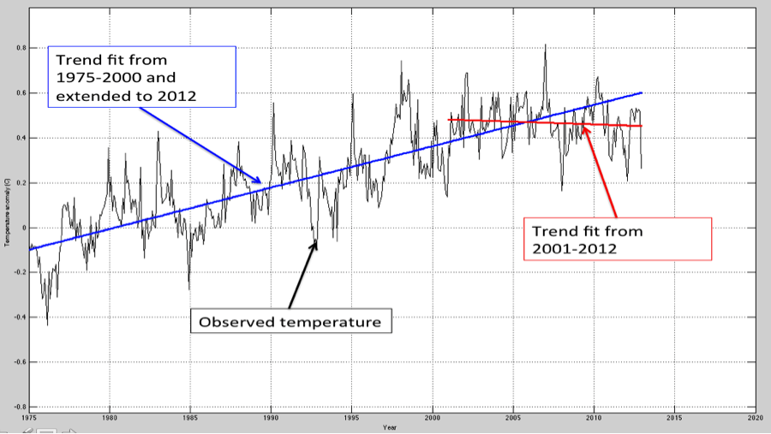
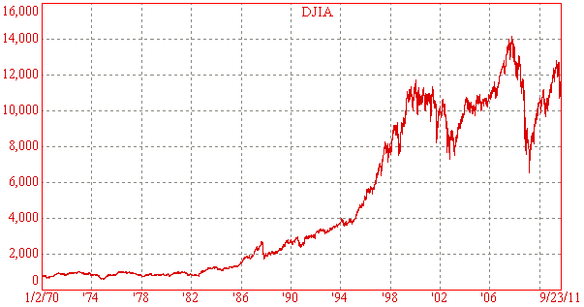
Climate has variability and trends
housing
bubble
Dot-com
bubble
Notes:
An example of variability you might already be familiar with is the stock market: large scale factors such as the recession, housing market bust (‘08), etc. influence the ups/downs of the market. Similarly when plotted over a long time, day to day weather shows fluctuations where local events such as volcanic eruptions can provide shape to the curve.
Overall there is an upward long-term trend, but that does not mean it will continue the temperature just hasn’t been this high before (within time depicted in graph), but we can summarize the change with a description of trend. Over the past decade this graph shows a pause in the warming trend as depicted by the red line.

Slide 9
Ex: Rainiest City in the US?
Mobile, AL
67 inches / year (>5 ft)
59 rainy days / year
Olympia, WA
50 inches / year (>4 ft)
63 rainy days / year
Lubbock, TX
19 inches / year (<2 ft)
57 days with some rain / year

Slide 10
“Weather” vs. “Climate”
Both meteorology and climatology involve studying the atmosphere..

Slide 11
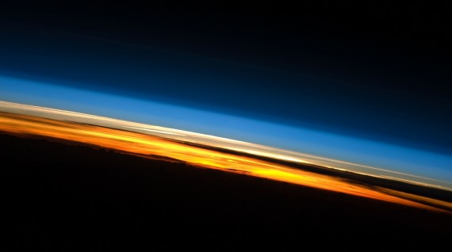
Earth’s Atmosphere
as seen from the International Space Station

Slide 12
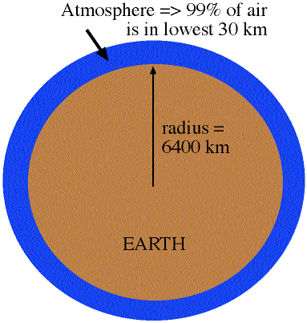
The Atmosphere
The atmosphere is the layer of gases that surround the planet, a three-dimensional fluid
No defined top
Compared to Earth, the atmosphere is very thin … traveling at 60 mph, you could drive through 99.999997% in an hour
It provides us air to breathe and protects us from the Sun’s most harmful radiation
Weather occurs in lowest 11 km (7mi)

Slide 13
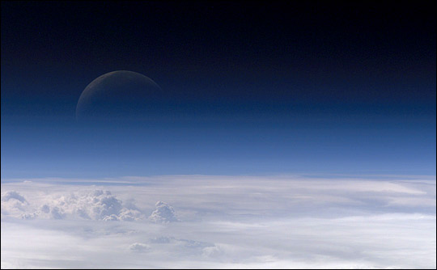
General Characteristics of the Atmosphere
Has mass, therefore weight, due to gravity (the mutual attraction of objects to each other)
Mainly composed of invisible gas molecules and aerosols

Slide 14
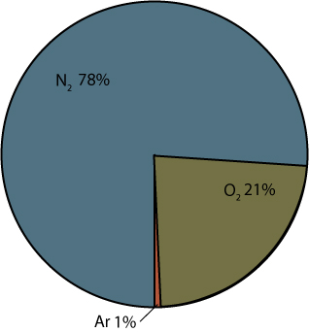
Permanent Atmospheric Gases
Nitrogen (N₂) – 78%
Oxygen (O₂) – 21%
Argon (Ar) – 1%

Slide 15
Variable (Trace) Gases
Water Vapor (H₂O) (varies from ~ 0-4%)
Carbon Dioxide (CO₂)
Ozone (O₃)
Methane (CH₄)

Slide 16
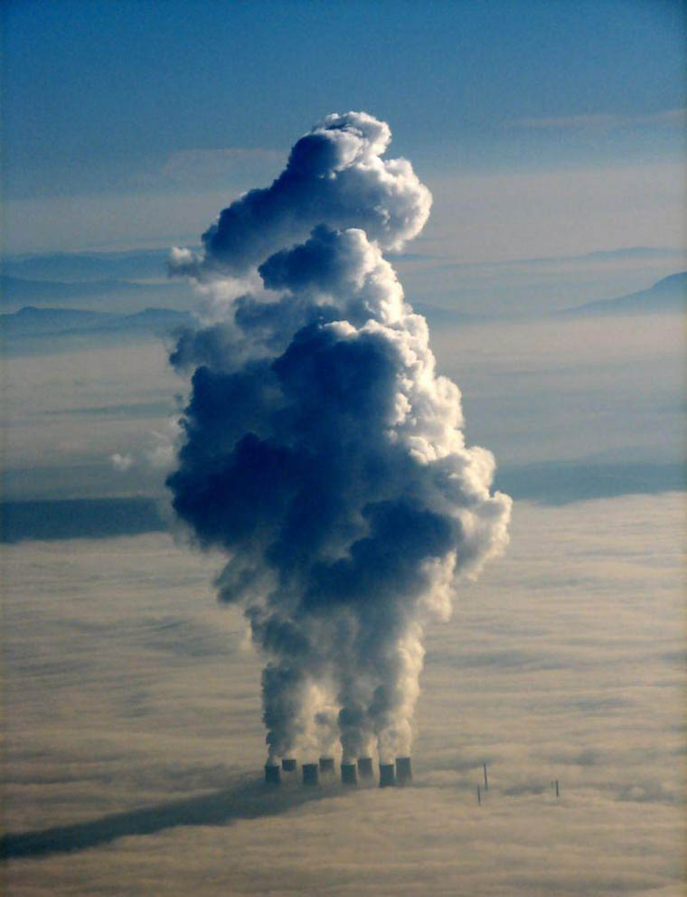
Carbon Dioxide
Controlling factor on temperature (greenhouse gas)
Increase since 1950s (intense debate regarding link to global warming)
Sources include: animal respiration, organic decay, and combustion.
Sinks include: Absorption by plants and oceans

Slide 17
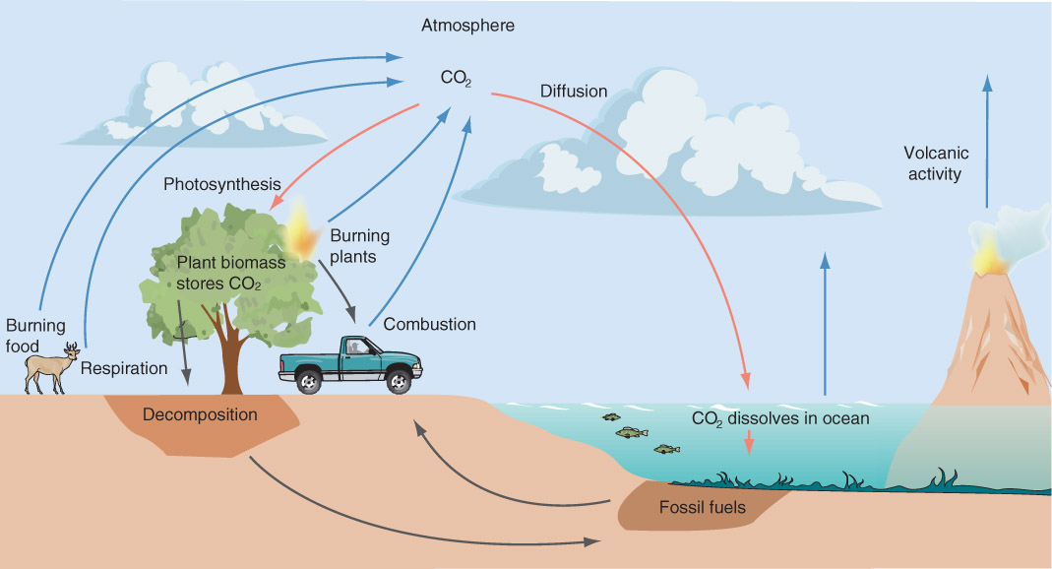
Ocean Acidification!
Fig. 1-3, p. 9

Slide 18
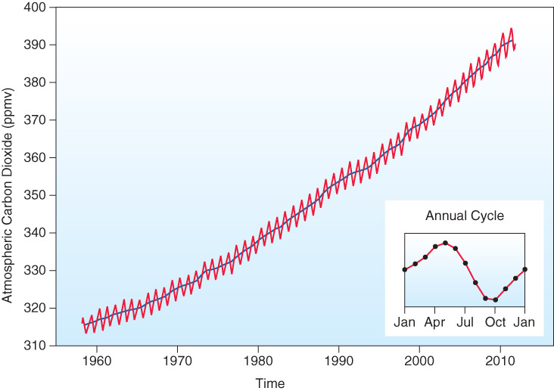
CO₂ Trend
Fig 1-4, pg 9: Carbon dioxide measurements made monthly since 1958 at Mauna Loa, Hawaii.

Slide 19
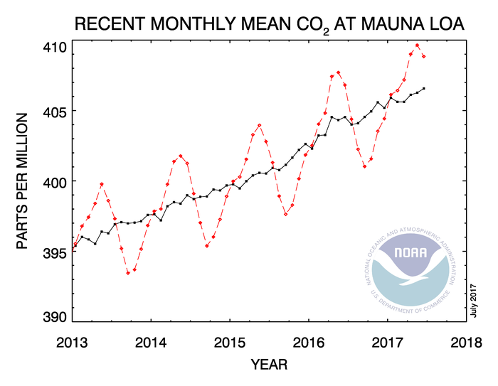
CO₂ Trend
ESRL Global Monitoring Division: http://www.esrl.noaa.gov/gmd/ccgg/trends/

Slide 20
Important Facts About
Water Vapor

Slide 21
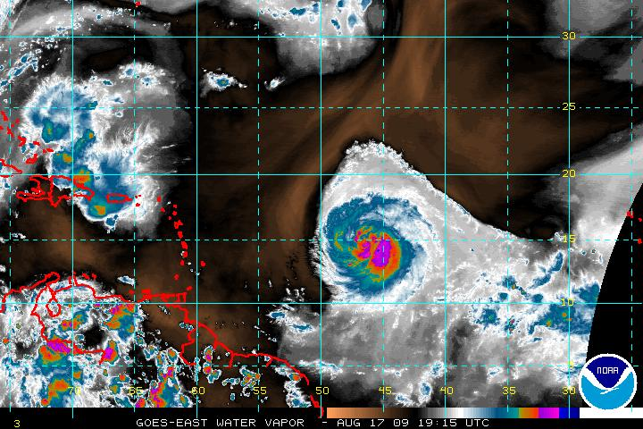
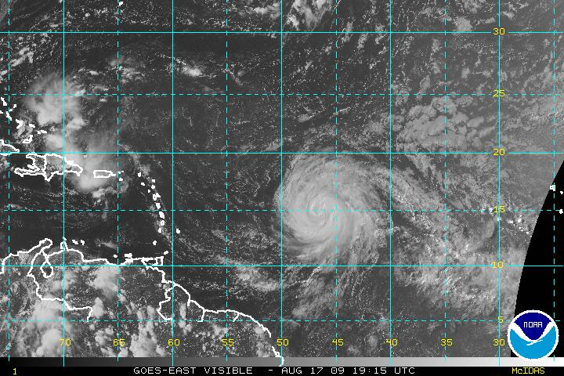
Water Vapor – the “other” greenhouse gas
An invisible gas
Gaseous phase of water
If you can see it, it’s not water vapor!

Slide 22
Water Vapor
Concentration can vary from 0 % (desert) to 4 % (along the coast).
Referred to as atmospheric moisture
Greatest concentration in lower atmosphere (near surface of the Earth)
WV vital to the production of weather:
Water transfers energy through the atmosphere via latent heat (more on that later)
WV “lighter” (less dense) than dry air. This can cause thunderstorms (more on that later too…)

Slide 23
Water Vapor
How does water vapor get into the atmosphere?
By a process called EVAPORATION
Liquid water to water vapor → Called a change of phase

Slide 24
Gas vs. Liquid
Gas
Liquid

Slide 25
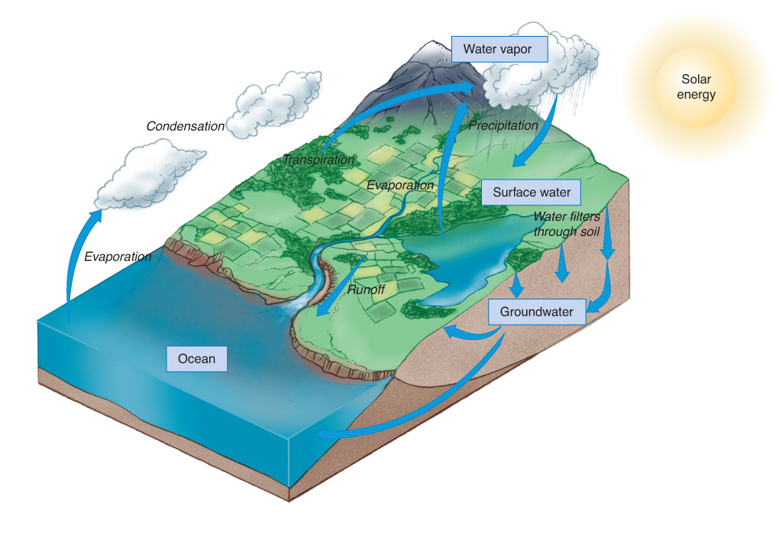
- Evaporation: Liquid Water → Water Vapor ; Energy exchange
Condensation: Water Vapor → Liquid Water ; Energy exchange
Precipitation: Liquid (or Solid!) water falls to the surface of the earth.
Fig. 1-5, p. 11

Slide 26
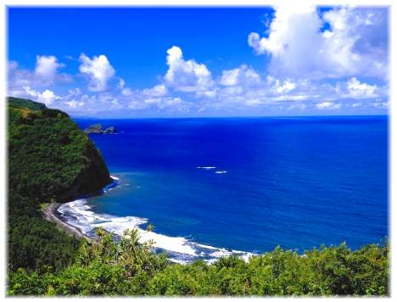
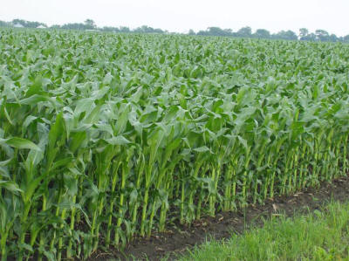
Sources of Water Vapor left photo from webworld98.com; right photo from killamfarms.com
EVAPORATION
TRANSPIRATION

Slide 27
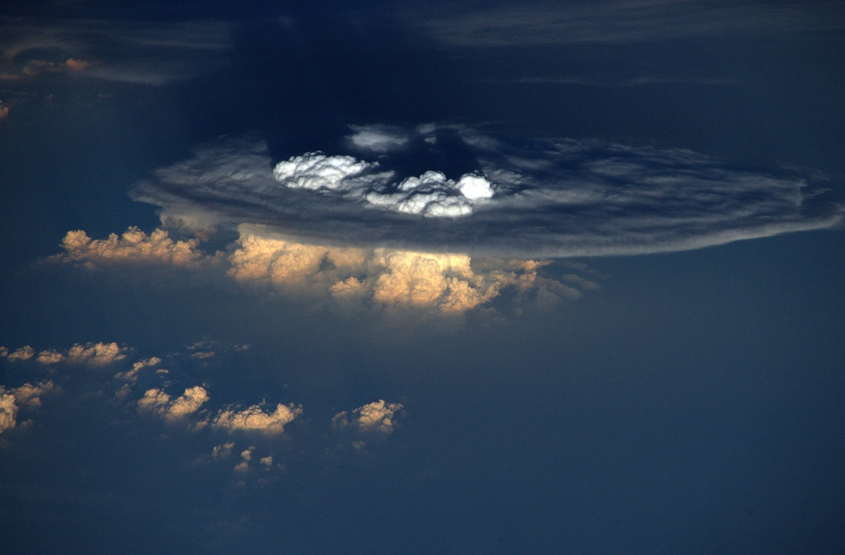
Importance of Water Vapor
Necessary for clouds to form (clouds are composed of LIQUID water droplets – CONDENSATION necessary!)
Controlling factor on temperature (greenhouse gas)
Phase transformations are a huge source of energy in the atmosphere
Energy from latent heat release (condensation) in a thunderstorm is on the order of a 1 kiloton nuclear bomb!
(more on energy transfer later!)
Cumulonimbus cloud taken from the International Space Station Credit: Astronaut Tim Peake

Slide 28
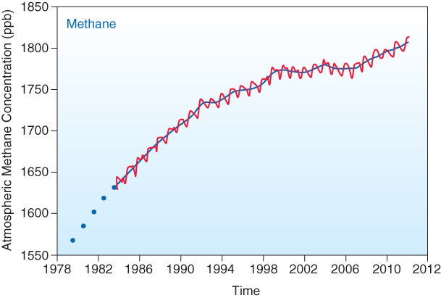
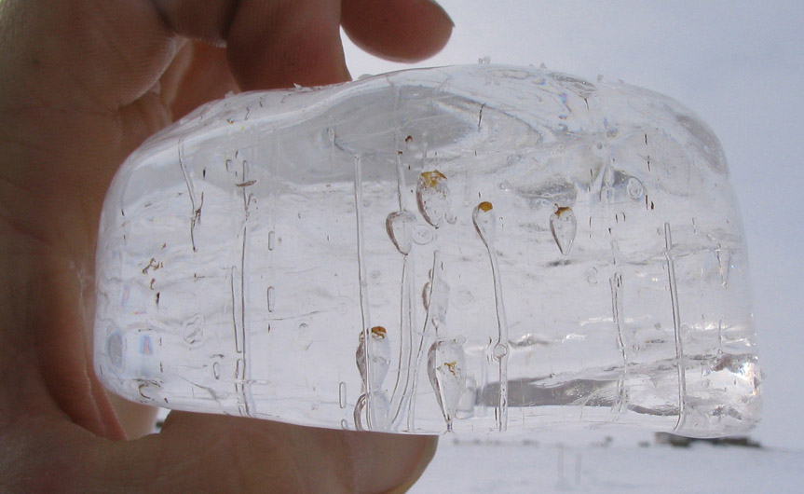
Methane
Greenhouse gas
Sources: decay of organic substances (rice), sub-surface emission, cows (28% of anthropogenic production)
Fig. 1-7, p. 12
Fig. 1-8, p. 13

Slide 29
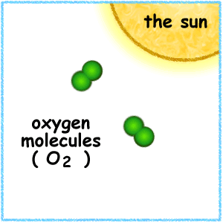
Ozone (O₃)
Mainly found in the Stratosphere (a beneficial shield), but can often be found in the Troposphere (a harmful pollutant).
Ozone absorbs UV radiation from the sun
Photochemical reactions determine development and destruction of ozone:
Creation:
O₂ → O + O
O₂ + O + M = O₃ + M
Anthrophogenic depletion (need ChloroFluoroCarbons, CFCs):
CFCl₃ + UV radiation = CFCl₂ + Cl
Cl + O₃ = ClO + O₂ ClO + O = Cl + O₂
(Ozone Hole!)
In Ch 1, 2, 15

Slide 30
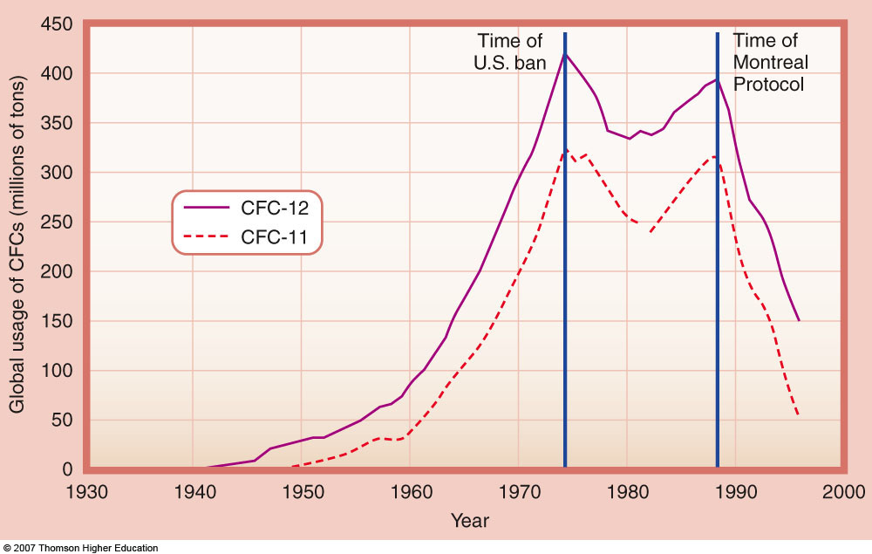
From 2nd edition: Fig. 1-8, p. 10

Slide 31
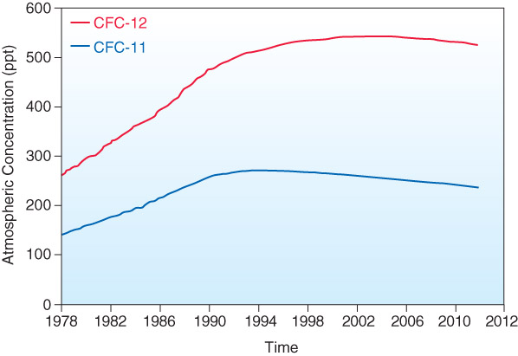
Fig. 1-9, p. 14

Slide 32
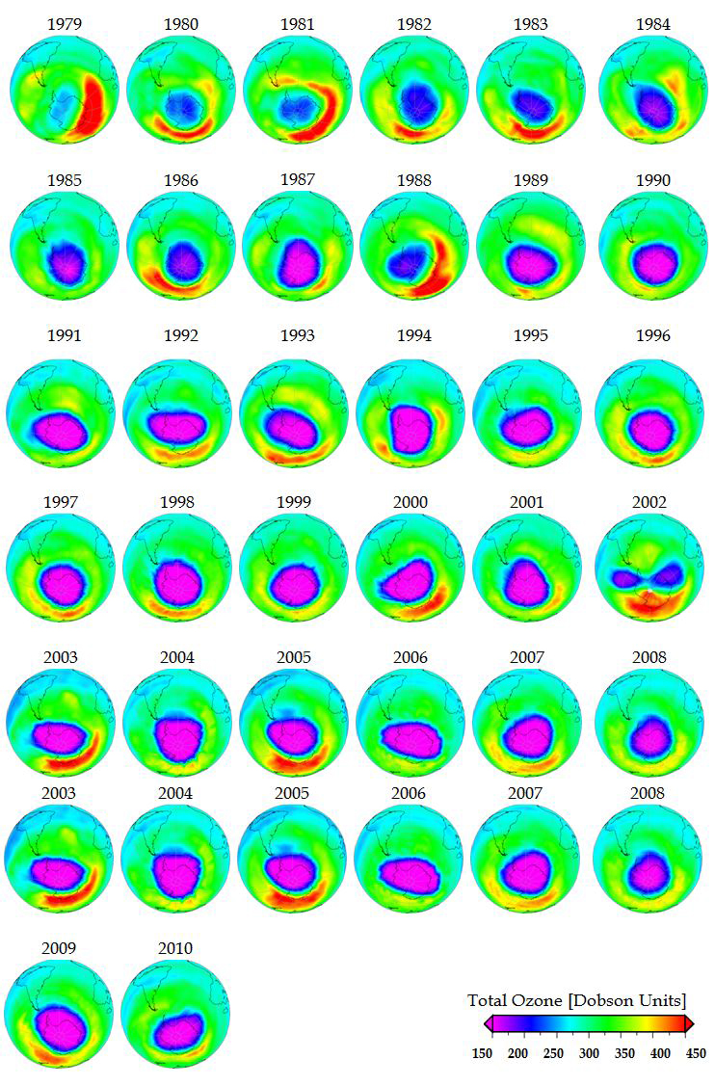
Seasonal – Occurs when the polar region receives sunlight after winter (Oct in southern hemisphere)
Occurs on both poles, but stronger in southern hemisphere
Related to the actual polar vortex (Stratosphere)
Image: http://www.intechopen.com/books/climate-change-geophysical-foundations-and-ecological-effects/chemistry-climate-connections-interaction-of-physical-dynamical-and-chemical-processes-in-earth-atmo

Slide 33
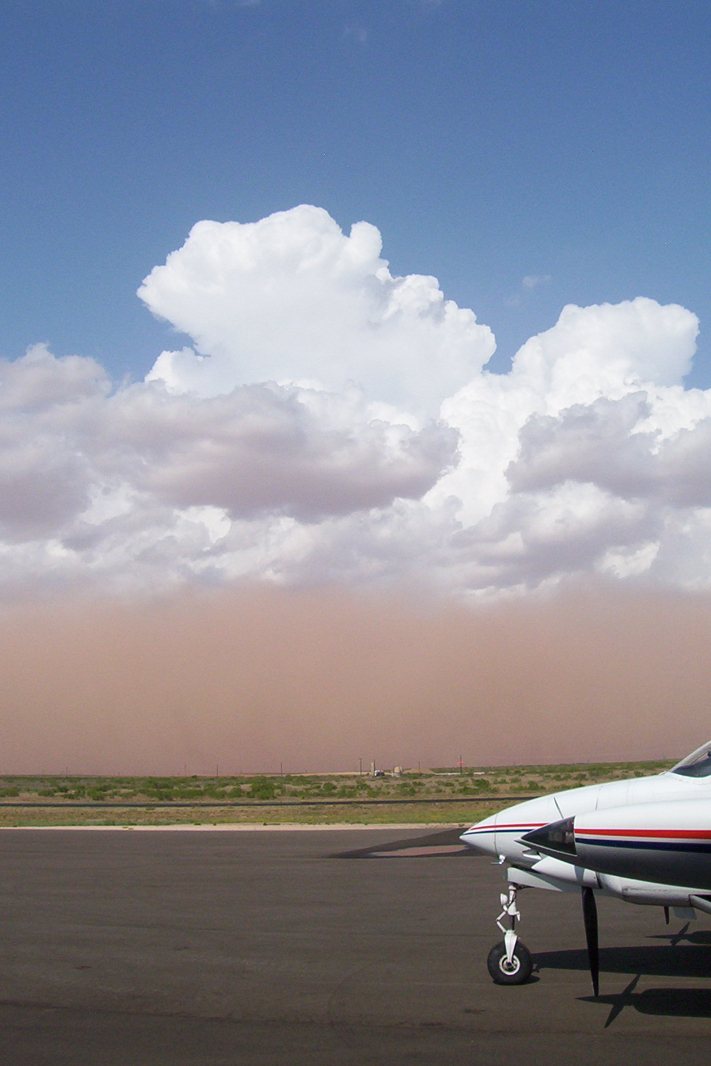
Aerosols
Small (microscopic) solid particles (e.g., clay, silver iodide, organic material)
Combustion by-products, sea spray, dust
Act as condensation nuclei
the beginning of the precipitation process
Affects health, visibility, optical effects

Slide 34
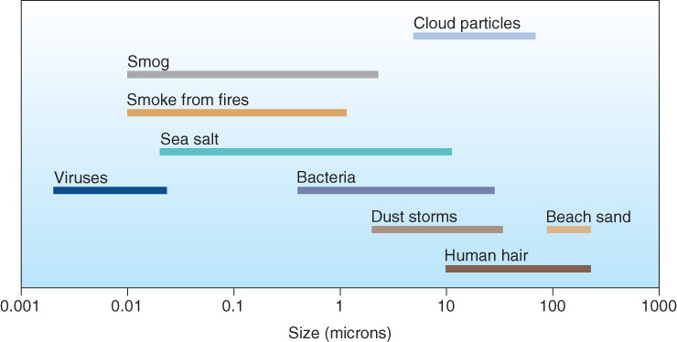
Aerosols
Fig. 1-10, p. 14

Slide 35
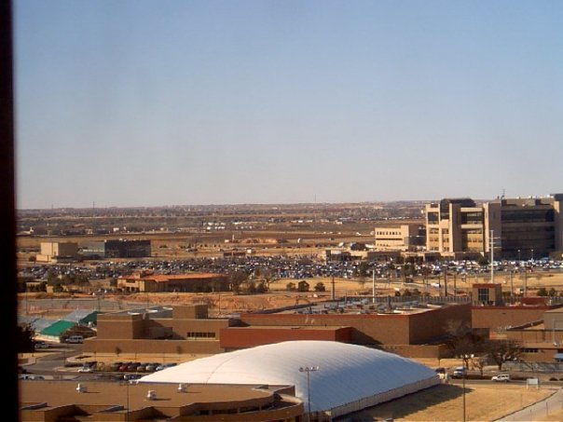
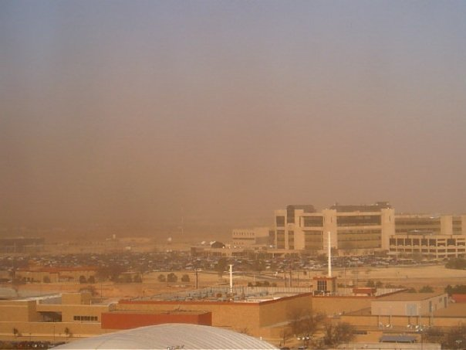
Blowing Dust in Lubbock
Welcome to Lubbock, those of you who are new to the area…

Slide 36
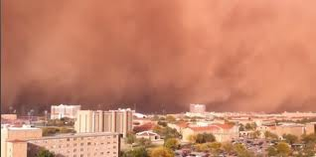
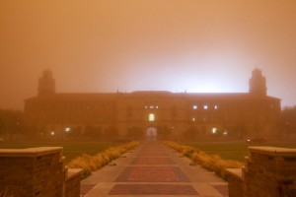
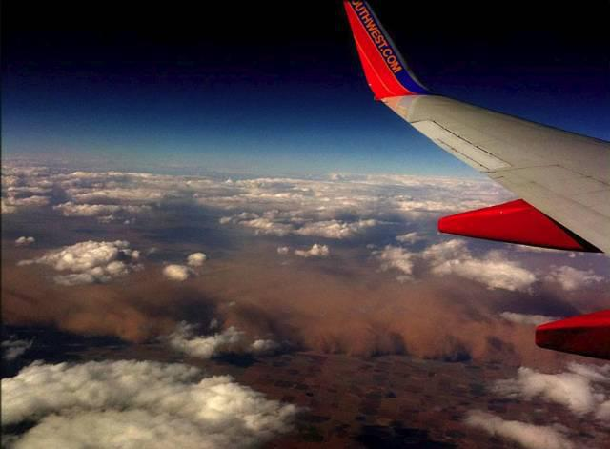
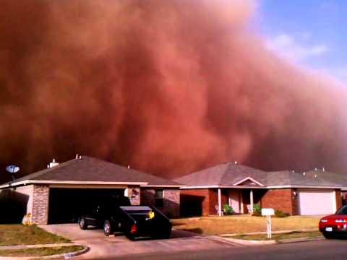
Haboob: Intense dust storm carried by an atmospheric density current

Slide 37
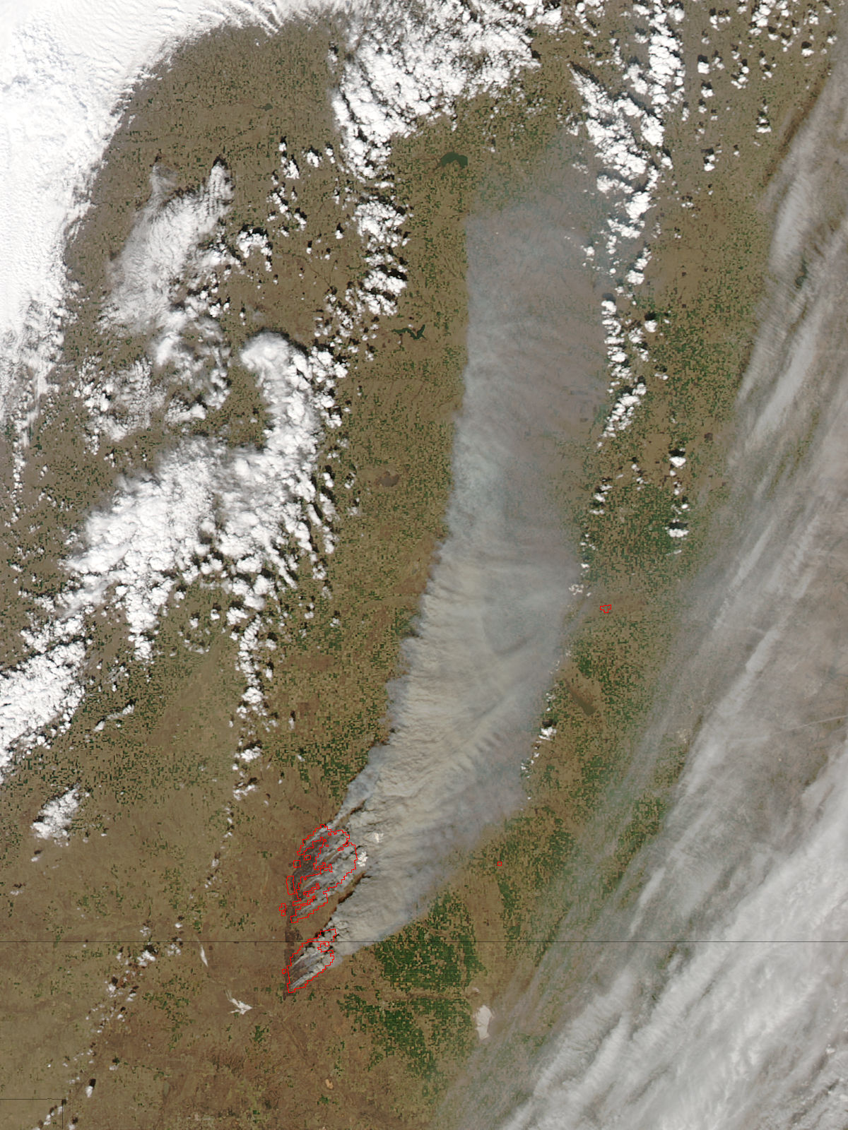
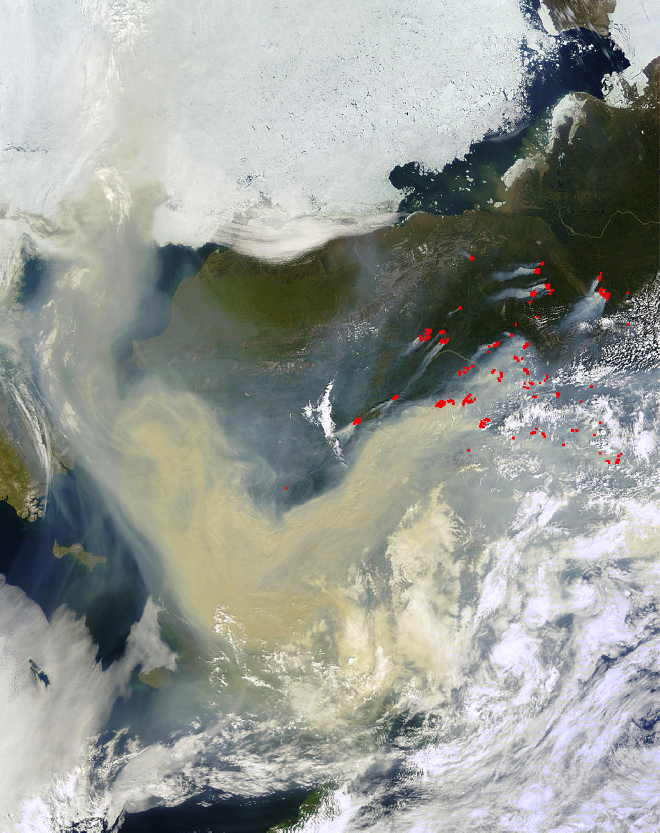

Slide 38
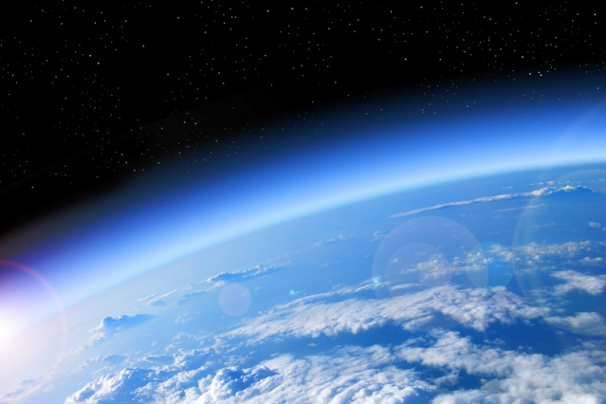
How is the atmosphere structured?

Slide 39
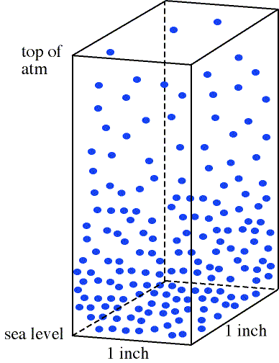
Vertical Distribution of Mass
Density = mass per unit volume. Given a box of air (volume), how many molecules are inside (mass)?
Density decreases with increasing altitude – less molecules.
Figure from apollo.lsc.vsc.edu/classes/met130

Slide 40
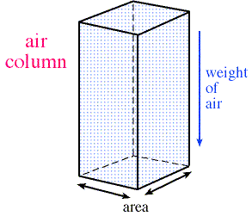
Atmospheric Pressure
Pressure = Force per unit Area
Related to Density
Its how much “stuff” is above you
Stuff= atmosphere (gas molecules)

Slide 41
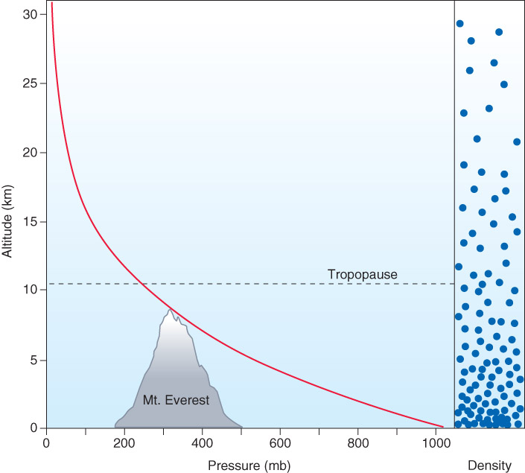
Pressure Change with Height
Like density, pressure decreases with increasing altitude.
It does so at a greater rate in the lower atmosphere
Here in Lubbock…we are at about 3300 ft (about 1 km) elevation → without correction, “surface” pressure lower at higher elevations.
Fig. 1-12, p. 17

Slide 42
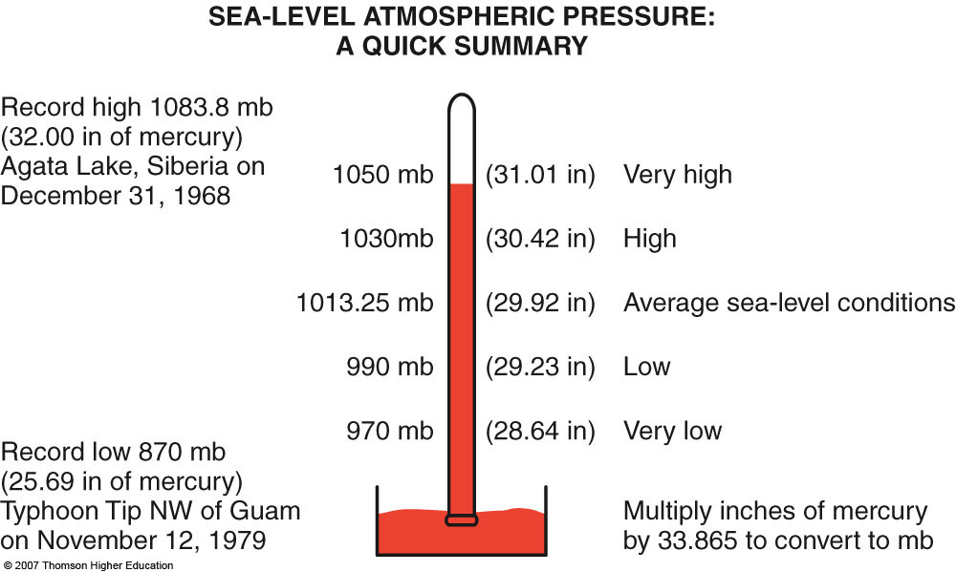
2nd Ed: Fig. 1-13, p. 18
New Records
--Highest surface pressure: 1085.7 mb, Dec 2001, Mongolia
-- Lowest surface pressure in the Atlantic: 882 mb, Hurricane Wilma, 2005
-- Lower measurements have been made in tornadoes recently
Low Pressure = Fast Winds!

Slide 43
Pressure and Density
They are related through the Ideal Gas Law:
Pressure = density X temperature X R
R=287.05 J/kg K
This equation shows that as pressure increases, density increases.
This equation also shows that warm air is less dense than cold air.

Slide 44
Vertical Structure of the Atmosphere
Vertical Distribution of Mass
Vertical Distribution of Temperature

Slide 45
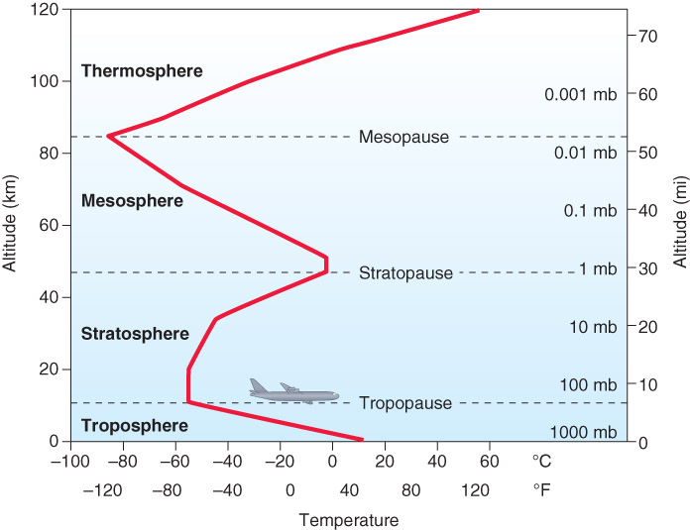
Vertical Distribution of Temperature
Average temperature distribution
FOUR layers
Temperature trend determines atmospheric layers – NOT A FIXED DEPTH!
Fig. 1-14, p. 20

Slide 46
Troposphere
Where most “weather” occurs

Slide 47
Troposphere Figure from www.atmos.ucla.edu/AS3
Temperature decreases with height (heated from the Earth’s surface
Amount of temperature decrease with height (e.g., -10 deg C / km) called a Lapse Rate
Strong cooling with height VERY important for development of thunderstorms!
Depth varies with latitude (greatest over tropics) and season (greatest in summer)

Slide 48
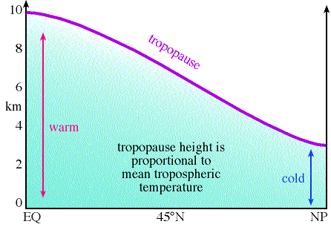
Tropopause
Boundary between the Troposphere and Stratosphere

Slide 49
Tropopause
Acts as an upper boundary for thunderstorms

Slide 50
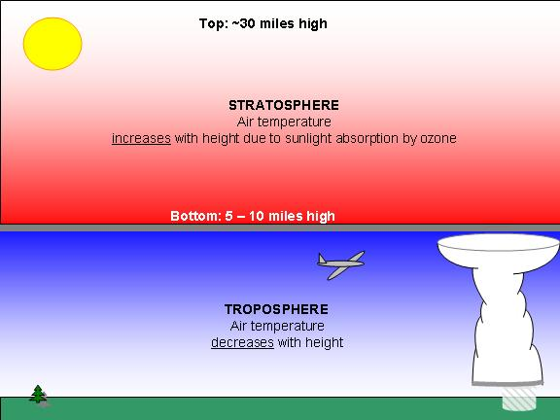
Stratosphere
Temperature increases with height – called an Inversion
Contains Ozone (i.e., the “ozone layer”)
Inversion exists here because of Ozone Layer → UV absorption heats air.
Not much “weather”
Actual polar vortex

Slide 51
Mesosphere/Thermosphere
Mesosphere – cooling with height; No ozone and far from the surface, so no heat source. Intense thunderstorms can produce massive electrical discharges (called sprites) that make it to the mesosphere.
Thermosphere – warming with height (inversion). Atmosphere slowly blends into interplanetary space.
Contains the ionosphere…

Slide 52
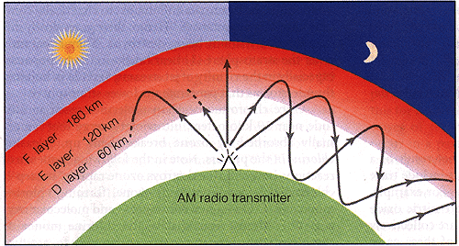
The Ionosphere
Affects radio transmissions
D layer absorbs AM radio waves
D layer disappears at night, E,F layers reflect AM radio waves back to earth
Figure from apollo.lac.vsc.edu/classes/met130

Slide 53
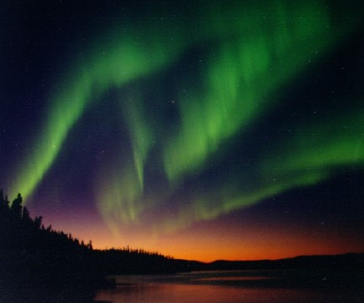
The Ionosphere
Where Aurora Borealis (northern lights) occurs
Photo from climate.gi.alaska.edu/Curtis

Slide 54
Recap
Weather (short term variations) vs Climate (long term state)
Atmosphere – shallow, 3D fluid, has mass, no “top”, keeps Earth warm and protects from harmful radiation, mostly nitrogen and oxygen
Important variable gases:
Carbon Dioxide: greenhouse gas, increasing trend, various sources and sinks (both natural and anthropogenic)
Methane: greenhouse gas, increasing trend
Water Vapor: greenhouse gas, highly variable (0-4%), import source of energy in the atmosphere, invisible, needed for cloud formation
Ozone: mostly in the stratosphere, protects from energetic UV radiation, broken down by CFC’s, annual cycle is normal but not large interannual changes
Aerosols: small solid particles such as dust, smoke, salt, smog, bacteria; important for cloud formation, pollution

Slide 55
Recap
Vertically: Density and pressure decrease with height
Density, pressure and temperature related through the ideal gas law (P=ρRT)
Warm air is less dense than cold air
If density increases so does pressure
Troposphere
Decreasing temperature with height
Where “weather” happens
Top of layer, tropopause, depends on latitude and season
Stratosphere
Increasing temperature with height
Contains the ozone layer
Mesosphere: decreasing temperature with height
Thermosphere: increasing temperature with height
Ionosphere: in thermosphere, where the northern lights occur, not defined by temperature

Slide 56
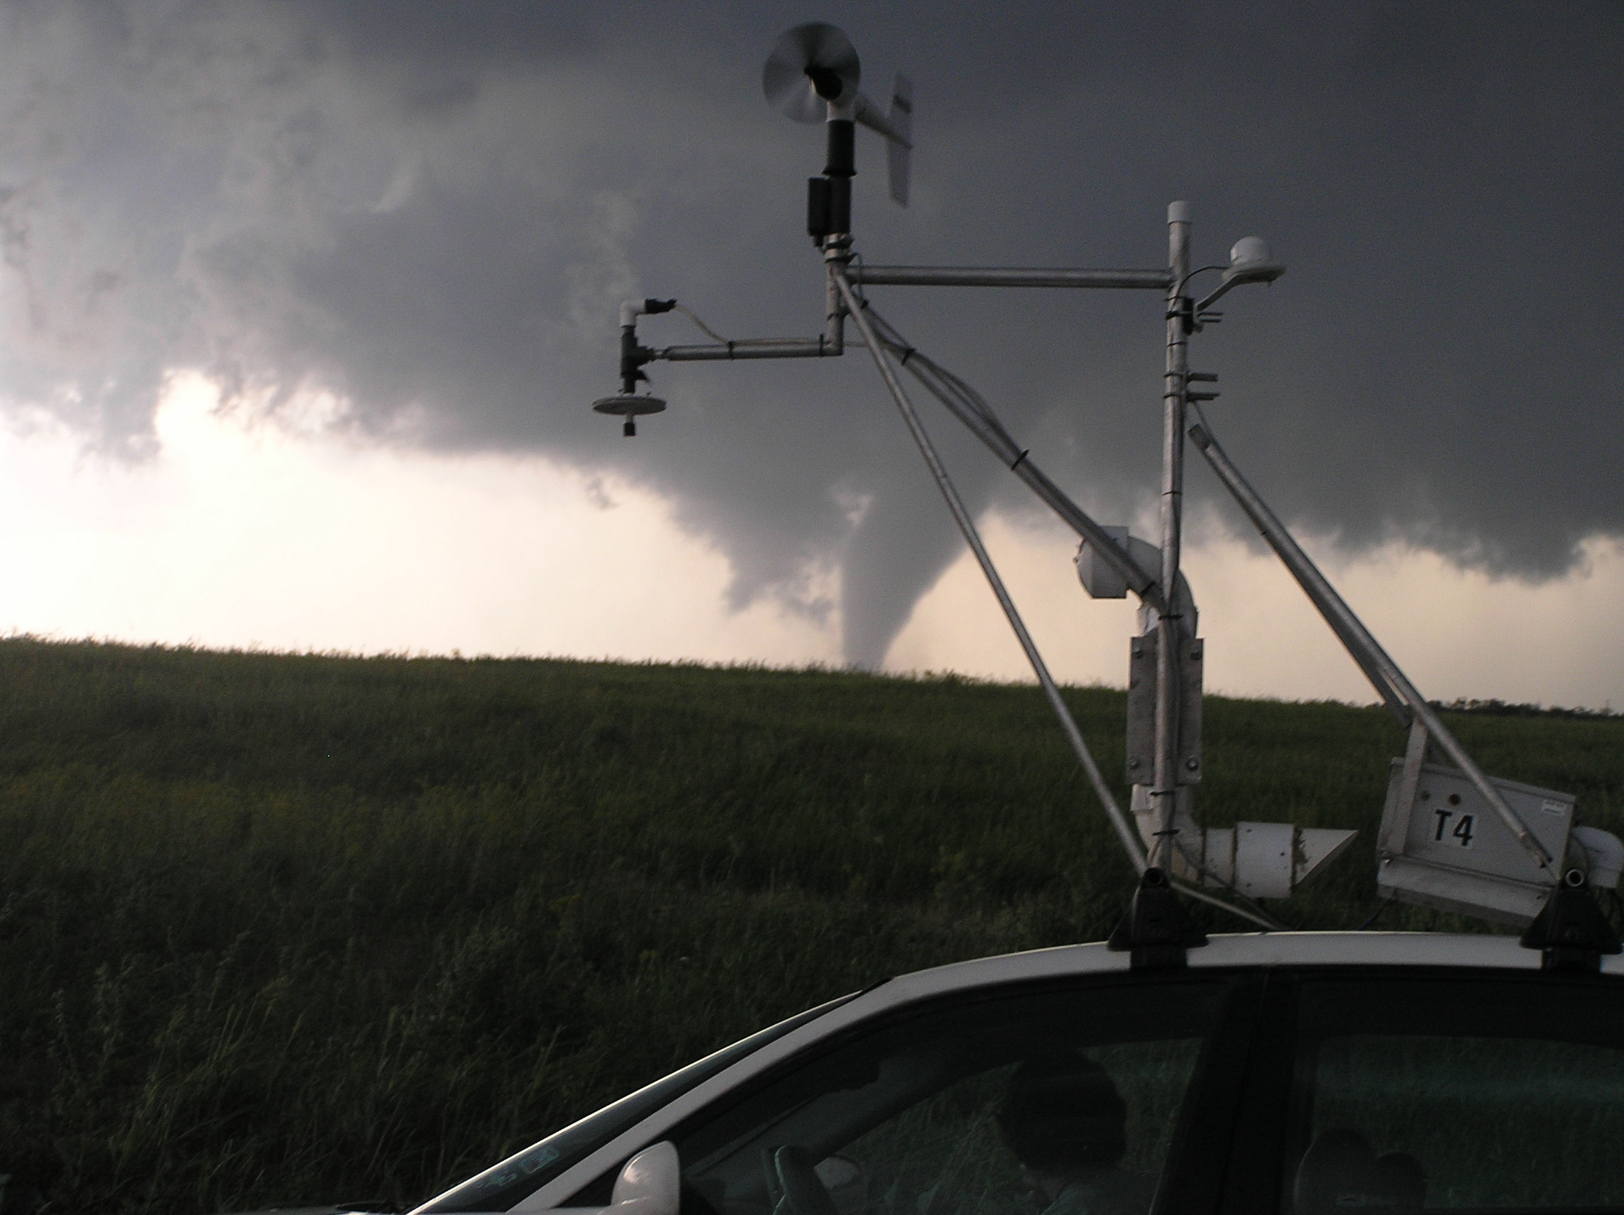
End of Chapter 1

